Slide 1
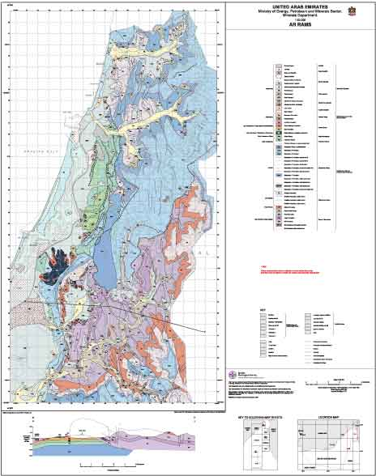
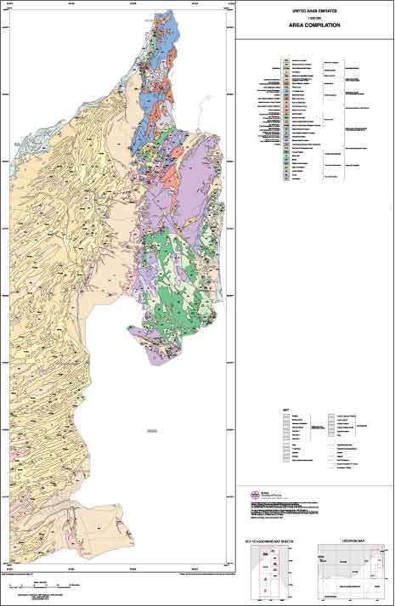
Geological Maps Analysis & Interpretation

Slide 2
What is a Geological Map?
Geol. maps shows “mappable” rock units
Geol. Maps graphically communicate vast amounts of geological information.
Geol. Maps display geological structures such as faults and folds
Display 3D features in a 2D flat piece of paper.
A mappable unit of rock or sediment
Can be consistently recognized
Can trace across a landscape
Can be described so that it is easily
recognized and verified by others

Slide 3
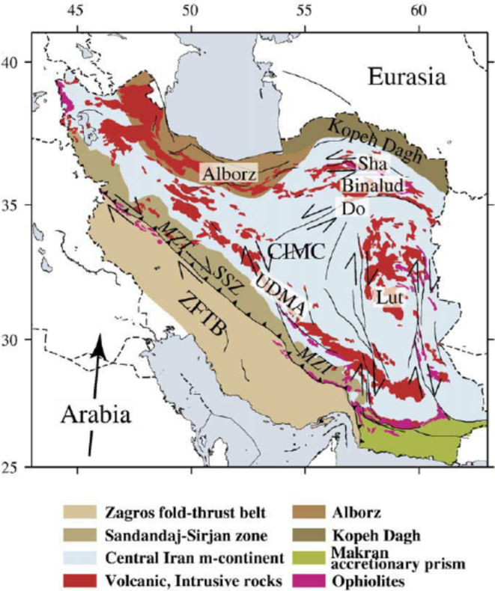
Why are Geological Maps Important?
Geological Maps and cross-sections can provide an insight in to the history of the earth in a specific location
Geological Maps can provide invaluable information to civil engineers, petroleum engineers, economic geologists and hazard assessment specialist
These maps can tell us where to look for economic mineral resources such as gems, metal ore and petroleum.
Geological Maps also help us with identifying locations for building roads, farms, houses, finding ground water.
Questions a detailed geologic map can answer:
• What are you standing on?
• Where are similar rocks or sediments found?
• How old are the rocks?
• What are they composed of?
• How were they formed?
• How have they been affected by faulting, folding, or other geological processes?
• What is the existing or potential mineral resources and geologic hazards?

Slide 5
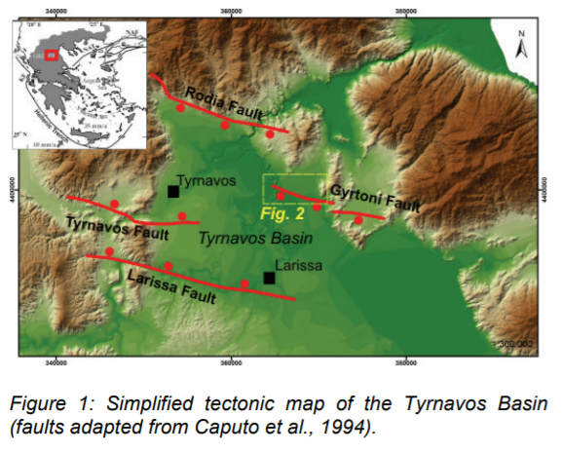
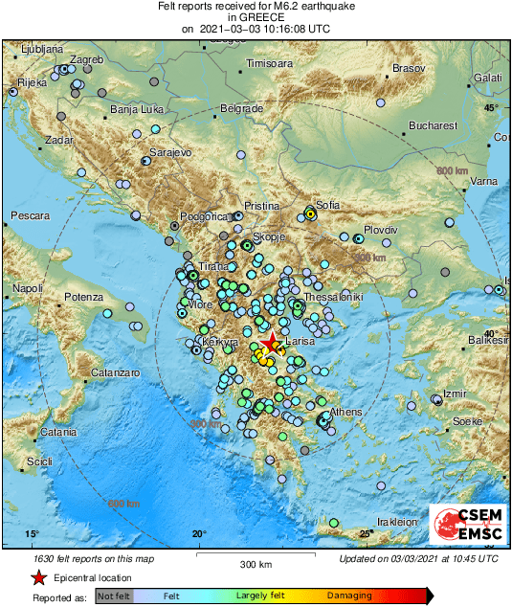
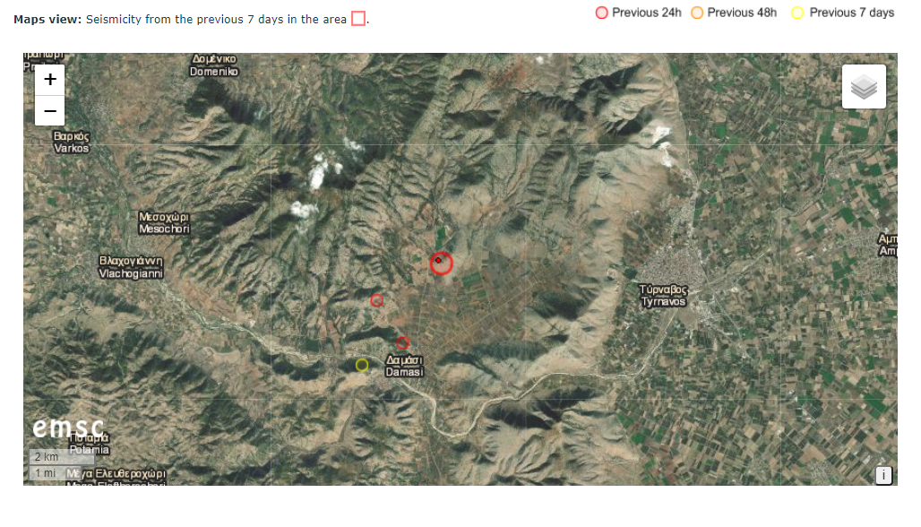
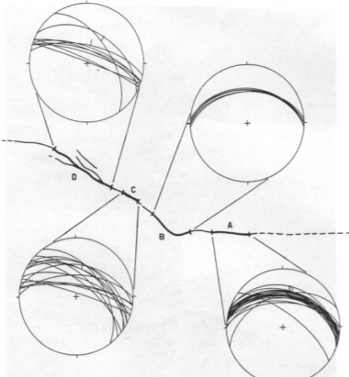
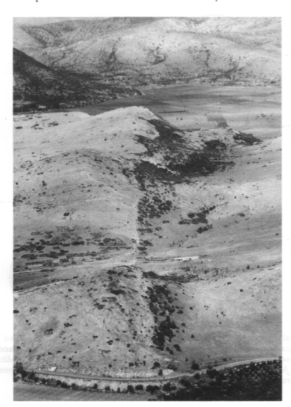
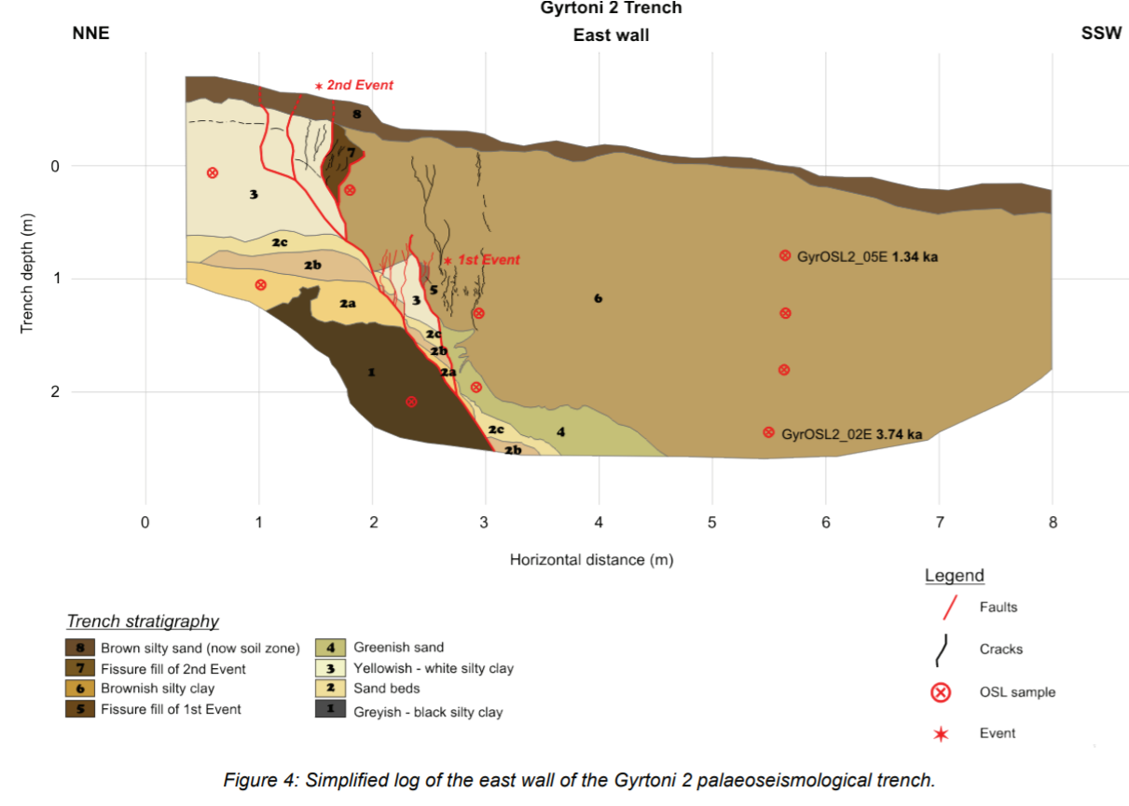
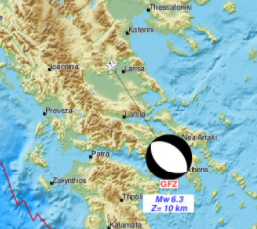
Breaking news-Seismic event 2 h ago

Slide 6
History of Geological Mapping
The first extensive regional geology map was
published in 1815 and was created by William Smith
or “strata Smith”
William Smith is considered to be the Father of
Stratigraphy
The map was created in response to a need
during the industrial revolution for coal and raw materials
as well as means of transporting them (train )
http://www.nhm.ac.uk/nature-online/science-of-natural-history/biographies/william-smith/index.html

Slide 7
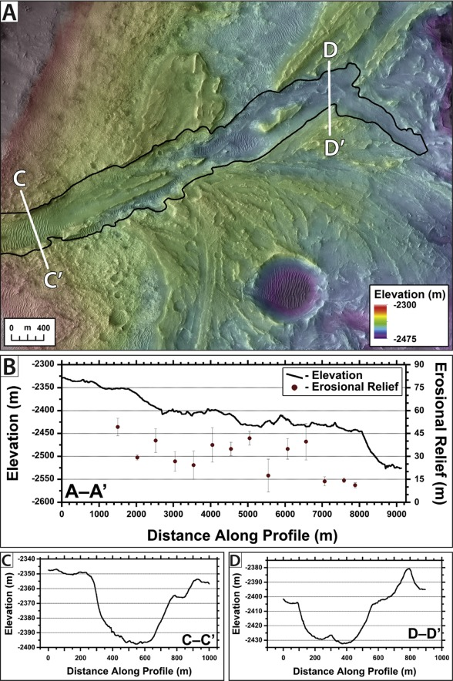
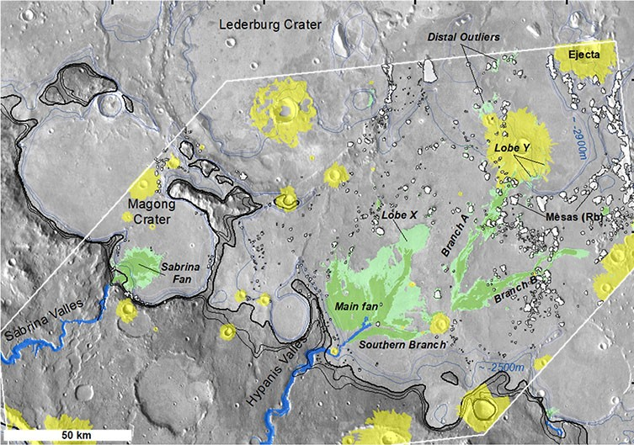
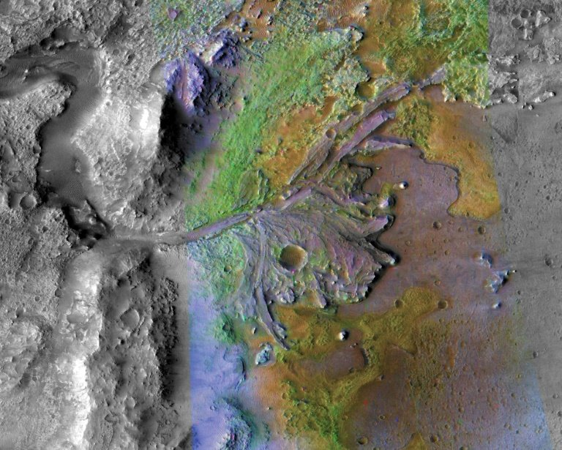
Mapping and geomorphology on Mars
Α

Slide 8
History of Geological Mapping
Smith’s Map (to the right), called “Delineation Of the Strata of England and Wales with Part of Scotland” was the first geological map to identify the layers of rock based on the fossils they contained rather than on their composition.
It is now widely accepted that looking at fossils is the most accurate way to compare sedimentary rocks and answer questions about geological time.
http://www.nhm.ac.uk/nature-online/science-of-natural-history/biographies/william-smith/index.html

Slide 9
History of Geological Mapping
"Fossils have been long studied as great curiosities, collected with great pains, treasured with great care and at a great expense, and shown and admired with as much pleasure as a child's hobby-horse is shown and admired by himself and his playfellows, because it is pretty; and this has been done by thousands who have never paid the least regard to that wonderful order and regularity with which nature has disposed of these singular productions, and assigned to each class its peculiar stratum."
William Smith, notes
written January 5, 1796
http://en.wikipedia.org/wiki/
History_of_geology

Slide 10
What will you should know when you leave this course?
Employ appropriate geological techniques to understand and interpret geological maps.
Construct (balanced) geological cross sections.
Understand the principles employed in constructing a stratigraphic chart.
Develop the ability to visualize and interpret three dimensional geological structures.
Interpret structures and geological history from a map.
Design and draw a geological map employing appropriate geological data.
Describe measure and analyze geologic structures.
Develop skills in preparation for field mapping
Understand and demonstrate practical skills in the acquisition of geological field data.
Utilize safe practices in the field.

Slide 11
Key Features of a Geological Map
Geological Maps Several Key Features:
The map itself which provides information about topography, regional structures, faults and folds
The map legend or key which includes symbols that explain the map content
An accompanying explanation of the rock or sediment units
Geological cross section of the area that the map covers
Some geological maps may include stratigraphic logs of key areas

Slide 13
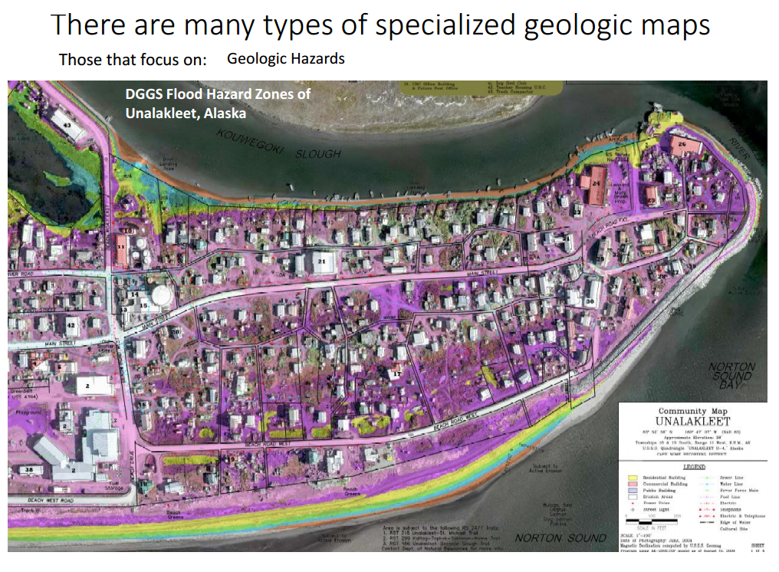

Slide 16
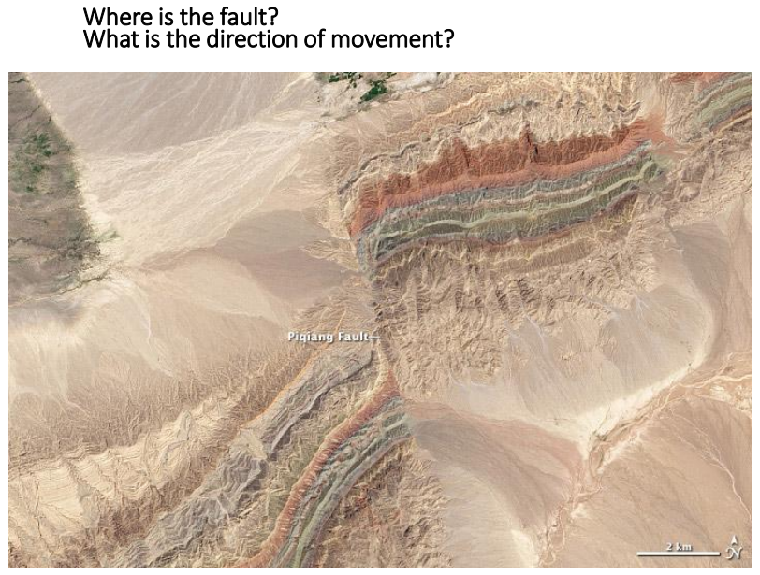
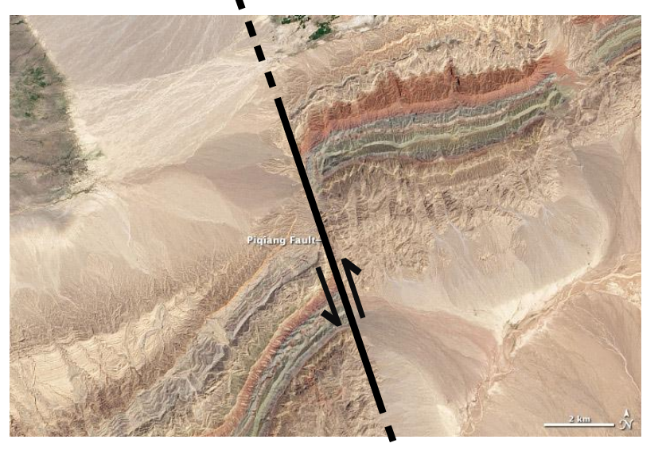

Slide 17
Geological Cross Sections
A Geological cross-section is a sideways view of a slice of the earth
It shows how different rock types are layered or otherwise related to each other
It also portrays geological structures beneath earth’s surface such as folds and faults
Cross-sections are constructed based on geological mapping combined with geophysical data if it is available
Argillaceous shales
Limestones with rudists and chert nodules
limestones
Sandstones and shales
Sandstones and shales
Granite intrusion
http://britgeoheritage.blogspot.ae/2013_05_01_archive.html

Slide 18
Geological Cross Sections
http://geology.utah.gov/online_html/pi/pi-66/images/pi66expl.jpg

Slide 19
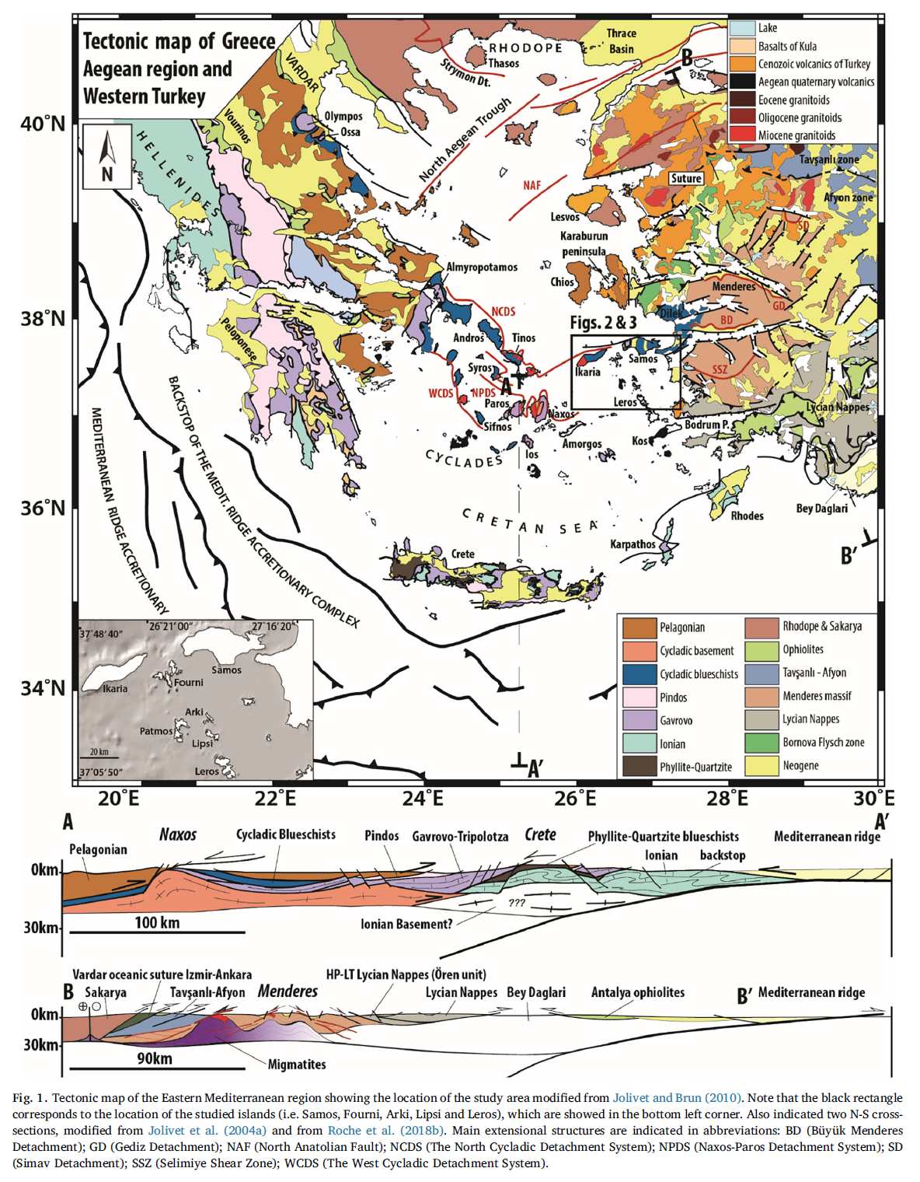

Slide 20
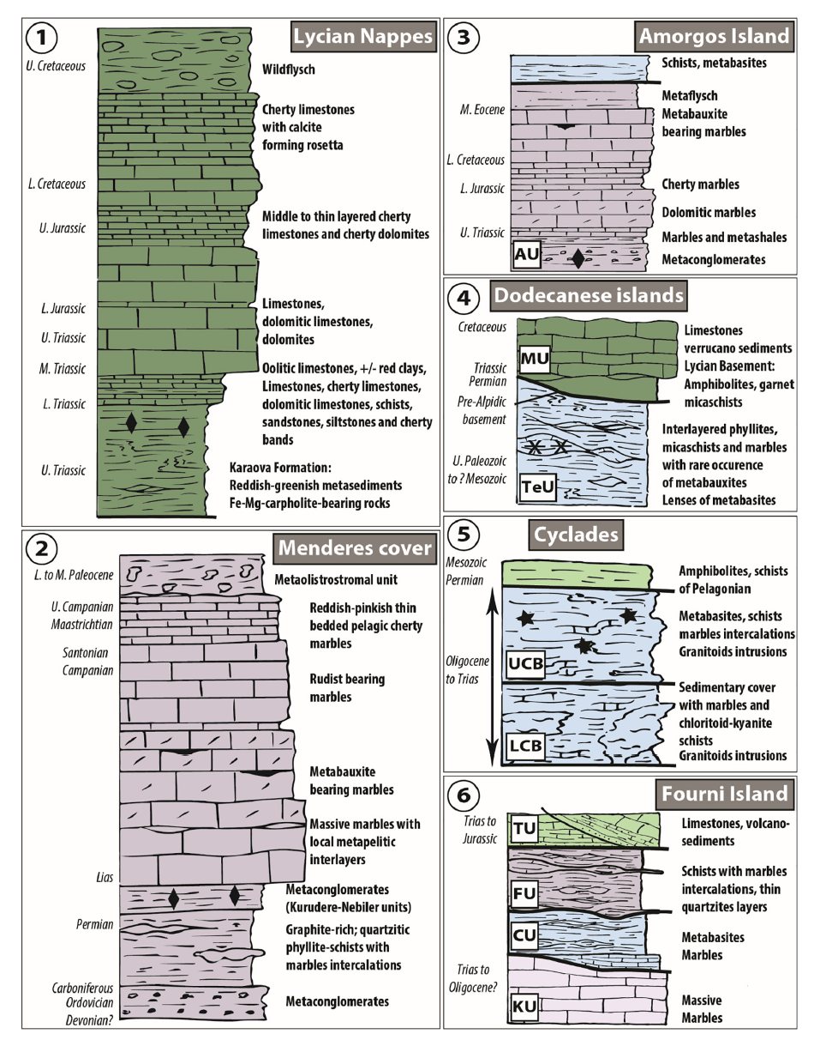

Slide 21
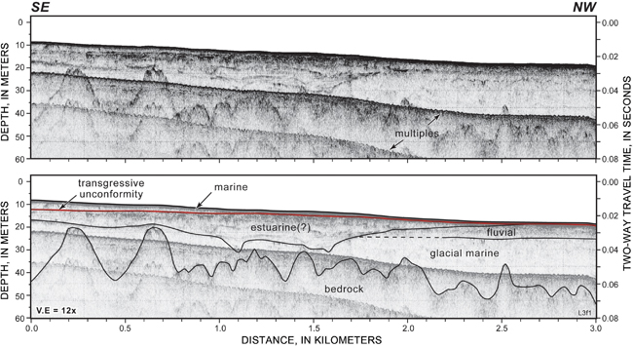
Seismic Interpretation and Subsurface Mapping

Slide 22
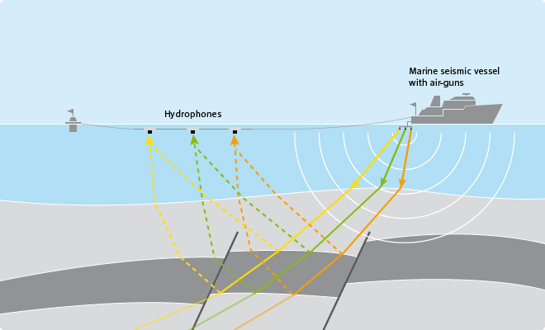
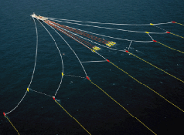
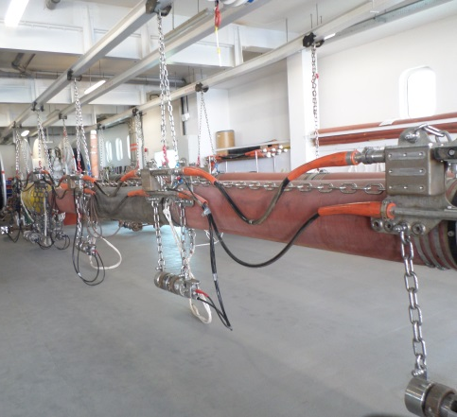
Seismic acquisition offshore
Towed streamer geometry
Cable (or Streamer)
Air-gun sound source

Slide 23
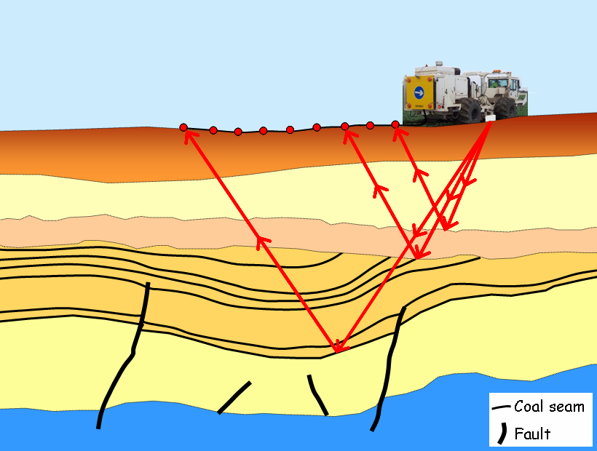
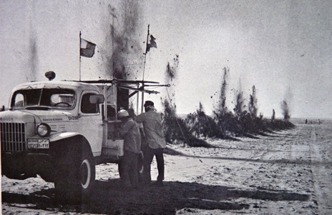
Seismic acquisition onshore (1)
Onshore seismic acquisition requires an energy input from a “thumper” truck or dynamite. Geophones arrayed in a line behind the truck record the returning seismic signal.
Geophones (receivers)
Vibrator (source)
Sub-horizontal beds
Unconformity
Dipping beds

Slide 24
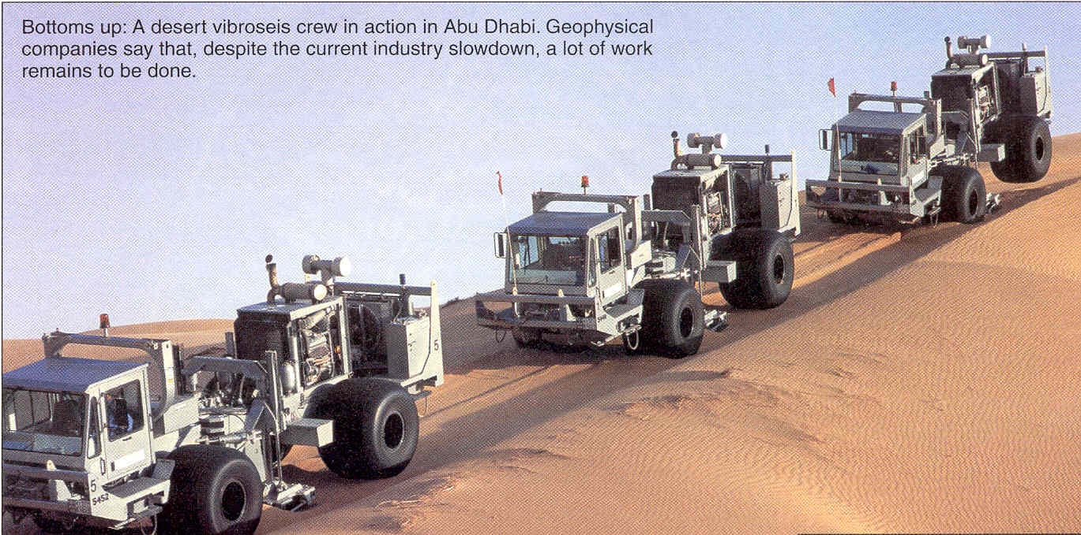
Seismic acquisition onshore (1)
Geophones (receivers)
Vibrator (source)
A desert vibroseis crew in Abu Dhabi in action.
Vibroseis trucks example

Slide 25
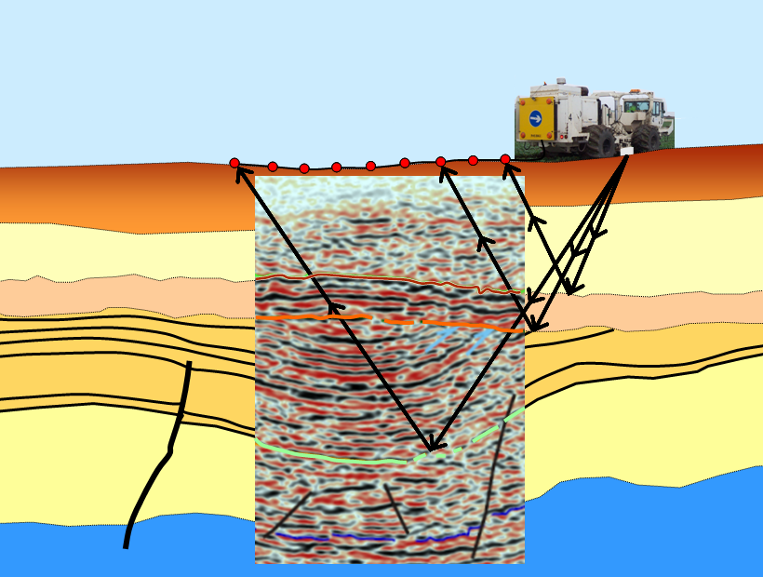
Seismic acquisition onshore (2)
Seismic horizons represent changes in density and allow the subsurface geology to be interpreted.
Lithology change
Angular unconformity
Lithology change

Slide 26
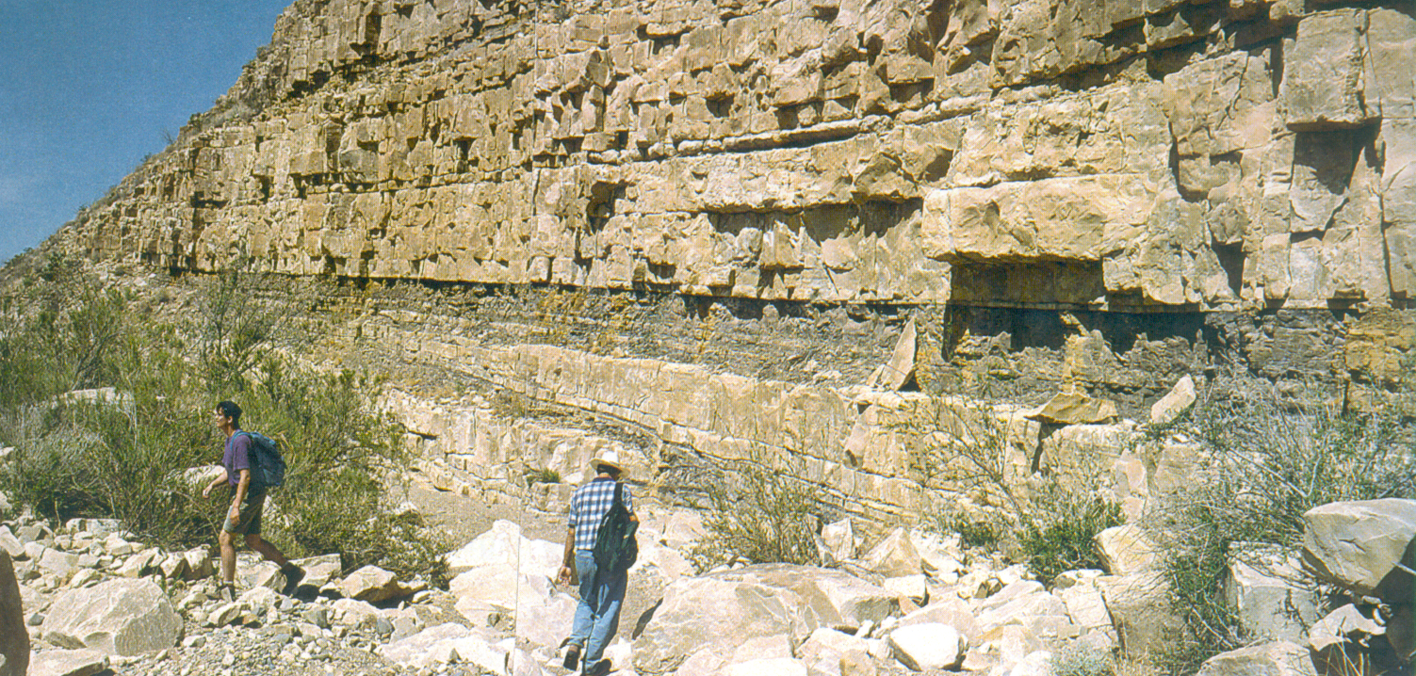
The Ideal Seismic Response
Able to resolve boundaries of beds a few meters thick
1 meter
Increase in Impedance
Decrease in Impedance
Notes:
SLIDE 2
The ideal seismic response would give us information about the stratigraphy in the subsurface at the same scale as an outcrop
Here the beds are about a foot thick – the ideal seismic line would show us this level of detail
Unfortunately, we do not live in an ideal world
Seismic Reflections do not allow us to “resolve” (be able to distinguish) strata at this scale

Slide 27
What is a reflector?
A seismic reflector is a boundary between beds with different properties. There may be a change of lithology or fluid fill from Bed 1 to Bed 2. These property changes cause some sound waves to be reflected towards the surface.
There are many reflectors on a seismic section. Major changes in properties usually produce strong, continuous reflectors as shown by the arrow.
energy source
signal receiver
Bed 1
Reflected ray
Incoming ray
lower velocity
higher velocity
Refracted ray
Bed 2

Slide 28
Seismic cross-section of UAE
Oman
Mountains
Abu Dhabi
Al-Ain
United Arab Emirates
Foreland Basin
Semail
Thrust
Adapted from
Prof. Mohammed Ali, 2010
Notes:
Sedimentary basin can be divided into:
A lower rifted margin sequence (~5 km)
An upper foreland basin sequence (~3.4 km).

Slide 29
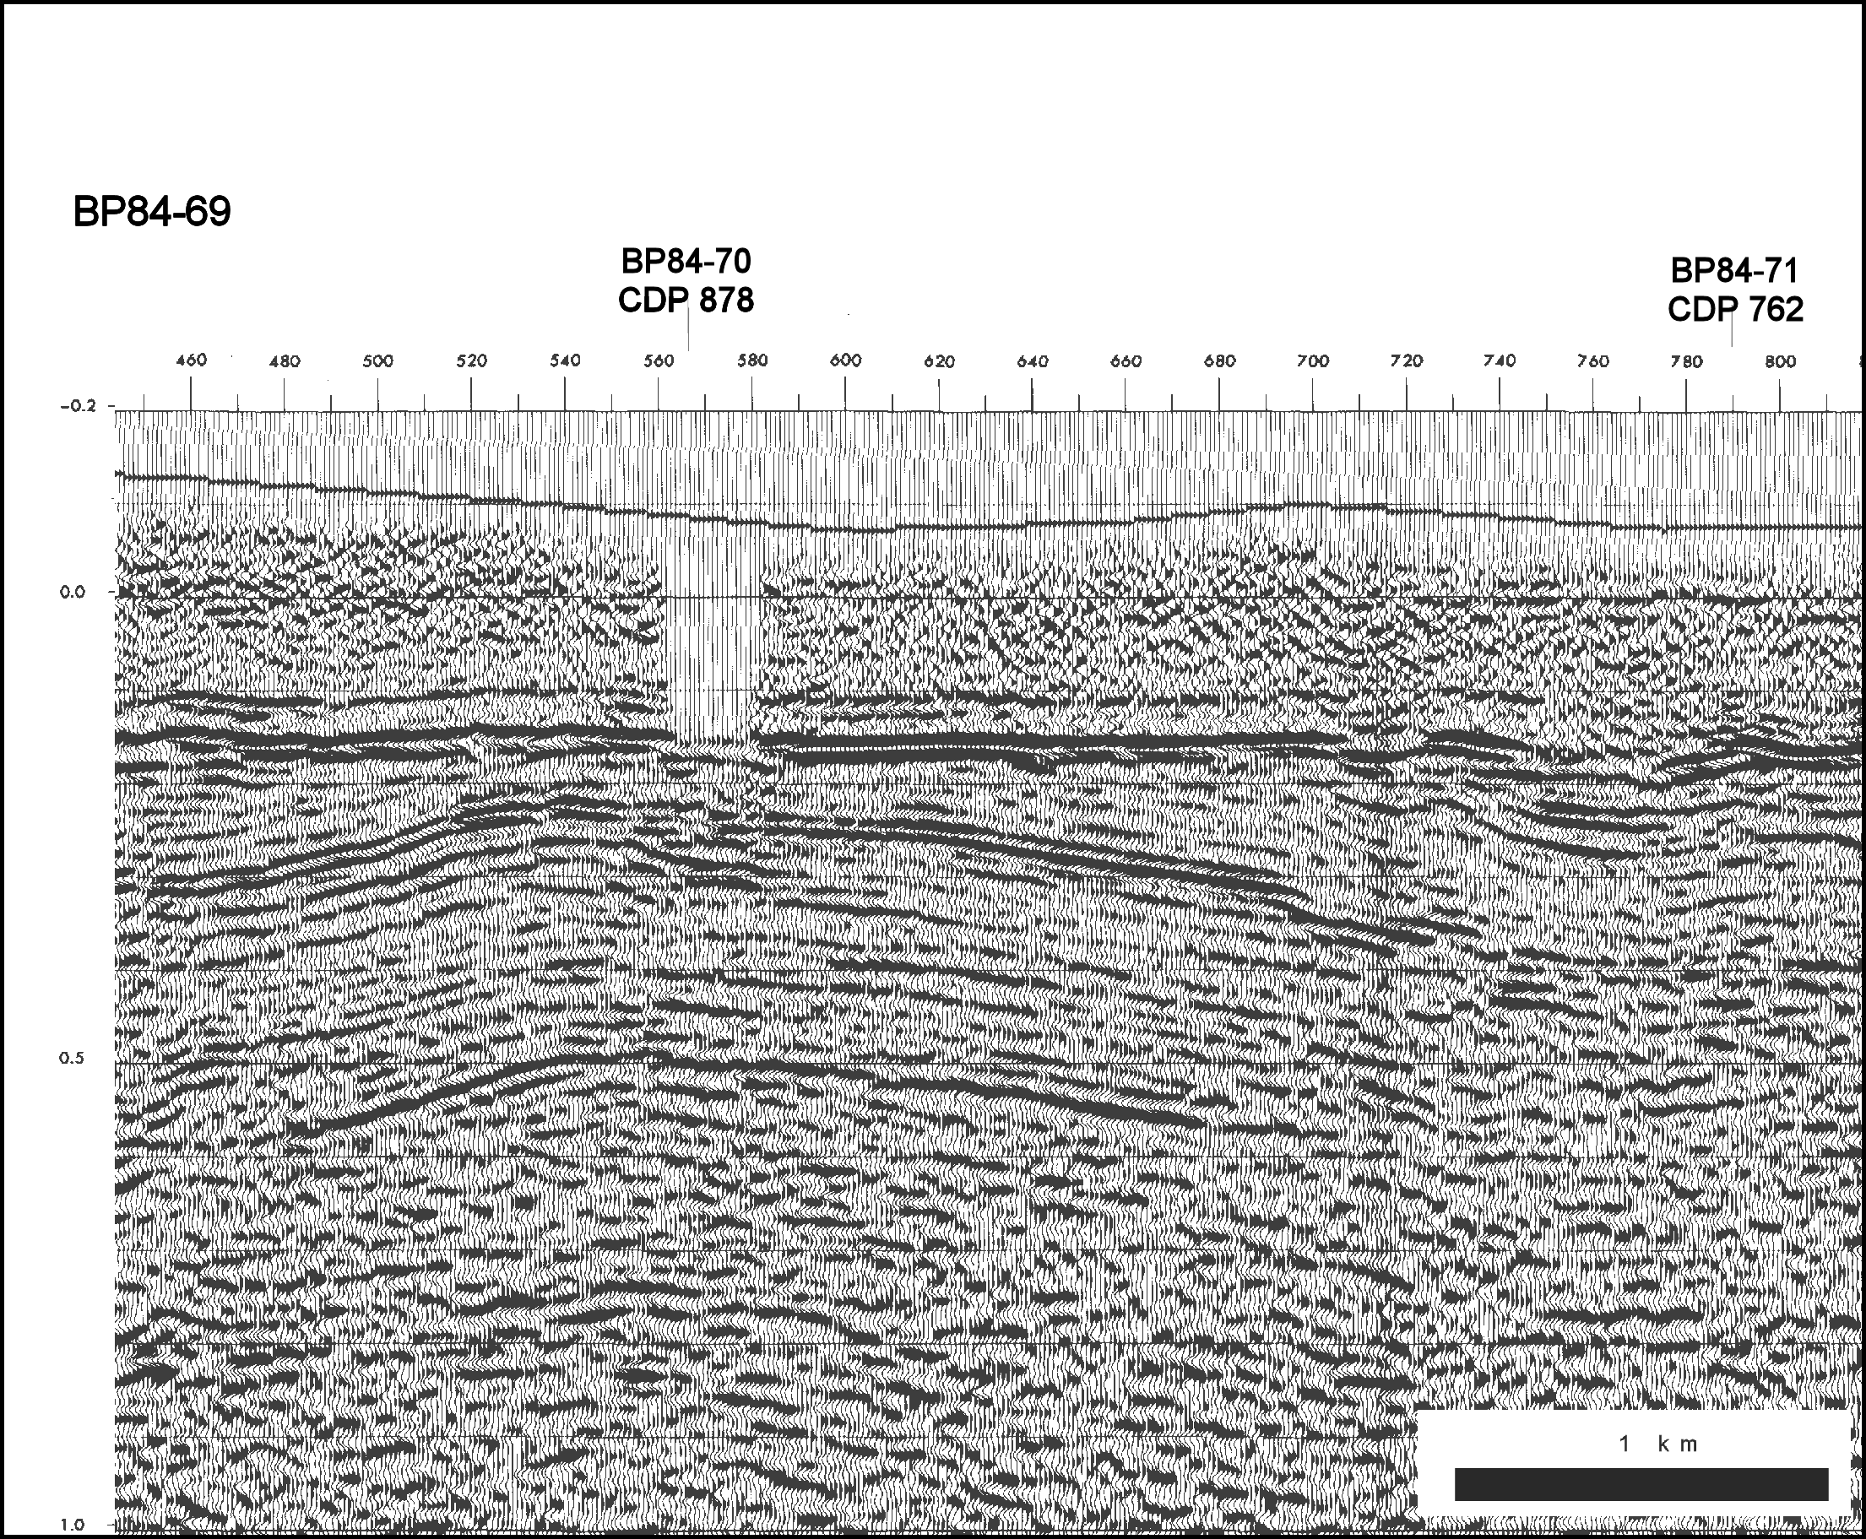
Well tie to seismic
Eakring Village (projected)
Eakring Village (projected)
-0.2
-0.1
0.0
Base Permian 150 ms
0.1
Base Permian 150 ms
0.2
0.3
Potential reservoir interval
Blackshale Coal 240 ms
0.4
Blackshale Coal 240 ms
0.5
Near Top Dinantian 500 ms
Two Way Time (TWT) in Seconds
1.0

