Slide 1
Modeling Health Diseases using Competitive Fuzzy Cognitive Maps
9th International Conference on Artificial Intelligence Applications and Innovations
AIAI 2013
PhD Candidate Antigoni P. Anninou
Professor Peter P. Groumpos
Laboratory for Automation and Robotics
Department of Electrical and Computer Engineering

Slide 2
Outline
Aim
Decision Support Systems
Fuzzy Cognitive Maps
Augmenting FCMs using Case Based Reasoning
Competitive Fuzzy Cognitive Maps
Competitive Fuzzy Cognitive Maps for Knee Injuries
Conclusions

Slide 3
Aim
Present
A new approach in modeling knee injuries using Competitive Fuzzy Cognitive Maps (CFCMs)
Simulation Results

Slide 4
Decision Support System (DSS)
Definition: Interactive computer – based support system for making decisions in any complex system, when individuals or a team of people are trying to solve unstructured problems on an uncertain environment
Aim: Reach acceptable and realistic decisions
Methodology: Exploitation of experts’ experience

Slide 5
Problems in medical decision support systems
High amount of data and information from interdisciplinary sources
Medical information may be vague, or missing
Variety of inputs in order to infer the final diagnosis

Slide 6
Solution
A modeling tool that can handle all these challenges and at the same time to be able to infer a decision
A special type of FCM has been introduced for Medical Diagnosis systems, with advanced capabilities, the Competitive Fuzzy Cognitive Map (CFCM)

Slide 7
Fuzzy Cognitive Maps (FCM) (1/2)
Modeling method for describing particular domains
Fyzzy-graph structures for representing causal reasoning

Slide 8
Fuzzy Cognitive Maps (2/2)
Nodes: Represent the system’s concepts or variables
Arrows: Interconnection between nodes. Show the cause-effect relationship between them
W: Interrelationship between two nodes:
W>0 positive causality
W<0 negative causality
W=0 no relationship

Slide 9
Types Of Concepts
In Decision-Making Systems the Fuzzy Cognitive Maps consist of two different types of concepts:
the n decision-concepts
the m factor-concepts
The factor-concepts can be considered as inputs whereas the decision-concepts as outputs

Slide 10
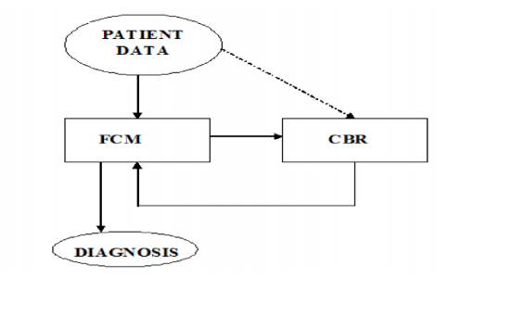
Case Based Reasoning (cbr)
Advantages:
Use the CBR subsystem to generate a sub-FCM emphasizing the nodes activated by the patient data and thus redistributing the causal weights between the concept-nodes
Avoid the possibility of a wrong diagnosis by using only a small part of nodes of the entire system

Slide 11
Competitive Fuzzy Cognitive Maps (CFCM)
The output nodes of a FCM used in decision-making, in many cases, must "compete" against each other in order for only one of them to dominate and be considered the correct decision
In order to achieve this "competition", the interaction of each of these nodes with the others should have a very high negative weight. This implies that the higher the value of a given node, the lower the value of competing nodes

Slide 12
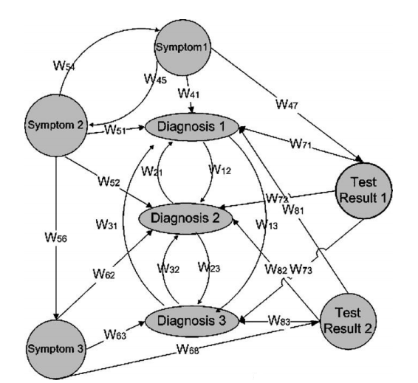
A General Medical Decision Support CFCM

Slide 13
Competitive Fuzzy Cognitive Maps for Knee Injuries
n decision-nodes (as outputs):
C₁: Overuse injuries
C₂: Patellofemoral pain syndrome
C₃: Osteochondritis dissecans of the femoral condyles
C₄: Tibial tuberosity apophysitis
C₅: Iliotibial band syndrome
C₆: Biceps femoris tendinitis
C₇: Inferior patellar pole osteochondritis

Slide 14
Competitive Fuzzy Cognitive Maps for Knee Injuries
m factor-nodes (as inputs):
C₈: Patellar Instability
C₉: Patellar Crepitation
C₁₀: Patella Dislocation
C₁₁: Patella Pain
C₁₂: Rectus Femoris Pain
C₁₃: Muscle Pain
C₁₄: Quadriceps Pain
C₁₅: Tendon Injury
C₁₆: Edema
C₁₇: Heat
C₁₈: Passive Hyperextension Pain
C₁₉: Active Hyperextension Pain
C₂₀: Pain during exercise
C₂₁: Patellofemoral Joint Crepitation

Slide 15
Competitive Fuzzy Cognitive Map for Knee Injuries

Slide 16
Linguistic Variables of the Concepts Relationships

Slide 17
Simulation Results (1/3)
After:
defuzzification method
the recursive algorithm
each node converges to a final value and the decision node with the maximum value is the most possible diagnosis based on the model

Slide 18
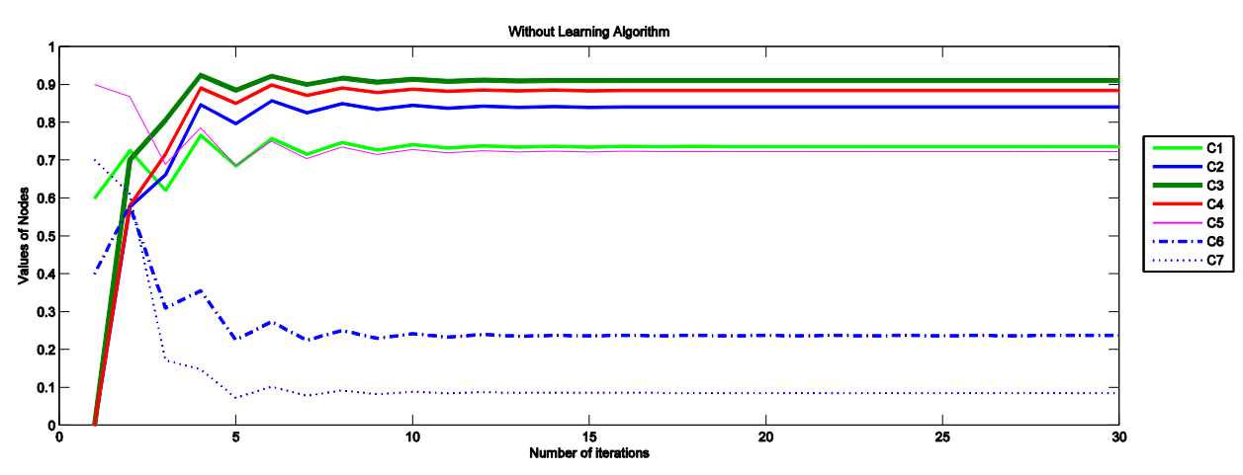
Simulation Results (2/3)
Subsequent values of concepts till convergence

Slide 19
Simulation Results (3/3)
In the specific case there is more than one output that has also high convergence values
These types of injuries are very similar because of the adjacent symptoms
Patellofemoral pain syndrome, osteochondritis dissecans of the femoral condyles, and tibial tuberosity apophysitis are the predominant types of injuries that the patient of the example may suffer

Slide 20
Conclusions
Need for software tools for Medical Decision Support Systems using theories of FCMs
Learning algorithms should be considered to further investigate Medical problems
More simulation results and more examples are necessary in order to compute the system’s reliability in the diagnosis of a specific injury

Slide 21
Thank you for your attention
PhD Candidate Antigoni P. Anninou
Email: anninou@ece.upatras.gr
Professor Peter P. Groumpos
Email: groumpos@ece.upatras.gr

