Slide 1
Ατμοσφαιρική Ρύπανση (ΕΕΕ423)
Μάθημα 8^{ο}
Μέθοδοι και τεχνικές καταγραφής ατμοσφαιρικής ρύπανσης
4/12/2017
Ελένη Αθανασοπούλου
1

Slide 2
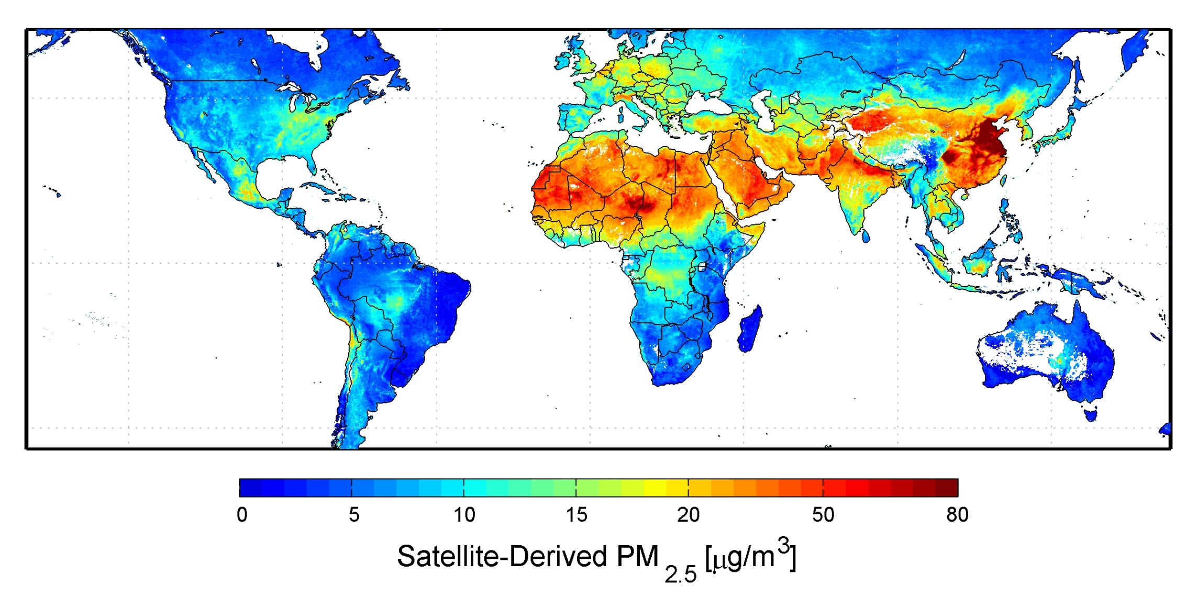
Εισαγωγή
Ορισμός: Ιστορικά, η ποιότητα της ατμόσφαιρας καταγράφεται για 2 βασικούς λόγους:
Νομική παρακολούθηση (υγεία-κλίμα) και επιστημονική έρευνα.
Notes:
http://www.sciencedirect.com/science/article/pii/S0160412016309989
Currently air pollution concentrations are monitored by professional personnel (i.e., government authorities, scientists, health experts) using static monitoring stations equipped with certified reference instruments for measuring regulatory pollutants, such as carbon monoxide (CO), nitrogen oxides (NO_{x}, NO, NO₂), ozone (O₃) and particulate matter (PM₁₀, PM_{2.5}). The air pollutant analyzers are relatively large, heavy and expensive, with prices ranging between €5000 and €30,000 per device. Traditional fixed-site air quality monitoring stations are also subject to strict routines of maintenance and calibration of their instruments, to ensure high quality data and comparability between different stations and regions.
Large cities in developed countries are usually dotted with a network of reference monitoring stations that monitor air quality in real-time. However, the high costs of installation and maintenance of reference monitoring stations results in a relatively sparse monitoring, which provides accurate data but only in few locations, satisfying the legislative requirements but not providing information about localized gradients of potential importance to health protection. Moreover, in smaller cities or in underdeveloped regions, such air quality monitoring (AQM) stations may not exist. The fixed monitoring network is sometimes complemented by mobile air quality monitoring stations. These units usually have the same line of instrumentation as the fixed monitoring stations, mounted on vehicles, and the instruments have the same maintenance and calibration routines. Often, mobile monitoring stations are used for stationary measurements over a fixed period of time (e.g., a measurement campaign) in certain locations not covered by the fixed monitoring network (Glasius, 2006; Röösli et al., 2000). However, due to their high cost, mobile AQM vehicles cannot significantly increase spatial sampling density. The major limitation of mobile AQM data from the perspective of health protection is that their temporal coverage is incomplete.
Air quality monitoring may also be based on passive samplers. Such devices have the advantage in that they are inexpensive to deploy and operate (excluding laboratory analysis), easy to use and do not require electricity. The limitation of passive samplers is that they only allow the quantification of cumulative air pollutant levels, and therefore cannot identify short-term pollutant episodes or even track common temporal patterns (e.g., diurnal variability). Moreover, passive samplers are not as accurate as reference instrumentation, suffer from chemical interference, and are also affected by the atmospheric conditions (Krupa and Legge, 2000; Plaisance et al., 2004).
Finally, air quality models are an effective tool to supplement air quality monitoring. Models can also be used for tasks that cannot be conducted by monitoring alone, (e.g., scenario analysis, forecasting). However, the use of models requires a highly specialized knowledge and input data that is not available in all places. Moreover, in most cases air quality models do not run in an operational mode but rather in a prospective mode. Modelled concentrations may also suffer from systematic errors, including bias, depending on the input data and on the modeller parametrization choices (Pannullo et al., 2016).
All European countries are required to comply with the EU Directives. The framework and legal requirements for assessment and management of ambient air quality are described in the Air Quality Directive 2008/50/EC (EU, 2008). The Air Quality Directive (AQD) establishes the criteria for air quality monitoring. It defines the reference measurement methods that Member States shall apply when monitoring air quality. These methods are currently applied in the fixed monitoring station networks in European cities. However, the AQD also opens the door for the use of other supplementary techniques, such as air quality models and indicative measurements.
Legislation requires measuring of PM₁₀ and PM_{2.5}. However, there is a growing concern on whether mass-based measurements are indeed relevant for assessing health effects of particulate pollution, or number-based measurements should be eventually promoted (Kumar et al., 2010). Several toxicological and panel studies present significant associations between elevated nanoparticle number concentrations (10–100 nm) and daily total as well as cardio-respiratory mortality using time-series epidemiological analysis (Stölzel et al., 2007), promoting number concentrations measurements as an appropriate metric for assessing health effects (Nel et al., 2006; Peters et al., 1997 and Xia et al., 2009).

Slide 3
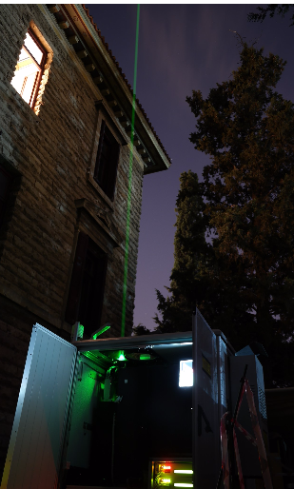
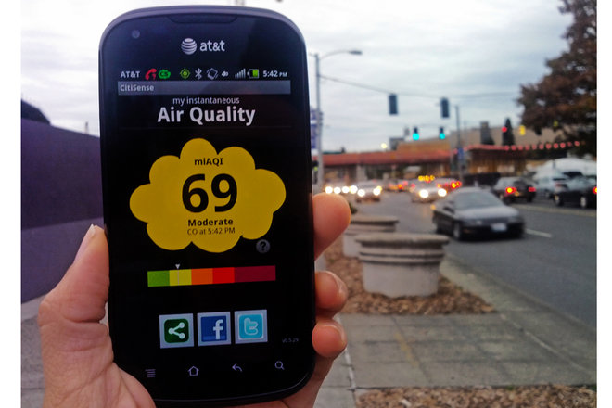
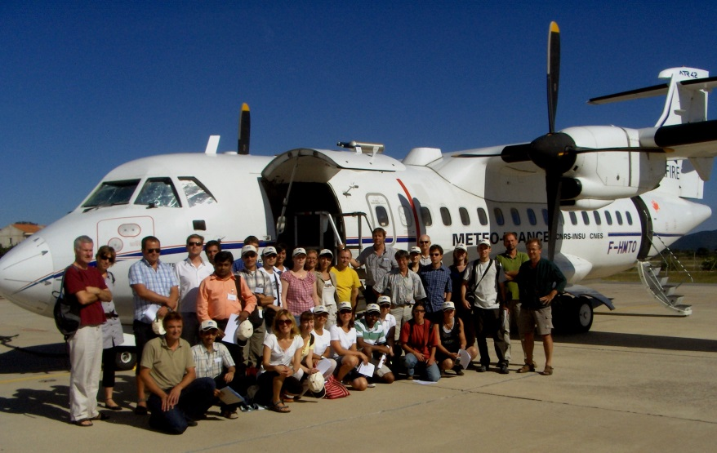
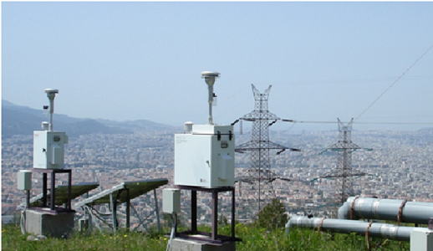
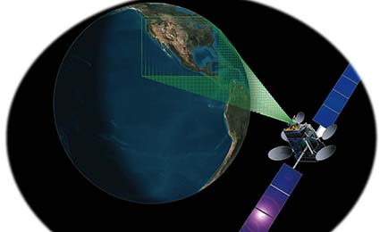
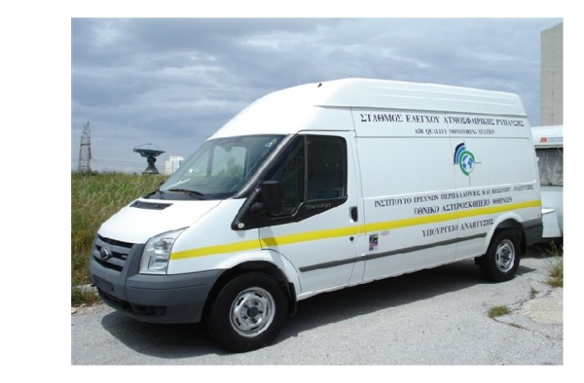
Εισαγωγή
Ορισμός: Ιστορικά, η ποιότητα της ατμόσφαιρας καταγράφεται για 2 βασικούς λόγους:
Νομική παρακολούθηση (υγεία-κλίμα) και επιστημονική έρευνα.
Notes:
Ian colbeck kefalaia 3-6
Useful material/Esa video + website
Zanis kefalaio 6
Sta8moi patras… diktyo attikhs
Useful material/modis
http://digitalearthlab.jrc.ec.europa.eu/app/senseeurair
https://itunes.apple.com/us/app/senseeurair/id1180917747

Slide 4
Δομή Μαθήματος
Στατικοί σταθμοί εδάφους
Τηλεπισκόπηση:
Δορυφόροι & όργανα εδάφους
Κινητοί σταθμοί εδάφους & καθ’ ύψος:
Μεταφορικά μέσα, ατομικοί αισθητήρες κλπ.
Εργαστήριο χημικών αναλύσεων
Αερο-σήραγγες
Notes:
Η ανάπτυξη της τεχνολογίας κατά τα τελευταία 50 χρόνια έχει δώσει την δυνατότητα ανάπτυξης μεγάλης ποικιλίας οργάνων και τεχνικών που μπορούν να χρησιμοποιηθούν ώστε να μετρηθούν αποτελεσματικά ένα μεγάλων αριθμός ρύπων και χημικών ενώσεων στην ατμόσφαιρα. Μετρήσεις γίνονται είτε με δειγματοληπτικό τρόπο και ανάλυση στο εργαστήριο είτε με συνεχή μέτρηση επιτόπου αλλά και με παρατήρηση από μακριά (τηλεπαρατήρηση) γεγονός που διευκολύνει μια τρισδιάστατη χωροχρονική καταγραφή της σύνθεσης της ατμόσφαιρας που μας περιβάλλει. Κατά την μέτρηση ατμοσφαιρικών ρύπων έχουμε υπόψη δυο βασικούς στόχους: (α) την ορθή ταυτοποίηση των ρύπων και (β) τον ποσοτικό τους προσδιορισμό.
Τεχνικές που εφαρμόζονται συνήθως στην μελέτη της ατμοσφαιρικής ρύπανσης περιλαμβάνουν:
• Χρωματογραφία
• Φωτομετρία
• Υπέρυθρη και Υπεριώδης φασματοσκοπία
• Φασματοσκοπία Ατομικής Απορρόφησης
• Φασματοσκοπία με ακτίνες Χ
• Φασματομετρία μάζας
• Ηλεκτροχημικές τεχνικές

Slide 5
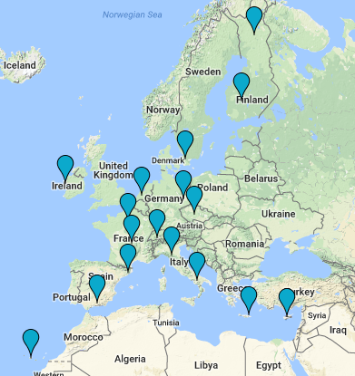
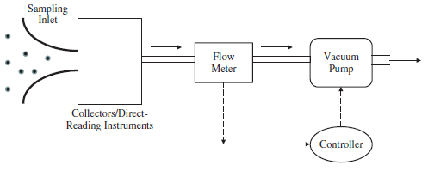
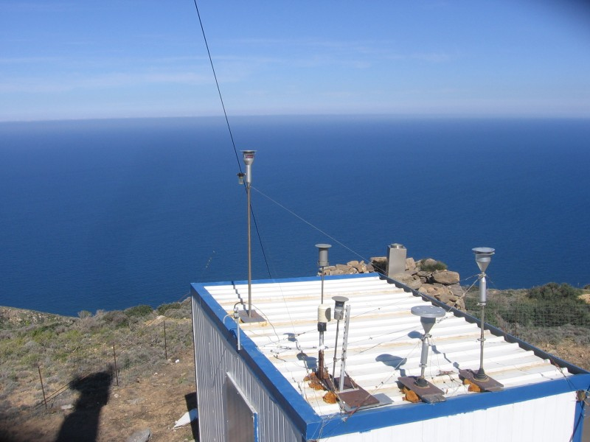
1. Δειγματοληψία: φίλτρο συλλογής σωματιδίων σε ορισμένο χρονικό διάστημα (αντικατάστασης του φίλτρου). 2. Αυτόματη-στιγμιαία καταγραφή αέριου ρύπου.
Σταθμοί επιφάνειας
Video: https://www.youtube.com/watch?v=mp3kztZy7ow
Notes:
The common strategy for aerosol characterization is depicted in Figure 4.1. Aerosol particles
are sampled from the ambient environment or from specific sources into an instrument
via a sampling inlet. Size-selective sampling inlets are often used either to meet the specific requirements of aerosol applications and standards, such as PM2.5 sampling, or to reduce
potential interference from particles of larger sizes. Once sampled into the instrument, particles
are either deposited on/in a collector (i.e. substrate or filter) in an aerosol sampling
instrument or directed into the sensing volume of a direct-reading instrument. A vacuum
pump is used to enable the sampling task and a flow meter monitors the sampling flow
rate in volume or mass. A feedback control loop is often implemented to accurately control
the sampling flow rate. Since the physical properties of aerosols are often presented in
the unit of concentration (i.e. number/mass concentration), the total sampling volume in
the sampling period (calculated by multiplying the measured volumetric flow rate with the
sampling time) is a key parameter for aerosol instruments.
Note: because of their time-averaging nature, the possibility of chemical interaction between particles–particles and particles–substrates may become an issue.

Slide 6
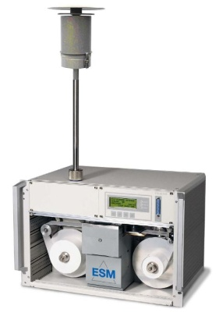
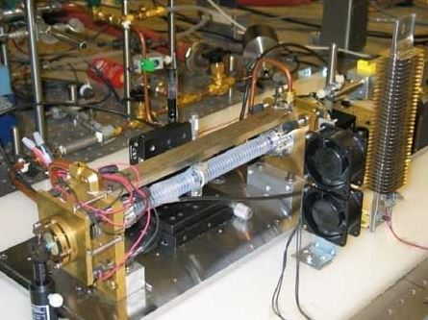
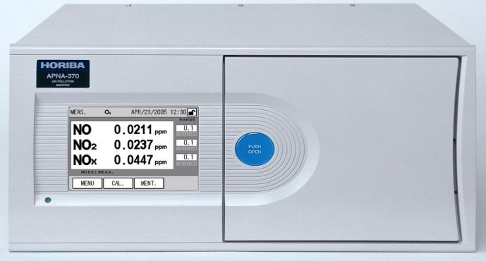
Μέθοδοι μέτρησης /αρχές λειτουργίας οργάνων/ μετρούμενοι ρύποι
Σταθμοί επιφάνειας
Beta ray attenuation | radiometric microbalance system, strength of a beta ray beam passing through the filter paper | Mass of PM10, PM2.5 & PM1
Φασματοσκοπία Cavity ring down spectroscopy | optical spectroscopic technique , measurement of absolute optical extinction by samples that scatter and absorb light | Ppt CO2, CH4 & CO
Χημιφωταύγεια Chemiluminescence | emission of light (luminescence), as the result of a chemical reaction. activated NO2 luminesces broadband visible to infrared light | NO, NO2
Notes:
https://www.eea.europa.eu/data-and-maps/data/aqereporting-2
Beta ray attenuation:The instrument's primary operating mechanism is the radiometric microbalance system, which relies on changes in the strength of a beta ray beam passing through the filter paper to determine changes in particulate mass collected. A Beta Attenuation Monitor is comprised of three main components: the PM air inlet, the central instrument, and the vacuum pump.
Cavity ring down spectroscopyfor measuring CO2, CH4 & CO. is a highly sensitive optical spectroscopic technique that enables measurement of absolute optical extinction by samples that scatter and absorb light. It has been widely used to study gaseous samples which absorb light at specific wavelengths, and in turn to determine mole fractions down to the parts per trillion level. The technique is also known as cavity ring-down laser absorption spectroscopy (CRLAS).
Chemiluminescence: Chemiluminescence (sometimes "chemoluminescence") is the emission of light (luminescence), as the result of a chemical reaction. One known gas phase reaction is the basis of nitric oxide detection in commercial analytic instruments applied to environmental air-quality testing. Ozone is combined with nitric oxide to form nitrogen dioxide in an activated state. The activated NO2 luminesces broadband visible to infrared light as it reverts to a lower energy state. A photomultiplier and associated electronics counts the photons that are proportional to the amount of NO present. To determine the amount of nitrogen dioxide, NO2, in a sample (containing no NO) it must first be converted to nitric oxide, NO, by passing the sample through a converter before the above ozone activation reaction is applied. The ozone reaction produces a photon count proportional to NO that is proportional to NO2 before it was converted to NO. In the case of a mixed sample that contains both NO and NO2, the above reaction yields the amount of NO and NO2 combined in the air sample, assuming that the sample is passed through the converter.

Slide 7
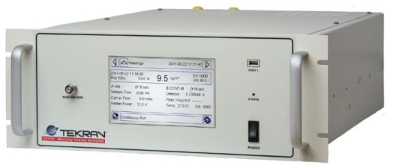
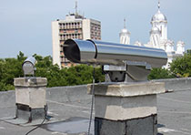
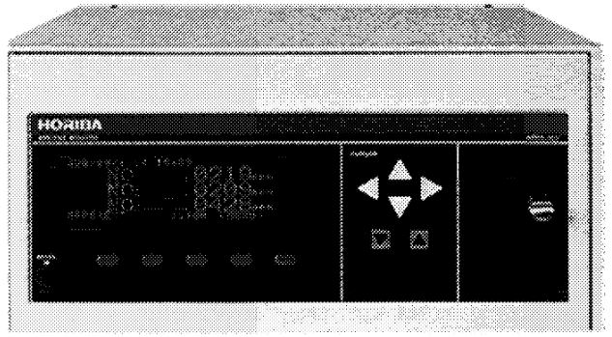
Σταθμοί επιφάνειας
Μέθοδοι μέτρησης /αρχές λειτουργίας οργάνων/ μετρούμενοι ρύποι
Cold vapour atomic fluorescence | Free mercury atoms in a carrier gas are excited The excited atoms re-radiate their absorbed energy (fluoresce) | trace amounts of volatile heavy metals such as mercury
Φασματοσκοπία Differential Optical Absorption Spectroscopy (DOAS) | optical absorption in the ultraviolet wavelength region | SO2, NO2
Flame ionization detection | detection of organic compounds is most effectively done with flame ionization | NO, NO2
Notes:
https://www.eea.europa.eu/data-and-maps/data/aqereporting-2
Cold vapour atomic fluorescence: Cold vapour atomic fluorescence spectroscopy is a subset of the analytical technique known as atomic fluorescence spectroscopy (AFS). Used in the measurement of trace amounts of volatile heavy metals such as mercury, cold vapour AFS makes use of the unique characteristic of mercury that allows vapour measurement at room temperature. Free mercury atoms in a carrier gas are excited by a collimated ultraviolet light source at a wavelength of 253.7 nanometres. The excited atoms re-radiate their absorbed energy (fluoresce) at this same wavelength.
Differential Optical Absorption Spectroscopy (DOAS): In atmospheric chemistry, differential optical absorption spectroscopy (DOAS) is used to measure concentrations of trace gases. When combined with basic optical spectrometers such as prisms or diffraction gratings and automated, ground-based observation platforms, what we have is a cheap and powerful means for the measurement of such trace gas species as ozone and nitrogen dioxide.
Flame ionization detection: A flame ionization detector (FID) is a type of gas detector used in gas chromatography. The detection of organic compounds is most effectively done with flame ionization.

Slide 8
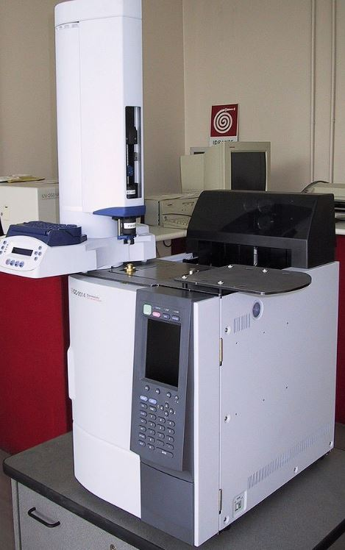
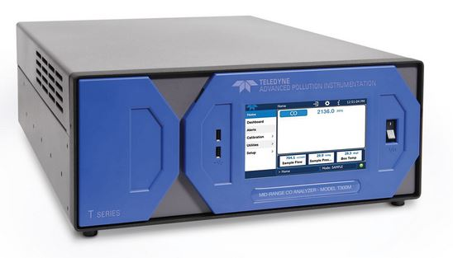
Μέθοδοι μέτρησης /αρχές λειτουργίας οργάνων/ μετρούμενοι ρύποι
Σταθμοί επιφάνειας
Χρωματογραφία Gas chromatography | each compound elutes at a different time, known as the retention time of the compound. The comparison of retention times is what gives GC its analytical usefulness. Can be followed by followed by flame ionization detection , mass spectrometry, photo ionization detection | Toluene, benzene, toluene, ethyl benzene, o-Xylene, Total non-methane hydrocarbons etc.
Infrared gas filter correlation | ability of gases to absorb unique light wavelengths: the absorbance difference provides a direct output of the gas concentration | CO
Notes:
https://www.eea.europa.eu/data-and-maps/data/aqereporting-2
Gas chromatography : is a common type of chromatography used in analytical chemistry for separating and analyzing compounds that can be vaporized without decomposition. Typical uses of GC include testing the purity of a particular substance, or separating the different components of a mixture (the relative amounts of such components can also be determined). In some situations, GC may help in identifying a compound. In preparative chromatography, GC can be used to prepare pure compounds from a mixture.
elution is the process of extracting one material from another by washing with a solvent.
Infrared gas filter correlation
GFx sensing is based on the ability of gases to absorb unique light wavelengths, a property used to detect the concentration of a selected gas in a mixture. Two gas filled cuvettes are mounted on a rotating disc, which pass through a beam of light alternately. One cuvette (the measure cuvette) is filled with nitrogen (typically) while the other cuvette (the reference cuvette) is filled with a sample of the gas to be measured. Light is passed through the gas to be measured: the difference in absorbance is measured and provides a direct output of the gas concentration.

Slide 9
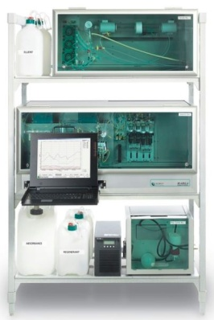
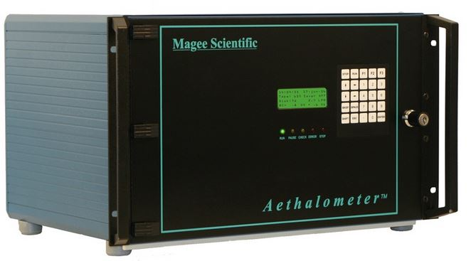
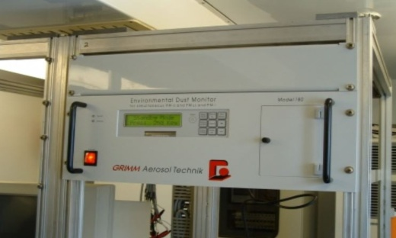
Σταθμοί επιφάνειας
Μέθοδοι μέτρησης /αρχές λειτουργίας οργάνων/ μετρούμενοι ρύποι
Χρωματογραφία Ion chromatography | separation of ions and polar molecules based on their charge | Calcium, magnesium, sodium, sulphate, ammonium, chloride, nitrate, potassium in PM2.5
Απορρόφηση φωτός Light absorption | light absorption of carbon particles at different wavelengths. Interpretation of the differences in optical response across the wavelength spectrum | Black Carbon, ozone, CO, aerosol size distribution, physical properties, and assist in identifying the primary components
Σκέδαση φωτός Light scattering | fine dust monitoring, measuring the light scattered by a sample into a plurality of angles | Dust -PM10, PM2.5, PM1 and the TC (Total particle counts)., particle size distribution
Notes:
https://www.eea.europa.eu/data-and-maps/data/aqereporting-2
Ion chromatography: Ion chromatography (or ion-exchange chromatography) is a process that allows the separation of ions and polar molecules based on their charge. It can be used for almost any kind of charged molecule including large proteins, small nucleotides and amino acids. The solution to be injected is usually called a sample, and the individually separated components are called analytes. It is often used in protein purification, water analysis, and quality control.
Light absorption: The Rack Mount Aethalometer Model AE22 measures the light absorption of carbon particles at two wavelengths: 880 nm (IR), quantitative for the mass of ‘Black’ or Elemental Carbon; and 370 nm (UV), indicating the presence of aromatic organic compounds such as are found in wood smoke, biomass-burning smoke, and tobacco smoke. The Real-time measurements can be made with time resolution from one second to one hour. Performing the 2 wavelength measurement is important in determining the sources of airborne black carbon particles (ie. diesel exhaust vs. wood smoke combustion). The instrument is widely used in monitoring applications involving human exposure to localized, community-based sources of air pollution.
The Rack Mount Aethalometer Model AE31 measures light absorption by suspended aerosol particles at seven wavelengths, from 370 nm (UV) to 950 nm (IR). Real-time measurements of particle concentrations can be made with a time resolution of two minutes to one hour. Interpretation of the differences in optical response across the wavelength spectrum reveal information regarding aerosol size distribution, physical properties, and assist in identifying the primary components. This instrument is widely used in monitoring studies involving large scale, regional air pollution problems.
Light scattering: measure particle size distribution and particulate mass based on a light scattering measurement of individual particles in the sampled air

Slide 10
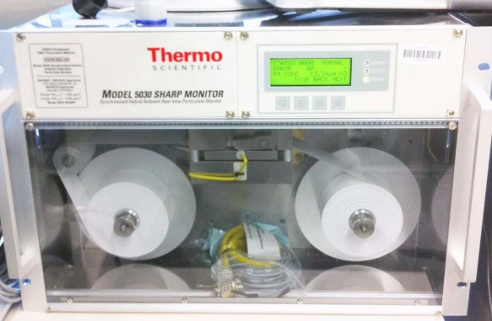
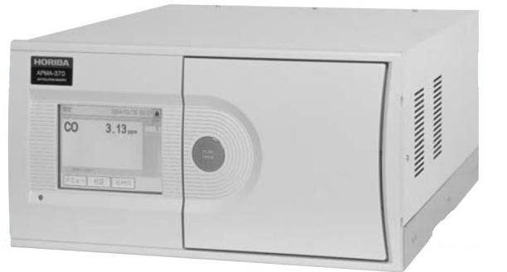
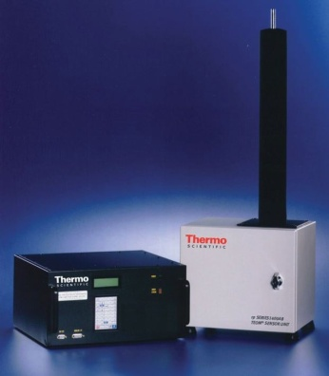
Σταθμοί επιφάνειας
Μέθοδοι μέτρησης /αρχές λειτουργίας οργάνων/ μετρούμενοι ρύποι
Nephelometry | light scattering method to detect particles in liquid samples. Measure forwarded scattered light | PM2.5, PM10
Φασματοσκοπία Non-dispersive infrared spectroscopy | concentration is measured electro-optically by its absorption of a specific wavelength in the infrared | CO
Tapered Element Oscillating Microbalance | small vibrating glass tube whose oscillation frequency changes when aerosol particles are deposited on it | PM-10 or PM-2.5 mass concentrations
Notes:
https://www.eea.europa.eu/data-and-maps/data/aqereporting-2
Nephelometry: Nephelometry is a light scattering method to detect particles in liquid samples. The principle is to measure forwarded scattered light when a laser beam passes through a sample and the light is deflected by the particles.
Non-dispersive infrared spectroscopy: A nondispersive infrared sensor (or NDIR) sensor is a simple spectroscopic device often used as gas detector. The main components are an infrared source (lamp), a sample chamber or light tube, a wavelength sample chamber, and gas concentration is measured electro-optically by its absorption of a specific wavelength in the infrared (IR). The IR light is directed through the sample chamber towards the detector. In parallel there is another chamber with an enclosed reference gas, typically nitrogen. The detector has an optical filter in front of it that eliminates all light except the wavelength that the selected gas molecules can absorb.
Tapered Element Oscillating Microbalance: A continuous direct mass measurement of particulate matter utilizing a tapered element oscillating microbalance (TEOM). Small vibrating glass tube whose oscillation frequency changes when aerosol particles are deposited on it

Slide 11
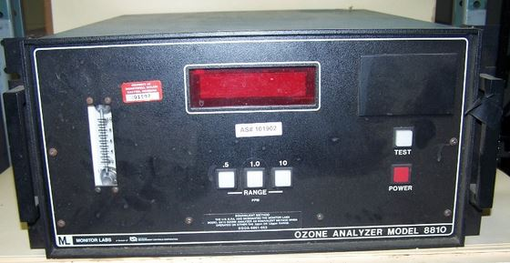
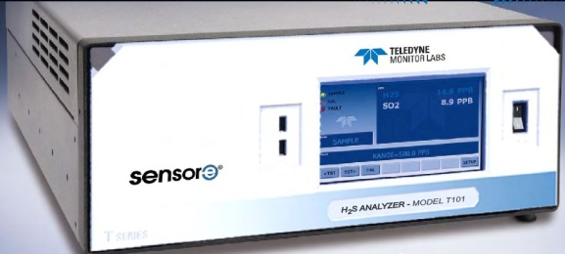
Σταθμοί επιφάνειας
Μέθοδοι μέτρησης /αρχές λειτουργίας οργάνων/ μετρούμενοι ρύποι
Φωτομετρία Ultraviolet (UV) photometry | absorption of UV light by the ozone, measure reduction of the quanta of light | Ozone
UV fluorescence | UV fluorescence principle | SO2
Notes:
https://www.eea.europa.eu/data-and-maps/data/aqereporting-2
Ultraviolet (UV) photometry: absorption of UV light by the ozone molecule and subsequent use of photometry to measure reduction of the quanta of light reaching the detector
UV fluorescence: UV fluorescence principle to measure hydrogen sulfide at levels commonly required for ambient air monitoring

Slide 12
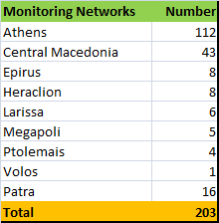
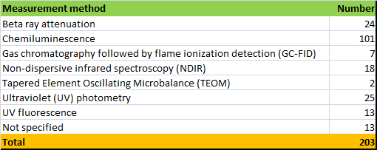
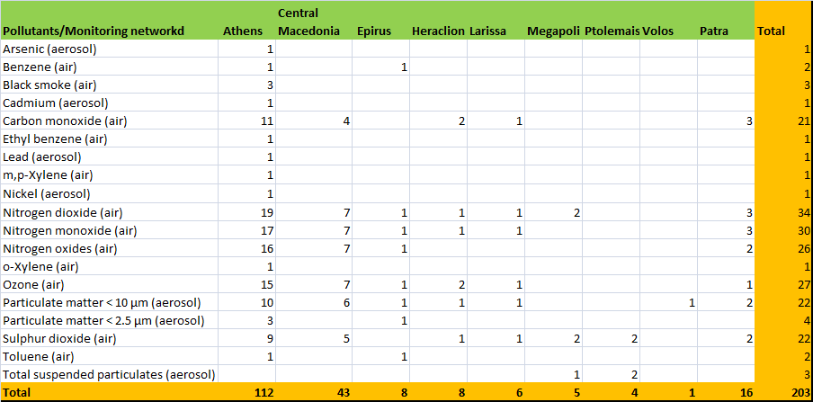
Καταγραφή στην Ελλάδα (EEA 2017)
Σταθμοί επιφάνειας
Notes:
https://www.eea.europa.eu/data-and-maps/data/aqereporting-2

Slide 13
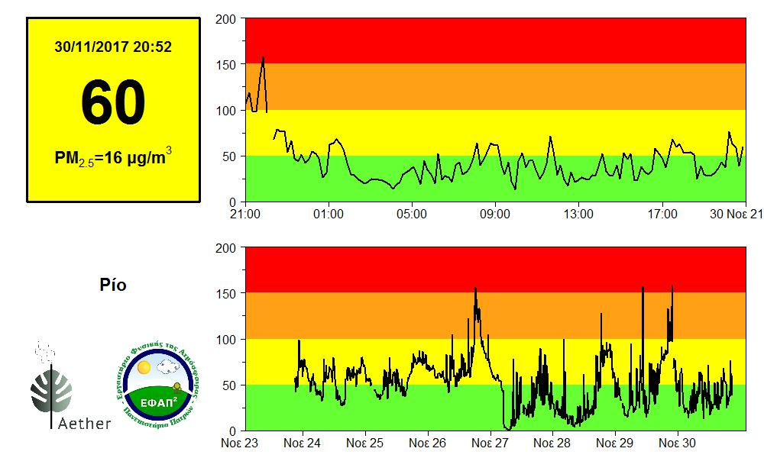
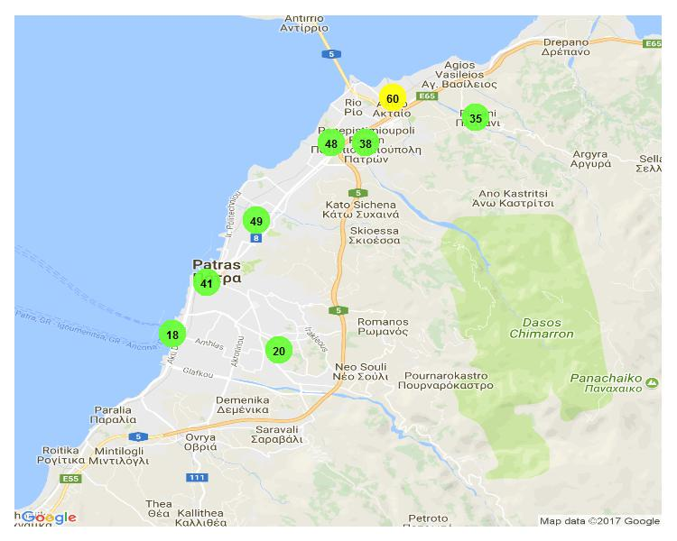
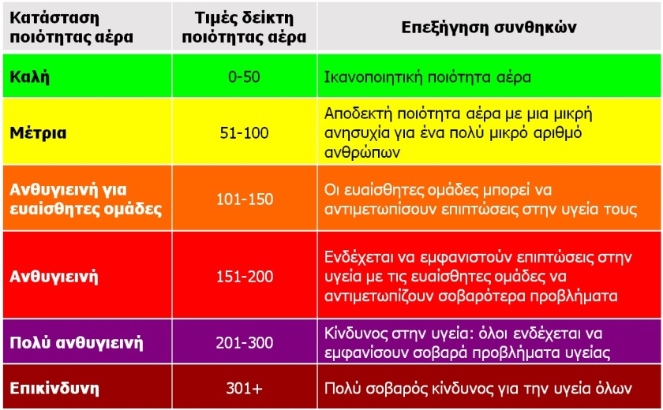
Καταγραφή στην Πάτρα (Αιθέρας, Εργαστηρίου Φυσικής της Ατμόσφαιρας του Πανεπιστημίου Πατρών 2017)
Σταθμοί επιφάνειας
Source: http://www.patrasair.gr/
Notes:
https://www.eea.europa.eu/data-and-maps/data/aqereporting-2
Aether is a hybrid system of 180° panoramic IP cameras and particle counters that track air quality and visibility levels across a city. Aether can sense and monitor air pollution in real time to alert and raise awareness about the air we breathe. Our vision is evolved into a useful tool able to detect and estimate various atmospheric compounds that affect both our health and climate.

Slide 14
Σταθμοί επιφάνειας
Notes:
The database compiles ground measurements of annual mean concentrations of particulate matter of a diameter of less than 10 m (PM10) or 2.5 m (PM2.5) and aims at representing an average for the city or town as a whole, rather than for individual stations. Years of measurements range from 2010 to 2015, unless the latest available data was older.

Slide 15
Δομή Μαθήματος
Στατικοί σταθμοί εδάφους
Τηλεπισκόπηση:
Δορυφόροι & όργανα εδάφους
Κινητοί σταθμοί εδάφους & καθ’ ύψος:
Μεταφορικά μέσα, ατομικοί αισθητήρες κλπ.
Εργαστήριο χημικών αναλύσεων
Αερο-σήραγγες

Slide 16
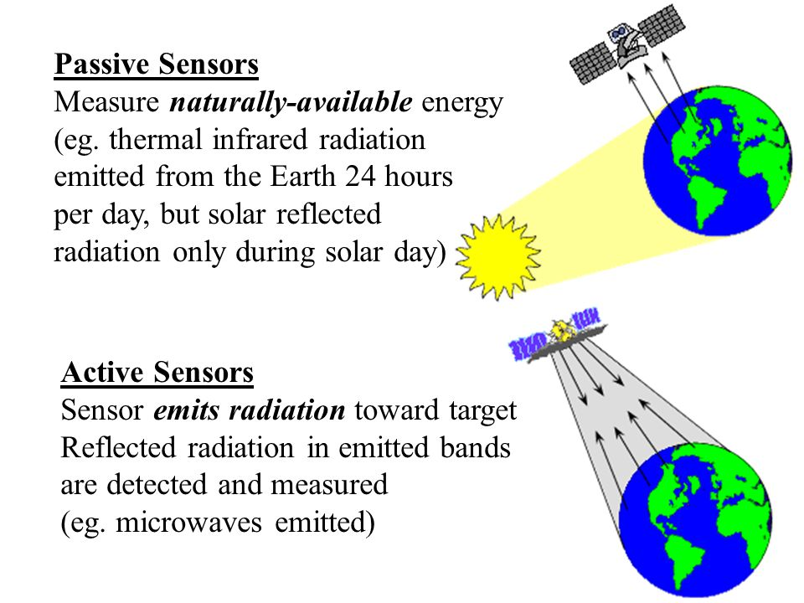
Τηλεπισκόπηση – Remote sensing
Video: https://www.youtube.com/watch?v=zQbeLSh-XF8
Καταγραφή αέριας ρύπανσης με αισθητήρα που βρίσκεται σε απόσταση από αυτήν
Ενεργοί vs. Παθητικοί αισθητήρες:
1.Δορυφορική τηλεπισκόπηση: εξοπλισμός κατάλληλος για μέτρηση αέριας ρύπανσης πάνω σε δορυφόρους της γης
2.Τηλεπισκόπηση εδάφους:
Λέιζερ Ραντάρ (Lidars)
Ραδιόμετρα
Φωτόμετρα
Notes:
http://www.teramobile.org/teramobile.html
https://en.wikipedia.org/wiki/Remote_sensing#Acoustic_and_near-acoustic
http://www.sciencedirect.com/science/article/pii/S1352231012011144
The spatial resolution of ground-based measurements is constrained by the limited number of monitors and their proximity. High quality in situ measurements are frequently lacking in developing countries. Remote sensing of air pollution can supplement existing ground-based monitors and provide coverage where ground-based data are unavailable (Brauer et al., 2012; van Donkelaar et al., 2010). Satellite observations of tropospheric NO₂ column abundance have been conducted since 1995 (Burrows et al., 1999) and have been improving in spatial and temporal resolution (Martin, 2008). Methods to relate these remotely sensed column abundances to surface concentrations are necessary for satellite measurements to inform discussions on air pollution and attributable health effects. Ground-level NO₂concentrations obtained from OMI on the basis of surface-to-column ratios simulated with a chemical transport model (CTM) have been shown to agree well with corrected in situ measurements in the US and Canada (Lamsal et al., 2008, 2010). That finding suggests that OMI can detect regional variability in NO₂. Much of the research comparing satellite and ground-level measurements of NO₂ has focused on temporal (Ghude et al., 2011; Kramer et al., 2008; Meng et al., 2010; Petritoli et al., 2004; Russell et al., 2010) or spatio-temporal (Boersma et al., 2009; Lamsal et al., 2008, 2010; Ordoñez et al., 2006) patterns, and focused on large spatial scales (Blond et al., 2007; Duncan et al., 2010) and/or rural locations. Studies that have focused on urban NO₂ are limited to a single monitor (Boersma et al., 2009; Ghude et al., 2011; Petritoli et al., 2004) or a spatial average (Kramer et al., 2008; Russell et al., 2010) for the urban areas examined. Limited work has been done to evaluate the ability of OMI or other current satellite sensors to detect gradients of surface NO₂ within a single urban area. In addition, modeled NO₂ is susceptible to biases in coarse-resolution chemical transport models, owing to non-linearity in NO₂ chemistry. Valin et al. (2011a) found that a model resolution of 4–12 km is necessary to predict NO₂ column abundance with 10% accuracy.
Principle of Lidar and white-light Lidar. Light pulses are emitted in the atmosphere, where they are attenuated and backscattered. The backscattered signal as a function of time, hence of distance, is collected on a telescope, and permits to retrieve information about the components present in the atmosphere. In the case of white-light Lidar, the signal is recorded at several wavelengths, allowing measurements with both spectral and spatial resolution.
The quality of remote sensing data consists of its spatial, spectral, radiometric and temporal resolutions.
Spatial resolutionThe size of a pixel that is recorded in a raster image – typically pixels may correspond to square areas ranging in side length from 1 to 1,000 metres (3.3 to 3,280.8 ft).Spectral resolutionThe wavelength of the different frequency bands recorded – usually, this is related to the number of frequency bands recorded by the platform. Current Landsat collection is that of seven bands, including several in the infrared spectrum, ranging from a spectral resolution of 0.07 to 2.1 μm. The Hyperion sensor on Earth Observing-1 resolves 220 bands from 0.4 to 2.5 μm, with a spectral resolution of 0.10 to 0.11 μm per band.Radiometric resolutionThe number of different intensities of radiation the sensor is able to distinguish. Typically, this ranges from 8 to 14 bits, corresponding to 256 levels of the gray scale and up to 16,384 intensities or "shades" of colour, in each band. It also depends on the instrument noise.Temporal resolutionThe frequency of flyovers by the satellite or plane, and is only relevant in time-series studies or those requiring an averaged or mosaic image as in deforesting monitoring. This was first used by the intelligence community where repeated coverage revealed changes in infrastructure, the deployment of units or the modification/introduction of equipment. Cloud cover over a given area or object makes it necessary to repeat the collection of said location.

Slide 17
Δορυφορικές μετρήσεις
Οι παρατηρήσεις από δορυφόρους γίνονται σε διαφορετικές τροχιές, γωνίες λήψης, ζενίθιες γωνίες και ποικίλουν χρονικά μέσα στην ημέρα και στο έτος (εποχή).
Sentinel-5 Precursor is the first Copernicus mission dedicated to monitoring our atmosphere. With air pollution a major concern, the satellite carries the state-of-the-art Tropomi instrument to map a multitude of trace gases such as nitrogen dioxide, ozone, formaldehyde, sulphur dioxide, methane, carbon monoxide and aerosols – all of which affect the air we breathe and therefore our health, and our climate.
Notes:
https://www.slideshare.net/AbhiramKanigolla/131869
https://www.researchgate.net/publication/224828860_Air_Pollution_Monitoring_Using_Earth_Observation_GIS
http://www.sciencedirect.com/science/article/pii/S1352231014004270
Μεθοδολογία: Satellite-based retrievals of aerosol properties by passive sensors account for the viewing geometry in the radiative transfer model. The retrieval algorithms follow several steps. The first is the cloud screening, where
a pixel is identified as ‘clear’ or ‘cloudy’. High reflectance of clouds in the pixel overshadows
the ‘aerosol’ reflectance and hence aerosol cannot be detected in a cloudy pixel by
passive remote sensing (Ackerman et al., 1998). Various cloud-masking techniques have
been developed, based on the sensor characteristics. The next step is to separate the surface
reflectance from clear-sky atmospheric reflectance. The contribution of molecular scattering
and absorption to atmospheric reflectance is estimated using a radiative transfer model.
Look-up tables (LUTs) are prepared in order to expedite the retrieval, with TOA radiance
theoretically calculated for a set of aerosol models, taking into account the sun and sensor
geometry. Aerosol properties are then retrieved by comparing the measured TOA radiance
with the theoretical radiance values from the LUTs. Retrieved aerosol products at high resolution
are reported as level 2 data. All level 2 pixels within a larger domain (typically at
1.0∘ or 0.5∘ grids) are averaged and reported as level 3 data, which are distributed on ‘daily’
and ‘monthly’ timescales. Aerosol remote sensing is currently carried out using UV and
visible–near-infrared (VIS-NIR) wavelengths.

Slide 18
Δορυφορικές μετρήσεις
Source: Remote Sens. 2011, 3, 524-538; doi:10.3390/rs3030524
Notes:
The role of satellite observations in the resolution of the previous issues has considerably increased during the last twenty years as the spatial, spectral and temporal characteristics of the sensors have been constantly improving, and new methods for the exploitation of satellite data have been developed.
The first satellite instrument capable of crudely monitoring aerosol optical depth from space—the Advanced Very High Resolution Radiometer (AVHRR)—retrieved optical depth from measurements in the visible and near-infrared spectrum, beginning in the late 1970s. AVHRR, a passive radiometer, measured the intensity of sunlight as it reflected off aerosols, using the dark ocean as the background. AVHRR was the first satellite sensor in polar orbit to provide data from the spectral regions of short-wave infrared or SWIR (centered at 3.9 μm) and of thermal infrared or TIR (centered at 10.8 μm), both associated to the detection of temperature variations on the Earth’s surface. Various algorithms using AVHRR data for detecting hot spots associated to wildfires have hitherto been proposed [7-9]. Algorithms for fire detection using other polar satellite data have also been proposed, and a series of satellite based fire products (using ATSR or MODIS data) are currently available [10-12]. Most of these algorithms and products show an overestimation of fire detections (i.e., false alarms) in Southern Europe, but the most important limitation of polar satellite systems, with regard to the needs of continuous and in-real-time monitoring of wildfires, is their infrequent overpasses, varying inversely with the spatial resolution of the sensor (Figure 1).
In this respect only geostationary systems with their inherent high temporal resolution can be helpful; the Spinning Enhanced Visible and Infrared Imager (SEVIRI), on board the geostationary Meteosat Second Generation (MSG) satellite, allows for observations over Europe every 15 minutes (or every 5 minutes in the Rapid Scanning Service mode at the expense of coverage). SEVIRI has 12 spectral bands, two of which are operative in the SWIR and in the TIR wavelengths sensitive to fire and to Earth’s surface radiative temperature, respectively.
Over subsequent decades, the instruments have grown more sophisticated and made it possible to study aerosols over the land as well. Newer radiometers such as the Multi-angle Imaging Spectroadiometer (MISR) and the Moderate Resolution Imaging Spectroradiomer (MODIS) are capable of viewing aerosols at many more angles and wavelengths, providing more accurate results. The Moderate Resolution Imaging Spectroradiometer (MODIS) onboard NASA’s Terra
spacecraft performs near-global daily observations of atmospheric aerosols. The MODIS
instrument measures upwelling radiance in 36 bands for wavelengths ranging from 0.4 to
14.385 μm and has a spatial resolution of 250m (2 channels), 500m (5 channels), and 1 km (29
channels) at nadir. (Kaufman et al, 1997; Tanré et al, 1997, 1999; Remer et al, 2005 ; Vermote
and Saleous, 2000). The aerosol retrieval makes use of 7 of these channels (0.47 – 2.12 μm) to retrieve aerosol boundaries and characteristics. MODIS has one camera and measures
radiances in 36 spectra bands, from 0.4 μm to 14.5 μm with spatial resolutions of 250m
(bands 1-2), 500 m (bands 3-7) and 1000 m (bands 8-36). Daily level 2 (MOD04) aerosol
optical thickness data (550 m) are produced at the spatial resolution of 10x10 km over land,
using the 1 km x 1 km cloud-free pixel size. MODIS aerosol products are provided over land
and water surfaces.
ASTER is an advanced multi-spectral imager that was launched onboard NASA’s Terra
spacecraft in December 1999. ASTER covers a wide spectral region with 14 bands from
visible to thermal infrared with high spatial, spectral and radiometric resolutions. The
spatial resolution varies with wavelength: 15m in the visible and near-infrared (VNIR), 30m
in the short wave infrared (SWIR), and 90m in the thermal infrared (TIR).
The Landsat Thematic Mapper (TM) is an advanced, multi-spectral scanning, Earth resources
sensor designed to achieve higher spatial resolution, sharper spectral separation, improved
geometric fidelity, and greater radiometric accuracy and resolution (Guanter, 2006). TM data
are scanned simultaneously in 7 spectral bands. Band 6 scans thermal (heat) infrared radiation,
the other ones scan in the visible and infrared. The Enhanced Thematic Mapper-Plus (ETM+)
on Landsat-7 that was launched on April 15, 1999 is providing observations at a higher spatial
resolution and with greater measurement precision than the previous TM
LANDSAT mission is the longest running mission till the date, earth is observed with the help of it. Tons of information and documentation about changing earth is collected thanks to LANDSAT mission. This mission has been running since 40 years now. Knowing this, one can understand that remote sensing must be throwing some benefits for entire globe. And definitely, that is true.

Slide 19
Δορυφορικές μετρήσεις
Cams - COPERNICUS: Ευρωπαϊκό πρόγραμμα παρατήρησης της ατμόσφαιρας της γης
Notes:
https://atmosphere.copernicus.eu/cams-input-data
Satellites provide the space–time coverage required to monitor atmospheric aerosol
concentration at the global scale and complement ground-based monitoring. Satellite
remote sensing applications began to retrieve information on aerosol properties (e.g.
AOD or absorbing aerosol index (AAI)) some 30 years ago (Lee et al., 2009). The Multi
Spectral Scanner (MSS) onboard the Earth Resources Technology Satellite (ERTS-1)
was the first sensor used to retrieve AOD (Griggs, 1975). However, the Advanced Very
High Resolution Radiometer (AVHRR) onboard the TIROS-N satellite was the first to
be used for operational aerosol products (Stowe et al., 2002). Originally launched for
weather observations, AVHRR’s ability to measure reflected solar radiation at visible
and mid-infrared wavelengths was utilized for aerosol retrieval. Since then, a number of
passive sensors have been launched to measure aerosols over ocean and land (Figure 6.5).
Early passive sensors were developed for other purposes (e.g. Total Ozone Mapping
Spectrometer, TOMS was launched onboard the Nimbus 7 satellite in order to detect
ozone, but its ultraviolet (UV) bands were used to measure absorbing aerosols), but their
measurement capabilities have been utilized to retrieve aerosol properties, with varying
success. Our understanding of the limitations of existing sensors in measuring aerosol
properties has led to the development of more robust techniques. Recently, an active
remote sensing technique was utilized to retrieve aerosol vertical distributions, adding a
new dimension to aerosol remote sensing.
The determination of the AOT from the Landsat TM/ETM+
imagery is based on the use of radiative transfer equation, the principle of atmospheric
correction such as darkest pixel method (Hadjimitsis et al., 2002). Since MODIS has a sensor
with the ability to measure the total solar radiance scattered by the atmosphere as well as
the sunlight reflected by the Earth’s surface and attenuated by atmospheric transmission,
the AOT results found by MODIS were compared with the sun-photometer’s AOT results
for systematic validation (Tang et al., 2004). For the MODIS images, despite its low pixel
resolution, aerosol optical thickness values were extracted for the 550 nm band. MODIS data
have been extended correlated with PM10 over several study areas (Hadjimitsis et al., 2010;
Nisanzti et al., 2011) with improved correlation coefficients but with several limitations.
PM2.5 are also found to be correlated against MODIS data using new novel improved
algorithms (e.g Lee et al., 2011) that considers the low spatial resolution of MODIS with
future positive premises.
Global real-time analysis and forecast system
The CAMS global real-time production system uses satellite data in its 4-dimensional variational (4D-Var) data assimilation system to constrain the initial atmospheric state that is used for the 5-day forecast. Apart from all the meteorological observations that form part of the ECMWF numerical weather prediction system, CAMS uses additional observations on atmospheric composition. Three categories of observations are listed below. The assimilated observations are the observations that are currently used to constrain the model; the monitored observations are the observations that are part of the full system (near-real-time (NRT) data acquisition, calculations of observation-model differences,...), but are not used yet to constrain the model; planned observations are observations that are being considered to be implemented in the CAMS system.

Slide 20
Δορυφορικές μετρήσεις
Europe has launched the first satellite of what is heralded as one of the most ambitious Earth-observation programmes ever (3/4/15)
The first Copernicus mission dedicated to monitoring our atmosphere, Sentinel‑5P, has been launched from the Plesetsk Cosmodrome in northern Russia (13/10/17).
Source: https://www.nature.com/news/earth-observation-enters-next-phase-1.15006
The European Space Agency (ESA) is Europe's gateway to space.
Notes:
https://www.slideshare.net/AbhiramKanigolla/131869
https://www.researchgate.net/publication/224828860_Air_Pollution_Monitoring_Using_Earth_Observation_GIS
http://www.sciencedirect.com/science/article/pii/S1352231014004270
http://www.esa.int/spaceinimages/Images/2017/07/Bringing_air_pollution_into_focus
http://www.esa.int/Our_Activities/Observing_the_Earth/Copernicus/Sentinel-5P/Air_quality-monitoring_satellite_in_orbit
Sentinel-5P – the ‘P’ standing for ‘Precursor’ – is the first Copernicus mission dedicated to monitoring our atmosphere. The satellite carries the state-of-the-art Tropomi instrument to map a multitude of trace gases such as nitrogen dioxide, ozone, formaldehyde, sulphur dioxide, methane, carbon monoxide and aerosols – all of which affect the air we breathe and therefore our health, and our climate.
The first stage separated 2 min 16 sec after liftoff, followed by the fairing and second stage at 3 min 3 sec and 5 min 19 sec, respectively. The upper stage then fired twice, delivering Sentinel-5P to its final orbit 79 min after liftoff.
After separating from the upper stage, Sentinel-5P deployed its three solar panels and began communications with Earth. The first signal was received 93 min after launch as the satellite passed over the Kiruna station in Sweden.
Telemetry links, command and control were then established by controllers at ESA’s operations centre in Darmstadt, Germany, allowing them to monitor the health of the satellite.
The launch and the early orbit phase will last three days, during which controllers will check the satellite’s key systems and configure it for flight in space
Following this, a commissioning phase will check all elements of the satellite’s systems and the main instrument will be decontaminated. Once completed after a few weeks, the cooler door will be opened and the calibration and validation of Sentinel-5P’s main Tropomi instrument will be performed.
The mission is expected to begin full operations six months from now.
“Launching the sixth Sentinel satellite for the Copernicus programme is testament to the extensive competence we have here at ESA, from its moment of conception to well into operations,” said ESA Director General Jan Woerner.
“The Sentinel-5P satellite is now safely in orbit so it is up to our mission control teams to steer this mission into its operational life and maintain it for the next seven years or more.”
Sentinel-5P – the P standing for Precursor – is the first Copernicus mission dedicated to monitoring our atmosphere.
The mission is one of six families of dedicated missions that make up the core of Europe’s Copernicus environmental monitoring network. Copernicus relies on the Sentinels and contributing missions to provide data for monitoring the environment and supporting civil security activities. Sentinel-5P carries the state-of-the-art Tropomi to do just that.
Developed jointly by ESA and the Netherlands Space Office, Tropomi will map a multitude of trace gases such as nitrogen dioxide, ozone, formaldehyde, sulphur dioxide, methane, carbon monoxide and aerosols – all of which affect the air we breathe and therefore our health, and our climate.
Sentinel-5P was developed to reduce data gaps between the Envisat satellite – in particular the Sciamachy instrument – and the launch of Sentinel-5, and to complement the GOME-2 sensor on the MetOp satellite.
“Having Sentinel-5P in orbit will give us daily and global views at our atmosphere with a precision we never had before,” said Josef Aschbacher, ESA’s Director of Earth Observation Programmes.
“Our historic data records, together with the long-term perspective of the Copernicus satellite programme, opens the doors for generating datasets spanning decades – a prerequisite to understanding our ever-changing Earth. ”
In the future, both the geostationary Sentinel-4 and polar-orbiting Sentinel‑5 missions will monitor the composition of the atmosphere for Copernicus Atmosphere Services. Both missions will be carried on meteorological satellites operated by Eumetsat.
Until then, the Sentinel-5P mission will play a key role in monitoring and tracking air pollution.

Slide 21
Δορυφορικές μετρήσεις
Το οπτικό βάθος των αερολυμάτων (Aerosol optical depth – AOD) είναι το μέτρο της εξασθένησης της ηλιακής ακτινοβολίας από τα σωματίδια σκόνης και αέριας ρύπανσης.
Τα αιωρούμενα σωματίδια (σκόνη, καπνός, ρύπανση) δεσμεύουν το φως του ήλιου απορροφώντας ή/και σκεδάζοντάς το. Το AOD εκφράζει το μέτρο της παρεμπόδισης της διάδοσης της άμεσης ηλιακής ακτινοβολίας στο έδαφος, από τα αιωρούμενα σωματίδια. Είναι ένας αδιάστατος αριθμός που εκφράζει το ποσό των αιωρούμενων σωματιδίων που περιέχεται σε μια κατακόρυφη στήλη της ατμόσφαιρας πάνω από το εκάστοτε σημείο μέτρησης.
Source: https://earthobservatory.nasa.gov/GlobalMaps/view.php?d1=MODAL2_M_AER_OD
Notes:
These maps show average monthly aerosol amounts around the world based on observations from the Moderate Resolution Imaging Spectroradiometer (MODIS) on NASA's Terra satellite. Satellite measurements of aerosols, called aerosol optical thickness, are based on the fact that the particles change the way the atmosphere reflects and absorbs visible and infrared light. An optical thickness of less than 0.1 (palest yellow) indicates a crystal clear sky with maximum visibility, whereas a value of 1 (reddish brown) indicates very hazy conditions.
High aerosol amounts are linked to different process in different places and times of year. High aerosol amounts occur over South America from July through September. This pattern is due to land clearing and agricultural fires that are widespread across the Amazon Basin and Cerrado regions during the dry season. Aerosols have a similar seasonal pattern in Central America (March-May), central and southern Africa (June-September, and Southeast Asia (January-April).
In other cases, however, aerosol concentrations are not related to fires. For example, from May through August each year, aerosol amounts rise dramatically around the Arabian Peninsula and nearby oceans due to dust storms. Elevated aerosol amounts nestle at the foothills of the Himalaya Mountains in northern India in some months, and linger over eastern China for much of the year. These elevated aerosol amounts are due to human-produced air pollution.

Slide 22
Δορυφορικές μετρήσεις
Το οπτικό βάθος των αερολυμάτων (Aerosol optical depth – AOD) είναι το μέτρο της εξασθένησης της ηλιακής ακτινοβολίας από τα σωματίδια σκόνης και αέριας ρύπανσης.
Τα αιωρούμενα σωματίδια (σκόνη, καπνός, ρύπανση) δεσμεύουν το φως του ήλιου απορροφώντας ή/και σκεδάζοντάς το. Το AOD εκφράζει το μέτρο της παρεμπόδισης της διάδοσης της άμεσης ηλιακής ακτινοβολίας στο έδαφος, από τα αιωρούμενα σωματίδια. Είναι ένας αδιάστατος αριθμός που εκφράζει το ποσό των αιωρούμενων σωματιδίων που περιέχεται σε μια κατακόρυφη στήλη της ατμόσφαιρας πάνω από το εκάστοτε σημείο μέτρησης.
Notes:
The longest global record of AOD is provided by aerosol retrieval using near-UV remote
sensing technique by TOMS sensor onboard Nimbus 7 (October 1978–April 1993),
Meteor3 (August 1991–December 1994), and EP-TOMS (July 1996–December 2005).
Figure 6.7 shows the inter-annual variability of latitudinal distribution of near-UV AOD
that captures the broad regional features. High AOD at ∼50∘N corresponds to boreal
forest fires, while tropical biomass burning and desert dusts contribute to large AOD in
the tropics. The influence of two major volcanic eruptions (El Chichon in 1982 and Mt
Pinatubo in 1991) on global AOD is also evident.

Slide 23
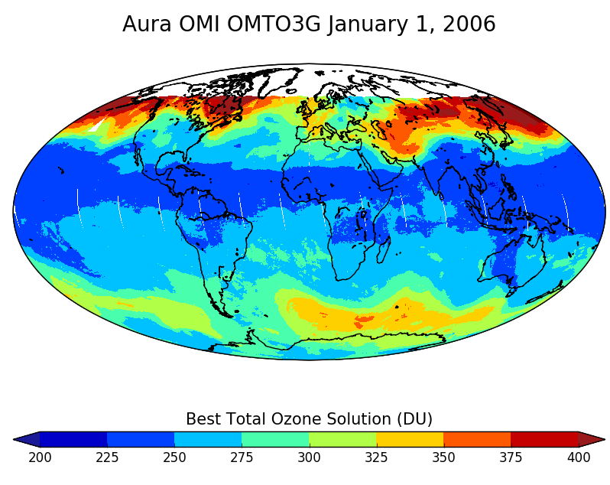
Δορυφορικές μετρήσεις
Ο αισθητήρας OMI βρίσκεται στον δορυφόρο Aura και καταγράφει την τροποσφαιρική στήλη NO₂ σε ημερήσια βάση. Ο ΟΜΙ παίρνει 60 μετρήσεις κατά μήκος 2600 km διακριτικής ικανότητας 13 × 24 km² και παρατηρεί την ίδια τοποθεσία κάθε 16 ημέρες.
Source: http://www.sciencedirect.com/science/article/pii/S1352231012011144
Notes:
http://www.sciencedirect.com/science/article/pii/S1352231012011144
The OMI sensor (Levelt et al., 2006) aboard the Earth Observing System (EOS) Aura satellite provides daily global measurements of tropospheric NO₂ column abundance. The satellite follows a sun-synchronous orbit, passing over each location at ∼13:30 local time (Schoeberl et al., 2006). OMI takes 60 cross-track measurements along a 2600 km swath with nadir resolution up to 13 × 24 km². The OMI nadir pixel observes the same location every 16 days; the center point and pixel size at a given location differs by day during this cycle. Adjacent OMI pixels along the flight path also exhibit slight overlap at the edges of the swath, so the effective spatial resolution of OMI observations increases with temporal averaging. We use the OMI Standard Product (Version 1.0.5, Collection 3) from the NASA Goddard Earth Sciences Data and Information Services Center (GES DISC) (available: http://disc.gsfc.nasa.gov/Aura/OMI/omno2_v003.shtml). We use data from 2005, when emission inventories for CAMx are available (Ospital et al., 2008). Details regarding the OMI NO₂ Standard Product are available elsewhere (Boersma et al., 2002; Bucsela et al., 2006; Celarier et al., 2008). Briefly, retrievals rely on the determination of slant column densities calculated by differential optical absorption spectroscopy in a spectral window specific to NO₂ (405–465 nm). A background (stratospheric) NO₂ field is determined by applying masks over areas with high tropospheric NO₂ column abundance, smoothing the remaining data, and performing a zonal planetary wave analysis up to wave-2. Slant columns are then converted to tropospheric vertical column densities using a tropospheric air mass factor (AMF) that accounts for vertical profiles of temperature and NO₂ (the latter based on an annual average profile as simulated by GEOS-Chem), viewing geometry, and the pressure and reflectivity from clouds and terrain. Cloud top height and cloud fraction are obtained from OMI using the O₂–O₂ algorithm (Acarreta et al., 2004).

Slide 24
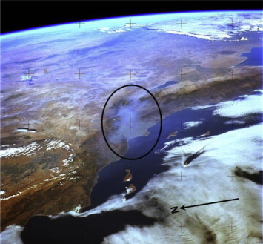
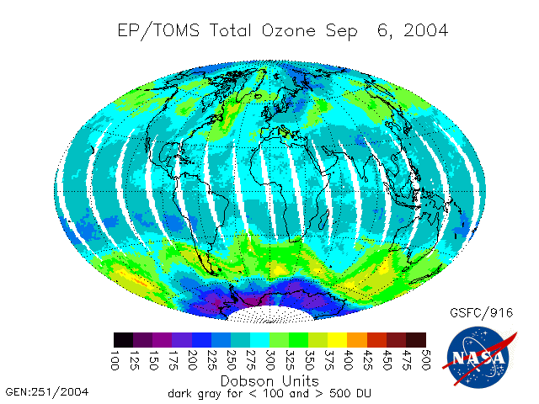
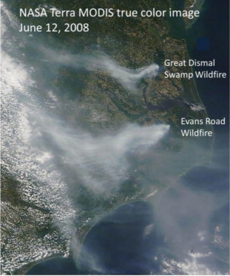
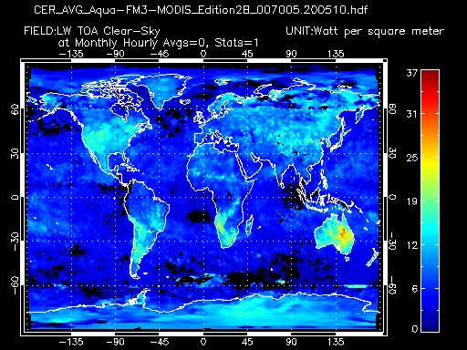
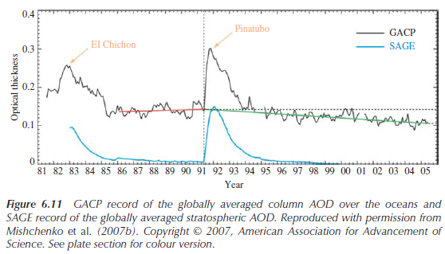
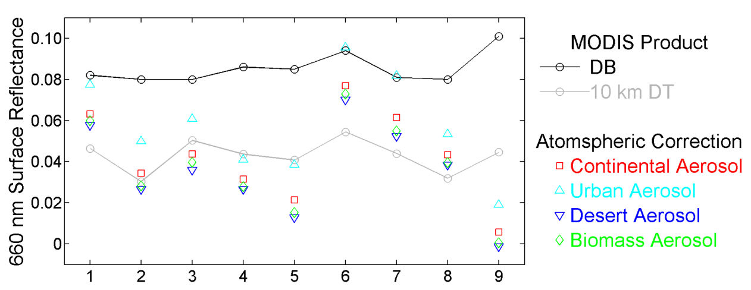
Δορυφορικές μετρήσεις
Παραδείγματα προβλημάτων - εφαρμογών:
Tracking pollutant plumes
AQ forecasting support
Evaluating output of models and providing input to models
Aerosol Characterization
Aerosol Trends
Aerosol Radiative
Forcing
Notes:
https://atmosphere.copernicus.eu/cams-input-data
http://www.sciencedirect.com/science/article/pii/S1352231014004270
Εφαρμογές:
Themistocleous et al. (2010) used Landsat TM/ETM+ and MODIS
AOT data to investigate the air pollution near to cultural heritage sites in the centre of
Limassol area in Cyprus.
Nisantzi et al. (2011) used both particulate matter (PM10) device,
backscattering lidar system, AERONET and hand-held sun-photometers for developing
PM10 Vs MODIS AOT regression model over the urban area of Limassol in Cyprus.
Tracking pollutant plumes: τhe power of satellite data to provide an overview of the regional buildup and the long-range transport of pollution, which can degrade AQ far downwind.
The unique multiangle view ofMISR further allows for the retrieval of aerosol plume and
the tracking of its transport (Kahn et al., 2007). First, mean wind is derived at the reflecting
level at coarse resolution (70.4 km). Then matching is performed between the 26∘ forward
and nadir views and independently between the 26∘ backward and nadir views, using
the MISR-275m spatial resolution red-band images over each 1.1 km horizontal region.
Aerosol plume height is calculated from each fore and aft pair over the entire 70.4 km
domain
One of the most frequent applications of satellite data is for AQ forecasting support. Satellite imagery is often accessed on a daily basis by state AQ agencies, such as the Virginia Department of Environmental Quality (DEQ), the Idaho DEQ, and the California Air Resources Board (CARB). The use of satellite data for AQ forecast support is generally qualitative, such as imagery which has a natural color rendition similar to a photograph (e.g., Fig. 3), and AOD, CO and smoke extent maps. For instance, the Idaho DEQ used imagery to support their AQ forecasts during the summer wildfire season of 2012. Each day, staff at the DEQ combined satellite data with surface monitor information to produce a daily report that was forwarded to the forecasters.
2.4. Evaluating output of models and providing input to models
Satellite data can be applied in a variety of ways to improve AQ models used to develop State Implementation Plans (SIP). Specifically, they can be used to evaluate the quality of the model-predicted pollutant concentrations (e.g., Kondragunta et al., 2008) and to constrain model input, such as pollutant emissions (e.g., wildfires with fire-counts and fire radiative power data), biogenic emissions of VOCs (e.g., with photosynthetically active radiation and leaf area index data), and photolysis rates (e.g., ozone VCD data). As a specific example, the NASA Aura Ozone Monitoring Instrument (OMI) NO₂ VCD data could be used to evaluate the simulation of NO_{x}(=NO + NO₂), an important ozone precursor, in the EPA Community Air Quality Model (CMAQ). Such an evaluation may reveal inaccuracies of emissions as well as deficiencies in the chemical mechanism. For instance, a long-standing problem for simulating NO_{x} is the uncertainties associated with the lifetime and chemical fate of alkyl nitrate
Trend analysis using
satellite data requires caution, because surface reflectance may change over time due to
land-cover and land-use change, and hence bias the AOD retrieval. However, MISR’s
multiangle view provides a simultaneous retrieval of surface reflectance and AOD, limiting the chance of artificial bias in trend analysis. Satellite aerosol products have also been used for regional (e.g. Ramachandran and Cherian, 2008; Xia et al., 2008; Dey
and Di Girolamo, 2010; Marey et al., 2011) and global (e.g. Remer et al., 2008; Liu and Mishchenko, 2008) aerosol climatology.

Slide 25
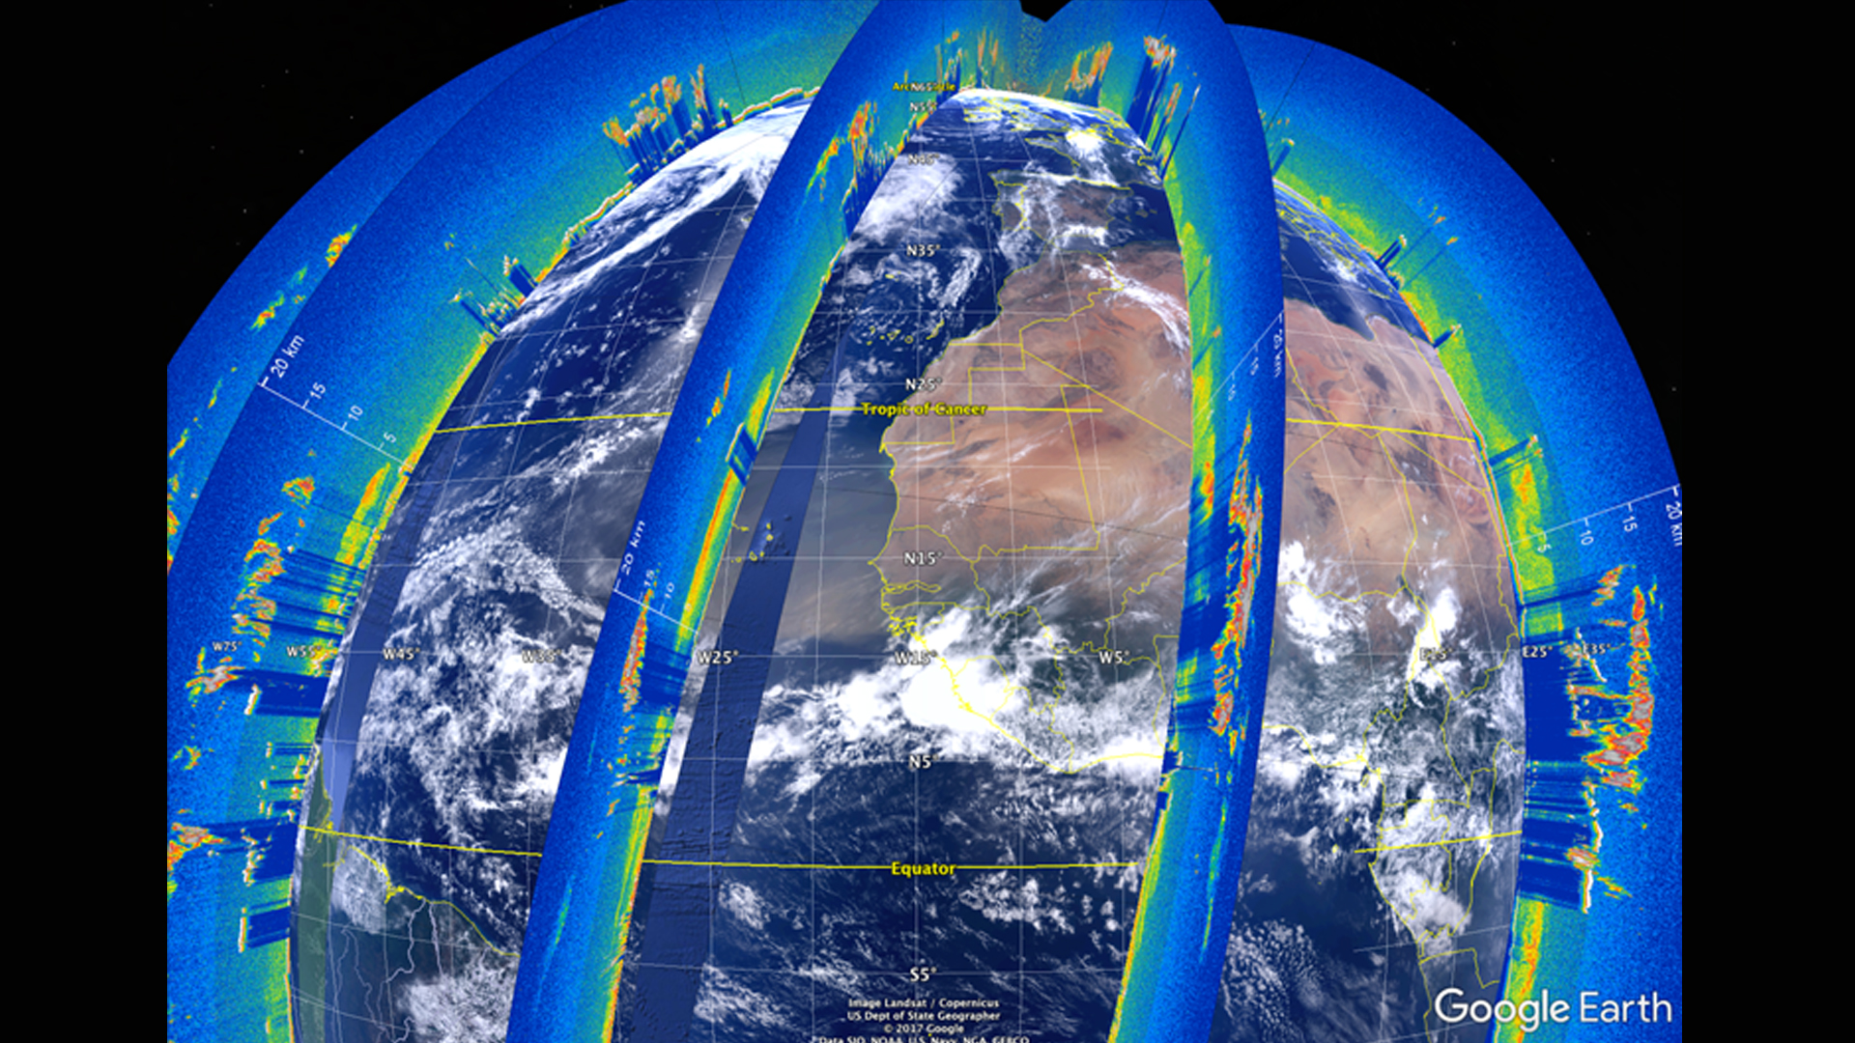
Δορυφορικές μετρήσεις
Ο δορυφόρος Cloud-Aerosol Lidar and Infrared Pathfinder Satellite Observations (CALIPSO) εκτοξεύτηκε τον Απρίλιο 28, 2006
Για τη μελέτη της επίδρασης των νεφών και των αιωρούμενων σωματιδίων στο κλίμα και τον καιρό.
Είναι εξοπλισμένος με 3 όργανα:
the Cloud-Aerosol Lidar with Orthogonal Polarization (CALIOP Lidar)
the Imaging Infrared Radiometer (IIR)
the Wide Field Camera (WFC).
CALIPSO is a partnership between NASA and the French Space Agency (CNES).
Notes:
http://slideplayer.com/slide/5683482/
One of the major factors influencing the quality of retrieval of aerosol properties using passive
remote sensing techniques is the impact of clouds. Undetected clouds within clear
pixels enhance the TOA radiance. Even when a pixel is identified correctly as ‘clear’,
aerosol retrieval in that pixel is influenced by enhanced reflectance from cloud edge (Wen,
Marshak, and Cahalan, 2006). This artifact can impact the interpretation of aerosol–cloud
interaction based on remote sensing data (Loeb and Schuster, 2008; Koren et al., 2007).
Aerosol and cloud can be simultaneously detected within a pixel using active remote sensing.
Moreover, active remote sensing can provide information on aerosol vertical profiles
in both day and night, unlike the daytime-only retrieval of columnar aerosol properties by
passive sensors.
Newer instruments also provide insight into properties of light that AVHRR couldn’t detect. The Cloud Aerosol Lidar and Infrared Pathfinder Satellite Observer (CALIPSO) uses a laser-based technology that provides detailed vertical profiles of aerosol plumes and clouds.
CALIOP was launched onboard the CALIPSO satellite as part of a constellation of satellites
popularly known as the ‘A-Train’ (Stephens et al., 2002) in the year 2006. It measures
the vertical profiles of two orthogonal polarization components of attenuated backscatter at
532 nm (at 30m vertical resolution and 1/3 km horizontal resolution below 8.2 km altitude,
and at 60m vertical and 1 km horizontal resolution between 8.2 and 20.2 km altitude) and of total backscatter at 1064 nm (at 60m vertical resolution). Color ratio (ratio of 532 and
1064 nm backscatter) is utilized to distinguish between aerosol and clouds. Furthermore,
utilizing the sensitivity of the volume depolarization ratio, VDR (the ratio of the layer
integrated perpendicular to parallel components of 532 nm backscatter) to the irregularity
of particle shape, nonspherical dusts can be separated out from other spherical particles
(Liu et al., 2008). Comparison with ground-based lidar reveals a poor match closer to the
surface, primarily due to uncertainty in the assumption of the lidar ratio in the CALIPSO
algorithm, combined with a low sensitivity as the signal gets attenuated closer to the surface
by the presence of a heavy aerosol layer aloft (Misra et al., 2012).
Nonetheless, CALIPSO measurements provide an opportunity to study aerosol vertical
distributions on a global scale, which is critical in quantifying the aerosol-induced radiative
effect. CALIPSO profiles have been used to examine aerosol transport (e.g. Liu et al.,
2008; Abdi Vishkaee et al., 2012; Cabello et al., 2012; Di Pierro, Jaegle, and Anderson,
2011), aerosol distribution (e.g. Chen et al., 2012; Mishra and Shibata, 2012), aerosol
radiative forcing (e.g. Chand et al., 2009), and the validation of climate models (e.g. Koffi
et al., 2012).
The Cloud-Aerosol LiDAR and Infrared Pathfinder Satellite Observation (CALIPSO) satellite's CALIOP sensor generates vertical LiDAR profiles of the atmosphere at a global scale. Currently, the standard visualization tool for these data is written in Interactive Data Language (IDL), a proprietary language that does not support features for tracking aerosols, selecting data, or sharing those selected sections. This makes working with CALIPSO data difficult for researchers and does not allow them to visually identify aerosol features from these data. Previous DEVELOP teams have built a working version of the Visualization of CALIPSO (VOCAL) software, a Python language replacement for this IDL-based software. During this term, the team enhanced VOCAL by improving the shape drawing tool, adding the capability to view multiple levels of data, and more flexible data inputs and outputs that support a decentralized database in the form of a CSV file. These features will increase the usability of VOCAL, expediting the process of visually identifying features and analyzing the resulting subsets of data. Finally, the DEVELOP team conducted a case study with Saharan Dust transport over the Atlantic Ocean to test the capabilities of the VOCAL software and to produce a database of dust events. The database and case study will help members of the CALIPSO Science Team compare the performance of classification algorithms used to create Level 2 (L2) CALIPSO data products, and will also support preliminary analysis of the atmospheric interactions and consequences related to long range dust transport.
the limitations of the satellite data (e.g., the lack of information on the vertical distribution and chemical composition of the aerosols, and gaps in spatial coverage due to clouds)

Slide 26
Δορυφορικές μετρήσεις
Ο δορυφόρος Cloud-Aerosol Lidar and Infrared Pathfinder Satellite Observations (CALIPSO) εκτοξεύτηκε τον Απρίλιο 28, 2006
Για τη μελέτη της επίδρασης των νεφών και των αιωρούμενων σωματιδίων στο κλίμα και τον καιρό.
Είναι εξοπλισμένος με 3 όργανα:
the Cloud-Aerosol Lidar with Orthogonal Polarization (CALIOP Lidar)
the Imaging Infrared Radiometer (IIR)
the Wide Field Camera (WFC).
Video: https://www.youtube.com/watch?time_continue=154&v=jG8mtlaiW9A
CALIPSO is a partnership between NASA and the French Space Agency (CNES).
Notes:
https://develop.larc.nasa.gov/2017/summer/CALIPSOCross.html

Slide 27
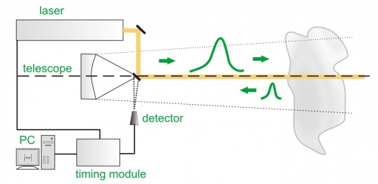
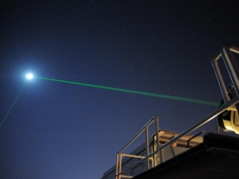
Λέιζερ ραντάρς (Lidars)
Το Lidar (light Detection and Ranging) εκπέμπει δέσμη φωτός από laser, σε επιλεγμένα μήκη κύματος και λαμβάνει το επιστρεφόμενο φως λόγω ανάκλασης ή/και σκέδασης σε απομακρυσμένους στόχους.
Notes:
http://www.sciencedirect.com/science/article/pii/0165993694870624
https://www.picoquant.com/applications/category/metrology/lidar-ranging-slr
Satellites provide a critical global perspective for understanding how aerosols affect Earth’s climate, but they are far from the only source of information. Networks of ground-based sensors are used to validate satellite measurements and offer some of the most accurate measurements of AOD available.
The most accurate information about aerosol characteristics can be obtained through ground-based remote sensing, as it does not have to deal with surface reflectance issues.
There are a number of international and national networks that maintain ground-based
monitoring of aerosol properties using passive remote sensing techniques.
Τα βασικά μέρη ενός συστήματος LIDAR είναι μια πηγή ακτινοβολίας Laser και ο ανιχνευτής της επιστρέφουσας ακτινοβολίας. Το μήκος κύματος της εκπεμπόμενης δέσμης Laser κυμαίνεται από το υπέρυθρο μέχρι το υπεριώδες και είναι καθοριστικό για το είδος του στοιχείου που θέλουμε να ανιχνεύσουμε. Για την πραγματοποίηση μετρήσεων μεγάλου φάσματος (πολλών συστατικών) πρέπει να έχουμε την δυνατότητα μεταβολής του μήκους κύματος. Ένας φασματικός αναλυτής αναλύει την επιστρέφουσα ακτινοβολία και επιλέγει εκείνα τα μήκη κύματος που περιέχουν πληροφορίες. Το επιλεγμένο οπτικό σήμα κατευθύνεται σε ένα φωτοανιχνευτή, μετατρέπεται σε ηλεκτρικό σήμα και με κατάλληλη επεξεργασία εξάγεται η πληροφορία που μεταφέρει.
LIDAR τύπου Raman: Στηρίζεται στη συλλογή της επανασκεδαζόμενης μέσω μηχανισμού Raman ακτινοβολία, η οποία έχει μήκη κύματος διαφορετικά της εκπεμπόμενης δέσμης. Η μεταβολή αυτή χαρακτηρίζει το είδος των μορίων του στόχου και η έντασή της σχετίζεται με την συγκέντρωση.
Selection of the wavelength range is based on the coincidence of available laser wavelengths and characteristic fingerprint regions of absorption spectra associated with the molecules of interest.
LIDAR is based on laser spectroscopy and allows measurement of both the spatial and temporal distribution or concentration of selected contaminating compounds and the characterization of pollutant emissions.
PollyXT portable lidar system, developed by IAASARS and TROPOS researchers. The PollyXT is an automated multi-wavelength (1064, 532, and 355nm) backscatter/Raman and polarization lidar. The system combines the latest EARLINET lidar quality standards in a stand-alone design. It is equipped with two (2) receiver units; one (1) far-range and one (1) near-range telescope. It is capable of performing measurements with very high vertical and temporal resolution, for the following physical quantities: a) particle backscatter coefficient at 355, 532 and 1064nm, b) particle extinction coefficients at 355 and 532nm, c) volume/particle linear depolarization ratio at 355 and 532nm, d) near-range backscatter and extinction coefficients at 532nm, e) water vapor at 407nm. This innovative setup provides autonomous and quality-assured vertically resolved measurements of aerosol and cloud properties

Slide 28
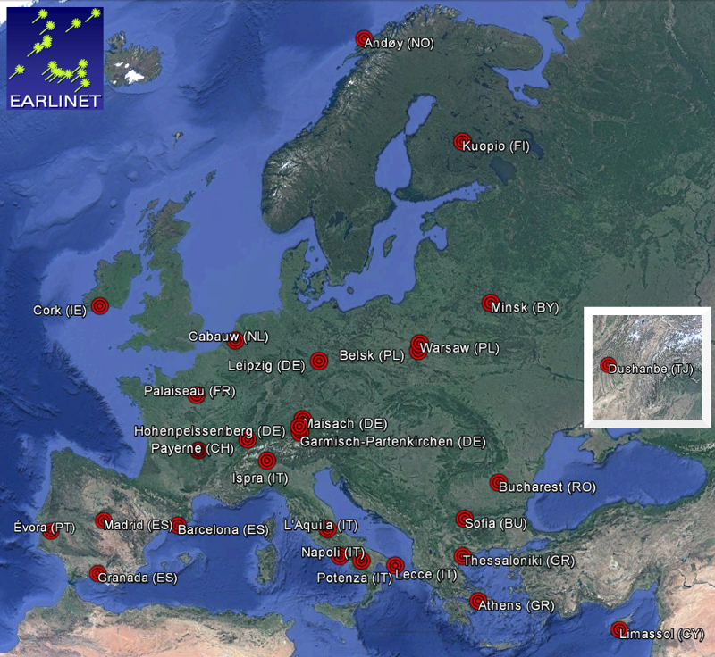
Λέιζερ ραντάρς (Lidars)
Α European Aerosol Research Lidar Network to Establish an Aerosol Climatology: EARLINET
Σήμερα, οι σταθμοί του δικτύου είναι 28 και φαίνονται στο διπλανό σχήμα.
Δεδομένα: aerosol backscatter coefficient profiles (as a function of height above mean sea level), at one or more out of the following wavelengths: 355 nm, 532 nm and 1064 nm. In case Raman-lidars are operated, both backscatter and extinction coefficients are provided.
Notes:
http://www.sciencedirect.com/science/article/pii/0165993694870624
https://www.earlinet.org/index.php?id=earlinet_homepage

Slide 29
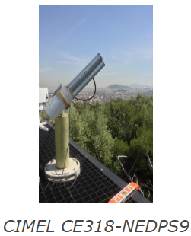
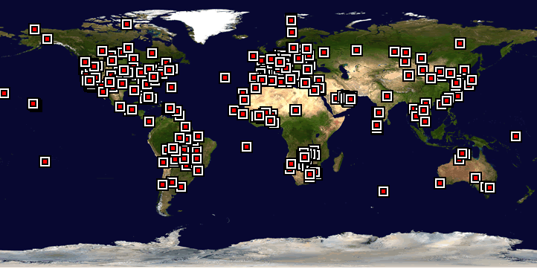
Φωτόμετρα - Sunphotometers
Μετρήσεις υψηλής ακρίβειας AOD , οπτικών ιδιοτήτων των αερολυμάτων (π.χ. single scattering albedo, the aerosol phase function, the asymmetry parameter, the indexes of refraction and the size distribution) και τύπων αερολυμάτων σε επιλεγμένα μήκη κύματος.
Land-based remote sensing instruments of the AERONET (AErosol RObotic NETwork) program:
>200 carefully calibrated sun photometers around the world. The relatively simple instruments deduce the amount and type of aerosol in the sky by measuring the intensity of light under cloud-free conditions.
Notes:
http://apcg.meteo.noa.gr/index.php?pageNum=1&total_res_pagedata=3&option=112&client=1&langid=2
The AERONET (AErosol RObotic NETwork) program is a federation of ground-based remote sensing aerosol networks established by NASA and PHOTONS and is greatly expanded by networks and collaborators from national agencies, institutes, universities, individual scientists, and partners. The program provides a long-term, continuous and readily accessible public domain database of aerosol optical, microphysical and radiative properties for aerosol research and characterization, validation of satellite retrievals, and synergism with other databases. The network imposes standardization of instruments, calibration, processing and distribution.
NASA co-sponsors a global network of ground sensors called the Aerosols Robotic Network, or AERONET, which is comprised of more than 200 carefully calibrated sun photometers measuring aerosol optical depth around the world. The relatively simple instruments deduce the amount and type of aerosol in the sky by measuring the intensity of light under cloud-free conditions. Aircraft and other ground stations deploy in situ instruments that measure certain aerosol properties with greater accuracy, but less frequently.
The most popular and widespread ground-based network of aerosol remote sensing is
the Aerosol Robotic Network (AERONET), which maintains well-calibrated sunphotometers
and sky-radiance radiometers (Holben et al., 1998, 2001). The radiometers measure
direct sun radiance in eight spectral bands (between 340 and 1020 nm) across 10 seconds.
A sequence of three such measurements is taken at 15-minute intervals in order to minimize
the influence of clouds on the measured radiance. Sky-radiance measurements in the
almucanter and principal plane are carried out at 440, 670, 870, and 1020 nm wavelengths
in order to acquire a large range of scattering angles for the retrieval of size distribution,
phase function, and SSA (Dubovik and King, 2000). AERONET-retrieved AOD is highly
accurate, with an uncertainty <±0.01 for wavelengths greater than 440 nm and <±0.02 for
shorter wavelengths. The aerosol optical properties are retrieved with greater accuracy for
AOD440≥0.5 with solar zenith angle >50∘ (Dubovik et al., 2000). AERONET data have
been used by numerous researchers to examine aerosol characteristics and composition in
several regions of the world.
CIMEL CE318-NEDPS9 sunphotometer for the retrieval of aerosol optical depth at 8 wavelengths from 340 to 1640 nm, including polarization measurements. The measurements of aerosol optical depth are at a rate approximately 1 measurement per 15 minutes when the sun is not obstructed by clouds. In addition, it performs measurements of the diffuse sky radiance and using inversion algorithms it produces microphysical aerosol properties such as the single scattering albedo, the aerosol phase function, the asymmetry parameter, the indexes of refraction and the size distribution. The CIMEL instrument is a part of NASA’s AERONET (Aerosol Robotic Network) network (http://aeronet.gsfc.nasa.gov). The data are processed every day (level 2.0 Quality Assured) and are available at AERONET’s webpage along with the aerosol inversion retrievals for the complete aerosol characterization (e.g. Saharan dust events, smoke cases etc). The instrument is located on the roof of the Research Center for Atmospheric Physics and Climatology of the Academy of Athens with an elevation of 130 m from mean sea level. The campus is located in the city center and 10 km from the sea.

Slide 30
Δομή Μαθήματος
Στατικοί σταθμοί εδάφους
Τηλεπισκόπηση:
Δορυφόροι & όργανα εδάφους
Κινητοί σταθμοί εδάφους & καθ’ ύψος:
Μεταφορικά μέσα, ατομικοί αισθητήρες κλπ.
Εργαστήριο χημικών αναλύσεων
Αερο-σήραγγες

Slide 31
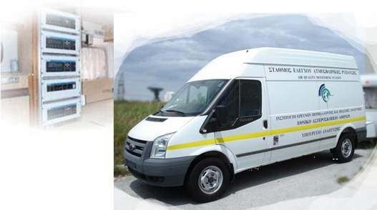
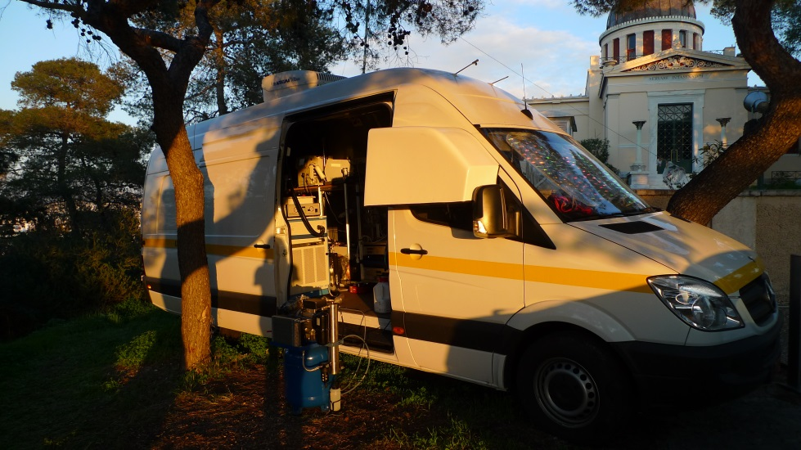
Κινητός σταθμός εδάφους
Α Mobile AQ Monitoring Station enhances mobility and flexibility in cases of special events (e.g. pollution emergencies/accidents, wildfires, collocation with satellite swaths) or research campaigns. Its design allows the use of different instrumentation depending on the measurement objectives.
Τμήμα Χημ. Μηχ., Πανεπιστήμιο Πατρών http://laqs.iceht.forth.gr/en/laqs/research-facilities.html
Εθνικό Αστεροσκοπείο Αθηνών
http://www.meteo.noa.gr/aclab/aclab_infrastructure.html
Ενδεικτικά μετρητικά συστήματα – εξοπλισμός οχημάτων:
NO, ΝΟ₂, O₃, SO₂, CO, HC, CH₄, PM₁₀, DOAS (BTX), meteorological station, noise monitoring, Volatile Organic, particle-phase (size distribution, mass/composition distribution using an Aerosol Mass Spectrometer, black carbon) pollutants and their properties (scattering, absorption, volatility).

Slide 32
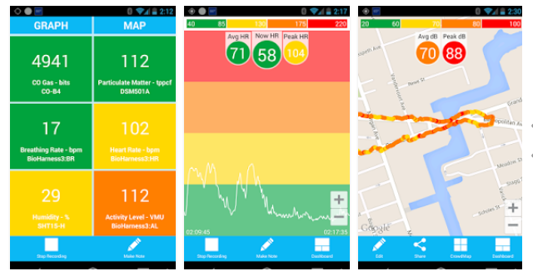
Παρατηρητήρια πολιτών
Attributes of sensor platforms are relatively lower in cost, easier to use and less bulky than traditional equipment, and provide the possibility for citizens and communities to monitor their local air quality that may affect their health
AirCasting - an open-source solution for collecting, displaying and sharing air pollution data (http://aircasting.org/).
Video: https://www.youtube.com/watch?v=C87a3LtRYtM
Notes:
AirCasting is an open-source, end-to-end solution for collecting, displaying, and sharing health and environmental data using your smartphone. The platform consists of wearable sensors that detect changes in your environment and physiology, including a palm-sized air quality monitor called the AirBeam, the AirCasting Android app, the AirCasting website, and wearable LED accessories. By documenting and leveraging health and environmental data to inform personal decision-making and public policy, the AirCasting platform empowers citizen scientists and changemakers.
The AirBeam uses a light scattering method to measure fine particulate matter or PM2.5. Air is drawn through a sensing chamber wherein light from an LED bulb scatters off particles in the airstream. This light scatter is registered by a detector and converted into a measurement that estimates the number of particles in the air.

Slide 33
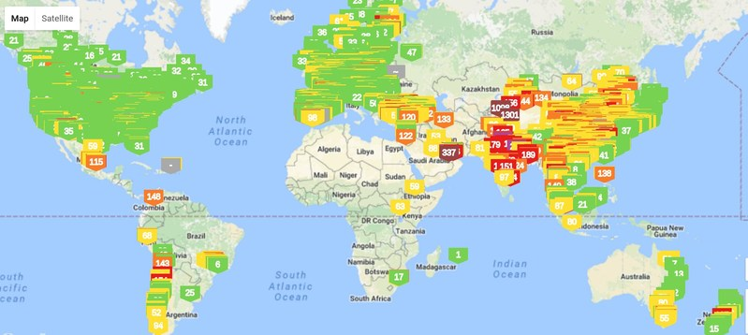
Παρατηρητήρια πολιτών
AirVisual now hosts the largest global air quality data set, covering 9,000 cities across nearly 70 countries.
AirVisual, a social enterprise driving free air quality data and forecasts, has facilitated the first real-time public air pollution measurements from a growing number of communities across the globe, by equipping engaged citizens with accessible and connected air monitors (http://aircasting.org/).
Notes:
https://airvisual.com/earth
https://www.prnewswire.com/news-releases/crowdsourced-air-quality-monitoring-network-revolutionizes-environmental-reporting-through-distributed-sensors-producing-the-worlds-largest-air-pollution-dataset-300443335.html (crowd sourcing)
The AirVisual Node high accuracy air quality monitor has disrupted the monitoring market by empowering users to broadcast their local readings onto the global air quality map. Since its 2016 launch, an engaged community of air quality activists has grown a worldwide network of these connected sensors, becoming the first to report real-time PM2.5 air quality on behalf of countries including Italy, Cambodia, Philippines, Pakistan, Saudi Arabia and Mauritius, revolutionizing the way that environments are publicly reported.

Slide 34
Παρατηρητήρια πολιτών
The Aeroflex: A Bicycle for Mobile Air Quality Measurements
Video: https://www.youtube.com/watch?v=X6pYcwALVRU
Notes:
http://www.mdpi.com/1424-8220/13/1/221/htm
https://itunes.apple.com/us/app/senseeurair/id1180917747

Slide 35
Μετρήσεις καθ’ ύψος - Αεροσκάφη
Video: https://www.youtube.com/watch?v=LgMPoXTiAvk
Notes:
Created in 2000, EUFAR was born out of the necessity to create a central network for the airborne research community in Europe with the principal aim of supporting scientists, by granting them access to research aircraft and instruments otherwise not accessible in their home countries. In this way, scientists all over Europe can have an equal chance to carry out various atmospheric and in situ measurements on board research aircraft. In essence, EUFAR links scientists with operators of research facilities, and financially supports this collaboration by providing funding for flight hours as well as for travel and subsistence during campaigns.
With time EUFAR has grown, introducing new activities and objectives to place itself as the unique network and portal of airborne research for the environmental and geosciences in Europe. From organising summer schools, expert workshops, and serving as an interactive and dynamic hub of information, to maintaining a central data archive, and developing tools and standards to collect, process and analysis data, EUFAR continues to improve the operational environment for conducting airborne research.

Slide 36
Μετρήσεις καθ’ ύψος - Αεροσκάφη

Slide 37
Μετρήσεις καθ’ ύψος - Αεροσκάφη
Project: AEGEAN Pollution: Gaseous and Aerosol airborne MEasurements (AEGEAN_GAME)
Participants: University of Athens National Observatory of Athens, Greece University of the Aegean, Mytilini, Greece University of Crete, Heraklion, Greece University of Manchester, U.K.

Slide 38
Μετρήσεις καθ’ ύψος - Balloons
Τα μπαλόνια εξοπλίζονται με κατάλληλο εξοπλισμό (π.χ. ozone sonde and meteorological sonde) και ανυψώνονται παραπάνω από 20 miles. Είναι εφοδιασμένα με ραδιοπομπό που μεταδίδει τα δεδομένα και τη θέση (GPS) σε επίγειο σταθμό.
Τα δεδομένα αυτά είναι υψηλής ακρίβειας και μπορούν να χρησιμοποιηθούν για συγκρίσεις με μετρήσεις πχ ενός Lidar.
The balloon and the payload lift off, and the sondes immediately begin collecting and returning meteorological and ozone data.
Credits: NASA/David C. Bowman
Video: https://www.youtube.com/watch?v=lwEfMbuweXE
Notes:
https://www.nasa.gov/larc/the-practicality-behind-flying-balloons-and-shooting-lasers
Collaboration, like the current one with the Langley Mobile Ozone Lidar, is nothing new to CAPABLE, or its balloons. The site is a collaborative effort between the Science Directorate at NASA Langley, the U.S. Environmental Protection Agency and the Virginia Department of Environmental Quality. In the case of DeYoung and the mobile laser, the collaboration gives the balloon launches even more applicability. But, as Knepp explained, the launches have been taking place for more than two years — at a rate of approximately once a week.
As you might suspect, a larger balloon carries a heavier payload and flies higher. The typical balloon launched at NASA Langley is intended to lift about three pounds. For the launch of a single sonde, they sometimes use a smaller balloon that carries less than a pound. But, as Knepp explains, once the balloons reach lower pressures, the volume of the balloon increases 20 times. Eventually, the balloon pops, and the Styrofoam payload returns to land.
Though the mobile lidar has been operating for about a year, these final comparisons, before Knepp travels to Australia and DeYoung heads to Colorado, will prove helpful for testing the accuracy of ozone concentrations.
When all of the data is collected from the mobile lidar and the balloons, the ozone profiles are used to build a climatological database. Eventually, the data will be fed into an online archive used for model and satellite runs, which is available for use by the public.

Slide 39
Μετρήσεις καθ’ ύψος – UAV’s – Drones
Μετρήσεις προφίλ ατμοσφαιρικής ρύπανσης με τη χρήση μη επανδρωμένων εναέριων οχημάτων
Source: https://experiment.com/projects/measurement-of-atmospheric-pollution-profiles-using-drones
Notes:
https://experiment.com/projects/measurement-of-atmospheric-pollution-profiles-using-drones
Balloons and light aircraft can reach such low altitudes, but cost several thousand dollars to deploy.
New technologies such as low cost commercial micro-sensors that interface with the "Arduino" micro-controller offer the ability to measure important pollutants like ozone with similar resolution and detection limit as those previously available, but at a fraction of the cost and power demands. Similarly the availability of unmanned aerial vehicles (UAVs) or "drones" for commercial and recreational use now exists at costs that make them more accessible to the average user.

Slide 40
Δομή Μαθήματος
Στατικοί σταθμοί εδάφους
Τηλεπισκόπηση:
Δορυφόροι & όργανα εδάφους
Κινητοί σταθμοί εδάφους & καθ’ ύψος:
Μεταφορικά μέσα, ατομικοί αισθητήρες κλπ.
Εργαστήριο χημικών αναλύσεων
Αερο-σήραγγες

Slide 41
Εργαστήριο χημικών αναλύσεων
Χρησιμοποιείται για την χημική ανάλυση των φίλτρων που συλλέγονται από τους σταθμούς μέτρησης (ανόργανα και οργανικά συστατικά σωματιδίων, διαχωρισμός οργανικού/στοιχειακού άνθρακα κλπ).
Video: https://www.youtube.com/watch?v=1xUJbNLVjN8
Τμήμα Χημ. Μηχ., Πανεπιστήμιο Πατρών http://laqs.iceht.forth.gr/en/laqs/research-facilities.html

Slide 42
Αεροσήραγγα
Στόχοι:
δημιουργία (οργανικών) σωματιδίων,
φωτοχημική γήρανση
Πρόδρομες οργανικές ενώσεις και δημιουργία δευτερογενών οργανικών σωματιδίων
Διεργασίες πυρηνοποίησης
Διεργασίες δημιουργίας νεφών μέσω πυρήνων συμπύκνωσης
Σύγκριση μετρήσεων οργάνων
Χημική σύσταση σωματιδίων, ετερογενείς αντιδράσεις κλπ
Δημιουργία σωματιδίων λόγω διαφορετικών τύπων καυσίμων και πηγών ρύπανσης
Σε μια αεροσήραγγα η θερμοκρασία είναι ρυθμιζόμενη, ενώ η φωτοκάλυψη ρυθμίζεται ώστε να προσομοιώνει συνθήκες ηλιόλουστης ή νεφελώδους ημέρας.
Διαθέτει οργανολογία παροχέτευσης και μέτρησης στοχευμένων ρύπων και διεργασιών εντός των αεροθαλάμων.
PSI, Ελβετία https://www.psi.ch/lac/smog-chamber
Notes:
http://laqs.iceht.forth.gr/en/laqs/research-facilities.html
https://www.psi.ch/lac/smog-chamber
https://www.popsci.com/article/science/how-students-are-using-worlds-largest-indoor-smog-chamber-save-planet

Slide 43
Αεροσήραγγα
A glimpse into the world's largest smog chamber.
Courtesy University of California, Riverside
Notes:
http://laqs.iceht.forth.gr/en/laqs/research-facilities.html
https://www.psi.ch/lac/smog-chamber
https://www.popsci.com/article/science/how-students-are-using-worlds-largest-indoor-smog-chamber-save-planet
It’s not easy to make a cloud indoors, but students at the University of California, Riverside are certainly trying. They’re using the Atmospheric Processes Laboratory—the world’s largest indoor smog chamber—to learn precisely how clouds form.
Led by atmospheric scientist Akua Asa-Awuku, the students inject aerosol-forming compounds and water vapor into the Teflon-lined, two-story-tall chamber. Black lights and a 200-kilowatt Argon arc lamp simulate the sun; factors like temperature, pressure, humidity, and heat can be altered to mimic various conditions. More than 30 instruments—many built by students—help measure the aerosols’ chemical and physical characteristics as they attract water to form cloud droplets.

