Slide 1
ΑΝΑΛΟΓΙΚΑ ΦΙΛΤΡΑ

Slide 2
General Considerations Why Filters?

Slide 3
Filter Characteristics
(a) Generic and (b) ideal filter characteristics.
Which characteristics of the above filter are important here? First, the filter must not affect the desired signal; i.e., it must provide a “flat” frequency response across the bandwidth of X(f).
Second, the filter must exhibit a “sharp” transition [Fig(a)].More formally, we divide the frequency response of filters into three regions: the “passband,” the “transition band,” and the “stopband.”
The characteristics of the filter in each band play a critical role in the performance. The “flatness” in the passband is quantified by the amount of “ripple” that the magnitude response exhibits. If excessively large, the ripple substantially (and undesirably) alters the frequency contents of the signal. In Fig.(b), for example, the signal frequencies between f2 and f3 are attenuated whereas those between f3 and f4 are amplified.
The width of the transition band must be sufficiently narrow, i.e., the filter must provide sufficient “selectivity.”
The stopband “attenuation” and ripple also impact the performance. The attenuation must be
large enough below the signal level. The ripple in this case proves less critical than that in the passband, but it simply subtracts from the stopband attenuation. In Fig. (b), for example, the stopband attenuation is degraded between f5 and f6 as a result of the ripple.

Slide 4
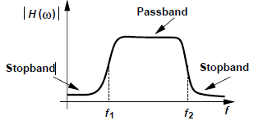
Classification of Filters
Filters can be categorized according to their various properties. We study a few classifications of filters. One classification of filters relates to the frequency band that they “pass” or “reject.” The example illustrated in previous slide is called a “low-pass” filter as it passes low-frequency signals and rejects high-frequency components. Conversely, one can envision a “high-pass” filter, wherein low-frequency signals are rejected (see Fig. below).
High-pass filter frequency response.
Some applications call for a “bandpass” filter, i.e., one that rejects both low- and high frequency signals and passes a band in between Fig. below illustrates such kind of filters
Figure above summarizes four types of filters, including a “band-reject” response, which suppresses components between f1 and f2.

Slide 5
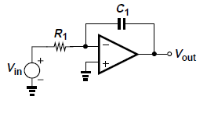
Classification of Filters
(a) (b) (c )
Another classification of analog filters concerns their circuit implementation and includes “continuous-time” and “discrete-time” realizations.
The former type is exemplified by the familiar RC circuit depicted in Fig. (a), where C1 exhibits a lower impedance as the frequency increases, thus attenuating high frequencies. The realization in Fig.(b) replaces R1 with a “switched-capacitor” network. Here, C₂ is periodically switched between two nodes with voltages V1 and V2. In each cycle, C₂ stores a charge of Q₁ = C₂ V₁ while connected to V1 and Q₂ = C₂ V₂ while tied to V2. For example, if V1 > V2, C₂ absorbs charge from V1 and delivers it to V2, thus approximating a resistor. We also observe that the equivalent value of this resistor decreases as the switching is performed at a higher rate since the amount of charge delivered from V1 to V2 per unit time increases.
The third classification of filters distinguishes between “passive” and “active” implementations. The former incorporates only passive devices such as resistors, capacitors, and inductors, whereas the latter also employs amplifying components such as transistors and op amps. (integrator) in Fig.(c). Active filters provide much more flexibility in the design and find wide application in many electronic systems.

Slide 6
Classification of Filters
Summarization of filters’ Classifications.

Slide 7
Filter Transfer Function
(a) First-order filter along with its frequency response, (b) addition of another RC section to sharpen the selectivity
Filter applications point to the need for a sharp transition (a high selectivity) in many cases. How do we achieve a high selectivity? The simple low-pass filter of Fig. (a) exhibits a slope of only 20 dB/dec beyond the passband, thus providing only a tenfold suppression as the frequency increases by a factor of ten. We therefore postulate that cascading two such stages may sharpen the slope to 40 dB/dec, providing a suppression of 100 times for a tenfold increase in frequency [Fig. (b) above]. In other words, increasing the “order” of the transfer function can improve the selectivity of the filter.
The selectivity, ripple, and other attributes of a filter are reflected in its transfer function, H(s) so it is important to get to know the properties and characteristics of filters arising from H(s). These will be analyzed in the following slides

Slide 8
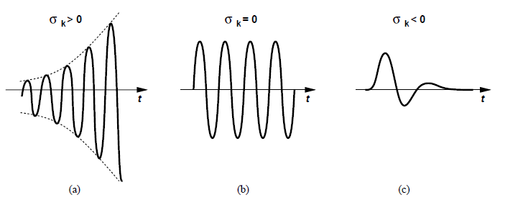
Filter Transfer Function
The selectivity, ripple, and other attributes of a filter are reflected in its transfer function, H(s):
where z_{k} and p_{k} (real or complex) denote the zero and pole frequencies, respectively.
It is common to express z_{k} and p_{k} as σ_{k} + j ω_{k}, where σ_{k} represents the real part and ω_{k} the
imaginary part. One can then plot the poles and zeros on the complex plane.
The poles of H (s) should always lie in the left half of the complex plane i.e their real parts should be negative for stability reasons . Why that?
Recall that the impulse response of a system contains terms such as exp(p_{k}t) =
exp(σ_{k}t) exp(jω_{k}t). If σ_{k}> 0, these terms grow indefinitely with time while oscillating at a
frequency of ω_{k} [Fig(a)]. If σ_{k} = 0, such terms still introduce oscillation at ω_{k} [Fig (b)]. Thus, we require σ_{k} < 0 for the system to remain stable [Fig(c)].

Slide 9
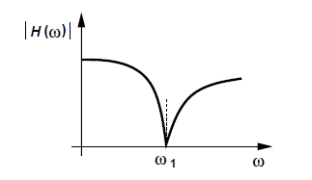
Filter Transfer Function
It is instructive to make several observations in regards to a filter transfer function(H(s)).
The order of the numerator, m, cannot exceed that of the denominator; otherwise, H(s) → s as s→ 1, an unrealistic situation.
(2) For a physically-realizable transfer function, complex zeros or poles
must occur in conjugate pairs, e.g., z1 = σ1 + jω1 and z2 = σ1 -jω1.
(3) If a zero is located on the jω axis, z1,2 = (+, - ) jω1, then H(s) drops to zero at a sinusoidal input frequency of ω1 (see Fig. below). This is because the numerator contains a product such as. which vanishes at s = jω1. In other words, imaginary zeros force [Hj] to zero, thereby providing significant attenuation in their vicinity. For this reason, imaginary zeros are placed only in the stopband.
Effect of imaginary zero on the frequency response

Slide 10
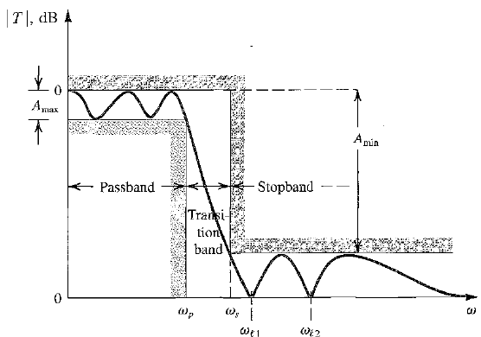
Filter Transfer Function
Example with Low-Pass Filter
The figure (Fig. 12.3) presents the Specification of the transmission characteristics of a low-pass filter. The response of a filter that just meets specifications is also shown
The transition band extends from the passband edge ωp to the stopband edge ωs. The ratio (ωs l ωp) is usually used as a measure of the sharpness of the low-pass filter response and is called the selectivity factor.
The low-pass filter is specified by four parameters:
(1). The passband edge ωp, (2). The maximum allowed variation in passband transmission Amax,
(3). The stopband edge ωs, (4). The minimum required stopband attenuation A min
This filter has infinite attenuation (zero transmission) at two stopband frequencies: ωl1 and ωl12. The filter then must have transmission zeros at s = +jωl1 and s = +jωl2 .
Since complex zeros occur in conjugate pairs, there must also be zeros at s = -jωl1 and s =-jωl2 . Thus the numerator polynomial of this filter will have the factors (s + +jωl1 )(s -jωl1 ) (s +jωl2 )(s –jωl2 ), which can be written as (s² + ω_{l1}²) (s² + ω_{l2}²) . For s = jω (physical frequencies) the numerator becomes (-ω² + ω_{l2}² ) (-ω² + ω_{l1}² ) which indeed is zero at ω = ω_{l1} and ω = ω_{l2}
Continuing with the example we observe that the transmission decreases toward 0 as ω approaches ∞. Thus the filter must have one or more zeros at s = ∞. In general, the number of transmission zeros at s = ∞ is the difference between the degree of the numerator polynomial, m, and the degree of the denominator polynomial, n, of the transfer function).
This is because as s approaches s = ∞
H (s) approaches a_{m}/s^{n-m} and thus is said to have n-m zeros at s = ∞

Slide 11
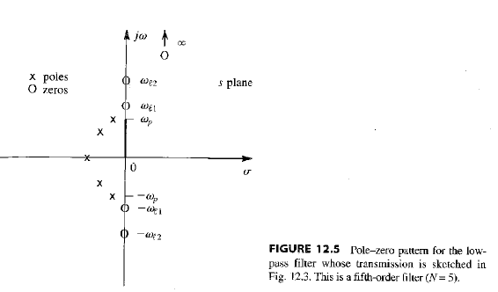
Filter Transfer Function
Example of previous slide continued

Slide 12
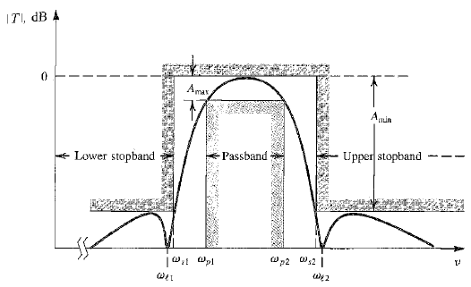
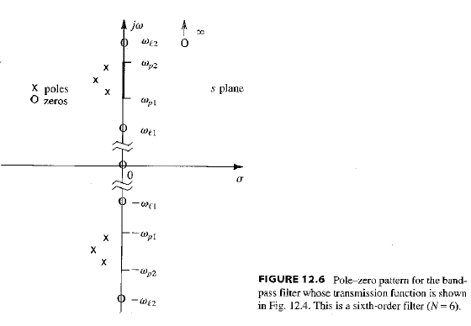
Filter Transfer Function
Example with Pass-band Filter
A typical pole-zero plot for such a filter is shown in Fig. 12.6.

Slide 13
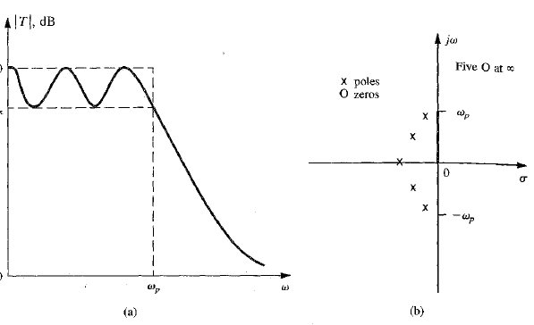
Filter Transfer Function
As a third and final example, consider the low-pass filter whose transmission function is
depicted in Fig. (a) above. We observe that in this case there are no finite values of ω at which the attenuation is infinite (zero transmission). Thus it is possible that all the transmission zeros of this filter are at s = ∞. If this is the case, the filter transfer function takes the form
Such a filter is known as an all-pole filter. Typical pole-zero locations for a fifth-order all pole low-pass filter are shown in Fig. 12.7(b).

Slide 14
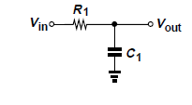
Sensitivity
The frequency response of analog filters naturally depends on the values of their constituent components. In the simple filter of Fig. below, for example, the -3-dB corner frequency is given by 1/(R₁C₁). Such dependencies lead to errors in the cut-off frequency and other parameters in two situations: (a) the value of components varies with process and temperature (in integrated circuits), or (b) the available values of components deviate from those required by the design (indiscrete implementations)
We must therefore determine the change in each filter parameter in terms of a given change (tolerance) in each component value. This is accomplished by calculating the sensitivity of the filter with respect to the value deviations of its constituent components (R1,C1 in the pecific example)
Let’s assume i.e. that in the low-pass filter above resistor R1 experiences a (small) change of ΔR1. Determine the error in the corner frequency, ωο = 1/(R₁C₁).For small changes it holds:
Since we interested in the relative (percentage) error in ω in terms of the relative change in R1, we have:
This means for example that a +5% change in R1 translates to a -5% error in ωο.

Slide 15
Sensitivity
The example of previous slide leads to the concept of “sensitivity,” i.e., how sensitive each filter parameter is with respect to the value of each component. Since in the first-order circuit, we say the sensitivity of ωο with respect to R1 is unity in this example. More formally,
The sensitivity of parameter P with respect to acomponent value C is defined as:
It is obvious that Sensitivities substantially higher than unity are undesirable
As a last example and based on the above the calculation of the sensitivity of ωο with respect to C1 for the low-pass filter is given as follows:
We calculate the first derivative with respect to C1 and we get :
and hence

Slide 16
First- Order Filters
In the following, we will consider first-order realizations, described by the transfer functions:
The circuit of the previous slide and its transfer function are examples of such filter types
In general , first order filters and its transfer function (shown above) could lead only to low-pass or high pass-ones. Specifically, depending on the relative values of z1 and p1, low-pass or high-pass characteristics are conveyed by the specific filter results are , as illustrated in the plots of Fig. below. Note that the stopband attenuation factor is given by z1/p1
First-order (a) high-pass and (b) low-pass filters.

Slide 17
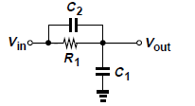
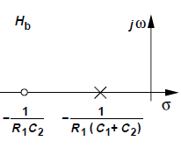
First- Order Filters
Parametrized Examples
The below circuit is firstly considered as a candidate for realization of the specific first order transfer function
Its transfer function as can be easily derived is :
The circuit therefore contains a zero at -1/(R₁C₂) and a pole at -1=[R1(C₁ + C₂)] plottedin Fig. below. Note that the zero arises from C₂.
It’s easy to note that since z1 = -1/(R₁C₂ and p1= -1/[R1(C₁ + C₂)] , the zero
always falls above the pole, allowing only the response shown in Fig. (b) of previous slide i.e. that of a low-pass filter

Slide 18
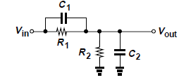
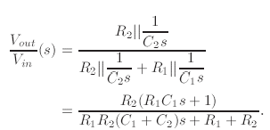
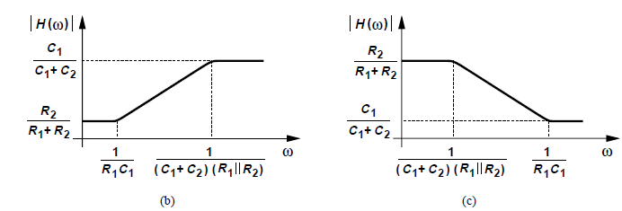
First- Order Filters
Parametrized Examples
The transfer function of the circuit is derived
as follows:
The circuit contains a zero at -1/(R₁C₁) and a pole at -[(C₁ + C₂)R₁ II R₂]⁻¹. Depending on the component values, the zero may lie below or above the pole thus resulting in high pass or low pass behaviour respectively
Specifically, for the zero frequency to be lower: = =>
or

Slide 19
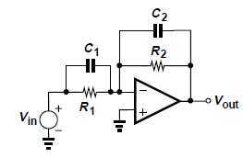
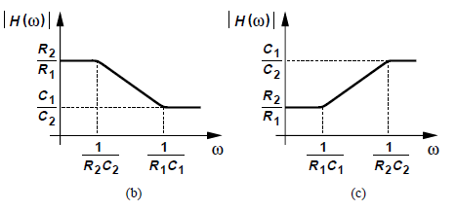
First- Order Filters
Active Counterpart Circuit
The active counterpart of the filter in previous slide is shown in Figure below:
Assuming that the gain
of the op-amp is large it holds:
Figure 14.18

Slide 20
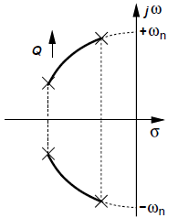
Second-Order Filters
The first-order filters studied above provide only a slope of -20 dB/dec in the transition band. For a sharper attenuation, we must seek circuits of higher order.
The general transfer function of second-order filters is given by the “biquadratic” equation
the denominator is expressed in terms of quantities ωn and Q because they signify important aspects of the response. We begin our study by calculating the pole frequencies. Since most second-order filters incorporate complex poles, we assume and
As the “quality factor” of the poles, Q, increases, the real part decreases while the imaginary part approaches (+ - ) ωn-see Fig. below. In other words, for high Q’s, the poles look “very imaginary,” thereby bringing the circuit closer to instability
Variation of poles as a function of Q.

Slide 21
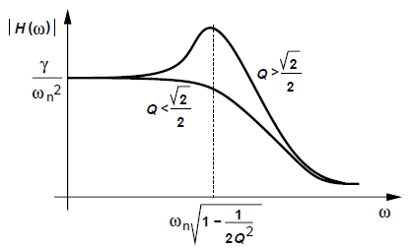
Second-Order Filters
A few special cases of the biquadratic transfer function will be analyzed that prove useful in practice.
First, suppose α=β=γ=0 so that the circuit contains only poles and operates as a low-pass filter (why?). The magnitude of the transfer function is then obtained by making the substitution s= jω and we get:
It can be shown that the response is (a) free from peaking if and (b) reaches a peak at (Fig. 14.20). In the latter case, In the latter case, the peak magnitude is
Frequency response of second-order system for different values of Q

Slide 22
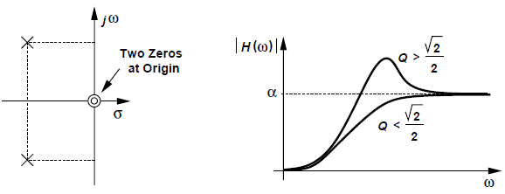
Second-Order Filters(Highpass and Bandpass characteristics)
High Pass
How does the bi quadrative transfer function provide a high-pass response? In a manner similar to the first-order realization, the zero(s) must fall below the poles. For
example, with two zeros at the origin we get :
a) Pole and zero locations and (b) frequency response of a second-order high-pass filter

Slide 23
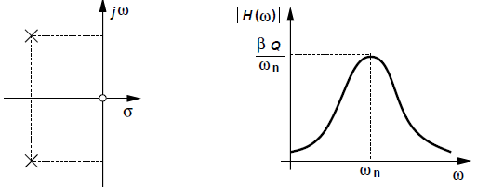
Second-Order Filters(Highpass and Bandpass characteristics)
High Pass
Is it possible that a high-pass response can be obtained if the biquadratic equation contains only one zero?
In such a case :
It is obvious that since H(s) → 0 as s→∞, the system cannot operate as a high-pass filter.
Band Pass
A second-order system can also provide a band-pass response. In that case the transfer function has the following form:
It can be seen that the magnitude approaches zero for both s → 0 and s →∞, reaching a maximum in between. It can be proved that the peak occurs at ω = ωn and equals to βQ/ωn.
(a) Pole and zero locations and (b) frequency response of a second-order band-pass filter

Slide 24
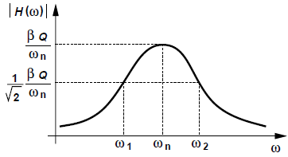
Second-Order Filters(Highpass and Bandpass characteristics)
Band Pass
The Determination of the -3-dB bandwidth of the response of the Bandpass Filter of the previous slide is calculated as follows:
As shown in Fig. below the response reaches times its peak value at frequencies ω1 and ω2, exhibiting a bandwidth of ω2-ω1
To calculate ω1 and ω2, we equate the squared magnitude to
=>
The total -3-dB bandwidth spans ω1 to ω2 and is equal to ωn/Q.

Slide 25
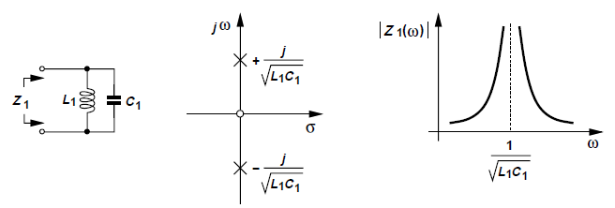
RLC Realizations
It is possible to implement the second-order transfer function by means of RLC realizations, since they (a) find practical applications in low-frequency discrete circuits or high-frequency integrated circuits, and (b) prove useful as a procedure for designing active filters. We therefore study their properties here and determine how they can yield low-pass, high-pass, and band-pass responses. Consider the parallel LC combination (called a “tank”) depicted in Fig. below We get:
(a) LC tank, (b) imaginary poles, and (c) frequency response

Slide 26
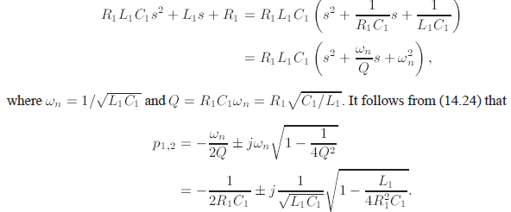
RLC Realizations
Based on the results of LC tank we analyze now the full RLC circuit
Z2 can be obtained by replacing R1 in parallel with Z1 in transfer function of
The impedance still contains a zero at the origin due to the inductor. The poles are computed as follows:

Slide 27
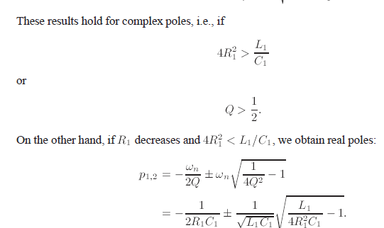
RLC Realizations
As long as the excitation of the circuit does not alter its topology, the poles are given as above, a point that proves useful in the choice of filter structures.

Slide 28
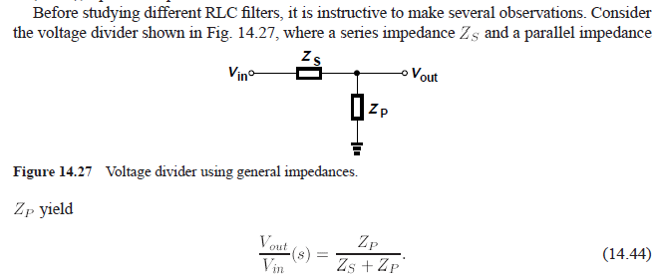
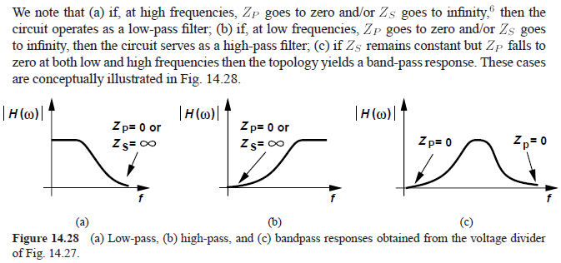
RLC Realizations

Slide 29
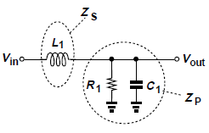
RLC Realizations
Low-Pass Filter
Based on the observations mentioned in previous slide it is derived that the circuit below
forms an RLC type realization of an LPF filter, since
This arrangement provides a low-pass response having the same poles as those given by (14.39) or (14.43) because for Vin = 0, it reduces to the topology of Fig. 14.26. furthermore, the transition beyond the passband exhibits a second-order roll-off because both
It can be shown that:

Slide 30
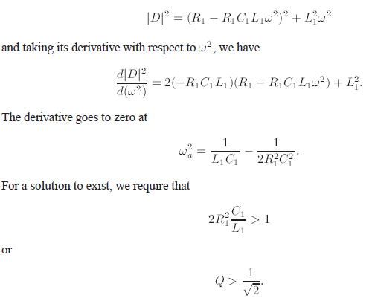
RLC Realizations
Low-Pass Filter
If the Q of the network is sufficiently high, the frequency response exhibits “peaking,” i.e., a
gain of greater than unity in a certain frequency range. The transfer function provides this effect if the denominator falls to a local minimum
Comparison with the condition provided during RLC analysis in previous slides reveals that the poles are complex here.

Slide 31
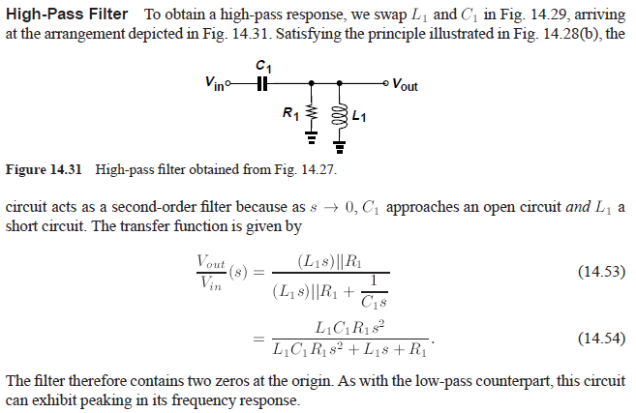
RLC Realizations

Slide 32
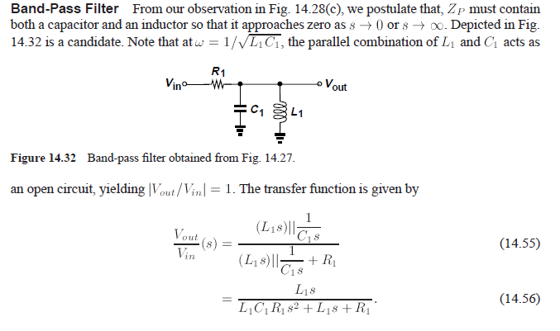
RLC Realizations

Slide 33
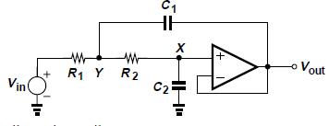
Active Filters
Passive filters suffer from a number of drawbacks; e.g., they constrain the type of transfer function that can be implemented, and they may require bulky inductor. For these reasons active implementations are preferred Most active filters employ op amps to allow simplifying idealizations and hence a systematic procedure for the design of the circuit.
An important concern in the design of active filters stems from the number of op amps required as it determines the power dissipation and even cost of the circuit. In the following second order realizations will be considered using one, two, or three op amps.
Sallen and Key Filter
The low-pass Sallen and Key (SK) filter employs one op amp to provide a second-order transfer function (see Fig. below). Note that the op amp simply serves as a unity-gain buffer,
Basic Sallen and Key Filter.
Assuming an ideal op amp, we have V_{X} = Vout. Also, since the op amp
draws no current, the current flowing through R₂ is equal to V_{X}C₂s = VoutC₂s,
Note: Please note that in the following slides regarding Salien and Key filters, ω_{n} might also be mentioned as ωο

Slide 34
Active Filters
Sallen and Key Filter-LPF case
As mentioned in previous slide , we have V_{X} = Vout, while also since the op amp draws no current, the current flowing through R₂ is equal to V_{X}C₂s = VoutC₂s, yielding
Forming a KCL at node Y gives
and after some calculations:
To obtain a form similar to that (with α=β=0) we divide the numerator
and the denominator by R₁R₂C₁C₂ and define

Slide 35
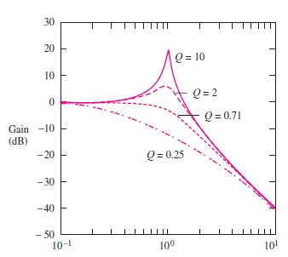
Active Filters
Sallen and Key LPF filter-Graphical representations for various Q and ωο
The frequency ωo is referred to as the cutoff frequency of the filter, although the exact value
of the cutoff frequency,, is equal to ωo only for Q = 1/√2.
At low frequencies—that is, ω << ωo—the filter has unity gain, but for frequencies well above ωo, the filter response exhibits a two-pole roll-off, falling at a rate of 40 dB/decade. At ω = ωo, the gain of the filter is equal to Q
LPF response for ωo = 1 and four values of Q.
Figure above shows the response of the filter for ωo = 1 and four values of Q: 0.25, 1/√2, 2
and 10. Q = 1/√2 corresponds to the maximally flat magnitude response of a Butterworth filter, which gives the maximum bandwidth without a peaked response. For a Q larger than 1/√2, the filter response exhibits a peaked response that is usually undesirable, whereas a Q below 1/ √2 does not take maximum advantage of the filter’s bandwidth capability.
From a practical point of view, a much wider selection of resistor values than capacitor values
exists, and the filters are often designed with C1 = C2 = C. Then ωo and Q are adjusted by choosing different values of R1 and R2. For the equal capacitor design

Slide 36
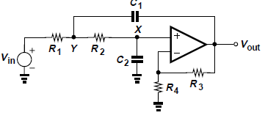
Active Filters
Sallen and Key LPF filter with gain>1
The SK topology below can provide a passband voltage gain of greater than unity for an LPF. Specifically we note that (1 + R3/R4)V_{X} = Vout , and the current flowing through R2 is given by V_{X}C₂s = VoutC₂s/(1 + R3/R4).
It follows that Vy equals to:
Forming a KCL at node Y yields
And solving for Vout we get:
It is interesting here to note that ωn remains the same

Slide 37
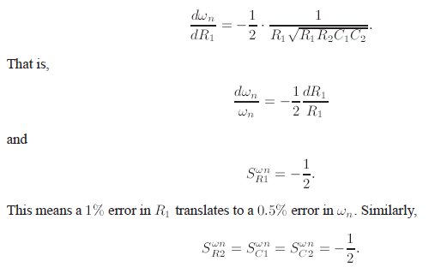
Active Filters
Sallen and Key LPF filter with gain>1, Sensitivity Issues
An important objective in choosing the values in filters is to minimize the sensitivities
of the circuit. Considering the topology shown in previous slide and defining K = 1+R3/R4
we compute the sensitivity of ωn and Q with respect to the resistor and capacitor values
we have that and hence:

Slide 38
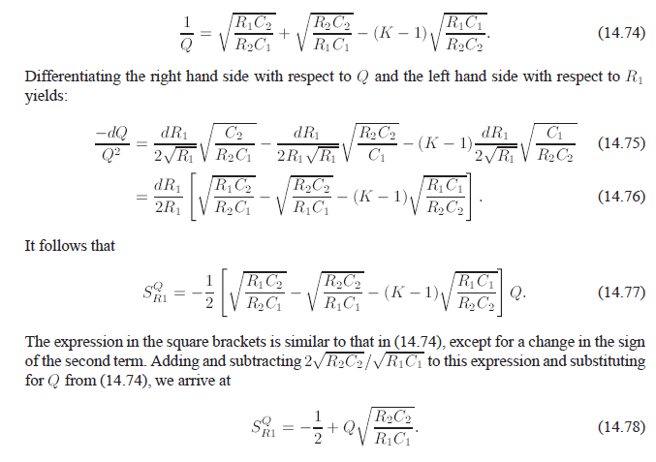
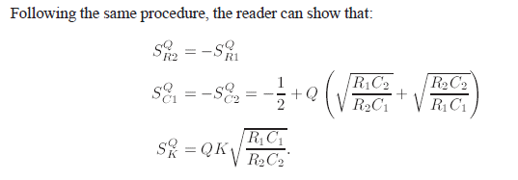
Active Filters
Sallen and Key LPF filter with gain>1, Sensitivity Issues
For the Q sensitivities, we first rewrite Eq. in terms of K = 1+R3/R4:
(14.80)

Slide 39
Active Filters
Sallen and Key LPF filter with gain>1, Sensitivity Issues
In applications requiring a high Q and/or a high K, one can choose unequal resistors or
capacitors so as to maintain reasonable sensitivities.
As an example, let’s assume that an SK filter must be designed for Q = 2 and K = 2. Determine the choice of filter components for minimum sensitivities
Notes:
Υπάρχει λάθος σε αυτή τη διαφάνεια : Δεν είναι S^{Q}_{k2}=0 αλλά S^{Q}_{R1}=0

Slide 40
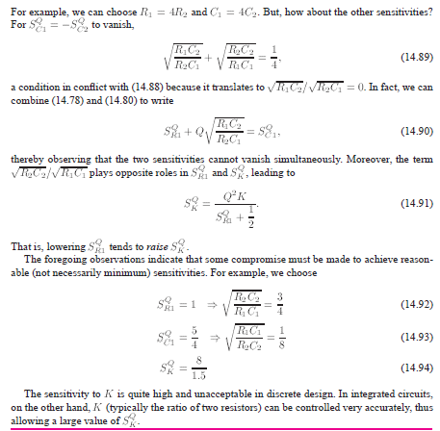
Active Filters
Sallen and Key LPF filter with gain>1, Sensitivity Issues
Notes:
Υπάρχει λάθος σε αυτή την διαφάνεια: Όπως φαίνεται από την σχέση (14.90) , η σχέση (14.93) πρέπει να είναι Square Root (R₁C₂/R₂C₁)

Slide 41
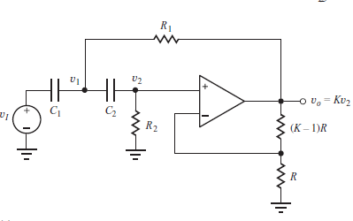
Active Filters
Sallen and Key filter - High Pass case
A high-pass filter can be achieved with the same topology as that of LPF by interchanging the position of the resistors and capacitors, as shown in specific Figure. Also the voltage follower in the low-pass filter has been replaced with a noninverting amplifier with a gain of K. Gain K provides an additional
degree of freedom in the filter design. The analysis is similar to that of LPF
It holds that: V₂= V_{o} R/[(k-1)R +R]=> V_{o}= KV_{2,} i_{c2}= V₂ /R₂= V_{o} / KR₂
V₁= V_{C2}+V₂= i_{c2}/ sC₂ + V_{o} / K = V_{o} / K (1 /R₂sC₂ +1)= V_{o} / K [ (1 +R₂sC₂ )/R₂ sC₂)]
Using KCL at node V₁, we have: i_{C1} + i_{R1} +i_{C2}=0 where: : i_{C1} = (V₁- V_{in})/ Z_{c1} = (V₁- V_{in}) sC₁ =>
i_{C1} = [ [V_{o} / K [ (1 +R₂sC₂ )/R₂sC₂)] - V_{in}] sC₁ , i_{c2}= V_{o} / KR₂ and
i_{R1} = (V₁- V_{o})/ R₁ = [ [V_{o} / K [ (1 + R₂sC₂ )/ R₂sC₂)] - V_{o}] / R₁ . Substituting the expressions for : i_{C1} , i_{R1} , i_{C2} to the KCL equation and after some calculations we have:
with
or
,
Notes:
Υπάρχει Λάθος στο v2 στην έκφραση για εύρεση του v1

Slide 42
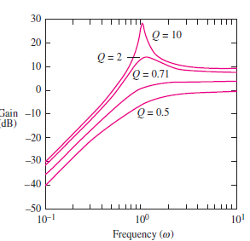
Active Filters
Sallen and Key High Pass filter-Graphical representations for various Q and ωο values
Figure in the left shows the high-pass filter responses for a filter with ωo = 1 and four values of Q. The parameter ωo corresponds approximately to the lower-cutoff frequency of the filter, and Q = 1/√2 again represents the maximally flat, or Butterworth, filter response.
Usually the case R1 = R2 = R and C1 = C2 = C is used for this filter design, where H(s), ωο and Q are simplified to
HPF response for ωo = 1 and 4 Q values.
The noninverting amplifier circuit obviously must have K ≥ 1. Note that K = 3 for this case
corresponds to infinite Q. This situation corresponds to the poles of the filter being exactly on the imaginary axis at s = jωo and results in sinusoidal oscillation. For K > 3, the filter poles will be in the right-half plane, and thus values of K ≥ 3 correspond to unstable filters.
Therefore, 1 ≤ K < 3.

Slide 43
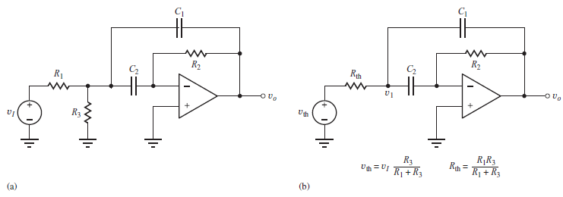
Active Filters
Sallen and Key filter - Band pass case
A band-pass filter can be realized by combining the low-pass and high-pass characteristics of the corresponding filters. Figure below shows one possible circuit for such a band-pass filter.
(a) Band-pass filter using inverting op amp (b) Simplified band-pass filter after Thevenin is applied
It holds: i_{c2}=(V₁-0)/Z_{c2} = V₁/ (1/sC₂ )= sV₁C₂ , i_{R2}= [(V_{o} -0)/R₂], i_{c2}= - i_{R2} => sV₁C₂ = - V_{o} /R₂ =>
V₁ = - V_{o} /s C₂R₂ Using KCL at node V₁, we have: i_{Rth} + i_{c1} +i_{c2}=0=> - i_{Rth} =i_{c1} +i_{c2} =>
- (υ₁ -V_{th} )/R_{th}= i_{c1} +i_{c2} . Setting G_{th} =1/ R_{th} we get :
Combining the above equation with the expression
derived for V₁ we have:
Finally substituting V_{th} with
the equivalent expression with Vin we get

Slide 44
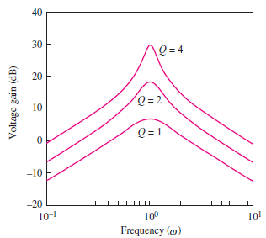
Active Filters
Sallen and Key BandPass filter-Graphical representations for various Q and ωο values
The response of the band-pass filter is shown in Figure on the left for ωo = 1, C1 = C2, R3 = ∞,
and three values of Q. Parameter ωo now represents the center frequency of the band-pass filter. The response peaks at ωo, and the gain at the center frequency is equal to 2Q². At frequencies much less than or much greater than ωo, the filter response corresponds to a single-pole high- or low-pass filter, changing at a rate of 20 dB/decade.
A usual design choice for this filter is to have C1 set equal to C2 = C, where the expressions for H(s), ωο and Q become:

Slide 45
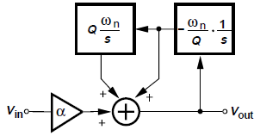
Integrator-Based Biquads
KHN biquad Filters
It is possible to realize the biquadratic transfer function by means of integrators. Let us consider a special case where β = γ = 0, i.e.a High Pass Filter
This expression suggests that Vout can be created as the sum of three terms: a scaled version of the input, an integrated version of the output, and a doubly-integrated version of the output. Figure below illustrates how Vout is generated by means of two integrators and a voltage adder
(a) Flow diagram showing the generation of Vout as a weighted sum of three terms

Slide 46
Integrator-Based Biquads
The corresponding circuit realization is depicted in Fig. below.
b) realization of KHN filter, (c) simplified diagram for calculating Vout
Note that the inherent signal inversion in each integrator necessitates returning V_{X} to the noninverting input of the adder and V_{Y} to the inverting input. It holds that:
we obtain from Fig. (c) the weighted sum of Vin, V_{X} , and V_{Y} as
Equating similar terms in eq .above and we get
It is thus possible to select the component values so as to obtain a desired transfer function.

Slide 47
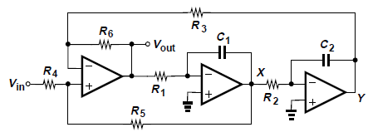
Integrator-Based Biquads
LPF and BPF filters
The topology of Figure (on the left) is called the “KHN biquad” after its inventors, Kerwin, Huelsman, and Newcomb. This topology proves quite versatile, since in addition to providing the high-pass transfer function of previous slide the circuit can also serve as a low-pass and a band-pass filter. Specifically,
BPF case
If in the above Figure the output is taken from X then we have a Band pass filter since
which is a bandpass transfer function
LPFcase
If in the above Figure the output is taken from Y then we have a Lowpass filter since
which is a lowpass transfer function
The most important attribute of the KHN biquad is its low sensitivities to component
values. It can be shown that the sensitivity of ωn with respect to all values is equal to 0.5 and
It is Interesting to note that, if R3 = R6, then S^{Q} _{R3;R6} vanishes
The use of three op amps in the feedback loop of Fig. above raises concern regarding the stability of the circuit because each op amp contributes several poles. Careful simulations are necessary to avoid oscillation.

Slide 48
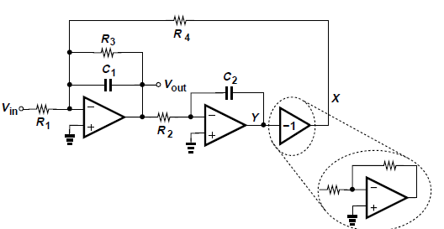
Integrator-Based Biquads
Tow and Thomas Biquad Filters
Another type of biquad developed by Tow and Thomas is shown in Fig. on the left Here, the adder and the first integrator are merged, and resistor R₃ is introduced. (Without R3, the loop consisting of two ideal integrators oscillates.) Noting that V_{X} = -V_{Y} and
, we sum the currents flowing through R₄ and R₁ and multiply the result by the parallel impedances of R₃ and C₁
=>
which provides a band-pass response
The output at Y exhibits a low-pass behavior
It can be shown that the sensitivities of the Tow-Thomas biquad with respect to the componentvalues are equal to 0.5 or 1

Slide 49
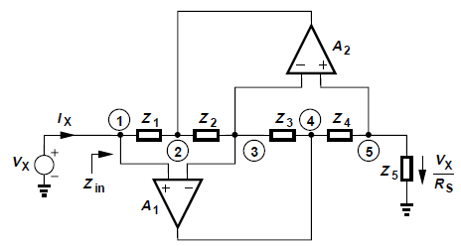
Biquads Using Simulated Inductors
In previous slides it was shown that second-order RLC circuits can provide low-pass, high-pass, or band-pass responses, but their usage in integrated circuits is limited because of the difficulty in building high-value, high-quality on-chip inductors. We may therefore ask: is it possible to emulate the behavior of an inductor by means of an active (inductorless) circuit? The answer is given by the circuit on the left
General impedance converter
Consider the circuit shown in Fig. above, where general impedances Z1-Z5 are placed in series and the feedback loops provided by the two (ideal) op amps force V1-V3 and V3- V5 to zero: V1 = V3 = V5 = VX That is, the op amps establish a current of VX/Z5 through Z5. This current flows through Z4, yielding V4 =(VX/Z5)Z4 + VX:
The current flowing through Z3 (and hence through Z2) is given by:
I_{Z3} = (V4 -V3)/Z3=(VX/Z5 ) (Z4/Z3):
The voltage at node 2 is thus equal to: V2 = V3 - Z2 I_{Z3} = VX - Z2 (VX/Z5 ) (Z4/Z3):
Finally, I_{X} = (VX -V2)/ Z1 = VX ( Z2 Z4)/ (Z1 Z3 Z5)
and hence
:

Slide 50
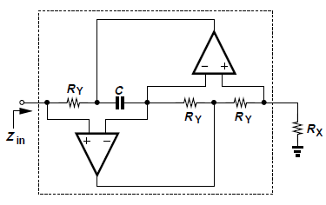
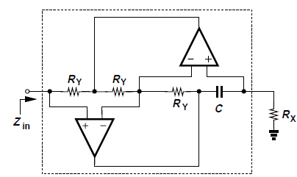
Biquads Using Simulated Inductors
The result derived in previous slide, i.e. suggests that the circuit can
“convert” Z5 to a different type of impedance if Z1 - Z4 are chosen properly. For example, if Z5 = R_{X}, Z2 = (Cs)⁻¹, and Z1 = Z3 = Z4 = R_{Y} we can get from the Figure below that:
which is an inductor of value R_{X} R_{Y} C. We say the circuit converts a resistor to an inductor, i.e., it “simulates” an inductor.
Example of inductance simulation.
From Eq. above, another possible combination of components that yields a simulated inductor is to choose Z4 = (Cs)⁻¹ and the remaining passive elements to be resistors: Z1 =Z2 = Z3 = R_{Y} . Thus, by the Eq. above it is derived that:
Zin = R_{X} R_{Y} C s
The resulting topology is shown in Fig. on the left

Slide 51
Biquads Using Simulated Inductors
The “general impedance converter” (GIC) and its descendants presented in the previous slides, were Introduced by Antoniou, and are useful in transforming a passive RLC filter to an active counterpart. For example, as depicted in Fig. below , a high-pass (RLC) active section is obtained by replacing L1 with a simulated inductor. Similar comments hold for the derivation of the bandpass (RLC) active section with respect to the corresponding L replacement
High-pass filter using a simulated inductor.
It can be proved that node 4 in Fig. above can also serve as an output. Specifically:
Since Vout = V1 = V3 = V5, the current flowing through R_{X} is equal to Vout/R_{X}, yielding
This means that V4 is simply an amplified version of Vout. Driven by op amp A1, this port exhibits a lower output impedance than does node 1, and is often utilized as the output of the circuit

Slide 52
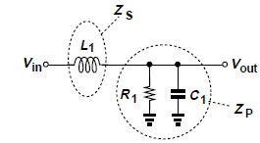
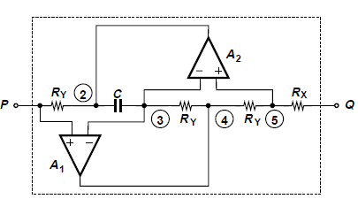
Biquads Using Simulated Inductors
LPF case
How is a low-pass filter derived? From the RLC network of Fig. on the right , we note the need for a floating (rather than grounded) inductor and attempt to create such a device as shown in Fig. (a) below .
A simple test to see whether this circuit can behaves as an inductor is to tie a voltage source to node P and determine the Thevenin equivalent as seen from node Q (Fig. (b) below) . To compute the open-circuit voltage, VThev, recall that the op amps force V5 to be equal to VP (=Vin). Since no current flows through RX, VThev = Vin:
General impedance converter as a floating impedance, (b) Thevenin equivalent
To obtain Z_{thev} , we set Vin to zero and apply a voltage to the left terminal of R_{X} [Fig. (c)].
Since V5 = V1 = 0, I_{X} = V_{X}/R_{X} and hence Z_{Thev} = R_{X}
Consequently, the network operates as a simple resistor rather than a floating inductor

Slide 53
Biquads Using Simulated Inductors
LPF case
Although the circuit of previous slide behave as a resistor, this difficulty can be overcome and LPF can be derived through the impedance converter of Fig. (a) below . Consider the special case illustrated in Fig. (a), where Z1 = (Cs)⁻¹, Z3 = (Cs)⁻¹ II R_{X}, and Z2 = Z4 = Z5 =
R_{X}. From (Antoniou) impedance equation we get
=>
This impedance may be viewed as a “super capacitor” because it is equal to the product of two capacitive components: Now, by examining the circuit depicted in Fig. (b) below we have:
This topology thus provides a second-order low-pass filter response. As mentioned in the high pass case in previous slides, we note that node 4 serves as a better output port.
(a) General impedance converter producing a “super capacitor,” (b) LPF filter obtained from (a).

Slide 54
Biquads Using Simulated Inductors
LPF case
By using the general impedance converter, the circuit shown in Fig. below can be derived as an alternative to that in Fig. (b) of previous slide
Specifically by employing Z3 = R_{X} and Z5 = (Cs)⁻¹ II R_{X} , this configuration provides the same transfer function as the one derived in previous slide . This topology , though is less useful, since V4 is no longer a scaled version of Vout:
Thus, the output can be sensed at only node 1, suffering from a relatively high impedance (since it is positioned at the input of an op-amp which as it is well known is characterized by high impedance
The important issue is that as it can be proved the sensitivities of the general impedance converter and the resulting filters with respect to component values are equal to 0.5 or 1. Such circuits therefore prove useful in both discrete and integrated design.

Slide 55
Butterworth and Chebyshev Filters
Approximation of Filter Response
How does the design of a filter begin? Based on the expected levels of the desired signal we decide on the required stopband attenuation. Next, depending on how close the “interferer” frequency is to the desired signal frequency, we choose a slope for the transition band. Finally, depending on the nature of the desired signal (audio, video, etc.), we select the tolerable passband ripple (e.g., 0.5 dB). We thus arrive at a “template” such as that shown in Fig below for the filter frequency response
With the template in hand, how do we determine the required transfer function? This task is
called the “approximation problem,” by which a transfer function is chosen to approximate the response dictated by the template. We prefer to select a transfer function that leads to efficient, low-sensitivity circuit realization.
Several approximations with various trade-offs exist. Examples include “Butterworth,” “Chebyshev,” “elliptic,” and “Bessel” responses. Most filters suffer from a trade-off between the passband ripple and the transition band slope. We study the first two types here.

Slide 56
Butterworth and Chebyshev Filters
Butterworth Response
The Butterworth response completely avoids ripple in the passband (and the stopband) at the cost of the transition band slope. This type of response defines the magnitude of the transfer function as:
where n denotes the order of the filter
It is instructive to examine above equation carefully and understand its properties. First, we observe that the -3-dB bandwidth is calculated as:
=>
the -3-dB bandwidth remains independent of the order of the filter. Second, as n increases, the response exhibits a sharper transition band and a greater passband flatness. Third, the response exhibits no ripple (local maxima or minima) since the first derivative of the above equation with respect to ω vanishes only at ω = 0. Figure below illustrates these points

Slide 57
Butterworth and Chebyshev Filters
Butterworth Response
Given filter specifications and hence a template, we can readily choose ωο and n in
to arrive at an acceptable Butterworth approximation.
This equation suggests that the corresponding transfer function contains no zeros. To obtain the poles, we make a reverse substitution, ω= s/j , and set the denominator to zero. We have:

Slide 58
Butterworth and Chebyshev Filters
Butterworth Response
To get an idea how these poles are located in the complex plane let’s assume that n = 2. Then,
As shown in Fig. below, the poles are located at 135^{ο}, i.e., their real and imaginary parts are equal in magnitude. For larger values of n, each pole falls on a circle of radius ωο and bears an angle of π/n with respect to the next pole [Fig (b)].
Since we have given a closed expression for the poles the transfer function can be written as:
The factor in the numerator is included to yield H(s = 0) =1

Slide 59
Butterworth and Chebyshev Filters
Example with Butterworth-Part1
A low-pass filter must provide a passband flatness of 0.45 dB for f < f1 = 1 MHz and a
stopband attenuation of 9 dB at f2 = 2 MHz. Determine the order of a Butterworth filter
satisfying these requirements. Figure below shows the template of the desired response
Clalculating that |H(f1 = 1 MHz)I = 0.95(= -0.45 dB) and IH(f2 = 2MHz)I = 0.355 (=-9 dB), the
following two equations can be formed
The first equation yields
which, if used in the second equation , yields
Since f2 = 2f1, the smallest n that satisfies equation on the left is 3.With n = 3, we obtain ωο from the first equation above as follows:
ωο = 2π x (1.45 MHz):

Slide 60
Butterworth and Chebyshev Filters
Example with Butterworth-Part2
Using a Sallen and Key topology as basis , we would like to design a Butterworth filter having the response and parameters derived in the previous slide example .
With n = 3 and ωο = 2π x (1.45 MHz) from previous example, the poles appear as shown in Fig. below. The complex conjugate poles p1 and p3 can be created by a second-order SK filter, and the real pole p2 by a simple RC section. Since
the SK transfer function
can be written as

Slide 61
Butterworth and Chebyshev Filters
Example with Butterworth-Part2
We remind from previous slide
and thus
It is also reminded that in SK filter it holds
In Eq. for Q above we choose R1 = R2 and C1 = 4C2 to obtain Q = 1. From Eq. for ωn above, to obtain , we have some freedom, e.g.,
R1 = 1 kΩ and C2 = 54.9 pF. It can be verifeid that this design achieves low sensitivities.
The real pole, p2, is readily created by an RC section
For example, it can be selected, R3 = 1 k and C3 = 109:8 pF.
In general a Butterworth filter is employed only in rare cases where no ripple in the passband can be tolerated. We typically allow a small ripple (e.g., 0.5 dB) so as to exploit responses that provide a sharper transition slope and hence a greater stopband attenuation. The Chebyshev response is one such example.
Notes:
Υπάρχει λάθος –Το C2=54.9 pf και όχι 4.52 pF

Slide 62
Butterworth and Chebyshev Filters
Chebyshev response
The Chebyshev filter exhibits an “equiripple” passband behavior, i.e., with equal local maxima and minima). The magnitude of the transfer function is defined as :
where ϵ sets the amount of ripple and C²_{n} (ω/ωο) denotes the “Chebyshev polynomial” of n-th order. We consider ωο as the “bandwidth” of the filter. These polynomials are expressed recursively as:
or, alternatively, as

Slide 63
Butterworth and Chebyshev Filters
Chebyshev response
As shown in Fig. (a), higher-order polynomials experience a greater number of fluctuations between 0 and 1 in the range of 0 < ω /ωο < 1, and monotonically rise thereafter. Scaled by ϵ ², these fluctuations lead to n ripples in the passband of ΙHΙ [Fig.(b)].
=>
(a) Behavior of Chebyshev polynomials, (b) second- and third-order Chebyshev responses

Slide 64
Butterworth and Chebyshev Filters
Chebyshev response
Summarizing about Chebyshev response, As shown in Fig. below, the magnitude of the transfer function in the passband is given by
which exhibits a peak-to-peak ripple of
Regarding stopband the
transfer function is given by:
which gives the attenuation at frequencies greater than ωο.
General Chebyshev response.
In practice, we must determine n so as to obtain the required values of ωο, ripple, and stopband attenuation. This will be demonstrated in the examples of following slides

Slide 65
Butterworth and Chebyshev Filters
Chebyshev response
As mentioned in previous slide , it is essential that the filter order n is determined so as to obtain the required values of ωο, ripple, and stopband attenuation
After the order of the filter response has been determined, the next step in the design is to obtain the poles and hence the transfer function. It can be shown that the poles are given by:
k = 1, 2,…, n
The poles, as it can be shown, reside on an ellipse. The transfer function is then expressed as:

Slide 66
Butterworth and Chebyshev Filters
Example 1
Determine the order of a Chebyshev filter that provides a passband ripple of 1 dB across a bandwidth of 5 MHz and an attenuation of 30 dB at 10 MHz.
It is obvious that ωο= 2π x(5 MHz) and thus we have:
=> ϵ=0.509
to 0.0316 (= -30 dB) at ω=2ωο getting :
We equate to
Since cosh⁻¹ 2 =1.317, Eq. above yields
Which leads to n > 3.66. Consequently we should select n = 4.

Slide 67
Butterworth and Chebyshev Filters
Example 2
Design a (Chebyshev) filter using two Sallen Key filter stages, that satisfies the requirements in Example of previous slide, i.e. that the filter should provide a passband ripple of 1 dB across a bandwidth of 5 MHz and an attenuation of 30 dB at 10 MHz
Having calculated from previous example that in order to satisfy the above requirement this filter should have ϵ= 0:509 and n = 4, the filter poles can be calculated as follows:
These can be grouped in two set ,where each set contains the conjugate poles
Figure (a) on the right plots the pole locations. We note that p1 and p4 fall close to the imaginary axis and thus a relatively high Q is expected.

Slide 68
Butterworth and Chebyshev Filters
Example 2
Having calculated the poles ,the two SK stages should be defined . For p1 and p4 the corresponding SK filter is characterized by the following transfer function:
Keeping in mind that the denominator of a second order filter should be of the form: s²+(ωn/Q)s +ωn² ωn1 and Q1 can be derived .Specifically:
Equation which estimates Q for SK filters suggests that such a high
Value of Q can be obtained only if C1/C2 is large. For example, with R1 = R2, from the Q equation above we require C1 = 50.4 C2 and thus from the equation that estimates ωn for SK filters we have:
=>
If it is assumed that R1 = 1 kΩ, then C2 = 4.52 pF. (For discrete implementations, this value of C2 is excessively small, necessitating that R1 be scaled down by a factor of, say, 5.)

Slide 69
Butterworth and Chebyshev Filters
Example 2
Similarly, the SK stage corresponding to poles p2 and p3 leads to the following transfer function
And thus ωn2 and Q2 can be estimated as :
If we set R1 = R2 = 1 k, then the equations
which estimate ωn and Q for SK filters can be translated to C1 = 2.45 C2 (from the Q equation and C2 = 38.5 pF from the ωn equation
The overall design is shown in Fig. (b) below

