Slide 1
CROCODILE2 SSTPA in Greece
Yorgos Stephanedes
Athanasios Koukounaris
Marina Kouta
CROCODILE 2

Slide 2
DIRECTIVE 2010/40/EU PRIORITY ACTIONS ON SSTPA
Priority Action E: Provision of information services for safe and secure parking places for trucks and commercial vehicles
Priority Action F: Provision of reservation services for safe and secure parking places for trucks and commercial vehicles
CROCODILE 2

Slide 3
REGULATION No 885/2013
DATA COLLECTION
Static data related to the parking areas
Information on safety & equipment of parking area
Dynamic data on availability of parking places
DATA SHARING/EXCHANGE (using DATEX II)
Parking operators
Service providers
Single access points
National/International access point
CROCODILE 2

Slide 4
SSTPA DESIGN in GREECE [1/7] DATEX II IMPLEMENTATION PLAN
Static/dynamic data related to parking areas
Identification information of parking area
{“ParkingName”, “parkingAlias”, “parkingSiteAddress”}
Location information
{“Latitude/Longitude”}
Primary Road identifier1/direction and Primary RoadIdentifier2/direction
{“roadName”, “roadIdentifier”, “roadDestination”, “distanceToThisRoad”}
CROCODILE 2

Slide 5
SSTPA DESIGN in GREECE [2/7] DATEX II IMPLEMENTATION PLAN
Indication of the exit
{“junctionName”}
Total number of free parking places for trucks {“parkingNumberOfVacantSpaces”}
Price and currency of parking places !Without charge
{“maximumDuration”}
CROCODILE 2

Slide 6
SSTPA DESIGN in GREECE [3/7] DATEX II IMPLEMENTATION PLAN
Information on safety and equipment of parking area
Description of security, safety and service equipment {“parkingSecurity”, “parkingAddtionalSecurity”, “parkingSecurityNationalClassification”, “labelSecurityLevelSelfAssessment”, “labelServiceLevelSelfAssessment”, “parkingSupervision”}
Contact information of the parking operator {“contactPersonName”, “contactPersonFirstName”, “contactDetailsTelephoneNumber”, “contactDetailsEMail”, “publishingAgreement”}
CROCODILE 2

Slide 7
SSTPA DESIGN in GREECE [4/7] PRIORITY ACTION F IMPLEMENTATION PLAN
Dynamic data related to parking space reservation
Available parking spaces for reservation
{NumberOfParkSpaces}
Reservation of a parking space
{ReservationOrNot, EntryTime, ExitTime}
CROCODILE 2

Slide 8
SSTPA DESIGN in GREECE [5/7] EQUIPMENT SUPPLY – SOFTWARE DEVELOPMENT
Fencing
Lighting
Parking barriers
Quick Response (QR) code system (generator+reader)
Server operating system
Security cameras and video surveillance systems
Automatic Number Plate Recognition (ANPR) system
Machine Vision (MV) System
e-platform
Application for mobile devices
CROCODILE 2

Slide 9
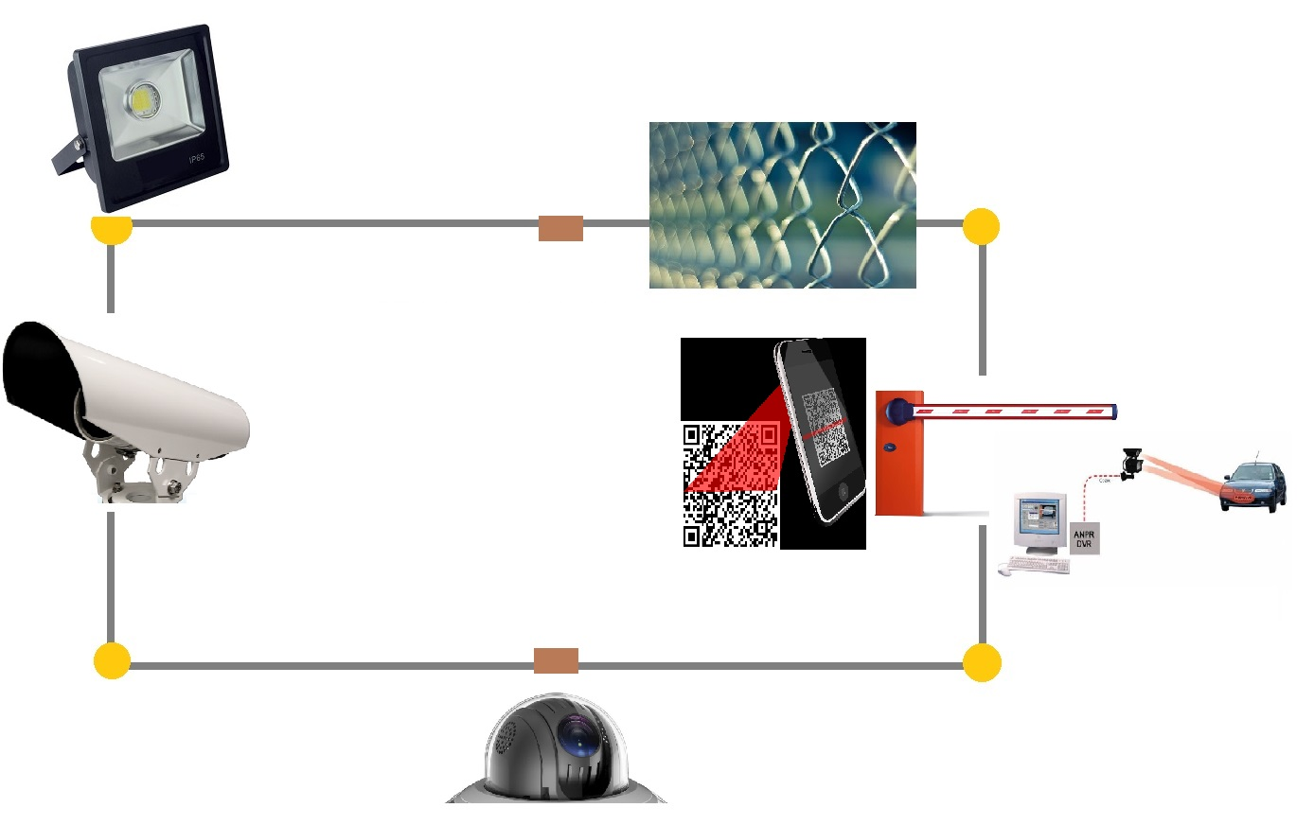
SSTPA DESIGN in GREECE [6/7] EQUIPMENT INSTALLATION
CROCODILE 2

Slide 10
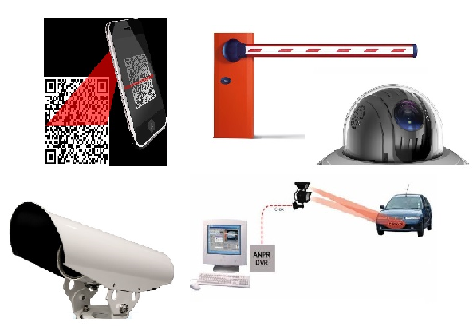
SSTPA DESIGN in GREECE [7/7] DATA TRANSMISSION
Installed equipment
End user services
(e-platform & application)
input data
Server operating system
output
data
data available to parking operators, service providers, nat./int. access pt
primary
data
DATEX II
CROCODILE 2

