Slide 1
Graph-based visualization of sensitive medical data
Panagiotis Karampelesis
Module: Big Data Analytics
Institution: University of Patras
Date: 16/12/2024

Slide 2
Overview
Challenges
Proposed Graph-based Method
Graph construction
Node glyphs
Incremental Graph Formation
Three Use Cases:
Frailty in older adults
Patients with Sjogren’s Syndrome
A large diabetes dataset
Comparison
Suggestions
Conclusion

Slide 3
Challenges
The management, analysis, and interpretation of large-scale medical data is challenging due to:
Data Volume
Data Sensitivity

Slide 4
Visualization… what else?
Effective graph-based visualization can:
Reveal patterns
Assist in diagnoses
Ensure better patient outcomes
while maintaining privacy and protecting sensitive data.

Slide 5
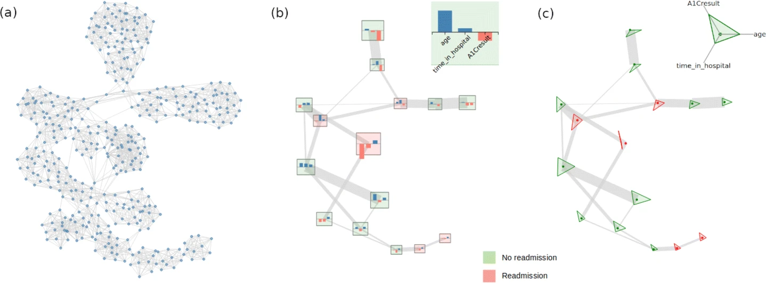
The proposed method: graph-based visualization with glyph encoding
Graph Construction:
Each node represents a patient.
Edges encode pairwise similarities between patients based on their attributes.
Patients are represented as mathematical vectors (blood pressure, disease presence(0/1) etc.)
Normalization: All data are z-score normalized to avoid dominance of large-scale attributes.
Node Glyphs:
Visualize attributes using bar charts and radar glyphs.
Incremental Graph Formation:
Aggregate patient data into group summaries.
Privacy-Preserving Federated Model
Figure 1. Example of the proposed graph-based method for a dataset of 400 patients. (a) The graph of all patients. (b) The reduced graph, using bar chart glyphs. (c) The reduced graph, using radar chart glyphs

Slide 6
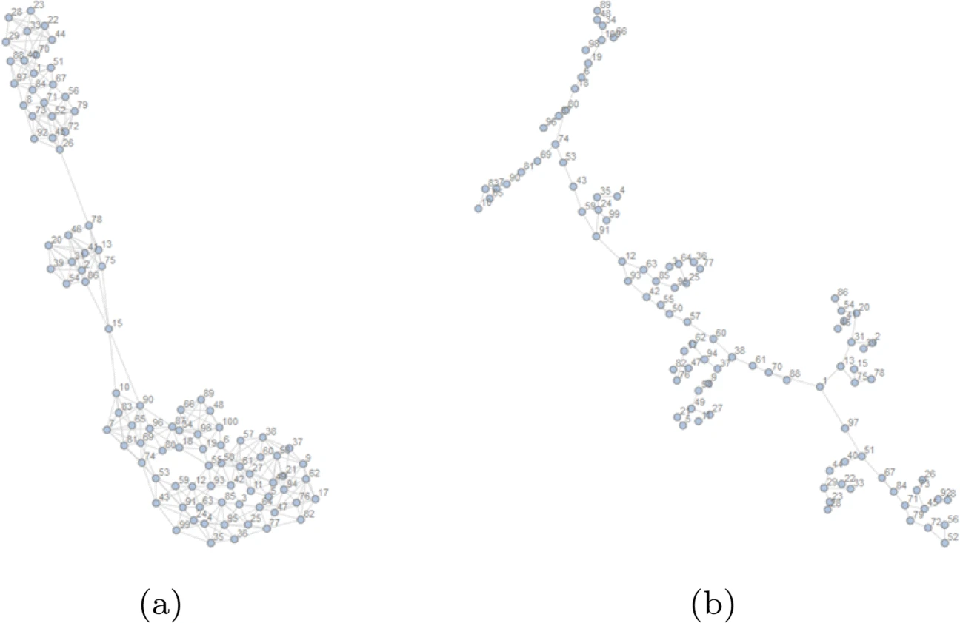
Graph Construction Algorithms
k-Nearest Neighbors (k-NN):
Connect nodes based on distance in feature space.
Minimum Spanning Tree (MST):
Connect all nodes with the minimum total edge weight.
Figure 2. Visualizations of the same dataset. a) K-nearest, b) MST

Slide 7
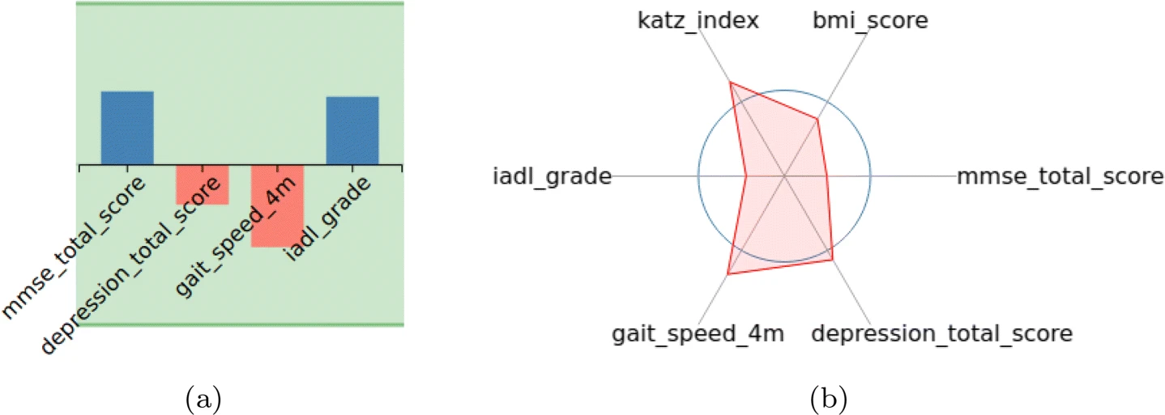
Node Glyphs - Visual Encoding
Bar Chart Glyphs:
Suitable for a small number of attributes.
Intuitive to read values.
Radar Chart Glyphs:
Compact and efficient for high-dimensional data.
Color Encoding:
Red: High risk (e.g., frailty, readmission).
Green: Low risk.
Figure 3. Α)Bar chart glyph with four attributes. Β) Radar chart glyph with six attributes

Slide 8
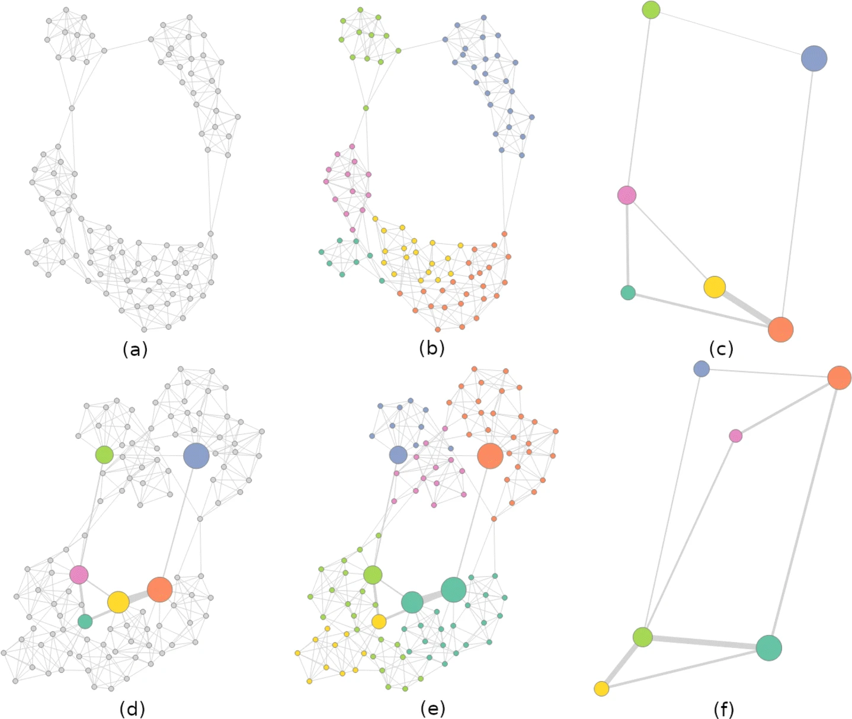
Incremental Graph Formation
Cohort Graph Creation:.
Use Spectral Graph Partitioning to divide patients into groups (sub-cohorts).
each group’s information:
Cardinality: Number of patients.
Group Centroid: Average attribute values.
Standard Deviation: Variability within the group.
Reduced Graph Construction:
Groups become single nodes.
Edges reflect similarity between groups with multiplicity (number of connections).
Merging Graphs:
Combine the reduced graph with a new cohort:
New partitions can form, and the graph can be further reduced.
Benefits: Scalable, privacy-preserving, and efficient.
Figure 4. Incremental Graph Formation. (a)-(c) reduced graph of cohort 1. (d)-(f) the reduced graph merges with cohort 2

Slide 9
Technological Implementation
Back-End:
Graph Construction: Implemented in Node.js (JavaScript/Python).
Provides RESTful web services with JSON input for flexible graph creation.
Front-End:
Graph Visualization: Implemented using D3.js (JavaScript library).
Supports interactive glyph-based node visualizations for detailed data inspection.

Slide 10
Case Study 1 - older adults in relation to frailty status
Dataset: Collected from the FrailSafe Project (200 participants).
Objective: Identify frail patients and detect sensor anomalies.
Attributes Used:
Cognitive: MMSE score (Mini-Mental State Exam).
Activity: Gait speed, IADL grade, Katz index.
Psychological: Depression score.
Physical: BMI and frailty status (Non-frail, Pre-frail, Frail).

Slide 11
Results
Top right:
High cognitive (MMSE) and physical activity (IADL) scores.
Group of non-frail patients with good health status.
Bottom left:
Low cognitive and physical scores.
Cluster of frail patients at risk of health decline.
Figure 5. Visualization of the FrailSafe dataset, using bar chart glyphs and 5-nearest neighbours graph construction method

Slide 12
Results
Non-Frail Glyphs: Balanced shapes with high MMSE, IADL, and moderate BMI.
Frail Glyphs: Skewed shapes with low cognitive and activity values.
Figure 6. Visualization of the FrailSafe dataset, using radar chart glyphs and the MST graph construction method

Slide 13
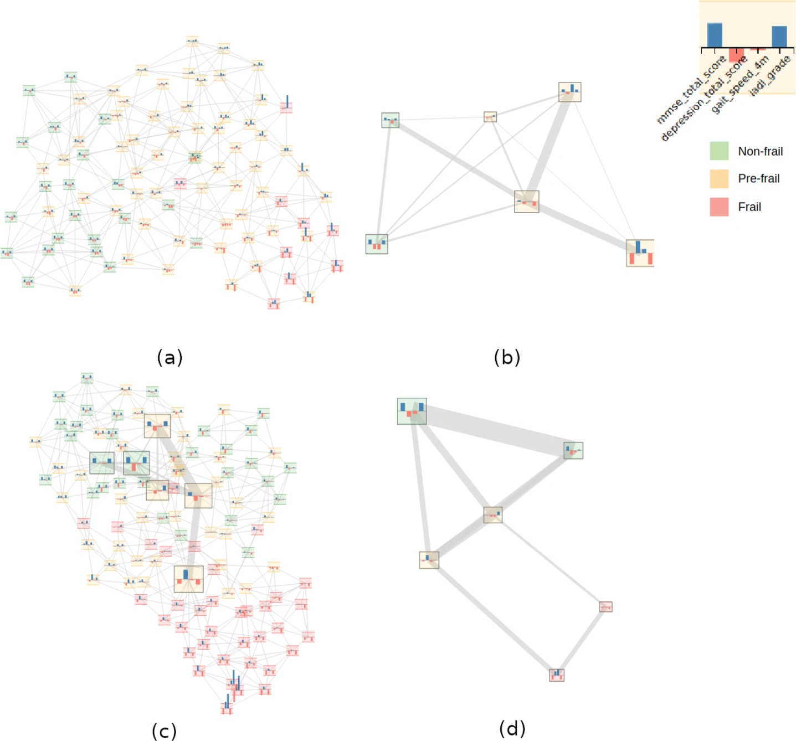
Merging the two cohorts:
Gray Borders: Represent patient groups from Cohort #1.
New Nodes: Appear near relevant patient groups from the first cohort based on health similarities.
Disconnected Nodes: Some patients appear far from existing groups, indicating unique health conditions or new subgroups.
Figure 7. Incremental graph construction for the FrailSafe dataset. (a-b) Graph of cohort #1. (c-d) Merging cohort #1 with cohort #2

Slide 14
Case Study 2 - Sjögren’s Syndrome
Objective:
Detect lymphoma cases among patients.
Graph Type: k-NN with node glyphs.
Attributes available (from 200 patients):
SGE: The Salivary Gland Echography measurement.
Lymphadenopathy: Whether the person has lymphadenopathy.
C3: Concentration of Complement C3 proteins.
C4: Concentration of Complement C4 proteins.
Dryness upper resp.: Dryness of the upper respiratory system, as subjectively qualified by the patient.
Reynaud: Existence of Reynaud’s disease.
Lymphoma: A binary categorical variable, indicating whether the person has lymphoma, i.e. cancer of the lymph nodes.

Slide 15
Observations:
Right cluster: Low SGE values indicate impaired salivary glands (a common symptom of Sjögren’s).
Bottom cluster: High levels of swollen lymph nodes.
Most patients with lymphoma (red nodes) are concentrated in the bottomand left clusters.
Figure 8. Visualization of the HarmonicSS dataset, using bar chart glyphs and the nearest neighbors graph construction method

Slide 16
Observations:
Top-left: High C3/C4 values and lymphadenopathy presence, indicating potential immune system activation.
Central Area: Balanced radar shapes with average attribute values (normal patients).
Bottom-Right Area: High respiratory dryness, likely tied to advanced Sjögren’s Syndrome.
Figure 9. Visualization of the HarmonicSS dataset, using radar chart glyphs and the nearest neighbors graph construction method

Slide 17
Observation:
Top Cluster:
Insight: Patients with low C3/C4 levels and high lymphadenopathy form a distinct high-risk group.
Lymphoma Detection: Most lymphoma cases are concentrated here.
Bottom Cluster:
Insight: Patients with balanced clinical metrics are clustered together.
Interpretation: This cluster shows healthy individuals or those with mild Sjögren’s symptoms.
Figure 10. Incremental graph construction for the HarmonicSS dataset, using a k-nearest neighbors graph. (a-b) Graph of cohort #1. (c-d) Merging cohort #1 with cohort #2

Slide 18
Case Study 3 - Diabetes Dataset
Objective:
Visualize 17,000 patients and identify readmission patterns.Graph Type: Incremental k-NN with k=150 .
Graph Type: Incremental k-NN with k=150 .
Incremental Approach:
Graphs built in batches and aggregated incrementally.
The attributes used for this use case are the following:
– Age: The age of the patient in years, binned into ten-year wide bins.
– Time at hospital: The hospitalization duration, in days.
– HbA1C value: The result of the HbA1C measurement of the patient.
– Readmission: Whether or not the patient is known to have been readmitted to the hospital.

Slide 19
Observations:
The graph was partitioned into 20 components, simplifying the visualization.
The dataset was split into 17 batches of 1,000 patients each.Each batch was processed incrementally.
Figure 11. Visualization of the first 2000 patients of the diabetes dataset. (a) The graph of all patients. (b) The partitioned graph

Slide 20
Observations:
Bottom Clusters: Patients with low HbA1c levels but high readmission rates, indicating possible undiagnosed health risks.
Figure 12. Visualization of the partitioning of the whole diabetes dataset of 17000 records

Slide 21
Comparison of Methods
Method | Pros | Cons
k-Nearest Neighbors | Dense connections for local detail | Computationally expensive
Minimum Spanning Tree | Sparse and efficient representation | May miss local similarities
Incremental Graphs | Scalable and privacy-preserving | Information loss in summaries

Slide 22
Suggestions for Improvements
Hybrid Methods:
Combine k-NN for local connections and MST for global structure.
Dynamic Updates:
Enable real-time graph updates for evolving data.

Slide 23
Conclusion
A graph-based method for visualizing patient data was proposed.
Key features:
Graph construction (k-NN, MST, Incremental).
Glyph-based encoding for multi-attribute visualization.
Applications: FrailSafe, Sjögren’s Syndrome, Diabetes datasets.
Future work: dynamic updates, and hybrid methods.

Slide 24
Thank you! Any questions?
All data and figures used in this presentation have been sourced from:
Kalamaras, I., Glykos, K., Megalooikonomou, V., Votis, K., & Tzovaras, D. (2021). Graph-based visualization of sensitive medical data. Multimedia Tools and Applications. https://doi.org/10.1007/s11042-021-10990-1

