Slide 1
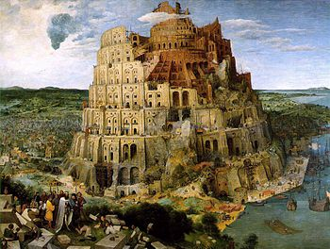
ΙΝΔΟΕΥΡΩΠΑΪΚΗ ΓΛΩΣΣΟΛΟΓΙΑ
Η Αρία φυλή και η μητέρα-γλώσσα

Slide 2
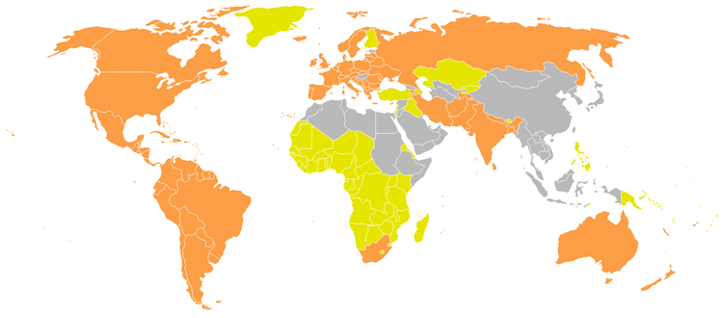

Slide 3
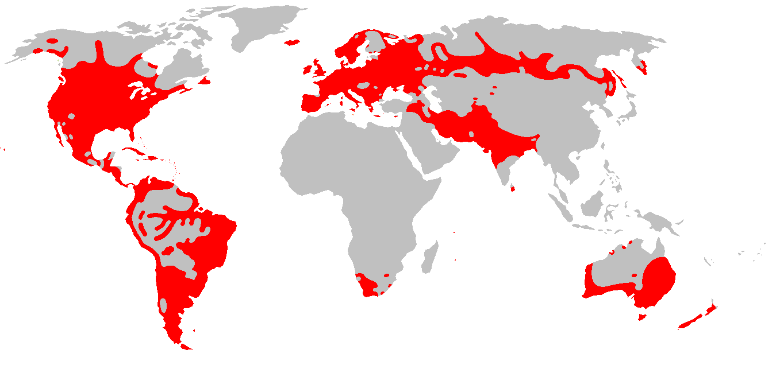

Slide 4
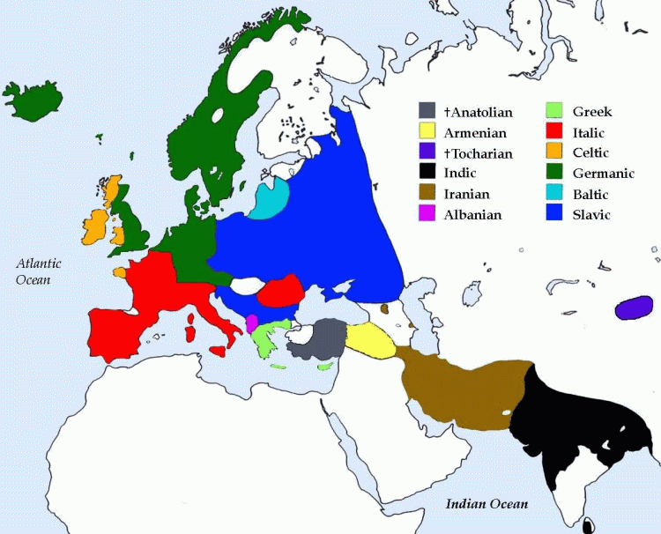
«Αρχαία» ΙΕ οικογένεια

Slide 5
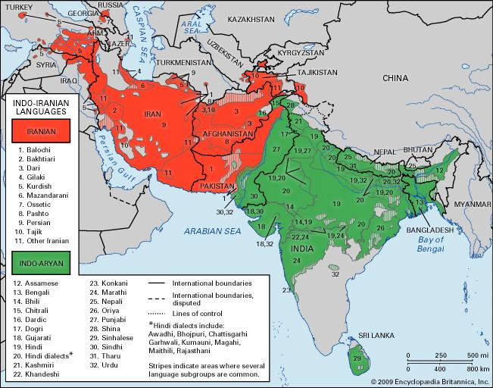

Slide 6
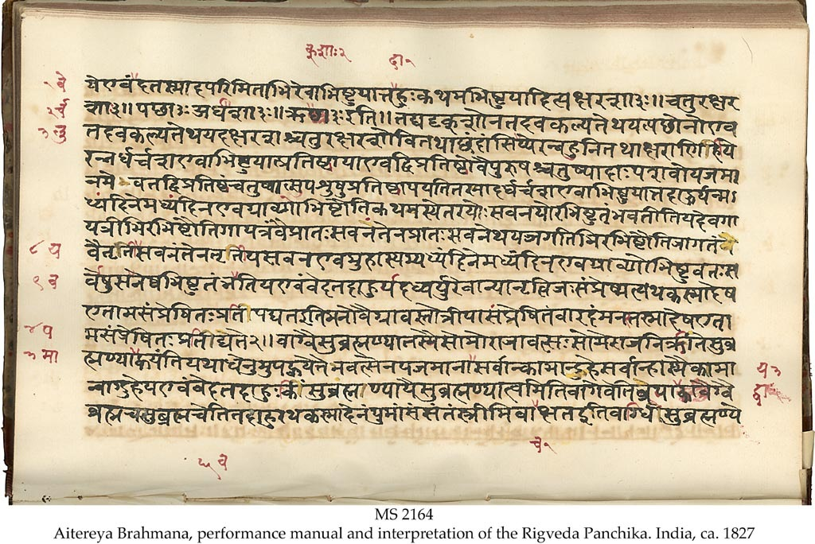
Σανσκριτικά: Rigveda
Notes:
Το αρχαιότερο κείμενο της Σανσκριτικής γλώσσας (χρονολογείται γύρω στο 1200 π.Χ.)

Slide 7
Rigveda: Ύμνος στον Ίντρα
1.006.01a yuñjánti bradhnám aruṣáṃ 1.006.01b cárantam pári tasthúṣaḥ 1.006.01c rócante rocanā́ diví 1.006.02a yuñjánti asya kā́miyā 1.006.02b hárī vípakṣasā ráthe 1.006.02c śóṇā dhr̥ṣṇū́ nr̥vā́hasā 1.006.03a ketúṃ kr̥ṇvánn aketáve 1.006.03b péśo maryā apeśáse 1.006.03c sám uṣádbhir ajāyathāḥ 1.006.04a ã́d áha svadhā́m ánu 1.006.04b púnar garbhatvám eriré 1.006.04c dádhānā nā́ma yajñíyam 1.006.05a vīḷú cid ārujatnúbhir 1.006.05b gúhā cid indra váhnibhiḥ 1.006.05c ávinda usríyā ánu 1.006.06a devayánto yáthā matím 1.006.06b áchā vidádvasuṃ gíraḥ 1.006.06c mahā́m anūṣata śrutám 1.006.07a índreṇa sáṃ hí dŕ̥kṣase 1.006.07b saṃjagmānó ábibhyuṣā 1.006.07c mandū́ samānávarcasā 1.006.08a anavadyaír abhídyubhir 1.006.08b makháḥ sáhasvad arcati 1.006.08c gaṇaír índrasya kā́miyaiḥ 1.006.09a átaḥ parijman ā́ gahi 1.006.09b divó vā rocanā́d ádhi 1.006.09c sám asminn r̥ñjate gíraḥ 1.006.10a itó vā sātím ī́mahe 1.006.10b divó vā pā́rthivād ádhi 1.006.10c índram mahó vā rájasaḥ
1 They who stand round him as he moves harness the bright, the ruddy Steed The lights are shining in the sky. 2 On both sides to the car they yoke the two bay coursers dear to him, Bold, tawny, bearers of the Chief. 3 Thou, making light where no light was, and form, O men: where form was not, Wast born together with the Dawns. 4 Thereafter they, as is their wont, threw off the state of babes unborn, Assuming sacrificial names. 5 Thou, Indra, with the Tempest-Gods, the breakers down of what is firm, Foundest the kine even in the cave. 6 Worshipping even as they list, singers laud him who findeth wealth, The far-renowned, the mighty One. 7 Mayest thou verily be seen coming by fearless Indra's side: Both joyous, equal in your sheen. 8 With Indra's well beloved hosts, the blameless, hastening to heaven, The sacrificer cries aloud. 9 Come from this place, O Wanderer, or downward from the light of heaven: Our songs of praise all yearn for this. 10 Indra we seek to give us help, from here, from heaven above the earth, Or from the spacious firmament.

Slide 8
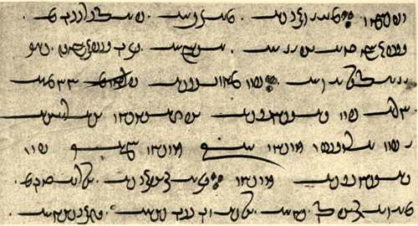
Αρχαία Ιρανικά: Avestan
Notes:
Η αρχαιότερη Ιρανική γλώσσα, η Αβεστική

Slide 9
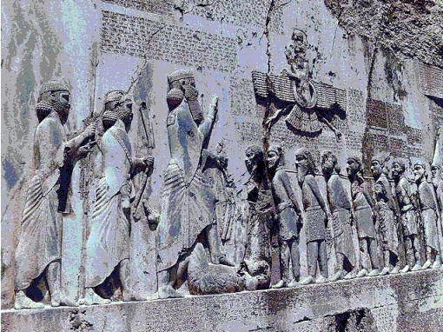
Αρχαία Περσική

Slide 10
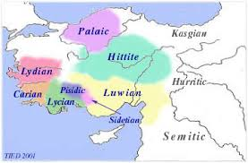

Slide 11
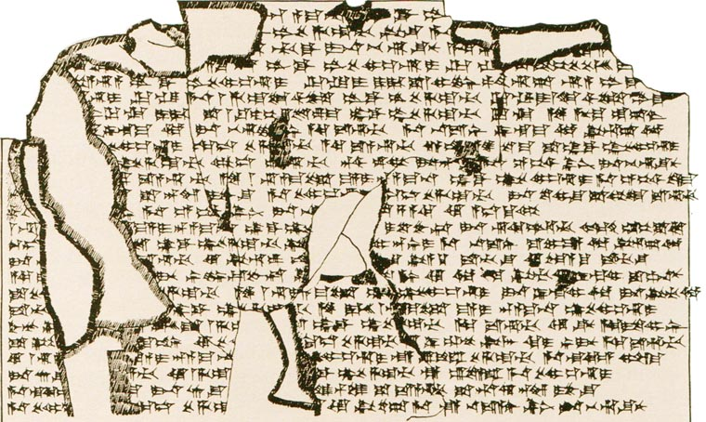
Χεττιτική (σφηνοειδής)

Slide 12
Χεττιτική: Χρονικά
1. UMMA ^{d}UTU-ŠI Mursili LUGAL GAL LUGAL KUR Hatti UR.SAG
2. DUMU Suppiluliuma LUGAL GAL UR.SAG :
──────────────────
3. Kuitman=za=kan ANA ^{GIŠ}GU.ZA ABI=YA nāwi eshat nu=mu arahzenas
4. KUR.KUR.MEŠ ^{LÚ}KÚR hūmantes kururiyahhir. Nu=za ABU=YA kuwapi DINGIR-is iyat,
5. Arnuandas=ma=za=kan ŠEŠ=YA ANA ^{GIŠ}GU.ZA ABI=ŠU esat. Appan=ma=as
6. irmaliyattat=pat. Mahhan KUR.KUR^{MEŠ LÚ}KÚR Arnuandan ŠEŠ=YA irman
7. istamassir, nu KUR.KUR^{MEŠ LÚ}KÚR kururiyahhiskiuan dāir.
1) Thus speaks my Sun, Mursilis, the great king, king of the land of Hatti, the valiant, son of Suppiluliumas, the great king, the valiant :
(3) Even before I sat on the throne of my father, all the foreign countries were hostile against me. After my father had become a god (i.e. died), my brother Arnuandas sat on the throne of his father. Afterwards, he fell ill. When the foreign countries heard that my brother Arnuandas (was) ill, the foreign countries started to be hostile.

Slide 14
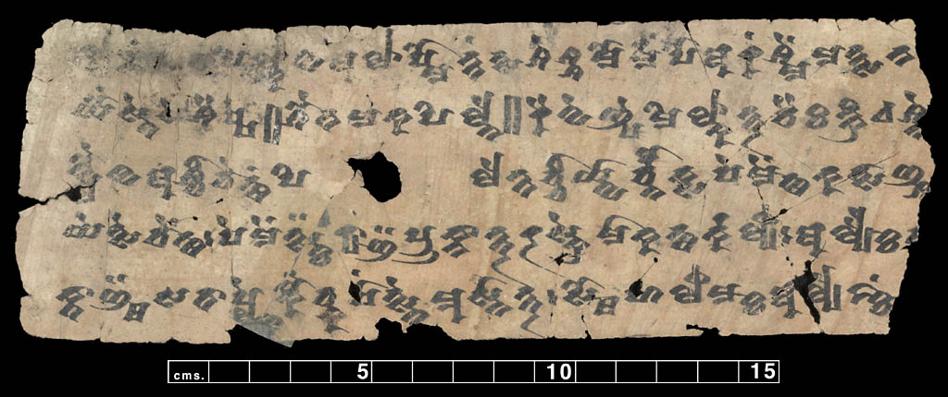
Τοχαρική

Slide 15
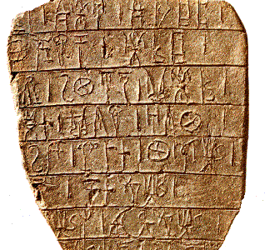
Ελληνική (Γραμμική Β)

Slide 16
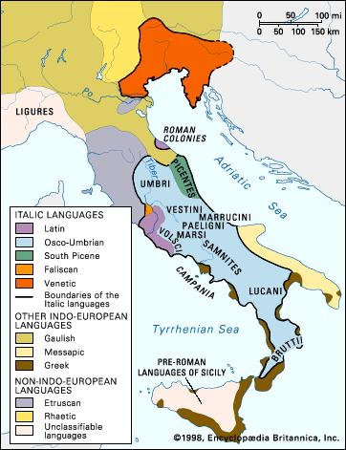

Slide 17
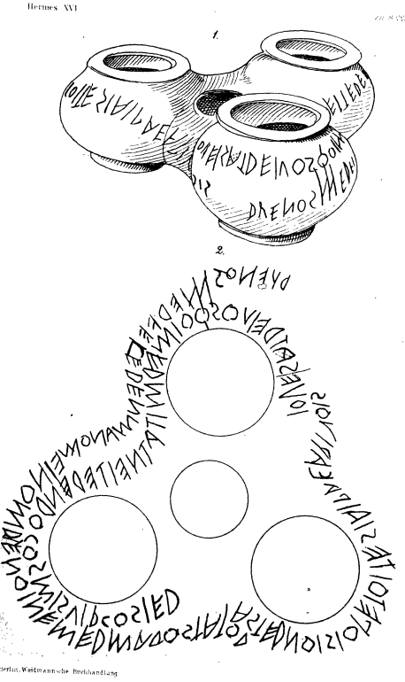
Λατινική

Slide 18
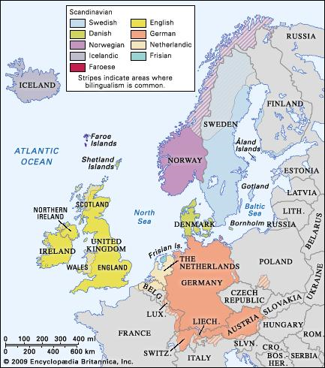

Slide 19
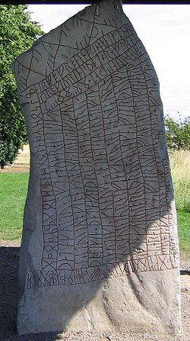
Γερμανική (Ρουνικά)

Slide 20
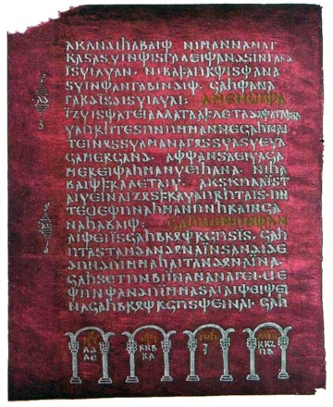
Γερμανική (Γοτθική)

Slide 21
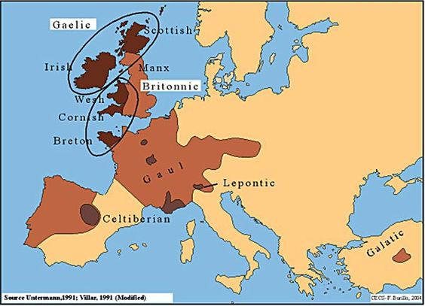

Slide 22
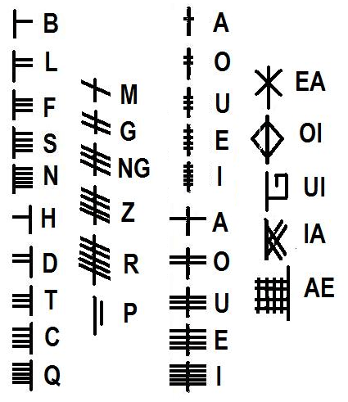
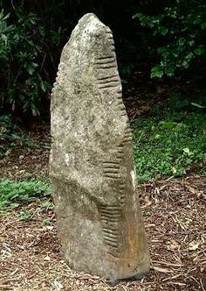
Notes:
ogham

Slide 23
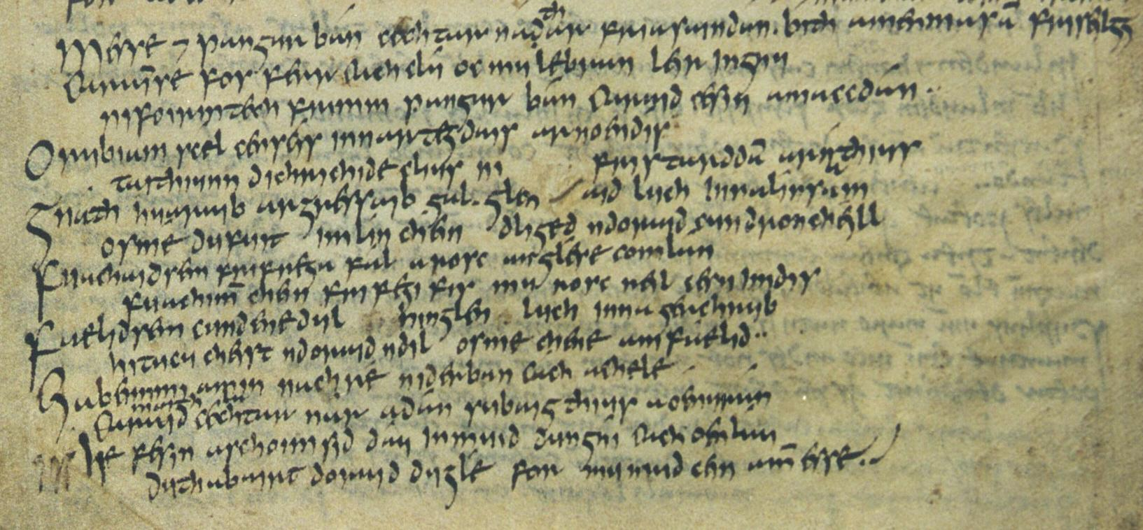
Αρχαία Ιρλανδική

Slide 24
Ουαλική
http://www.telegraph.co.uk/news/uknews/wales/11853790/Channel-4-weatherman-pronounces-longest-place-name-in-Wales-perfectly.html

Slide 25
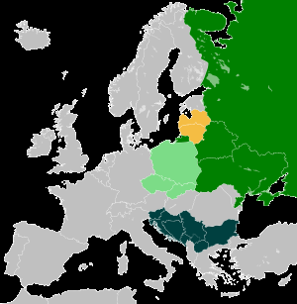

Slide 26
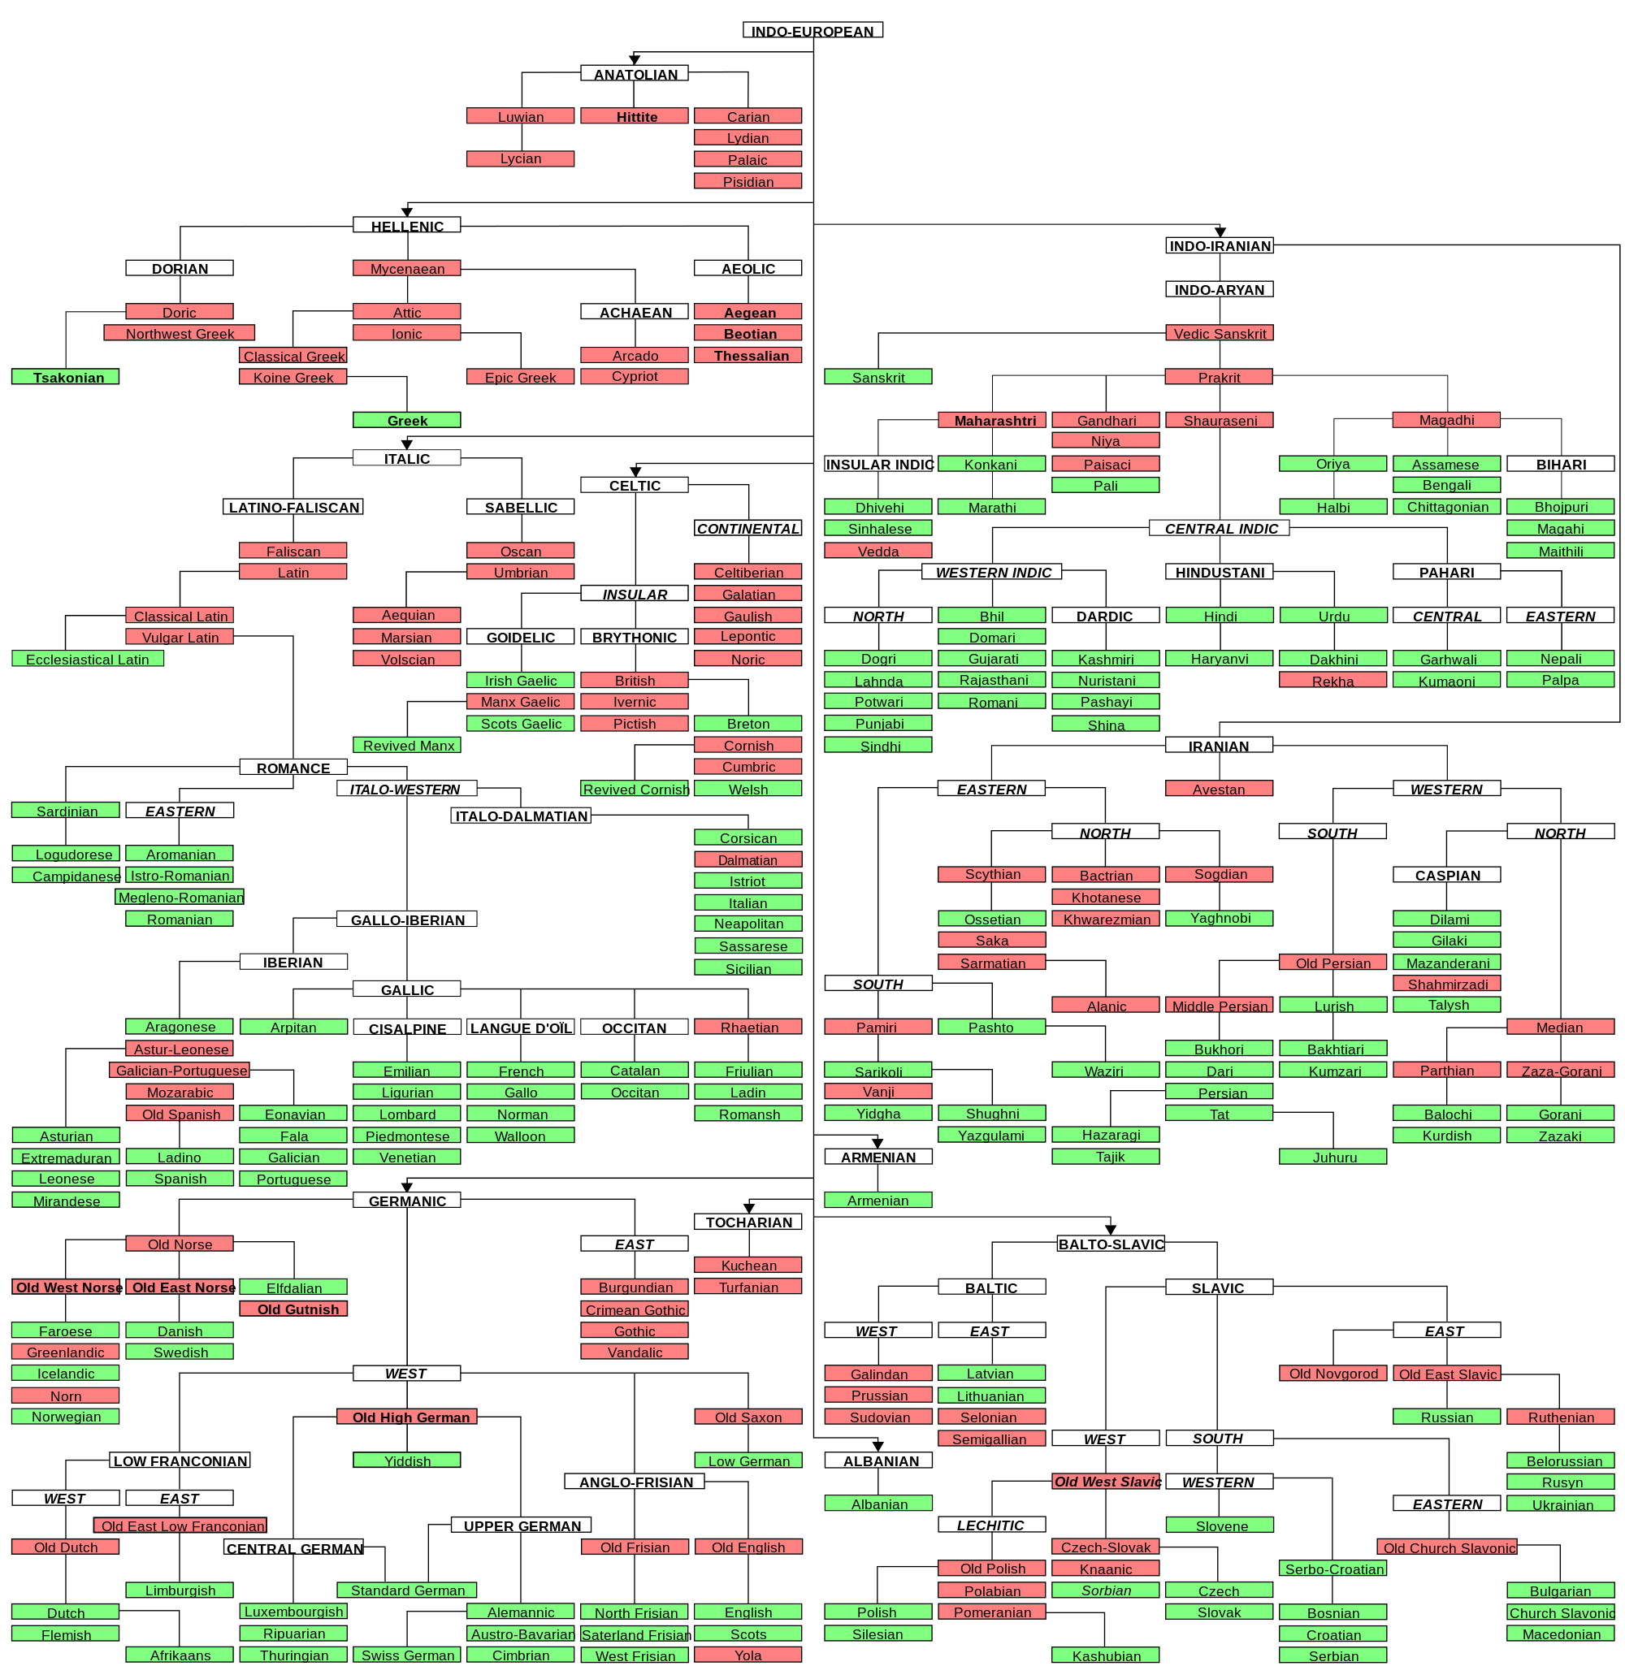

Slide 27
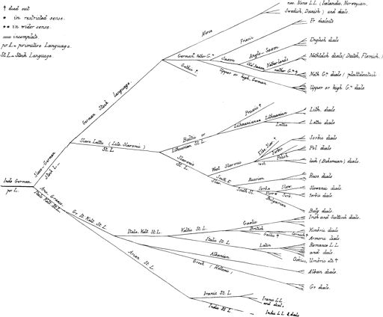

Slide 28
