Slide 1
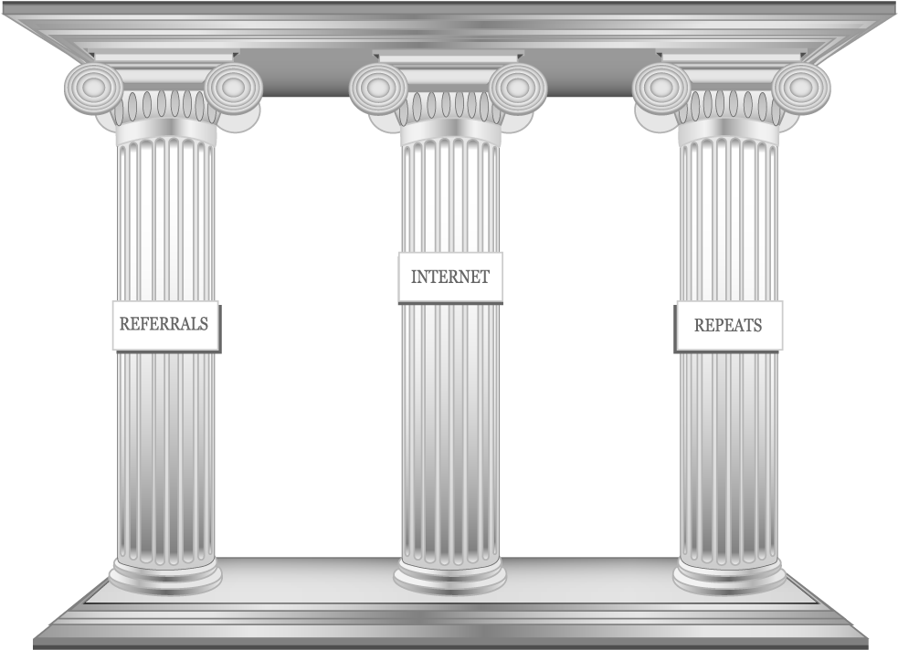
Decentralization & Blockchains
The Three Pillars
Distributed Systems
Crypto
Economic Models

Slide 2
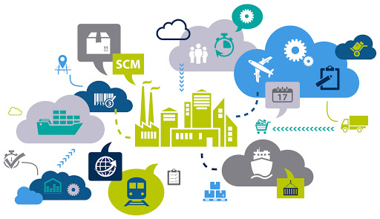
Supply Chain Management: The Players and the Game

Slide 3
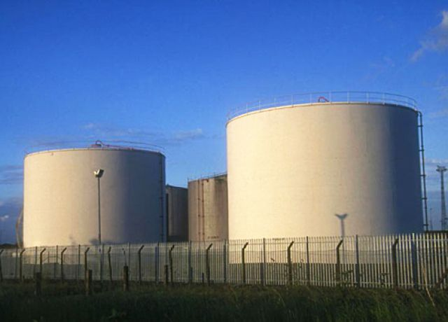
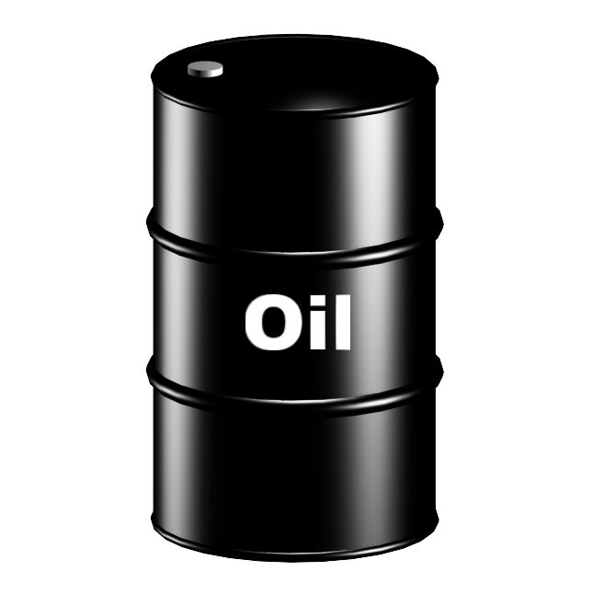
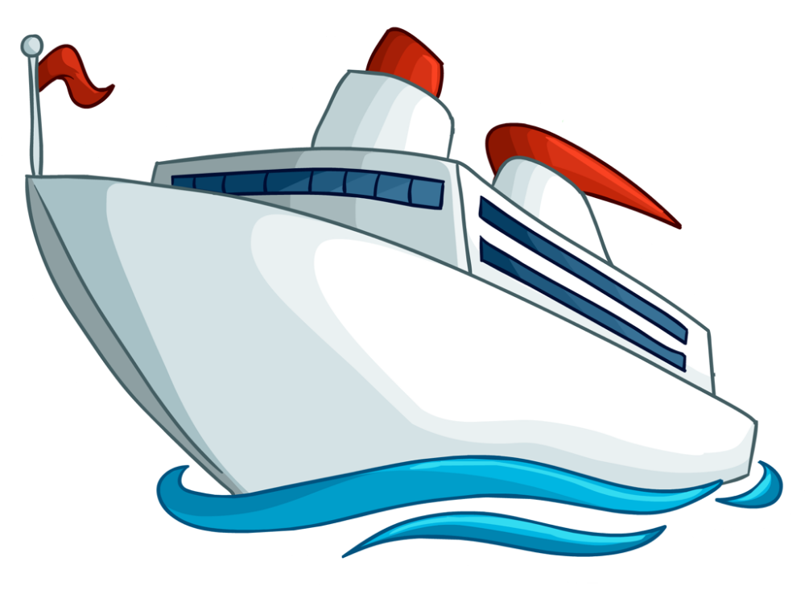
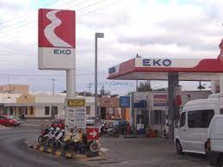
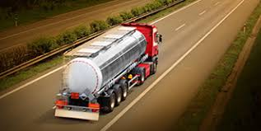
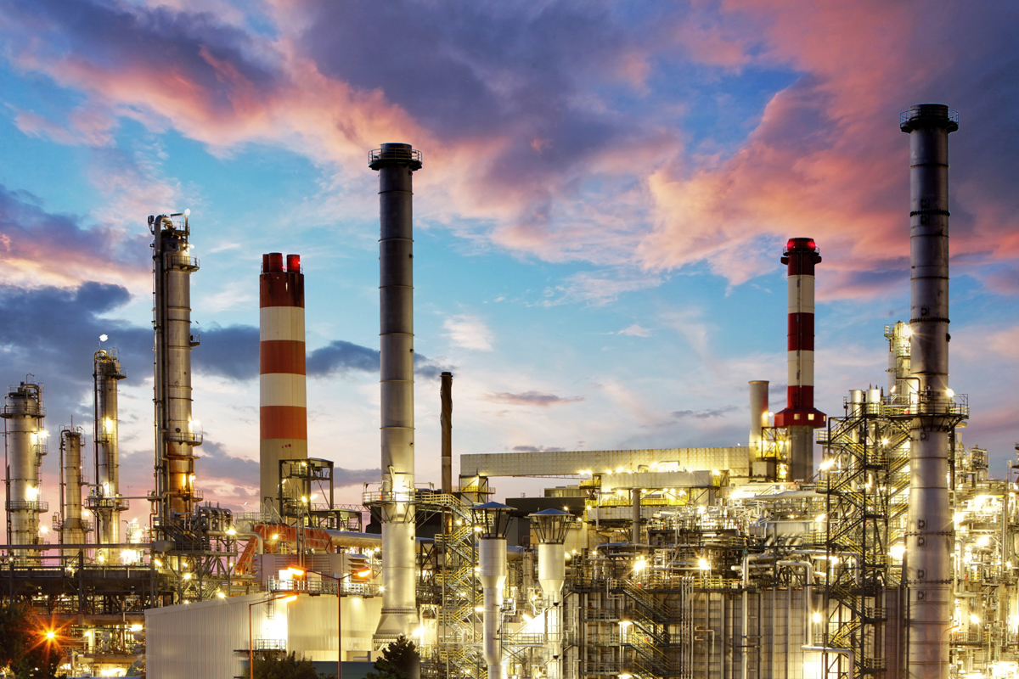
Supply Chain in Petroleum Industry
Crude Transportation
Crude Storage
Crude Purchase
Retail
Distribution
Refining

Slide 4
Requirements of a Successful Supply Chain
Minimization of material procurement (ελαχιστοποίηση της προμήθειας από μεσάζοντες)
Maximization of manufacturing capacity and sales (μεγιστοποίηση βιομηχανικής χωρητικότητας και κερδών)
Meet demand numbers (συνατάει – προλαβαίνει...τη ζήτηση)
Respond quickly to market opportunity by purchasing the production shortfall from other players (αποκρίνεται γρήγορα αγοράζοντας την πτώση του προϊόντος από άλλους παίχτες)
Objective of each production unit would be to maximize the throughput and its margin
(Στόχος κάθε μονάδας προϊόντος είναι να μεγιστοποιήσει τη διακίνηση και τα περιθώριά του)
Procurement would purchase the feedstock with not the best yields at lowest cost
(Η προμήθεια θα μπορούσε να αγοράσει την πρώτη ύλή χωρις τις καλύτερες αποδόσεις στη χαμηλότερη τιμή)
Notes:
Ελαχιστοποίηση της προμήθειας υλικών
Η προμήθεια θα αγόραζε την πρώτη ύλη με όχι τις καλύτερες αποδόσεις με το χαμηλότερο κόστος

Slide 5
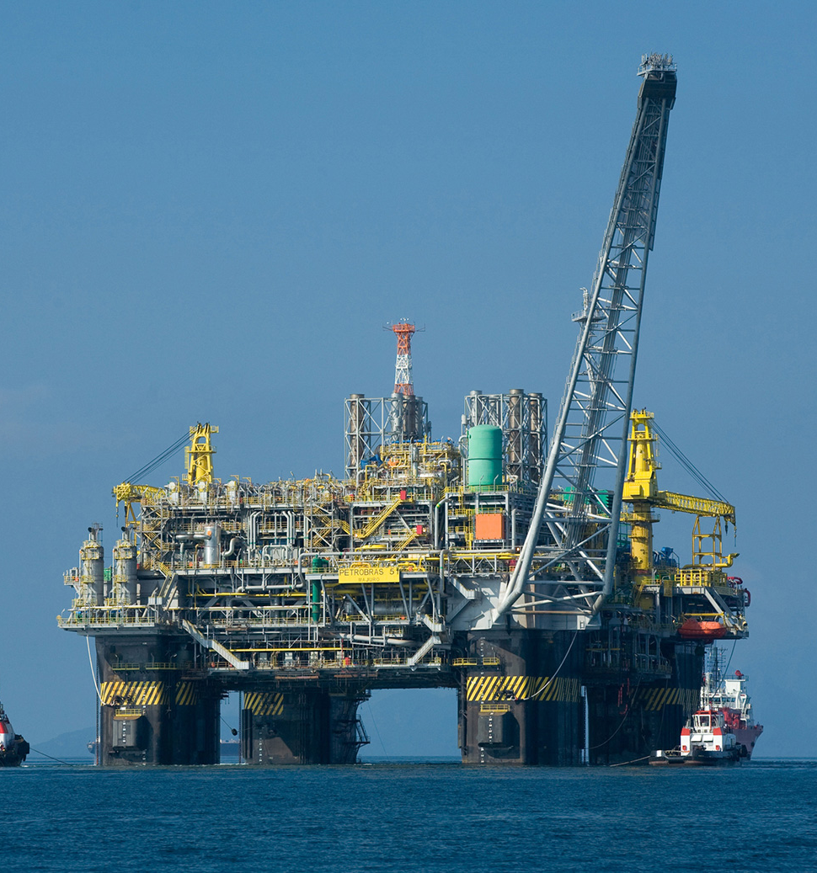
Requirements of a Successful Supply Chain
Needs Strong Coordination among the Players
How do we obtain Real-time Information from the Stakeholders?
A web-based portal?

Slide 6
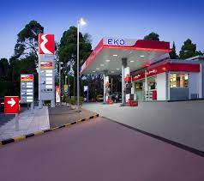
Requirements of a Successful Supply Chain
How do we obtain Real-time Information from the Stakeholders?
What is the guarantee that the information submitted is correct?
What if someone denies the information later on?
Blockchain is the answer !!

Slide 7
How Can We Obtain Real Time Information?

Slide 8
Use a Public Bulletin Board
Advantages:
Everyone can see all the logs and verify
Any change in information is visible to everyone
The board is not erasable, no one can deny later
Simple one-step auditing
- 10432 barrels produced in Thasos on Dec 26, 2022
- 6327 barrels transported from Thasos to ELPE Refinery on Dec 26, 2022 at 2:30 pm
- Received 6327 barrels on Dec 26, 2022 at 8:48 pm
Notes:
Audit -> έλεγχος

Slide 9
Use a Public Bulletin Board - Challenges
Who will maintain this bulletin board?
- Buy Cloud from amazon
Who will manage it and provide the cost?
- One of the enterprises maintain a private cloud
What is the guarantee that it is not a fraud?
Let everyone maintain the same copy of the board individually and independently
– BUT HOW?

Slide 10
What is this “Blockchain”?
A decentralized and multi-authority networked information data storage and access system

Slide 11
What is this “Blockchain”?
- 10432 barrels produced in Thasos on Dec 26, 2022
- 6327 barrels transported from Thasos to ELPE Refinery on Dec 26, 2022 at 2:30 pm
- 10432 barrels produced in Thasos on Dec 26, 2022
- 6327 barrels transported from Thasos to ELPE Refinery on Dec 26, 2022 at 2:30 pm
- Received 6327 barrels on Dec 26, 2022 at 8:48 pm
- Received 6327 barrels on Dec 26, 2022 at 8:48 pm
No one is the sole-owner of the data, but everyone has a copy of the data - there is no central database
Everyone holds exactly the same copy of the data at the same instance of the time
- 10432 barrels produced in Thasos on Dec 26, 2022
- 10432 barrels produced in Thasos on Dec 26, 2022
- 6327 barrels transported from Thasos to ELPE Refinery on Dec 26, 2022 at 2:30 pm
- 6327 barrels transported from Thasos to ELPE Refinery on Dec 26, 2022 at 2:30 pm
- Received 6327 barrels on Dec 26, 2022 at 8:48 pm
- Received 6327 barrels on Dec 26, 2022 at 8:48 pm

Slide 12
What is this “Blockchain”?
An immutable append-only ever-growing chain of data. Data once added cannot be deleted or modified later
Once something is added in the blockchain, it cannot be denied later
The information is transparent to all - everyone can see what is going on in the system
No-one can make any change without others to notice it

Slide 13
So, What is the Definition of a "Blockchain"
A decentralized immutable append-only public ledger

