Slide 2
An 81-year-old man with a 75-pack-year history of cigarette smoking reports, during a routine follow-up visit, that he quit smoking 3 months ago.
His last spirometry, obtained 2 months ago, documented an FEV1 of 44% of predicted and an FEV1/FVC ratio of 69%.The patient has not had any hospitalizations or emergency department visits in the past year. He feels that his breathing-related symptoms have been well controlled on his current inhaler regimen: albuterol as needed, daily tiotropium, and twice-daily fluticasone–salmeterol.
He has a current temperature of 36.4°C, a heart rate of 89 beats per minute, a respiratory rate of 19 breaths per minute, a blood pressure of 126/72 mm Hg, and an oxygen saturation of 88% while he is breathing ambient air.
His physical examination is significant only for diminished air movement bilaterally.Arterial blood gas testing reveals a pH of 7.36 (reference range, 7.38–7.44), partial pressure of carbon dioxide of 48 mm Hg (35–45), and partial pressure of oxygen of 54 mm Hg (80–100).

Slide 3
Which one of the following management approaches is most appropriate for this patient?
»
Add ipratropium to the inhaler regimen
»
Initiate treatment with low-dose prednisone
»
Begin daily azithromycin
»
Begin long-term supplemental oxygen therapy
»
Begin theophylline

Slide 4
Add ipratropium to the inhaler regimen
Initiate treatment with low-dose prednisone
Begin daily azithromycin
Begin long-term supplemental oxygen therapy
Begin theophylline
Key Learning Point
View Case Presentation
A patient with chronic obstructive pulmonary disease and hypoxemia who is on an adequate pharmacologic regimen should begin long-term supplemental oxygen therapy.
Detailed Feedback
According to Global Initiative for Chronic Obstructive Lung Disease criteria, patients with chronic obstructive pulmonary disease (COPD), regardless of severity, should be treated with long-term supplemental oxygen therapy if their measured oxygen saturation is ≤88% or their partial pressure of oxygen is ≤55 mm Hg.
Given that this patient has not had an exacerbation in a year, it would be reasonable to also consider stepping down his medical regimen and withdrawing his inhaled glucocorticoid. Although inhaled glucocorticoids can be useful in patients with frequent exacerbations, they are associated with an increased risk of pneumonia, and withdrawal can be safely attempted once control of exacerbations has been established.
Adding inhaled ipratropium is inappropriate for a patient who is already taking a long-acting anticholinergic agent (tiotropium); elderly patients, in particular, are at increased risk for anticholinergic toxicity.
Daily azithromycin may have a role in a patient with COPD and a history of frequent exacerbations, but this strategy is less established for a patient with well-controlled symptoms on an appropriate pharmacologic regimen. Daily glucocorticoids are not effective for patients with COPD and have a variety of serious adverse effects.
Theophylline has fallen out of favor as a standard treatment for COPD in light of its relatively narrow therapeutic index.

Slide 6
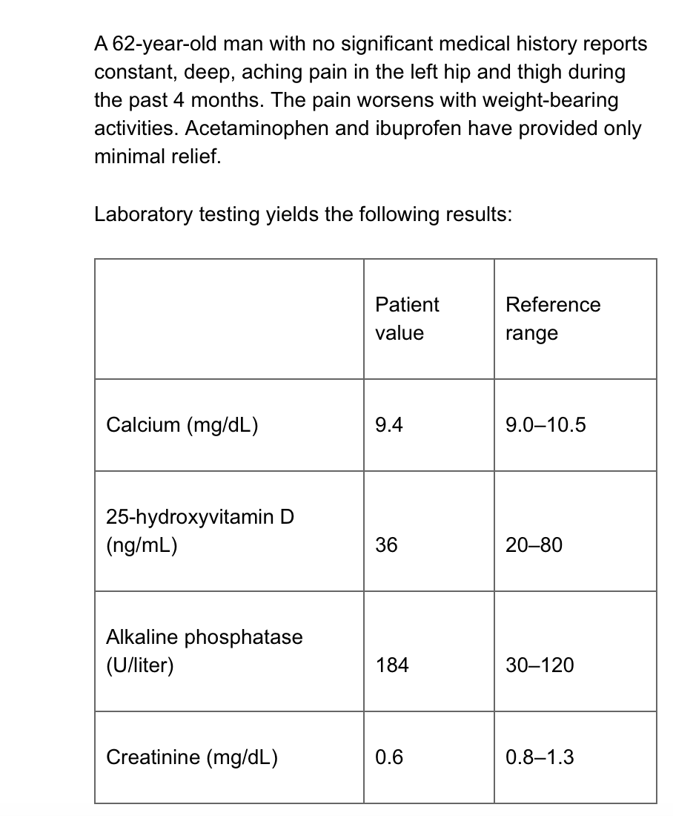

Slide 7
Your answer is correct.
Prednisone
Etidronate
Zoledronic acid
Naproxen
Calcitonin

Slide 8
The first-line therapy for symptomatic Paget disease of bone is a high-potency intravenous bisphosphonate.
Detailed Feedback
An elevated serum level of alkaline phosphatase; radiographic evidence of cortical thickening, coarsening of the trabeculae, and lytic lesions; and increased uptake on bone scintigraphy are key findings of Paget disease of bone. Although the diagnosis can usually be made on the basis of plain radiography and an elevated alkaline phosphate level, a bone scan is indicated at diagnosis to determine the extent of disease. Treatment should be initiated for symptomatic patients who have an elevated serum alkaline phosphatase level.
The symptoms of Paget disease that indicate treatment include the presence of bone pain, fracture, osteolytic lesions, bony deformities, involvement of weight-bearing bones, compression of spinal cord and nerve roots, bone compression of the eighth cranial or optic nerve, and radiculopathy. Treatment is also indicated when surgical intervention on an affected bone is anticipated.
High-potency, long-acting, intravenous bisphosphonates, such as zoledronic acid, are effective for lowering the alkaline phosphatase level and improving quality of life in patients with Paget disease. Although etidronate, a non–nitrogen-containing bisphosphonate, is approved for the treatment of Paget disease of bone, it is much less effective than nitrogen-containing bisphosphonates, such as zoledronic acid, and is therefore not the best choice for first-line treatment. It is generally reserved for second-line treatment in patients who are intolerant of nitrogen-containing bisphosphonates. In addition, etidronate can cause impaired bone mineralization, which can lead to increased fracture risk; it is therefore contraindicated in patients who have lytic lesions in weight-bearing bones.
Calcitonin does not effectively change the disease process in Paget disease.
Although naproxen and prednisone might reduce pain, they have no effect on the disease process and are not indicated for treating symptomatic Paget disease.

Slide 10
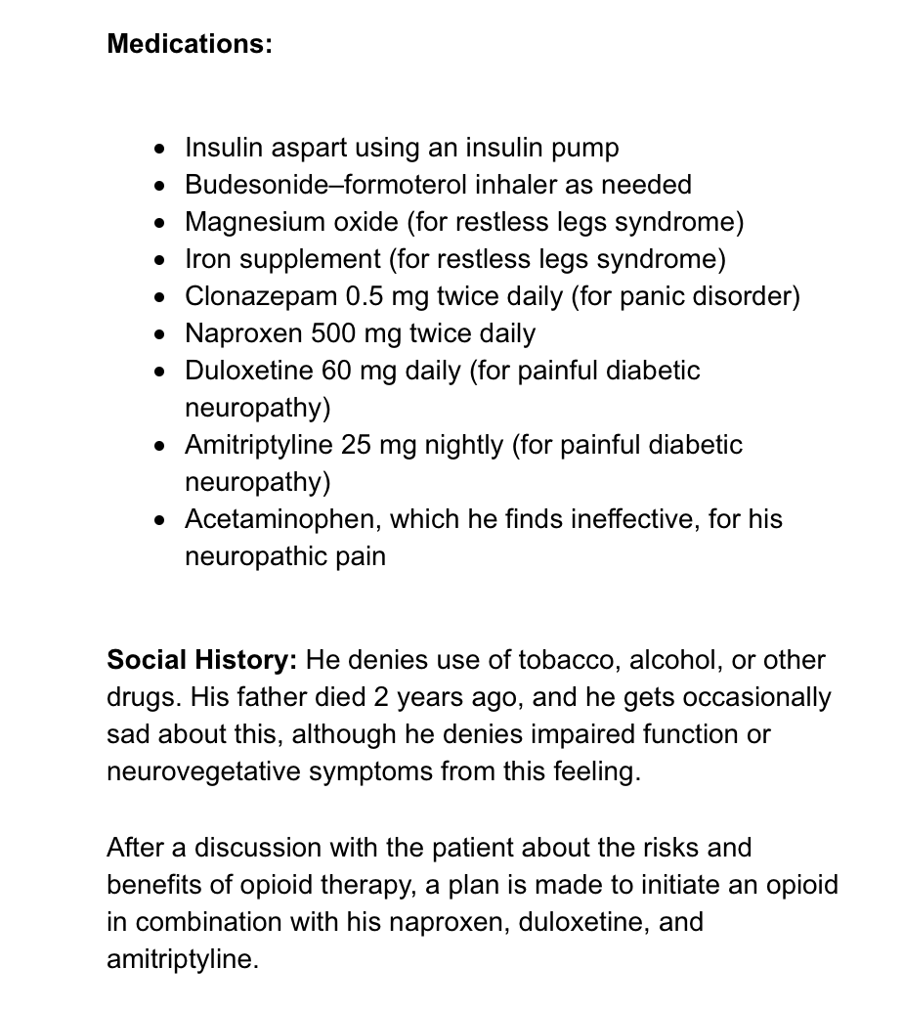

Slide 16
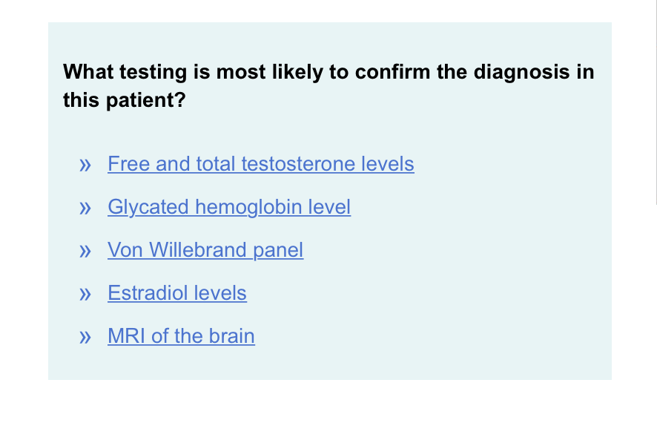

Slide 17
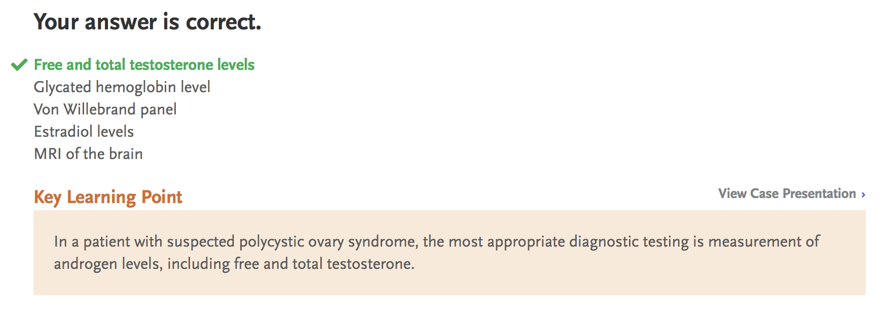

Slide 18
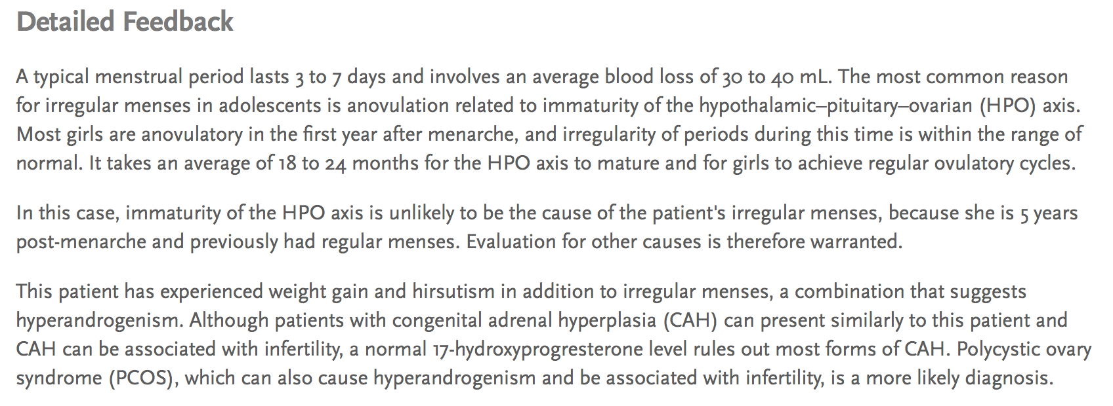

Slide 20
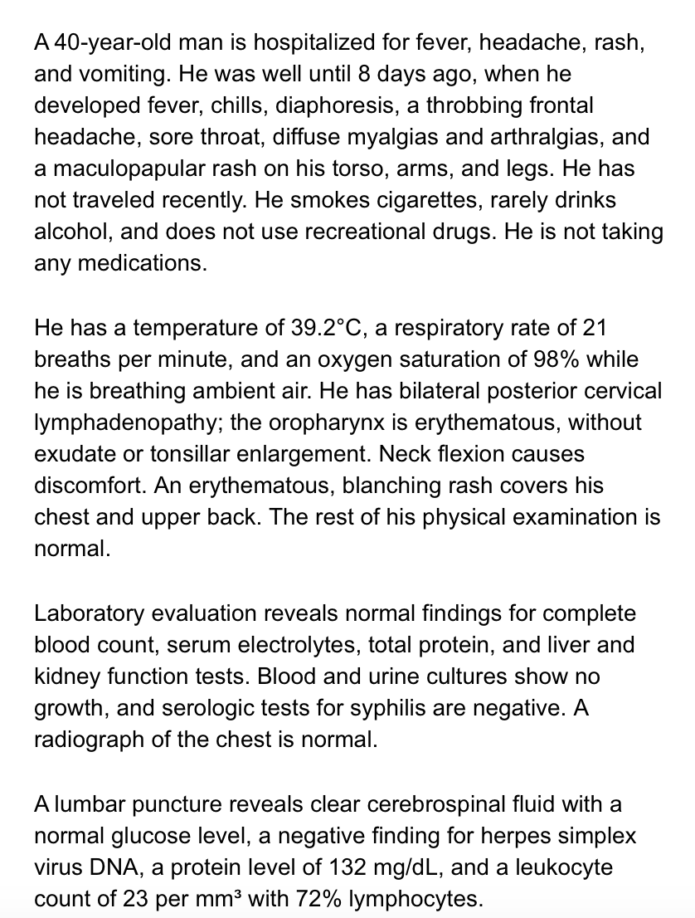

Slide 21
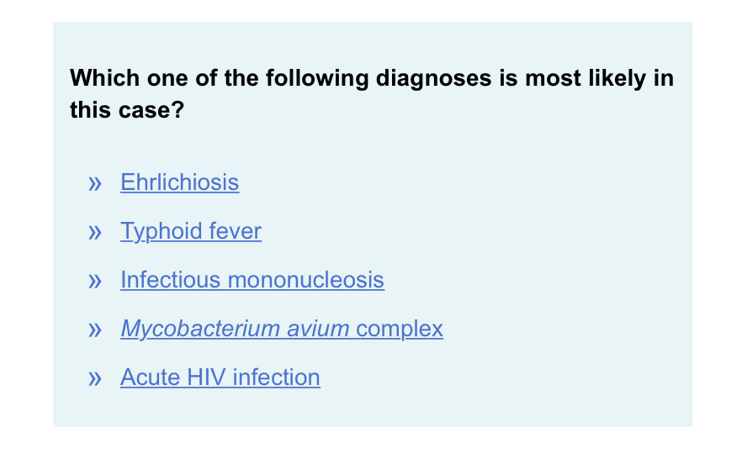

Slide 23
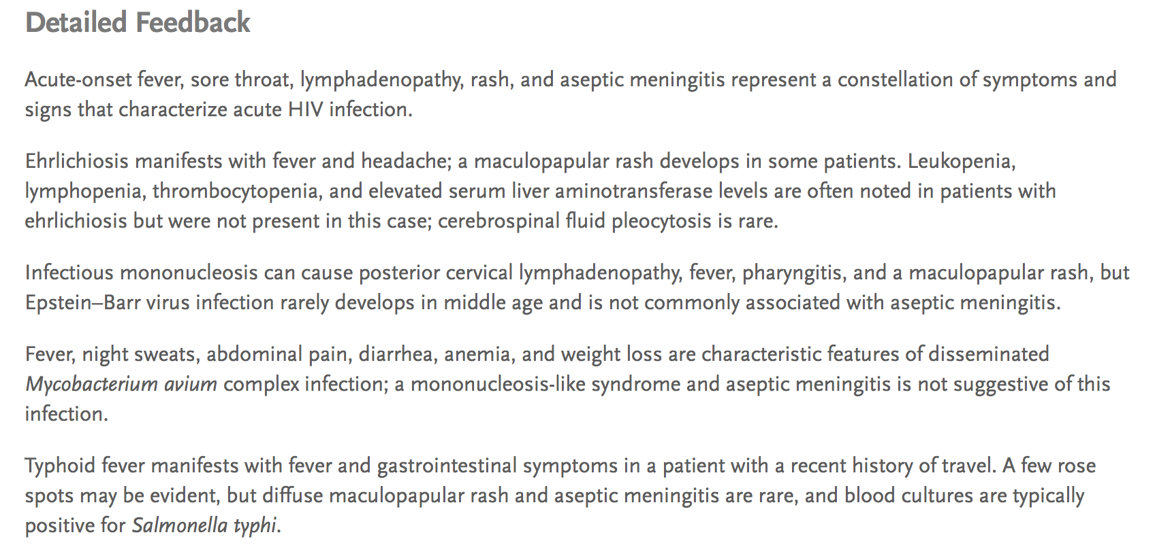

Slide 30
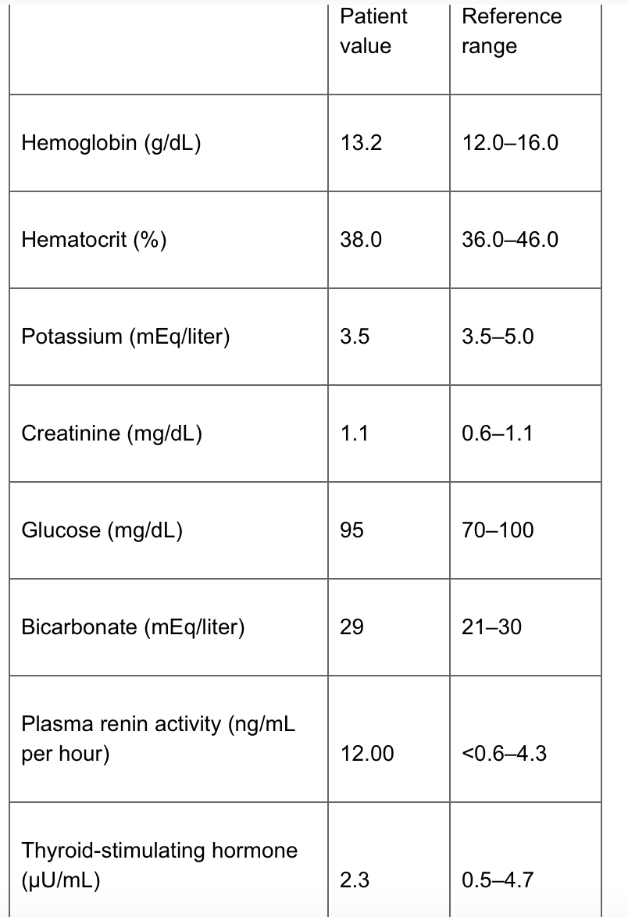

Slide 31
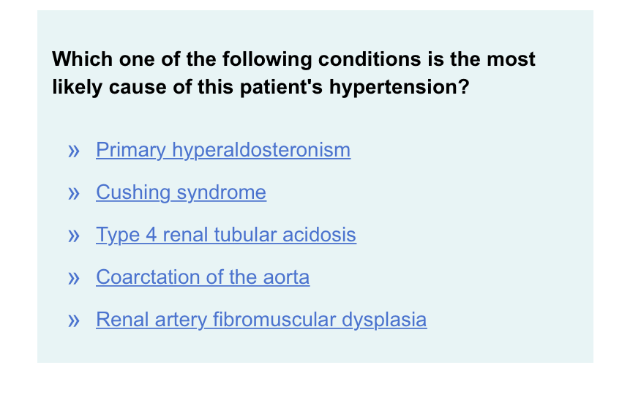

Slide 32
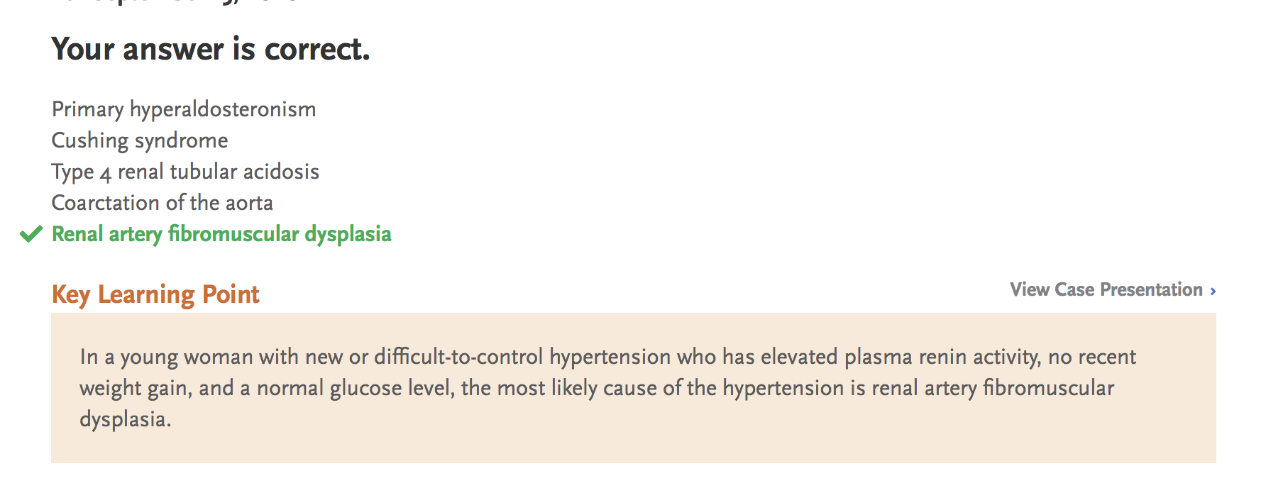

Slide 34
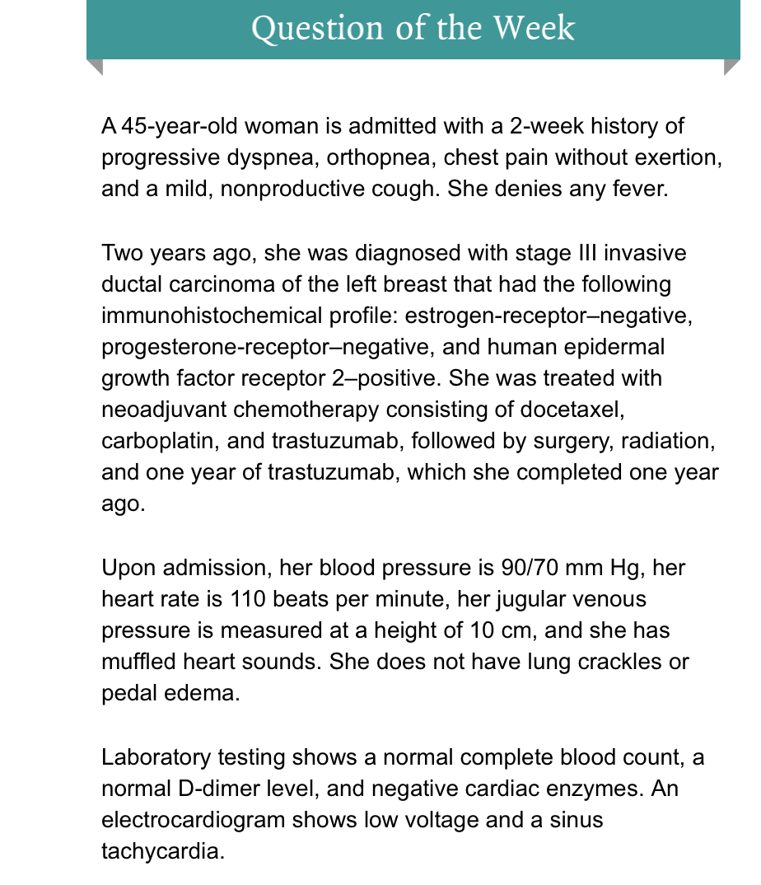

Slide 35
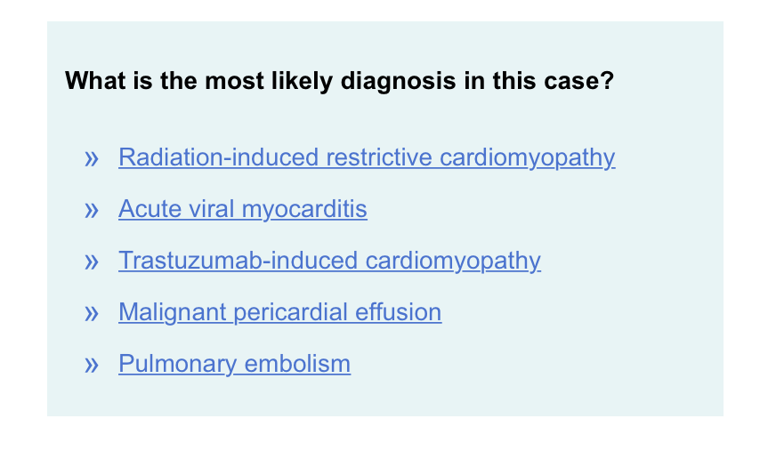

Slide 36
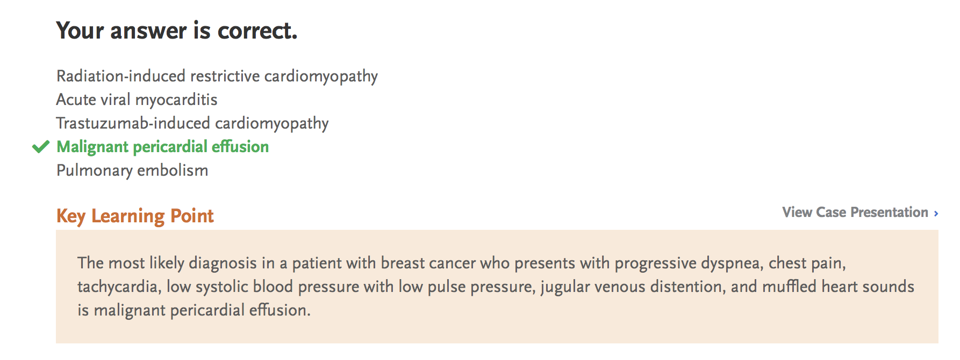

Slide 37
