Slide 1
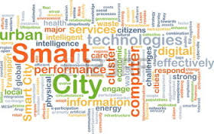
ΠΑΝΕΠΙΣΤΗΜΙΟ ΠΑΤΡΩΝ ΤΜΗΜΑ ΠΟΛΙΤΙΚΩΝ ΜΗΧΑΝΙΚΩΝ ΜΑΘΗΜΑ: ΕΥΦΥΕΙΣ ΠΟΛΕΙΣ, ΥΠΟΔΟΜΕΣ ΚΑΙ ΜΕΤΑΦΟΡΕΣ Ακαδημαϊκό έτος 2015-2016 10^{ο} Εξάμηνο
ΑΣΤΙΚΑ ΕYΦΥΗ ΣΥΣΤΗΜΑΤΑ ΜΕΤΑΦΟΡΩΝ –
CASE STUDY:TORINO SMART MOBILITY

Slide 2
Local Agency-5T Traffic Operations Centre
Traffic Operations Centre: real-time monitoring and supervision of traffic on over 34,000 kilometers of roads by using traffic sensors, info panels and traffic cameras
The main functions of the regional TOC consist of:
-Monitoring traffic in real-time
-Measurements of flow and speed made by 56 fixed stations for detecting traffic flows
-Monitoring the transport of dangerous goods by means of 6 gates
-Forecasts on traffic conditions in 1 hour

Slide 3
Local Agency-5T Traffic Operations Centre
The data are collected from:
the fixed stations and
through the Floating Car Data (data from fleets of private vehicles in motion)
The data are integrated and processed with traffic events (weather conditions, construction sites, strikes, e.tc.), with the objective of:
monitoring traffic in real time
and providing information to travelers through the traffic information service

Slide 4
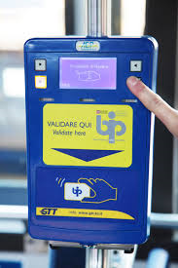
Local Agency-5T BIP
Piedmont Integrated Ticket (BIP): electronic ticketing system that allows access to any means of public transport (suitably equipped) using a contactless smart card
The BIP replaces the traditional annual pass or paper ticket
Possible to load onto the smart card all the travel documents of the services and the means or the transport company used, and to have access to the services of bike-sharing and car-sharing or to pay for parking.

Slide 5
Local Agency-5T Travel Planner
Torino travel planner service: help travelers to calculate the best way to move by public transport or private car.
Provides information about public transport services operating at the urban and extraurban level
For private car users, the service considers data regarding traffic conditions and events provided by monitoring and control systems.
The service is available on www.gtt.to.it, www.5t.torino.it and by GTT Mobile application for smartphones
Total average of about 400,000 accesses per month.

Slide 6
Local Agency-5T Travel Planner

Slide 7
Local Agency-5T B.U.NE.T
B.U.NE.T-(Bike's Urban Network): Supporting cycling mobility
Citizens plan their trips, both by using their own bikes and bike sharing service(TOBIKE sharing service)
System calculations mainly based on 3 parameters:
Security: the journey planner prefers cycle lanes and low traffic areas for a bike-friendly trip
Faster trip: the journey planner tries to reduce the travel time
Altimetry: the journey planner prefers flat path

Slide 8
Local Agency-5T B.U.NE.T
(http://www.bunet.torino.it/otp-rest-servlet/)

Slide 9
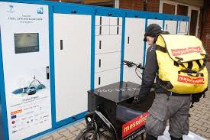
Last Mile Logistics-City Log
Experimentation of EU’s City Log mobility project (sustainability and efficiency of urban delivery goods)
Project (called the Bentobox) is based on the concept of ‘smart packaging’
Deliveries of goods are made out-of-hours to drop-off points
Customers can pick them up or where cleaner ‘last mile’ vehicles such as cargo bikes can deliver them to final destination

Slide 10
Last Mile Logistics-City Log
The purpose of Bentobox project is to:
Limit the number of trucks in downtown during rush hour and participate in decongesting the city
Provide flexibility for recipients who can collect their packages when they like
Contribute to a better logistics organization of malls and decongest delivery areas

Slide 11
Electrical Vehicles-Smart CEM
Smart-CEM (Smart Connected Electro Mobility-EU project) proposes ICT to:
Facilitate vehicle-sharing, public transportation or freight distribution
Optimize the performance of EVs,
Increase public awareness and acceptance, and enhance the confidence of end users towards a new form of mobility: electro-mobility

