Slide 1
A New Meniscus Injury Diagnostic Model Using Fuzzy Cognitive Maps
MED'16: The 24th Mediterranean Conference on Control and Automation
Athens, Greece
June 21-24, 2016
PhD Candidate Antigoni P. Anninou
Laboratory for Automation and Robotics
Department of Electrical and Computer Engineering
University of Patras

Slide 2
Authors
Anninou P. Antigoni, Ph.D Candidate, Laboratory of Automation and Robotics, Department of Electrical and Computer Engineering, University of Patras
Poulios Panagiotis, Orthopaedic Clinic, Department of Medicine, University of Patras,Greece
Groumpos P. Peter, Professor, Laboratory of Automation and Robotics, Department of Electrical and Computer Engineering, University of Patras
Gkliatis Ioannis, Assistant Professor, Orthopaedic Clinic, Department of Medicine, University of Patras, Greece

Slide 3
Acknowledgements
Elpiniki I. Papageorgiou
E.I. Papageorgiou, & P.P. Groumpos, “Optimization of Fuzzy Cognitive Map model in Clinical Radiotherapy Through the Differential Evolution Algorithm”,Biomedical Soft Computing and Human Sciences, Vol. 9, No. 2, 2004, pp. 25-31
Chrysostomos D. Stylios
Stylios, Chrysostomos D., and Petros P. Groumpos. "Modeling complex systems using fuzzy cognitive maps." IEEE Transactions on Systems, Man, and Cybernetics-Part A: Systems and Humans 34.1 (2004): 155-162
George Georgoulas
Papageorgiou, E., Georgoulas, G., Stylios, C., Nikiforidis, G., & Groumpos, P. (2006, October). Combining fuzzy cognitive maps with support vector machines for bladder tumor grading. In International Conference on Knowledge-Based and Intelligent Information and Engineering Systems (pp. 515-523). Springer Berlin Heidelberg

Slide 4
Layout
Aim
Meniscus Injury-Diagnostic Procedure
Diagnostic Model Construction Using Fuzzy Cognitive Maps
Case Studies
Discussion of the Results
Conclusions
Future Research

Slide 5
Aim
Create an integrated meniscus injury diagnostic model, which by exploiting information about patient history and clinical examination made by physicians concludes to a final diagnosis using Fuzzy Cognitive Maps

Slide 6
Meniscal Tears
One of the most common knee disorders
Evaluation Method
MRI
Advantage:
Accurate Results
Disadvantages:
Expensive Diagnostic Tool
Significant amount of false positive results regarding medial meniscus pathology
Cornerstones of Diagnosis
Detailed history
Physical Examination
Disadvantage:
Ambiguous outputs

Slide 7
Solution
Need for a different perspective
Proposal: The advanced modelling methodology of Fuzzy Cognitive Maps

Slide 8
Fuzzy Cognitive Maps (FCM)
Modeling method for describing particular domains
Fyzzy-graph structures for representing causal reasoning

Slide 9
Fuzzy Cognitive Maps
Nodes: Represent the system’s concepts or variables
Arrows: Interconnection between nodes. Show the cause-effect relationship between them.
W: Weight between two nodes:
W>0 positive causality
W<0 negative causality
W=0 no relationship

Slide 10
Fuzzy Cognitive Maps
The value of each concept at every simulation step is calculated, computing the influence of the interconnected concepts to the specific concept, by applying the following calculation rule:

Slide 11
Fuzzy Cognitive Maps
Ai^{(k+1)} : the value of the concept C_{i} at the iteration step k+1
Ai^{(k)}: the value of the concept C_{j} at the iteration step k
Wij : the weight of interconnection from concept Ci to concept Cj
k1: the influence of the interconnected concepts in the configuration of the new value of the concept A_{i}
k2: the proportion of the contribution of the previous value of the concept in the computation of the new value
f : the sigmoid function

Slide 12
Competitive Fuzzy Cognitive Maps (CFCM)
The output nodes of a FCM used in decision-making, in many cases, must "compete" against each other in order for only one of them to dominate and be considered the correct decision
In order to achieve this "competition", the interaction of each of these nodes with the others should have a very high negative weight. This implies that the higher the value of a given node, the lower the value of competing nodes

Slide 13
Diagnostic Procedure and Methods
Patients with knee injury initially arrived at the Accident and Emergency Department or general practitioner
Were referred to either the next available trauma clinic or the next available weekly specialist knee clinic
Complete a copy of Tegner Lysholm Knee Scoring Scale and a Knee Injury and Osteoarthritis Outcome Score (KOOS)
History and physical examination

Slide 14
Physical Examination Results
Extracted and translated in Fuzzy Control Language
Convert natural language into fuzzy sets
Fuzzy sets yield other fuzzy propositions
Converting the final fuzzy sets into statements in natural
language with deffuzification method

Slide 15
Symptoms Checklist

Slide 16
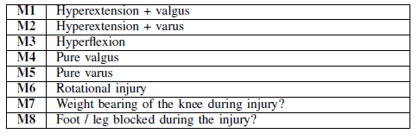
Possible Mechanisms of Injury
Possible Mechanisms of Injury
Clinical Examination Results (Tests)

Slide 17
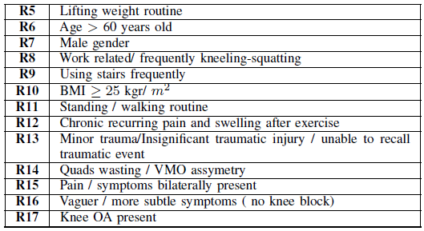
Risk Factors
Acute Meniscal Tears
Degenerative Meniscal Tears

Slide 18
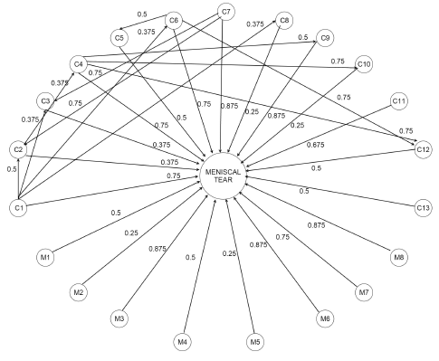
Diagnostic Procedure-First Level
Collect Mechanisms of Injury and Symptoms
Construct FCM Model according to experts
Output: FCM Equation
Transform to fuzzy variable (low, medium, high)

Slide 19
Diagnostic Procedure-First Level
Test Results
Fuzzy Rules:
IF Meniscal Tear is LOW THEN the patient does not suffer from meniscal tear regardless test results
IF Meniscal Tear is Medium AND one or more tests from the list: T1, T2, T3, T4, T5, T6 are positive THEN the patient suffers from meniscal tear
IF Meniscal Tear is Medium AND only test T7 is positive THEN the patient does not suffer from meniscal tear
IF Meniscal Tear is High THEN the patient suffers from meniscal tear regardless test results
OUTPUT: Meniscal Tear on not

Slide 20
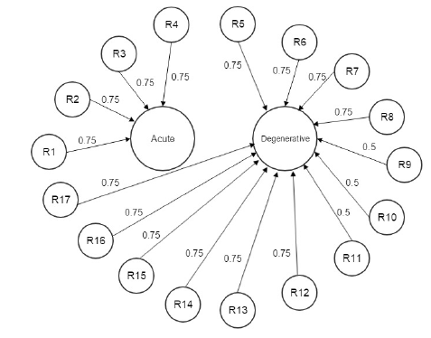
Diagnostic Procedure-Second Level
Collect Risk Factors
Construct CFCM
Inputs: Risk Factors
Outputs:
Acute Injury
Degenerative Injury
Negative High weights between outputs (-1)
Positive high weight to acute injury when risk factors R12 to R17 do not exist
Output: Highest Value

Slide 21
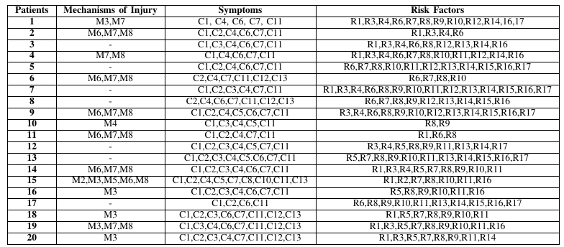
Case Studies
Data collected by 20 Patients

Slide 22
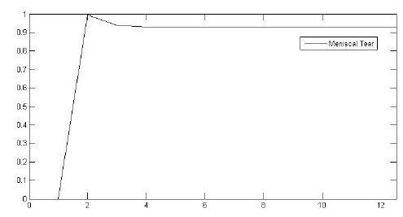
1st Patient-1st Level
Mechanisms: M3, M7
Symptoms: C1, C4, C6, C7, C11
First level Output
Fuzzy Variable “HIGH”
Meniscal Tear regardless test results

Slide 23
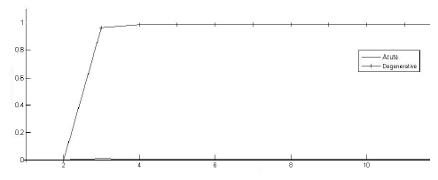
1st Patient-2nd Level
Risk Factors: R1, R4, R5, R6, R7, R8, R10, R11
Second Level CFCM Output
Degenerative Injury

Slide 24
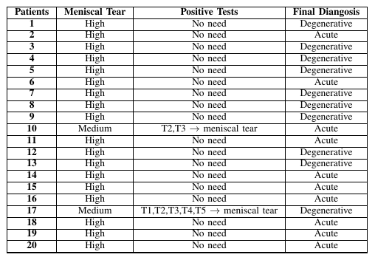
Overall Results

Slide 25
Discussion of Results
The whole procedure from the time that damage happened to patient to the point that final diagnosis must be decided, is being simulated
All patients suffered from meniscal tears
In only two cases we had to check the examination results according to fuzzy rules
Weights decision is crucial
Competitive FCM lead to one final diagnosis
Simulation results from real patients
MRI results evaluate the decision
Physicians found them very satisfactory

Slide 26
Conclusions
Accurate tool
Detection of meniscal tear
Distinguishing between acute and degenerative injury
Good feedback from patients
Exploitation of experts knowledge and experience
Method
Fast
Simple
Cost effective

Slide 27
Future Research
More patients and clinical data
Model evaluation
Learning algorithms
Real time clinical use
User friendly software tool

Slide 28
Thank you for your attention
Antigoni P. Anninou
Email: anninou@ece.upatras.gr

