Slide 1
MapReduce Examples

Slide 2
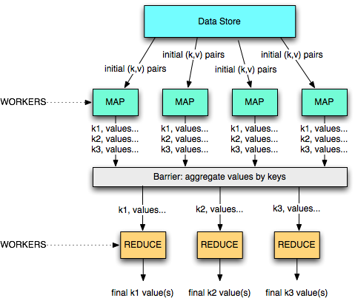
A divide and conquer approach

Slide 3
Example 1: word count
(d1, ‘A B D’)
(A, 2)
(A, 2)
(d2, ‘A B C D’)
(B, 3)
(B, 3)
(d3, ‘ B C D’)
(C, 2)
(A, 3)
(D, 3)
(B, 4)
(A, 3)
(A, 8)
(B, 3)
(B, 10)
(d4, ‘A B C’)
(A, 3)
(d5, ‘A C D’)
(B, 4)
(d6, ‘A D B B’)
(C, 2)
(d7, ‘D B A’)
(D, 3)
(C, 2)
(C, 8)
(D, 3)
(D, 7)
(d8, ‘B B C’)
(A, 3)
(C, 2)
(d9, ‘A A C C’)
(B, 3)
(D, 3)
(d10, ‘ B A D C’)
(C, 4)
(C, 4)
(D, 1)
(D, 1)
M=3
mappers
R=2 reducers

Slide 4
Example 2: URL access frequency
Input: log of web page requests (after a query)
Output: how many times each URL is accessed
Variant: what are the top-k most-accessed URLs?
Map function
Parse the log, output a <URL, 1> pair for each access
Reduce function
For each key URL, a list of n “1” is associated (i.e., added)
Emit a final pair <URL, n>

Slide 5
Example 3: Reverse Web-link graph
Get all the links pointing to some page
This is the basis for the PageRank algorithm!
Map function
output a <target,source> pair for each link to target URL in a page named source
Reduce function
Concatenate the list of all source URLs associated with a given target URL and emits the pair: <target,list(sources)>

Slide 6
Example 4: Inverted index
Get all documents containing some particular keyword
Used by the search mechanisms of Google, Yahoo!, etc.
Second input for PageRank
Map function
Parse each document and emit a set of pairs <word, documentID>
Reduce function
Take all pairs for a given word
Sort the document IDs
Emit a final <word,list(document IDs)> pair

Slide 7
Example 4: Inverted index
To be, or not to be
To be is to do
map
map
<to,a>,<be,a>,<or,a>,
<not,a>,<to,a>,<be,a>
<to,b>,<be,b>,<is,b>,
<to,b>,<do,b>
<be,<a,a,b>>,<do,<b>>,<is,<b>>
<not,<a>>,<or,<a>>,
<to,<a,a,b,b>>
reduce
reduce
<be,<a,b>>,<do,<b>>,<is,<b>>,<not,<a>>,<or,<a>>,<to,<a,b>>

Slide 8
Hadoop

Slide 9
Hadoop
Hadoop is the most known open-source MapReduce implementation
Lots of contributions by Yahoo!, now an Apache foundation project
Written in Java
Uses the HDFS file system (amongst others)
Many extensions and optimizations over the original Google paper
A MapReduce implementation of choice when using Amazon’s cloud services
EC2: rent computing power and temporary space
S3: rent long term storage space

Slide 10
HDFS – Hadoop Distrib. File System
A distributed, scalable file system for M-R applications
Distributed: Runs in a cluster
Scalable: 10K nodes, 100M files, 10PB storage
Closed-source optimizations
HDFS provides a single file system view to the whole cluster
Files are split up in blocks
Typically 128MB
Each block is replicated on multiple DataNodes (typically 3)
Block placement is rack-aware

Slide 11
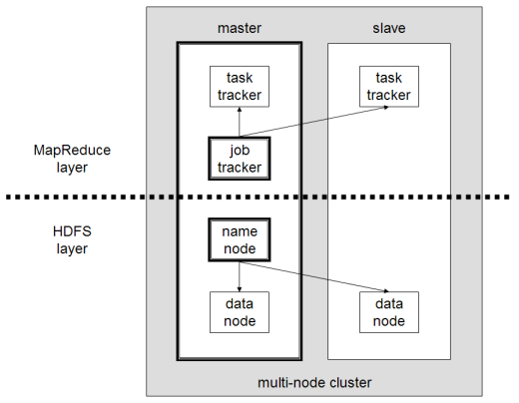
HDFS/MapReduce Architecture
Master/Slave Architecure
HDFS
A centralized NameNode controls multiple DataNodes
NameNode: keeps track of which DataNode stores which block
DataNodes: “dumb” servers storing raw file chunks
MapReduce
A centralized JobTracker controls multiple TaskTrackers
Placement
NameNode and JobTracker run on the master
DataNode and TaskTracker run on workers
Data locality is exploited

Slide 12
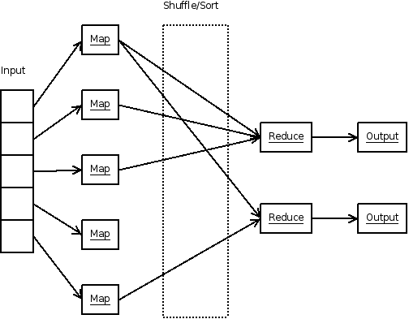
MapReduce

Slide 13
Hadoop: big picture
0. Allocate Hadoop cluster
1. Scp data to cluster
2. Move data into HDFS
EC2
3. Develop code locally
4. Submit MapReduce job
4a. Go back to Step 3
You
Your Hadoop Cluster
5. Move data out of HDFS
6. Scp data from cluster
7. Clean up!
Uh oh. Where did the data go?
courtesy of Prof. Lin, university of Maryland, CC-BY-NC-SA (USA)

Slide 14
On Amazon: EC2 and S3
Copy from S3 to HDFS
EC2 (The Cloud)
S3 (Persistent Store)
Your Hadoop Cluster
Copy from HFDS to S3

Slide 15
Hadoop Usecases

Slide 16
Use cases 1/3
NY Times
Large Scale Image Conversions
100 Amazon EC2 Instances, 4TB raw TIFF data
11 Million PDF in 24 hours and 240$
Facebook
Internal log processing
Reporting, analytics and machine learning
Cluster of 1110 machines, 8800 cores and 12PB raw storage
Open source contributors (Hive)
Twitter
Store and process tweets, logs, etc
Open source contributors (Hadoop-lzo)

Slide 17
Use cases 2/3
Yahoo
100.000 CPUs in 25.000 computers
Content/Ads Optimization, Search index
Machine learning (e.g. spam filtering)
Open source contributors (Pig)
Microsoft
Natural language search (through Powerset)
400 nodes in EC2, storage in S3
Open source contributors (!) to HBase
Amazon
ElasticMapReduce service
On demand elastic Hadoop clusters for the Cloud

Slide 18
Use cases 3/3
AOL
ETL processing, statistics generation
Advanced algorithms for behavioral analysis and targeting
LinkedIn
Used for discovering People you May Know, and for other apps
3x30 node cluster, 16GB RAM and 8TB storage
Baidu
Leading Chinese language search engine
Search log analysis, data mining
300TB per week
10 to 500 node clusters

Slide 19
Conclusion

