Slide 1
Channels of Monetary Policy Transmission

Slide 2
Discusses the transmission mechanism of monetary policy, i.e. how changes in the central bank policy rate are transmitted through the economy, affecting aggregate demand, inflation expectations and the rate of inflation
The reason that central banks can affect interest rate formation in the economy is that they have monopoly power in supplying money in the economy, i.e. base money which comprises notes and coin in circulation and the reserves of financial institutions in the central banks
Central bank interest rate decisions affect short and long-term interest rates, liquidity in the financial system, the quantity of money and bank credit, exchange rates, other asset prices and, last but not least, market expectations about the future development of all these variables
All these, in turn, influence consumption and investment decisions of individuals and firms, and thereby aggregate demand and, ultimately, inflation

Slide 3
The Channels of Monetary Policy Transmission
Four channels of transmission of monetary policy have been identified in modern financial systems:
The Interest Rate Channel, through the direct interest rate effects; which affect not only the cost of credit but also the cash flows of debtors and creditors
The Asset Price Channel through the impact of monetary policy on domestic asset prices; such as bond, stock market and real estate prices
The Exchange Rate Channel (will not be discussed)
The Credit Channel; which includes the Bank Lending Channel and the Balance Sheet Channel

Slide 4
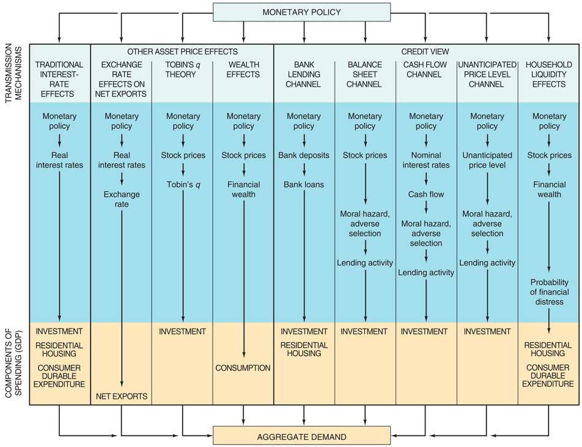
The Link Between Monetary Policy and Aggregate Demand: Monetary Transmission Mechanisms

Slide 5
The Interest Rate Channel

Slide 6
Direct interest rate effects: cost of credit
In the most conventional model of monetary transmission, a shift in policy leads to a change in the money supply that, for a given money demand, leads to a change in money-market interest rates
Changes in policy and interbank rates lead, in turn, to changes in bank loan rates for borrowers, which may affect investment decisions, and in deposit rates, which may affect the choice between consuming now and later
A key issue in this channel of transmission is the extent to which a policy-induced change in the interest rate most directly under the central bank’s control (usually an over night interbank rate) affects all short-term money market interest rates, and in turn spreads to the entire spectrum of interest rates
In particular the long-term interest rates most relevant to investment (including housing) or to purchases of durable goods

Slide 7
The present value of durable goods is inversely related to the real interest rate. A lower rate of interest increases the present value of such goods and thus increases demand. In this framework, interest-rate-sensitive spending is affected by changes in the marginal cost of borrowing
Changes in interest rates also lead to changes in average rates on outstanding contracts, and these changes increase over time as old contracts come up for renegotiation. Similarly, marginal adjustments in deposit rates will over time change the average deposit rate
These changes in average interest rates will affect the income and cash flow of borrowers and lenders

Slide 8
Monetary Transmission Mechanisms
Traditional Interest-Rate Channels: M ↑, i_{r} ↓, I ↑, Y ↑
The interest rate channel of monetary transmission applies equally to C
Also, it places emphasis on i_{r} rather than i
Moreover, it is the long-term i_{r} and not the short-term i_{r} that is viewed as having the major impact on C and I spending
With sticky P, an ↑ in M leads to a ↓ in short term i and also ↓ short term i_{r}.
According to the expectations hypothesis of the term structure of interest rates, this also ↓ long-term i_{r}.
The ↓ in short and long-term i_{r} leads to an ↑ in C and I spending
Note: The interest rate transmission mechanism is effective even when i has already been driven to zero by the MA during a deflationary period. With i = 0,
M ↑, P^{e} ↑, π^{e} ↑, i_{r} ↓, C and I ↑, Y ↑

Slide 9
Asset prices channel

Slide 10
Indirect effects of interest rates via other asset prices
Policy-induced interest rate changes also affect the level of asset prices, principally those of bonds, equities and real estate
Another means by which asset price changes triggered by monetary policy actions can affect aggregate demand is described by the so-called Tobin’s q
With an tighter monetary policy stance, equity prices may fall, lowering the market price of firms relative to the replacement cost of their capital
This will increase the effective cost of capital, as newly issued equity can command a lower price relative to the cost of real plant and equipment
A decline in asset prices may have particularly strong effects on spending when the resultant change in debt-to-asset ratios prevents households and firms from meeting debt repayment obligations

Slide 11
it can have similar effects if it raises fears about the ability to service debts in the future. A substantial fall in stock and bond prices for instance, may reduce the value of liquid assets available to repay loans
As households and firms thus become more vulnerable to financial distress, they may attempt to rebuild their balance-sheet positions by cutting spending and borrowing
The effects of monetary policy actions on aggregate demand, working through asset prices and balance sheets, may become amplified as the pace of economic activity begins to respond
For example, increases in interest rates that depress asset prices and weaken balance sheets may lead to an initial decline in output and income
This initial decline in economic activity , in turn, reduces the cash flow of households and firms, further heightening their vulnerability to financial distress, and leading to a second round of expenditure reduction

Slide 12
Other Asset Channels
Tobin’s q Channel:
where MVF = market value of firms and RCC = replacement cost of capital.
If q is high, MFV is high relative to RCC, and new plant and equipment capital is cheap relative to the market value of firms
In this case, companies can issue stock and get a high price for it relative to the cost of the facilities and equipment they are buying
I ↑ because firms can buy a lot of new investment goods with only a small issue of stock
The transmission mechanism for monetary policy is
M ↑, P_{e} ↑, q ↑, I ↑, Y ↑
where P_{e} is the price of equity (not the expected price level)

Slide 13
Other Asset Channels
Wealth Channel:
introduced by Franco Modigliani in his famous “life cycle hypothesis of consumption”, arguing that the most important transmission mechanism of monetary policy involves consumption
Considering that an expansionary monetary policy ↑ stock prices, the wealth transmission mechanism works as follows:
M ↑, P_{e} ↑, W ↑, C ↑, Y ↑
Note: Tobin’s q and wealth mechanisms allow for a general definition of equity that includes housing and land. For example, an ↑ in house prices, which ↑ their value relative to replacement cost, ↑ Tobin’s q for housing, thereby stimulating its production. Also, an ↑ in housing and land prices ↑ W, thereby ↑ C and Y.

Slide 14
The Credit Channel

Slide 15
Credit View
Dissatisfaction with the conventional stories that interest-rate effects explain the impact of monetary policy on expenditures on durable assets has led to a new explanation based on the problem of asymmetric information in financial markets that leads to financial frictions
Adverse selection is an asymmetric information problem that occurs before the transaction occurs: potential bad credit risks are the ones who most actively seek out loans
Moral hazard arises after the transaction occurs: the lender runs the risk that the borrower will engage in activities that are undesirable form the lender’s point of view
This explanation, referred to as the credit view, proposes that two types of monetary transmission channels arise as a result of financial frictions in credit markets: those that operate through effects on bank lending and those that operate through effects on firms’ and households’ balance sheets
Bank Lending Channel: based on the analysis demonstrating that banks play a special role in the financial system because they are especially well suited to solve asymmetric information problems in credit markets
Balance Sheet Channel: like the bank lending channel, the balance sheet channel arises from the presence of financial frictions in credit markets
Cash Flow Channel: another balance sheet channel operates by affecting cash flow, the difference between cash receipts and cash expenditures

Slide 16
The credit channel
the bank lending channel (or net worth) emphasizes the special role of bank loans, particularly for “bank-dependent” borrowers (e.g. small firms), while the balance-sheet channel operates through the balance-sheet positions of business firms
the credit channel is not really an independent alternative to the traditional interest rate mechanism but rather an amplifying mechanism.

Slide 17
The Balance Sheet Channel

Slide 18
The Balance Sheet Channel
Define the External Finance Premium (EFP) as the wedge (difference) between the corporation’s or household’s cost of funds raised externally (by imperfectly collateralising borrowing, for example) and the opportunity cost of internal funds
This premium is very similar to the spread charged by banks between borrowing and lending rates and it is an important determinant of investment and spending decisions
It has been recognized in the literature that monetary policy affects not only the interest rate but also the EFP
Based on the theoretical prediction that the EFP a borrower faces should depend on borrower’s financial position, then the greater is the borrower’s net worth, the lower the external finance premium should be
Since borrower’s financial position affect the EFP, and thus the overall terms of credit that they face, fluctuations in the quality of borrowers balance sheets should affect their investment decisions

Slide 19
The balance-sheet channel of monetary policy transmission arises because rising interest rates, following the adoption of a tighter monetary policy, directly increase the interest expenses of those non-financial firms
Higher for those who rely more heavily on short-term debt to finance inventories and working capital, reducing their net cash flows and weakening their financial positions
Furthermore, rising interest rates are also associated with falling asset prices, which indirectly erode the value of the firms’ collateral
These effects lead to a reduction in the firms’ net worth, thereby raising the premium for external finance
Small borrowers such as small firms are most likely to face a proportionately larger premium for external finance

Slide 20
the balance-sheet channel
With a rise in the policy rate, the net worth of individuals diminishes since their balance sheets have deteriorated
Such circumstances exacerbate the problems of adverse selection and moral hazard
By reducing the banking system’s willingness to lend, this reduces individuals’ spending ability
In general lending ability within the banking system also diminishes, since the interest rate rise has the same effect on its net worth and access to new credit. Monetary policy can also affect individuals’ willingness to borrow through a liquidity channel, because a rise in interest rates can increase the probability of financial distress later on

Slide 21
Balance Sheet Channel:
The lower the net worth (NW) of firms (and therefore the lower the collateral that they have for their loans), the more severe the adverse selection and moral hazard problems in lending to these firms
In fact, a ↓ in NW, ↑ the adverse selection and moral hazard problems and leads to a ↓ in lending and hence in I
Monetary policy can affect firms’ balance sheets in several ways. For example, expansionary monetary policy, ↑ P_{e} (along lines discussed earlier) and ↑ the NW of firms and so leads to an ↑ in I and Y.
The monetary policy transmission is:
M ↑, P_{e} ↑, adverse selection ↓, moral hazard ↓, lending ↑, I ↑, Y ↑

Slide 22
Cash Flow Channel
This is another balance sheet channel operating through its effects on cash flow, the difference between cash receipts and cash expenditures
Expansionary monetary policy, ↓ i and raises cash flow.
The ↑ in cash flow causes an improvement in firms’ balance sheets, because it ↑ liquidity and makes it easier for lenders to know if the firm will be able to pay its obligations
This ↓ adverse selection and moral hazard problems, leading to an ↑ in lending
Hence, M ↑, i ↓, cash flow ↑, adverse selection ↓, moral hazard ↓, lending ↑, I ↑, Y ↑
Note: In this transmission mechanism it is the short-term i (not i_{r}) that affects cash flow. Hence, this interest rate mechanism is different from the traditional interest rate mechanism

Slide 23
The Bank Lending Channel

Slide 24
The Bank Lending Channel
Monetary policy may also affect the external finance premium by shifting the supply of bank credit
A reduction in the supply of bank credit, relative to other forms of credit, is likely to increase the external finance premium and to reduce real activity
For this channel to work it is sufficient that contractionary monetary policy increases bank’s cost of funds. An increase in the cost of funds would decrease the supply of funds
The main thrust of the bank lending channel rests on the idea that firms facing more severe informational frictions in financial markets, must rely primarily on bank loans for external finance because it is prohibitively expensive for these borrowers to issue securities in the open market

Slide 25
When bank loans are of special importance for bank-dependent firms, the effects of a monetary contraction may be amplified through the following two channels beyond those working through the interest rate channel:
the direct channel operates through the reduced willingness of banks to lend at the going market interest rates (this channel is direct because it does not depend on the extent to which market interest rates rise)
The indirect channel becomes operative when the increase in market interest rates following a monetary contraction raises loan rates enough both to cover the increase in lenders’ cost of funds as a result of the higher interest rates and to compensate them for the higher default risk.
Banks also tend to tighten other non-price terms of lending, such as collateral requirements and the maturity of loans
When either of these two bank lending channels operates, the banks are forced to reduce their total lending, and in most cases firms which rely primarily on banks for credit must curtail their spending on investment

Slide 26
Hence, in response to increases in the cost of credit, banks are likely both to raise loan interest rates and to tighten creditworthiness standards, leading to declines in the supply of credit along with increases in its price
Even borrowers whose creditworthiness has not been affected will face less favorable terms for their loans during periods of recession and at times of financial distress, because banks may be unable to distinguish fully between borrowers who have been adversely affected and those who have not
This phenomenon is called Credit Rationing and is likely to hit more financially opaque borrowers particularly hard because of the high cost of gathering information about them

Slide 27
Changes in the creditworthiness of bank customers and in the financial condition of banks themselves will induce changes in credit rationing only if the banks perceive themselves to be facing hard budget constraints
It has been argued that banking firms may be subject to the same sort of capital market imperfections as their non-financial counterparts
According to this view, if a bank lending channel is effective, a monetary contraction should have a disproportionately large impact on the lending behavior of smaller banks, which are more likely to experience difficulties offsetting a loss of reserves by expanding non-deposit sources of external finance
Consequently, such banks wish to cut loan supply by relatively more than do large banks

Slide 28
From the financial system to spending decisions

Slide 29
Firms
Firms relying on bank financing, or other types of credit funding linked to domestic short-term interest rate developments, are affected directly
Increased borrowing costs reduce their profit and raise the required return on all new investments
The willingness and ability to embark on new projects is therefore diminished, other things being equal
Likewise, higher interest rates increase firms’ inventory costs, which are often financed with short-term credit.
Higher interest rates also affect the demand for labour, by reducing their willingness to hire new staff. Firms might even reduce employment or hours worked
Monetary policy also affects the cost of capital through its temporary impact on long-term real interest rates. Thus a rise in the policy rate should also prompt a temporary rise in the required return on new projects, making it more likely for firms to postpone or simply abandon such plans

Slide 30
Another effect of monetary policy on firms’ spending decisions is through the asset price channel
As mentioned above, a rise in the policy rate usually leads to a fall in equity prices, causing the market value of firms to fall relative to the replacement cost of capital (a fall in the Tobin’s q)
Accordingly, it becomes relatively more expensive for firms to issue new equity to finance new investments
Firms experience a wealth effect, since higher interest rates reduce their net worth and their cash flow worsens, as well as lowering the price of assets which can be used as collateral
Adverse selection and moral hazard problems increase accordingly, making the banking system even less willing to lend
This applies particularly to more financial opaque firms, which lack easy access to other sources of financing outside the banking system

Slide 31
Households and individuals
Monetary policy has an effect on individuals’ behaviour through various channels
One of the most important effects of monetary policy is probably through disposable income. By influencing market interest rates, monetary policy affects the interest rate on savings, as well as on outstanding short-term liabilities (for example borrowing on credit cards and overdrafts)
A rise in the policy rate thus reduces disposable income of net debtors, which in turn affects their spending decisions
All things being equal, individuals’ consumption expenditure ought to contract when interest rates rise

Slide 32
Monetary policy also affects the timing of consumption decisions, since interest rates in effect represent the price of current consumption relative to that in the future
When interest rates rise, current consumption becomes more expensive compared to future consumption, i.e. current saving. Individuals should therefore reduce their current consumption by a corresponding amount
Monetary policy also affects individuals’ wealth. As discussed above, a rise in interest rates generally leads to a fall in stock and housing prices. Since these assets constitute an important part of individuals’ aggregate wealth, their consumption expenditure should decrease, since they are no longer as wealthy
Likewise, their access to credit becomes more difficult, because housing is often used as collateral for loans. Since the market prices of their assets has fallen, their borrowing capability decreases
Monetary policy affects consumption expenditure of individuals through their access to credit (especially for financing expenditure on consumer durables such as housing and motor vehicles)

Slide 33
Main references
Bernanke, B. S., and M. Gertler (1995), “Inside the black box: The credit channel of monetary policy transmission”, Journal of Economic Perspectives , 9, 27-48.
Kashyap, Anil K. and Jer y C. Stein (1995): “The impact of monetary policy on bank balance sheets”. Carnegie-Rochester Conference Series on Public Policy, 42, pp. 151–95.
Kashyap, Anil K., Jeremy C. Stein and David W. Wilcox (1993): “Monetary policy and credit conditions: evidence from the composition of external finance”. American Economic Review, 83(1), pp. 78–98.
Meltzer, A. H., (1995), “Monetary, credit and (other) transmission processes: A monetarist perspective”, Journal of Economic Perspectives, 9, 49-72
Mishkin, Frederic S. (1995): “Symposium on the monetary transmission mechanism”. Journal of Economic Perspectives, 9(4), pp. 3–10.

