Slide 1
Security systems in Greek health care institutions: A scoping Review towards an effective benchmarking approach
Savina Mariettou
Constantinos Koutsojannis
Vassilios Triantafillou

Slide 2
Table of contents
Risk Management Components
Vulnerabilities in Greek Public Hospitals
Challenges and Solutions
Solutions
Benefits of Proposed Solutions
Importance of Hospital Security Systems
Balance Between Security and Accessibility
Future Perspectives
Scientific and Developing Team
Abstract
Historical Development
Historical Review (1960s - 1970s)
Historical Review (1980s - 1990s)
Historical Review (2000s - 2010s)
Historical Review (2010s - Present)
Essential Cybersecurity System
Key Aspects of Cybersecurity
Research Methodology
Differences Across Health Regions
Findings from Website Analysis

Slide 3
Abstract
Healthcare informatics plays a vital role in modern healthcare, utilizing technology to enhance care delivery, patient outcomes, and operational efficiency.
However, the increasing digitization of healthcare systems has also brought about growing concerns regarding cybersecurity threats in hospitals.
This presentation explores the vital link between healthcare informatics and cybersecurity, emphasizing the need to protect patient data and ensure the reliability of healthcare systems.

Slide 4
Historical development
Healthcare computer systems evolved from basic administrative functions to advanced clinical support systems.
This evolution highlights the integration of technology in healthcare, enhancing patient care management and operational efficiency.

Slide 5
Historical review (1960s - 1970s)
Hospital information systems advanced significantly, integrating patient diagnoses, information, and care plans.
Challenges like limited adoption and expert skepticism persisted, indicating the early stage of health informatics development.

Slide 6
Historical review (1980s - 1990s)
Health informatics saw growth, marked by more data and the use of clinical decision support systems.
Despite benefits, challenges like data integrity and patient privacy arose, showing the changing healthcare technology scene.

Slide 7
Historical review (2000S – 2010S)
Emergence of E-Health and M-Health
electronic healthcare (e-health) and mobile healthcare (m-health) emerged, transforming healthcare via digital platforms and mobile devices.
these innovations improved patient engagement, remote monitoring, and healthcare accessibility, shaping the future of healthcare delivery.

Slide 8
Historical review (2010s - Present)
Importance of Information Systems
serving as critical tools for delivering high-quality care, optimizing operations, and adapting to the evolving healthcare landscape.
the ongoing evolution of healthcare delivery relies heavily on the integration of technology to improve efficiency, enhance patient outcomes, and ensure seamless communication and coordination among healthcare professionals.

Slide 9
Essential cybersecurity systems
Firewalls: Key network security devices that monitor and filter incoming and outgoing network traffic to prevent unauthorized access.
Intrusion Detection Systems (IDS): Monitor network traffic and systems for suspicious activity or unauthorized access attempts, providing alerts for further investigation.
Intrusion Prevention Systems (IPS): Build upon IDS capabilities by actively blocking suspicious activities or attacks in real-time.
Antivirus: Software designed to detect, prevent, and remove malware infections from computer systems.
Email Security: Protects against phishing attacks, spam, and email-borne malware through various security measures.
Security Checks: Include basic and advanced security controls such as virus protection, data backup, encryption, incident response planning, and vulnerability management.

Slide 10
Key aspects of cybersecurity
Information Security: Protects the confidentiality, integrity, and availability of information in both digital and physical forms.
Data Security: Focuses on safeguarding data from unauthorized access or misuse, using encryption and access controls.
Network Security: Ensures the security of communication channels and data transmission through tools like firewalls, VPNs, and intrusion detection/prevention systems.
Internet of Medical Things (IoMT): Networks interconnected medical devices and applications to improve patient care, requiring specialized security measures due to the sensitive nature of medical data.

Slide 11
Research methodology
To gather information on Greek hospitals' security systems, a comprehensive research methodology was employed, including database searches and website analysis.
Databases such as Google Scholar, Science Direct, IEEE, and hospital websites were utilized to ensure the reliability and comprehensiveness of the gathered data.
The research timeframe spanned from May 1, 2023, to November 15, 2023, to capture up-to-date information on Greek hospitals' security measures.
A total of 126 hospitals, representing all publicly owned hospitals in Greece across various health regions, were included in the analysis.

Slide 12
health regional | total hospitals | no website / no information | firewalls | IDS/IPS | cryptography | personal data, privacy policy | infrastructure and communications management | organization responsibilities | integrated information system
First Health Regional | 24 | 2 | 4 | 4 | 5 | 14 | 5 | - | 11
Second Health Regional | 24 | 3 | - | - | - | 18 | - | - | 4
Third Health Regions | 16 | - | - | - | 1 | 8 | - | 10 | 1
Fourth Health Regions | 14 | - | - | - | - | 12 | - | 4 | 2
Fifth Health Regional | 13 | 1 | - | - | - | 7 | - | 6 | 1
Sixth Health Regional | 27 | 2 | - | - | - | - | - | 26 | 3
Seventh Health Regional | 8 | 2 | - | - | - | 3 | - | 2 | 1

Slide 13
Differences across health regions
Disparities in security measures were noted across different health regions in Greece.
Health regions with higher IT department availability and integrated information systems tended to have more comprehensive information on security measures.
Regions with lower IT department availability and integrated information systems showed gaps in security information on their websites.

Slide 14
Findings from website analysis
Analysis of Greek hospital websites revealed varying levels of information regarding security systems and legal frameworks.
Some hospitals reported the presence of firewalls, intrusion detection/prevention systems, cryptographic tools, and privacy policies on their websites.
However, disparities were observed across different health regions, with some regions lacking comprehensive information.

Slide 15
Risk management components
Risk management in Greek hospitals encompasses various components, including safety, environmental safety, worker health, patient safety, and medical audits.
Findings from our survey on IT integration in Greek hospitals revealed disparities in IT department availability and integrated information systems across different health regions.
The survey highlighted areas of improvement in IT integration, particularly in health regions with lower IT department availability and integrated information systems.

Slide 16
Vulnerabilities in Greek public hospitals
Disclosure of vulnerabilities in the security systems of public hospitals in Greece.
Lack of clear understanding regarding the existence of information systems and corresponding responsibilities.
Deficiencies in informing citizens about their protection rights and the potential consequences of sensitive information leaks.

Slide 17
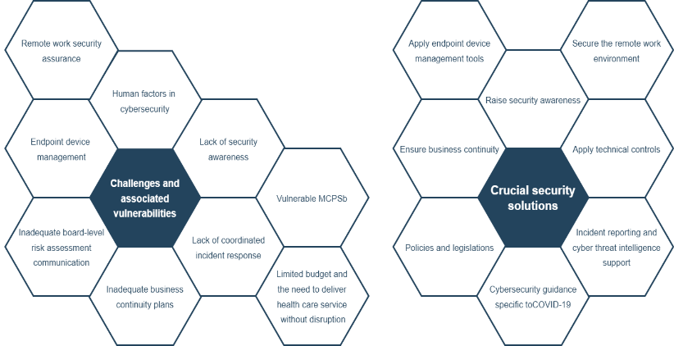
Challenges and solutions

Slide 18
Solutions
Robust cybersecurity measures must be implemented, focusing on ensuring confidentiality, integrity, and availability of healthcare data.
Compliance with regulations such as GDPR and HIPAA is crucial for safeguarding patient information.
Fostering transparency and accountability in data handling processes can help build trust among stakeholders.
Education and training programs on cybersecurity best practices can empower healthcare professionals to mitigate risks and respond effectively to security threats.

Slide 19
Benefits of proposed solutions
Highlighting the multiple benefits offered by the proposed solutions, including improvement in hospital performance and quality of care, as well as patient safety.
Closing with emphasis on the need for continuous improvement and protection of patient safety.
Encouragement for further research and action in this field.

Slide 20
Importance of hospital security systems
Hospital security systems play a crucial role in protecting patients' sensitive medical data from cyber threats.
Vulnerabilities identified in Greek hospital security systems highlight the need for enhanced cybersecurity measures.
Future strategies should focus on addressing these vulnerabilities to safeguard patient data and maintain trust in healthcare institutions.

Slide 21
Balance between security and accessibility
Achieving a balance between security and accessibility is essential for effective healthcare delivery.
Future strategies should prioritize both security measures and accessibility to ensure seamless patient care while safeguarding sensitive medical data.
Proposed future strategies include leveraging blockchain technology, implementing benchmarking practices, and developing effective interfaces.

Slide 22
Future perspectives
Effective communication interfaces and implementing blockchain technology.
Performance measurement to identify best practices and areas of improvement in security measures.
Improve workflow, staff performance and patient safety through integrated software solutions.
Working with experts and regulatory bodies to adopt innovative technologies and best practices.
Continuous monitoring and evaluation of security measures to adapt to evolving cyber threats and maintain patient trust.

Slide 23
Scientific and developing Team
University of Peloponnese, Electrical and Computer Engineering Department, Patras, Greece
Professor of Medical Physics & Electrophysiology, Director of Health Physics & Computational Intelligence Laboratory, Physiotherapy Department, School of Health Rehabilitation Sciences, University of Patras, Patras, Greece.
Professor of Network Technologies and Digital Transformation lab, Electrical and Computer Engineering Dpt., University of Peloponnese. Patras, Greece

Slide 24
Thank you for your attention

