Slide 1
ΚΛΙΝΙΚΗ ΕΞΕΤΑΣΗ ΓΟΝΑΤΟΣ
Kouzelis MD, pHD
Orthopaedic Department
Patras University Hospital

Slide 2
Milestones
Patient care – focused history and exam
Professionalism – respect, compassion
Interpersonal and communication skills – differential diagnosis
Medical knowledge base – anatomy, injury mechanisms
Systems based practice – accuracy, time-efficiency
Notes:
PATIENT CARE: Perform a focused history and examination of a patient with a knee-related problem/complaint
PROFESSIONALISM: Provide a respectful and compassionate evaluation of the patient with a knee complaint
INTERPERSONAL & COMMUNICATION SKILLS: Present a provisional working diagnosis to the patient who presents with a knee problem
MEDICAL KNOWLEDGE BASE:
Understand anatomy and physiology of knee joint and the relationship to pathology of knee problems
Understand mechanism of different types of injuries and use it to ascertain the proper diagnosis
SYSTEMS-BASED PRACTICE:
Appropriate utilization of imaging studies to augment the history and examination of a patient with a knee complaint
Conduct an accurate evaluation in a time-efficient manner

Slide 3
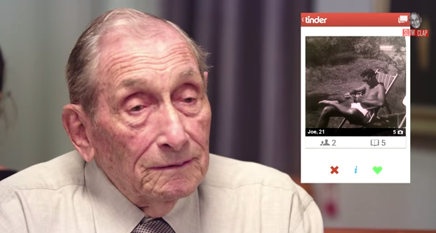
Assessing a knee, injured or not…

Slide 4
Assessing a knee, injured or not…
Components of the assessment include
Focused history
Attentive physical examination
Thoughtfully ordered tests/studies

Slide 5
Assessing a knee, injured or not…
Focused History Questions
Patient’s age + sex
Age Group | Males | Females
0-12 | Discoid lateral meniscus | Discoid lateral meniscus
12-18 | Osteochondritis dissecans Osgood-Schlatter’s | 1st patella dislocation
18-30 | Longitudinal meniscal tears | Recurrent dislocation patella Chondromalacia patellae Fat pad injury
30-50 | Rheumatoid arthritis | Rheumatoid arthritis
40-55 | Degenerative meniscus lesions | Degenerative meniscus lesions
45+ | Osteoarthritis | Osteoarthritis

Slide 6
Assessing a knee, injured or not…
Focused History Questions
Onset of Pain
Date of injury or when symptoms started
Location of pain
Anterior
Medial
Lateral
Posterior
Notes:
*Differential diagnosis by LOCATION:
Anterior – Patellofemoral syndrome, bursitis, Osgood-Schlatter’s disease, patellar tendinitis, patellar fracture
Medial – meniscus, MCL, DJD, pes anserine bursitis
Lateral – Meniscus, LCL, DJD, iliotibial band friction syndrome, fibular head dysfunction
Posterior – hamstring injury, tear of posterior horn of medial or lateral meniscus, Baker’s cyst, neurovascular injury (popliteal artery or nerve)

Slide 7
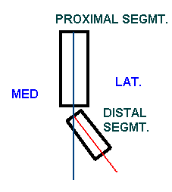
Assessing a knee, injured or not…
Focused History Questions2
Mechanism of Injury -helps predict injured structure
Contact or noncontact injury?
If contact, what part of the knee was contacted?
Anterior blow?
Valgus force?
Varus force?
Was foot of affected knee planted on the ground?
Valgus alignment = distal segment deviates lateral with respect to proximal segment.
Patellas Touch
Notes:
*CONTACT INJURIES/DIRECT BLOWS:
Commonly cause injury to: collateral ligaments, patellar dislocation, epiphyseal fractures in children with open growth plates
Valgus forces are more common than varus-directed forces
Blow to lateral aspect of knee resulting in stretch injury to soft tissues of medial knee (MCL more prone to injury than LCL)
Pearl to help remember the difference between varus and valgus stress, Valgus has “L” as in lateral and patella.
NONCONTACT INJURIES:
Vulnerable structures:
Cruciate ligaments (most common)
Menisci
Joint capsule
**Think ACL INJURY any time you have a patient with a significant NON-CONTACT injury with foot planed on the ground (foot planted then knee twisted or body changed direction, felt a pop, immediate swelling, could not continue playing)

Slide 8
Assessing a knee, injured or not…
Focused History Questions
Injury-Associated Events
Pop heard or felt?
Swelling after injury (immediate vs delayed)
Catching / Locking
Buckling / Instability (“giving way”)
Notes:
POP FELT OR HEARD: Ligament or meniscus injury
SWELLING AFTER INJURY=EFFUSION (intra-articular)
Immediate vs delayed onset swelling/effusion
Immediate refers to less than 6 hours after injury and correlates to:
Cruciate ligament tear
Articular fracture
Knee dislocation
Delayed swelling usually follows meniscal injuries
50% of patients with an acute ligament rupture will experience localized edema at injury site
In instances where swelling is less than expected:
Complete ligamentous or capsular disruption
Fluid exudes through tear
Localized swelling (rather than true joint swelling or effusion) can be caused by:
Prepatellar bursitis
Meniscal cystic changes
Outgrowth of a Baker/popliteal cyst
Dilation of an artery, such as a popliteal artery aneurysm
Nontraumatic Effusion - septic arthritis, tumor, gout, degenerative arthritis, synovitis, symptomatic arthridities
CATCHING / LOCKING
Knee gets caught or stuck (“locked”) in a flexed position due to something blocking normal joint motion and person cannot voluntarily flex further.
Often due to:
Tear in meniscus
Detached tissue lodging in knee joint
Injury to cruciate ligament(s)
Osteochondral fracture
Pseudolocking is due to pain and muscle spasm secondary to increasing edema
BUCKLING / INSTABILITY (“giving way”)
Displacement of osseous components of the knee suggesting ligamentous laxity (tibia slides forward on femur when ACL deficient) or patellar instability (patella moves laterally when subluxed or dislocated) OR
Quadriceps inhibition due to pain (such as during patellar subluxation or with meniscus tear) or weakness due to injury

Slide 9
Assessing a knee, injured or not…
Focused History Questions2
Degree of Immediate Dysfunction
|------→------→------→------→|
Unable to Antalgic Continued
Ambulate Gait* to Participate

Slide 10
Assessing a knee, injured or not…
Focused History Questions
Aggravating Factors
Activities, changing positions, stairs, kneeling
Relieving Factors/treatments tried
Ice, medications, crutches
History of previous knee injury or surgery

Slide 11
Assessing a knee, injured or not…
Historical Clues to Knee Injury Diagnoses
Clue
Result
Noncontact injury with “pop” | ACL tear
Contact injury with “pop” | MCL or LCL tear, meniscus tear, fracture
Acute swelling | ACL tear, PCL tear, fracture, knee dislocation, patellar dislocation
Lateral blow to the knee | MCL tear
Medial blow to the knee | LCL tear
Knee “gave out” or “buckled” | ACL tear, patellar dislocation
Fall onto a flexed knee | PCL tear

Slide 12
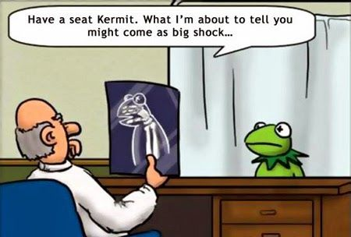
Physical Exam
Develop a standard routine
GENERAL STEPS
Exposure
General observation
Inspection
Palpation
Range of motion
Strength testing
Special tests
Alleviate the patient's fears

Slide 13
Physical Exam 1. Exposure
Adequate exposure - groin to toes bilaterally
Examine in supine position
Compare knees

Slide 14
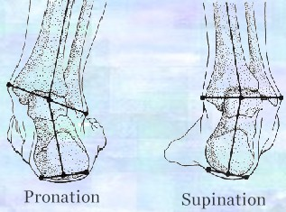
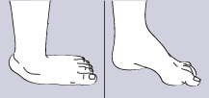
Physical Exam 2. Observe - Static Alignment
Patient stands facing examiner with feet shoulder width apart
Ankles, subtalar joints – pronation, supination
Feet – pes planus, pes cavus
Pes planus
Pes cavus

Slide 15
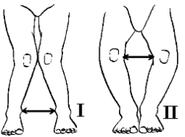
Physical Exam 2. Observe - Static Alignment
Patient then brings medial aspects of knees and ankles in contact
Knees – genu valgum (I), genu varum (II)
Genu valgum
Genu varum

Slide 16
Physical Exam 2. Observe – Dynamic Alignment
Pronation/Supination may be enhanced with ambulation
Antalgic gait indicates significant problem (anti = against, algic = pain)

Slide 17
Physical Exam 3. Inspection
Evidence of local trauma
Abrasions
Contusions
Lacerations
Patella position
Muscle atrophy
Warmth
Erythema
Effusion
Quadriceps atrophy
Notes:
*“Pearl” - Persistent or recurrent effusion is NOT normal and most likely signals internal derangement such as:
Cruciate Ligament Tear
Meniscal Tear
OCD - osteochondritis dessicans - localized osteocartilaginous separation at level of subchondral bone producing pain and swelling
Chondral Defect
Fracture

Slide 18
Physical Exam 3. Inspection
Effusion
presence of pathology which must be investigated
XS synovial (inflammatory) fluid/ blood/ pus
Absence of effusion
Does not exclude pathology, but less likely.
Long-standing meniscus lesions/ OA

Slide 19
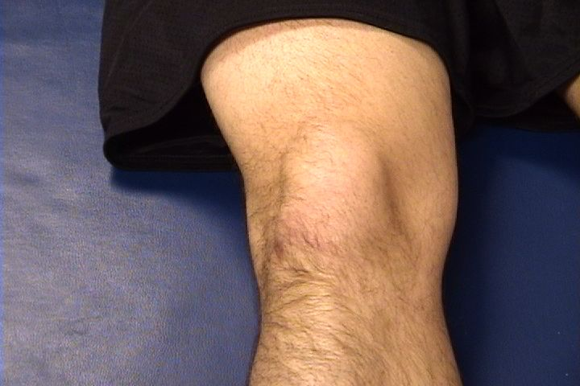
Physical Exam 4. Palpation
Knee – Anterior, Extended

Slide 20
Physical Exam 4. Palpation
Knee – Anterior, Extended
Patella
Indented
Hollow
Notes:
Appears hollow on either side of patella
There is a slight indentation above the patella
A small amount of fluid will make these hollow-appearing areas disappear. Larger effusions are most conspicuous as a fullness proximal to the patella.

Slide 21
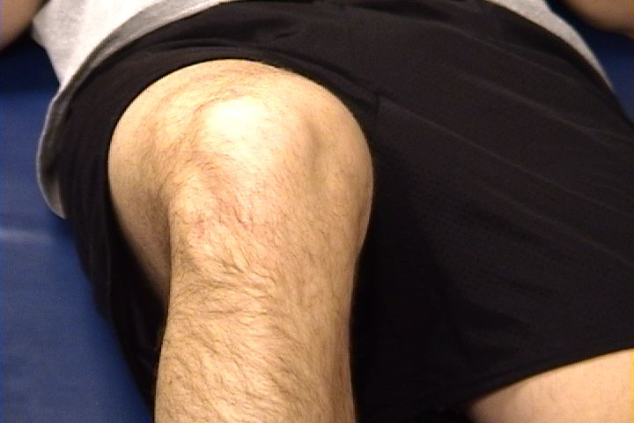
Physical Exam 4. Palpation
Knee – Anterior, Flexed

Slide 22
Physical Exam 4. Palpation
Knee – Anterior, Flexed
Patella
Tibial
Tuberosity
Head
Of
Fibula

Slide 23
Physical Exam 4. Palpation
Knee – Anterior, Extended
Patella:
Lateral and Medial Patellar Facets
Superior
And
Inferior
Patellar Facets
Medial Fat
Pat
Lateral Fat Pad
Patellar Tendon**
Notes:
*Assess for tenderness, edema, warmth
**Palpate the insertion of the patellar tendon on tibial tubercle in adolescents (location of pain in Osgood-Schlatter syndrome in adolescents)

Slide 24
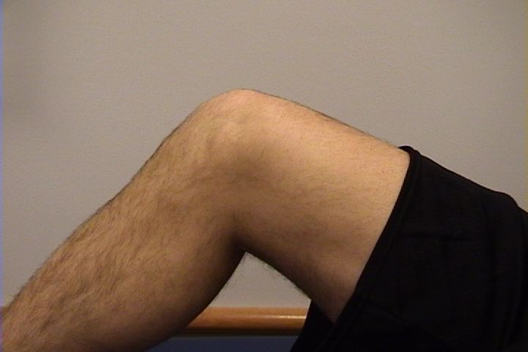
Physical Exam 4. Palpation
Knee – Medial
Tibial
Tuberosity
Patella
Medial
Femoral
Condyle
Joint
Line
Medial
Tibial
Condyle

Slide 25
Physical Exam 4. Palpation
Knee – Medial
Medial Collateral Ligament (MCL)*
Pes anserine
bursa**
Medial joint
line
Notes:
*Assess for tenderness along entire course of ligament from origin on medial femoral condyle to insertion on proximal tibia.
**Pes anserine bursa is about 3 finger widths inferior to the medial joint line and contains the insertion site for the sartorius, gracilis, and semitendinosis muscles

Slide 26
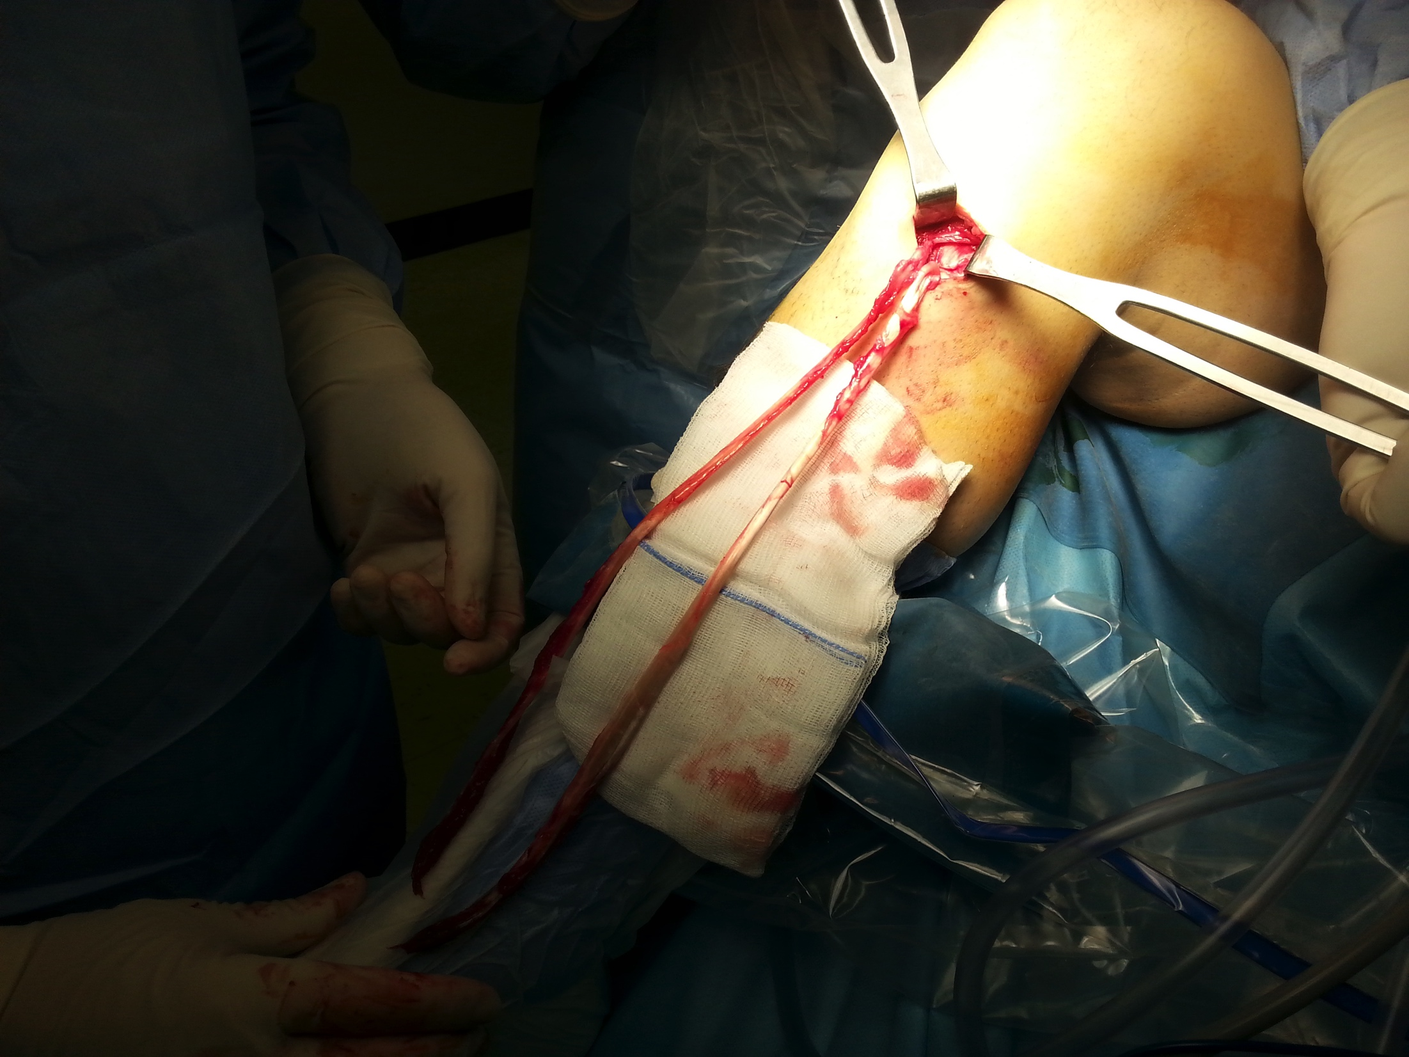

Slide 27
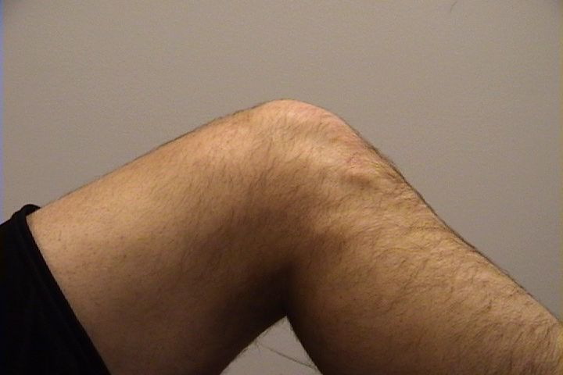
Physical Exam 4. Palpation
Knee – Lateral
Patella
Quadriceps
Tibial
Tuberosity
Head
Of
Fibula

Slide 28
Physical Exam 4. Palpation
Normal Knee – Lateral
Lateral Collateral
Ligament (LCL)**
Lateral joint
line
Notes:
* The LCL and joint line are more easily palpated with the knee in 90 degrees of flexion.
** LCL originates on lateral femoral epicondyle and inserts on fibular head

Slide 29
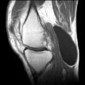
Physical Exam 4. Palpation
Knee – Posterior
Popliteal fossa*
Abnormal bulges
Popliteal artery aneurysm
Popliteal thrombophlebitis
Baker’s cyst

Slide 30
Physical Exam 5. Range of Motion
Extension Flexion
0º 135º
Describe loss of degrees of extension
Example: “lacks 5 degrees of extension”
Locking = patient unable to fully extend or flex knee due to a mechanical blockage in the knee (i.e., loose body, bucket-handle meniscus tear)
Notes:
*Locking vs Effusion
Effusion can hinder extension and is often confused with locking

Slide 31
Physical Exam 6. Strength testing
Test knee extensors (quadriceps) and knee flexors (hamstrings)
Can test both with patient in seated position, knees bent over edge of table
Ask patient to extend/straighten knee against your resistance
Then ask patient to flex/bend knee against your resistance
Compare to unaffected knee

Slide 32
Physical Exam 7. Special Tests
Patellofemoral joint assessment
Apprehension Test
Notes:
Patellar Apprehension Test
Steps
Patient lies supine with his/her quadriceps fully relaxed
Examiner attempts to move the patient's patella laterally as far as possible with the patient's legs fully extended
Examiner flexes the knee ~ 30 degrees & attempts to move the patient's patella laterally as far as possible
Positive TestPatient forcefully contracts quadriceps and/or demonstrates apprehension, c/o painPositive
Test ImplicationsPatellar subluxation/medial patellar retinaculum sprain

Slide 33
Physical Exam 7. Special Tests
Patellofemoral joint assessment
“J” sign

Slide 34
Patellofemoral joint assessment “J” sign

Slide 35
Physical Exam 7. Special Tests
Physical examination tests for the detection of meniscus
Joint-line tenderness
McMurray test
Apley grind test
Bounce home test
Finochietto test (jump sign)
Boehler test
Thessaly test
Childress test

Slide 36
Physical Exam 7. Special Tests
Physical examination tests for the detection of meniscus
Joint-line tenderness
Notes:
Direct palpation over medial and lateral joint line Tenderness can indicate a meniscus tear, collateral ligament injury, or DJD
Sensitivity: 55–85 % [ 21 – 23 ] Specifi city: 29.4–67 % [ 21 – 23 ]

Slide 37
Physical Exam 7. Special Tests
Physical examination tests for the detection of meniscus
2. McMurray test
Notes:
McMurray test Range knee from full fl exion to 90° of fl exion fi rst with full tibial IR and then with full tibial ER Positive test produces “click” in association with torn meniscus and reproduces patient’s painful sensation Sensitivity: 16–58 % [ 21 – 24 ] Specifi city: 77–98 % [ 22 – 24 ]

Slide 38
Physical Exam 7. Special Tests
Physical examination tests for the detection of meniscus
3. Apley grind test
Notes:
Apley grind test Strong ER force applied to knee fl exed at 90° at rest, with distraction, and with compression Joint-line pain with distraction is concerning for ligamentous injury. Joint-line pain with compression is concerning for meniscal pathology Sensitivity: 13–16 % Specifi city: 80–90 % [ 22 , 23 ]

Slide 39
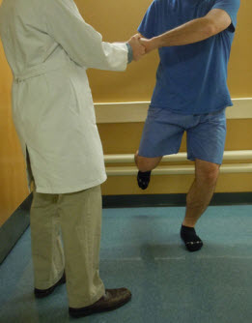
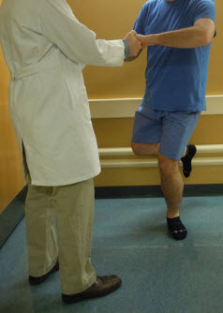
Physical Exam 7. Special Tests
Physical examination tests for the detection of meniscus
7. Thessaly Test
Notes:
Thessaly test Patient internally and externally rotates his or her knee and body while keeping one foot planted with the knee fl exed at 5° and then 20° Joint-line pain with maneuver indicates possible meniscus tear 20° Thessaly test Sensitivity: 89–92 % [ 25 ] Specifi city: 96–97 % [ 25 ]

Slide 40
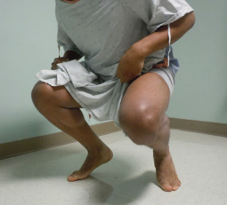
Physical Exam 7. Special Tests
Physical examination tests for the detection of meniscus
8. Childress test
Notes:
The Childress test is performed by asking the patient to perform a “duck walk” by moving forward while maintaining full knee fl exion (Fig. 2.5 ). Similar to the Thessaly test, this test is also positive for meniscal injury when the maneuver reproduces medial or lateral joint-line pain [ 10 ]. The Childress maneuver applies considerable compressive forces to the menisci and should not be performed in patients with a known positive McMurray test.

Slide 41
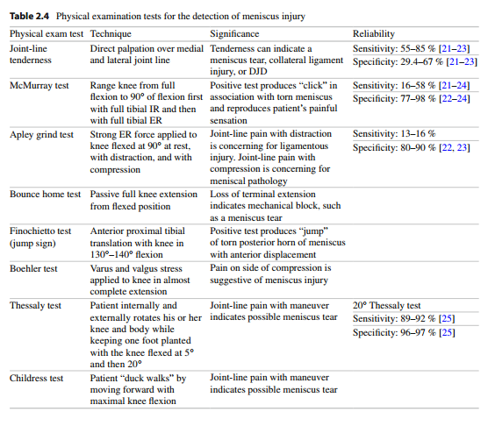
Physical Exam. 7. Special Tests
Physical examination tests for the detection of meniscus
McHale and Tzoumarakis, 2014

Slide 42
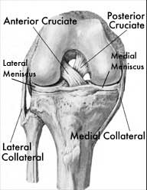
Physical Exam 7. Special Tests
Stress Testing of Ligaments
Posterior
Cruciate
Anterior Cruciate
Assess stability of 4 knee ligaments via applied stresses
Medial Collateral
Lateral Collateral
Notes:
* The stabilizing roles of each ligament include:
The medial collateral ligament (MCL) prevents the knee from buckling inwards (valgus injury)
The lateral collateral ligament (LCL) prevents the knee from buckling outwards (varus injury)
The anterior cruciate ligament (ACL) prevents the tibia from sliding forward under the femur
The posterior cruciate ligament (PCL) prevents the tibial from sliding backward under the femur

Slide 43
Physical Exam 7. Special Tests
Stress Testing of Ligaments
Use a standard exam routine
Direct, gentle pressure
No sudden forces
Abnormal test
Excessive motion = laxity
What is NORMAL motion?
Soft/mushy end point
Notes:
*Normal Stability
Medial and Lateral collateral ligaments
Normal test is no motion with varus and/or valgus stress with knee in neutral and 30 degrees of flexion
Anterior and Posterior Cruciate Ligements control anterior/posterior motion
Lachman’s test assesses Anterior Cruciate Ligament:
Normal test is <5mm of forward movement of tibia on femur with knee at 30 degrees of flexion
Anterior and posterior drawer testing assesses ACL and PCL
With knee in 90 degrees of flexion and foot stabilized, normal test will have <5mm of anterior motion (assessing ACL) or <5mm of posterior motion (assessing PCL)
** Normal end point of ligament that examiner feels with applied stress is FIRM. A soft or mushy end point implies ligament damage (stretching or complete tear).

Slide 44
Physical Exam 7. Special Tests
Collateral Ligament Assessment-MCL
Notes:
*VALGUS (MCL) stress
Proximal hand on lateral aspect of knee holds and stabilizes thigh
Distal hand directs ankle laterally
Attempt to open knee joint on medial side
Estimate the medial joint space and evaluate the stiffness of motion. Positive test = Significant gap in medial aspect of knee with valgus stress = MCL injury.
Laxity is graded on a 1 to 4 scale: 1+, 5mm of medial joint space opening with a firm but abnormal endpoint; 2+, 10mm medial opening with a soft endpoint; 3+ (15mm) and 4+ (20mm) may be indicative of an associated cruciate ligament injury and must be carefully examined.

Slide 45
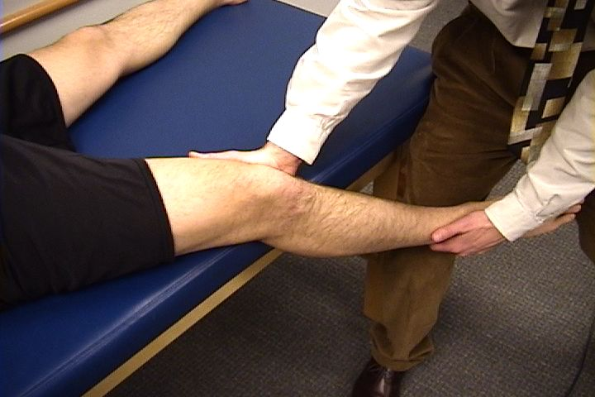
Physical Exam 7. Special Tests
Collateral Ligament Assessment-LCL
Notes:
*VARUS (LCL) Stress
Supine position, with knee at 20 to 30 degrees of flexion and thigh supported.
Stabilize medial aspect of knee and push ankle medially, trying to open knee joint on lateral side
Disruption of LCL is indicated by difference in degree of lateral knee tautness with varus stress. Compare affected knee to uninjured side

Slide 46
Physical Exam 7. Special Tests
Collateral Ligament Assessment
Grade 0 No joint Opening
Grade 1+ Less than 0.5 cm joint opening
Grade 2+ 0.5 to 1.0 cm joint opening
Grade 3+ 1 to 2cm joint opening
Grade 4+ (MCL) >2cm joint opening may be indicative of an associated cruciate ligament injury and must be carefully examined.

Slide 47
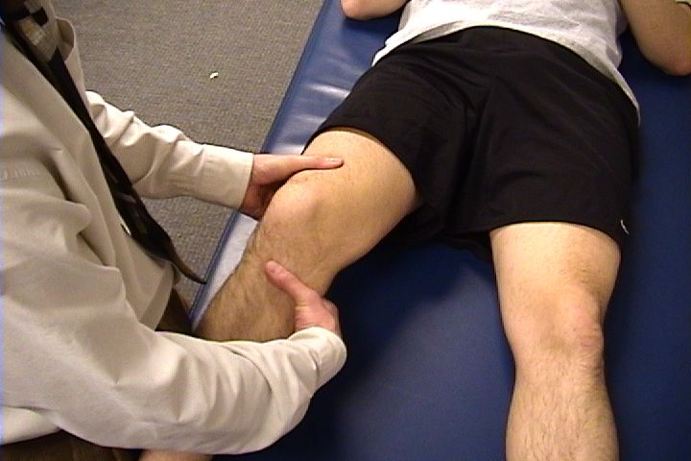
Physical Exam 7. Special Tests
Cruciate Ligament Assessment – ACL
Lachman’s test
Notes:
*Lachman Maneuver more sensitive and specific for ligamentous tears than drawer sign.
Patient is supine
Knee flexed to 20-30 degrees
Hand placement:
Grasp and stabilize patient’s thigh just proximal to patella
With opposite hand, try to move proximal tibia forward on femur
POSITIVE TEST = Excessive forward motion of tibia (>5mm) without firm endpoint indicates ACL damage
Modification for patient with large thighs:
Thigh placed over knee of examiner
Push downward on femur with hand while other hand grasps proximal tibia, attempting to move it anteriorly

Slide 48
Physical Exam 7. Special Tests
Cruciate Ligament Assessment – ACL
Reverse Lachman’s test
Notes:
Sensitivity and specificity is the same with the original lachman but it is easier to perform the test because the table stabilize the femur

Slide 49
Physical Exam 7. Special Tests
Cruciate Ligament Assessment – ACL
Anterior Drawer test
Notes:
*Patient Position
Supine
Flex hip of affected knee to 45 degrees
Bend knee to 90 degrees
Patient's foot planted firmly on examination table
Physician position:
Sitting on dorsum of foot, place both hands behind knee
Once hamstrings relaxed, try to displace proximal leg anteriorly
Anterior drawer test is LESS SENSITIVE for ACL damage than Lachman’s Maneuver

Slide 50
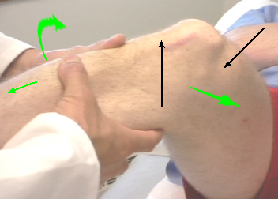
Physical Exam 7. Special Tests
Cruciate Ligament Assessment – ACL
Pivot Shift test
Notes:
MacIntosh – fully extend knee, hold foot in internal rotation, apply valgus stress, gradually flex knee, will jerk at 30 deg as tibial condyle reduces - if rotatory instability. – seen in ACL rupture, anterolateral displacement tibia then on further flexion, shifts back as ITB goes from extensor to flexor.

Slide 51
Physical Exam 7. Special Tests
Cruciate Ligament Assessment – ACL
Pivot Shift test

Slide 52
Physical Exam 7. Special Tests
Cruciate Ligament Assessment – PCL
Posterior Lachman’s test
Notes:
Patient is supine with his/her knee passively flexed to approximately 20 degrees & hands crossed across his/her chest
Examiner's thumb of the same–side hand as the knee to be examined is placed at the anterior medial tibial plateau/joint line, while digits 2–5 are positioned posterior, slighty distal to the popliteal fossa
Examiner's contralateral hand is placed laterally around the distal femur, just proximal to the patella with the thumb anterior & the digits 2–5 are positioned posteriorly
Examiner sets the tibia by pushing anterior (to make sure the ACL is in tact)
Examiner provides a posterior force to the tibia while applying anterior pressure to the femur; repeats the process 2–3 times
Positive Test Increased posterior tibial translation, pain
Positive Test ImplicationsPCL tear

Slide 53
Physical Exam 7. Special Tests
Cruciate Ligament Assessment – PCL
Posterior Drawer test
Notes:
Posterior Drawer Test
Steps
Patient is lying supine with his/her hip flexed to 45 degrees & knee flexed to 90 degrees
Examiner sits on the patient's foot & grasps the tibia just below the joint line
Examiner's thumbs are placed along the joint line on either side of the patellar tendon
Examiner ensures that the patient is relaxed, esp. the quadriceps
Examiner pushes the tibia posteriorly
Positive Test Increased posterior tibial translation, pain
Positive Test ImplicationsPCL tear

Slide 54
Physical Exam 7. Special Tests
Complex Ligament Injuries
Dial test

Slide 55
Physical Exam 7. Special Tests
Complex Ligament Injuries
Collateral Ligament Assessment at 0⁰

Slide 56
Physical Exam 7. Special Tests
McHale and Tzoumarakis, 2014

Slide 57
Conclusion

