Slide 1
Intro to Blockchains & Bitcoin & …
It is just an Intro…
Based on Slides from:
S. Chakraborty, S. Sural
P. Viswanath

Slide 2
Decentralization & Blockchains
The Three Pillars
Distributed Systems
Crypto
Economic Models

Slide 3
Basic CryptoPrimitives
Cryptographically Secure Hash Function
Digital Signature
Notes:
Hash Function: Used to connect the “blocks” in a “chain” in a tamper-proof way
Digital Signature: Digitally sign the data so that no one can “deny” about their own activities. Also, others can check whether it is authentic.

Slide 4
Secure Hash Functions and Linked Structures

Slide 5
Cryptographic Hash Functions
Takes any arbitrarily sized string as input
Input M: The message
Fixed size output (256 bits are used in Blockchain)
Output H(M): We call this the message digest
Efficiently computable

Slide 6
Cryptographic Hash Function: Properties
Deterministic
Always yield identical hash value for identical input data
Collision-Free
If two messages are different, then their digests also differ
Hiding
Hide the original message (the avalanche effect)
Puzzle-friendly
Given X and Y, find out k such that $Y=H(X|\left|k\right)$ - used to solve the mining puzzle in Bitcoin Proof of Work (PoW)

Slide 7
Collision Free
Hash functions are one-way; Given a $x$, it is easy to find $H(x)$. However, given an $H(x)$, no deterministic algorithm can find $x$
It is difficult to find $x$ and $y$, where $x≠y$, but $H\left(x\right)=H(y)$
Note the phrase difficult to find, collision is not impossible
Try with randomly chosen inputs to find out a collision – but it takes too long

Slide 8
Collision Free – How Do We Guarantee?
It may be relatively easy to find collision for some hash functions
Birthday Paradox: Find the probability that in a set of $n$ randomly chosen persons, some of them will have the same birthday
By Pigeonhole Principle, the probability reaches 1 when number of people reaches 366 (not a leap year) or 367 (a leap year)
0.999 probability is reached with just ~70 people, and 0.5 probability is reached with only ~23 people
If a hash function produces $N$ bits of output, an attacker need to compute only $2^{\frac{N}{2}}$ hash operations on a random input to find two matching outputs with probability > 0.98
For a 256-bit hash function, the attacker needs to compute $2^{128}$ hash operations – this is significantly time consuming
If every hash computation takes only 1 microsecond, it will need ${\sim 10}^{25}$ years

Slide 9
Hash as A Message Digest
If we observe $H\left(x\right)=H(y)$, it is safe to assume $x=y$
We need to remember just the hash value rather than the entire message – we call this as the message digest
To check if two messages $x$ and $y$ are same, $i.e., whether x=y$, simply check if $H\left(x\right)=H(y)$
This is efficient because the size of the digest is significantly less than the size of the original messages

Slide 10
Information Hiding through Hash
Given an $H(x)$, it is “computationally difficult” to find $x$
The difficulty depends on the size of the message digests
Hiding helps to commit a value and then check it later
Compute the message digest and store it in a digest store – commit
To check whether a message has been committed, match the message digest at the digest store

Slide 11
Puzzle Friendly
Say $M$ is chosen from a widely spread distribution; it is computationally difficult to compute $k$, such that $Z=H(M||k)$, where $M$ and $Z$ are known a priori.
A Search Puzzle (Used in Bitcoin Mining)
$M$ and $Z$ are given, $k$ is the search solution
Note: It might be not exactly a particular value Z, but some properties that Z satisfies, i.e., Z could be a set of possible values
Puzzle friendly property implies that random searching is the best strategy to solve the above puzzle

Slide 12
Proof of Work
Practical method to simulate the Oracle
Mining
cryptographic hash function creates computational puzzle
Hash(nonce, block-hash) < Threshold
nonce is the proof of work
include nonce inside the block
Threshold
chosen such that a block is mined successfully on average once in 10 minutes
a successfully mined block will be broadcast to all nodes in the network

Slide 13
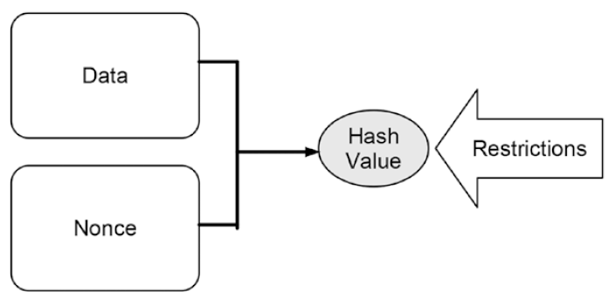
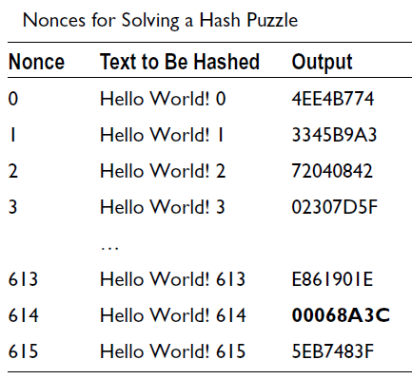
Causing Time Consuming Computations
Notes:
Hash values can be used for setting computationally challenging puzzles. These are used later for consensus.
Let’s consider a real hash puzzle for illustrating its functioning. In Step 10 you
saw that the shortened hash value of Hello World! is 7F83B165. But what data
combined with Hello World! would yield a shortened hash value with three
leading zeros? So the hash puzzle is: Find the nonce that combined with Hello
World! yields a shortened hash value that starts with three leading zeros.
Let’s get our hands dirty and try some nonce. Table 11-1 shows the nonce,
the text to be hashed, and the resulting shortened hash value. As you can see,
the nonce 614 solves the hash puzzle, which implies that starting with a nonce
0 and incrementing sequentially by 1 you would need 615 steps to find the
solution. If the restriction were to find a hash value with one leading zero, you
would have solved it already after four steps, since Hello World! 3 yields a
hash value with one leading zero.

Slide 14
Hash Pointer
A Cryptographic Hash Pointer (Often called Hash Reference) is a pointer to a location where:
Some information is stored
Hash of the information is stored
With the hash pointer, we can
Retrieve the information
Check that the information has not been modified (by computing the message digest and then matching the digest with the stored hash value)

Slide 15
Hash Pointer
H(DATA)
DATA
Hash Pointer
Reminds you of a linked list??

Slide 16
Detect Tampering from Hash Pointers - Hashchain
H(D^{(i-1)})
H(D^{(i)})
H(D^{(i+1)})
D^{(i)}
D^{(i+1)}
D^{(i+2)}

Slide 17
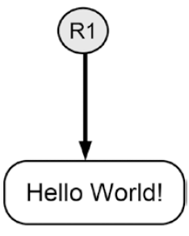
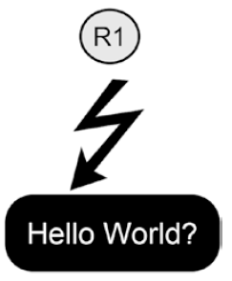
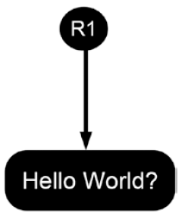
Tamper Detection using Hash Pointer
Notes:
The hash pointer is correct
The data of the hash pointer have been tampered with. The hash pointer is not correct
A new hash pointer has been created for the altered data

Slide 18
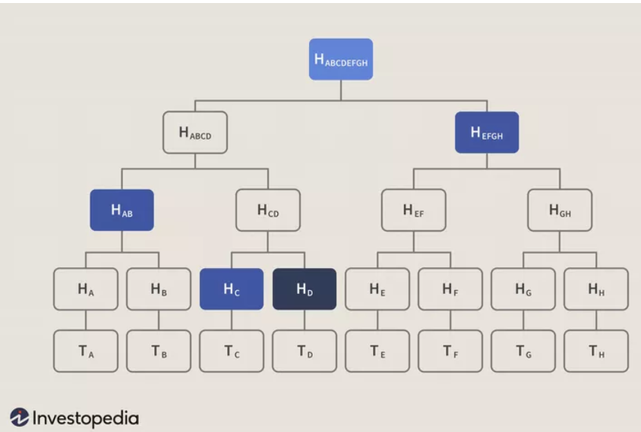
Merkle Tree – Organization of Hash Pointers in a Tree
Root Hash
H_{root}=Hash(H₀+H₁)
Merkle Root
L₁ Hash
H₀= Hash(H₀₀+H₀₁)
L₁ Hash
H₁=Hash(H₁₀+H₁₁)
L₂ Hash
H₀₀=Hash(T₁)
L₂ Hash
H₀₁=Hash(T₂)
L₂ Hash
H₁₀=Hash(T₃)
L₂ Hash
H₁₁=Hash(T₄)
Verify efficienctly transaction T_{D}
T₁
T₂
T₃
T₄
Notes:
The Merkle tree is useful because it allows users to verify a specific transaction without downloading the whole blockchain (over 350 gigabytes at the end of June 2021).4 For example, say that you wanted to verify that transaction T_{D} is included in the block in the diagram above. If you have the root hash (H_{ABCDEFGH}), the process is like a game of sudoku: you query the network about H_{D}, and it returns H_{C}, H_{AB,} and H_{EFGH}. The Merkle tree allows you to verify that everything is accounted for with three hashes: given H_{AB}, H_{C}, H_{EFGH,} and the root H_{ABCDEFGH}, H_{D} (the only missing hash) has to be present in the data.

Slide 19
Blockchain as a Hashchain
Block Header
Block Header
Block Header
Previous Hash
Nonce
Previous Hash
Nonce
Previous Hash
Nonce
Merkle Root
Block Hash
Merkle Root
Block Hash
Merkle Root
Block Hash

Slide 20
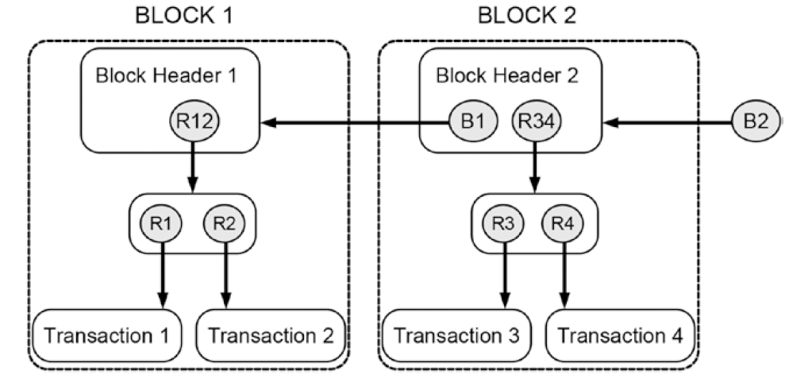
The BlockChain Data Structure
Notes:
A simplified blockchain-data-structure containing four transactions
R12 and R34 are roots of Merkle Trees

Slide 21
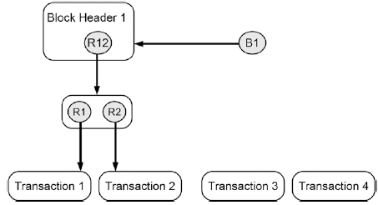
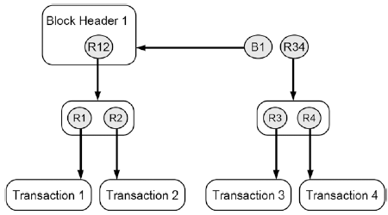
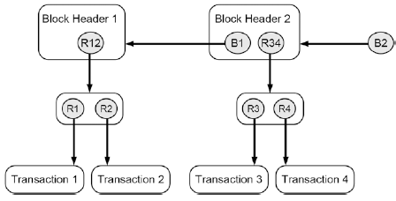
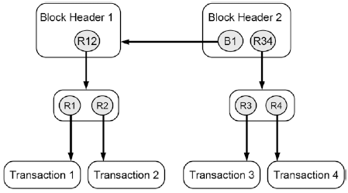
Adding New Transactions
Notes:
Creating a new Merkle tree that contains the new transactions
Create a new block header that contains both the hash reference to its preceding header and the root of the Merkle tree that contains the new transaction data
Create a new hash reference that points to the new block header, which is now the new head of the whole updated blockchain-data-structure

Slide 22
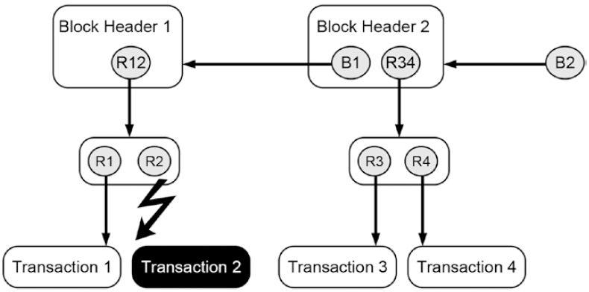
Detecting Changes Changing the Content of a Transaction
Notes:
Figure 15-5 illustrates what happens if we change Transaction 2. This transaction
is part of a Merkle tree, which consists of hash references. By changing some
properties of the Transaction 2 (e.g., the amount of goods being transferred
or the account that receives ownership), one also changes its fingerprint or its
cryptographic hash value, respectively. As a result, the hash reference R2 that
pointed to the original transaction data is broken. It detects that the transaction
data it originally referred were changed in the meantime and hence violates the
rules of staying unchanged. As a result, the whole blockchain-data-structure is
invalid.

Slide 23
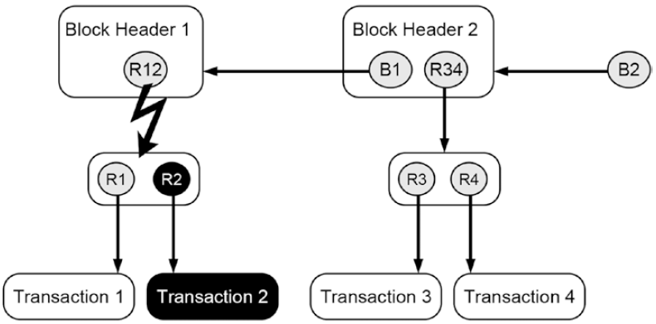
Detecting Changes Changing a Reference in the Merkle Tree
Notes:
Figure 15-6 illustrates what happens if one not only changes details of a transaction
but also changes the hash reference that points to the updated transaction.
The updated hash reference (R2) is valid as it correctly points to the
new transaction data. However, the updated hash reference is part of a Merkle
tree whose root is a hash reference as well. The root of the Merkle tree (R12)
points to a piece of data that contains the hash references R1 and R2. The
latter one has been changed in order to be consistent with the manipulated
version of Transaction 2. Hence, the cryptographic hash value of the piece
of data containing the updated version of R2 changes as well, which in turn
invalidates the root of the Merkle tree R12.

Slide 24
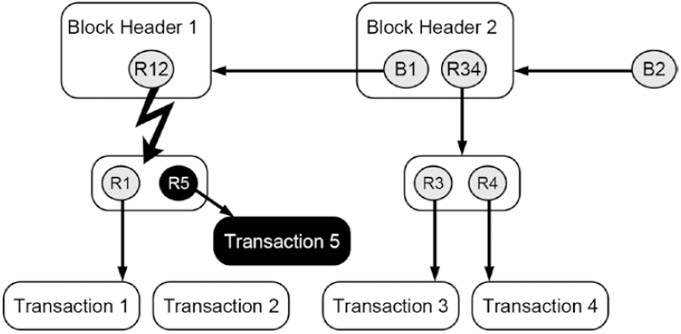
Detecting Changes Replacing a Transaction

Slide 25
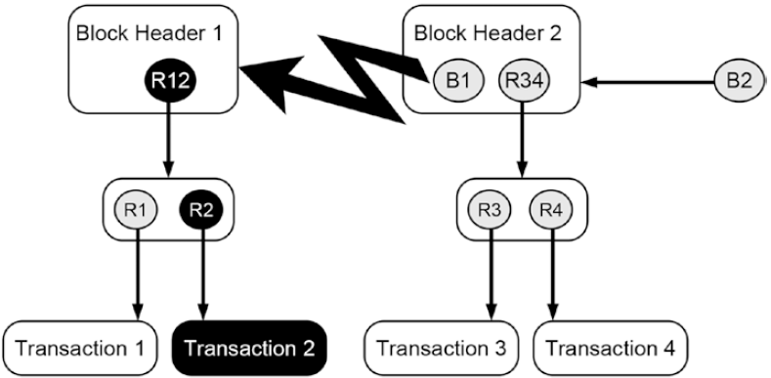
Detecting Changes Changing the Merkle Root
Notes:
The root of the manipulated Merkle tree (R12) is part of a block header
(Block Header 1). The change of the Merkle root changes the cryptographic
hash value of Block Header 1, which in turn causes the hash reference that
points to it (B1) to be invalid. The hash reference B1 that maintains the connection
or serves as a link from Block Header 2 to Block Header 1 becomes
invalid as it detects the change. As a result, the whole blockchain-data-structure
becomes invalid.

Slide 26
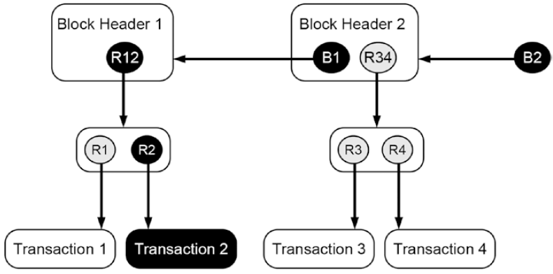
Detecting Changes Making a Correct Change

Slide 27
On Bitcoin
Notes:
Chapters 2-3 Princeton

Slide 28
The Block in a Blockchain – Securing Data Cryptographically
Digitally signed and encrypted transactions “verified” by peers
Cryptographic security – Ensures that participants can only view information on the ledger that they are authorized to see
Image source: http://dataconomy.com/

Slide 29
Structure of a Block
A block is a container data structure that contains a series of transactions
In Bitcoin: A block may contain more than 500 transactions on average, the average size of a block is around 1 MB (an upper bound proposed by Satoshi Nakamoto in 2010)
May grow up to 8 MB or sometime higher (several conflicting views on this!!)
Larger blocks can help in processing large number of transactions in one go.
But longer time for verification and propagation

Slide 30
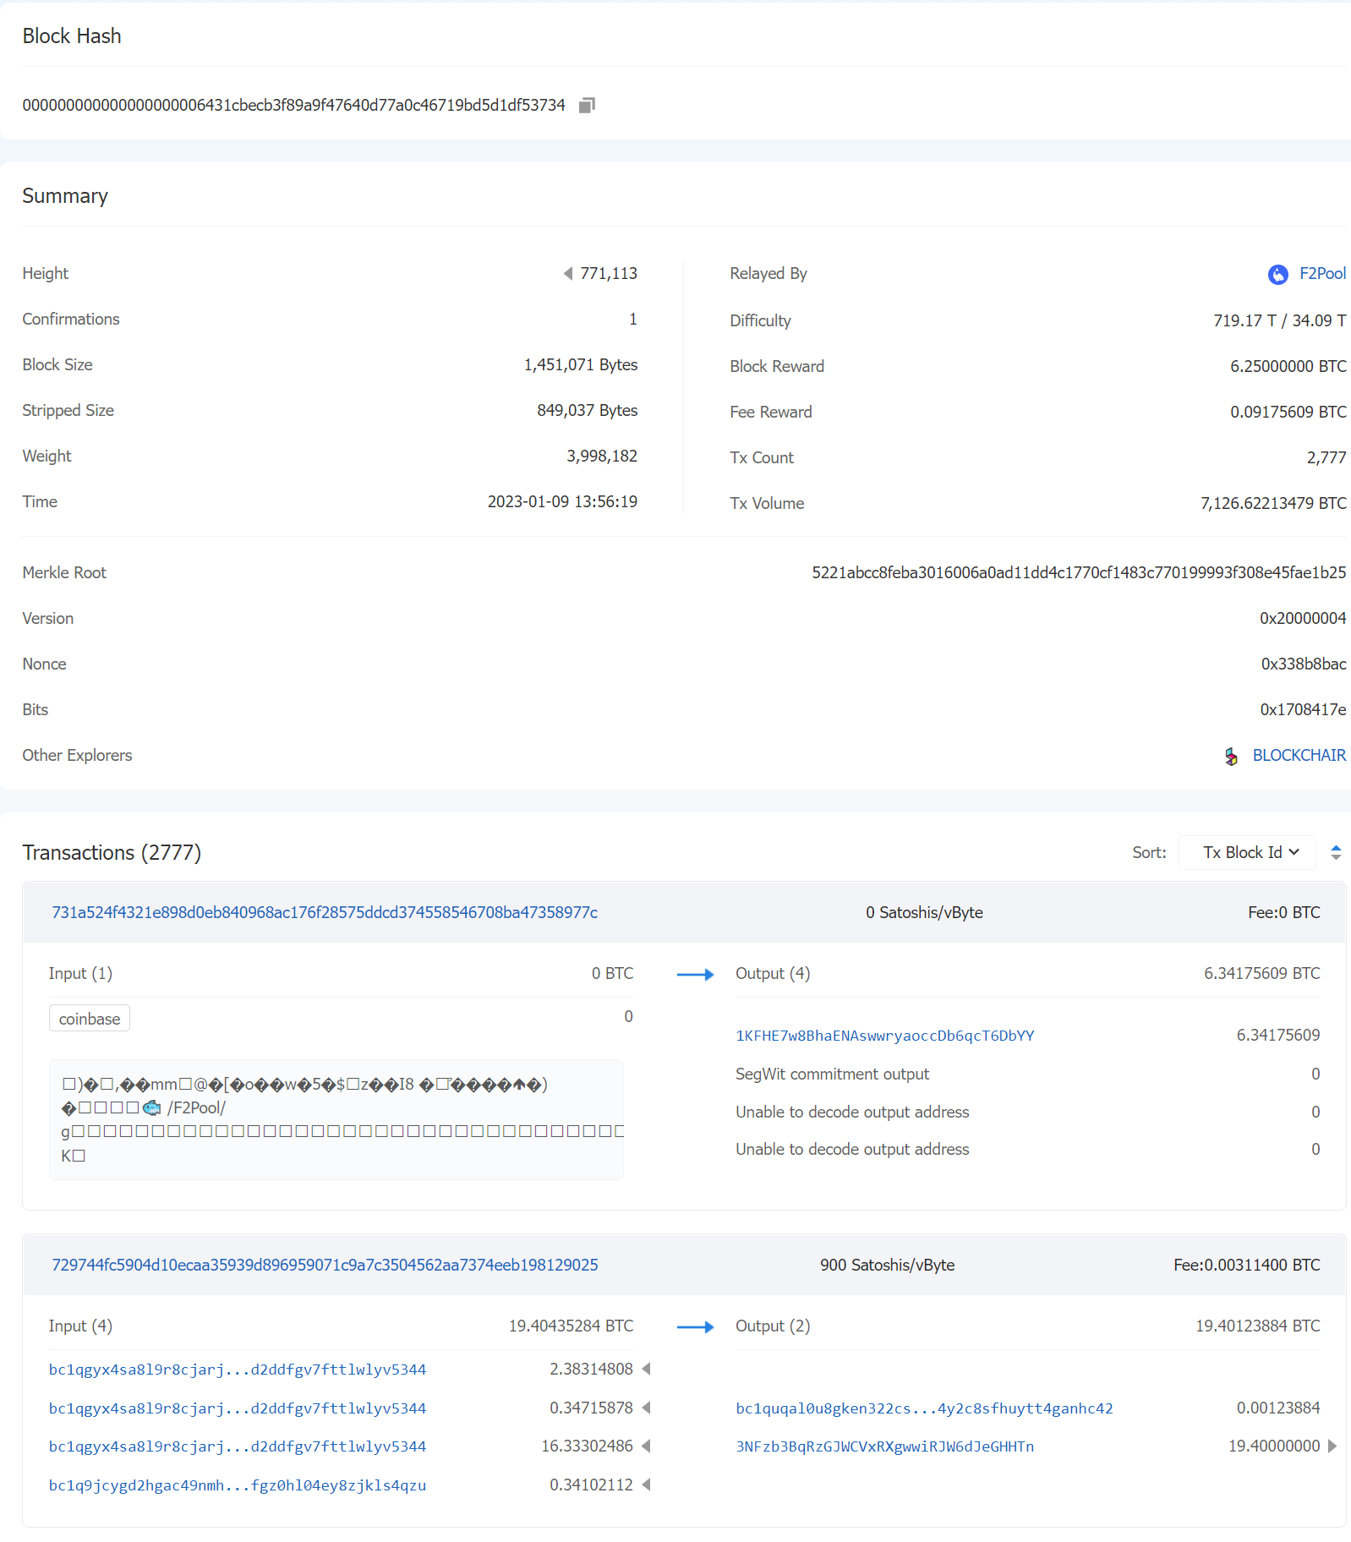
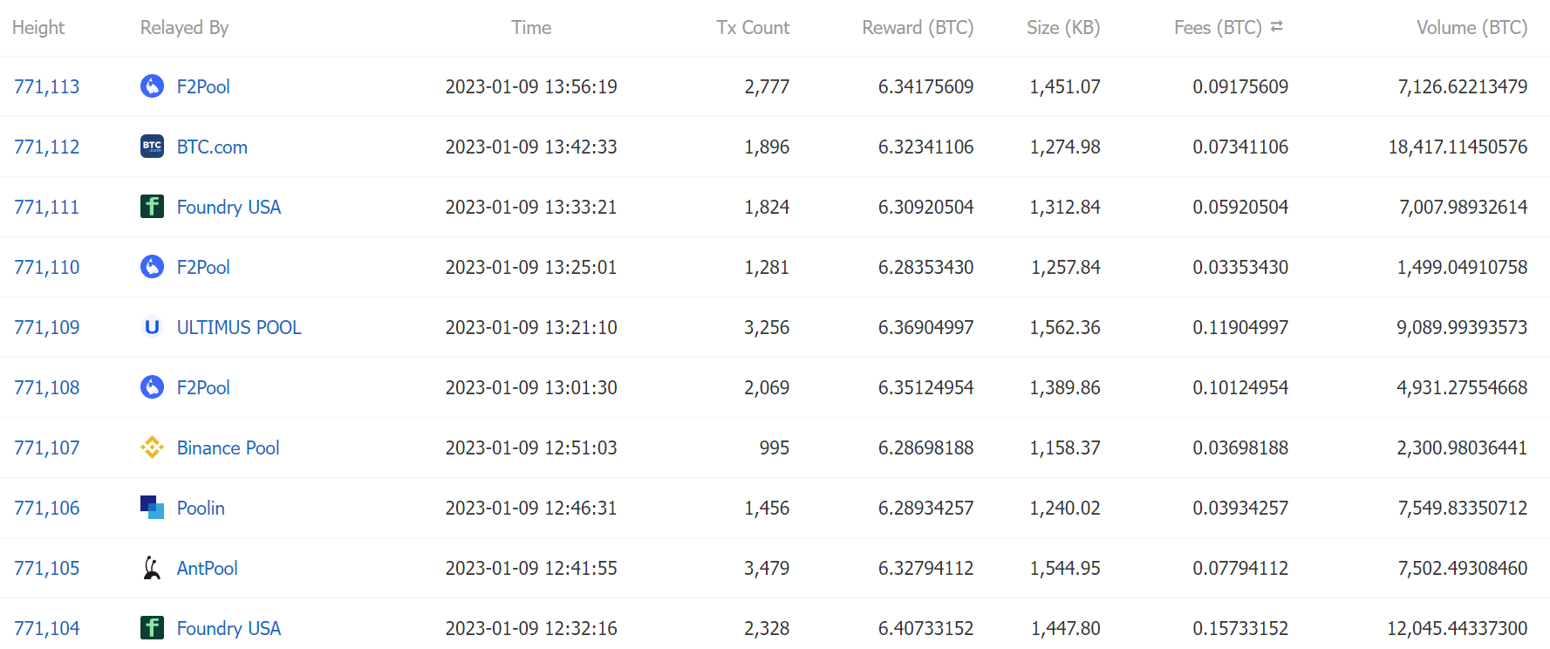
Structure of a Block (Reference: Bitcoin)
Two components:
Block Header
List of Transactions
Block Source: https://btc.com/btc/blocks OR https://blockchain.com/explorer
Notes:
The screen is from the noon. In the evening this block had already 40 confirmations

Slide 31
Block Generation Cost
Terahashes per second (Th/s) is equivalent to 1 trillion (1,000,000,000,000) hashes per second, a unit that indicates the power of a computer or mining machine.
ASIC Hardware μπορεί και εφαρμόζει περίπου 750 τρισεκατομύρια Hashes το δευτερόλεπτο!!!
Energy efficiency ~0.098 J/GH = ~100 J/TH
ASIC Hardware for bitcoin can perform about 750 TH/s
Hash rate of the Bitcoin network approx. 120M TH/s!! Many actually go waste ☹
Bitcoin network consumes about 80 TW-hours of electricity annually. These figures vary between sources and are all some form of estimates
Average household in Germany of four people consumes approx. 4,000 KW-hours of electricity per year.
Can power about 20,000 households
Notes:
ΤΗ -> Terra Hash
ASIC: Application-Specific Integrated Circuit

Slide 32
The Blockchain Replicas
Every peer in a Blockchain network maintains a local copy of the Blockchain.
Size is currently just about 447 GB ☺
As a new user joins the network, she can get the whole copy
Requirements
All the replicas need to be updated with the last mined block
All the replicas need to be consistent – the copies of the Blockchain at different peers need to be exactly similar

Slide 33
Transactions in a Block (Reference: Bitcoin)
Transactions are organized as a Merkle Tree. The Merkle Root is used to construct the block hash
If you change a transaction, you need to change all the subsequent block hashes
The difficulty of the mining algorithm determines the toughness of tampering with a block in a blockchain

Slide 34
Decentralization & Blockchains
The Three Pillars
Distributed Systems
Crypto
Economic Models

Slide 35
Our Core Problem
4
9
1
10
2
5
7
3
Other nodes in the network need to agree on this new block
The Classical Distributed Consensus Problem
6
8
11

Slide 36
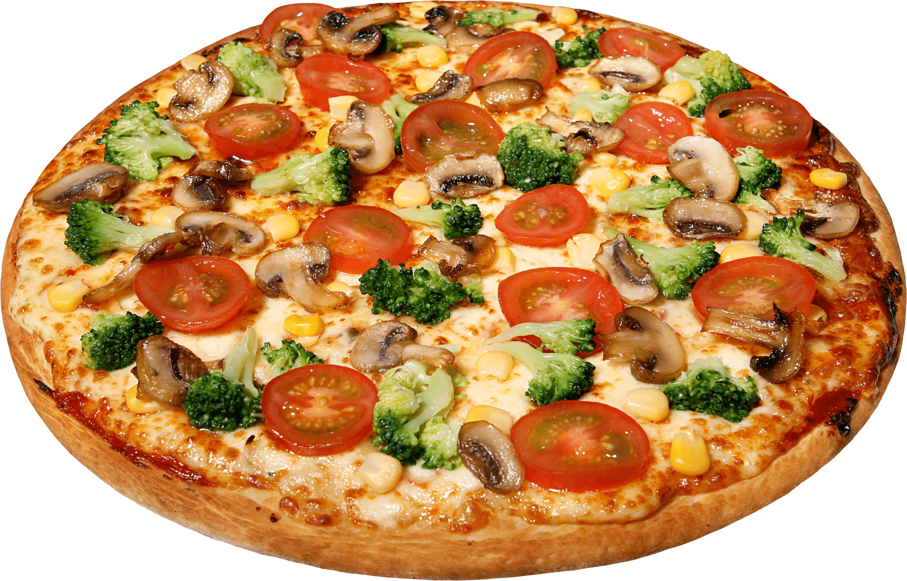
Centralized Consensus
3

Slide 37
Distributed Consensus – Message Passing
3

Slide 38
Distributed Consensus – Message Passing
3

Slide 39
Distributed Consensus – Message Passing
You told Pizza !!
3

Slide 40
Distributed Consensus – Message Passing
Nopes !! I told Burger
You told Pizza !!
3

Slide 41
What is the Issue with Classical Distributed Consensus?
Needs the identity of others
Works within a closed system ...
12

Slide 42
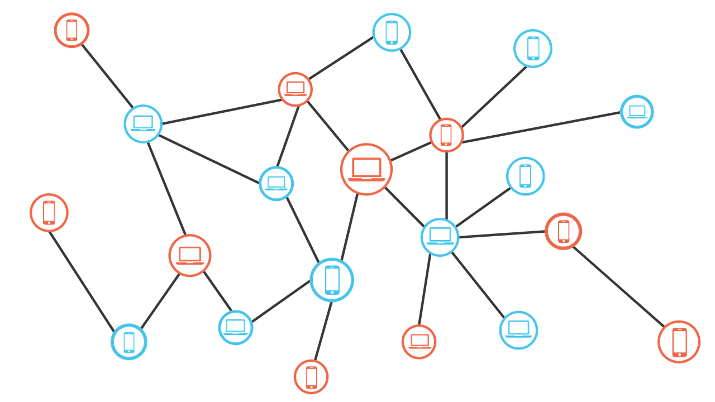
Smart Contracts
Program that is executed in a decentralized setting.
Acts on distributed ledger data.
Output of the program depends on consensus of independent participants executing it.
Smart Contracts

Slide 43
Ethereum Smart Contracts
Program that reads data from the Ethereum ledger, performs operations on it, and writes back the output to the ledger.
Smart contracts are a type of Ethereum account.
have a balance
can send transactions over the network
not controlled by a user, run as programmed
User accounts interact with a smart contract by submitting transactions that execute a function defined on the smart contract.

Slide 44
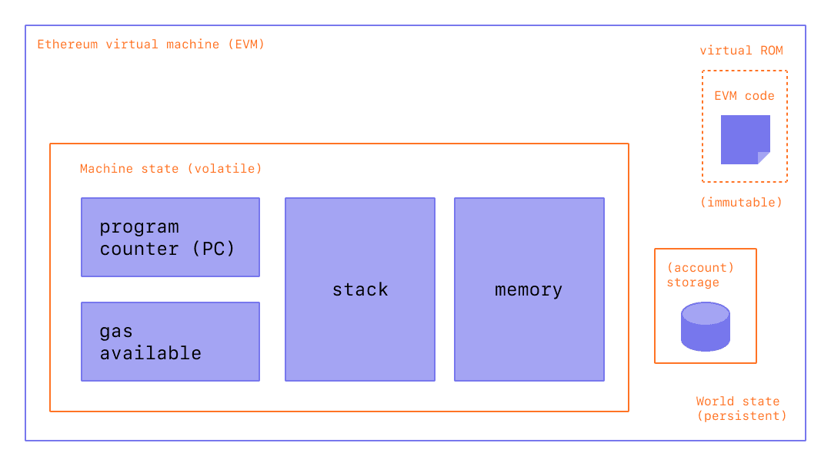
Ethereum Virtual Machine - EVM
Ethereum implements a distributed state machine / replicated state machine.
Ledger data holds the state - accounts, balances, and other variables.
Transactions deterministically change the machine from one state to another.

Slide 45
Solidity
High-level language for implementing smart contracts
Statically typed
Supports inheritance
Libraries
Complex user-defined types
Syntax influenced by Javascript and C++
// SPDX-License-Identifier: GPL-3.0
pragma solidity >=0.4.16 <0.9.0;
contract SimpleStorage {
uint storedData;
function set(uint x) public {
storedData = x;
}
function get() public view returns (uint) {
return storedData;
}
}
https://docs.soliditylang.org/en/v0.8.9/

Slide 46
Smart Contract Workflow

