Slide 1
Economics and the Environment: Part 1 – A brief introduction to economics
Dimitris Skuras
Professor, Department of Economics,
University of Patras, Greece

Slide 2
Economic Resources
Capital
Labour
Land

Slide 3
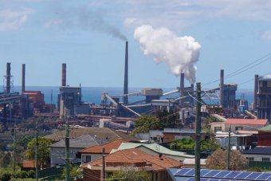
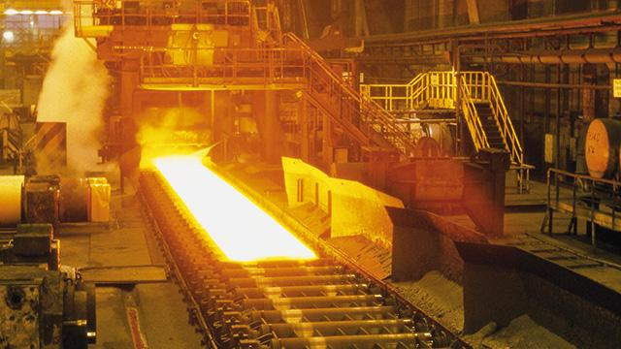
What is environment? everything that surrounds us
+
=
→
Iron Ore Mine
Energy
Steel Industry
Car Industry

Slide 4
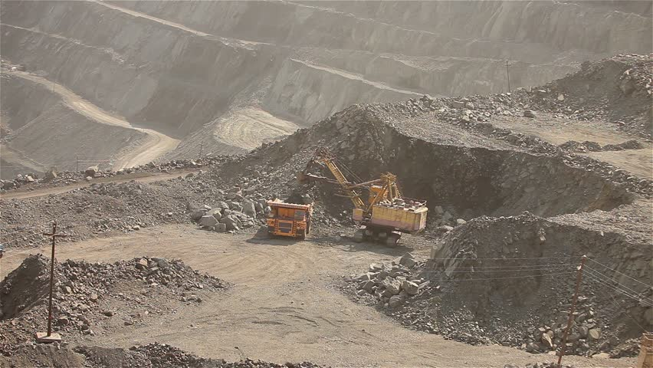
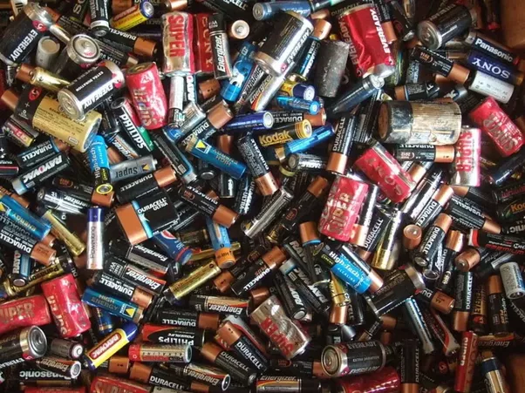
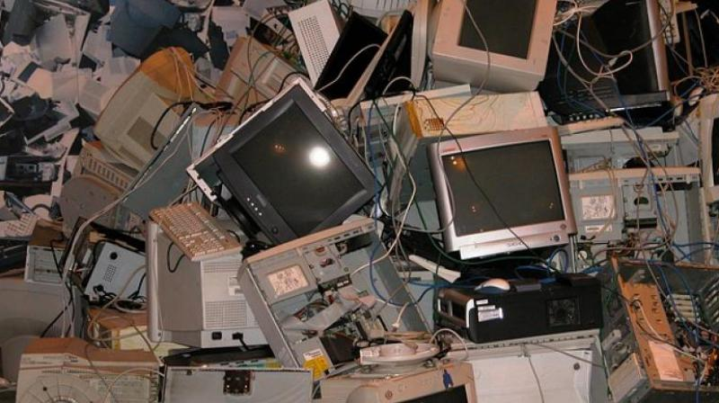
Production, Consumption and the Environment
Solid Wastes
Production
Environment
Liquid Wastes
(Effluents)
Consumption
Gas Emissions

Slide 5
Demand
D₀
D₁
Changes in prices change the quantity and cause movements ALONG the curve
Price (€)
p₁
The demand curve can be shifted by changes in:
Consumer preferences
Incomes
Prices of related goods
Expectations
The size of the market
p₂
q₁
q₂
q’₁
Quantity

Slide 6
Supply
Changes in prices change the quantity and cause movements ALONG the curve
Price (€)
S₀
S₁
The supply curve can be shifted by changes in:
The price of the factors of production and of intermediary goods
The technology
Expectations
The size of the market in terms of number of producers
The policy as concerns subsidies or taxes
p₁
p₂
q₂
q₁
Quantity
q’₁

Slide 7
Market Equilibrium
At price p*, quantity q* is demanded and supplied and the market for the good clears, i.e., consumers find and buy the quantities they want and producers bring to the market exactly the same quantities.
If the price was at p₁ or p₂ the market would be in disequilibrium.
At price p₁ consumers would demand quantities q₁ in excess of what is produced. The market would create shortages.
At price p₂ producers would produce quantities q₂ in excess of what is demanded by consumers. The market would create surpluses.
D₁
S₁
Price (€)
q₂
p₂
P*
p₁
q₁
q*
Quantity

Slide 8
Markets
Consumer
Market Efficiency:
Production efficiency
Allocative efficiency
Types of Markets:
Perfect Competition
Monopoly
Monopolistic Competition
Oligopoly
Monopsony
Oligopsony
buy-sell-exchange
Producer
Regulating Institutions

Slide 9
Marginal Private Costs and Benefits
Price (€)
MC
ATC
ATC = Average Total Cost
MC = Marginal Cost
MR = Marginal Revenue
The equilibrium rule:
MR = MC
Marginal Revenue = Marginal Cost
p
Price=MR
q
Quantity

