Slide 1
To DO
1. Talk about peer-to-peer systems and about disintermediation. An example is Napster (centralized peer-to-peer) that changed the music industry and showed that intermediaries were not necessary. See book [1], page 21. Blockchain is a tool to guarantee integrity in a peer-to-peer system.
2.
[1] Blockchain Basics: A non-technical introduction in 25 steps

Slide 2
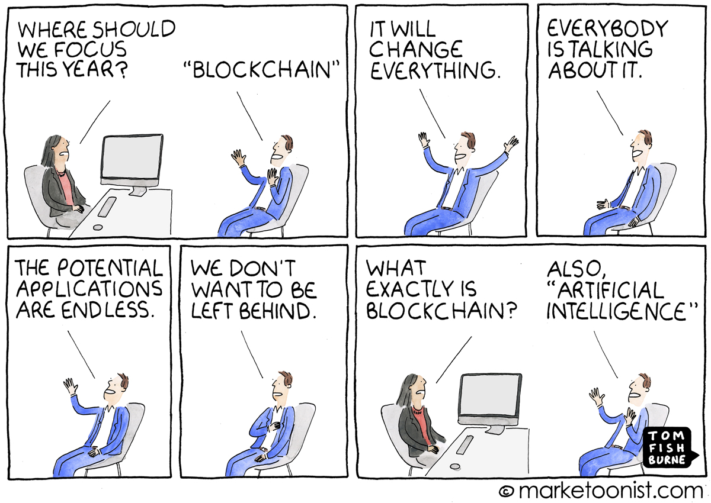
Intro to Blockchains
It is just an Intro…
Based on Slides from:
S. Chakraborty, S. Sural
P. Viswanath

Slide 3
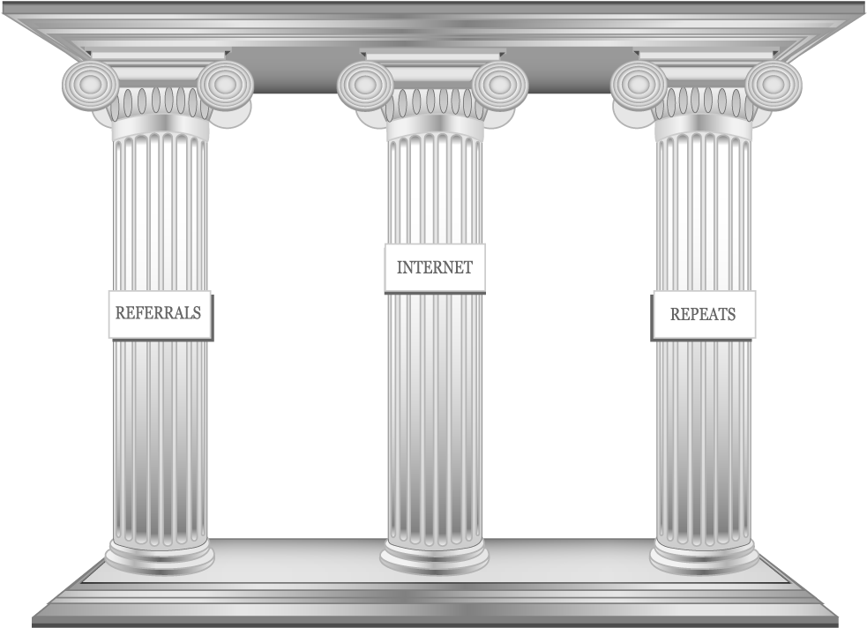
Decentralization & Blockchains
The Three Pillars
Distributed Systems
Crypto
Economic Models

Slide 4
The Myth Busters
Blockchain ≠ Bitcoin (or any other cryptocurrencies)
I am not going to talk about trading of cryptocurrencies!
I will try to make no comment on whether Bitcoin is good or whether Bitcoin should be blocked
Anything and everything in the world cannot be solved using a blockchain
Blockchain is good but may not be so "stellar" the way it is projected
You cannot replace a database with a blockchain
Blockchain is not a distributed database
Blockchain is not designed to securely store ANY data

Slide 5
What is a BlockChain? (or what should I talk about in a blockchain course ☺ )
Blockchain as a Data Structure
How does a blockchain look like?
How do we efficiently store data in a blockchain?
How can we efficiently manage data insertion in a blockchain? What is the complexity of data insertion and searching a data item within a blockchain?
Blockchain as a Security Blackbox
How do we ensure the security of the data stored in a blockchain?
What are the attack models that can be applied on a Blockchain architecture?
What level of data security can be ensured with the help of a blockchain?
How can we optimize various cryptographic operations to make a Blockchain implementation performant?

Slide 6
What is a BlockChain? (or what should I talk about in a blockchain course ☺ )
Blockchain as a Networking Protocol
For what types of network architectures, can we design a blockchain-based solution?
What different networking protocols are used in blockchain?
How does the design of various network protocols impact blockchain performance?
How can we optimize the networking architecture to make a blockchain performant?
Blockchain as a Distributed System
What happens when some participants in a blockchain-based system starts behaving maliciously?
How do we ensure the correctness of blockchain protocols?
How do we ensure "safety" and "liveness" of blockchain operations?

Slide 7
What is a BlockChain? (or, what should I talk about in a blockchain course ☺ )
Blockchain as a Programming Framework
How can you write a "smart" distributed application on top of blockchain?
What are the supported features for such a programming framework?
What can and cannot be done with such a programming framework?
Finally, the Blockchain Applications
What are the different types of applications that can be realized with blockchain?
What are the different types of applications that cannot be realized with blockchain?

Slide 8
What are Blockchains?
Blockchains are decentralized digital trust platforms

Slide 9
Evolution of Trust
Human success is based on flexible cooperation in large numbers. This requires trust

Slide 10
Bitcoin is the Original BlockChain
Bitcoin is a cryptocurrency
Launched in January 2009
Very secure: safety and liveness
Notes:
Safety properties ("bad things don't happen")
Liveness properties ("good things do happen")

Slide 11
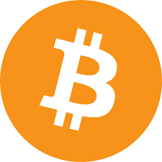
Bitcoin
Cryptocurrency
medium of exchange and store of value
Born during the 2008 Financial Crisis
Anonymous inventor
pseudonym: Satoshi Nakamoto

Slide 12
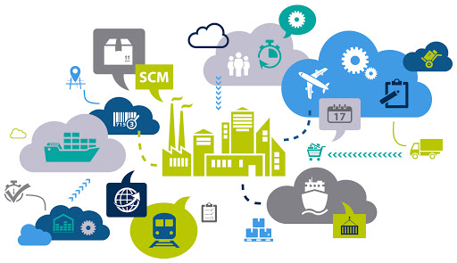
Supply Chain Management: The Players and the Game

Slide 13
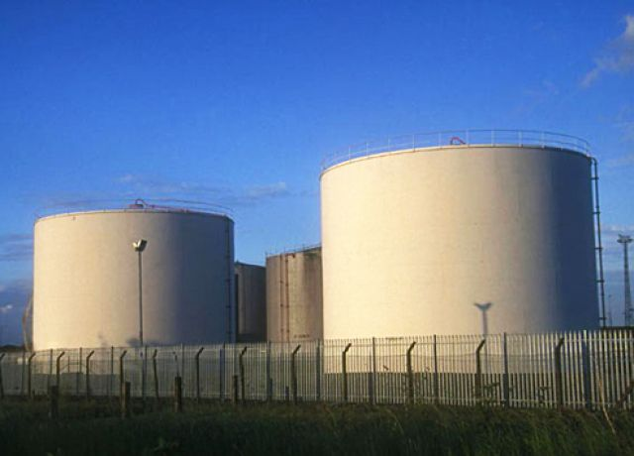
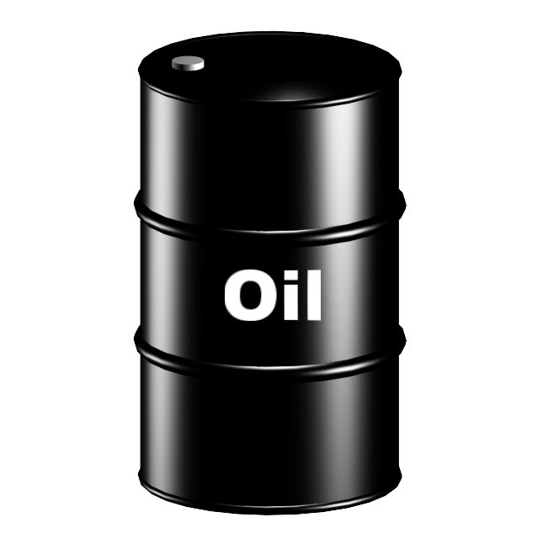
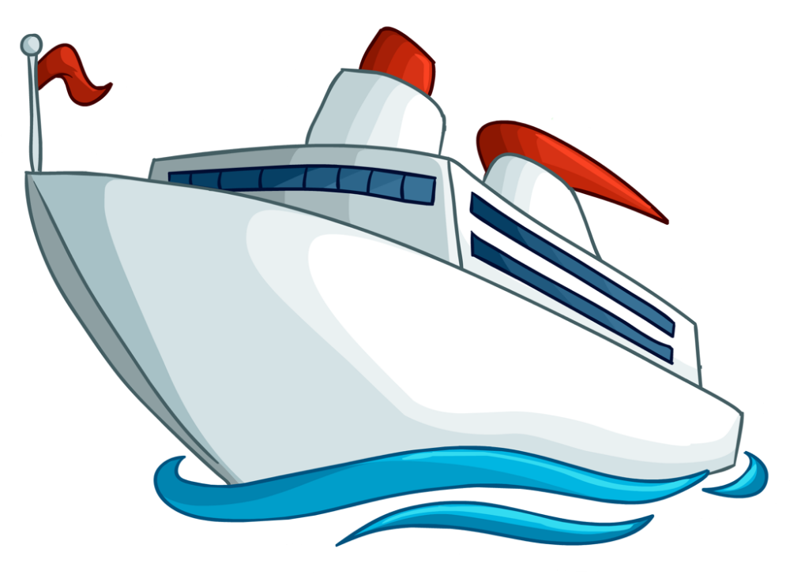
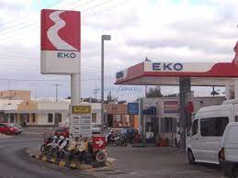
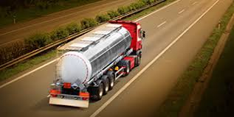
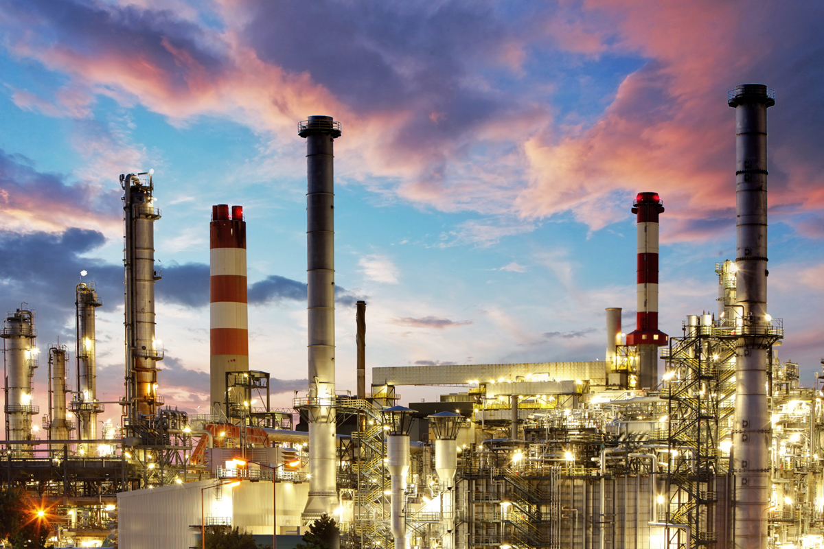
Supply Chain in Petroleum Industry
Crude Transportation
Crude Storage
Crude Purchase
Retail
Distribution
Refining

Slide 14
Requirements of a Successful Supply Chain
Minimization of material procurement (ελαχιστοποίηση της προμήθειας από μεσάζοντες)
Maximization of manufacturing capacity and sales (μεγιστοποίηση βιομηχανικής χωρητικότητας και κερδών)
Meet demand numbers (συνατάει – προλαβαίνει...τη ζήτηση)
Respond quickly to market opportunity by purchasing the production shortfall from other players (αποκρίνεται γρήγορα αγοράζοντας την πτώση του προϊόντος από άλλους παίχτες)
Objective of each production unit would be to maximize the throughput and its margin
(Στόχος κάθε μονάδας προϊόντος είναι να μεγιστοποιήσει τη διακίνηση και τα περιθώριά του)
Procurement would purchase the feedstock with not the best yields at lowest cost
(Η προμήθεια θα μπορούσε να αγοράσει την πρώτη ύλή χωρις τις καλύτερες αποδόσεις στη χαμηλότερη τιμή)
Notes:
Ελαχιστοποίηση της προμήθειας υλικών
Η προμήθεια θα αγόραζε την πρώτη ύλη με όχι τις καλύτερες αποδόσεις με το χαμηλότερο κόστος

Slide 15
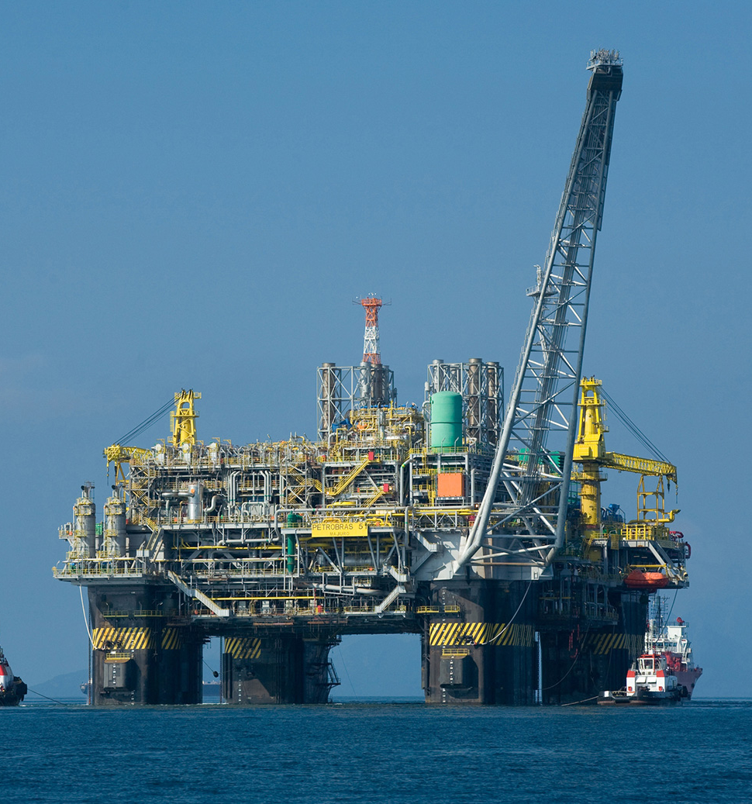
Requirements of a Successful Supply Chain
Needs Strong Coordination among the Players
How do we obtain Real-time Information from the Stakeholders?
A web-based portal?

Slide 16
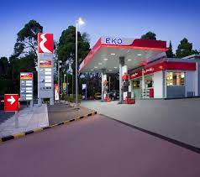
Requirements of a Successful Supply Chain
How do we obtain Real-time Information from the Stakeholders?
What is the guarantee that the information submitted is correct?
What if someone denies the information later on?
Blockchain is the answer !!

Slide 17
How Can We Obtain Real Time Information?

Slide 18
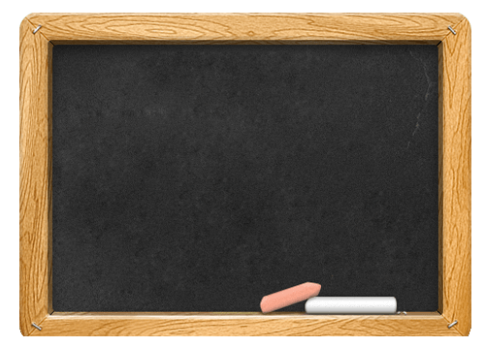
Use a Public Bulletin Board
Advantages:
Everyone can see all the logs and verify
Any change in information is visible to everyone
The board is not erasable, no one can deny later
Simple one-step auditing
- 10432 barrels produced in Thasos on Dec 26, 2022
- 6327 barrels transported from Thasos to ELPE Refinery on Dec 26, 2022 at 2:30 pm
- Received 6327 barrels on Dec 26, 2022 at 8:48 pm
Notes:
Audit -> έλεγχος

Slide 19
Use a Public Bulletin Board - Challenges
Who will maintain this bulletin board?
- Buy Cloud from amazon
Who will manage it and provide the cost?
- One of the enterprises maintain a private cloud
What is the guarantee that it is not a fraud?
Let everyone maintain the same copy of the board individually and independently
– BUT HOW?

Slide 20
What is this “Blockchain”?
A decentralized and multi-authority networked information data storage and access system

Slide 21
What is this “Blockchain”?
- 10432 barrels produced in Thasos on Dec 26, 2022
- 6327 barrels transported from Thasos to ELPE Refinery on Dec 26, 2022 at 2:30 pm
- 10432 barrels produced in Thasos on Dec 26, 2022
- 6327 barrels transported from Thasos to ELPE Refinery on Dec 26, 2022 at 2:30 pm
- Received 6327 barrels on Dec 26, 2022 at 8:48 pm
- Received 6327 barrels on Dec 26, 2022 at 8:48 pm
No one is the sole-owner of the data, but everyone has a copy of the data - there is no central database
Everyone holds exactly the same copy of the data at the same instance of the time
- 10432 barrels produced in Thasos on Dec 26, 2022
- 10432 barrels produced in Thasos on Dec 26, 2022
- 6327 barrels transported from Thasos to ELPE Refinery on Dec 26, 2022 at 2:30 pm
- 6327 barrels transported from Thasos to ELPE Refinery on Dec 26, 2022 at 2:30 pm
- Received 6327 barrels on Dec 26, 2022 at 8:48 pm
- Received 6327 barrels on Dec 26, 2022 at 8:48 pm

Slide 22
What is this “Blockchain”?
An immutable append-only ever-growing chain of data. Data once added cannot be deleted or modified later
Once something is added in the blockchain, it cannot be denied later
The information is transparent to all - everyone can see what is going on in the system
No-one can make any change without others to notice it

Slide 23
So, What is the Definition of a "Blockchain"
A decentralized immutable append-only public ledger

