Slide 1
Προχωρημένα Θέματα σε Κατανεμημένα Συστήματα
MapReduce / Hadoop
Σ.ΣΙΟΥΤΑΣ, Σ. ΒΟΥΛΓΑΡΗΣ

Slide 2
MapReduce

Slide 3
Big Data Processing
Crawled web documents (at Google, Bing, Yahoo!)
inverted indices (which pages contain each word)
graph representation of the links between pages
Monitoring
Web requests logs: what were the most popular queries today?
How did users click on ads in the last month? (who should pay for adwords traffic?)
Information retrieval, machine learning, AI.
Numerical mathematics
Bioinformatics...

Slide 4
Big Data processing: characteristics
Most of these computations are conceptually straightforward on a single machine
But the volume of data is HUGE
Need to use many (1.000s) of computers together to get results in a reasonable amount of time
Management of parallelization, data distribution, failures handling, etc. => much more complex than the computation itself

Slide 5
MapReduce
Simplifying model for large-scale data processing
Inspired by functional programming paradigm
LISP (LISt Processing)
Adapted to embarrassingly parallel workloads
Lots of concurrent operations on separate parts of the data with little or no synchronization
Runtime support for parallelization, data distribution, failures handling, etc.
Implementations
Google’s own C++ implementation
Hadoop Java open-source implementation
Many more in commercial and open-source products

Slide 6
Outline
MapReduce as seen by the programmer
Execution and runtime support
Examples
Some optimizations/extensions
Hadoop

Slide 7
Typical processing
Iterate over a large number of records
Extract something of interest from each
Shuffle and sort intermediate results
Aggregate intermediate results
Generate final output
Key idea: provide an abstraction at the point of these two operations, make others implicit
MAP
REDUCE

Slide 8
MapReduce: Programmers’ View
Programmers specify two functions:
map (k, v) → <k’, v’>*
reduce (k’, v’) → <k’’, v’’>*
All v’ with the same k’ are reduced together
Usually, programmers also specify a partition function:
partition (k’, number of partitions n) → partition for k’
Often a simple hash of the key, e.g., hash(k’) mod n
Allows reduce operations for different keys in parallel
MapReduce jobs are submitted to a scheduler that allocates the machines and deals with scheduling, fault tolerance, etc.

Slide 9
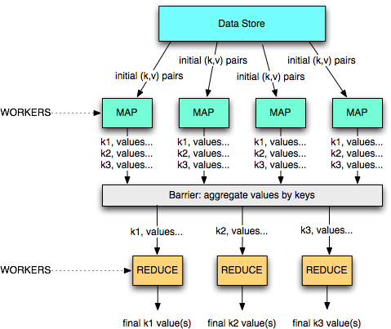
A divide and conquer approach

Slide 10
When is MapReduce relevant
Good choice for:
Log files indexing/analysis
Sorting huge data volumes
Image processing, etc.
Bad choice for:
Computing the first 1,000,000 digits of π
Computing Fibonacci series
Replacing MySQL

Slide 11
Job Execution on a MapReduce cluster
The job is submitted to a master process
The master orchestrates its execution
Each node supports one or more workers
Each worker can handle a map or reduce job when instructed by the master
The communication is based on key/value pairs
e.g., a DHT or key-value store
Store the location of data in the DHT and use direct communication between workers
Map jobs get the data from a storage layer
unstructured: file system (e.g., Google File System, HDFS, or local file system)
(semi-)structured: local database (e.g., MySQL) or distributed database (e.g., Google’s BigTable)

Slide 12
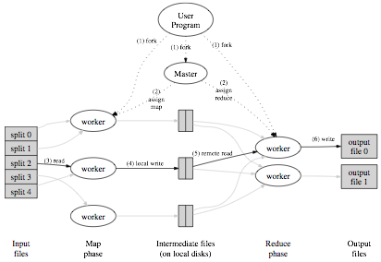
Execution overview
0. The MapReduce library splits the input files into M pieces (typically 16MB to 64MB)
1a. The library starts many processes on the cluster
1b. One of the process is special -- it is the master that orchestrates the execution
(from the original MapReduce paper)

Slide 13
Execution overview
2. The Master assigns the map job and part of the input to a worker
4. Periodically the map worker flushes intermediate pairs to disk
(or to a key/value store or DHT)
3. The map worker reads from the FS/DB
(from the original MapReduce paper)

Slide 14
Execution overview
5a. The Map workers inform the Master of the location of fresh data
The Master informs the workers where to get some data for the part of the key space they are in charge of (locally)
5b. The Reduce workers collect all key, value pairs where the keys are in their responsibility range
(from the original MapReduce paper)

Slide 15
Execution overview
6. Once a reduce worker has ALL the key value pairs (as instructed by the master) it processes the values and sends the result to the global file system
(from the original MapReduce paper)

Slide 16
Execution overview
NOTE: these can be the input values for another MapReduce job!
(from the original MapReduce paper)

Slide 17
MapReduce data flow
Each map job gets part of the data to process
It outputs a set of <key,value> pairs to an intermediate storage
Each key is associated to a set of values
The reduce jobs start once all map jobs have completed
(barrier)
It is often possible to aggregate partially the values before all maps are complete (e.g., on the same machine as the map job)
see the combine operation in a few slides
Each reduce job gets the set of values associated to one key
Shuffling/sort operation aggregates the map results for each key
Each reduce job gets a set of keys and the associated values for each of the keys
Using an iterator provided by the MapReduce implementation
And outputs a final <key,value(s)> pair (or a boolean, a log, ...)

Slide 18
MapReduce Examples

Slide 19
Example 1: word count
Count how many times each word appears in a text corpus
Map(String input_key, String input_value):
// input_key: document name
// input_value: document contents
for each word w in input_values:
EmitIntermediate(w, "1");
Reduce(String key, Iterator intermediate_values):
// key: a word, same for input and output
// intermediate_values: a list of counts
int result = 0;
for each v in intermediate_values:
result += ParseInt(v);
Emit(AsString(result));
(complete C code in the OSDI MapReduce paper)

Slide 20
Example 1: word count
(d1, ‘A B D’)
(A, 2)
(A, 2)
(d2, ‘A B C D’)
(B, 3)
(B, 3)
(d3, ‘ B C D’)
(C, 2)
(A, 3)
(D, 3)
(B, 4)
(A, 3)
(A, 7)
(B, 3)
(B, 15)
(d4, ‘A B C’)
(A, 3)
(d5, ‘A C D’)
(B, 4)
(d6, ‘A D B B’)
(C, 2)
(d7, ‘D B A’)
(D, 3)
(C, 2)
(C, 8)
(D, 3)
(D, 7)
(d8, ‘B B C’)
(A, 3)
(C, 2)
(d9, ‘A A C C’)
(B, 3)
(D, 3)
(d10, ‘ B A D C’)
(C, 4)
(C, 4)
(D, 1)
(D, 1)
M=3
mappers
R=2 reducers

Slide 21
Example 2: distributed grep
Grep reads a file line by line, and if a line matches a pattern (e.g., regular expression), it outputs the line
Map function
read a file or set of files
emit a line if it matches the pattern
key = original file (or unique key if origin file does not matter)
Reduce function
identity (use intermediate results as final results)

Slide 22
Example 3: URL access frequency
Input: log of web page requests (after a query)
Output: how many times each URL is accessed
Variant: what are the top-k most-accessed URLs?
Map function
Parse the log, output a <URL, 1> pair for each access
Reduce function
For each key URL, a list of n “1” is associated (i.e., added)
Emit a final pair <URL, n>

Slide 23
Example 4: Reverse Web-link graph
Get all the links pointing to some page
This is the basis for the PageRank algorithm!
Map function
output a <target,source> pair for each link to target URL in a page named source
Reduce function
Concatenate the list of all source URLs associated with a given target URL and emits the pair: <target,list(sources)>

Slide 24
Example 5: Inverted index
Get all documents containing some particular keyword
Used by the search mechanisms of Google, Yahoo!, etc.
Second input for PageRank
Map function
Parse each document and emit a set of pairs <word, documentID>
Reduce function
Take all pairs for a given word
Sort the document IDs
Emit a final <word,list(document IDs)> pair

Slide 25
Example 5: Inverted index
To be, or not to be
To be is to do
map
map
<to,a>,<be,a>,<or,a>,
<not,a>,<to,a>,<be,a>
<to,b>,<be,b>,<is,b>,
<to,b>,<do,b>
<be,<a,a,b>>,<do,<b>>,<is,<b>>
<not,<a>>,<or,<a>>,
<to,<a,a,b,b>>
reduce
reduce
<be,<a,b>>,<do,<b>>,<is,<b>>,<not,<a>>,<or,<a>>,<to,<a,b>>

Slide 26
Ex. 6: Avg. max temp per calendar day
<200001011200,10>
<200001011230,12>...
<200101011500,21>
<200101011530,21>...
map
map
<20000101,10>
<20000101,12>...
<20010101,21>
<20010101,21>
<20000101,<10,12,...>>...
<20010101,<21,21,...>>...
reduce
reduce
<20000101,15>,<20010101,23>...

Slide 27
Ex. 6: Avg. max temp per calendar day
<20000101,15>
<20010101,23>...
<20000201,21>
<20010201,22>...
map
map
<0101,15>
<0101,23>...
<0201,21>
<0201,22>
<0101,<15,23,...>>...
<0201,<21,22,...>>...
reduce
reduce
<0101,17>,<0201,23>...

Slide 28
MapReduce Challenges

Slide 29
MapReduce: (some) challenges
Fault tolerance
Overall performance and slow tasks
Bandwidth costs
Data locality
Combiner functions: local pre-reduction

Slide 30
Fault tolerance
Worker failure
The Master periodically pings each worker
If unresponsive, reassigns to another one
The map and reduce operations are stateless: restart is easy to implement
If transient failure of a Map or Reduce job, no problem of duplicates as the intermediate results are stored on local disk
Failure during the send to the global store: atomic commit protocol for results
Master failure
Periodically checkpoint the state of the master to the global storage
If master fails, restart from last checkpoint
May lead to duplicate work for workers, but seldom happens

Slide 31
Slow tasks
Some machines may be responsive but slow
e.g., if other jobs are scheduled by another MR master
Bottleneck for the entire job execution time
When a complete MR is close to execution (either map or reduce phase)
Re-allocate the non-finished jobs on the fastest nodes
Let the first node that finishes commit its results to the reduce workers or to the global file system

Slide 32
Data locality
The data is stored in a distributed file system
For Google: GFS
For Hadoop: HDFS (open source)
The splits are GFS/HDFS blocks
The master gets the location of a block from GFS and allocates the map job on the same node or on a close-by node

Slide 33
Bandwidth saving
Moving the intermediate key,value pairs from map workers to reduce workers costs bandwidth
Some reduce operations can be combined
e.g., counting
Some others cannot
e.g., top-k computation
If possible to combine, execute a combiner function on the same node as the map worker to pre-reduce the data
Often the same function as the final reduce job
Example: in the word-count MR job, apply the reduce job locally to all <word,1> pairs to send <word, n> pairs to the reduce job

Slide 34
Hadoop

Slide 35
Hadoop
Hadoop is the most known open-source MapReduce implementation
Lots of contributions by Yahoo!, now an Apache foundation project
Written in Java
Uses the HDFS file system (amongst others)
Many extensions and optimizations over the original Google paper
A MapReduce implementation of choice when using Amazon’s cloud services
EC2: rent computing power and temporary space
S3: rent long term storage space

Slide 36
HDFS – Hadoop Distrib. File System
A distributed, scalable file system for M-R applications
Distributed: Runs in a cluster
Scalable: 10K nodes, 100M files, 10PB storage
Closed-source optimizations
HDFS provides a single file system view to the whole cluster
Files are split up in blocks
Typically 128MB
Each block is replicated on multiple DataNodes (typically 3)
Block placement is rack-aware

Slide 37
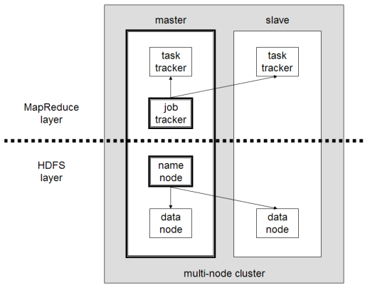
HDFS/MapReduce Architecture
Master/Slave Architecure
HDFS
A centralized NameNode controls multiple DataNodes
NameNode: keeps track of which DataNode stores which block
DataNodes: “dumb” servers storing raw file chunks
MapReduce
A centralized JobTracker controls multiple TaskTrackers
Placement
NameNode and JobTracker run on the master
DataNode and TaskTracker run on workers
Data locality is exploited

Slide 38
MapReduce

Slide 39
Hadoop: big picture
0. Allocate Hadoop cluster
1. Scp data to cluster
2. Move data into HDFS
EC2
3. Develop code locally
4. Submit MapReduce job
4a. Go back to Step 3
You
Your Hadoop Cluster
5. Move data out of HDFS
6. Scp data from cluster
7. Clean up!
Uh oh. Where did the data go?
courtesy of Prof. Lin, university of Maryland, CC-BY-NC-SA (USA)

Slide 40
On Amazon: EC2 and S3
Copy from S3 to HDFS
EC2 (The Cloud)
S3 (Persistent Store)
Your Hadoop Cluster
Copy from HFDS to S3

Slide 41
Hadoop Usecases

Slide 42
Use cases 1/3
NY Times
Large Scale Image Conversions
100 Amazon EC2 Instances, 4TB raw TIFF data
11 Million PDF in 24 hours and 240$
Facebook
Internal log processing
Reporting, analytics and machine learning
Cluster of 1110 machines, 8800 cores and 12PB raw storage
Open source contributors (Hive)
Twitter
Store and process tweets, logs, etc
Open source contributors (Hadoop-lzo)

Slide 43
Use cases 2/3
Yahoo
100.000 CPUs in 25.000 computers
Content/Ads Optimization, Search index
Machine learning (e.g. spam filtering)
Open source contributors (Pig)
Microsoft
Natural language search (through Powerset)
400 nodes in EC2, storage in S3
Open source contributors (!) to HBase
Amazon
ElasticMapReduce service
On demand elastic Hadoop clusters for the Cloud

Slide 44
Use cases 3/3
AOL
ETL processing, statistics generation
Advanced algorithms for behavioral analysis and targeting
LinkedIn
Used for discovering People you May Know, and for other apps
3x30 node cluster, 16GB RAM and 8TB storage
Baidu
Leading Chinese language search engine
Search log analysis, data mining
300TB per week
10 to 500 node clusters

Slide 45
Conclusion

Slide 46
Conclusion
MapReduce is a powerful simplifying abstraction for programming large-scale data processing
Naturally suited to embarrassingly parallel jobs
But is not adapted to all types of jobs (e.g., jobs with data interdependencies)
Master = single point of failure
Extensions
Process streams of data (StreamMine project, StreamMapReduce)
Real-Time support and complex event processing
Decentralize the master and use a collaborative scheme
Build the master using a DHT and replication for fault tolerance
Automatic MapReduce-ization
Some work already on automatic MR code generation from SQL queries (Prof. W. Zwaenepoel @ EPFL - EuroSys 2011)

