Slide 1

Tourism Management: Strategies, Examples, and Case Studies
Exploring planning, marketing, operations, and sustainability in tourism
Notes:
Tourism management plays a crucial role in the travel industry, encompassing various aspects such as planning, marketing, operations, and sustainability. This presentation will explore key strategies, real-world examples, and insightful case studies in the field of tourism management.

Slide 2

Agenda Items
Introduction to Tourism Management
Tourism Planning and Development
Marketing in Tourism
Tourism Operations and Services
Economic, Social, and Environmental Impacts
Future Trends and Innovations in Tourism Management
Notes:
We will delve into different facets of tourism management, starting with an introduction to the field and its importance. We will then explore topics like tourism planning, marketing strategies, operational aspects, economic and social impacts, and future trends in the industry.

Slide 3
Introduction to Tourism Management
Notes:
Understanding the foundation of tourism management is essential for effective planning and implementation in the travel sector. This section will cover the definition, scope, key concepts, principles, and the significance of tourism management in today's globalized world.

Slide 4

Definition and Scope of Tourism Management
Planning in Tourism Management
  Tourism management includes strategic planning to organize and coordinate activities that enhance the visitor experience and ensure smooth operations.
Marketing Strategies
  Effective marketing strategies are essential in tourism management to attract visitors, promote destinations, and create brand awareness in the competitive market.
Operations Management
  Operations management in tourism involves coordinating day-to-day activities, optimizing resources, and ensuring quality service delivery for visitor satisfaction.
Notes:
Tourism management involves planning, organizing, and controlling activities related to tourism and hospitality services. It encompasses various functions like marketing, operations, and sustainability to ensure a positive visitor experience.

Slide 5

Key Concepts and Principles
Destination Development
  Destination development involves creating and enhancing tourism infrastructure and attractions to attract visitors and promote economic growth.
Visitor Experience
  Visitor experience focuses on providing tourists with memorable and enjoyable interactions during their travel, enhancing satisfaction and loyalty.
Stakeholder Engagement
  Stakeholder engagement involves collaborating with various entities involved in tourism to ensure mutual benefits and sustainable development.
Sustainability
  Sustainability in tourism aims to minimize negative environmental and social impacts, preserve cultural heritage, and support local communities.
Notes:
Key concepts in tourism management include destination development, visitor experience, stakeholder engagement, and sustainability. Understanding these principles is crucial for effective decision-making in the industry.

Slide 6

Importance of Tourism Management in Today's World
Economic Development
  Tourism management significantly contributes to the economic growth of destinations by creating job opportunities, generating revenue, and boosting local businesses.
Cultural Exchange
  Tourism management fosters cultural exchange by promoting local traditions, heritage, and arts, leading to a better understanding and appreciation of diverse cultures.
Environmental Sustainability
  Effective tourism management practices ensure the protection of natural resources, wildlife conservation, and minimizing the environmental impact of tourism activities.
Notes:
In a globalized world, tourism management plays a vital role in economic development, cultural exchange, and environmental sustainability. Effective management practices can enhance visitor satisfaction and contribute to the growth of destinations.

Slide 7
Tourism Planning and Development
Notes:
Strategic planning, sustainable development, and destination management are key components of effective tourism planning. This section will explore these aspects along with a case study on eco-tourism initiatives in Costa Rica.

Slide 8

Strategic Planning and Destination Management
Strategic Planning for Sustainable Development
  Strategic planning in tourism involves setting long-term goals, formulating effective strategies, and allocating resources to ensure sustainable development in the industry.
Destination Management for Visitor Experience
  Destination management focuses on enhancing the overall visitor experience by providing quality services, preserving cultural heritage, and protecting natural environments.
Notes:
Strategic planning involves setting goals, formulating strategies, and allocating resources to achieve sustainable tourism development. Destination management focuses on enhancing the overall visitor experience and preserving the cultural and natural heritage.

Slide 9

Sustainable Tourism Development
Minimizing Negative Impacts
  Sustainable tourism development aims to reduce adverse effects on the environment, society, and economy by implementing eco-friendly practices and policies.
Maximizing Benefits for Communities
  Sustainable tourism development seeks to enhance the well-being of local communities and future generations by ensuring that tourism activities generate positive socio-economic outcomes.
Focus on Responsible Tourism
  Sustainable tourism development emphasizes responsible travel practices that respect local cultures, support social inclusivity, and promote environmental conservation.
Notes:
Sustainable tourism development aims to minimize negative impacts on the environment, society, and economy while maximizing benefits for local communities and future generations. It focuses on responsible tourism practices and conservation efforts.

Slide 10
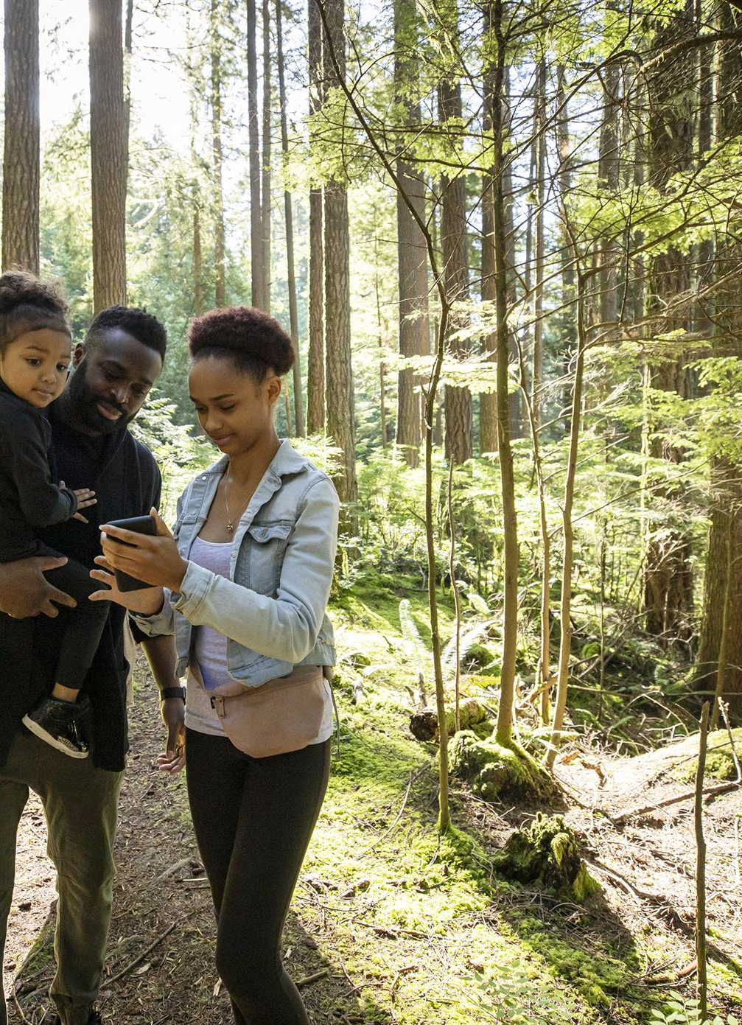
Case Study: Eco-Tourism Initiatives in Costa Rica
Biodiversity Conservation
  Costa Rica's eco-tourism initiatives focus on promoting biodiversity conservation by preserving the country's rich ecosystems and wildlife habitats.
Community Empowerment
  Costa Rica's eco-tourism initiatives empower local communities by involving them in tourism activities, creating opportunities for sustainable livelihoods and cultural preservation.
Sustainable Tourism Practices
  Costa Rica's eco-tourism initiatives promote sustainable tourism practices that minimize negative environmental impacts and support the long-term well-being of both the environment and local communities.
Notes:
Costa Rica is known for its innovative eco-tourism initiatives that promote biodiversity conservation, community empowerment, and sustainable tourism practices. The country's approach serves as a model for balancing tourism growth with environmental protection.

Slide 11
Marketing in Tourism
Notes:
Effective marketing strategies are essential for promoting destinations and attracting visitors. This section will discuss tourism marketing strategies, the role of digital marketing and social media, and a case study on promoting Iceland as a tourist destination.

Slide 12

Tourism Marketing Strategies
Destination Positioning
  Tourism marketing strategies focus on positioning destinations in the minds of potential travelers, highlighting unique features and attractions that set them apart from competitors.
Compelling Campaigns
  Creating compelling marketing campaigns is essential to attract tourists. These campaigns should be engaging, informative, and evoke a sense of wanderlust in the audience.
Targeting Market Segments
  Effective tourism marketing involves identifying and targeting specific market segments based on demographics, interests, and travel preferences to tailor promotional efforts and maximize reach.
Notes:
Tourism marketing strategies involve positioning destinations, creating compelling campaigns, and targeting specific market segments. Effective communication and branding help attract tourists and differentiate destinations in a competitive market.

Slide 13

Role of Digital Marketing and Social Media
Global Audience Reach
  Digital marketing and social media enable businesses to reach a global audience, expanding their reach and potential customer base beyond geographical boundaries.
Traveler Engagement
  Digital marketing and social media platforms provide opportunities for engaging with travelers in real-time, creating personalized interactions and enhancing their overall experience.
Influencing Decisions
  Digital marketing on platforms like Instagram, Facebook, and TripAdvisor can significantly impact travelers' perceptions, influencing their decision-making process and choices.
Notes:
Digital marketing and social media play a vital role in reaching a global audience, engaging with travelers, and influencing their decision-making process. Platforms like Instagram, Facebook, and TripAdvisor impact travelers' perceptions and choices.

Slide 14

Case Study: Promoting Iceland as a Tourist Destination
Visual Storytelling
  Iceland's promotion as a tourist destination is enhanced by stunning visuals that showcase the country's unique landscapes and attractions, capturing the attention of potential travelers.
Social Media Influence
  Iceland leverages social media influencers to reach a wider audience and create buzz about the country as a must-visit destination, influencing travel decisions and increasing visitor numbers.
Branding Strategy
  Iceland's successful marketing strategies demonstrate the importance of branding in promoting a destination, establishing a unique identity that resonates with travelers and sets the country apart from other destinations.
Notes:
Iceland's success in promoting itself as a unique travel destination through stunning visuals, engaging storytelling, and social media influencers has attracted a growing number of tourists. The country's marketing strategies showcase the power of branding and digital outreach.

Slide 15
Tourism Operations and Services
Notes:
Efficient management of tourism services and activities is essential for delivering exceptional visitor experiences. This section will cover topics such as managing services, ensuring quality, and a case study on customer service excellence at Disney Parks.

Slide 16

Managing Tourism Services and Activities
Tourism Services Overview
  Tourism services include accommodation, transportation, attractions, and experiences that enhance visitor satisfaction and overall travel experience.
Effective Management Approach
  Effective management of tourism services involves strategic planning, coordination between service providers, and a commitment to continuous improvement of service quality to meet visitor expectations.
Notes:
Tourism services encompass accommodation, transportation, attractions, and experiences that contribute to the overall visitor satisfaction. Effective management involves planning, coordination, and continuous improvement of service quality.

Slide 17
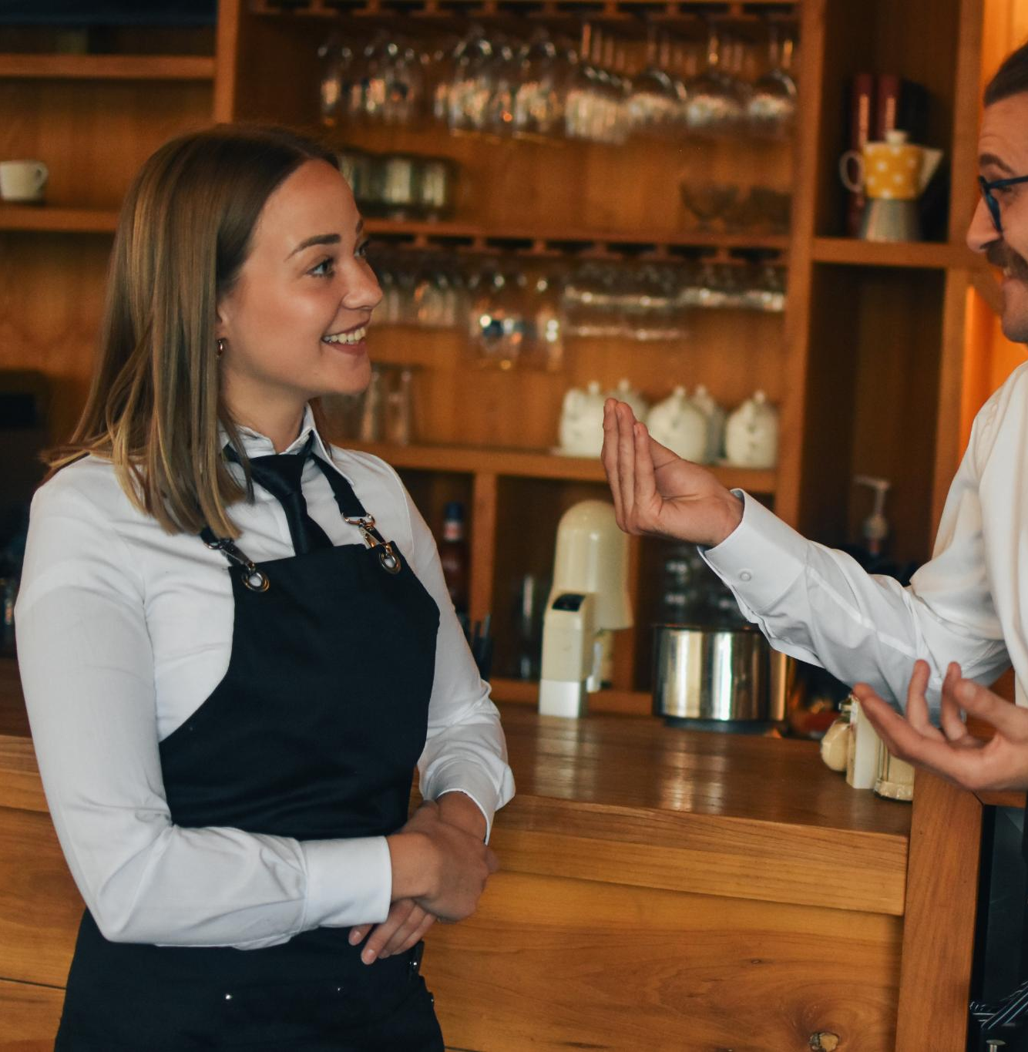
Quality Management in Tourism
Consistent Service Quality
  Focus on delivering consistent and high-quality services to meet visitor expectations, ensuring a positive experience for tourists.
Customer Feedback Monitoring
  Monitoring customer feedback is essential in quality management to identify areas for improvement and enhance overall service quality.
Notes:
Quality management focuses on delivering consistent and high-quality services to meet visitor expectations. It involves monitoring customer feedback, implementing standards, and training staff to ensure excellence in service delivery.

Slide 18

Case Study: Customer Service Excellence at Disney Parks
Exceptional Customer Service
  Disney Parks are known for providing exceptional customer service to guests, ensuring a memorable and magical experience for visitors of all ages.
Immersive Experiences
  Disney Parks offer immersive experiences that transport guests to magical worlds through detailed theming, storytelling, and interactive attractions.
Attention to Detail
  Attention to detail is a key aspect of Disney Parks' success, with meticulous planning and execution evident in every aspect of the guest experience, from attractions to dining options.
Notes:
Disney Parks are renowned for their exceptional customer service, immersive experiences, and attention to detail. The theme parks prioritize guest satisfaction through personalized interactions, efficient operations, and creating magical moments for visitors.

Slide 19
Economic, Social, and Environmental Impacts
Notes:
Tourism has diverse impacts on economies, societies, and environments. Understanding these impacts is crucial for sustainable tourism management. This section will explore economic benefits and challenges, social and cultural impacts, and environmental considerations.

Slide 20

Economic Benefits and Challenges of Tourism
Economic Growth
  Tourism can stimulate economic growth by creating job opportunities and generating revenue for destinations, contributing to the overall prosperity of the local economy.
Job Opportunities
  The tourism industry provides job opportunities across various sectors, from hospitality to transportation, boosting employment rates and supporting livelihoods in local communities.
Challenges of Tourism
  Despite its benefits, tourism faces challenges such as seasonality, over-tourism, and economic leakage that can have negative impacts on destinations and local communities if not managed effectively.
Notes:
Tourism can stimulate economic growth, create job opportunities, and generate revenue for destinations. However, it also faces challenges such as seasonality, over-tourism, and economic leakage that need to be addressed sustainably.

Slide 21
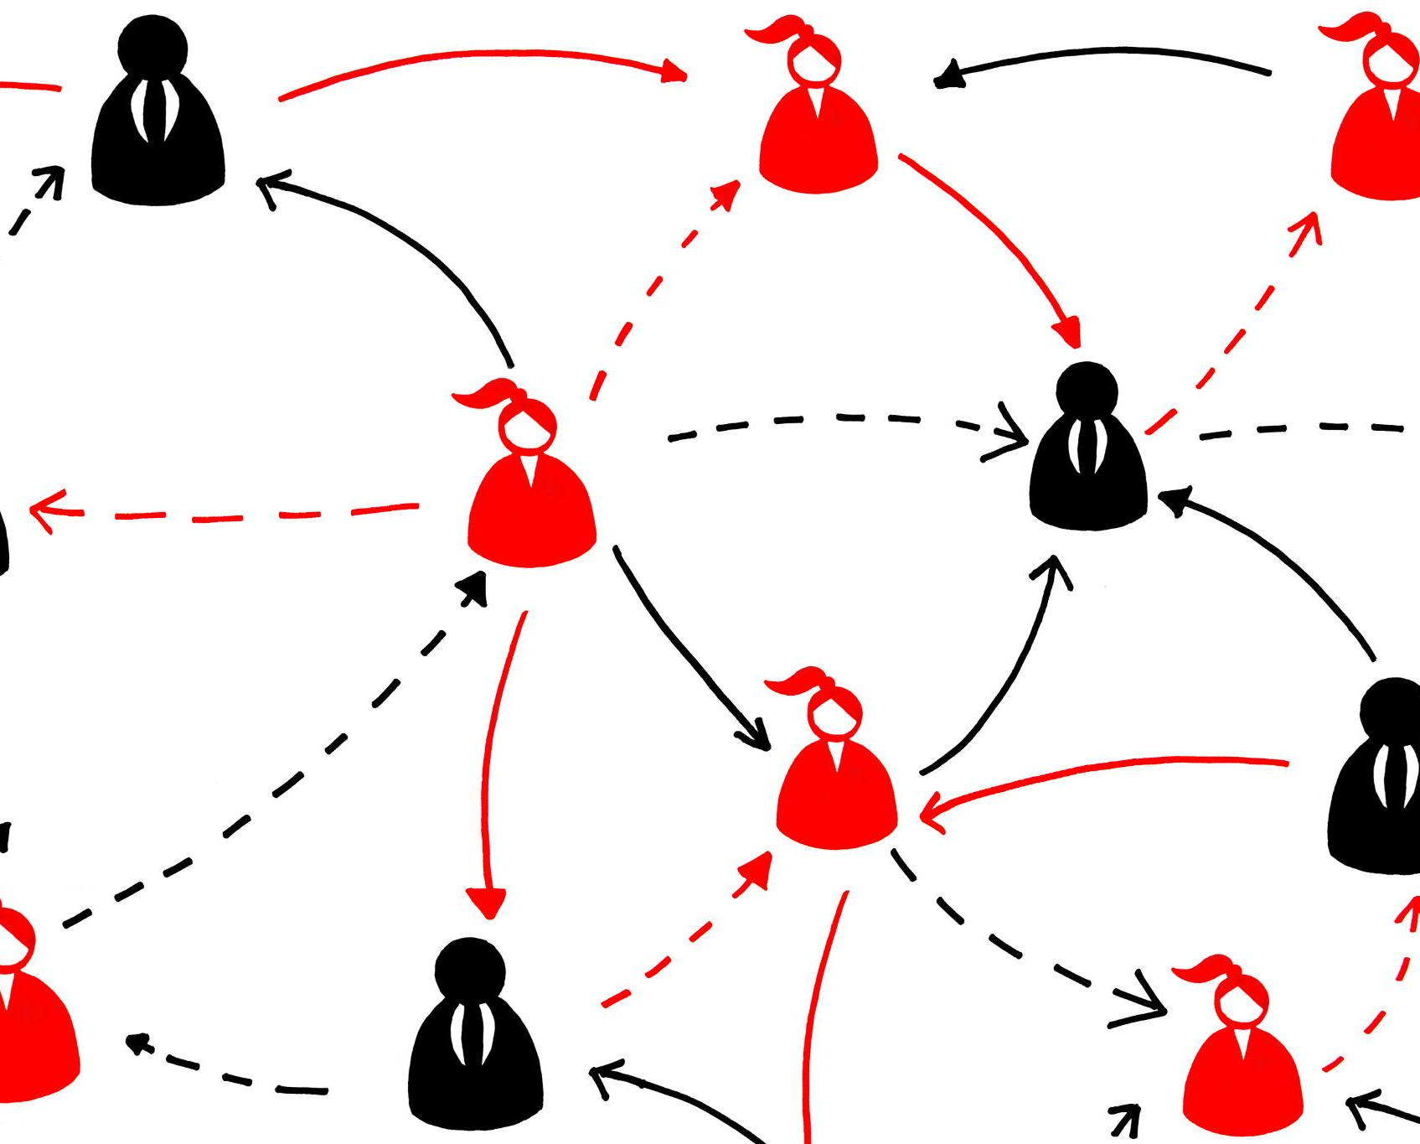
Social and Cultural Impacts
Promotion of Cultural Exchange
  Tourism promotes cultural exchange by bringing people from different backgrounds together, facilitating the sharing of traditions, customs, and beliefs.
Preservation of Heritage
  Tourism plays a vital role in preserving heritage sites, traditions, and practices, ensuring that they are passed down to future generations.
Social Tensions and Cultural Erosion
  Tourism can sometimes lead to social tensions and cultural erosion as a result of commercialization, overcrowding, and cultural misunderstandings.
Community Dynamics Changes
  Tourism can bring changes in community dynamics by altering local economies, social structures, and traditional ways of life, leading to both positive and negative impacts.
Notes:
Tourism influences local communities, cultures, and traditions. It can promote cultural exchange, preserve heritage, and foster social cohesion. At the same time, tourism can lead to cultural erosion, social tensions, and changes in community dynamics.

Slide 22

Environmental Considerations and Responsible Tourism
Positive Impacts of Tourism
  Tourism can positively contribute to local economies, cultural exchange, and preservation of heritage sites.
Responsible Tourism Practices
  Responsible tourism practices focus on minimizing environmental impacts, conserving natural resources, and supporting local communities for sustainable development.
Conservation Efforts
  Conservation efforts play a vital role in preserving natural landscapes, protecting wildlife habitats, and ensuring the long-term sustainability of tourism destinations.
Notes:
Tourism can have both positive and negative impacts on the environment. Responsible tourism practices aim to minimize environmental degradation, conserve natural resources, and promote sustainable development. Conservation efforts and eco-friendly initiatives are essential for preserving natural landscapes.

Slide 23
Future Trends and Innovations in Tourism Management
Notes:
The tourism industry is constantly evolving with technological advancements, changing consumer preferences, and emerging market trends. This section will explore future innovations, new market opportunities, and a case study on the rise of virtual and augmented reality in tourism.

Slide 24

Technological Advancements and Their Implications
AI in Tourism Industry
  Artificial Intelligence (AI) is revolutionizing the tourism industry by enabling personalized services and enhancing customer experiences through advanced algorithms and data analysis.
Big Data Analytics Impact
  Big Data Analytics is transforming the tourism sector by providing insights into customer behavior, preferences, and trends, leading to enhanced marketing strategies and personalized offerings.
Blockchain Technology Benefits
  Blockchain technology is revolutionizing the tourism industry by ensuring secure transactions, protecting customer data, and improving operational efficiency through decentralized processes.
Notes:
Technological advancements such as AI, big data analytics, and blockchain are reshaping the tourism industry. These innovations offer opportunities for personalization, enhanced customer experiences, and improved operational efficiency.

Slide 25
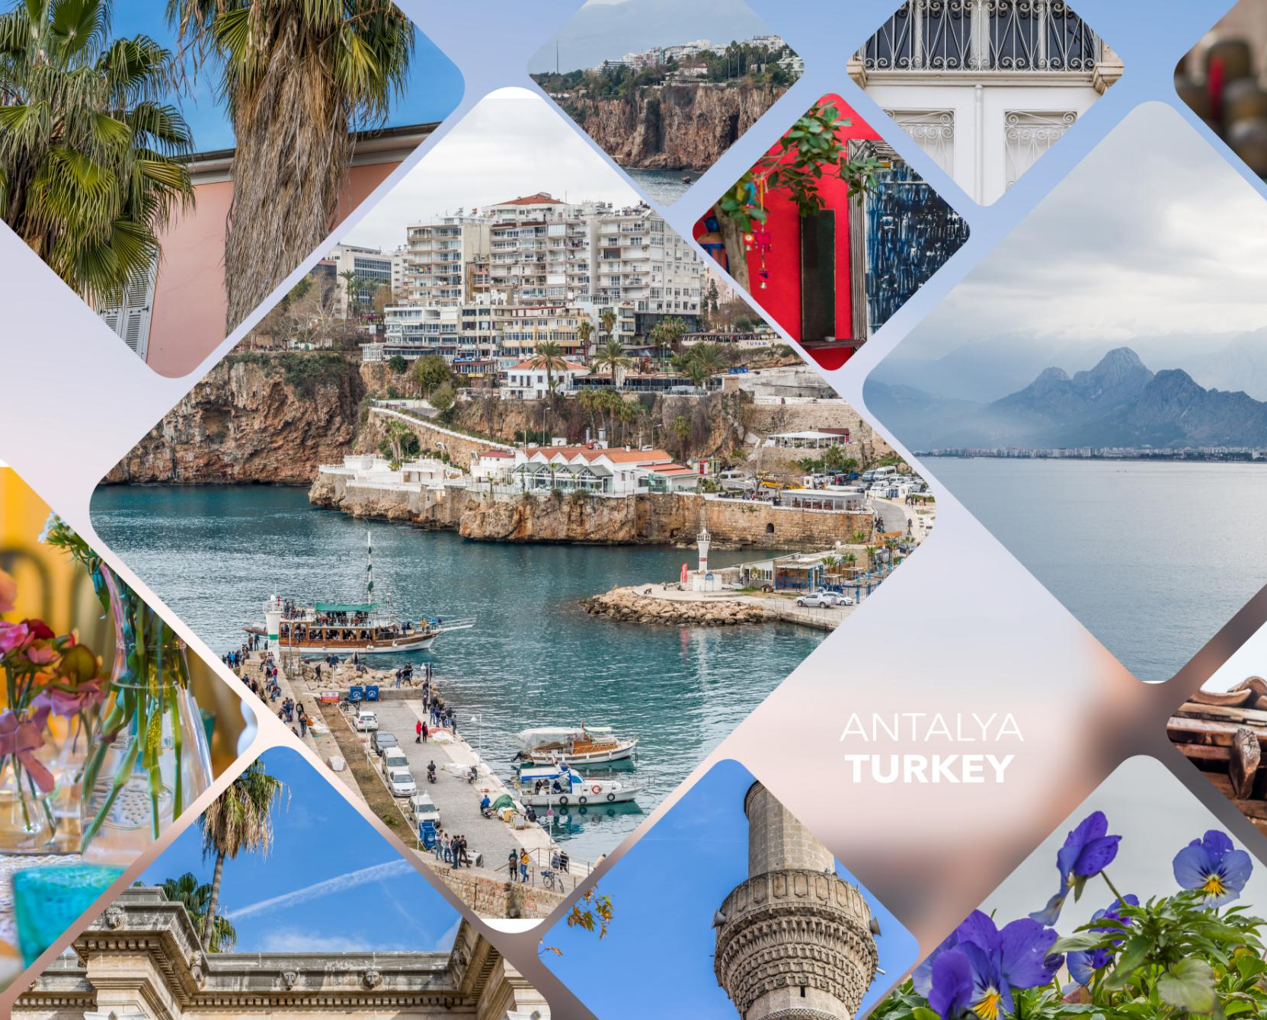
Emerging Trends and New Tourism Markets
Experiential Travel
  Experiential travel is a growing trend in tourism, focusing on authentic, immersive experiences that connect travelers with local culture and heritage.
Sustainable Tourism
  Sustainable tourism emphasizes responsible travel practices that conserve natural environments, support local communities, and promote cultural heritage preservation.
Wellness Tourism
  Wellness tourism focuses on promoting physical, mental, and spiritual well-being through activities like yoga retreats, spa treatments, and health-focused travel experiences.
New Tourism Markets
  New tourism markets are emerging due to changing demographics, preferences, and increased global connectivity, creating opportunities for innovative travel experiences and destinations.
Notes:
Emerging trends like experiential travel, sustainable tourism, and wellness tourism are reshaping the tourism landscape. New tourism markets are emerging, driven by changing demographics, preferences, and global connectivity.

Slide 26

Case Study: The Rise of Virtual and Augmented Reality in Tourism
Immersive Virtual Tours
  Virtual and augmented reality technologies offer travelers immersive virtual tours of destinations, allowing them to experience places virtually before visiting in person.
Interactive Attractions
  VR and AR technologies provide interactive attractions for travelers, creating engaging experiences and adding a new dimension to tourism.
Notes:
Virtual and augmented reality technologies are revolutionizing the travel experience by offering immersive virtual tours, interactive attractions, and engaging storytelling. These technologies are enhancing the way travelers research destinations and plan their trips.

Slide 27
Conclusion
Strategic Planning
Tourism management involves strategic planning to ensure the success of operations and the creation of memorable experiences for travelers.
Innovative Marketing
Innovative marketing strategies play a crucial role in attracting tourists and promoting destinations, enhancing the overall tourism experience.
Focus on Sustainability
Sustainability is essential in tourism management to preserve natural resources, protect local cultures, and ensure long-term success in the industry.
Notes:
Tourism management is a dynamic field that requires strategic planning, innovative marketing, quality operations, and a focus on sustainability. By understanding the diverse impacts of tourism and embracing future trends, industry professionals can drive positive change and create memorable experiences for travelers.

