Slide 1

Key Vocabulary in Tourism: Examples and Exercises
Exploring essential terms for effective communication in tourism
Notes:
Understanding key vocabulary in tourism is essential for effective communication and service delivery. In this presentation, we will explore various terms related to accommodation, hospitality, tourism infrastructure, consumer behavior, travel logistics, leisure activities, tourism economics, customer experience, and international tourism.

Slide 2
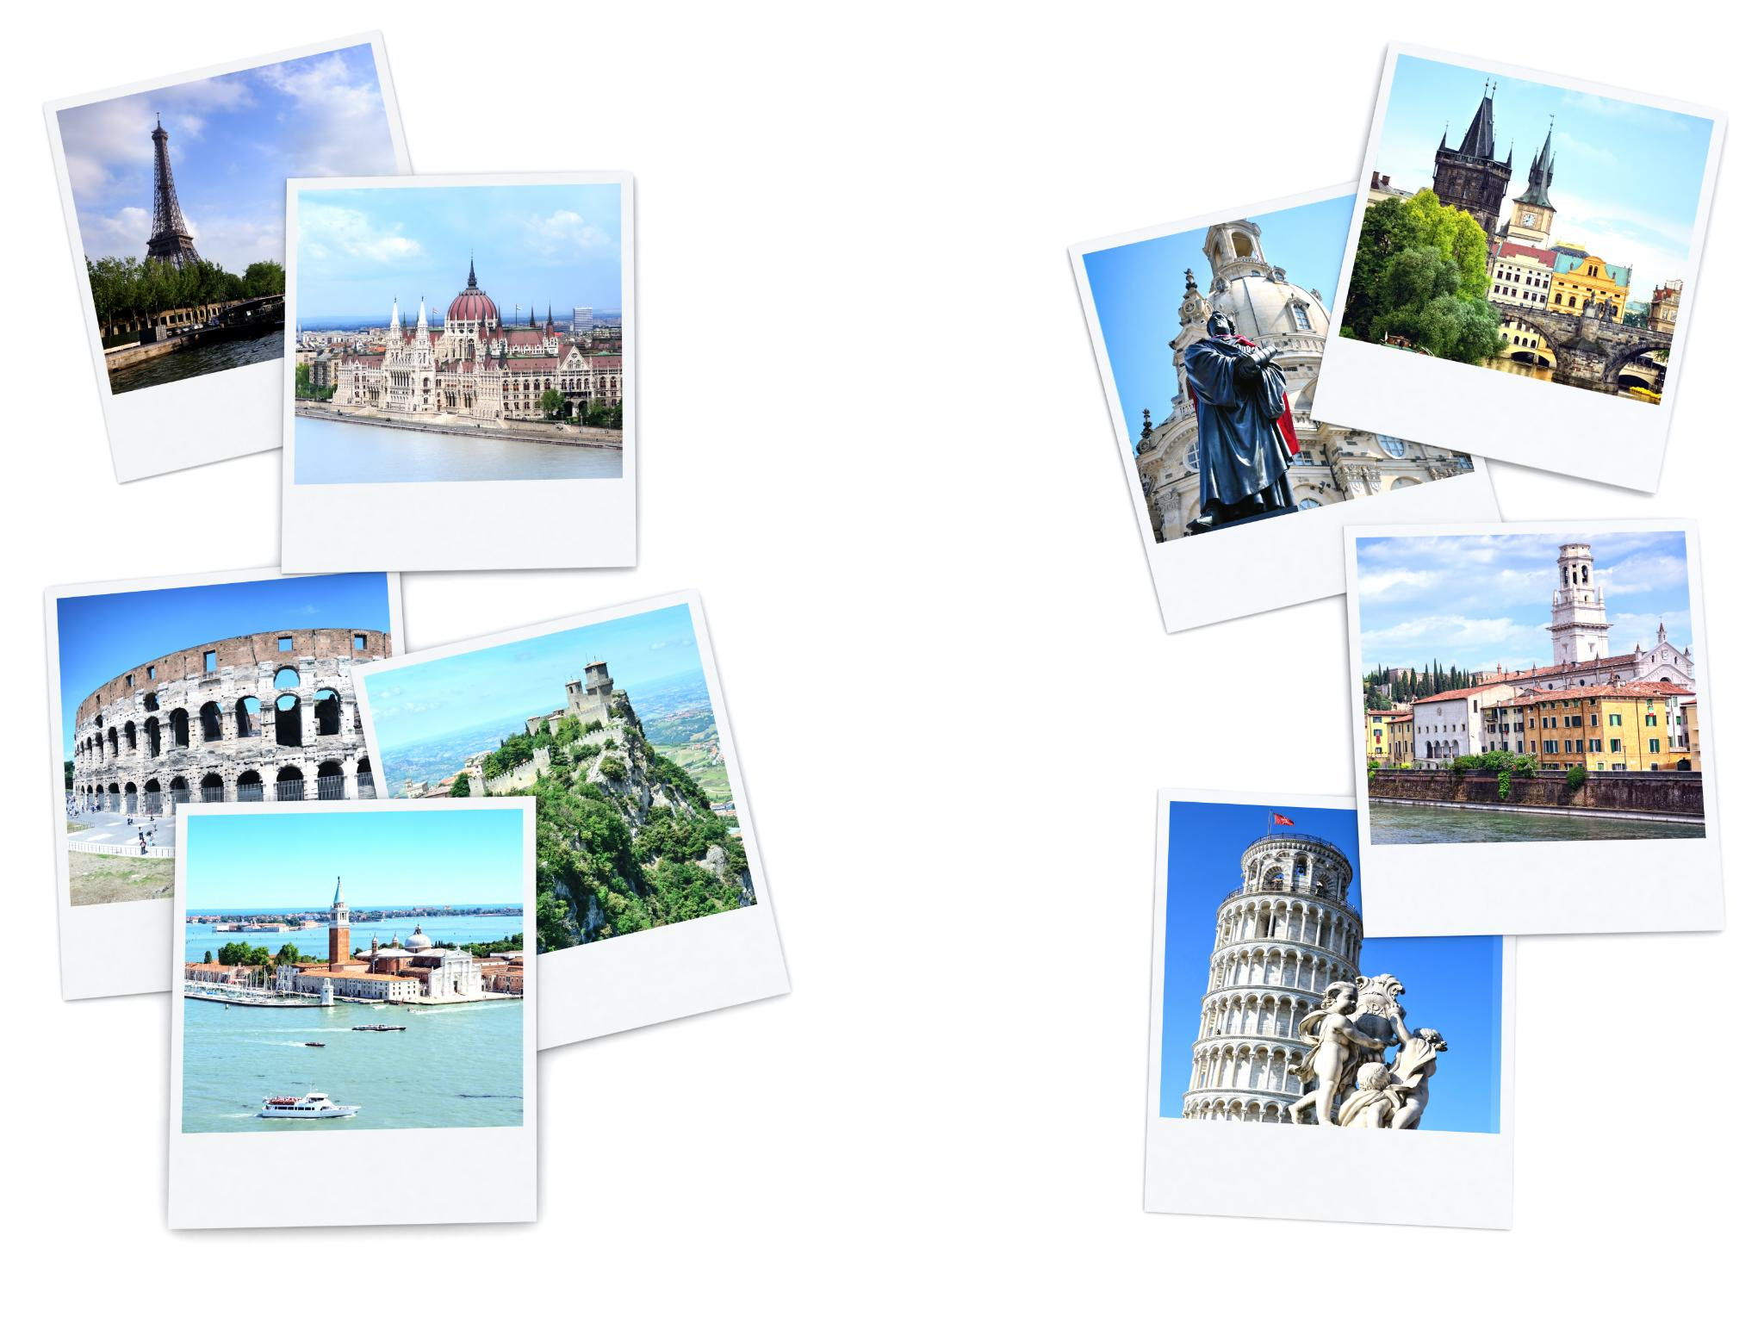
Agenda Items
Understanding Accommodation and Related Terms
Key Terms in Hospitality and Service
Tourism Infrastructure and Facilities
Consumer Behavior and Marketing in Tourism
Travel Logistics and Management
Leisure and Recreation in Tourism
Tourism Economics and Real Estate
Customer Satisfaction and Experience
International Tourism
Notes:
We will delve into the important vocabulary used in the tourism industry, focusing on accommodation, hospitality, infrastructure, consumer behavior, travel management, leisure activities, economics, customer satisfaction, and international travel. Each section will include definitions, examples, and interactive exercises.

Slide 3
Understanding Accommodation and Related Terms
Notes:
Accommodation plays a crucial role in the tourism sector. In this section, we will explore the definitions and usage of terms like 'accommodate' and 'accommodation', provide real-life examples, and engage in exercises to identify different types of accommodation.

Slide 4

Definitions and Usage of 'Accommodate' And 'Accommodation'
Definition of 'Accommodate'
  The term 'accommodate' means to provide lodging or space for someone, especially in the context of hospitality and tourism.
Definition of 'Accommodation'
  'Accommodation' refers to a place where people can stay temporarily, such as hotels, lodges, or guesthouses, crucial for the tourism industry.
Notes:
The term 'accommodate' refers to providing lodging or space for someone, while 'accommodation' refers to a place where people can stay temporarily. Understanding these terms is essential for effective communication in the tourism industry.

Slide 5

Examples and Real-Life Applications
  Real-life examples demonstrate the provision of accommodation services in various scenarios, aiding in the better understanding of accommodation-related terms.
Notes:
Real-life examples help illustrate how accommodation services are provided in different scenarios. By examining these examples, we can better understand the practical applications of accommodation-related terms.

Slide 6

Exercises: Identifying Different Types of Accommodation
Enhancing Knowledge and Vocabulary
  Engaging in exercises to identify different types of accommodation helps enhance knowledge and vocabulary in the tourism sector, leading to a deeper understanding of lodging options.
Differentiation Skills Improvement
  Practicing exercises to identify various types of accommodation can help improve our ability to distinguish between different lodging options, enabling better decision-making in the hospitality sector.
Notes:
Engaging in exercises to identify various types of accommodation enhances our knowledge and vocabulary in the tourism sector. By practicing these exercises, we can improve our ability to differentiate between different accommodation options.

Slide 7
Key Terms in Hospitality and Service
Notes:
Hospitality and service are at the core of the tourism industry. In this section, we will explore key terms like 'hospitality', 'host', 'guest', 'serve', and 'service', as well as the importance of staff and equipment in delivering exceptional service.

Slide 8

Definitions and Examples: 'Hospitality', 'Host', 'Guest', 'Serve', 'Service'
Hospitality Definition
  Hospitality involves the friendly and generous reception and entertainment of guests, creating a welcoming and pleasant atmosphere for visitors.
Host and Guest Relationship
  Understanding the roles of hosts and guests is essential in providing exceptional customer experiences. It involves creating positive interactions and experiences for visitors.
Service Providers
  Service providers play a crucial role in delivering exceptional customer experiences. They ensure that guests are taken care of and their needs are met effectively.
Notes:
Hospitality encompasses the friendly and generous reception and entertainment of guests. Understanding the roles of hosts, guests, and service providers is crucial for delivering exceptional customer experiences.

Slide 9

The Role of 'Staff' And 'Equipment' In the Hospitality Industry
Efficient Staff
  Efficient and well-trained staff play a crucial role in providing high-quality hospitality services. They are responsible for ensuring a positive guest experience.
Appropriate Equipment
  Having appropriate equipment is essential in the hospitality industry to enhance service quality. The right tools contribute to a seamless guest experience.
Notes:
Efficient and well-trained staff, along with appropriate equipment, are essential for providing high-quality hospitality services. Their roles contribute significantly to the overall guest experience.

Slide 10

Exercises: Creating Service Scenarios and Role-Plays
  Engaging in role-plays helps simulate real-life hospitality situations, enhancing customer service skills and problem-solving abilities.
Notes:
Engaging in role-plays and creating service scenarios allows us to simulate real-life hospitality situations. By practicing these exercises, we can enhance our customer service skills and problem-solving abilities.

Slide 11
Tourism Infrastructure and Facilities
Notes:
Infrastructure and facilities are vital components of the tourism industry. In this section, we will explore the importance of infrastructure, define terms like 'facilities', 'venue', 'terminal', and 'stadium/stadia', and engage in exercises to match facilities with their functions.

Slide 12
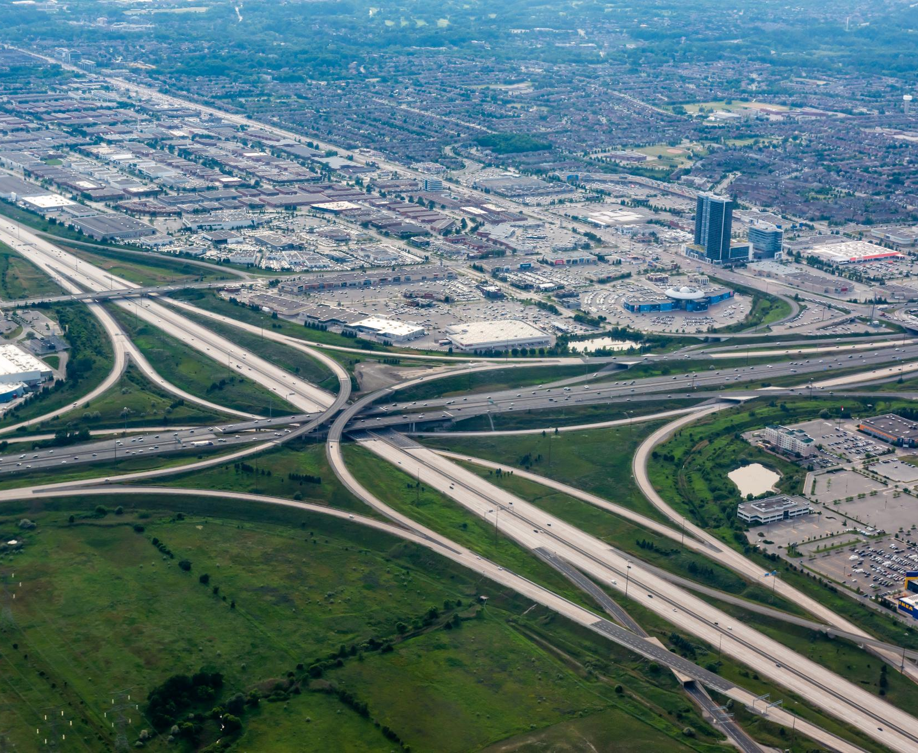
Understanding 'Infrastructure' And Its Importance in Tourism
Definition of Infrastructure
  Infrastructure encompasses the basic physical and organizational structures needed for the functioning of a society or entity.
Importance of Infrastructure in Tourism
  In the context of tourism, infrastructure plays a pivotal role in enhancing the overall travel experience, providing essential services and facilities for tourists.
Notes:
Infrastructure refers to the fundamental facilities and systems necessary for a society or organization to function. In the context of tourism, infrastructure plays a crucial role in supporting the travel experience.

Slide 13

Definitions and Examples of 'Facilities', 'Venue', 'Terminal', 'Stadium/Stadia'
Facilities
  Facilities refer to the physical structures or buildings that provide services or amenities to tourists. Examples include hotels, resorts, restaurants, and tourist attractions.
Venue
  A venue is a location where events or performances take place. Examples of venues in tourism include convention centers, theaters, and exhibition halls.
Terminal
  Terminals are points of transportation connection where travelers arrive or depart. Examples include airports, bus stations, cruise terminals, and train stations.
Stadium/Stadia
  Stadiums or stadia are large sports venues where athletic events and concerts are held. Examples include football stadiums, baseball parks, and concert arenas.
Notes:
Facilities, venues, terminals, and stadiums are key elements of tourism infrastructure. Understanding the functions and characteristics of these facilities is essential for providing quality services to travelers.

Slide 14
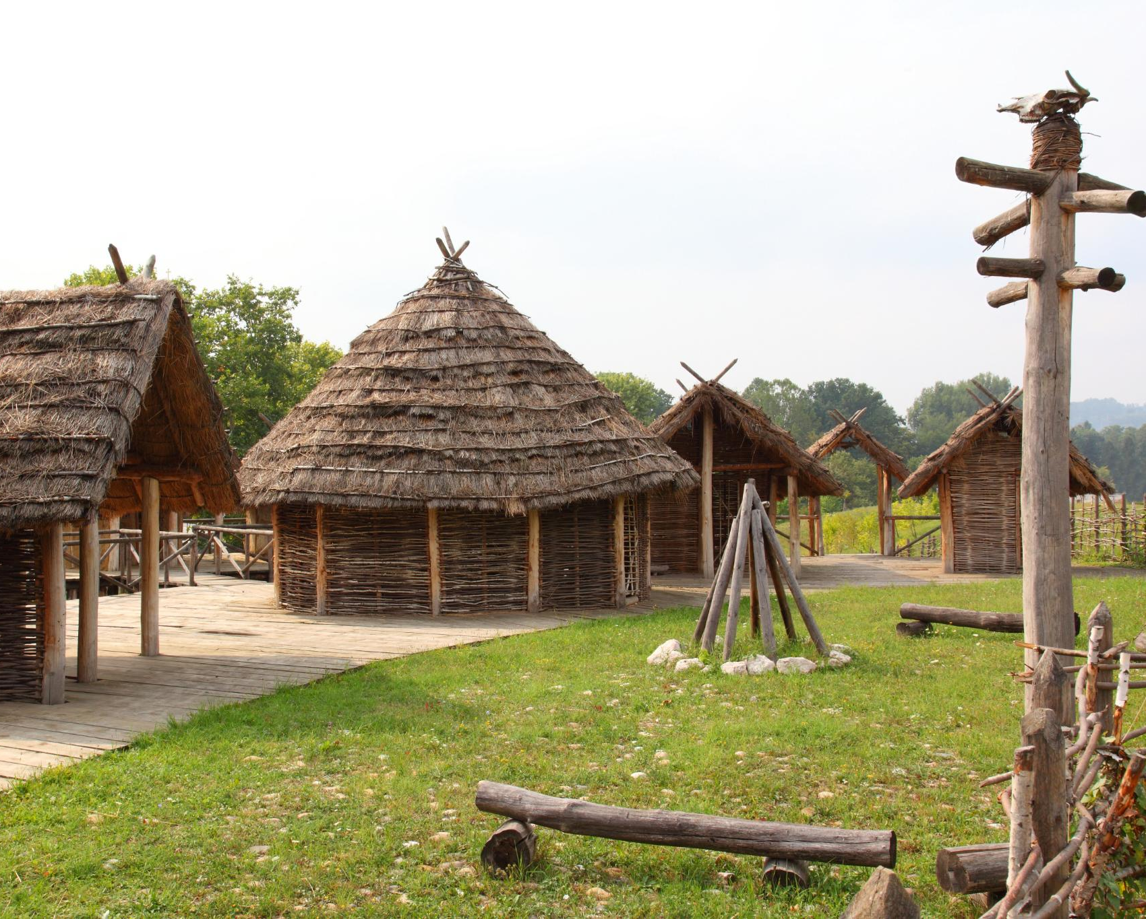
Exercises: Matching Facilities with Their Functions
Understanding Tourism Infrastructure
  Matching facilities with their functions aids in comprehending how various elements of tourism infrastructure enhance the overall travel experience.
Knowledge Enhancement
  Completing exercises that involve matching facilities with functions can enhance our knowledge and understanding of tourism facilities.
Notes:
Matching facilities with their respective functions helps us understand how different elements of tourism infrastructure contribute to the overall travel experience. By completing these exercises, we can improve our knowledge of tourism facilities.

Slide 15
Consumer Behavior and Marketing in Tourism
Notes:
Consumer behavior and marketing strategies play a crucial role in the success of tourism businesses. In this section, we will explore terms like 'consume', 'consumer', 'purchase', 'advertisement', 'promotion', 'promotional', as well as the difference between quantitative and qualitative research in tourism.

Slide 16

Definitions of 'Consume', 'Consumer', 'Purchase', 'Advertisement', 'Promotion', 'Promotional'
Consume
  The act of using a product or service by an individual or group for personal satisfaction or benefit.
Consumer
  A person or organization that uses economic goods or services for personal use or consumption.
Purchase
  The act of buying a product or service in exchange for money or other valuable consideration.
Advertisement
  A communication strategy used to promote or sell products, services, or ideas to consumers.
Promotion
  Marketing activities that aim to increase the sales of a product or service through communication and persuasion.
Promotional
  Related to or involved in the promotion of a product or service through marketing activities.
Notes:
Understanding consumer behavior and marketing concepts is essential for designing effective promotional strategies in the tourism industry. Terms like 'consume', 'consumer', 'purchase', 'advertisement', 'promotion', and 'promotional' are fundamental in this context.

Slide 17

Quantitative Vs. Qualitative Research and Its Application in Tourism
Quantitative Research in Tourism
  Quantitative research methods in tourism focus on numerical data and statistical analysis to understand consumer preferences and behavior. It provides measurable insights for businesses to make data-driven decisions.
Qualitative Research in Tourism
  Qualitative research methods in tourism involve in-depth exploration of consumer preferences and behavior through interviews, observations, and case studies. It provides rich, descriptive insights for businesses to understand the 'why' behind consumer actions.
Notes:
Quantitative and qualitative research methods provide valuable insights into consumer preferences and behavior in the tourism sector. By exploring these research approaches, businesses can better understand their target audience and tailor their marketing strategies accordingly.

Slide 18

Exercises: Analyzing Marketing Strategies and Consumer Behavior
Practical Application of Theoretical Knowledge
  Exercises help in applying theoretical marketing knowledge to real-world scenarios, enabling a deeper understanding of marketing strategies and consumer behavior.
Evaluation of Marketing Approaches
  Through exercises, we can evaluate various marketing approaches to understand their impact on consumer behavior and overall marketing effectiveness.
Notes:
Analyzing marketing strategies and consumer behavior through exercises allows us to apply theoretical knowledge to practical scenarios. By evaluating different marketing approaches and consumer responses, we can enhance our understanding of effective marketing practices in tourism.

Slide 19
Travel Logistics and Management
Notes:
Efficient travel logistics and management are essential for smooth operations in the tourism industry. In this section, we will explore key terms like 'destination', 'transit route', 'transport', 'travel agency', and 'travel agent', as well as booking processes and terminology.

Slide 20

Key Terms: 'Destination', 'Transit Route', 'Transport', 'Travel Agency', 'Travel Agent'
Destination
  The destination is the place to which a person or cargo is going. It is the final point of a journey or the endpoint of a transportation route.
Transit Route
  A transit route is a specific path taken by vehicles or travelers to reach a destination. It includes stops, waypoints, and modes of transportation used during the journey.
Transport
  Transport refers to the movement of people or goods from one place to another. It includes various modes such as air, land, and water transportation.
Travel Agency
  A travel agency is a business that assists individuals or groups in planning and booking travel arrangements, including flights, accommodations, and tours.
Travel Agent
  A travel agent is a person who works for a travel agency and helps clients with arranging, booking, and managing their travel plans to ensure a smooth and enjoyable trip.
Notes:
Understanding terms related to travel logistics is crucial for planning and executing successful trips. Concepts like destination, transit route, transport, travel agency, and travel agent play a significant role in facilitating smooth travel experiences.

Slide 21
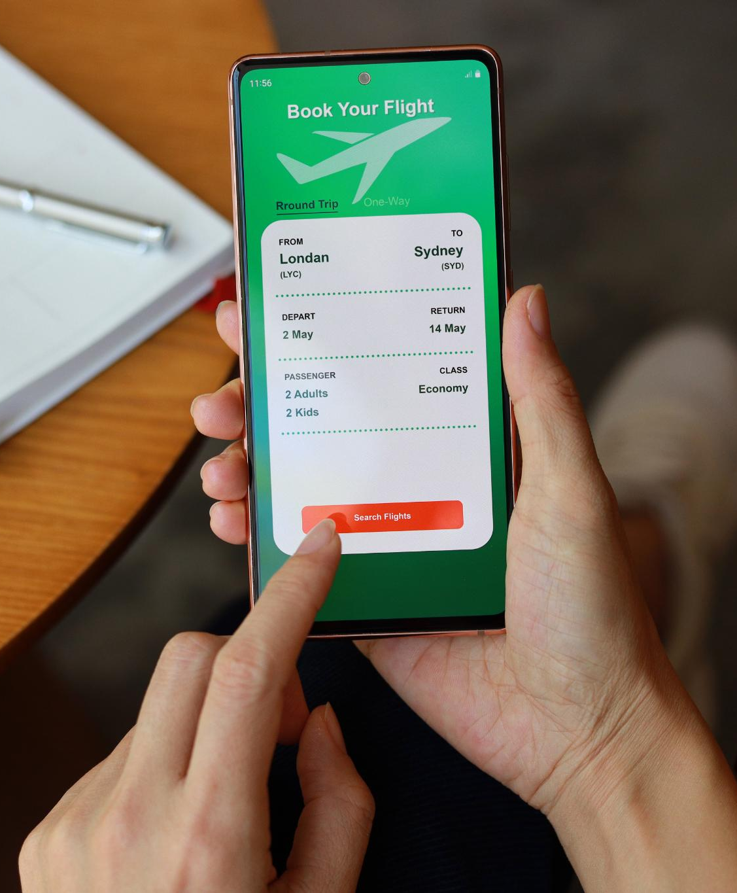
Booking Processes: 'Book', 'Check In', 'Check-In', 'Overbook', 'Reconfirm', 'Reservation', 'Ticket'
Reservation
  Making a reservation is the initial step in the booking process, ensuring a place is secured for the traveler's journey.
Check-In
  Check-in involves confirming the traveler's presence for the journey and receiving necessary travel documents.
Ticket
  Tickets are essential documents that grant travelers access to their chosen transportation mode, be it a flight, train, or bus.
Notes:
Booking processes involve a series of steps, from making reservations to checking in and receiving tickets. Familiarizing ourselves with booking terminology helps ensure efficient travel management and customer satisfaction.

Slide 22

Exercises: Creating Travel Itineraries and Role-Playing Booking Scenarios
Travel Itinerary Creation
  Creating travel itineraries helps in organizing trips efficiently and ensuring a smooth travel experience for clients. It involves selecting destinations, modes of transportation, accommodations, and activities.
Role-Playing Booking Scenarios
  Role-playing booking scenarios involve simulating real-life interactions with clients, practicing booking procedures, handling customer inquiries, and resolving issues effectively to enhance customer service skills.
Notes:
Creating travel itineraries and role-playing booking scenarios allow us to practice organizing trips and handling booking procedures. By engaging in these exercises, we can improve our travel planning skills and customer service abilities.

Slide 23
Leisure and Recreation in Tourism
Notes:
Leisure and recreation activities are essential components of the tourism experience. In this section, we will explore terms like 'leisure', 'recreation', 'relaxation', 'event', 'theme park', as well as the concept of mass travel and overnight stays.

Slide 24

Definitions and Examples: 'Leisure', 'Recreation', 'Relaxation', 'Event', 'Theme Park'
Leisure
  Leisure refers to free time activities that provide relaxation and enjoyment, such as reading, watching movies, or engaging in hobbies.
Recreation
  Recreation involves activities done for enjoyment and relaxation, such as sports, games, or outdoor adventures, aiming to recharge and rejuvenate.
Relaxation
  Relaxation refers to the state of being free from tension and stress, achieved through activities like meditation, spa treatments, or enjoying nature.
Event
  An event is a planned occasion or activity that gathers people for a specific purpose, such as concerts, festivals, conferences, or sports competitions.
Notes:
Leisure activities provide opportunities for relaxation, enjoyment, and entertainment during travel. Understanding the various forms of leisure, recreation, and events helps in planning memorable experiences for travelers.

Slide 25

Understanding 'Mass Travel' And 'Overnight' Stays
Mass Travel
  Mass travel involves the movement of large groups of people for leisure or business purposes. It plays a significant role in shaping travel trends and preferences.
Overnight Stays
  Overnight stays refer to accommodations where guests spend the night. Understanding this concept is crucial in the hospitality and travel industry.
Notes:
Mass travel involves the movement of large groups of people for leisure or business purposes. Overnight stays refer to accommodations where guests spend the night. Exploring these concepts enhances our understanding of travel trends and preferences.

Slide 26

Exercises: Planning Leisure Activities and Events
Engaging Leisure Activities
  Engaging in exercises to plan leisure activities allows for the creation of memorable experiences for travelers, enhancing overall satisfaction.
Unique Event Design
  Designing unique leisure programs and events caters to diverse preferences, ensuring a personalized and memorable experience for travelers.
Notes:
Engaging in exercises to plan leisure activities and events allows us to create engaging and memorable experiences for travelers. By designing unique leisure programs and events, we can cater to diverse preferences and enhance customer satisfaction.

Slide 27
Tourism Economics and Real Estate
Notes:
Economic factors and real estate play significant roles in shaping the tourism industry. In this section, we will explore terms like 'real estate', 'subsidized', 'impact', and examine the concept of 'charge' in the context of tourism.

Slide 28

Definitions and Implications of 'Real Estate', 'Subsidized', 'Impact'
Real Estate in Tourism
  Real estate comprises properties, land, and buildings utilized in the tourism sector, playing a vital role in the industry's infrastructure and development.
Subsidies in Real Estate
  Understanding subsidies in real estate involves analyzing financial assistance provided to support property investments, impacting market dynamics and affordability.
Economic Impact
  The economic impact of real estate investments influences local economies and communities, emphasizing the importance of strategic planning for sustainable growth.
Notes:
Real estate refers to properties, land, and buildings used in the tourism sector. Understanding the implications of real estate investments, subsidies, and economic impacts helps in making informed decisions and strategic planning.

Slide 29

Understanding 'Charge' As Both Noun and Verb in Tourism Context
Charge as Noun
  In tourism, 'charge' as a noun refers to the price or cost of services provided to customers, impacting pricing strategies and financial management.
Charge as Verb
  'Charge' as a verb in tourism refers to the act of imposing a fee or cost for specific services, influencing financial transactions and customer interactions.
Notes:
The term 'charge' can be used as both a noun and a verb in the tourism context. It refers to the price or cost of services provided. Exploring the different meanings and applications of 'charge' is essential for pricing strategies and financial management in tourism.

Slide 30

Exercises: Case Studies on Tourism Economics and Real Estate Investments
Tourism Economics Case Studies
  Studying case studies on tourism economics helps apply economic principles to real-world situations, providing insights into financial implications of tourism projects.
Real Estate Investments Case Studies
  Exploring case studies on real estate investments aids in understanding financial implications of property developments, enhancing knowledge of the real estate industry.
Notes:
Analyzing case studies on tourism economics and real estate investments allows us to apply economic principles to real-world scenarios. By exploring the financial implications of tourism projects and property developments, we can enhance our understanding of the industry.

Slide 31
Customer Satisfaction and Experience
Notes:
Customer satisfaction and experience are key indicators of success in the tourism sector. In this section, we will explore terms like 'experience', 'dissatisfaction', 'satisfaction', and examine the impact of 'environment' and 'information' on customer perceptions.

Slide 32

Key Terms: 'Experience', 'Dissatisfaction', 'Satisfaction'
Exceptional Customer Experiences
  Delivering exceptional customer experiences is crucial in the tourism industry to create positive interactions and build long-lasting relationships with customers.
Dissatisfaction Management
  Managing dissatisfaction effectively is key to addressing customer concerns and improving service quality to prevent negative experiences and feedback.
Ensuring Customer Satisfaction
  Ensuring customer satisfaction is a primary focus for tourism businesses to meet customer expectations and enhance loyalty, leading to positive reviews and referrals.
Notes:
Providing exceptional customer experiences and ensuring satisfaction are fundamental goals in the tourism industry. Terms like 'experience', 'dissatisfaction', and 'satisfaction' guide businesses in delivering high-quality services and fostering positive relationships with customers.

Slide 33

The Role of 'Environment' And 'Information' In Customer Satisfaction
Physical Environment Impact
  The physical environment plays a crucial role in customer satisfaction, creating welcoming spaces can enhance customer experiences and increase loyalty.
Quality of Information
  Providing accurate and relevant information to customers is essential for their satisfaction levels and influences their overall experience with a business.
Notes:
The physical environment and quality of information provided to customers significantly influence their satisfaction levels. By creating welcoming spaces and offering accurate information, businesses can enhance customer experiences and loyalty.

Slide 34

Exercises: Evaluating Customer Feedback and Improving Services
Customer Feedback Evaluation
  Evaluating customer feedback is crucial for understanding customer needs and expectations, leading to the improvement of services and overall customer satisfaction.
Service Improvement Strategies
  Implementing service improvements based on customer feedback helps businesses enhance their offerings, address weaknesses, and meet customer expectations effectively.
Notes:
Evaluating customer feedback and implementing service improvements are essential for maintaining high levels of customer satisfaction. By analyzing feedback and addressing areas for enhancement, businesses can continuously enhance their services and meet customer expectations.

Slide 35
International Tourism
Notes:
International tourism involves unique challenges and considerations due to cross-border travel. In this section, we will explore the concept of 'international' tourism, examine examples of international destinations, and engage in exercises to plan an international trip.

Slide 36
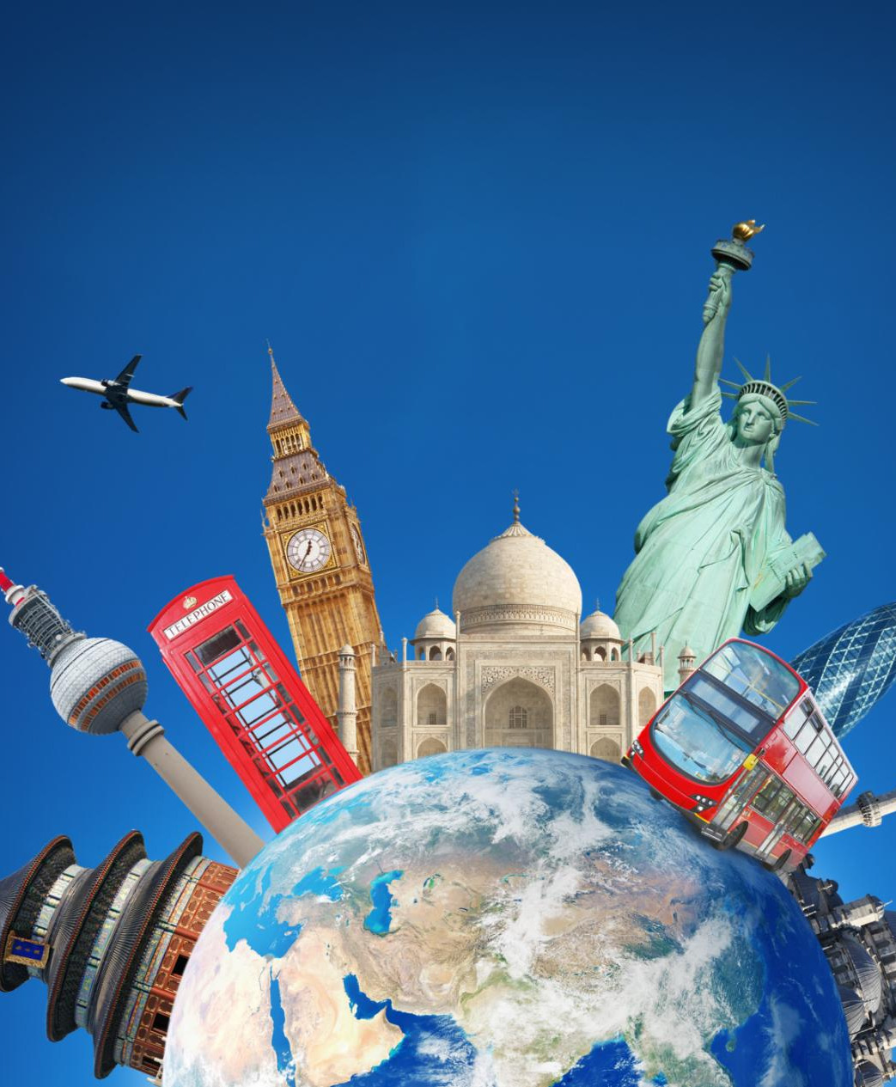
Understanding 'International' Tourism and Its Challenges
Cultural Differences
  International tourism brings travelers into contact with diverse cultures, customs, and traditions, leading to a greater understanding and appreciation of global diversity.
Language Barriers
  Language differences can pose challenges in international travel, emphasizing the importance of learning basic phrases and using translation tools to facilitate communication.
Regulations and Compliance
  Navigating international regulations and compliance requirements is crucial for a smooth travel experience, ensuring travelers adhere to local laws and customs.
Notes:
International tourism entails travel across national boundaries, presenting challenges related to cultural differences, language barriers, and regulations. Exploring the complexities of international travel enhances our preparedness for global tourism encounters.

Slide 37

Examples of International Destinations and Travel Considerations
Diverse International Destinations
  International destinations provide travelers with a wide range of experiences and attractions to explore, from bustling cities to serene beaches and natural wonders.
Travel Considerations for International Trips
  Understanding key travel considerations, such as visa requirements, currency exchange rates, and cultural norms, is essential for planning successful and stress-free international trips.
Notes:
International destinations offer diverse experiences and attractions for travelers. Understanding travel considerations, such as visa requirements, currency exchange, and cultural norms, is crucial for planning successful international trips.

Slide 38

Exercises: Planning an International Trip
Itinerary Creation
  Creating a detailed itinerary is crucial for planning an international trip, ensuring that all activities and destinations are well-coordinated and organized.
Logistical Arrangements
  Making logistical arrangements such as booking flights, accommodations, and transportation is essential for a smooth international travel experience.
Skill Enhancement
  Engaging in exercises to plan international travel can enhance skills in trip organization, time management, budgeting, and cross-cultural communication, leading to a more enriching and successful trip.
Notes:
Planning an international trip involves coordinating various aspects, from itinerary creation to logistical arrangements. By engaging in exercises to plan international travel, we can enhance our skills in trip organization and cross-cultural communication.

Slide 39
Conclusion
Importance of Key Vocabulary
Mastering key vocabulary in tourism is crucial for effective communication, service delivery, and ensuring customer satisfaction in the industry.
Enhancing Skills and Excelling
By understanding and applying key terms through examples and exercises, individuals can enhance their skills and excel in various roles within the dynamic field of tourism.
Notes:
Mastering key vocabulary in tourism is essential for effective communication, service delivery, and customer satisfaction in the industry. By understanding and applying these terms through examples and exercises, individuals can enhance their skills and excel in various roles within the dynamic field of tourism.

