Slide 1
Ατμοσφαιρική Ρύπανση (ΕΕΕ423)
Μάθημα 1^{ο}
Ιστορία της Ατμοσφαιρικής ρύπανσης
και έρευνας

Slide 2
Δομή Μαθήματος
Ορισμοί βασικών εννοιών
Ανακάλυψη στοιχείων και ενώσεων
Εξέλιξη της ατμόσφαιρας
Εξέλιξη της μελέτης της ρύπανσης της Ατμόσφαιρας
Θέματα επιστημονικού ενδιαφέροντος και αιχμής
Ατμοσφαιρική ρύπανση: Έρευνα στην Ελλάδα
Πρόγραμμα διδασκαλίας μαθήματος

Slide 3
Ορισμοί βασικών εννοιών (1/3): Ατμόσφαιρα της γης
Είναι το στρώμα αερίων – «ο αέρας» - που περιβάλλει τον πλανήτη μας, συγκρατείται από την βαρύτητα και προστατεύει τη ζωή στη Γη
Notes:
The atmosphere of Earth is the layer of gases, commonly known as air, that surrounds the planet Earth and is retained by Earth's gravity.
The atmosphere of Earth protects life on Earth by absorbing ultraviolet solar radiation, warming the surface through heat retention (greenhouse effect), and reducing temperature extremes between day and night (the diurnal temperature variation).
The atmosphere is actually very thin compared to the size of the earth, equivalent in thickness to a piece of paper laid over a beach ball. However, it is responsible for keeping our earth habitable and for producing weather.
Η ατμόσφαιρα είναι εκείνη, που συγκρατεί την υπεριώδη ακτινοβολία μικρού μήκους κύματος, μέρος από τη κοσμική ακτινοβολία, είναι εκείνη που προκαλεί τους χρωματισμούς του ουρανού και των νεφών, ενώ συγχρόνως αποτελεί το μέσον στη διάδοση του ήχου, αλλά και στη διάχυση του φωτός.
Το ατμοσφαιρικό στρώμα μέχρι τα 80-100 χιλιόμετρα ύψος ονομάζεται ομοιόσφαιρα, καθώς επικρατούν συνθήκες πλήρους μίξης και ο αέρας έχει σταθερό μοριακό βάρος. Πάνω από αυτό το όριο (τυρβόπαυση) υπάρχει η ετερόσφαιρα. Η πυκνότητα εκεί είναι τόσο μικρή που τα μόρια και τα άτομα συγκρούονται λιγότερο συχνά με αποτέλεσμα τα αέρια να διαστρωματώνονται ανάλογα με το μοριακό τους βάρος. Επίσης, ουσίες που φυσιολογικά είναι αντιδραστικές (π.χ. τα ελεύθερα ριζικά) παρουσιάζουν μεγάλους χρόνους παραμονής στην ετερόσφαιρα
Η χημική σύνθεση της ατμόσφαιρας μέχρι το ύψος των 80-100 χλμ. είναι σχεδόν αμετάβλητη. Ανάλογα όμως της μεταβολής της θερμοκρασίας διακρίνονται σε αυτή τα ακόλουθα στρώματα:
Τροπόσφαιρα, από ύψος 0 μέχρι 9-18 χλμ. (ανάλογα με το γεωγραφικό πλάτος) όπου και η τροπόπαυση.
The constant motion in this layer is significant in discussing air quality because it results in the dispersion of pollutants. In one respect this dispersion is considered beneficial because it has the effect of diluting pollutants, which can reduce harmful impacts on a local level. On the other hand, this dispersion also results in the movement of air pollutants (and therefore air pollution problems) from areas of high pollution production to areas of lower production. For example, pollutants produced in an industrialized and heavily populated city often adversely impact smaller communities and ecosystems in a large surrounding area.
Στρατόσφαιρα, από την τροπόπαυση μέχρι τα 50 χλμ. όπου και η στρατόπαυση.
pollutants in the stratosphere do not disperse, and tend to remain in the atmosphere for long periods of time.
Μεσόσφαιρα, από την στρατόπαυση μέχρι τα 80 χλμ. όπου και η μεσόπαυση.
Θερμόσφαιρα ή Ιονόσφαιρα, από την μεσόπαυση μέχρι 800 χλμ. όπου η θερμόπαυση. Σε αυτό το κομμάτι της ατμόσφαιρας βρίσκεται ο Διεθνής Διαστημικός Σταθμός ISS. Και τέλος
Εξώσφαιρα, από θερμόπαυση μέχρι 3.500 χλμ.

Slide 4
Ορισμοί βασικών εννοιών (2/3): Ατμοσφαιρικοί ρύποι
Είναι οι ουσίες (χημικά, σωματίδια, βιολογικό υλικό) που εισάγονται στην ατμόσφαιρα κυρίως από την ανθρωπογενή δραστηριότητα και δημιουργούν δυσανεξία στους οργανισμούς και στο οικοσύστημα
Notes:
http://www.explainthatstuff.com/air-pollution-introduction.html
Air pollution is the introduction into the atmosphere of chemicals, particulate matter or biological materials that cause harm or discomfort to organisms.
CO, SO2, O3, Nox, VOCs, Particulates, Toxic metals
Sulfur dioxide: Coal, petroleum, and other fuels are often impure and contain sulfur as well as organic (carbon-based) compounds. When sulfur (spelled "sulphur" in some countries) burns with oxygen from the air, sulfur dioxide (SO₂) is produced. Coal-fired power plants are the world's biggest source of sulfur-dioxide air pollution, which contributes to smog, acid rain, and health problems that include lung disease.
Carbon monoxide: This highly dangerous gas forms when fuels have too little oxygen to burn completely. It spews out in car exhausts and it can also build up to dangerous levels inside your home if you have a poorly maintained gas boiler, stove, or fuel-burning appliance. (Always fit a carbon monoxide detector if you burn fuels indoors.)
Carbon dioxide: This gas is central to everyday life and isn't normally considered a pollutant: we all produce it when we breathe out and plants such as crops and trees need to "breathe" it in to grow. However, carbon dioxide is also a greenhouse gas released by engines and power plants. Since the beginning of the Industrial Revolution, it's been building up in Earth's atmosphere and contributing to the problem of global warming and climate change.
Nitrogen oxides: Nitrogen dioxide (NO₂) and nitrogen oxide (NO) are pollutants produced as an indirect result of combustion, when nitrogen and oxygen from the air react together. Nitrogen oxide pollution comes from vehicle engines and power plants, and plays an important role in the formation of acid rain, ozone and smog. Nitrogen oxides are also "indirect greenhouse gases" (they contribute to global warming by producing ozone, which is a greenhouse gas).
Volatile organic compounds (VOCs): These carbon-based (organic) chemicals evaporate easily at ordinary temperatures and pressures, so they readily become gases. That's precisely why they're used as solvents in many different household chemicals such as paints, waxes, and varnishes. Unfortunately, they're also a form of air pollution: they're believed to have long-term (chronic) effects on people's health and they also play a role in the formation of ozone and smog.
Particulates: These are the sooty deposits in air pollution that blacken buildings and cause breathing difficulties. Particulates of different sizes are often referred to by the letters PM followed by a number, so PM₁₀ means soot particles of less than 10 microns (10 millionths of a meter or 10µm in diameter). In cities, most particulates come from traffic fumes.
Ozone: Also called trioxygen, this is a type of oxygen gas whose molecules are made from three oxygen atoms joined together (so it has the chemical formula O₃), instead of just the two atoms in conventional oxygen (O₂). In the stratosphere (upper atmosphere), a band of ozone ("the ozone layer") protects us by screening out harmful ultraviolet radiation (high-energy blue light) beaming down from the Sun. At ground level, it's a toxic pollutant that can damage health. It forms when sunlight strikes a cocktail of other pollution and is a key ingredient of smog (see box below).
Chlorofluorocarbons (CFCs): Once thought to be harmless, these gases were widely used in refrigerators and aerosol cans until it was discovered that they damaged Earth's ozone layer. We discuss this in more detail down below.
Unburned hydrocarbons: Petroleum and other fuels are made of organic compounds based on chains of carbon and hydrogen atoms. When they burn properly, they're completely converted into harmless carbon dioxide and water; when they burn incompletely, they can release carbon monoxide or float into the air in their unburned form, contributing to smog.
Lead and heavy metals: Lead and other toxic "heavy metals" can be spread into the air either as toxic compounds or as aerosols(when solids or liquids are dispersed through gases and carried through the air by them) in such things as exhaust fumes and the fly ash (contaminated waste dust) from incinerator smokestacks.

Slide 5
Σύσταση της ατμόσφαιρας
Ορισμοί βασικών εννοιών (3/3): Ατμόσφαιρα της γης
Notes:
http://climate.ncsu.edu/edu/k12/.AtmComposition
The troposphere is therefore a highly varying mixture of gases. Note that compared to the amounts of oxygen and nitrogen, the other gases are in small quantities measured in units of parts per million (or ppm) meaning one molecule of the gas in every million molecules of air (approximately 780,000 N₂ and 21,000 O₂). These small ppm-level imbalances in the composition of the atmosphere are enough to cause disruption in local and global atmospheric conditions and affect temperature and weather patterns.

Slide 6
Δομή Μαθήματος
Ορισμοί βασικών εννοιών
Ανακάλυψη στοιχείων και ενώσεων
Εξέλιξη της ατμόσφαιρας
Εξέλιξη της μελέτης της ρύπανσης της Ατμόσφαιρας
Θέματα επιστημονικού ενδιαφέροντος και αιχμής
Ατμοσφαιρική ρύπανση: Έρευνα στην Ελλάδα
Πρόγραμμα διδασκαλίας μαθήματος

Slide 7
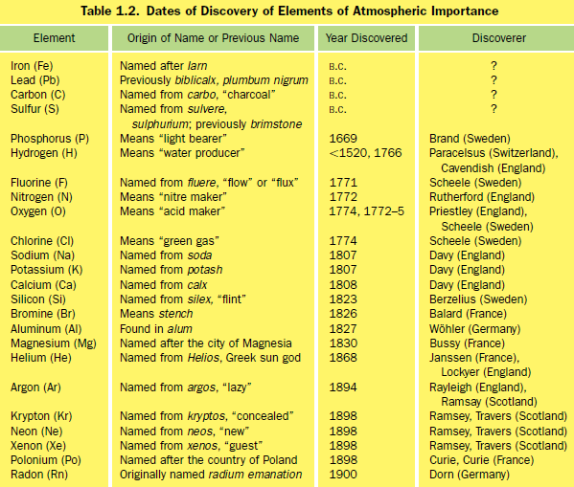
Ανακάλυψη στοιχείων & ενώσεων (1/4)
Μόλυβδος: μπλε-άσπρο μέταλλο μεγάλης πυκνότητας
Θείο: κιτρινωπό κρυσταλλικό, μη μεταλλικό ορυκτό (εντός ηφαιστειακού υλικού και θερμών πηγών)
Άνθρακας: κρυσταλλικός εντός διαμαντιών και γραφίτη. Ποικίλων μορφών εντός καυσίμων.
Notes:
Lead: Beginning in the 1920s, lead was emitted in gasoline. Due
to its serious health effects, most countries have since banned leaded gasoline. Lead is
also still emitted worldwide during certain industrial processes.
Sulfur: Sulfur was known by ancient Egyptian alchemists (Brown,
1913). It was also mentioned by the Greek Dioscorides and by Pliny the Elder in the
first century A.D. The word brimstone (or “burn-stone,” referring to its combustibility)
is an Old English word for sulfur. In the Book of Genesis, “brimstone and fire” were
said to have rained down on the cities of Sodom and Gomorrah, destroying them. If
this event occurred, it may have been due to a volcanic eruption in which various
forms of sulfur emanated. Sulfur in the air is primarily in the form of sulfur dioxide
gas [SO2(g)] and aqueous sulfuric acid [H2SO4(aq)].
Ανθρακας: In the Ancient World, diamonds were valued only for their rarity, not for their
beauty, because diamonds were not cut (and thus did not shine) until the fifteenth century.
In the Ancient World, graphite was used to make black marks on paper and charcoal
was used as a fuel. Today, the emission of elemental carbon (also called black carbon) in
the form of soot particles exacerbates global warming, visibility, and health problems.

Slide 8
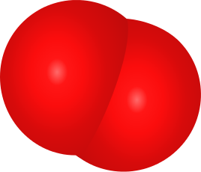
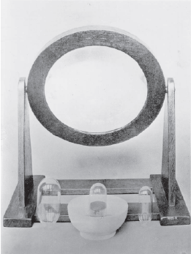
Ανακάλυψη στοιχείων & ενώσεων (2/4)
Το οξυγόνο ανακαλύφθηκε από τον Joseph Priestley το 1774 και –σχεδόν ταυτόχρονα και ανεξάρτητα- από τον Karl Wilhelm Scheele (το 1777).
Πείραμα: Καύση υδραργύρου → δημιουργία οξειδίου υδραργύρου (σκόνη) → Εξαέρωση δοχείου οξειδίου υδραργύρου, μέσω θέρμανσης → Δημιουργία αερίου μοριακού οξυγόνου
Ο₂
Notes:
Molecular oxygen gas [O2(g)] was discovered
independently by two chemists, on August 1, 1774,
by Joseph Priestley (1733–1804; Fig. 1.10) and
sometime between 1772 and 1775 by Karl Wilhelm
Scheele (1742–1786; Fig. 1.11), a Swedish chemist.
Although both chemists discovered oxygen near the
same time, Priestley announced his discovery in
1774, and Scheele published his discovery in 1777.
To obtain oxygen, Priestley burned the element
mercury (Hg), a silvery-white liquid metal, in air to
form bright red mercuric oxide [HgO(s)], a powder. He
then heated the mercuric oxide in a container from
which all air had been removed. Burning mercuric
oxide in a vacuum released oxygen so that the only gas
in the container was molecular oxygen.

Slide 9
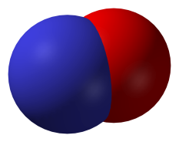
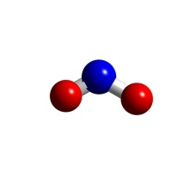
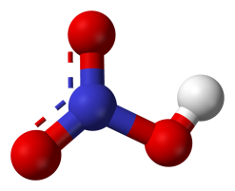
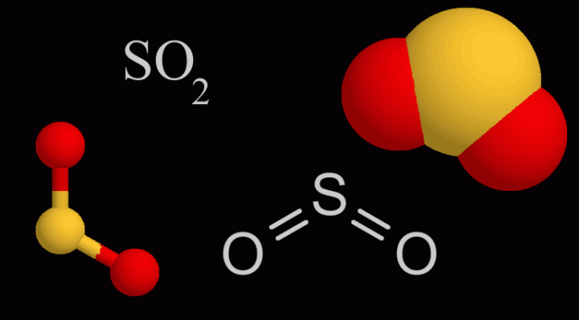
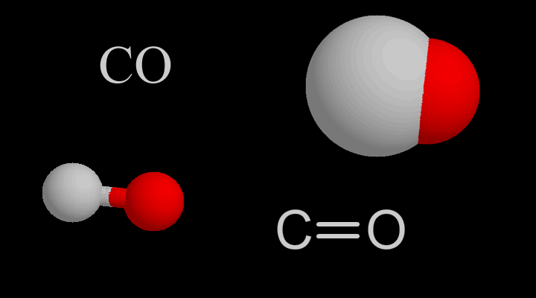
Ανακάλυψη στοιχείων & ενώσεων (3/4)
Ο Priestley ανακάλυψε επίσης και τους βασικούς ατμοσφαιρικούς ρύπους:
τα οξείδια του αζώτου, το μονοξείδιο του άνθρακα, το διοξείδιο του θείου και το νιτρικό οξύ.
Το διοξείδιο του αζώτου πιθανά είχε ήδη παρατηρηθεί από τον Bernardo Ramazzini (1633–1714), ενώ τη σύσταση του νιτρικού οξέος είχε ήδη αποκαλύψει ο Henry Cavendish (1731-1810).
ΝΟ
ΝΟ₂
ΗΝΟ₃
Notes:
During his career, Priestley discovered several additional gases relevant to air pollution.
Between 1767 and 1773, while working at Mill Hill Chapel, in Leeds,
Yorkshire, he isolated nitric oxide [NO(g), “nitrous air”], nitrogen dioxide [NO2(g),
“red nitrous vapor”], nitrous oxide [N2O(g), “diminished nitrous air”], and
hydrochloric acid gas [HCl(g), “marine acid air”]. Nitrogen dioxide may have been
observed earlier by Bernardo Ramazzini (1633–1714), an Italian medical doctor and
early pioneer in industrial medicine. Priestley also discovered carbon monoxide
[CO(g)], and sulfur dioxide [SO2(g), “vitriolic acid air”]. He formed gas-phase nitric
acid [HNO3(g)], although Cavendish uncovered its composition

Slide 10
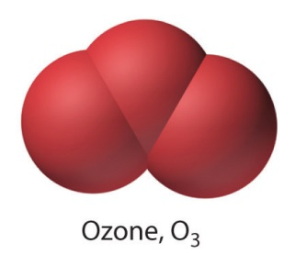
Ανακάλυψη στοιχείων & ενώσεων (4/4)
To 1839, ανακαλύφθηκε ένα από τα σημαντικότερα αέρια της ατμόσφαιρας, από τον Γερμανό χημικό Christian Friederich Schφnbein (1799–1868). Το όνομα Όζον προέρχεται από την ελληνική λέξη όζω (=μυρίζω), επειδή έχει μια έντονη μυρωδιά που μοιάζει με του χλωρίου.
Notes:
In 1785, the Dutch chemist Martinus van Marum was conducting experiments involving electrical sparking above water when he noticed an unusual smell, which he attributed to the electrical reactions, failing to realize that he had in fact created ozone.^{[6]} A half century later, Christian Friedrich Schönbein noticed the same pungent odour and recognized it as the smell often following a bolt of lightning. In 1839, he succeeded in isolating the gaseous chemical and named it "ozone", from the Greek word ozein (ὄζειν) meaning "to smell".^{[7][8]}For this reason, Schönbein is generally credited with the discovery of ozone.^{[6][9]} The formula for ozone, O₃, was not determined until 1865 by Jacques-Louis Soret^{[10]} and confirmed by Schönbein in 1867.^{[7][11]}
For much of the second half of the nineteenth century and well into the twentieth, ozone was considered a healthy component of the environment by naturalists and health-seekers. Beaumont, California had as its official slogan "Beaumont: Zone of Ozone", as evidenced on postcards and Chamber of Commerce letterhead.^{[12]} Naturalists working outdoors often considered the higher elevations beneficial because of their ozone content. "There is quite a different atmosphere [at higher elevation] with enough ozone to sustain the necessary energy [to work]", wrote naturalist Henry Henshaw, working in Hawaii.^{[13]} Seaside air was considered to be healthy because of its believed ozone content; but the smell giving rise to this belief is in fact that of halogenated seaweed metabolites.^{[14]}
In fact, even Benjamin Franklin believed that the presence of cholera was connected with the deficiency or lack of ozone in the atmosphere, a sentiment shared by the British Science Association (then known simply as the British Association).^{[15]}

Slide 11
Δομή Μαθήματος
Ορισμοί βασικών εννοιών
Ανακάλυψη στοιχείων και ενώσεων
Εξέλιξη της ατμόσφαιρας
Εξέλιξη της μελέτης της ρύπανσης της Ατμόσφαιρας
Θέματα επιστημονικού ενδιαφέροντος και αιχμής
Ατμοσφαιρική ρύπανση: Έρευνα στην Ελλάδα
Πρόγραμμα διδασκαλίας μαθήματος

Slide 12
Εξέλιξη της ατμόσφαιρας
Video 1: https://www.youtube.com/watch?v=Gyn754vw8ZQ&t=188s

Slide 13
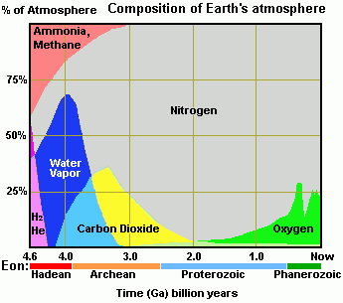
Εξέλιξη της ατμόσφαιρας
1. Καταρχαιοζωικός 2. Αρχαιοζωικός 3. Πρωτεροζωικός 4. Φανεροζωικός
Σύγκρουση με πλανήτη
Σύγκρουση με μετεωρίτη
Εξαφάνιση ειδών
Επανεμφάνιση ειδών & δεινοσαύρων
Ηφαιστειακή δραστηριότητα
Αυξημένη ενεργότητα του Ήλιου
Notes:
http://www.scientificpsychic.com/etc/timeline/atmosphere-composition.html
Earth's primordial atmosphere (Hadean Eon, 4.56 to 4.0 Ga) When the material forming the Earth coalesced and melted, it organized itself into layers with dense materials at the core and less dense compounds closer to the surface. The gases comprising the atmosphere formed the outermost layer and had a composition similar to that of the gases of the condensing planetary nebula.
During the Hadean Eon, the Earth's surface consisted of molten rock, a magma ocean, and water existed only as steam in the atmosphere. The circulation of molten metallic iron-nickel alloy in the core of the Earth established the magnetosphere, a region in space where the motions of gas and fast charged particles are controlled by the magnetic field of the Earth. The magnetosphere deflects most solar wind ions before they penetrate the atmosphere, but the charged particles which are not deflected are directed toward the Earth's magnetic poles where high-energy collisions with atoms of the atmosphere produce an aurora light display. The average speed of hydrogen molecules and helium atoms is greater than the escape velocity from the Earth, and these light gases were lost and swept away through photoevaporation by the solar wind early in the Hadean Eon due to Earth's weak gravity.
Around 4.45 Ga, the Earth experienced a violent collision with a planetoid called Theia that was about the size of Mars. The impact added extra mass to the Earth, but a portion of the impact debris went into orbit and accreted to form the Moon.[10] Some scientists have proposed that this giant impact blasted away into space all of the Earth's atmosphere, including much of the water, and that the atmosphere and water were subsequently replenished by volcanic outgassing and impacts from asteroids and comets.[14] A problem with this proposal is that the ratio of deuterium to hydrogen (D/H) for comets is very different from what is found in the Earth's oceans, so comets are not a likely source for Earth's water. Also, volcanic emissions do not have much nitrogen, so it is unlikely that volcanism provided the nitrogen in our current atmosphere. While it is true that a great collision would have sent much of the atmosphere into space, most of it would have remained within the Earth's gravitational sphere of influence and could have been recaptured by the Earth as the debris from the giant impact cooled and was partitioned between the Earth and the newly formed Moon giving both a similar chemical composition.
After the hydrogen and helium had escaped, Earth's Hadean atmosphere was left with methane, ammonia, water vapor, and small percentages of nitrogen and carbon dioxide. A cataclysmic meteorite bombardment around 3.9 Ga kept much of the Earth's surface in the molten state, and the incoming impactors may have brought additional water, methane, ammonia, hydrogen sulfide and other gases that supplemented the atmosphere.
The high surface temperature of the Earth during the Hadean eon favored the depletion of atmospheric methane through the endothermic reaction of methane with the steam in the atmosphere. Reactions such as the following require high temperatures of approximately 700°C to 1100°C which would have been common in the hot crust and magma lakes of the Hadean Earth. The resulting carbon monoxide would readily combine with metals to form carbonyl compounds.
CH₄ + H₂O CO + 3 H₂ Methane reacts with steam to produce carbon monoxide and hydrogen.
The Hadean Eon was too hot for liquid water to condense on the surface of the Earth, but water vapor would have been able to condense at high altitude in the atmosphere and produce rain that evaporated quickly as it fell when it approached the ground.
Toward the end of the Hadean Eon, volcanic activity started increasing the percentage of carbon dioxide in the atmosphere. The Earth's surface changed from molten lava to solid rock, and liquid water started to accumulate on the surface.
Earth's second atmosphere (Archean Eon, 4.0 to 2.5 Ga) The crust of the Earth started to cool down during the Archean Eon. The amount of water vapor in the atmosphere decreased as water started condensing in liquid form. Continuous rainfall for millions of years led to the buildup of the oceans. As steam condensed into water, the atmospheric pressure of the Earth became lower, and the water started dissolving gases like ammonia and removed them from the atmosphere creating ammonium compounds, amines and other nitrogen-containing substances suitable for the origin of life. The condensation of water with gases such as sulfur dioxide produced acid rain that created new minerals on the Earth's surface. Volcanic carbon dioxide peaked during the Archean Eon and started to decrease through the formation of carbonate minerals that resulted from reactions of metals with the carbonic acid generated from carbon dioxide and water.
Microfossils of sulfur-metabolizing cells have been found in 3.4-billion-year-old rocks[6], and it is known that the first aquatic photosynthetic organisms originated around 3.5 Ga. The oxygen produced by cyanobacteria (blue-green algae) during the Archean Eon reacted with the metal ions in the anoxic sea. Billions of years would pass before the photosynthetic microorganisms could eventually change the composition of the atmosphere. By the middle of the Archean Eon, the Earth had cooled enough so that most of the water vapor in the atmosphere had condensed as water, and the Earth had its first days without clouds. Ammonia and methane were only minor constituents of the atmosphere. Carbon dioxide comprised about 15% of the atmosphere and the percentage of nitrogen was 75%.[5] In essence, most of the original components of the atmosphere had escaped, precipitated as liquids or reacted chemically to form solid compounds. The volcanic activity and the photosynthetic bacteria were now the major factors influencing the Earth's atmospheric composition.
Earth's third atmosphere (Proterozoic Eon, 2.5 to 0.54 Ga) Monocellular life proliferated during the Proterozoic Eon. Anaerobic microbial life thrived in a planet with little oxygen. Anaerobic organisms obtained their energy in various ways. Methanogens combined hydrogen and carbon dioxide to produce methane and water:
CO₂ + 4 H₂ CH₄ + 2 H₂O
Sulfate reducing bacteria combined methane and sulfate radicals:
CH₄ + SO₄⁻⁻ HCO₃⁻ + HS⁻ + H₂O
Other organisms capable of photosynthesis used the energy of sunlight to convert the abundant carbon dioxide and water into carbohydrates (C₆H₁₂O₆) and oxygen, which was deadly to the anaerobes.
6 CO₂ + 6 H₂O C₆H₁₂O₆ + 6 O₂ Production of oxygen through photosynthesis
By the first quarter of the Proterozoic Eon, the Sun had become brighter and its luminosity had increased to 85% of the present level. By this time, most of the carbon dioxide had been depleted from the atmosphere, leaving nitrogen as the main atmospheric gas with a small percentage of oxygen. Nitrogen gas (N₂), which is quite inert chemically, had been a small percentage of the Earth's atmosphere during the Hadean Eon, but it became the major component of the atmosphere during the Proterozoic Eon once all the other gases were gone.
The Earth's surface and seas contained great quantities of iron that readily combined with oxygen to produce iron oxides. From the beginning of the Proterozoic Eon to 1.85 Ga, atmospheric oxygen levels rose as the rate of photosynthesis increased considerably. Shallow seas became partially oxygenated but the deep oceans continued to be anoxic. Although photosynthetic organisms had been releasing oxygen since Archean times, the oxygen levels could not build up in the atmosphere because the oxygen was being depleted by the oxidation of metals and by the oxidation of methane to yield carbon dioxide and water in the presence of ultraviolet (UV) radiation.
4 Fe + 3 O₂ 2 Fe₂O₃ Oxidation of metallic iron to form iron(III)oxide CH₄ + 2 O₂ CO₂ + 2 H₂O Oxidation of methane
The cooling of the Earth during the Proterozoic stabilized the land masses and reduced the volcanic outgassing of carbon dioxide. Methane and carbon dioxide are greenhouse gases; their decrease in the atmosphere may have contributed to the Huronian glaciation that lasted from 2.4 Ga to 2.1 Ga. The cold temperature sequestered additional methane from the atmosphere by forming methane clathrate, a crystal structure of water similar to ice that traps a large amount of methane. An increased period of oxygen production occurred between 2.4 Ga and 2.0 Ga and is known as the Great Oxidation Event or Oxygen Catastrophe. The higher oxygen level created banded iron formations (BIF) by precipitating dissolved iron.[7] The reaction of oxygen with iron in its reduced state (Fe²⁺) continued to create BIF deposits of iron in its oxidized state (Fe³⁺) until about 1.9 Ga whenever volcanic activity or crustal plate movements exposed unoxidized iron. Additional oxygen continued to be consumed by oxidation of minerals on the Earth's crust, but enough free oxygen accumulated in the atmosphere to kill anaerobes near the Earth's surface thus creating an opportunity for the development of aerobic life forms.
Starting around 2.4 Ga, oxygen molecules migrated into the upper atmosphere and formed an ozone layer. This is a region in the stratosphere located between 15 to 35 kilometers above the Earth's surface where oxygen molecules (O₂) are converted to ozone (O₃) by the Sun's ultraviolet rays. The reverse conversion of ozone back to oxygen releases heat. The ozone layer basically absorbs high-energy ultraviolet radiation and converts it to heat. The high energy UV light is dangerous for life because it can cause mutations in DNA sequences.
The atmospheric composition was very steady between 1.85 Ga to 0.85 Ga. During this time, Earth's atmosphere had approximately 10% oxygen. Photosynthetic organisms were still producing oxygen at a high rate, but the reaction of oxygen with dissolved minerals in the deep oceans and with rock and clay on the Earth's surface did not allow atmospheric oxygen levels to increase. By 0.85 Ga, the minerals in the sea and on land could not bind as much oxygen, and the excess oxygen began to accumulate in the atmosphere. With the increased oxygen levels and the protection of the ozone layer, organisms capable of aerobic respiration could now proliferate all over the surface of the Earth.
Earth's present atmosphere (Phanerozoic Eon, 0.542 Ga to present) The beginning of the Phanerozoic Eon, the Cambrian period, is marked by an abundance of multicellular life. Most of the major groups of animals first appeared at this time. Vegetation covered the surface of the Earth, and oxygen accounted for 30% of the atmosphere. Air enriched with so much oxygen allowed giant insects to develop and caused frequent forest fires set off by lightning.
A great mass-extinction event occurred 251 million years ago (0.251 Ga) marking the boundary of the Permian and Triassic periods. Oxygen levels dropped from 30% to 12%, and carbon dioxide levels reached about 2000 ppm. This was Earth's worst mass extinction and it eliminated 90% of ocean dwellers and 70% of land plants and animals. The cause of this mass extinction is thought to have been a series of volcanic events in Siberia that lasted for about one million years and released large volumes of carbon dioxide and gases containing sulfur, chlorine and fluorine.[8,12] By 228 million years ago, oxygen levels had risen to about 15% of the atmosphere, and the first dinosaurs appeared.[11] Oxygen levels continued to increase, and by the end‐Cretaceous, 100 million years ago, oxygen had risen to about 23% of the atmosphere. At this time, dinosaurs were well established and modern mammals and birds began to develop. For the last 100 million years, the percentage of oxygen has fluctuated between 18% and 23% to the present level of about 21% of the atmosphere.[13] The following table shows the percentages of the five most common gases in today's atmosphere.[9]
Earth's future atmosphere. Since the beginning of the industrial revolution in 1750, humans have been burning coal and petroleum products to provide the energy to power machinery. The combustion of fossil fuels has been generating large quantities of the greenhouse gases carbon dioxide (CO₂), methane (CH₄), and nitrous oxide (N₂O). The chart below shows the levels of atmospheric carbon dioxide during the last millennium and the sharp rise during the twentieth century.[2] The concentration of atmospheric carbon dioxide today is approximately 400 parts per million (ppm) and the North Pole's mean annual temperature is -20°C. When the carbon dioxide concentration was 2,000 ppm 55 million years ago during the Paleocene–Eocene Thermal Maximum (PETM), the North Pole's temperature averaged 23°C (73.4°F).[3] It is thought that elevated levels of greenhouse gases will cause global warming and influence weather patterns. Many cities bordering the coastal areas will be permanently flooded if the ice deposits in Greenland and Antarctica melt.

Slide 14
Δομή Μαθήματος
Ορισμοί βασικών εννοιών
Ανακάλυψη στοιχείων και ενώσεων
Εξέλιξη της ατμόσφαιρας
Εξέλιξη της μελέτης της ρύπανσης της Ατμόσφαιρας
Θέματα επιστημονικού ενδιαφέροντος και αιχμής
Ατμοσφαιρική ρύπανση: Έρευνα στην Ελλάδα
Πρόγραμμα διδασκαλίας μαθήματος

Slide 15
Εξέλιξη της μελέτης της ρύπανσης της Ατμόσφαιρας (1/7)
Η ατμοσφαιρική ρύπανση συνδέεται άμεσα με την παγκόσμια βιομηχανική ανάπτυξη.
Notes:
https://www.niehs.nih.gov/health/topics/agents/air-pollution/index.cfm
Air pollution had become a harsh consequence of industrial growth across the country and world.
Scientists started investigating the link between air pollution and health. States began passing legislation to reduce air pollution. And in 1970, a milestone year, Congress passed the Clean Air Act Amendments which led to the establishment of the nation's air quality standards.
Over the past 30 years, researchers have unearthed a wide array of health effects which are believed to be associated with air pollution exposure. Among them are respiratory diseases (including asthma and changes in lung function), cardiovascular diseases, adverse pregnancy outcomes (such as preterm birth), and even death. In 2013, the World Health Organization concluded that outdoor air pollution is carcinogen to humans.
air quality is slowly improving, air pollution remains the single largest environmental health hazard in Europe. https://www.eea.europa.eu/articles/air-quality-remains-a-hot

Slide 16
Εξέλιξη της μελέτης της ρύπανσης της Ατμόσφαιρας (2/7)
Άμεσα, οι επιστήμονες άρχισαν να ερευνούν τη σχέση της αέριας ρύπανσης με την υγεία.
Παράλληλα, άρχισε να διαμορφώνεται νομοθεσία προστασίας από την ατμοσφαιρική ρύπανση.

Slide 17
Εξέλιξη της μελέτης της ρύπανσης της Ατμόσφαιρας (3/7)

Slide 18
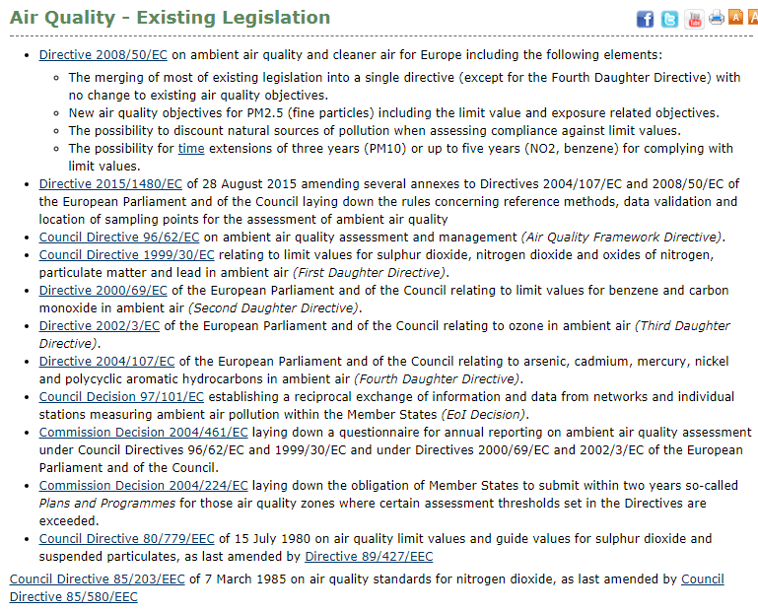
Εξέλιξη της μελέτης της ρύπανσης της Ατμόσφαιρας (1/7)
Στην Ευρώπη, η σχετική νομοθεσία άρχισε να διαμορφώνεται το 1980.
Notes:
http://ec.europa.eu/environment/air/quality/existing_leg.htm

Slide 19
Εξέλιξη της μελέτης της ρύπανσης της Ατμόσφαιρας (5/7)
Big Smoke was a severe air-pollution event that affected the British capital of London in December 1952. It lasted 5 days.
Until 8 December, 4,000 people had died as a direct result of the smog and 100,000 more were made ill by the smog's effects on the human respiratory tract. More recent research suggests that the total number of fatalities was considerably greater, about 12,000.
Notes:
https://en.wikipedia.org/wiki/Great_Smog_of_London
The Great Smog of London, or Great Smog of 1952 sometimes called the Big Smoke,^{[1]} was a severe air-pollution event that affected the British capital of London in December 1952. A period of cold weather, combined with an anticyclone and windless conditions, collected airborne pollutants – mostly arising from the use of coal – to form a thick layer of smog over the city. It lasted from Friday, 5 December to Tuesday, 9 December 1952 and then dispersed quickly when the weather changed.
It caused major disruption by reducing visibility and even penetrating indoor areas, far more severe than previous smog events experienced in the past, called "pea-soupers". Government medical reports in the following weeks, however, estimated that up until 8 December, 4,000 people had died as a direct result of the smog and 100,000 more were made ill by the smog's effects on the human respiratory tract. More recent research suggests that the total number of fatalities was considerably greater, about 12,000.^{[2]}
London had suffered since the 1200s from poor air quality,^{[3]} which worsened in the 1600s,^{[4][5]} but the Great Smog is known to be the worst air-pollution event in the history of the United Kingdom,^{[6]} and the most significant in terms of its effect on environmental research, government regulation, and public awareness of the relationship between air quality and health.^{[2][4]} It led to several changes in practices and regulations, including the Clean Air Act 1956.
Although London was accustomed to heavy fogs, this one was denser and longer-lasting than any previous fog.^{[11]} Visibility was reduced to a few metres ("It's like you were blind"^{[12]}) making driving difficult or impossible.
Public transport ceased, apart from the London Underground, and the ambulance service stopped functioning, forcing users to transport themselves to hospital. The smog even seeped indoors, resulting in the cancellation or abandonment of concerts and film screenings as visibility decreased in large enclosed spaces, and stages and screens became harder to see from the seats.^{[13]} Outdoor sports events were also affected.
In the inner London suburbs and away from town centres there was no disturbance by moving traffic to thin out the dense fog in the back streets. The result was that visibility could be down to a metre or so in the daytime. Walking out of doors became a matter of shuffling one's feet to feel for potential obstacles such as road kerbs. This was made even worse at night since each back street lamp at the time was fitted with an incandescent light-bulb, which gave no penetrating light onto the pavement for pedestrians to see their feet, or even the lamp post. Fog-penetrating fluorescent lamps did not become widely available until later on in the 1950s. "Smog masks" were worn by those who were able to purchase them from chemists.
Near railway lines, on which "fog working" was implemented, loud explosions similar to the report of a shotgun were a common feature. The explosions were made by "detonators" – a form of large percussion cap placed on the track and activated by the wheels of trains. These devices were placed by certain signals to provide an audible warning to match the visual indication provided by the signal for the driver.
There was no panic, as London was renowned for its fog. In the weeks that ensued, however, statistics compiled by medical services found that the fog had killed 4,000 people.^{[14]}Most of the victims were very young or elderly, or had pre-existing respiratory problems. In February 1953, Lieutenant-Colonel Lipton suggested in the House of Commons that the fog had caused 6,000 deaths and that 25,000 more people had claimed sickness benefits in London during that period.^{[15]}
Mortality remained elevated for months after the fog. A preliminary report, never finalised, blamed the ongoing deaths on an influenza epidemic.^{[2]} Emerging evidence revealed that only a fraction of the deaths could be from influenza.^{[16]} Most of the deaths were caused by respiratory tract infections, from hypoxia and as a result of mechanical obstruction of the air passages by pus arising from lung infections caused by the smog.^{[17][18][19]} The lung infections were mainly bronchopneumonia or acute purulent bronchitis superimposed upon chronic bronchitis.^{[20][21]}
More recent research suggests that the number of fatalities was considerably greater than contemporary estimates, at about 12,000.
It is theorized that in 1952 in London, the nitrogen dioxide and sulfur dioxide combined with fog rather than humidity; larger droplets of water diluted the acid products, allowing more sulfate production as sulfuric acid. Sunrise burned off the fog, leaving concentrated acid droplets which killed citizens.

Slide 20
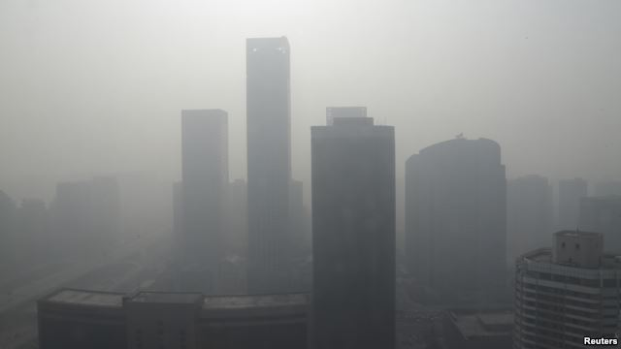
Εξέλιξη της μελέτης της ρύπανσης της Ατμόσφαιρας (6/7)
Τα τελευταία 30 χρόνια, έρευνες αποκάλυψαν πολλά προβλήματα υγείας που συνδέονται με την αέρια ρύπανση: άσθμα, πνευμονικές & καρδιαγγειακές παθήσεις, πρόωρες γεννήσεις και θάνατος.
Το 2013, o WHO συμπέρανε επίσημα πως η ρύπανση της ατμόσφαιρας προκαλεί καρκινογενέσεις.
“Smog Blankets Chinese Cities”
Buildings are seen in heavy haze in Beijing's central business district, January 14, 2013.
PM2.5 ~ 900 micrograms per cubic meter. The World Health Organization recommends maximum daily level of PM 2.5 = 20 micrograms per square meter.
Notes:
Over the past 30 years, researchers have unearthed a wide array of health effects which are believed to be associated with air pollution exposure. Among them are respiratory diseases (including asthma and changes in lung function), cardiovascular diseases, adverse pregnancy outcomes (such as preterm birth), and even death. In 2013, the World Health Organization concluded that outdoor air pollution is carcinogen to humans.

Slide 21
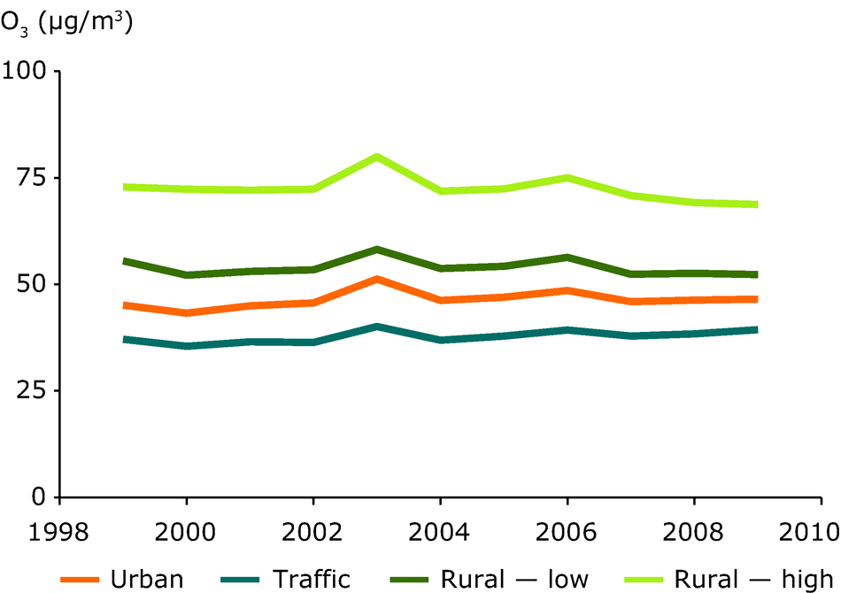
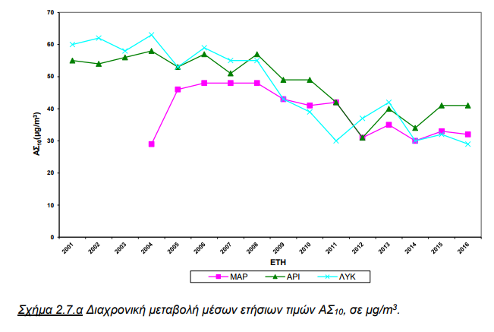
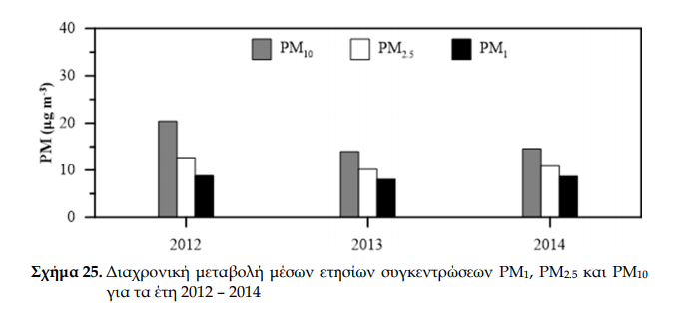
Εξέλιξη της μελέτης της ρύπανσης της Ατμόσφαιρας (7/7)
Αν και η ποιότητα της ατμόσφαιρας σταδιακά βελτιώνεται, το πρόβλημα της αέριας ρύπανσης παραμένει από τα σοβαρότερους περιβαλλοντικούς κινδύνους στην Ευρώπη.
Notes:
air quality is slowly improving, air pollution remains the single largest environmental health hazard in Europe.
https://www.eea.europa.eu/data-and-maps/indicators/air-pollution-by-ozone-1/assessment
There is no clear trend in the annual mean concentration of ozone recorded at different types of stations (urban vs. rural) over the period 1999–2009, although there is a slight decreasing tendency since 2006 in rural stations, at various geographical levels, both low-level and high-level (Figure 1). Meanwhile, a slight tendency towards increased annual mean concentrations is detected close to traffic. Ozone precursor emissions in Europe have been cut substantially recently whereas average ozone concentrations in Europe have largely stagnated. Meteorological variability and climate change could play a role in this discrepancy, including by increasing emissions of biogenic non-methane volatile organic compounds (NMVOCs) during wildfires, but increasing intercontinental transport of ozone and its precursors in the Northern Hemisphere also needs to be considered [i]. Formation of tropospheric ozone from increased concentrations of CH₄ may also contribute to the sustained ozone levels in Europe [ii].
The relative contributions of local or regional emission reduction measures, specific meteorological conditions (such as heat waves), hemispheric transport of air pollution and emissions from natural sources (such as wildfires), on overall ozone concentrations is difficult to estimate. A statistical analysis of ozone and temperature measurements in Europe for 1993–2004 shows that in central-western Europe and the Mediterranean area a change in the increase in daily maximum temperatures in 2000–2004 compared with 1993–1996 contributed to extra ozone exceedances. In southern and central Europe, the observed temperature trend was responsible for 8 extra annual exceedance days (above the threshold of 120 μg/m³) on average, which corresponds to 17 % of the total number of exceedances observed in that region [iii]. A modelling study suggests that observed climate variability and change have contributed to increased ozone concentrations during the period 1979–2001 in large parts of central and southern Europe (Andersson et al., 2007). The reason for this is a combination of changes in temperature, wind patterns, cloud cover and atmospheric stability. Temperature plays a role in various processes which directly affect the formation of ozone, like the emission of biogenic NMVOCs, for example isoprene, and the photo-dissociation of nitrogen dioxide (NO₂).
A study by [iv] showed that ozone trends in Europe in the years 1997–1998 were influenced by El Niño and biomass burning events and in the year 2003 by the heat wave in north-west Europe. The study did not conclude on the impact of emission reduction on long-term ozone trends, due to the influence of meteorological variability, changes in background ozone and shift in emission source patterns. Decreased anthropogenic emissions of some ozone precursors (NO_{X}, CO, and some NMVOCs) in the past two decades have reduced the number of peak ozone concentrations [v].
In order to understand historical tropospheric ozone trends, further retrospective sensitivity analysis of precursor emission changes and hindcast modelling of ozone concentrations are needed to quantify the impact and variability of the various factors influencing ozone levels. Figure 2 shows the estimated trends in tropospheric ozone concentrations over Europe for two time periods derived from such hindcast modelling. There has been a marked increase in ozone concentrations in many regions from 1978 to 2001. However, taking into account a longer perspective starting from 1958, increases are limited to a few European regions. Unfortunately, more recent data is not available.
Το Εργαστήριο Τεχνολογίας του Περιβάλλοντος του Τμήματος Πολιτικών
Μηχανικών διαθέτει Σταθμό μετρήσεων ατμοσφαιρικών ρύπων και μετεωρολογικών
παραμέτρων. Ο Διευθυντής του Εργαστηρίου και υπεύθυνος για το αντικείμενο της
ατμοσφαιρικής ρύπανσης, Καθηγητής κ. Παναγιώτης Χρ. Γιαννόπουλος, λαμβάνοντας
υπ’ όψιν την αναγκαιότητα για παρακολούθηση της ατμοσφαιρικής ρύπανσης στην
Πανεπιστημιούπολη Ρίου, εγκατέστησε σε κατάλληλη θέση του υπαίθριου χώρου και
λειτουργεί τον Σταθμό του Εργαστηρίου προκειμένου να παρακολουθήσει την
ατμοσφαιρική ρύπανση.
Προς τον σκοπό αυτόν δημιουργήθηκε το αυτοχρηματοδοτούμενο πρόγραμμα
«Παρακολούθηση Ατμοσφαιρικής Ρύπανσης Πανεπιστημιουπόλεως Ρίου Πατρών» από
πιστώσεις ΤΣΜΕΔΕ του Εργαστηρίου Τεχνολογίας του Περιβάλλοντος. Η έναρξη
λειτουργίας του προγράμματος έγινε τον Απρίλιο του 2012 και συνεχίζεται.

Slide 22
Δομή Μαθήματος
Ορισμοί βασικών εννοιών
Ανακάλυψη στοιχείων και ενώσεων
Εξέλιξη της ατμόσφαιρας
Εξέλιξη της μελέτης της ρύπανσης της Ατμόσφαιρας
Θέματα επιστημονικού ενδιαφέροντος και αιχμής
Ατμοσφαιρική ρύπανση: Έρευνα στην Ελλάδα
Πρόγραμμα διδασκαλίας μαθήματος

Slide 23
Θέματα επιστημονικού ενδιαφέροντος και αιχμής (1/2)
Η επίδραση της ατμοσφαιρικής ρύπανσης στην υγεία/ασθένεια και η ανάπτυξη βιώσιμων και ολοκληρωμένων στρατηγικών ρύθμισης της ποιότητας της ατμόσφαιρας
Η μελέτη της αλληλεπίδρασης των ρύπων στην ατμόσφαιρα, π.χ. των φυσικής και ανθρωπογενούς προέλευσης ρύπων, και η επίδραση της αλληλεπίδρασής τους στις επιπτώσεις για την υγεία
Η αλληλεπίδραση της ατμοσφαιρικής ρύπανσης με την κλιματική αλλαγή και οι συνέπειές της στην υγεία και στο περιβάλλον, π.χ. το φαινόμενο του θερμοκηπίου πιθανά θα συμβάλει σε καιρικά φαινόμενα που συνδέονται με συχνότερη εμφάνιση σοβαρών επεισοδίων ρύπανσης
Προσδιορισμός του ωφελειών της μείωσης των ρύπων, οι οποίοι συμβάλουν στον μετριασμό της κλιματικής αλλαγής
Ανάπτυξη μεθόδων προσαρμογής και μετριασμού του φαινομένου του θερμοκηπίου (π.χ. μείωση CO₂).
Μελέτη της διαφοροποιημένης έκθεσης, επιρρέπειας και τρωτότητας του πληθυσμού στην ατμοσφαιρική ρύπανση

Slide 24
Θέματα επιστημονικού ενδιαφέροντος και αιχμής (2/2)
Η συνέργεια διαφορετικών πλατφορμών καταγραφής της ατμοσφαιρικής ρύπανσης (επιτόπιες μετρήσεις, δορυφορικά δεδομένα, ατμοσφαιρικά μοντέλα κλπ)
Η εκμετάλλευση ‘ελεύθερων δεδομένων’, π.χ. δορυφορικών δεδομένων του Ευρωπαϊκού προγράμματος Κοπέρνικος (EU’s Copernicus programme
Παρατηρητήριο πολιτών: ενεργητικό – παθητικό
Τεχνολογική πρόοδος στην καταγραφή της αέριας ρύπανσης με μεσαίου-χαμηλού κόστους αισθητήρες

Slide 25
Δομή Μαθήματος
Ορισμοί βασικών εννοιών
Ανακάλυψη στοιχείων και ενώσεων
Εξέλιξη της ατμόσφαιρας
Εξέλιξη της μελέτης της ρύπανσης της Ατμόσφαιρας
Θέματα επιστημονικού ενδιαφέροντος και αιχμής
Ατμοσφαιρική ρύπανση: Έρευνα στην Ελλάδα
Πρόγραμμα διδασκαλίας μαθήματος

Slide 26
Ατμοσφαιρική ρύπανση: Έρευνα στην Ελλάδα (1/3)
> 10 τομείς τμημάτων πανεπιστημίων
Φυσικό, Χημικό, Γεωλογικό ΕΚΠΑ
Φυσικό, Πολ. Μηχ., Χημ. Μηχ. Π.Πάτρας
Χημικό, Μηχ. Περιβ. Π. Κρήτης
Φυσικό, Χημικό, Γεωλογικό Π. Θεσ/νικης
Περιβάλλοντος Αιγαίου
Φυσικό Π. Ιωαννίνων
6 ινστιτούτα ερευνητικών κέντρων
Ίδρυμα Τεχνολογίας και Έρευνας (ΙΤΕ) Πάτρα και Ηράκλειο Κρήτης
Εθνικό Αστεροσκοπείο Αθηνών (ΕΑΑ), Εθνικό Κέντρο Έρευνας Φυσικών Επιστημών " ΕΚΕΦΕ ΔΗΜΟΚΡΙΤΟΣ, Ακαδημία Αθηνών, Αθήνα.
Εθνικό Κέντρο Έρευνας και Τεχνολογικής Ανάπτυξης (ΕΚΕΤΑ), Θεσσαλονίκη

Slide 27
Ατμοσφαιρική ρύπανση: Έρευνα στην Ελλάδα (2/3)
Μεταπτυχιακά προγράμματα Ατμοσφαιρικής Φυσικής/Περιβάλλοντος/Μετεωρολογίας, π.χ.:
Φυσική Περιβάλλοντος, ΕΚΠΑ
Επιστήμες και Μηχανική Περιβάλλοντος, Π. Κρήτης
Ενέργεια & Περιβάλλον, Π. Πάτρας
Ερευνητικά προγράμματα
Ευρωπαϊκά, π.χ. H2020, Life, Συνεργασίας χωρών
Εθνικά, π.χ. ενίσχυση διδακτόρων / μεταδιδακτόρων, ερευνητικών ομάδων, συμπράξεων φορέων.

Slide 28
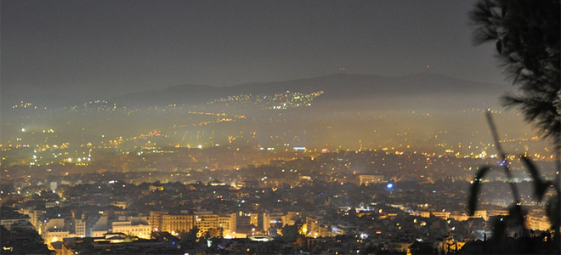
Ατμοσφαιρική ρύπανση: Έρευνα στην Ελλάδα (3/3)
Παράδειγμα ερευνητικού προγράμματος συνεργασίας
Παρακολούθηση αέριας και σωματιδιακής ρύπανσης για την αποτύπωση και αξιολόγηση του προβλήματος της αιθαλομίχλης
…
Notes:
Description: The aim of this project is the identification of pollution sources that affect aerosol (PM) concentrations in the big cities of Greece and over the Aegean sea. In parallel, the related physicochemical processes are studied so that the effects in climate are identified. In order to achieve these goals, measurements of mass concentrations, chemical composition and physicochemical properties of aerosols are measured over Athens, Thessaloniki , Patras and at 2 Aegean sites (Lesvos and Crete) simultaneously, using state-of-the-art measurement techniques. Model predictions are also designed and applied in order to be evaluated over the greater area of Greece. The provided outputs are used to study the contribution of primary and secondary aerosols in CCN formation and columnar aerosol loadings over urban and marine areas. Satellite images are also used for an inter-comparison with ground observations over the aforementioned sites in Greece.

Slide 29
Video 2: https://www.youtube.com/watch?v=zJmsxEw8vJ4

Slide 30
Δομή Μαθήματος
Ορισμοί βασικών εννοιών
Ανακάλυψη στοιχείων και ενώσεων
Εξέλιξη της ατμόσφαιρας
Εξέλιξη της μελέτης της ρύπανσης της Ατμόσφαιρας
Θέματα επιστημονικού ενδιαφέροντος και αιχμής
Ατμοσφαιρική ρύπανση: Έρευνα στην Ελλάδα
Πρόγραμμα διδασκαλίας μαθήματος

Slide 31
Πρόγραμμα διδασκαλίας μαθήματος Περιεχόμενα μαθημάτων

Slide 32
Πρόγραμμα διδασκαλίας μαθήματος Εργασίες

Slide 33
Πρόγραμμα διδασκαλίας μαθήματος Εποπτικά – Διδακτικά μέσα
Βιβλιογραφία σε έντυπη ή/και ηλεκτρονική μορφή
Οπτικοακουστικό υλικό
Προβολή παρουσιάσεων μέσω ηλεκτρονικού υπολογιστή
Χρήση λογισμικού συγγραφής κειμένου, στατιστικής επεξεργασίας δεδομένων, παρουσίασης εργασίας
Εκπαίδευση εφαρμογής αριθμητικού μοντέλου
Χρήση Λογισμικού οπτικοποίησης αποτελεσμάτων αριθμητικών μοντέλων
Χρήση διαδικτύου για εύρεση επιστημονικής πληροφορίας
Χρήση αισθητήρα μέτρησης ατμοσφαιρικού ρύπου
Επιτόπια παρατήρηση και εκπαίδευση

Slide 34
Πρόγραμμα διδασκαλίας μαθήματος Τρόπος αξιολόγησης
Πρακτικές ασκήσεις με παραδοτέο: 50%
Project/Παρουσίαση: 40%
Ενεργή συμμετοχή στις ασκήσεις χωρίς παραδοτέο: 10%

Slide 35
Πρόγραμμα διδασκαλίας μαθήματος Βιβλιογραφία σε έντυπη ή/και ηλεκτρονική μορφή
«Ατμοσφαιρική ρύπανση με στοιχεία μετεωρολογίας», Μ. Λαζαρίδη. Εκδόσεις Τζιόλα, 2005
«Ατμοσφαιρική Ρύπανση: Επιπτώσεις, έλεγχος και εναλλακτικές τεχνολογίες», Ι. Γεντεκάκης, εκδόσεις Τζιόλα, 2003
"Atmospheric Pollution", M.Z. Jacobson, Cambridge University Press, 2002
“Fundamentals of Atmospheric Modelling”, M.Z. Jacobson, Cambridge University Press, 2005
"Atmospheric Chemistry and Physics: from air pollution to climate change", J.H. Seinfield, S.N. Pandis, John Wiley & Sons, 2006

Slide 36
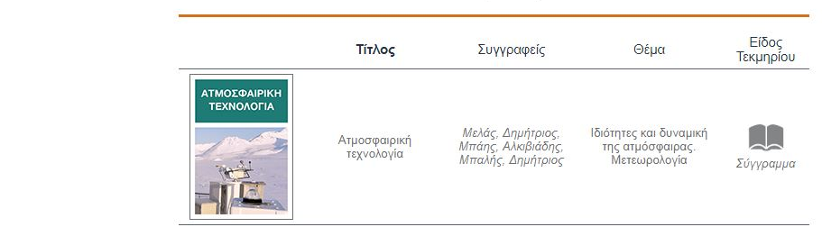
Βοηθητικά: https://www.kallipos.gr/el/

