Slide 1
Ατμοσφαιρική Ρύπανση (ΕΕΕ423)
Μάθημα 2^{ο}
Ατμοσφαιρικοί ρύποι και πηγές ρύπανσης
Δημιουργία και εξέλιξη ατμοσφαιρικής ρύπανσης (1)

Slide 2
Δομή Μαθήματος
Εισαγωγή
Πηγές ατμοσφαιρικής ρύπανσης
Χημικά συστατικά της ατμόσφαιρας (ρύποι)
Ρύπανση εσωτερικών χώρων
Διαδικασίες μεταφοράς, εξέλιξης, τροποποίησης ρύπων στην ατμόσφαιρα

Slide 3
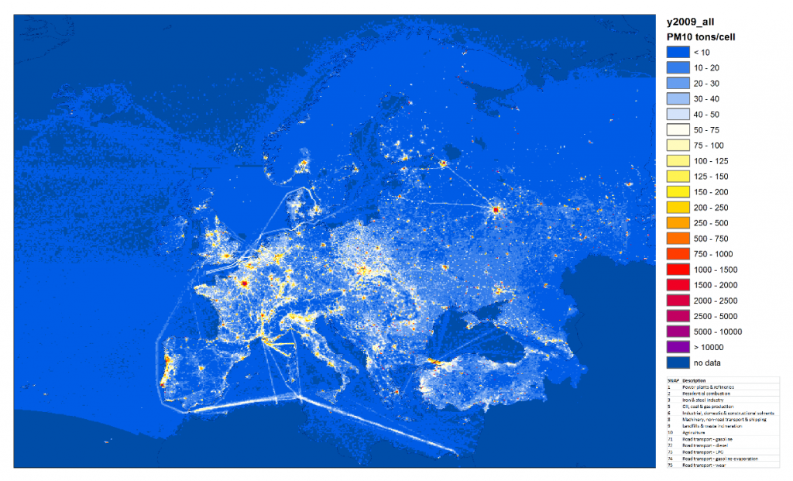
Εισαγωγή
Ατμοσφαιρική ρύπανση
η προσθήκη κάθε υλικού (αέριας, υγρής/στερεής μορφής) στην ατμόσφαιρα που μας περιβάλει, με αρνητικές επιπτώσεις στην υγεία των ζωντανών οργανισμών και στο οικοσύστημα.

Slide 4
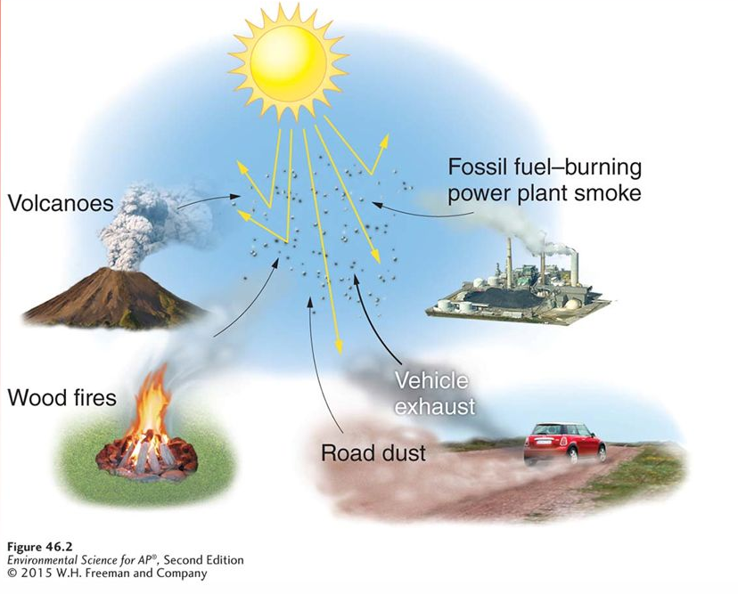
Εισαγωγή
Κατηγοριοποίηση της ρύπανσης (1/5)
Φυσικής – Ανθρωπογενούς προέλευσης

Slide 5
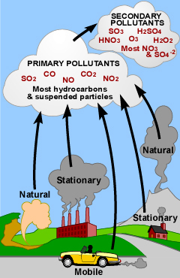
Εισαγωγή
Κατηγοριοποίηση της ρύπανσης (2/5)
Παραγωγή – Δημιουργία
Πρωτογενείς – Δευτερογενείς ρύποι

Slide 6
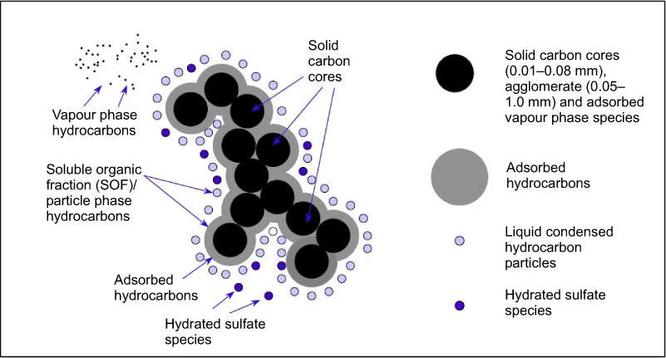
Εισαγωγή
Κατηγοριοποίηση της ρύπανσης (3/5)
Αέριοι – Σωματιδιακοί ρύποι

Slide 7
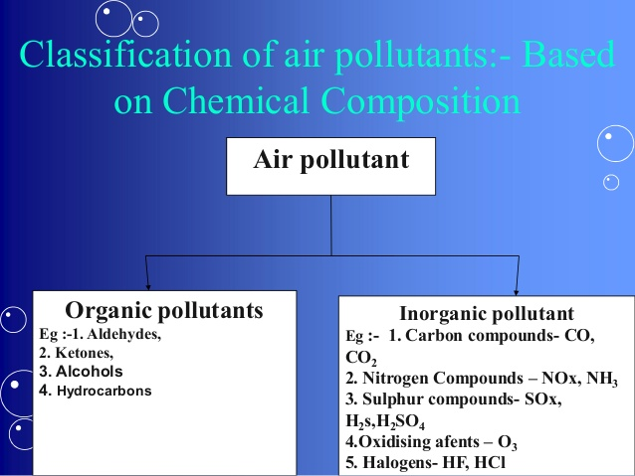
Εισαγωγή
Κατηγοριοποίηση της ρύπανσης (4/5)
Οργανικοί – Ανόργανοι ρύποι
Notes:
https://en.wikipedia.org/wiki/Organic_compound

Slide 8
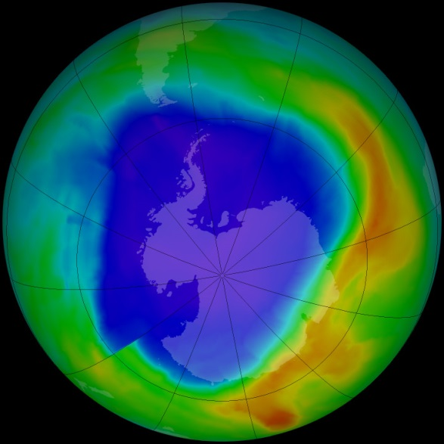
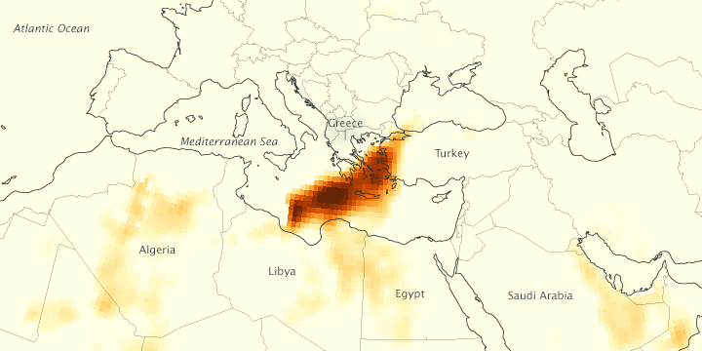
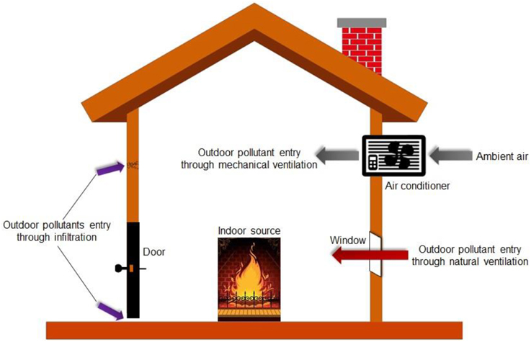
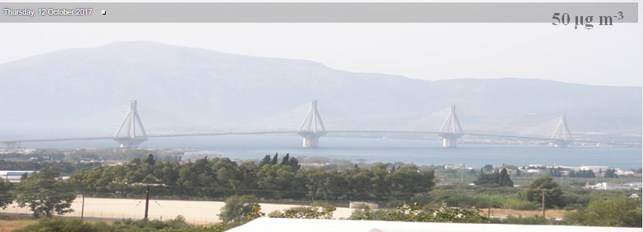
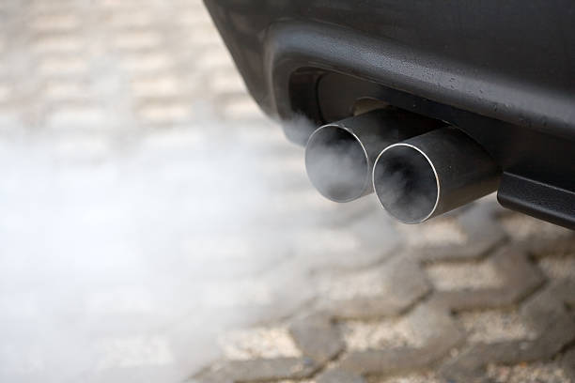
Εισαγωγή
Κατηγοριοποίηση της ρύπανσης (5/5)
Χωρική κλίμακα (τοπική, αστική, περιφερ., παγκόσ.)
Εξωτερικού – Εσωτερικού χώρου
Notes:
https://www.frontiersin.org/articles/10.3389/fenvs.2014.00069/full#T1
Τοπικη: εκπομπές σε αυτοκινητόδρομους ή εκπομπές από καμινάδες διάφορων βιομηχανιών πρωτογενών
Η αστική και περιαστική κλίμακα που εκτείνεται μέχρι μερικές δεκάδες χιλιόμετρα και όπου εχουμε εμφανιση πρωτογενών και την εμφάνιση δευτερογενών ρύπων.
ώστε να μπορέσουνε να μεταφερθούν από μία ήπειρο σε άλλη ήπειρο ή ακόμη και σε όλο το ημισφαίριο διαμέσου της γενικής κυκλοφορίας της ατμόσφαιρας.
Η παγκόσμια κλίμακα αφορά στα φαινόμενα ρύπανσης που πλήττουν όλο το πλανήτη.

Slide 9
Εισαγωγή
Ατμοσφαιρική ρύπανση – Κατηγορίες/Τύποι
Video: https://www.youtube.com/watch?v=0vQK1z8HPBM

Slide 10
Δομή Μαθήματος
Εισαγωγή
Πηγές ατμοσφαιρικής ρύπανσης
Χημικά συστατικά της ατμόσφαιρας (ρύποι)
Ρύπανση εσωτερικών χώρων
Διαδικασίες μεταφορές, εξέλιξης, τροποποίησης ρύπων στην ατμόσφαιρα

Slide 11
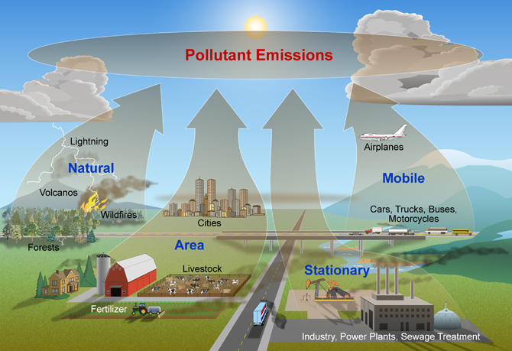
Πηγές ατμοσφαιρικής ρύπανσης
Notes:
https://docslide.com.br/documents/air-pollution-zanhs-shmeioseis.html
Αντίθετα με την κοινή αντίληψη, το μεγαλύτερο ποσοστό των παραγόμενων αέριων ρύπων προέρχεται από καθαρά φυσικές πηγές. Με τον όρο φυσικές πηγές αναφερόμαστε στις πηγές εκπομπών αερίων ρύπων που δεν οφείλονται στην ανθρώπινη δραστηριότητα. Παρ’ όλα αυτά οι ανθρωπογενείς εκπομπές είναι κυρίως υπεύθυνες για τα μεγάλα περιβαλλοντικά προβλήματα που εμφανίσθηκαν. Αυτό οφείλεται βεβαίως στην ανατροπή της φυσικής ισορροπίας αλλά επίσης και στην μεγάλη πυκνότητα των εκπομπών από ανθρωπογενείς εκπομπές οι οποίες συγκεντρώνονται σε μικρές γεωγραφικές περιοχές (κυρίως αστικές περιοχές και βιομηχανικές ζώνες). Αντίθετα, η καλή διασπορά των φυσικών πηγών ανά την υφήλιο προσφέρει τη δυνατότητα καλύτερης ανάμιξης των ρύπων με τον καθαρό αέρα. Κατά συνέπεια, με κάποιες μικρές εξαιρέσεις, οι εκπομπές αερίων ρύπων από φυσικές πηγές από μόνες τους δεν οδηγούν σε υψηλές συγκεντρώσεις
Οι σημαντικότερες φυσικές πηγές είναι:
1. Τα ηφαίστεια (κυρίως αιωρούμενα σωματίδια, διοξείδιο του θείου, υδρόθειο και μεθάνιο).
2. Οι πυρκαγιές δασών (κυρίως αιωρούμενα σωματίδια, μονοξείδιο και διοξείδιο του άνθρακα).
3. Οι ωκεανοί και γενικότερα οι θαλάσσιες εκτάσεις (κυρίως χλωριούχο νάτριο και θειικά άλατα).
4. Βιολογική αποσύνθεση των φυτών και των ζώων (κυρίως υδρογονάνθρακες, αμμωνία και υδρόθειο).
5. Η αποσάθρωση του εδάφους (αιωρούμενα σωματίδια).
6. Τα φυτά και τα δέντρα (κυρίως υδρογονάνθρακες).

Slide 12
Φυσικές πηγές ατμοσφαιρικής ρύπανσης
Ηφαίστεια
Φωτιές
Ερημική (ή/και εδαφική) σκόνη
Άλλες (π.χ. ζώα, αποσύνθεση από βακτήρια)
Notes:
Natural Sources
Although industrialization and the use of motor vehicles are overwhelmingly the most significant contributors to air pollution, there are important natural sources of "pollution" as well. Wildland fires, dust storms, and volcanic activity also contribute gases and particulates to our atmosphere.
Unlike the above mentioned sources of air pollution, natural "air pollution" is not caused by people or their activities. An erupting volcano emits particulate matter and gases; forest and prairie fires can emit large quantities of "pollutants"; plants and trees naturally emit VOCs which are oxidized and form aerosols that can cause a natural blue haze; and dust storms can create large amounts of particulate matter. Wild animals in their natural habitat are also considered natural sources of "pollution". The National Park Service recognizes that each of these sources emits gases and particulate matter into the atmosphere but we regard these as constituents resulting from natural processes.
Methane gas is one of the biggest contributors to global warming and is said to be 21 timesmore powerful a greenhouse gas than carbon dioxide. And do you know where most of earth’s methane gas comes from? Cows. Cattle on factory farms and feedlots are fed low-quality grains which their bodies were not made to digest, resulting in high levels of indigestion and flatulence. All that gas has to go somewhere — and into our atmosphere it goes.
Above average levels of hydrogen sulfide, ammonia, particulate matter, endotoxins, carbon dioxide, dust and methane in the air in areas surrounding factory farms are not uncommon.

Slide 13
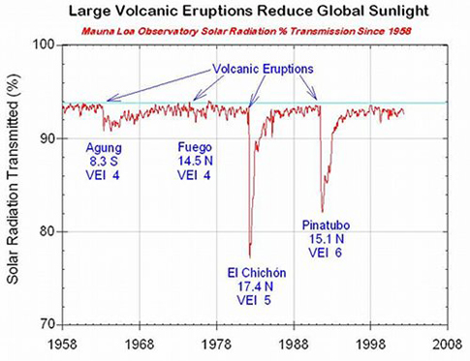
Φυσικές πηγές ατμοσφαιρικής ρύπανσης
Ηφαίστεια
Volcanic eruptions can inject millions of tonnes of dust and gaseous sulfur dioxide into the stratosphere, which evolves to sulfate aerosols, i.e. effective scatterers of solar radiation.
Mount Pinatubo 1991:
20 millions tons SO₂
20-30 % decline in the solar radiation reaching the surface of the earth
0.5 °C drop in average global air temperature
Notes:
https://volcanoes.usgs.gov/vhp/gas.html
Magma contains dissolved gases, which provide the driving force that causes most volcanic eruptions. As magma rises towards the surface and pressure decreases, gases are released from the liquid portion of the magma (melt) and continue to travel upward and are eventually released into the atmosphere. Large eruptions can release enormous amounts of gas in a short time. The 1991 eruption of Mt. Pinatubo is thought to have injected more than 250 megatons of gas into the upper atmosphere on a single day. By far the most abundant volcanic gas is water vapor, which is harmless. However, significant amounts of carbon dioxide, sulfur dioxide, hydrogen sulfide and hydrogen halides can also be emitted from volcanoes.
During very large eruptions, SO₂ can be injected to altitudes of greater than 10km into the stratosphere. Here, SO₂is converted to sulfate aerosols which reflect sunlight and therefore have a cooling effect on the Earth's climate.
volcanoes can emit the halogens fluorine, chlorine and bromine in the form of hydrogen halides (HF, HCl and HBr). These species are all strong acids and have high solubility; therefore they rapidly dissolve in water droplets within volcanic plumes or the atmosphere where they can potentially cause acid rain. In an ash-producing eruption, ash particles are also often coated with hydrogen halides.

Slide 14
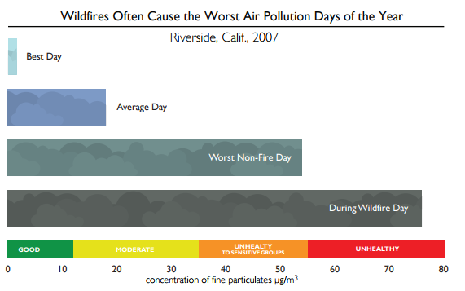
Φυσικές πηγές ατμοσφαιρικής ρύπανσης
Φωτιές

Slide 15
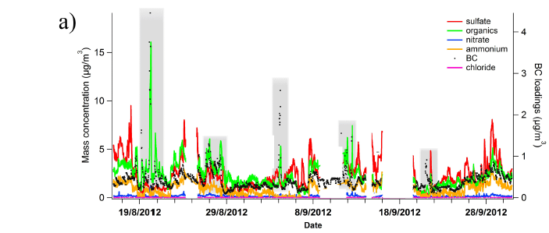
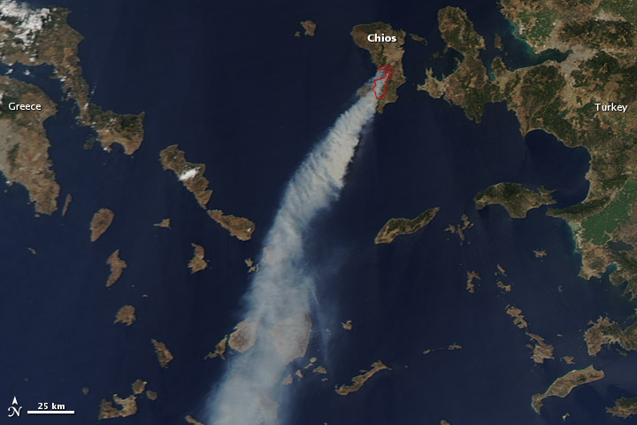
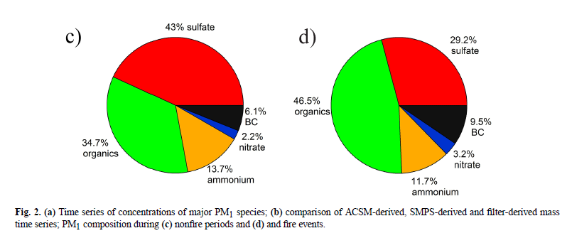
Φυσικές πηγές ατμοσφαιρικής ρύπανσης
Φωτιές
(MODIS) on NASA’s Aqua satellite captured this natural-color image on August 18, 2012.

Slide 16
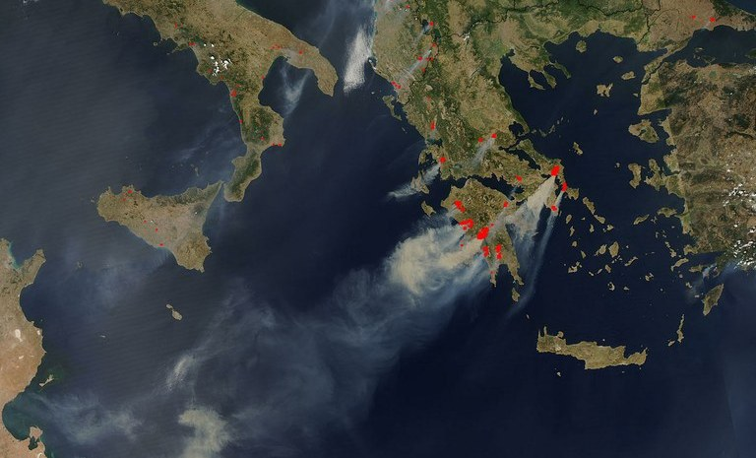
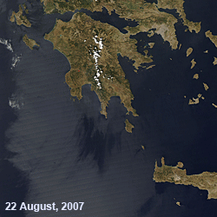
Φυσικές πηγές ατμοσφαιρικής ρύπανσης
Φωτιές
~1200 Km
MODIS image of smoke from fires in Greece, August 2007

Slide 17
Φυσικές πηγές ατμοσφαιρικής ρύπανσης
Ερημική (ή/και εδαφική) σκόνη
PM₇₀
άνεμος
Διάβρωση εδάφους ~ U* ³ ⁻ ⁴
Αποκόλληση εδαφικών σωματιδίων σκόνης
από εδαφικές ρωγμές
Notes:
Τα σωματίδια σκόνης χερσαίας ̟ροέλευσης (ΣΧΠ) είναι αιωρούμενη σκόνη ̟ου
̟αράγεται ή/και ε̟αναιωρείται α̟ό τις χερσαίες ε̟ιφάνειες, μέσω ανθρω̟ογενών
ή/και φυσικών διεργασιών. Η χημική σύσταση των ΣΧΠ είναι κυρίως μεταλλικά
συστατικά (ασβέστιο, μαγνήσιο, κάλιο, ̟υρίτιο, αργίλιο, σίδηρο, χλώριο και νάτριο),
βαρέα μέταλλα (χαλκός, ψευδάργυρος, σίδηρος, νικέλιο, χρώμιο και μαγγάνιο),
άνθρακας και θειικά, ενώ τα ̟οσοστά αυτών καθορίζονται α̟ό την ̟ροέλευσή της.
Dusts are solid particles ranging in size from below 1 µm up to around 100 µm, which may be or become airborne, depending on their origin, physical characteristics and ambient conditions.
The main species found in soil dust are quartz, clays, calcite, gypsum, and
iron oxides, and the properties (especially optical) depend on the relative abundance of the
various minerals.

Slide 18
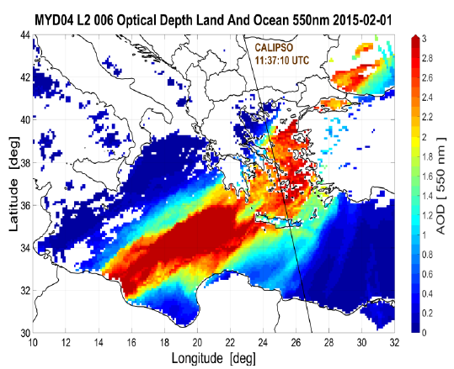
Φυσικές πηγές ατμοσφαιρικής ρύπανσης
Ερημική
(ή/και εδαφική)
σκόνη
Οπτικό βάθος αερολυμάτων (AOD) είναι ο βαθμός που τα αιωρούμενα σωματίδια εμποδίζουν τη διάδοση του φωτός στην ατμόσφαιρα λόγω απορρόφησης ή/και σκέδασης.

Slide 19
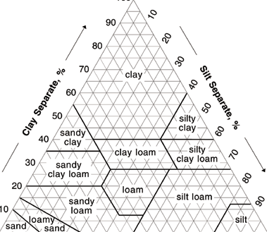

Φυσικές πηγές ατμοσφαιρικής ρύπανσης
Ερημική (ή/και εδαφική) σκόνη
PM₇₀
άνεμος
Διάβρωση εδάφους ~ U* ³ ⁻ ⁴
Εδαφικές κατηγορίες & τύποι
Αποκόλληση εδαφικών σωματιδίων σκόνης
από εδαφικές ρωγμές

Slide 20
Πηγές ατμοσφαιρικής ρύπανσης

Slide 21
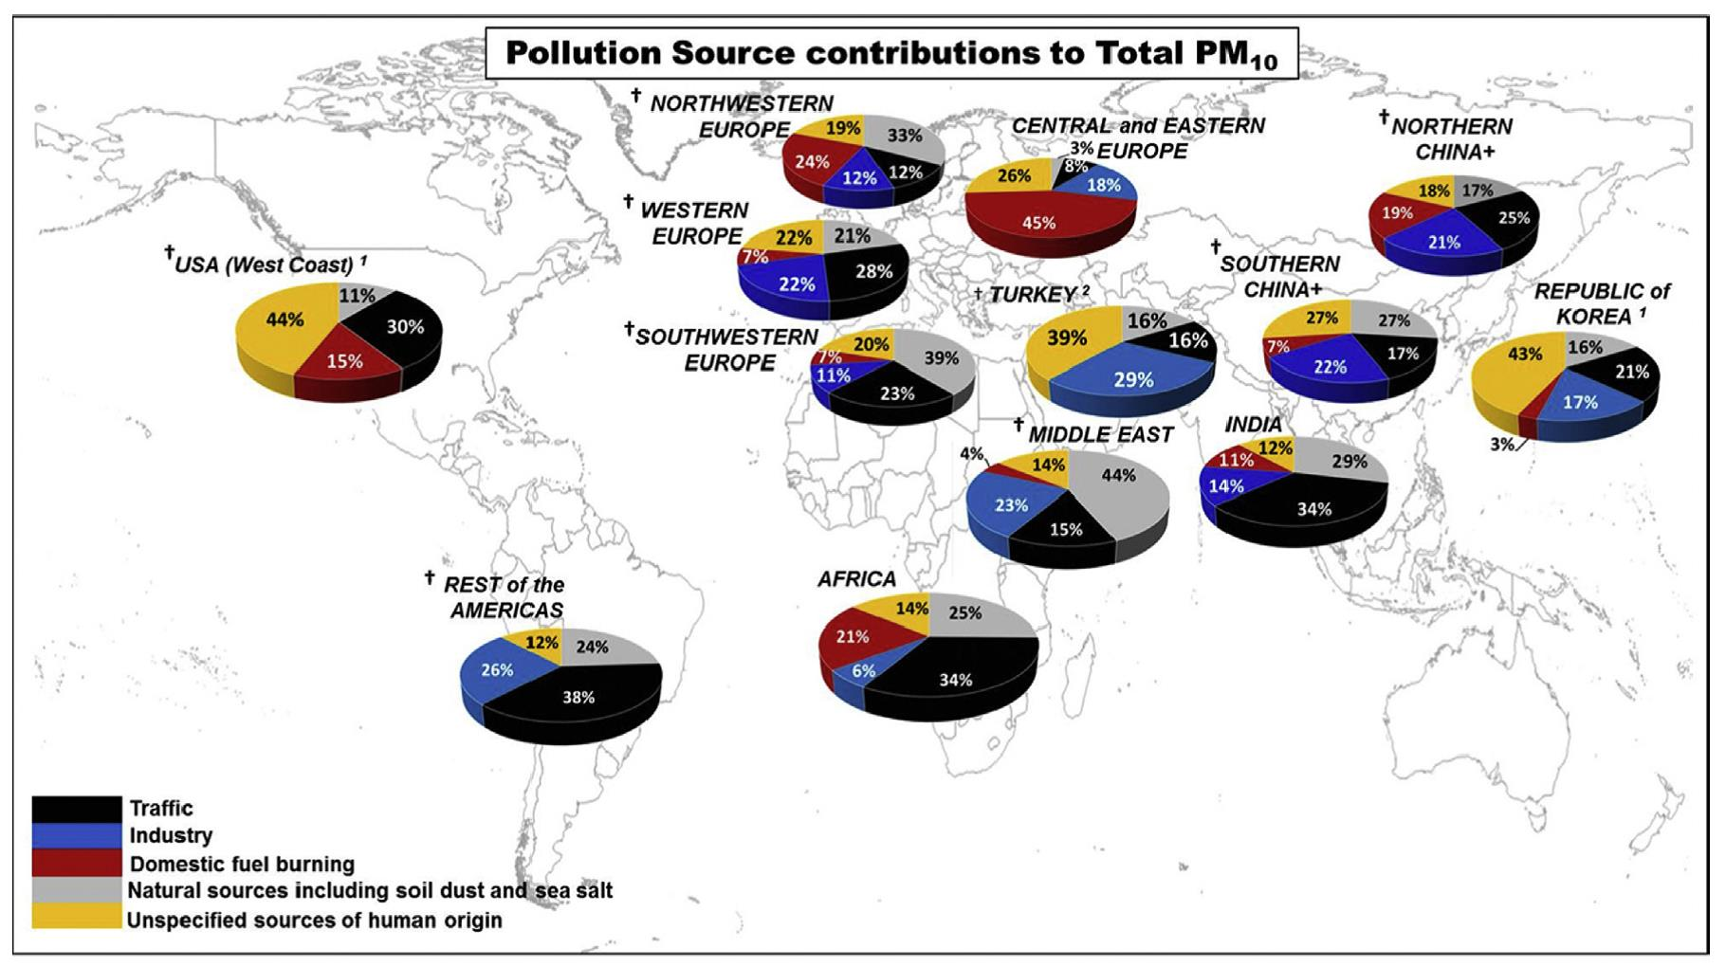
Ανθρωπογενείς πηγές ατμοσφαιρικής ρύπανσης
Βιομηχανία
Μεταφορές
Θέρμανση κτιρίων
Γεωργία
Notes:
https://www.nps.gov/shen/learn/nature/airpollution.htm
Stationary and Area Sources
A stationary source of air pollution refers to an emission source that does not move, also known as a point source. Stationary sources include factories, power plants, dry cleaners and degreasing operations. The term area source is used to describe many small sources of air pollution located together whose individual emissions may be below thresholds of concern, but whose collective emissions can be significant. Residential wood burners are a good example of a small source, but when combined with many other small sources, they can contribute to local and regional air pollution levels. Area sources can also be thought of as non-point sources, such as construction of housing developments, dry lake beds, and landfills.
Mobile Sources
A mobile source of air pollution refers to a source that is capable of moving under its own power. In general, mobile sources imply "on-road" transportation, which includes vehicles such as cars, sport utility vehicles, and buses. In addition, there is also a "non-road" or "off-road" category that includes gas-powered lawn tools and mowers, farm and construction equipment, recreational vehicles, boats, planes, and trains.
Agricultural Sources
Agricultural operations, those that raise animals and grow crops, can generate emissions of gases and particulate matter. For example, animals confined to a barn or restricted area (rather than field grazing), produce large amounts of manure. Manure emits various gases, particularly ammonia into the air. This ammonia can be emitted from the animal houses, manure storage areas, or from the land after the manure is applied. In crop production, the misapplication of fertilizers, herbicides, and pesticides can potentially result in aerial drift of these materials and harm may be caused.

Slide 22
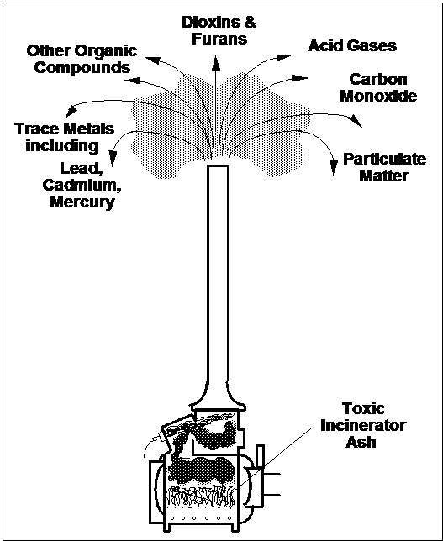
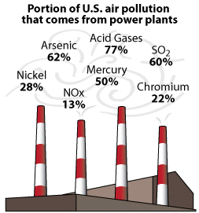
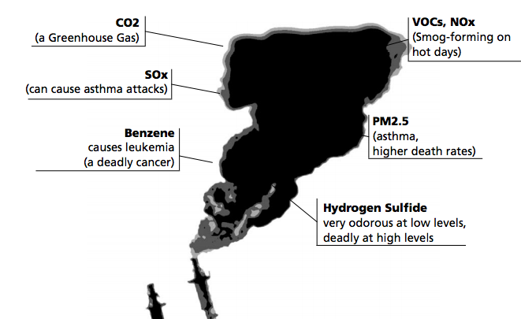
Ανθρωπογενείς πηγές ατμοσφαιρικής ρύπανσης
Βιομηχανία
Μονάδες παραγωγής
ηλεκτρικής ενέργειας
Διυλιστήρια
Καύση απορριμμάτων
Λοιπές βιομηχανικές
μονάδες
Notes:
https://www.eea.europa.eu/publications/2599XXX/page010.html#top
Siting fossil fuel power stations in mainly rural areas and distributing the pollution produced more evenly via tall chimneys has resulted in improved urban air quality, though they still remain a major source of pollution, mainly sulphur dioxide and nitrogen oxides.
Power generation is, however, likely to remain an important source of pollution for some time to come, particularly as some countries are reconsidering their programmes of nuclear power generation.
Although fossil fuel power plants are the major source of industrial air pollution in many countries, all industry and many businesses, large and small, can be significant local sources of a wide range of air pollutants.
Landfill and incineration are the two most common methods of waste disposal. If not properly managed landfill sites can cause a number of problems; these include the production of potentially explosive levels of methane gas (65%), dangerous levels of carbon dioxide (35%), plus trace concentrations of a range of organic gases and vapours.
Uncontrolled or poorly managed burning of waste (incineration) can result in the production of poisonous chemicals such as hydrochloric acid, dioxins, furans and heavy metals. Hydrochloric acid contributes locally to acid rain and is given off by the burning of plastics. If organic matter and plastics are burnt at low temperatures, dioxins and furans may be emitted. Modern, properly operated incinerators produce fumes which respect the strictest existing legislation.
Pollutants from Incineration
For many decades, incineration was the method of choice for the treatment of infectious waste. However, medical waste incinerators release into the air a wide variety of pollutants including organic compounds like benzene, chlorophenols, polycyclic aromatic hydrocarbons, vinyl chloride, and dioxins, heavy metals (mercury, arsenic, cadmium, chromium, lead, etc.); acid gases (hydrogen chloride, hydrogen fluoride, sulfur dioxides, nitrogen oxides); carbon monoxide; and particulate matter such as fly ash. Pathogens can also be found in the solid residues and in the exhaust of poorly designed and badly operated incinerators. In addition, the bottom ash residues are generally contaminated with leachable organic compounds, such as dioxins, and heavy metals and have to be treated as hazardous waste.

Slide 23
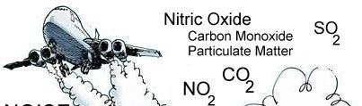
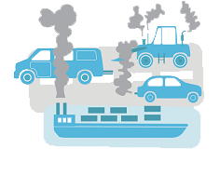
Ανθρωπογενείς πηγές ατμοσφαιρικής ρύπανσης
Μεταφορές
Οχήματα
Πλοία
Αεροπλάνα
Τρένα
Notes:
Air pollution from motor vehicles has, in many countries, replaced coal smoke as the major cause for concern; and the continuing growth in vehicle use means that efforts to reduce emissions from individual vehicles are in danger of being overtaken by increases in the volume of traffic. In much of eastern Europe the continued use of rather old cars, which are unable to meet modern pollution control requirements, means that efforts to control pollution from this source are going to be increasingly difficult.
pollutants produced by petrol-powered vehicles include carbon monoxide, nitric oxide, benzene, particulate matter and lead. Much of the lead emitted by vehicles burning leaded petrol emerges as particles. Diesel engines burn fuel in excess of air and so produce little carbon monoxide but, instead large quantities of carbon dioxide, (see table).
Catalysts substantially reduce emissions of hydrocarbons, NOx and carbon monoxide; they do however increase emissions of carbon dioxide, an important greenhouse gas, and have no effect on emissions of particles. Since 1993 all new petrol-engined cars in the European Union have to be fitted with catalytic converters.
Prior to the introduction of cars fitted with catalytic converters, diesel-powered vehicles were considered "cleaner" than petrol-powered cars. EU legislation requires that they meet the same limits for hydrocarbons, NOx and CO as petrol-driven cars. Diesel fuel contains no lead but is a considerable source of particulate matter, PAHs and SO2. The introduction of lower sulphur diesel fuels throughout the EU will reduce emissions from this source

Slide 24
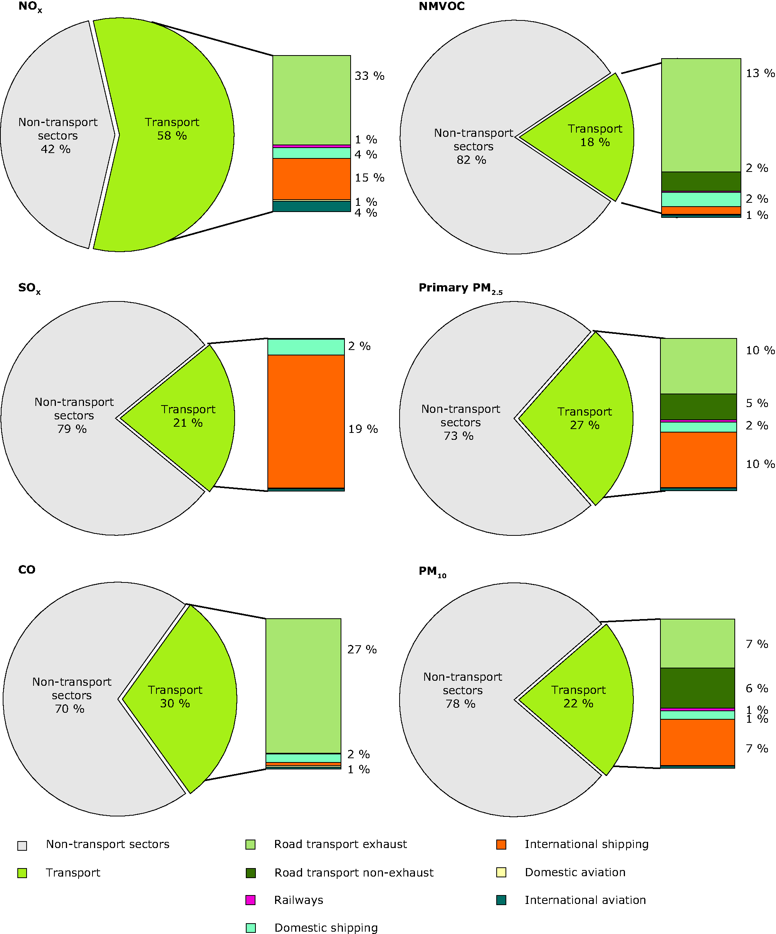
Ανθρωπογενείς πηγές ατμοσφαιρικής ρύπανσης
Μεταφορές
Οχήματα
Πλοία
Αεροπλάνα
Τρένα
According to EEA data, the breakdown for the six pollutants as it pertains to transportation is as follows:
NOx – 58%
NMVOC – 18%
SOx – 21%
PM 2.5 – 27%
CO – 30%
PM 10 – 22%
Source: European Environment Agency, 2012

Slide 25
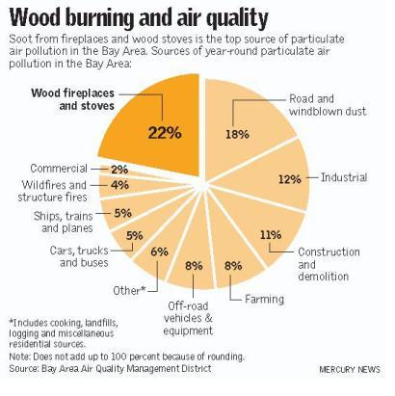
Ανθρωπογενείς πηγές ατμοσφαιρικής ρύπανσης
Θέρμανση κτιρίων
Κεντρική θέρμανση
Τζάκια, σόμπες ξύλου κλπ
Notes:
Before about 1960, the domestic use of coal was the major source of particles. Concentrations of airborne particles in many European cities frequently exceeded 1000 µg/m3 and annual average concentrations of several hundred µg/m3 were commonplace. Today, annual average concentrations in most European cities have fallen to less than 30 µg/m3. In eastern Europe much higher concentrations still occur as, to a lesser extent, they do in southern European cities such as Athens. Brown coal (lignite) is a key source of particles in many parts of eastern Europe.
Coal varies in composition and calorific value from mine to mine. Lignite is probably the poorest quality in terms of calorific value and generates most pollutants when used for domestic heating. Lignite contains 67% carbon (compared with the 95% in anthracite) and burns easily, though inefficiently, on an open fire. Special devices with carefully controlled air supplies are needed to burn anthracite but combustion is efficient and far less black smoke is produced.
S mall-scale domestic combustion in fireplaces, wood and coalfired stoves as well as boilers are significant contributors to air pollution. They emit fine particulate matter (PM2.5), sulphur oxides (SOx ), carbon monoxide (CO), poly-aromatic hydrocarbons (PAHs), dioxins, organic gaseous compounds (OGCs) and nitrogen oxides (NOx ) which form ground level ozone. These pollutants damage human health and cause premature deaths (see Air & Health factsheet). Wood and coal burning also emits black carbon (BC), known as soot.
In Athens, the intense use of open fireplaces and woodstoves for domestic heating during the last years has caused notable increases in the ambient PM concentrations, with the contribution from biomass combustion reaching up to 70% of the PM mass concentration during extreme pollution episodes. The relevant 5-year measurements study also showed an increase of 80% in BC due to increased wood burning (Paraskevopoulou et al., 2014). The chemical footprint of these smog events has been well established via specialized aerosol measurements, e.g., significant correlations between PM2:5 and levoglucosan, or high
fine mode particulate potassium, demonstrating that wintertime, wood burning in Athens could be responsible for
PM2:5 levels higher than 45 μgm-3.

Slide 26
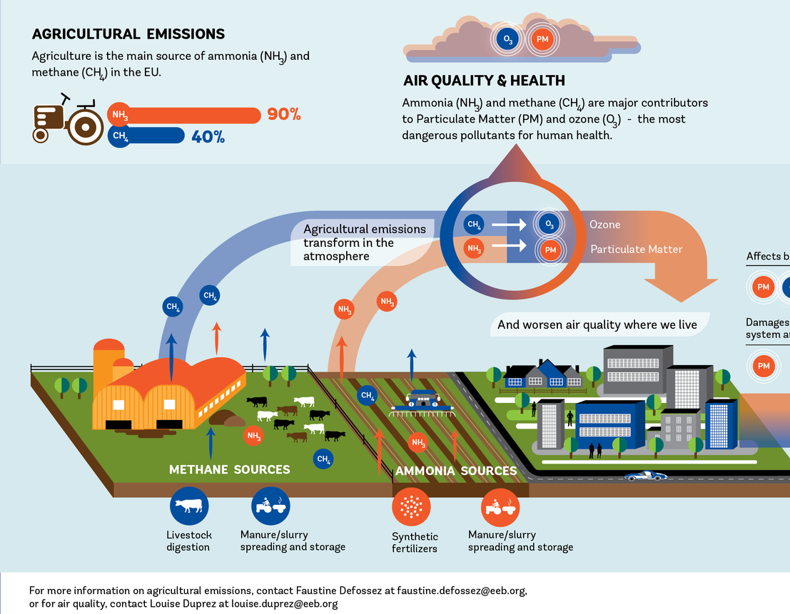
Ανθρωπογενείς πηγές ατμοσφαιρικής ρύπανσης
Γεωργία
Χώνευση
Περιττώματα
Κοπριά
Notes:
Agricultural air pollution comes mainly in the form of ammonia, which enters the air as a gas from heavily fertilized fields and livestock waste. It then combines with pollutants from combustion—mainly nitrogen oxides and sulfates from vehicles, power plants and industrial processes—to create tiny solid particles, or aerosols, no more than 2.5 micrometers across, about 1/30 the width of a human hair.
Agriculture is the main emitter sector in which
emissions of air pollutants have decreased least. The
agricultural sector is by far the greatest emitter of NH3
and of CH4 and was responsible for 94 % and 52 %
of total NH3 and CH4 emissions in the EU‑28 in 2014,
respectively. Its NH3 and CH4 emissions decreased
by only 7 % from 2000 to 2014. Agriculture increased
its NMVOC emissions by 15 between 2000 and 2014,
contributing to 11 % of total NMVOC emissions in the
EU‑28 in 2014. Agriculture is the third most important
source of PM10 primary emissions in the EU‑28, after
the commercial, institutional and household fuel
combustion and industry sectors. Its contribution to total
PM10 emissions in the EU‑28 was 17 % in 2014.

Slide 27
Δομή Μαθήματος
Εισαγωγή
Πηγές ατμοσφαιρικής ρύπανσης
Χημικά συστατικά της ατμόσφαιρας (ρύποι)
Ρύπανση εσωτερικών χώρων
Διαδικασίες μεταφορές, εξέλιξης, τροποποίησης ρύπων στην ατμόσφαιρα

Slide 28
Αέριοι ρύποι
Ενώσεις θείου (π.χ. SO2)
Ενώσεις αζώτου (π.χ. ΝΟ, ΝΟ2, ΝΗ3)
Ενώσεις άνθρακα (π.χ. CΟ, VOCs)
Όζον (Ο3)
Αιωρούμενα σωματίδια (PM or aerosol)
Notes:
Sulphur dioxide (SO2) is mainly emitted from the
combustion of fuels containing sulphur. The main
anthropogenic emissions of SO2 derive from stationary
power generation, industry, and commercial,
institutional and household fuel combustion. Volcanoes
are the biggest natural source of SO2.
Sulphur dioxide (SO₂) is a colourless gas. It reacts on the surface of a variety of airborne solid particles, it is soluble in water and can be oxidised within airborne water droplets to form sulphuric acid (H₂SO₄), which falls as acid precipitation or "acid rain". SO₂ emissions arise from the oxidation, during combustion, of the sulphur contained within fossil fuels. Fossil fuels, including coal, oil and to a lesser extent gas, contain sulphur in both organic and inorganic form.
nitric oxide (NO), is emitted by both natural and anthropogenic sources. Nitrogen dioxide (NO2) is emitted in small quantities
from combustion processes along with NO and is also formed in the atmosphere by oxidation of NO. The sum of NO and NO2 is usually designated as NOx. Nitric oxide is the major oxide of nitrogen formed during high-temperature combustion, resulting from both the interaction of nitrogen in the fuel with oxygen present in the air and the chemical conversion of atmospheric nitrogen and oxygen at the high temperatures of combustion.
Ammonia is the primary basic gas in the atmosphere and, after N2 and N2O, is the most
abundant nitrogen-containing compound in the atmosphere. The significant sources of
NH3 are animal waste, ammonification of humus followed by emission from soils,
losses of NH3-based fertilizers from soils, and industrial emissions (Table 2.8). The
ammonium (NH+
4) ion is an important component of the continental tropospheric
aerosol. Because NH3 is readily absorbed by surfaces such as water and soil, its
residence time in the lower atmosphere is estimated to be quite short, about 10 days.
Wet and dry deposition of NH3 are the main atmospheric removal mechanisms for NH3. In
fact, deposition of atmospheric NH3 and NH+
4 may represent an important nutrient to the
biosphere in some areas. Atmospheric concentrations of NH3 are quite variable, depending
on proximity to a source-rich region. NH3 mixing ratios over continents range typically
between 0.1 and 10 ppb.
The term volatile organic compounds (VOCs) is used to denote the entire set of vaporphase
atmospheric organics excluding CO and CO2. VOCs are central to atmospheric
chemistry from the urban to the global scale.
Vegetation naturally releases organic compounds to the atmosphere. In 1960, Went (1960)
first proposed that natural foliar emissions of VOCs from trees and other vegetation could
have a significant effect on the chemistry of the Earth's atmosphere.
Measurements in wooded and agricultural areas coupled with emission studies from
selected individual trees and agricultural crops have demonstrated the ubiquitous nature of
biogenic emissions and the variety of organic compounds that can be emitted. Isoprene (2-methyl-1,3-butadiene, C5H8) is unique among the biogenic hydrocarbons
in its relationship to photosynthetic activity in a plant. It is emitted from a wide variety of
mostly deciduous vegetation in the presence of photosynthetically active radiation,
exhibiting a strong increase in emission as temperature increases. Not only do the isoprene
and terpenoid emissions vary considerably among plant species, but the biochemical and
biophysical processes that control the rate of these emissions also appear to be quite distinct. Isoprene emissions appear to be a species-dependent byproduct of photosynthesis,
photorespiration, or both; there is no evidence that isoprene is stored within or
metabolized by plants. As a result, isoprene emissions are temperature- and lightdependent;
essentially no isoprene is emitted without illumination.
The global sources and sinks of CO are given in Table 2.14. Methane oxidation (by OH) is
a major source of CO, as are technological processes (combustion and industrial processes),
biomass burning, and the oxidation of nonmethane hydrocarbons. Uncertainties in each of
these estimated sources are large. It is estimated that about two-thirds of the CO comes from
anthropogenic activities, including oxidation of anthropogenically derived CH4.

Slide 29
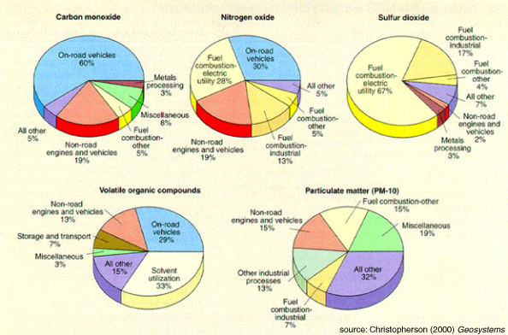
Αέριοι ρύποι

Slide 30
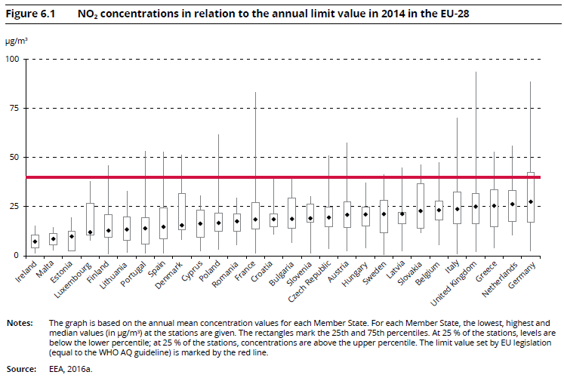
Διοξείδιο του αζώτου

Slide 31
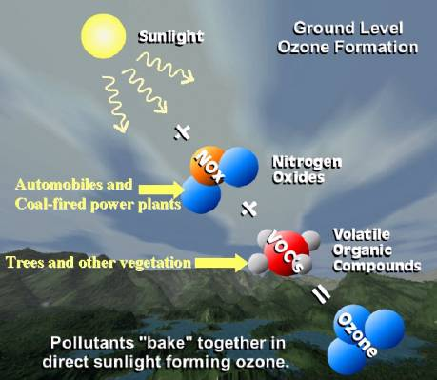
Όζον

Slide 32
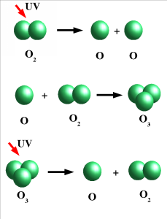
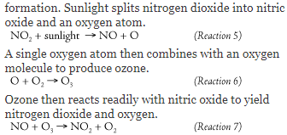

Όζον
Ozone
Notes:
Ozone is formed in the atmosphere when energetic ultraviolet (UV) radiation dissociates molecules of oxygen, O₂ , into separate oxygen atoms. Free oxygen atoms can recombine to form oxygen molecules but if a free oxygen atom collides with an oxygen molecule, it joins up, forming ozone. Ozone molecules can also be decomposed by ultraviolet radiation into a free atom and an oxygen molecule. Ozone is thus continuously created and destroyed in the atmosphere by UV radiation coming from the sun.
The formula above represents several series of reactions that do not lend themselves to simple depiction. They involve the oxidation of VOCs in reactions that also involve NO_{x}. Hydroxyl catalyzes some of the key reactions, and dozens of other chemical species take part. The result is ozone, nitrogen dioxide (available for more ozone formation), the regeneration of hydroxyl (available to catalyze more ozone formation), and some other chemical species. The specific ratio of NO_{x} to VOC determines the efficiency of the ozone formation process.

Slide 33
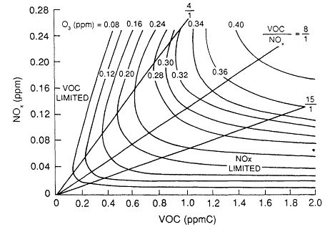
Όζον
Typical ozone isopleths used in EPA's EKMA. The NOx-limited region is typical
of locations downwind of urban and suburban areas, whereas the VOC-limited
region is typical of highly polluted urban areas. Source: Adapted from Dodge
Notes:
https://www.nap.edu/read/1889/chapter/8#165
Ozone (O3) is produced in the troposphere as a result of a complex set of reactions that involve volatile organic compounds (VOCs) and oxides of nitrogen (NOx). These reactions are discussed in detail in Chapter 5. Because the initial atmospheric concentrations (and corresponding emissions) of VOCs and NOx are not directly proportional to the maximum ozone concentration ultimately formed, a principal question associated with the VOC-NOx-O3 system is ''What is the maximum amount of ozone that can form from a given initial mixture of VOCs and NOx?'‘
A.J. Haagen-Smit (see, for example, Haagen-Smit and Fox, 1954) first plotted maximum ozone concentrations that result from initial mixtures of VOCs and NOx on a graph, the axes of which are the initial VOC and NOxconcentrations. Isopleths (lines of constant value) of the maximum ozone concentrations can be constructed by connecting points that correspond to various initial conditions. Each point on a particular isopleth represents the same ozone concentration. Because ozone isopleth diagrams are a concise way to depict the effect of reducing initial VOC and NOxconcentrations on the peak ozone concentrations, they have been used quantitatively to develop control strategies for ozone reduction by the U.S. Environmental Protection Agency's EKMA (empirical kinetic modeling approach) (Dodge, 1977). Figure 6-1 shows a typical set of EKMA ozone isopleths.
The location of a particular point on the ozone isopleth is defined by the ratio of the VOC and NOx coordinates of the point, referred to as the VOC/ NOx ratio. Figure 6-1 shows that the shape of the ozone isopleths depends on the VOC/NOx ratio. (The lines in Figure 6-1 correspond to VOC/NOx ratios of 15, 8, and 4 ppb carbon (C)/ppb.) The 0.32 parts per million (ppm) (320 ppb) ozone isopleth, for example, spans a wide range of VOC/NOx ratios. As a result, the degrees of VOC and NOx reductions required to move from the 320 ppb isopleth to the 120 ppb isopleth vary considerably depending on the VOC/NOx ratio at the starting point on the 320 ppb isopleth.
The VOC/NOx ratio is important in the behavior of the VOC-NOx-O3system. Moreover, it has a major effect on how reductions in VOC and NOxaffect ozone concentrations.
An ozone isopleth diagram characteristically exhibits a diagonal ridge from the lower left to the upper right corner of the graph. The corresponding VOC/NOx ratio is typically about 8:1, although the shape of the isopleths, and hence the ratio, is sensitive to a number of factors.
It is useful to consider two areas on the graph: those to the right of the ridge line and those to the left.

Slide 34
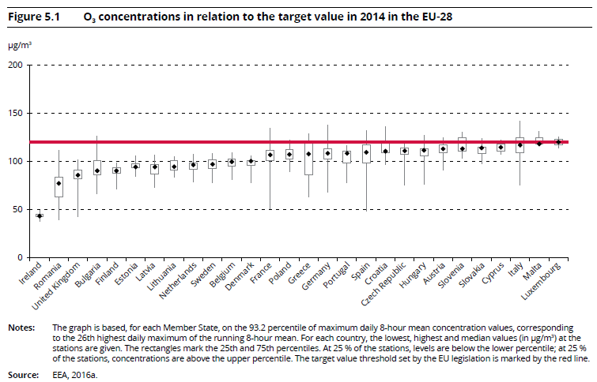
Όζον

Slide 35
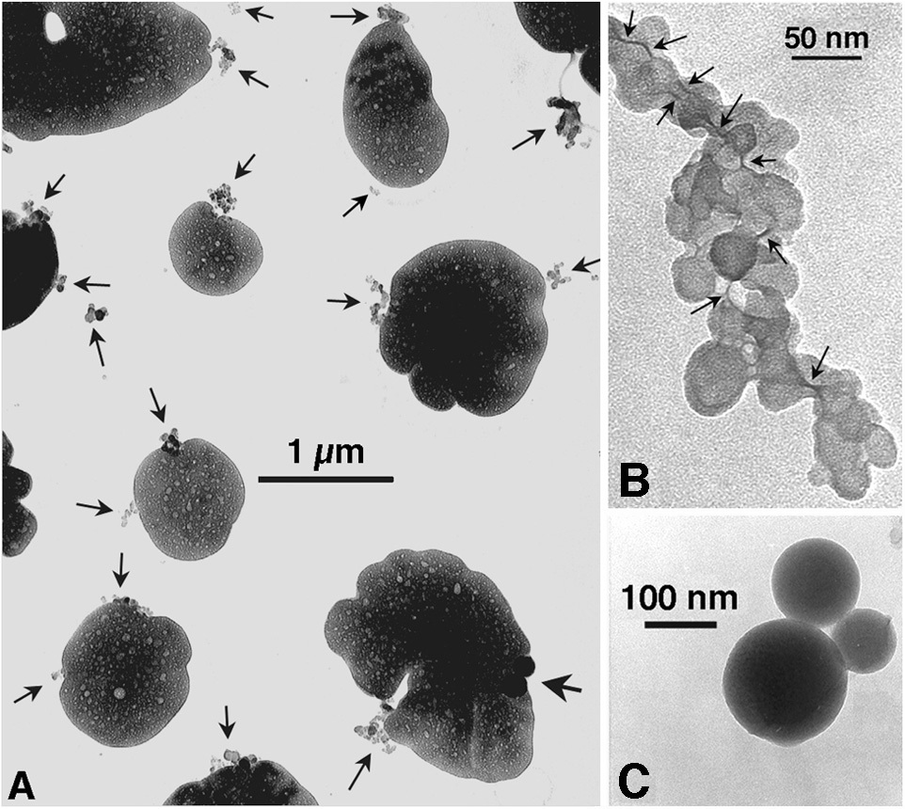
Αιωρούμενα σωματίδια
Aerosols are suspended particles in the air which are small enough to resist gravitational sedimentation (i.e. they remain afloat despite the force of gravity acting on them). Aerosols can be solid, liquid, or a combination of both. They typically range in size from 0.1 to 10.0 micrometers. (PM10). The main sources of aerosols are dust from the surface (e.g. deserts), sea spray (liquid droplets and solid sea-salt particles), volcanoes, forest fires, and anthropogenic combustion.
Small soot and sulfate aerosols are seen in these microscope slides. Trapped in the atmosphere, these tiny particles can have an important effect on climate. Credit: Mihály Pósfai, Arizona State University
Notes:
Τα αιωρούμενα σωματίδια είναι μικρά τεμάχια ύλης σε στερεή ή υγρή φάση, που μπορούν να αιωρούνται στην ατμόσφαιρα για μεγάλα χρονικά διαστήματα. Ανάλογα με την προέλευση τους μπορούν να παρουσιάζουν ανομοιογένεια στη μορφή, μέγεθος και χημική σύσταση. Οι κυριότερες πηγές εκπομπής αιωρουμένων σωματιδίων είναι οι διάφορες βιομηχανικές δραστηριότητες, τα αυτοκίνητα, οι πυρκαγιές, τα καψαλίσματα χωραφιών και άλλες γεωργικές δραστηριότητες, οι κατασκευές, η επαναιώρηση σκόνης λόγω ισχυρών ανέμων κλπ.
Ο χρόνος ζωής των σωματιδίων είναι αντιστρόφως ανάλογος με το μέγεθός τους. Οπότε τα μεγάλα σωματίδια έχουν χρόνο ζωής μερικές ώρες ενώ τα μικρά σωματίδια μερικές ημέρες. Αναλόγως με το μέγεθός τους η ταξινόμηση αιωρούμενων σωματιδίων γίνεται ως εξής:
* Aitken σωματίδια 0.001 – 0.1 μm
* λεπτά σωματίδια 0.1 – 1μm
* γιγαντιαία ή χονδρόκοκκα σωματίδια > 1 μm
* σωματίδια καπνού 1-1000 μm
* σκόνη μικρής διαμέτρου <100 μm
* σκόνη μεγάλης διαμέτρου >100 μm
* νεφοσταγονίδια 1-100 μm
* σταγόνες βροχής > 100 μm

Slide 36
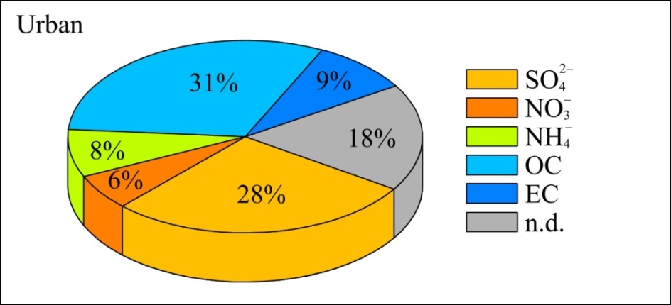
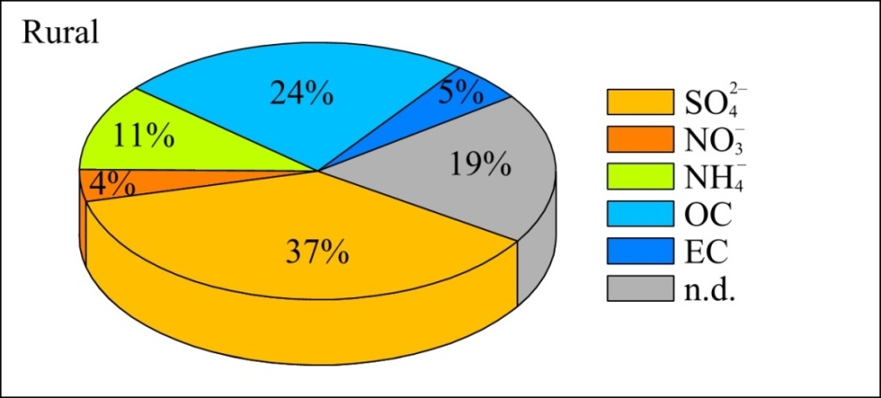
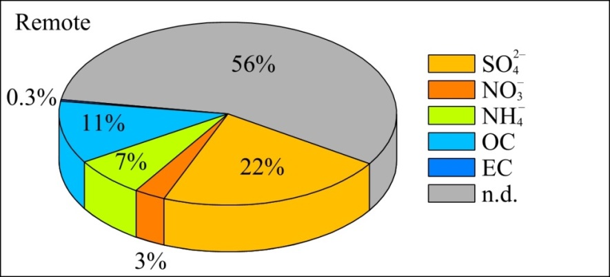
Αιωρούμενα σωματίδια
Average fine particle composition of aerosol types. Data correspond to mass fraction in % of the total fine particle mass concentration. OC = organic carbon, EC = elementary carbon. Source of data: Heitzenberg, 1994.
Notes:
http://elte.prompt.hu/sites/default/files/tananyagok/AtmosphericChemistry/ch09s02.html
The atmospheric aerosol has a very complex and variable chemical composition. Due to the various sources and transformations, each particle has individual composition. Atmospheric aerosols are generally composed of variable amounts of sulphate, nitrate, ammonium, sea salt, crustal elements and carbonaceous compounds (elemental and organic carbon) and other organic materials. Fine particles predominantly contain sulphate, nitrate, ammonium, elemental and organic carbon and certain trace metals (e.g. lead, cadmium, nickel, copper etc.). The primary components of coarse particle fraction are dust, crustal elements, nitrate, sodium, chloride and biogenic organic particles (e.g. pollen, spores, plant fragments etc.).
The main precursors of sulphate component () in the troposphere are sulphur dioxide (SO₂) emitted from anthropogenic sources and volcanoes, and dimethyl sulphide (DMS) from biogenic sources, especially from marine planktons. In the stratosphere, sulphate aerosols mostly converted from carbonyl sulphide (COS).
Nitrate () is formed mainly from the oxidation of atmospheric nitrogen dioxide (NO₂). Ammonium salts are also common components of atmospheric aerosols. They are formed during the reactions between ammonia (NH₃) and various acids, like sulphuric (H₂SO₄) and nitric acids (HNO₃). When atmospheric ammonia neutralises these acids, ammonium sulphate ((NH₄)₂SO₄), and ammonium nitrate (NH₄NO₃) particles are formed. Main source of chloride (Cl–) is sea spray, but ammonium chloride (NH₄Cl) particles form also during the reaction between ammonia and hydrochloric acid (HCl).
Carbonaceous materials constitute a large but highly variable fraction of the atmospheric aerosol. The carbonaceous fraction of the aerosols consists of both elemental carbon (EC) or black carbon (BC) and organic carbon (OC). The ratio of elemental to total carbon (EC+OC) is strongly depends on the sources. The main sources of elemental carbon particles are biomass and fossil fuel burning. Particles containing organic carbon can emitted directly to the atmosphere also from biomass burning or combustion processes and by secondary organic aerosol (SOA) formation during the atmospheric oxidation of biogenic or anthropogenic volatile organic compounds (VOC).
Typical chemical composition of aerosols can vary at different locations, times, weather conditions and particle size fractions. Figure 9.10, Figure 9.11 and Figure 9.12 show the relative abundance of different chemical components of fine particles in different locations, in urban area, in rural region and in a remote site, respectively.

Slide 37
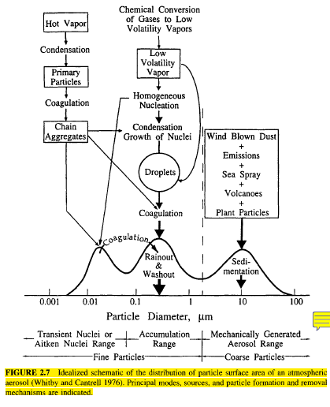
Αιωρούμενα σωματίδια
Notes:
Atmospheric aerosols consist of particles ranging in size from a few tens of angstroms
(A) to several hundred micrometers. Particles less than 2.5 μm in diameter are generally
referred to as "fine" and those greater than 2.5 μm diameter as "coarse." The fine and
coarse particle modes, in general, originate separately, are transformed separately, are
removed from the atmosphere by different mechanisms, require different techniques
for their removal from sources, have different chemical composition, have different
optical properties, and differ significantly in their deposition patterns in the respiratory
tract. Therefore the distinction between fine and coarse particles is a fundamental
one in any discussion of the physics, chemistry, measurement, or health effects of
aerosols.
The phenomena that influence particle sizes are shown in an idealized schematic in
Figure 2.7, which depicts the typical distribution of surface area of an atmospheric aerosol.
Particles can often be divided roughly into modes. The nucleation (or nuclei) mode
comprises particles with diameters up to about 10 nm. The Aitken mode spans the size
range from about 10 nm to 100 nm (0.1 μm) diameter. These two modes account for the preponderance of particles by number; because of their small size, these particles rarely
account for more than a few percent of the total mass of airborne particles. Particles in the
nuclei mode are formed from condensation of hot vapors during combustion processes and
from the nucleation of atmospheric species to form fresh particles. They are lost
principally by coagulation with larger particles. The accumulation mode, extending from
0.1 to about 2.5 μm in diameter, usually accounts for most of the aerosol surface area and a
substantial part of the aerosol mass. The source of particles in the accumulation mode is
the coagulation of particles in the nuclei mode and from con- densation of vapors onto
existing particles, causing them to grow into this size range. The accumulation mode is
so named because particle removal mechanisms are least efficient in this regime, causing
particles to accumulate there. The coarse mode, from > 2.5 urn in diameter, is formed by
mechanical processes and usually consists of human-made and natural dust particles.
Coarse particles have sufficiently large sedimentation velocities that they settle out of the
atmosphere in a reasonably short time. Because removal mechanisms that are efficient at the
small and large particle extremes of the size spectrum are inefficient in the accumulation
range, particles in the accumulation mode tend to have considerably longer atmospheric
residence times than those in either the nuclei or coarse mode.

Slide 38
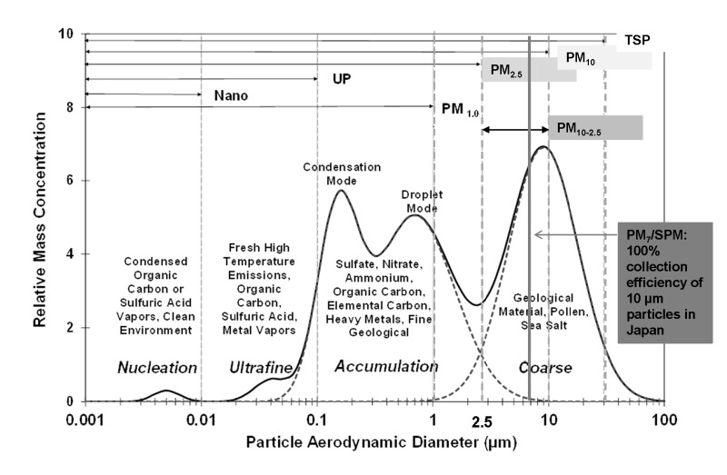
Αιωρούμενα σωματίδια

Slide 39
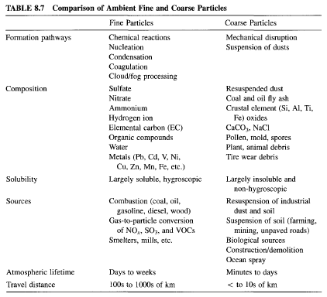
Αιωρούμενα σωματίδια
Notes:
Atmospheric aerosol particles contain sulfates, nitrates, ammonium, organic material,
crustal species, seasalt, metal oxides, hydrogen ions, and water. From these species sulfate,
ammonium, organic and elemental carbon, and certain transition metals are found
predominantly in the fine particles. Crustal materials, including silicon, calcium,
magnesium, aluminum, and iron, and biogenic organic particles (pollen, spores, plant
fragments) are usually in the coarse aerosol fraction. Nitrate can be found in both the fine
and coarse modes. Fine nitrate is usually the result of the nitric acid/ammonia reaction for
the formation of ammonium nitrate, while coarse nitrate is the product of coarse particle/
nitric acid reactions.
A typical urban aerosol size/composition distribution is shown in Figure 8.23 (Wall
et al. 1988). These results indicate that sulfate, nitrate, and ammonium have two modes in
the 0.1-1.0 μm size range (the condensation and droplet modes), and a third one over 1 μm
(coarse mode). The condensation mode has a peak around 0.2 μm and is the result of
condensation of secondary aerosol components from the gas phase. The droplet mode
peaks around 0.7 μm in diameter and its existence is attributed to heterogeneous, aqueousphase
reactions discussed in Chapter 7 (Meng and Seinfeld 1994). More than half of the
nitrate is found in the coarse mode together with most of the sodium and chloride. This
coarse nitrate is the result of reactions of nitric acid with sodium chloride or aerosol crustal
material (see Chapter 10). This is an interesting case where secondary aerosol matter
(nitrate) is formed through the reaction of a naturally produced material (seasalt or dust)
and an anthropogenic pollutant (nitric acid).
More than 40 trace elements are routinely found in atmospheric particulate matter
samples. These elements arise from dozens of different sources including combustion of
coal, oil, woodburning, steel furnaces, boilers, smelters, dust, waste incineration, and
brake wear. Depending on their sources, these elements can be found in either the fine or
the coarse mode. Concentrations of selected elements together with the size mode where
these elements are usually found are shown in Table 8.6. The concentrations of these
elements even for similar pollution levels vary over almost three orders of magnitude,
indicating the strong effect of local sources. In general, elements such as lead, iron, and
copper have the highest concentrations, while elements such as cobalt, mercury, and antimony are characterized by low concentrations. Elements produced during combustion
usually exist in the form of oxides (e.g., Fe2O3, Fe3O4, Al2O3), but their chemical form is
in general uncertain.
A summary of chemical information regarding the coarse and fine modes is presented
in Table 8.7.

Slide 40
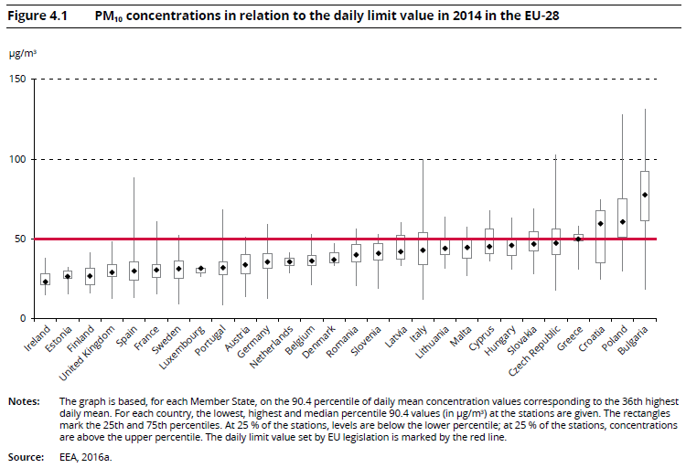
Αιωρούμενα σωματίδια

Slide 41
Δομή Μαθήματος
Εισαγωγή
Πηγές ατμοσφαιρικής ρύπανσης
Χημικά συστατικά της ατμόσφαιρας (ρύποι)
Ρύπανση εσωτερικών χώρων
Διαδικασίες μεταφοράς, εξέλιξης, τροποποίησης ρύπων στην ατμόσφαιρα

Slide 42
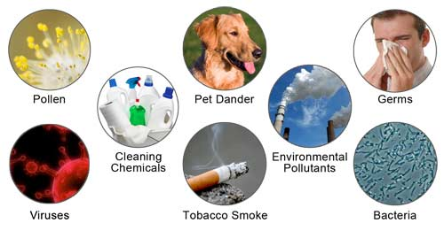
Ρύπανση εσωτερικών χώρων
Notes:
http://carypure.com/blog/2017/02/01/5-reasons-indoor-air-pollution-harmful-health/
Particulate matter (PM) is one of the main perpetrators of Indoor Air Pollution. It is made of minuscule solids, liquid droplets or it can also refer to a mixture of liquid and solid droplets suspended in air. Acids such as sulfuric and nitric acids, metals, organic chemicals, soil or dust particles, and biological contaminants all collectively contribute to particulate matter pollution.
The most common particles that can be found in a home are:
Dust as solid particulate matter or smoke and fumes, which are a combination of solid and liquid particles.
Biological particulate matter, including viruses, pollen, molds, bacteria, dust mite and cockroach body parts and droppings, and animal waste.
From a health standpoint, fine particles that have a diameter of 2.5 micrometers (μm) or less are the most harmful. These breathable particles can be inhaled and they penetrate deep into the lungs where they may cause chronic or acute health effects. Particles larger than this can be trapped in the throat and the nose and expelled by sneezing, or swallowing.

Slide 43
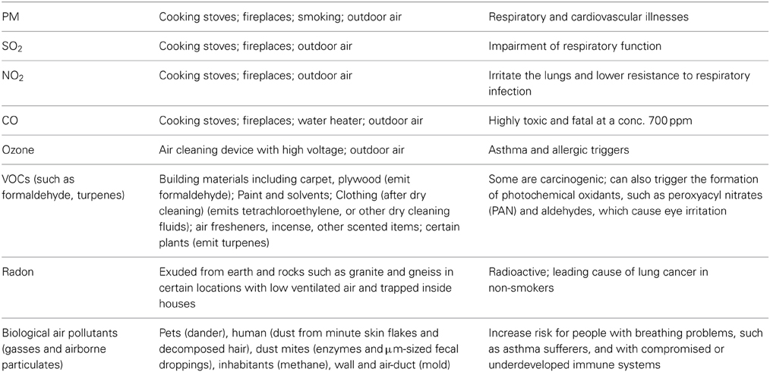
Ρύπανση εσωτερικών χώρων
Notes:
https://www.frontiersin.org/articles/10.3389/fenvs.2014.00069/full#T1

Slide 44
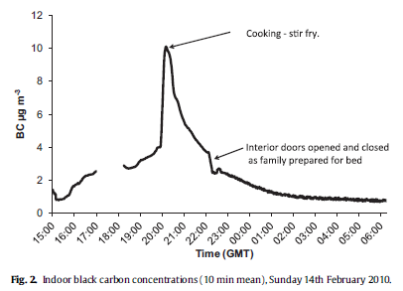
Ρύπανση εσωτερικών χώρων

Slide 45
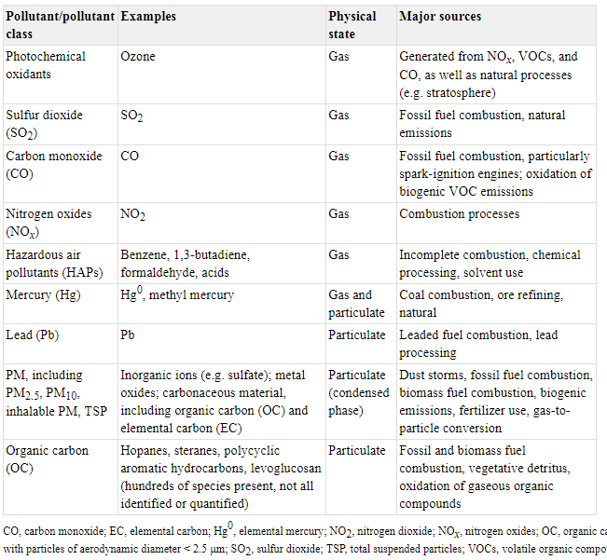
Σύνοψη
Notes:
https://www.ncbi.nlm.nih.gov/books/NBK368034/
From: 1.1, Definition of outdoor air pollution
Outdoor air pollution.
IARC Monographs on the Evaluation of Carcinogenic Risks to Humans, No. 109.
IARC Working Group on the Evaluation of Carcinogenic Risk to Humans.
Lyon (FR): International Agency for Research on Cancer; 2016.

Slide 46
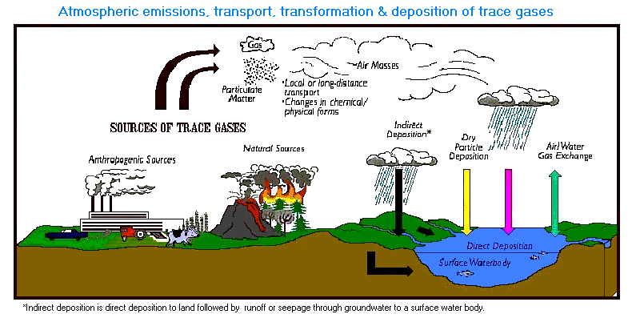
Δημιουργία & Εξέλιξη της ατμοσφαιρικής ρύπανσης

Slide 47
Δομή Μαθήματος
Εισαγωγή
Πηγές ατμοσφαιρικής ρύπανσης
Χημικά συστατικά της ατμόσφαιρας (ρύποι)
Ρύπανση εσωτερικών χώρων
Διαδικασίες μεταφοράς, εξέλιξης, τροποποίησης ρύπων στην ατμόσφαιρα

