Slide 1
Ancient Greek Literature
DEPARTMENT OF PHILOSOPHY
UNIVERSITY OF PATRAS

Slide 2
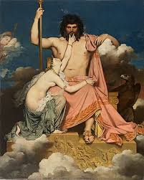
Supplication (hiketeia)
ἱκετεία was a ritualized, desperate request for help, often made by a weaker party (suppliant) to a stronger one, protected by religious obligation and Zeus Hikesios. It was a non-verbal and verbal act, typically involving grasping the knees and touching the chin of the supplicated person.

Slide 3
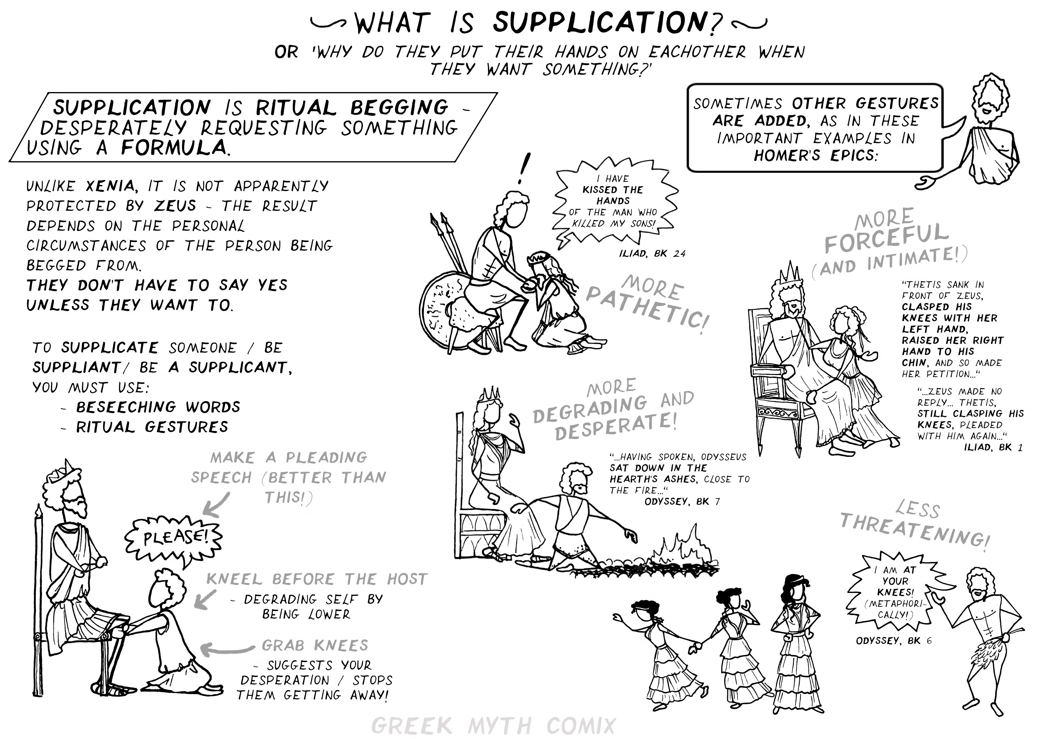
Supplication (hiketeia)

Slide 4
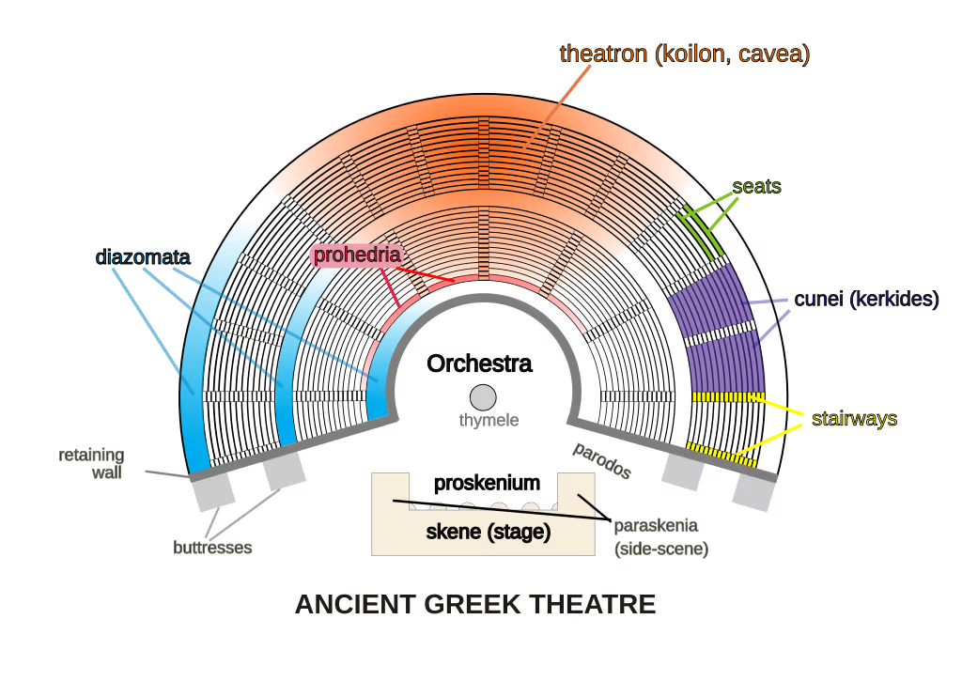
PARODOS
1) is a side-entrance to the stage
2) entrance song of the chorus

Slide 5
Sophocles, Oedipus Rex
Parodos 151 – 215
The chorus, consisting of 15 theban elders, takes its place in the orchestra, while Oedipus has now retreated to the interior of the palace, but the supplicants have also left, having expressed their desire for him to take the initiative, in order to confront the death that now dominates from end to end in the city.

Slide 6
Sophocles, Oedipus Rex
Chorus
Strophe 1
O sweetly-speaking message of Zeus, in what spirit have you come to glorious Thebes from golden Pytho? I am on the rack, terror shakes my phrēn, O Delian healer to whom wild cries rise, 155 in holy fear of you, wondering what thing you will work for me, perchance unknown before, perchance renewed with the revolving seasons [hōrai]. Tell me, immortal voice, child of golden hope.
Antistrophe 1
First I call on you, daughter of Zeus, immortal Athena, 160 and on your sister, Artemis, guardian of our earth, who sits on her throne of good kleos above the circle of our agorā, and on far-shooting Apollo: O shine forth for me, my three-fold help against death! 165 if ever before you drove a fiery pest from our borders to stop disasters [atai] rushing upon our polis, come now also!

Slide 7
Sophocles, Oedipus Rex
Strophe 2
Alas, countless are the sorrows I bear! 170 A plague is on all our people, and thought can find no weapon for defense. The fruits of the glorious earth do not grow; by no birth of offspring do women surmount the labors [kamatoi] in which they shriek. 175 you can see life after life speed away, like A bird on the wing, swifter than irresistible fire, to the shore of the western god.
Antistrophe 2
With such deaths past numbering, the polis perishes. 180 unpitied, her children lie on the ground, spreading pestilence, with no one to mourn them. Meanwhile young wives and gray-haired mothers raise A wail at the steps of the altars, some here, some there, 185 and groan in supplication for their terrible pains [ponoi]. The prayers to the healer ring clear, and with them the voice of lamentation. For which things, golden daughter of Zeus, send us the bright face of comfort.

Slide 8
Sophocles, Oedipus Rex
Strophe 3
190 Grant that the fierce god of death, who now, without the bronze of shields, yet amidst cries as though of battle, wraps me in the flames of his onset, may turn his back in speedy flight from our land, borne by a favorable wind to the great chamber of Amphitrite, 195 or to the Thracian waves, those waters where no xenoi find haven. For if night leaves anything undone, it comes to fulfillment [telos] by day. You who wield the 200 powers [kratos pl.] of fiery lightning, Zeus our father, slay him beneath your thunderbolt.
Antistrophe 3
Lykeian lord, would that the shafts from your bent bow’s string of woven gold might 205 go forth in their might, our champions in the face of the foe, and the flashing fires of Artemis too, with which she darts through the Lycian hills. I call him whose locks are bound with gold, 210 who is named with the name of this land, ruddy Dionysus to whom bacchants cry, to draw near with the blaze of his shining torch, 215 our ally against the god without tīmē among the gods.

Slide 9
Notes
Pytho: Delphi or Pytho, a sacred precinct that served as the seat of the oracle Pythia.
Delian healer: Apollo. Born in Delos. Healing powers.
Chamber of Amphitrite: associated with the Sanctuary of Poseidon and Amphitrite located in Kionia on the island of Tinos. Healing cult.
Thracian waves: Ancient Greeks viewed this region as cold and untamed.
Lykeian lord: Apollo Lykeios (or Lyceus, often translated as "Lycian Apollo" or "Wolf-Apollo") refers to a specific cult epithet. A surname of Apollo, describing him either as the god born in Lycia.
Bacchants: followers of Dionysus.

Slide 10
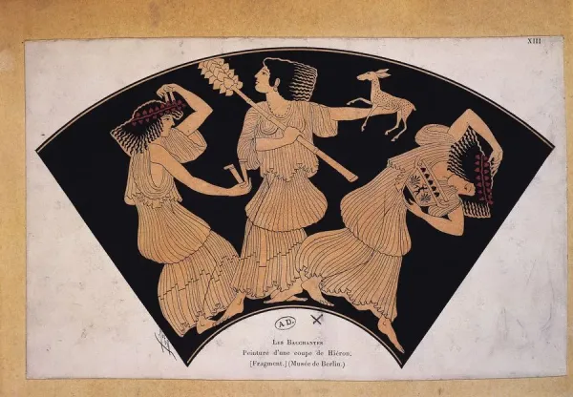
Notes

Slide 11
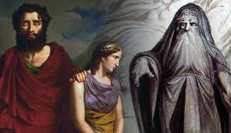
Τειρεσιασ (Tiresias)
A blind prophet of apollo in Thebes, famous for clairvoyance and for being transformed into a woman for seven years.
Participated fully in seven generations in Thebes, beginning as advisor to Cadmus, the founder of Thebes.

Slide 12
First Episode (216-462)
Oedipus returns to the stage, leaving his palace, and announces the punishment of Laius' murderer, in order to cure the city of the deadly epidemic that is plaguing it. Then Tiresias appears, who leaves hints about Oedipus' personal responsibility for Laius' murder. However, Oedipus suspects that there is a secret conspiracy between Tiresias and Creon, to dethrone him by blaming him for the specific murder.

Slide 13
First Episode (216-462)
Oedipus
You pray. And in answer to your prayer, if you will give a loyal reception to my words [epea], and minister to your own disease, you may hope to find succor and relief from woes. These words I will speak publicly, as one who was a stranger [xenos] to the report, 220 a stranger to the deed. I would not go far on the trail if I were tracing it alone, without a clue [sumbolon]. But as it is—since it was only after the event that I was counted a Theban among Thebans—to you, Kadmeians all, I do thus proclaim:
Whoever of you knows 225 by whom Laios son of Labdakos was slain, I bid him to indicate [sēmainein] all to me. And if he is afraid, I order him to remove the danger of the charge from his path by denouncing himself; he will suffer no other punishment, but will only leave this land, unhurt. 230 if anyone knows the assassin to be an alien, from another land, let him not keep silent. I will make him profit [kerdos], and my gratitude [kharis] shall rest with him besides. But if he keeps silent, if anyone, through fear, seeks to screen himself or a philos from my pronouncement [epos], 235 then hear what I shall do. I charge you that no resident of this land, of which I hold the royal power [kratos], receive or address that murderer, whoever he is, or make him a partner in prayer or sacrifice, 240 or give him a share of the lustral rite. Ban him from your houses, all of you, knowing that this is the pollution [miasma], as the oracle of the Pythian god has recently shown to me.

Slide 14
First Episode (216-462)
In this way 245 I am an ally to the daimōn and to the dead man. And I pray solemnly that the slayer, whoever he is, whether he has gotten away alone or with partners, may wear out his unblest life evilly as he is evil [kakos]. And for myself I pray that if he should, 250 with my knowledge, become a resident of my house, I may suffer [paskhein] the same things which I have just called down on others. I order you to make all these words come to fulfillment [telos], for my sake, for the sake of the god, and for the sake of our land, thus blasted with barrenness by angry heaven.
Even if the matter had not been urged upon us by a god, 255 it still would not have been fit that you should leave the guilt thus unpunished, when one so noble—and he your king—had perished. You should have searched it out.

Slide 15
First Episode (216-462)
But now, since I hold the powers which he once held, 260 possessing his bed and the wife who bore his children, and since, had his hope of offspring [genos] not been unsuccessful, children born of one mother would have tied us with a common bond—as it was, fate swooped upon his head—i will uphold this cause, as though it were that of my own father, 265 and will leave no stone unturned in my search for the one who shed the blood, for the honor of the son of Labdakos—and son of Polydoros and of Kadmos before him and of Agenor of old. And for those who do not obey me, I pray that the gods 270 send them neither harvest of the earth nor fruit of the womb, but that they perish by the present fate, or by one still worse. But to all you other Kadmeians who are satisfied by these things, may dikē, our ally, 275 and all the gods be gracious always.

Slide 16
First Episode (216-462)
Chorus: As you have put me under oath, on my oath, my lord, I will speak. I am not the slayer, nor can I reveal him. As for the investigation, it was for Phoebus, who enjoined it, to tell us who wrought the deed.
Oedipus: 280 Justly [dikaia] said. But no man on earth can force the gods to do what they do not want.
Chorus: I would like to say what seems to me the next best course.
Oedipus: And if there is a third course, do not hesitate to reveal it.
Chorus: I know that our lord Teiresias is the seer most like our 285 lord Apollo; From him, my lord, an investigator might learn most clearly about these affairs.
Oedipus: Not even this have I left uncared for. On Creon’s suggestion, I sent a man to bring him. And i’ve been wondering for some time why he is not here.
Chorus: 290 indeed—his skill apart—the words [epea] are but faint and old.
Oedipus: What sort are they? I am investigating every tale.
Chorus: He was said to have been killed by some wayfarers.
Oedipus: I too have heard that. But no one sees the one who did it.
Chorus: If he knows what fear is, he will not hesitate to come forward when he 295 hears your curses, so dire are they.
Oedipus: When a man does not shrink from a deed, neither is he scared by a word.
Chorus: But there is no one to convict him. For here they bring at last the godlike seer [mantis], the only man in whom what is true [alēthēs] lives.

Slide 17
First Episode (216-462)
Teiresias enters, led by a boy.
Oedipus
300 Teiresias, whose soul grasps all things, that which may be told and that which is unspeakable, the secrets of heaven and the affairs of the earth—you feel with your phrēn, though you cannot see, what a huge plague haunts our polis. From which, great prophet, we find you to be our protector and only savior [sōtēr]. 305 now, Phoebus—if indeed you have not heard the reports—has sent answer to our question that the only way to rid ourselves of this pest that afflicts us is to discover the slayers of Laios, and then to slay or banish them from our land. 310 do not, then, begrudge us the voice of the birds or any other path of the knowledge of the seer [mantis], but save yourself and your polis, save me, save all that is damaged by the defilement [miasma] of the dead. We are in your hands, and man’s noblest labor [ponos] is to help others 315 to the best of his means and powers.

Slide 18
First Episode (216-462)
Teiresias: Alas, how terrible it is to have phrenes when it does not benefit those who have it. I knew this well, but let it slip from mind; otherwise I would not have come here.
Oedipus: Ahat now? How disheartened you have come!
Teiresias: 320 Let me go home. For you will bear your own burden to the end, and I will bear mine, if you consent.
Oedipus: Your words are strange and unkindly to the polis which nurtured you, since you withhold this response.
Teiresias: I see that you, for your part, speak what is off the mark [kairos]. 325 therefore do not speak, so I will not suffer [paskhein] the same.

Slide 19
First Episode (216-462)
Oedipus: For the love of the gods, don’t turn away, if you have phrenes; we all implore you on our knees as suppliants.
Teiresias: All of you lack phrenes. Never will I reveal my evils—not to call them yours.
Oedipus: 330 What are you saying? Do you know the secret and refuse to tell it? Will you betray and destroy the polis?
Teiresias: I will grieve neither myself nor you. Why do you ask these things in vain? You will not learn the answers from me.
Oedipus: You would anger a stone! Most kakos of the kakoi, will you not speak out? 335 can nothing touch you? Will you never come to an end [telos]?
Teiresias: You find fault with my anger, but you do not perceive your own that lives with you; no, you blame me.

Slide 20
First Episode (216-462)
Oedipus: Who would not be angry hearing such words [epea], 340 with which you now are slighting the polis?
Teiresias: Though future will come of itself, though I shroud it in silence.
Oedipus: Since it must come anyway, it is right that you tell it to me.
Teiresias: I will speak no further; rage, if you wish, with the fiercest wrath your thūmos knows.
Oedipus: 345 In my anger I will not spare to speak all my thoughts. Know that you seem to me to have helped in plotting the deed, and to have done it, short of performing the actual murder with your own hands; if you had eye-sight, I would have said that you had done even this by yourself.
Teiresias: 350 true [alēthēs]? I order you to abide by your own decree, and from this day forth not to speak to these men or to me, since you are the accursed defiler of this land.
Oedipus: So brazen with your blustering taunt? 355 where do you think to escape to?

Slide 21
First Episode (216-462)
Teiresias: I have escaped. There is strength in my truth [alēthēs].
Oedipus: Who taught you this? Not your skill, at any rate.
Teiresias: You yourself. For you spurred me on to speak against my will.
Oedipus: What did you say? Speak again, so I may learn it better.
Teiresias: 360 did you not understand before, or are you talking to test me?
Oedipus: I cannot say I understood fully. Tell me again.
Teiresias: I say that you are the killer of the man whose slayer you seek.
Oedipus: Now you will regret that you have said such dire words twice.

Slide 22
First Episode (216-462)
Teiresias: 365 should I tell you more, that you might get more angry?
Oedipus: Say as much as you want; it will be said in vain.
Teiresias: I say that you have been living in unguessed shame with your most philos, and do not see to what woe you have come.
Oedipus: Do think that you will always be able to speak like this without smarting for it?
Teiresias: If indeed there is any strength in truth [alēthēs].
Oedipus: 370 there is, except for you. You do not have that strength, since you are maimed in your ears, in your noos, and in your eyes.
Teiresias: And you are a poor wretch to utter taunts that every man here will soon hurl at you.
Oedipus: Night, endless night has you in her keeping, so that you can never hurt me 375 nor any man that sees the light of the sun.

Slide 23
First Episode (216-462)
Teiresias: No, it is not your fate to fall at my hands, since apollo, to whom this matter is a concern, is sufficient.
Oedipus: Are these Creon’s devices, or your own?
Teiresias: Creon is no trouble for you; you are your own.
Oedipus: 380 O wealth, and tyranny, and skill surpassing skill in life’s keen rivalries, how great is the envy in your keeping, if, for the sake of this power which the polis has entrusted to me, a gift unsought, 385 Creon the trustworthy, Creon my old philos, has crept upon me by stealth, yearning to overthrow me, and has suborned such a scheming juggler as this, a tricky quack, who has eyes only for gain [kerdos], but is blind in his art!

Slide 24
First Episode (216-462)
390 Come, tell me, where have you proved yourself a seer [mantis]? Why, when the watchful dog who wove dark song was here, did you say nothing to free the people? Yet the riddle [ainigma] was not for the first comer to read: there was need for the help of a mantis, 395 and you were discovered not to have this art, either from birds, or as known from some god. But rather I, Oedipus the ignorant, stopped her, having attained the answer through my wit alone, untaught by birds. It is I whom you are trying to oust, thinking that 400 you will have great influence in Creon’s court. But I think that you and the one who plotted these things will rue your zeal to purge the land; if you did not seem to be an old man, you would have learned at the cost of your suffering [pathos] what sort of phrenes you have.
Chorus: To our way of thinking, these words, both his and yours, Oedipus, 405 have been said in anger. We have no need of this, but rather we must seek how we shall best discharge the mantis-delivered words of the god.

Slide 25
First Episode (216-462)
Teiresias: Though you are king (turannos), the right of reply must be deemed the same for both; over that I have power [kratos]. 410 for I do not live as your slave, but as Loxias’. I will not stand enrolled under Creon for my patron. And I tell you, since you have taunted my blindness, that though you have sight, you do not see what evil you are in, nor where you dwell, nor with whom. 415 do you know who your parents are? You have been an unwitting enemy to your own people, both in the underworld and on the earth above. And the double lash of your mother’s and your father’s curse will one day drive you from this land in dreadful haste, with darkness upon those eyes of yours which now can see. 420 what place will be harbor to your cries, what part of all Kithairon will not ring with them soon, when you have learned the meaning of the nuptials in which, within that house, you found a fatal haven, after a voyage so fair? And you have not guessed a throng of other evils, 425 which will bring you level with you true self and with your own children. Therefore heap your scorn upon Creon and upon my message; no man will ever be crushed more miserably than you.

Slide 26
First Episode (216-462)
Oedipus: Are these taunts to be endured from him? 430 be gone, to your ruin, be gone this instant! Will you not turn your back and leave this house?
Teiresias: I would not have come if you had not called me.
Oedipus: I did not know you would speak foolishly, for otherwise it would have been a long time before I summoned you to my home.
Teiresias: 435 I was born like this—as you think, a fool, but in the opinion of the parents who bore you, quite in control of the phrenes.
Oedipus: What parents? Wait. What man is my sire?
Teiresias: This day will reveal your birth and bring your ruin.
Oedipus: What riddles [ainigma pl.], What dark words you always say.
Teiresias: 440 are you not the best at unraveling mysteries?

Slide 27
First Episode (216-462)
Oedipus: Reproach me in what you will find me to be great.
Teiresias: Yet it was just that fortune that undid you.
Oedipus: But if it saved [sōzein] this polis, I care not.
Teiresias: I take my leave. You, boy, lead me.
Oedipus: 445 Yes, let him take you; here you are a hindrance, a source of trouble. When you have gone, you will vex me no more.

Slide 28
First Episode (216-462)
Teiresias: I will go when I have performed the errand for which I came, fearless to your frown; you can never destroy me. I tell you that the man whom you have been seeking this long while, 450 uttering threats and proclaiming a search into the murder of Laios, is here, apparently an emigrant stranger [xenos], but soon to be found a native of Thebes, unhappy about his fortune. A blind man, though now he sees, 455 a beggar, though now rich, he will make his way to a foreign land, feeling the ground before him with his staff. And he will be discovered to be at once brother and father of the children with whom he consorts; son and husband of the woman who bore him; 460 heir to his father’s bed, shedder of his father’s blood. So go in and evaluate this, and if you find that I am wrong, say then that I have no phrenes in the art of the mantis.
They exit.

Slide 29
notes
phrēn/phrenes: physical localization of the thūmos, In modern English we refer to the mind as residing in the brain, and emotion is often referred to in connection with the heart and sometimes the gut; in ancient Greek both functions are referred to as residing in the phrēn or phrenes which equates to the midriff.
thūmos: is ‘heart, spirit’ (designates realm of consciousness, of rational and emotional functions)

Slide 30
Sophocles, Electra (1126-1170)
Hλ. ὦ φιλτάτου μνημεῖον ἀνθρώπων ἐμοὶ
ψυχῆς Ὀρέστου λοιπόν, ὥς ‹σ᾽› ἀπ᾽ ἐλπίδων
οὐχ ὧσπερ ἐξέπεμπον εἰσεδεξάμην.
νῦν μὲν γὰρ οὐδὲν ὄντα βαστάζω χεροῖν,
δόμων δέ σ᾽, ὦ παῖ, λαμπρὸν ἐξέπεμψ᾽ ἐγώ. 1130
ὡς ὤφελον πάροιθεν ἐκλιπεῖν βίον,
πρὶν ἐς ξένην σε γαῖαν ἐκπέμψαι χεροῖν
κλέψασα τοῖνδε κἀνασώσασθαι φόνου,
ὅπως θανὼν ἔκεισο τῇ τόθ᾽ ἡμέρᾳ,
τύμβου πατρῴου κοινὸν εἰληχὼς μέρος. 1135
νῦν δ᾽ ἐκτὸς οἴκων κἀπὶ γῆς ἄλλης φυγὰς
κακῶς ἀπώλου, σῆς κασιγνήτης δίχα·
κοὔτ᾽ ἐν φίλαισι χερσὶν ἡ τάλαιν᾽ ἐγὼ
λουτροῖς σ᾽ ἐκόσμησ᾽ οὔτε παμφλέκτου πυρὸς
ἀνειλόμην, ὡς εἰκός, ἄθλιον βάρος, 1140
ἀλλ᾽ ἐν ξένῃσι χερσὶ κηδευθεὶς τάλας
σμικρὸς προσήκεις ὄγκος ἐν σμικρῷ κύτει.
οἴμοι τάλαινα τῆς ἐμῆς πάλαι τροφῆς
ἀνωφελήτου, τὴν ἐγὼ θάμ᾽ ἀμφὶ σοὶ
πόνῳ γλυκεῖ παρέσχον. οὔτε γάρ ποτε 1145
μητρὸς σύ γ᾽ ἦσθα μᾶλλον ἢ κἀμοῦ φίλος,
οὔθ᾽ οἱ κατ᾽ οἶκον ἦσαν ἀλλ᾽ ἐγὼ τροφός,
ἐγὼ δ᾽ ἀδελφὴ σοὶ προσηυδώμην ἀεί.

Slide 31
Sophocles, Electra (1126-1170)
νῦν δ᾽ ἐκλέλοιπε ταῦτ᾽ ἐν ἡμέρᾳ μιᾷ
θανόντι σὺν σοί. πάντα γὰρ συναρπάσας, 1150
θύελλ᾽ ὅπως, βέβηκας. οἴχεται πατήρ·
τέθνηκ᾽ ἐγώ σοι· φροῦδος αὐτὸς εἶ θανών·
γελῶσι δ᾽ ἐχθροί· μαίνεται δ᾽ ὑφ᾽ ἡδονῆς
μήτηρ ἀμήτωρ, ἧς ἐμοὶ σὺ πολλάκις
φήμας λάθρᾳ προύπεμπες ὡς φανούμενος 1155
τιμωρὸς αὐτός. ἀλλὰ ταῦθ᾽ ὁ δυστυχὴς
δαίμων ὁ σός τε κἀμὸς ἐξαφείλετο,
ὅς σ᾽ ὧδέ μοι προύπεμψεν ἀντὶ φιλτάτης
μορφῆς σποδόν τε καὶ σκιὰν ἀνωφελῆ.
οἴμοι μοι. 1160
ὦ δέμας οἰκτρόν. φεῦ φεῦ.
ὦ δεινοτάτας, οἴμοι μοι,
πεμφθεὶς κελεύθους, φίλταθ᾽, ὥς μ᾽ ἀπώλεσας·
ἀπώλεσας δῆτ᾽, ὦ κασίγνητον κάρα.
τοιγὰρ σὺ δέξαι μ᾽ ἐς τὸ σὸν τόδε στέγος, 1165
τὴν μηδὲν ἐς τὸ μηδέν, ὡς σὺν σοὶ κάτω
ναίω τὸ λοιπόν. καὶ γὰρ ἡνίκ᾽ ἦσθ᾽ ἄνω,
ξὺν σοὶ μετεῖχον τῶν ἴσων· καὶ νῦν ποθῶ
τοῦ σοῦ θανοῦσα μὴ ἀπολείπεσθαι τάφου.
τοὺς γὰρ θανόντας οὐχ ὁρῶ λυπουμένους. 1170

Slide 32
Sophocles, Electra (1126-1170)
Electra
Memorial of him whom I loved best on earth, sole remnant of Orestes' vitality! How contrary to the hopes with which I sent you away do I receive you back! Now I raise your nothingness in my hands; [1130] but then, my child, you were radiant, when I sent you away from home! Would that I had first abandoned life, before, stealing you away with these hands, I sent you to a strange land and rescued you from death, in order that you might have lain dead on that same day [1135] and had your share in the tomb of our father!
But now, an exile from home and fatherland, you have perished miserably, far from your sister. Ah, me, these loving hands have not washed or decked your corpse, nor taken up [1140] their sad burden from the all-consuming pyre, as was proper. No! At the hands of strangers, poor Orestes, you have been tended, and so have come to us, a small bulk in a small urn.
Ah, I grieve at the uselessness of my nursing long ago, the service that I often bestowed [1145] on you in sweet labor! For you were never your mother's darling so much as mine, nor was any in the house your nurse but I, and by you I was ever called “sister.” But now all this has vanished in a day [1150] with your death. Like a whirlwind you have swept everything away with you. Our father is gone; I am dead because of you; you yourself are dead and gone; our enemies laugh at us; and our mother, who is no mother, raves with joy. Unknown to her, you often [1155] sent me messages about her, saying that you yourself would appear for vengeance. But our evil fortune, yours and mine, has torn all that away, and has sent you back to me in this state, ash and a useless shade in place of your beloved form.

Slide 33
Sophocles, Electra (1126-1170)
[1160] Ah, me, ah, me! O pitiable body! Alas, dear one sent on a most dire journey, how you have destroyed me, destroyed me indeed, my brother! [1165] therefore accept me into this abode of yours—me, a nothing, into your nothingness,—so that I may dwell with you hereafter below. For when you were on earth, we shared equally, and now I wish to die and not to be left out of your grave, [1170] since I see that the dead are relieved of pain.

Slide 34
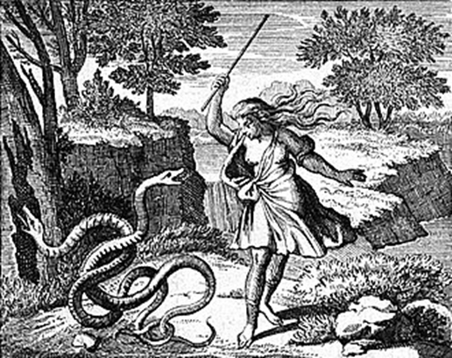
THANK YOU!
ΕΥΧΑΡΙΣΤΩ!

