Slide 1
Ancient Greek Literature
DEPARTMENT OF PHILOSOPHY
UNIVERSITY OF PATRAS

Slide 2
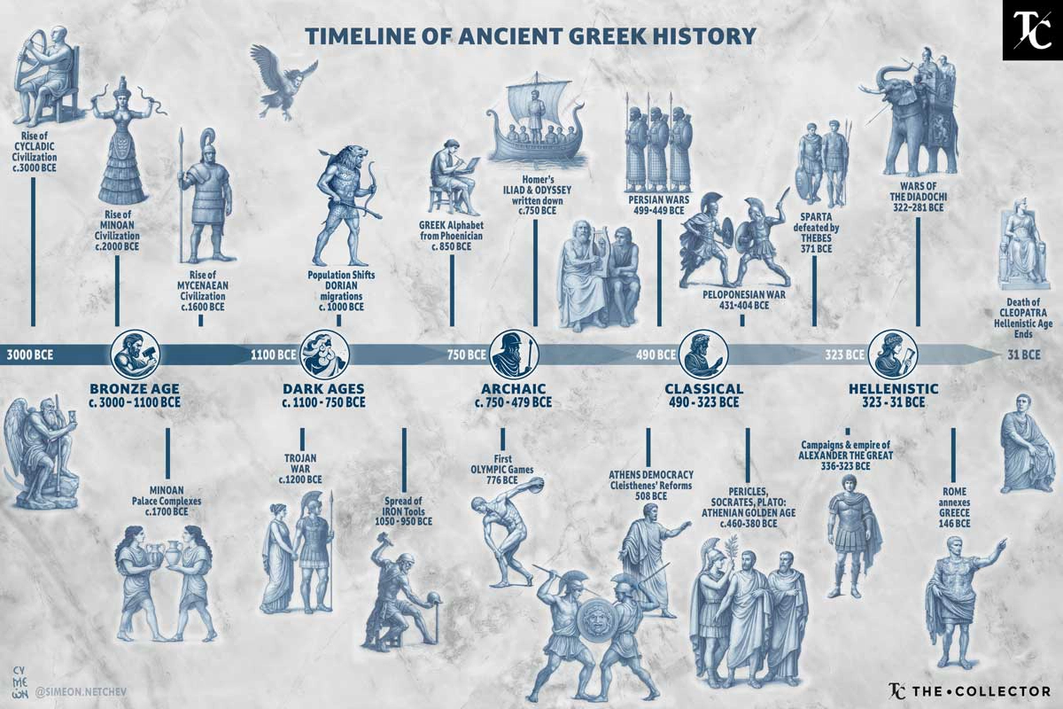
Timeline of Greek History

Slide 3
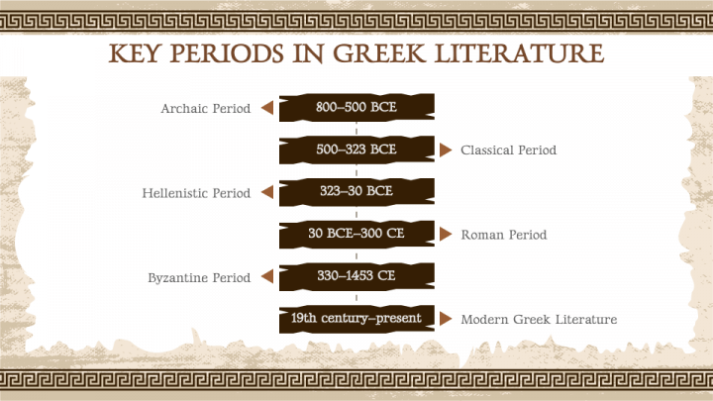
Periods of Ancient Greek Literature

Slide 4
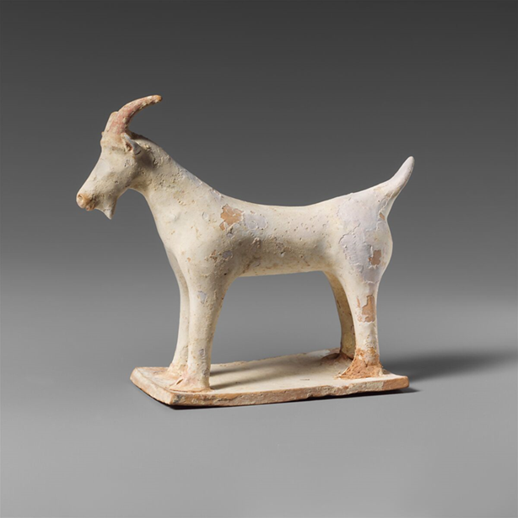
Greek Tragedy: Etymology
Τραγῳδία = τράγου (ή τράγων) ᾠδή ("goat song" (= goat + song).
Term coined around the 5th century BCE in Athens. It likely refers to the sacrificed goat, the goatskin garments worn by performers (satyrs), or the prize awarded to playwrights.

Slide 5
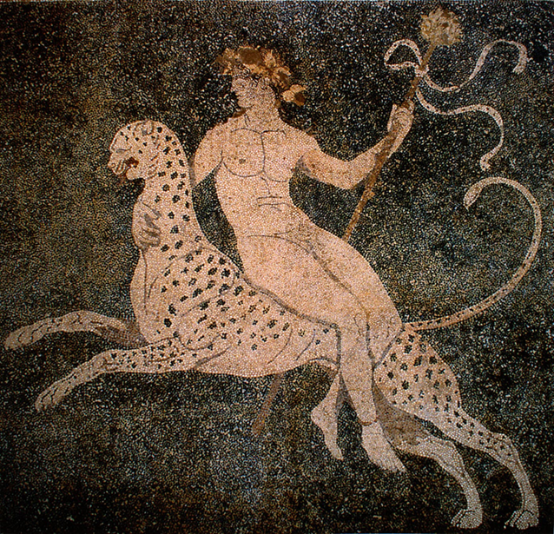
Greek Tragedy and Dionysus
It arose from the dithyramb. Associated with the Dionysian cult. Performances at festivals of Dionysus.
Proverbial phrase: οὐδὲν πρὸς Διόνυσον = nothing to do with Dionysus. It perhaps indicates that the introduction of non-Dionysian myths aroused protests. At the level of the plot, tragedy was moved away from Dionysus.
Why? Divine madness (μανία). Ecstasy (έκ + στάσις). Disguise and mask.

Slide 6
Definition of Tragedy
Aristotle, Poetics (1149b-24 κ.ε): Ἔστιν οὖν τραγῳδία μίμησις πράξεως σπουδαίας καὶ τελείας, μέγεθος ἐχούσης, ἡδυσμένῳ λόγῳ, χωρὶς ἑκάστῳ τῶν εἰδῶν ἐν τοῖς μορίοις, δρώντων καὶ οὐ δι' ἀπαγγελίας, δι' ἐλέου καὶ φόβου περαίνουσα τὴν τῶν τοιούτων παθημάτων κάθαρσιν.
Tragedy is, then, a representation of an action that is heroic and complete and of a certain magnitude—by means of language enriched with all kinds of ornament, each used separately in the different parts of the play: it represents men in action and does not use narrative, and through pity and fear it effects relief to these and similar emotions.

Slide 7
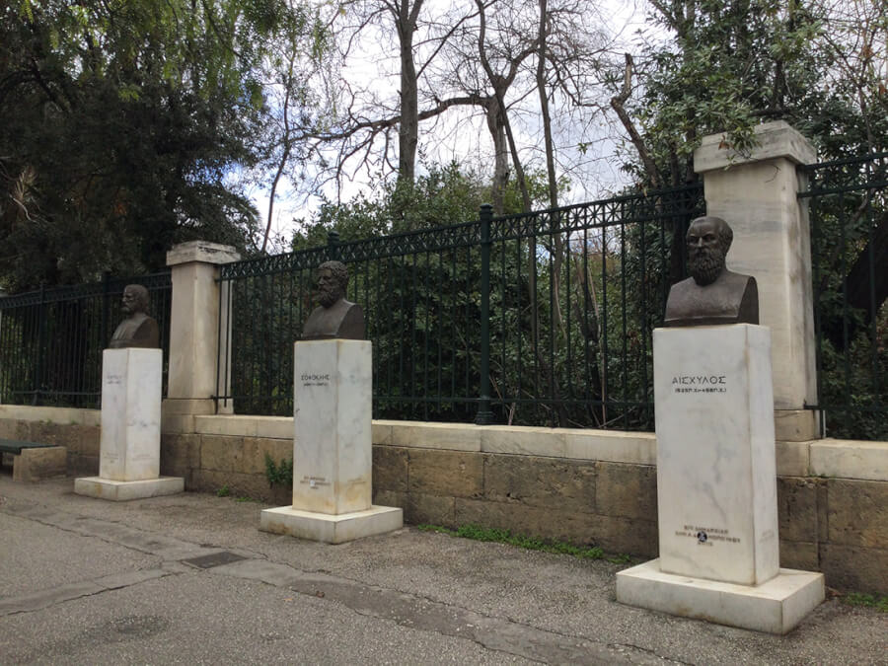
Tragic Poets

Slide 8
Tragic Poets
Aeschylus (525/524–456/455 bc) was the first of classical Athens’ great dramatists, lifting tragedy to soaring heights of poetry and theatrical impact. Often called the "Father of Tragedy," Aeschylus had a fundamental influence on the development of the genre.
Prior to Aeschylus, Greek drama was limited to one actor and a chorus. Aeschylus added a second actor, increasing the possibilities for dialogue, dramatic tension, and plot construction. He also made use of stage settings and machinery, designing costumes and training his choruses.
Aeschylus wrote approximately 90 plays, though only seven tragedies have survived in their entirety. He is recorded as having won 13 first prizes in dramatic competitions. Aeschylus's two sons also became prominent tragedians.

Slide 9
Tragic Poets
Sophocles (born c. 496 bce, Colonus, near Athens [Greece]—died 406, Athens) was, along with Aeschylus and Euripides, one of classical Athens’s three great tragic playwrights.
He was born at Colonus, a village outside the walls of Athens, where his father, Sophillus, was a wealthy manufacturer of armor. Sophocles himself received a good education. Because of his beauty of physique, his athletic prowess, and his skill in music, he was chosen in 480, when he was 16, to lead the paean (choral chant to a god) celebrating the decisive Greek sea victory over the Persians at the Battle of Salamis.
Active in his community.

Slide 10
Tragic Poets
Won his first victory at the Dionysian dramatic festival in 468, however, defeating the great Aeschylus in the process. This began a career of unparalleled success and longevity. In total, Sophocles wrote 123 dramas for the festivals. Since each author who was chosen to enter the competition usually presented four plays, this means he must have competed about 30 times. Sophocles won perhaps as many as 24 victories, compared to 13 for Aeschylus and four for Euripides, and indeed he may have never received lower than second place in the competitions he entered.
Ancient authorities credit Sophocles with several major and minor dramatic innovations. Among the latter is his invention of some type of “scene paintings” or other pictorial prop to establish locale or atmosphere. He also may have increased the size of the chorus from 12 to 15 members. Sophocles’ major innovation was his introduction of a third actor into the dramatic performance.

Slide 11
Tragic Poets
Euripides born c. 484 bc, Athens [Greece]—died 406, Macedonia) was the last of classical Athens’s three great tragic dramatists.
His mother’s name was Cleito; his father’s name was Mnesarchus or Mnesarchides. One tradition states that his mother was a greengrocer who sold herbs in the marketplace. Aristophanes joked about this in comedy after comedy; but there is better indirect evidence that Euripides came of a well-off family. Euripides first received the honour of being chosen to compete in the dramatic festival in 455, and he won his first victory in 441. Euripides left Athens for good in 408, accepting an invitation from Archelaus, king of Macedonia. He died in Macedonia in 406.
Myth and gods: different approach. Psychological realism. During the last decade of his career Euripides began to write “tragedies” that might actually be called romantic dramas, or tragicomedies with happy endings.

Slide 12
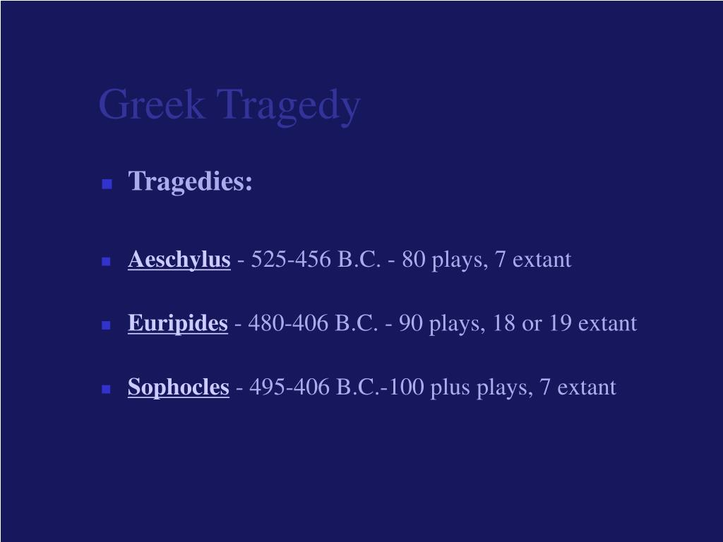
The Tragic Corpus

Slide 13
The Tragic Corpus
Aeschylus
The Persians (472 BC)
Seven Against Thebes (467 BC)
The Suppliants (463 BC)
Agamemnon (458 BC)
The Libation Bearers (458 BC)
The Eumenides (458 BC)
Plus: Prometheus Bound (479–424 BC)

Slide 14
The Tragic Corpus
Sophocles
Ajax (442 BC)
Antigone (441 BC)
Women of Trachis (450–425 BC)
Oedipus Rex (429 BC)
Electra (420–414 BC)
Philoctetes (409 BC)
Oedipus at Colonus (406 BC)

Slide 15
The Tragic Corpus
Euripides
Alcestis (438 BC)
Medea (431 BC)
Children of Heracles (430 BC)
Hippolytus (428 BC)
Andromache (425 BC)
Hecuba (424 BC)
The Suppliants (423 BC)
Electra (420 BC)
Herakles (416 BC)
The Trojan Women (415 BC)
Iphigenia in Tauris (414 BC)
Ion (413 BC)
Helen (412 BC)
The Phoenician Women (410 BC)
Orestes (408 BC)
Bacchae (406 BC)
Iphigenia in Aulis (406 BC)
Plus: Rhesus (450–440 BC) (attributed to Euripides, true author unknown)

Slide 16
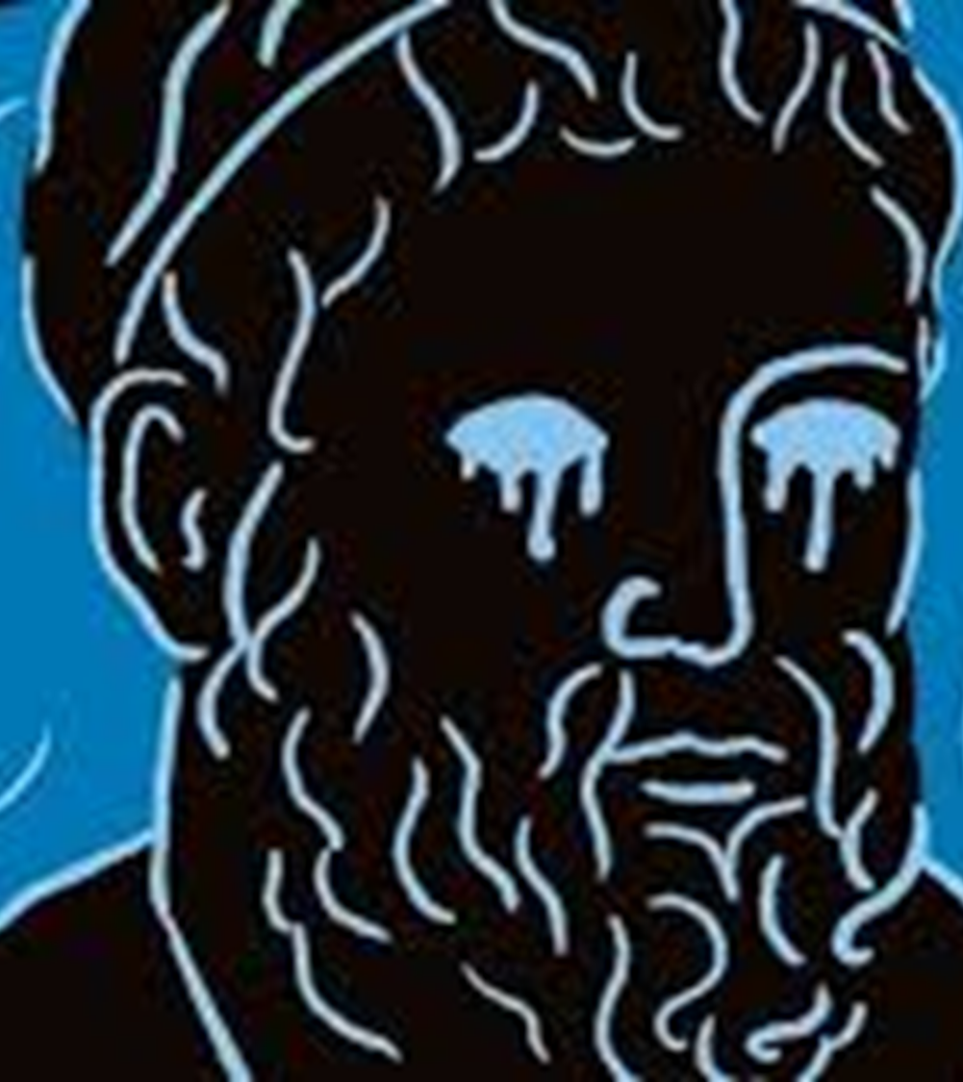
Oedipus Rex
Etymology: οἰδέω-ῶ (I am swollen) + πούς (foot).

Slide 17
Oedipus Rex
The family curse:
Laius, a guest of Pelops, king of Thebes, fell in love with the young Chrysippus (son of Pelops), kidnapped and raped him, an act that provoked Pelops' curse and the wrath of the gods, leading to the tragic fate of the Labdakids.
Chrysippus, ashamed, committed suicide, although other versions say that he was killed by his half-brothers, Atreus and Thyestes, at the behest of their mother Hippodamia, who feared that Pelops would make him heir.
This act provoked the wrath of Hera, who sent the Sphinx to Thebes as punishment, bringing plague and calamities.

Slide 18
Oedipus Rex
The myth:
Firstly, treated in Greek epic (Homer, the Thebaic circle).
Also treaded by Aeschylus (467 BCE: Laius, Oedipus, Seven against Thebes). Emphasis on the family curse.
Also treaded by Euripides (Oedipus, end of the 5th century BCE). Difference: The patricide was quickly discovered and he was blinded by Laius' servants. Jocasta did not commit suicide and followed him into exile to support him. Suppliants, Phoenissian Women.

Slide 19
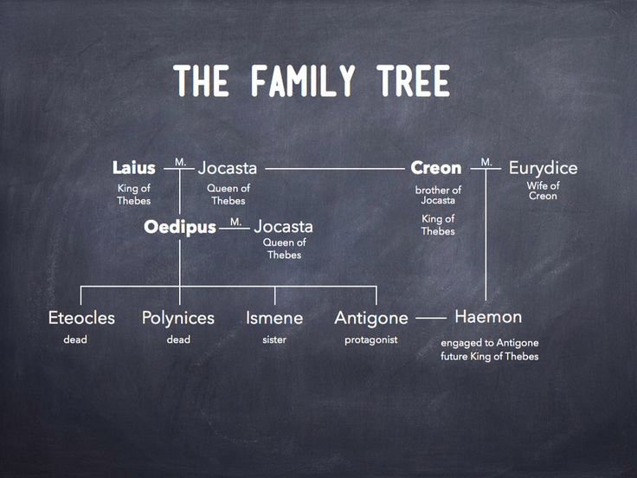
Oedipus Rex

Slide 20
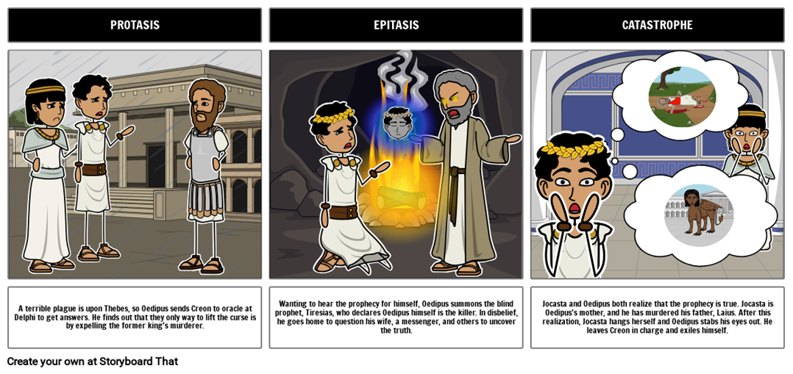
Oedipus Rex

Slide 21
Quantitative Parts of a Tragedy
Quantitative Parts of a Tragedy:
In Chapter 12 of Poetics, Aristotle breaks down the structure of a tragedy into its "quantitative" parts (or scenes):
Prologue: The part before the chorus enters.
Episode: A scene between complete choric songs.
Exode: The final part, with no choric song after it.
Choric Songs: Divided into Parode (first entry) and Stasimon (later songs).

Slide 22
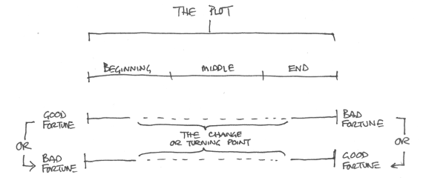
Essential Parts of a Tragedy

Slide 23
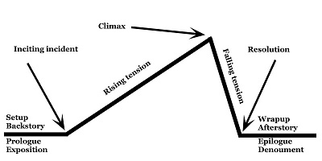
Essential Parts of a Tragedy

Slide 24
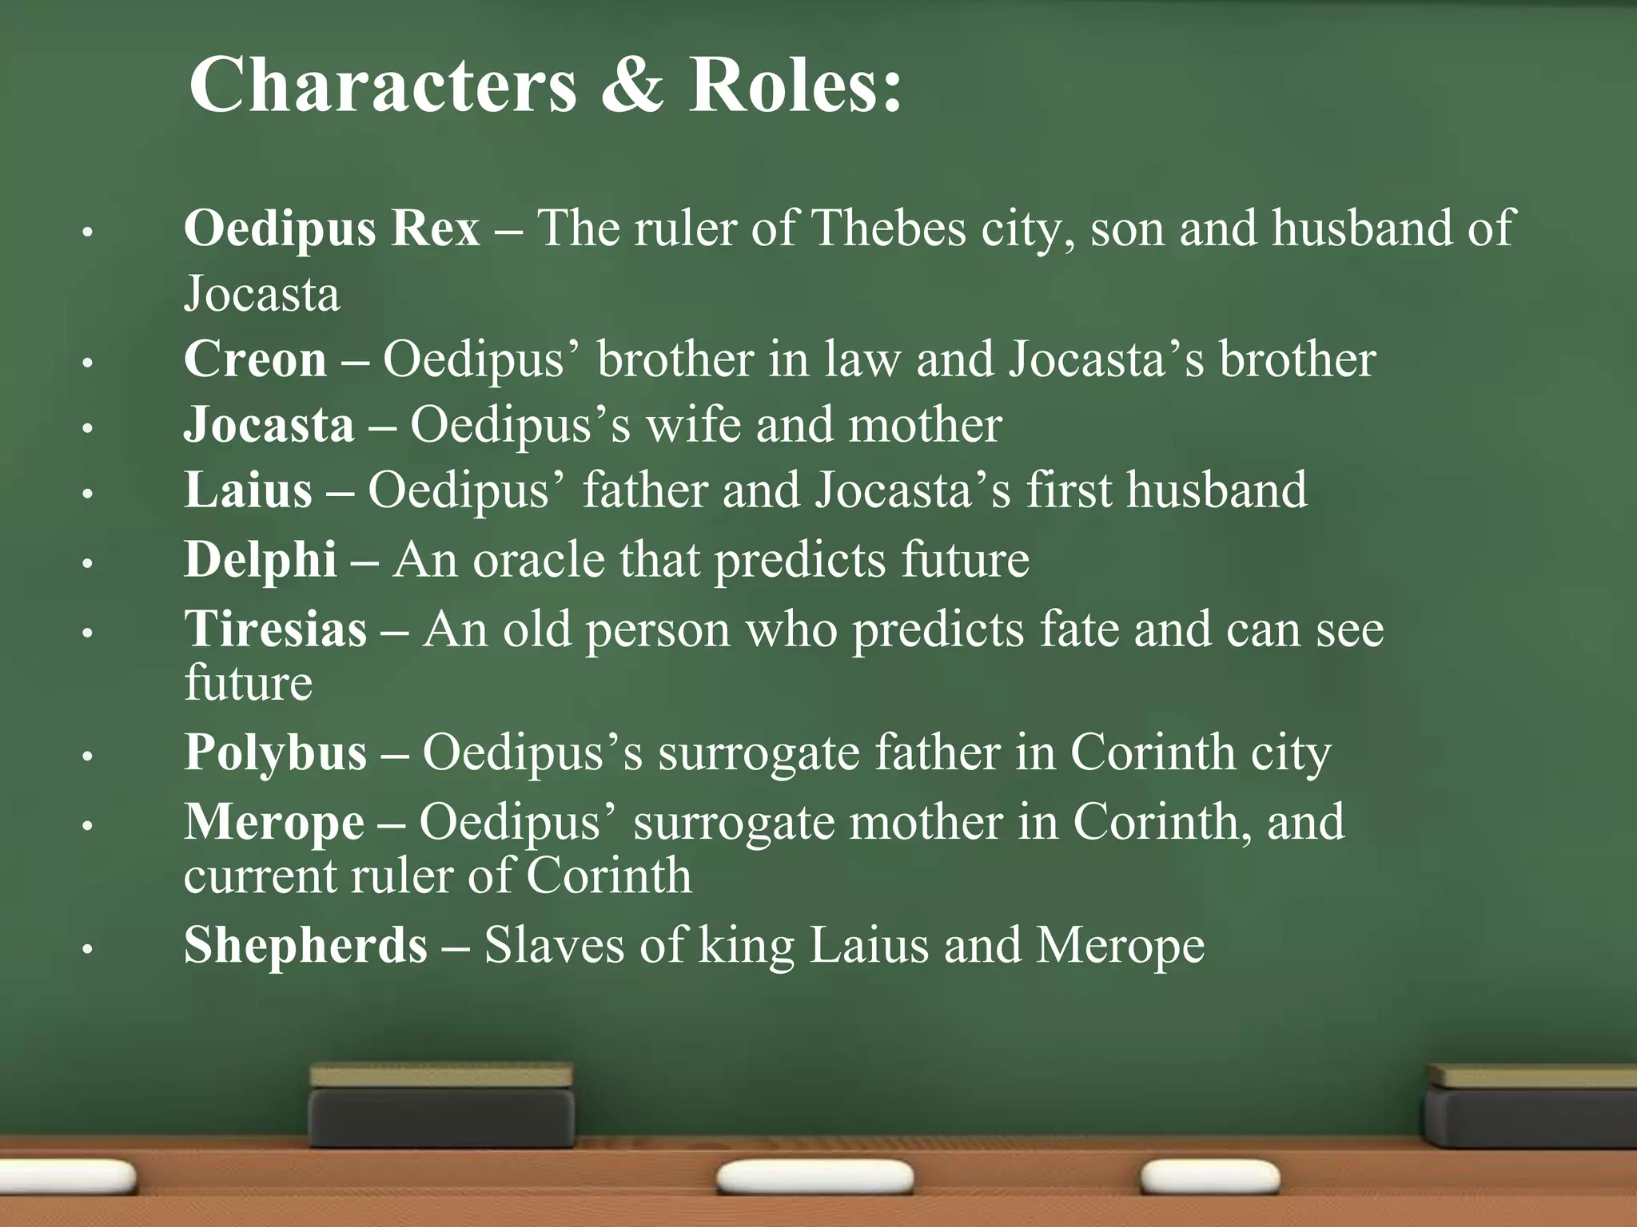
Oedipus Rex

Slide 25
Oedipus Rex
Editions and Commentaries:
Dain, A. 1958. Sophocles. Tome II. Ajax – Oedipe Roi – Électre. Texte établi par Alphonse Dain et traduit par Paul Mazon. Paris: Société d’édition “Les Belles Lettres”.
Dawe, R. D., ed. 1982. Sophocles: Oedipus Rex. Cambridge: Cambridge University Press.
Finglass, P. J. 2017. Sophocles: Oedipus the King. Cambridge Classical Texts and Commentaries. Cambridge, UK: Cambridge University Press.
Jebb, R. C., ed. 2004. Sophocles: Oedipus Tyrannus. 1887. Reprinted, Bristol, UK: Bristol Classical Press.
Kamerbeek, J. C. 1967. The Plays of Sophocles: Commentaries. Vol. 4, The Oedipus Tyrannus. Leiden, The Netherlands: Brill.
Lloyd-Jones, H., and N. G. Wilson, eds. 1990. Sophoclis Fabulae. Oxford: Clarendon Press.
Lloyd-Jones, H., trans. 1997. Sophocles: Ajax, Electra, Oedipus Tyrannus. Cambridge, MA: Harvard University Press.
Manuwald, B. 2012. Sophokles. König Ödipus. Berlin and Boston: De Gruyter.

Slide 26
Oedipus Rex
Translations:
Fagles, R. 1984. The Three Theban Plays: Antigone, Oedipus the King, Oedipus at Colonus. Westminster: Penguin Classics.
Gould, T. 1970. Oedipus the King: A Translation with Commentary. Englewood Cliffs, NJ: Prentice-Hall.
Grene, D. 1991. Sophocles. Oedipus the King. Chicago: The University of Chicago Press.
Kovacs, D. 2020. Oedipus the King: A New Verse Translation. Oxford; New York: Oxford University Press.
Lloyd-Jones, H. 1994. Sophocles. Oedipus the King. Cambridge, MA: Loeb Classical Library.

Slide 27
Oedipus Rex
Other Studies:
Ahl, F. M. 1991. Sophocles' Oedipus: Evidence and Self-Conviction. Ithaca, NY: Cornell University Press.
Anspach, M. and Tyrrell, W. (eds.) 2020. The Oedipus Casebook: Reading Sophocles' Oedipus the King. Studies in Violence, Mimesis, and Culture. East Lansing: Michigan State University Press.
Astier, C. 1974. Le mythe d'Œdipe. Paris: Armand Colin.
Balmary, M. 1982. Psychoanalyzing Psychoanalysis: Freud and the Hidden Fault of the Father. Baltimore: UMI.
Bloom, H. 1988. Sophocles' Oedipus Rex: Modern Critical Interpretations. New York: Chelsea House Publishers.
Bloom, H. 1997. The Anxiety of Influence. Oxford: OUP.
Blos, P. 1985. Son and Father: Before and Beyond the Oedipus Complex. New York: Free Press.
Caldwell, R. 1974. ‘‘The Blindness of Oedipus’’, International Review of Psycho-Analysis 1: 207-218.
Cameron, A. 1968. The Identity of Oedipus the King: Five Essays on the Oedipus Tyrannus. NY: New York University Press.

Slide 28
Oedipus Rex
Chase, C. 1979. ‘‘Oedipal Textuality: Reading Freud's Reading of Oedipus’’, Diacritics 9.4: 54-68.
Cocteau, J. 1963. The Infernal Machine and other Plays. Norfolk, CT: New Directions.
Dodds, E. R. 1966: ‘‘On Misunderstanding the Oedipus Rex’’, G & R 13: 37-49.
Edmunds, L. 1976. ‘‘Oedipus in the Middle Ages’’, Antike und Abendland 25: 140-155.
--- 1981. ‘‘The Cults and the Legend of Oedipus.’’, Harvard Studies in Classical Philology 85: 221-238.
--- 1985. Oedipus: The Ancient Legend and Its Later Analogues. Baltimore: Johns Hopkins University Press.

Slide 29
Oedipus Rex
Freud, S. 1950. Totem and Taboo. Transl. James Strachey. NY: Hogarth Press.
--- 1953. The Interpretation of Dreams. Transl. James Strachey. NY: Hogarth Press.
Girard, R. 1977. Violence and the Sacred. Transl. Patrick Gregory. Baltimore: Johns Hopkins University Press.
--- 1987. Things Hidden Since the Foundation of the World. Stanford: Stanford University Press.
Goldhill, S. 1984. ‘‘Exegesis: Oedipus (R)ex’’, Arethusa 17: 177-200.
--- 1988. ‘‘Blindness and Insight’’, In: Goldhill, S. Reading Greek Tragedy, 199-221, Cambridge: CUP.
Goodhart, S. 1978. ‘‘Lêistas Ephaske: Oedipus and Laius' Many Murderers’’, Diacritics 8.1: 55-71.
Coughanowr, E. 1997. ‘‘Philosophic Meaning in Oedipus Rex’’, L’Antiquité Classique 66: 55-74.

Slide 30
Oedipus Rex
Gould, T. 1965 and 1966. ‘‘The Innocence of Oedipus: The Philosophers on Oedipus the King’’, Part I: Arion 4: 363-386 and Part II: Arion 4: 582-611, and Part III: Arion 5: 478-525.
Goux, J. J. 1993. Oedipus, Philosopher. Meridian: Crossing Aesthetics. Stanford: Stanford University Press.
Green, A. 1979. The Tragic Effect: The Oedipus Complex in Tragedy. Cambridge: Cambridge University Press.
Harshbarger, K. 1979. Sophocles' Oedipus. Washington: University Press of America.
Hester, D. A. 1971. ‘‘Sophocles the Unphilosophical’’, Mnemosyne 24: 11-59.
--- 1977. ‘‘Oedipus and Jonah’’, Proceedings of the Cambridge Philological Society 23: 32-61.
Jones, E. 1949. Hamlet and Oedipus. Garden City: Gollancz.

Slide 31
Oedipus Rex
Kallich, M. 1968. Oedipus: Myth and Drama. NY: Odyssey Press.
Karakantza, E. D. 2020. Who Am I? (Mis)identity and the Polis in Oedipus Tyrannus. Washington DC: Centre for Hellenic Studies and Harvard University Press.
Knox, B. M. W. 1957. Oedipus at Thebes. New Haven: Yale University Press.
Leonard, M. 2005. Athens in Paris. Ancient Greece and the Political in Post-War French Thought. Oxford: OUP.
Lévi-Strauss, C. 1955. ‘‘The Structural Study of Myth’’, Journal of American Folklore 68: 428-444.
Lewis, R. G. 1989. ‘‘The Procedural Basis of Oedipus Tyrannus’’, GRBS 30: 41-66.
Maxwell-Stuart, P. G. 1975. ‘‘Interpretations of the Name Oedipus’’, Maia 27: 37-43.

Slide 32
Oedipus Rex
Mueller, M. 1980. Children of Oedipus, and Other Essays on the Imitation of Greek Tragedy, 1550-1800. Toronto: University of Toronto Press.
Mullahy, P. 1948. Oedipus: Myth and Complex. NY: Hermitage Press.
Nagera, H. 1975. Female Sexuality and the Oedipus Complex. NY: J. Aronson.
Pasolini, P. P. 1971. Oedipus Rex. Transl. John Mathews. NY: Taylor & Francis.
Pucci, P. 1988. ‘‘Reading the Riddles of Oedipus Rex’’, In: P. Pucci (ed.), Language and the Tragic Hero: Essays in Honor of Gordon M. Kirkwood, 131-154, Atlanta 1988.
--- 1992. Oedipus and the Fabrication of the Father: Oedipus Tyrannus in Modern Criticism and Philosophy. Baltimore: Johns Hopkins University Press.

Slide 33
Oedipus Rex
Robert, C. 1915. Oidipus: Geschichte eines poetischen Stoffs im griechischen Altertum. 2 volumes. Berlin: Weidmann.
Robert, M. 1976. From Oedipus to Moses: Freud's Jewish Identity. Garden City:
Rotimi, O. 1971. The Gods are Not to Blame. London: Anchor Books.
Rudnytsky, P. L. 1987. Freud and Oedipus. NY: Columbia University Press.
Segal, C. P. 1977. ‘‘Tragedy and Civilization: An Interpretation of Sophocles’’, Yale Classical Studies 25: 99-158.
Tabin, J. K. 1985. On the Way to Self: Ego and Early Oedipal Development. NY: Columbia University Press.
Tonelli, F. 1983. Sopocles’ Oedipus and the Tale of the Theatre. Ravenna: Longo.

Slide 34
Oedipus Rex
Vernant, J.-P., and Pierre V.-N. 1990. ‘‘Oedipus Without the Complex’’, In: Vernant, J.-P., and Pierre V.-N (eds.), Myth and Tragedy in Ancient Greece, 85-113, Cambridge, MA: M.I.T. Press.
Waldock, A. J. A. 1951. Sophocles the Dramatist. Cambridge and New York: Cambridge University Press.
Ward, A. 2011 ‘‘Oedipus and Socrates: Poetry and Philosophy on the Quest for Self-Knowledge’’, Available at SSRN: https://ssrn.com/abstract=1901916
Whitman, C. H. 1951. Sophocles: A Study of Heroic Humanism. Cambridge, MA: Harvard University Press.
Winnington-Ingram, W. P. 1980. Sophocles: An Interpretation. Cambridge: Cambridge University Press.
Woodruff, P. 2018. The Oedipus Plays of Sophocles: Philosophical Perspectives. Oxford and New York: Oxford University Press.
Vellacott, P. 1971. Sophocles and Oedipus: A Study of Oedipus Tyrannus with a New Translation. London: University of Michigan Press.
Vernant, J.-P. 1977-1978. ‘‘Ambiguity and Reversal: On the Enigmatic Structure of Oedipus Rex’’, Transl. P. duBois. New Literary History 9: 475-501.
--- 1982. ‘‘From Oedipus to Periander: Lameness, Tyranny, Incest in Legend and History’’, Arethusa 15: 19-38.
Vickers, B. 1973. Towards Greek Tragedy. London: Longman.

Slide 35
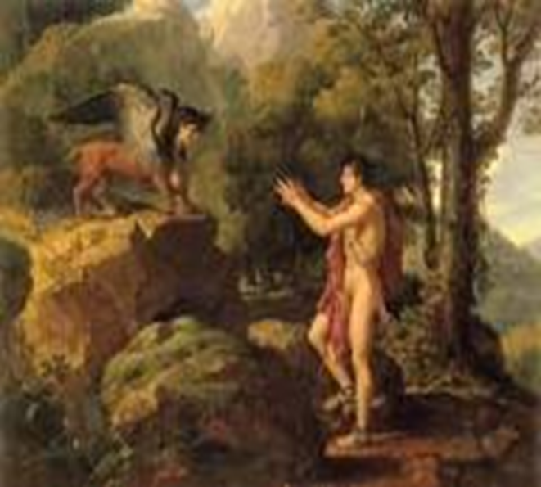
Thank you!
Σας ευχαριστώ!

