Slide 1
Θεραπευτικές Προσεγγίσεις Ακριβείας
Μεταπτυχιακό μάθημα τμήματος Φαρμακευτικής ΠΠ
Κωνσταντίνος Μικέλης
Αναπληρωτής Καθηγητής, Τμήμα Φαρμακευτικής, Πανεπιστήμιο Πατρών
Adjunct Associate Professor, Department of Pharmaceutical Sciences,
School of Pharmacy, Texas Tech University Health Sciences Center, USA
www.mikelislab.com
Πάτρα, 31 Μαΐου 2023

Slide 2
Targets to block tumor growth and metastasis: The example of Angiopoietin-2
What is angiogenesis?
Role of tumor microenvironment on angiogenesis and tumor growth.
How to block it (validation of the significance of each target and/or its receptor)
VEGF and personalized therapy
Angiopoietin-2
4. Examples where stratification of groups via personalized data provides solution.

Slide 3
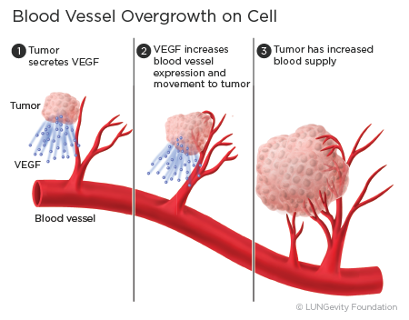
Angiogenesis

Slide 4
Types of angiogenesis
Mechanisms: VEGF and HIF
Ang2 blocking the inhibitory effect of Ang1

Slide 5
If you block angiogenesis, do you block tumor growth in all cancers?
A problem not solved
Vessel co-option: when the tumors don’t expand and create new vessels.
They use preexisting tissue vessels instead as their blood supply.
Do not respond to anti-angiogenic drugs.
Most cases where co-option takes place, includes angiogenesis.
The major players considered: VEGF and Angiopoietins
Limited work and data so far
Donnem et al., Cancer Med 2013

Slide 6
Side effects of current, VEGF-based, anti-angiogenic treatments
1. Inhibition of physiological angiogenesis.
2. “Evasive resistance”: acquired resistance due to compensation of other growth factors, i.e. bFGF and Ang2.
3. Increased vascular leakage and bleeding complications (& metastases in cancer).

Slide 7
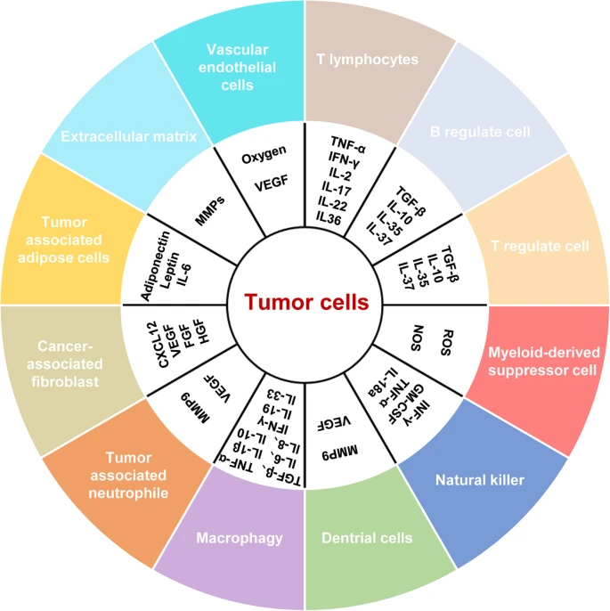
Tumor microenvironment and its role on angiogenesis
Tumor microenvironment: The environment where tumor grows:
Endothelial cells
Immune cells
Fibroblasts
Macrophages
Extracellular matrix
Cytokines and cell growth factors secreted in the tumor microenvironment
Jiang et al., J Exp Clin Res 2020

Slide 8
Tumor microenvironment and its role on angiogenesis
Jiang et al., J Exp Clin Res 2020

Slide 9
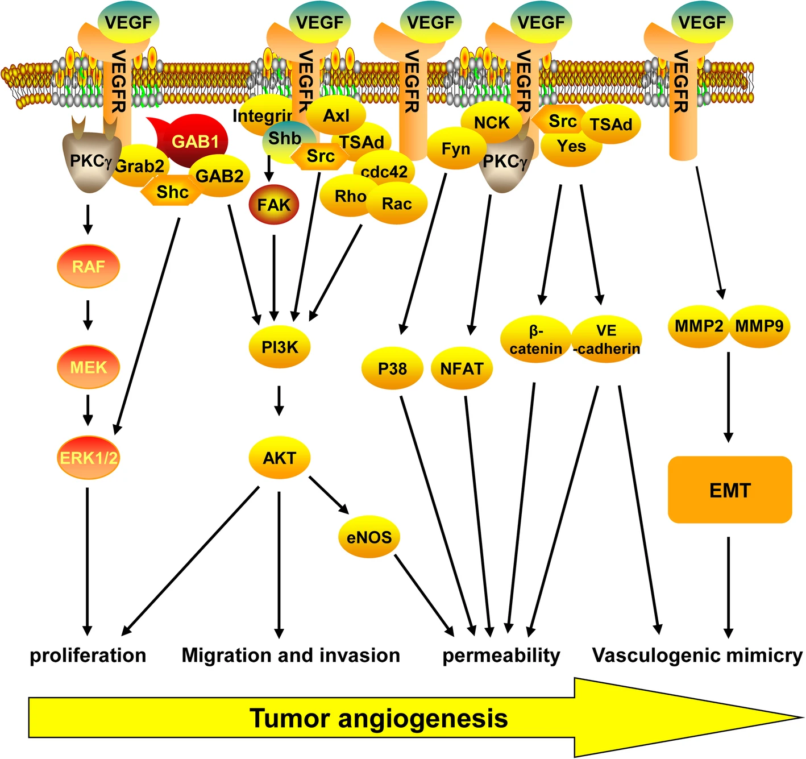
VEGF/VEGFR signal transduction pathways
Proliferation: VEGFR can interact with Grab/Src/Gab1/Shb/PKCγ to activate RAF/MEK/MAPK and PI3K/AKT signaling pathways, and promote the proliferation of endothelial cells.
Migration and invasion: VEGFR can activate PI3K/AKT by binding to cdc42, Rho, and RacGTPases, and promotes the migration and invasion of endothelial cells.
Permeability: VEGFR can enhance blood vessel permeability by activating NFAT/β-catenin/VE-cadherin, and eNOS.
Vasculogenic mimicry: VEGFR can promote EMT-induced vasculogenic mimicry by upregulating the expression of EMT-related genes
Jiang et al., J Exp Clin Res 2020

Slide 10
Anti-VEGF therapy in personalized medicine
Anti-VEGF therapy does not involve directing the drug to a specific molecular abnormality.
But it is considered targeted therapy, because:
It is not cytotoxic
Affects downstream signaling pathways
No biomarker to predict which patients will benefit from anti-angiogenic therapy.
BATTLE study: Phase II Biomarker-integrated Approaches of Targeted Therapy for Lung Cancer Elimination study
255 heavily-pretreated patients with metastatic NSCLC had biopsies and, based on the tumor markers, were randomized to receive treatment against:
EGFR (erlotinib)
KRAS/BRAF (sorafenib)
Retinoid-EGFR (bexarotene and erlotinib)
VEGFR (vandetanib)
Results: 46%: PFS 1.9 months, median OS 8.8 months, 1-year survival rate 35%
Feliz & Tsimberidou, Cancer Chemother Pharmacol 2013

Slide 11
Angiopoietin-2
Growth factor expressed in endothelial, mural, tumor cells.
Acts on Tie2 with antagonist/agonist activity, depending on the context.
Regulates vascular remodeling, vascular permeability, angiogenesis.
In diseases it participates in the development and severity of vascular-related conditions:
Inflammation
Pneumonia
Sepsis
Stroke
Diabetic retinopathy
COVID-19
Obesity
Cancer
Akwii et al. Cells, 2019; Akwii and Mikelis, Drugs 2021; Lahooti et al. J Contr Release Under Review

Slide 12
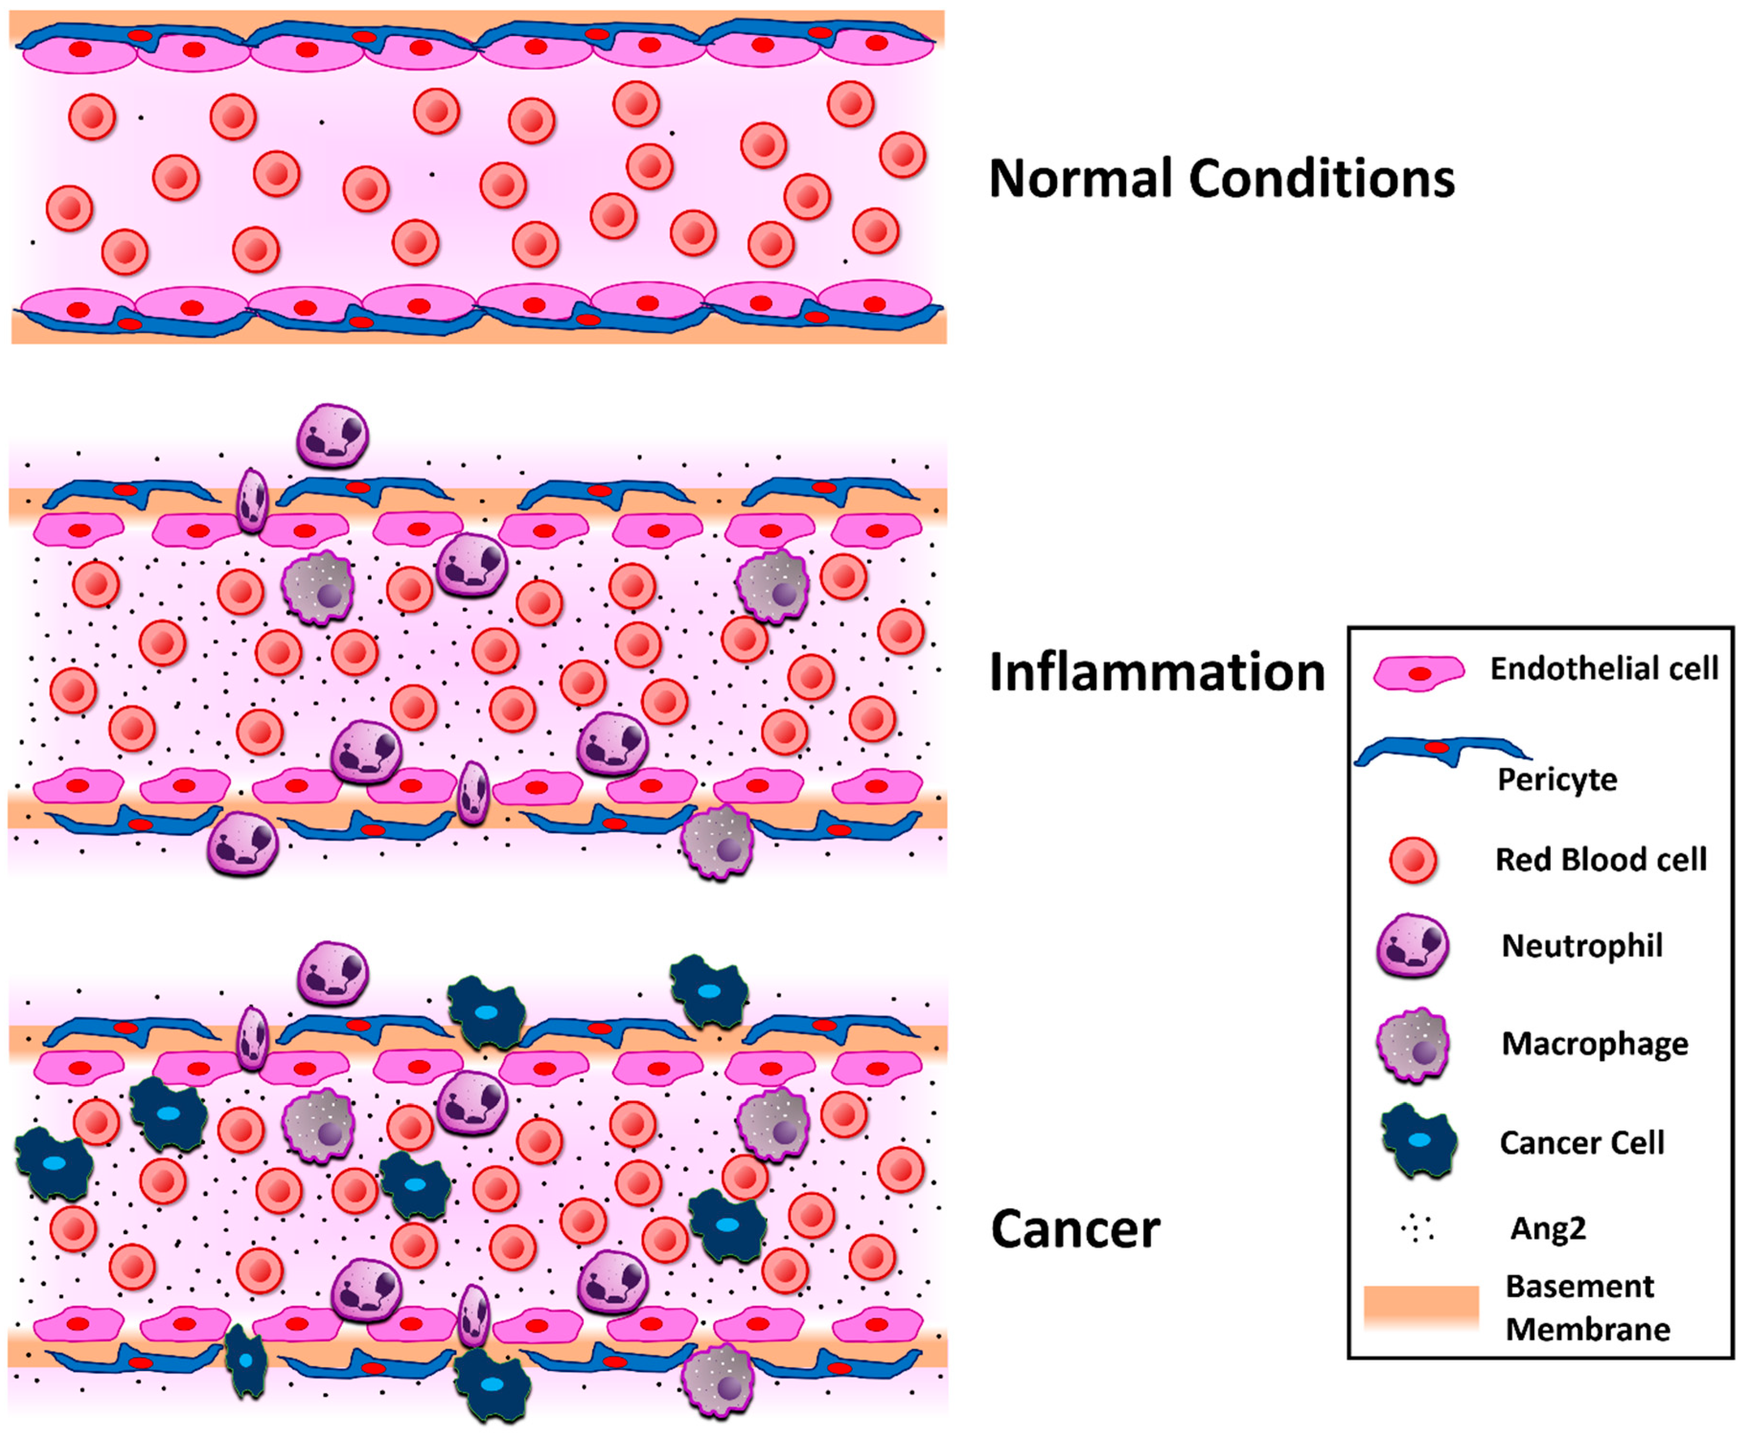
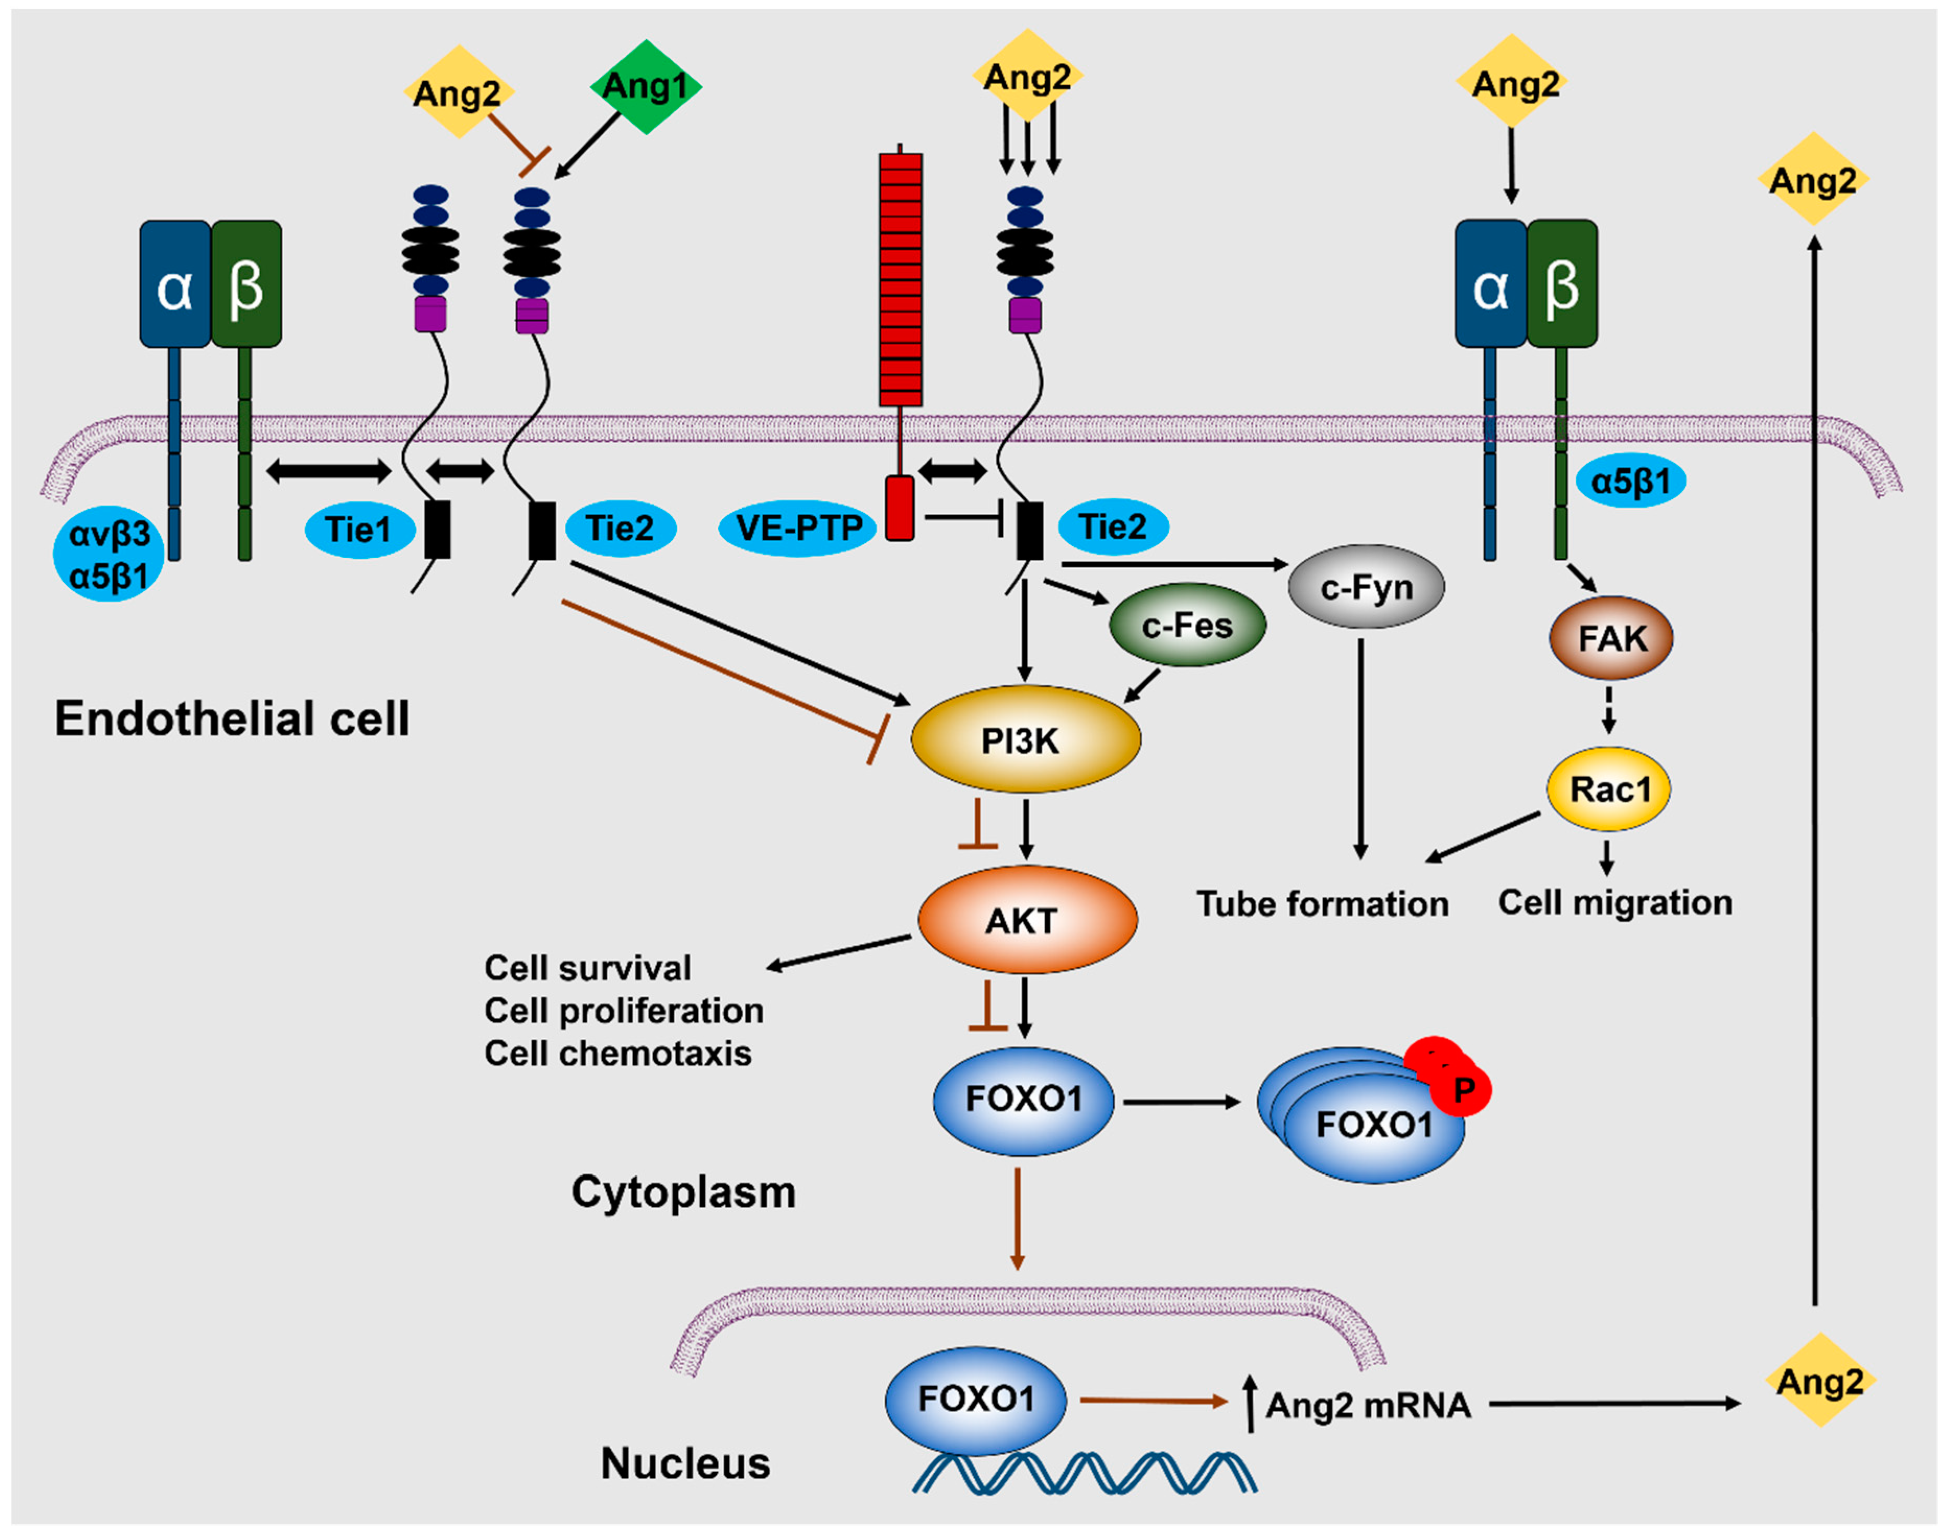
Angiopoietin-2
Akwii et al., Cells 2019

Slide 13
Angiopoietin-2 in retinal vascular disorders
A Schematic representation of the transverse cross-section of the eye. The parts and characteristic structures of the eye are depicted. B Abnormal angiogenesis of the choroid vessels during retinal vascular disorders. The abnormal, newly formed vessels disrupt the integrity of Bruch’s membrane, alter the structure of the retinal pigment epithelial cells and photoreceptors and cause subretinal hemorrhage, fluid accumulation and visual impairment. The severity of the retinal vascular disorders correlates with the levels of VEGF, Ang2, and VE-PTP and inversely correlates with the levels of Ang1 and Tie2 phosphorylation.
Akwii and Mikelis, Drugs 2021

Slide 14
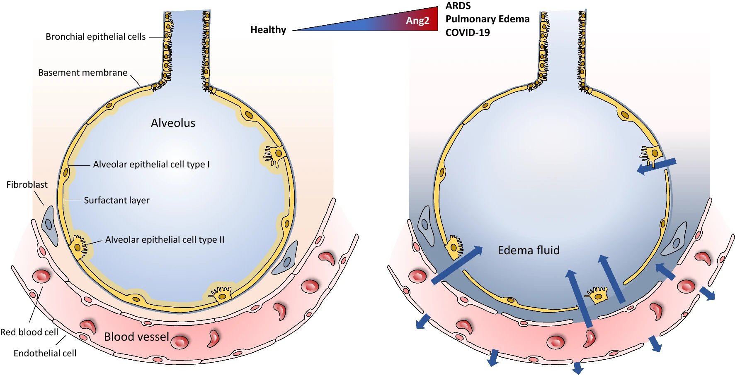
Angiopoietin-2 in pulmonary disorders
Akwii and Mikelis, Drugs 2021

Slide 15
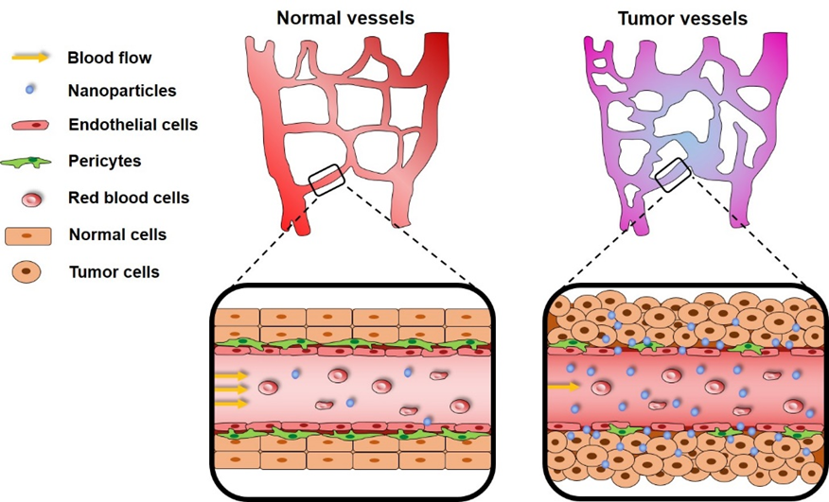
Angiopoietin-2 in cancer
Akwii et al. Cells, 2019; Akwii and Mikelis, Drugs 2021; Lahooti et al. Adv Drug Deliv Rev Under Review

Slide 16
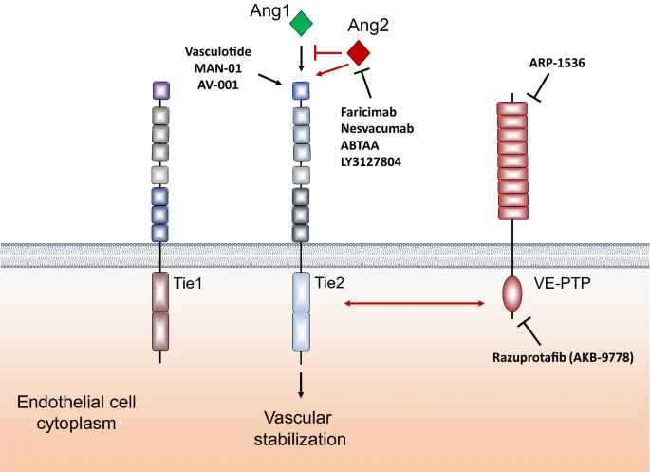
Targeting Angiopoietin-2
Akwii and Mikelis, Drugs 2021

Slide 17
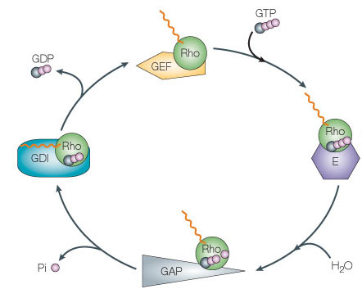
Rho family of small GTPases
A family of small G proteins (subfamily of the Ras superfamily), present in all eukaryotic organisms, including yeast and some plants
Small GTPase RhoA
Regulates:
Actin cytoskeleton
Cell polarity
Microtubule dynamics
Membrane transport pathways
Transcription factor activity
Cell growth
Role in tumorigenesis and cancer progression
Active
form
Modified from Rossman et al, 2005

Slide 18
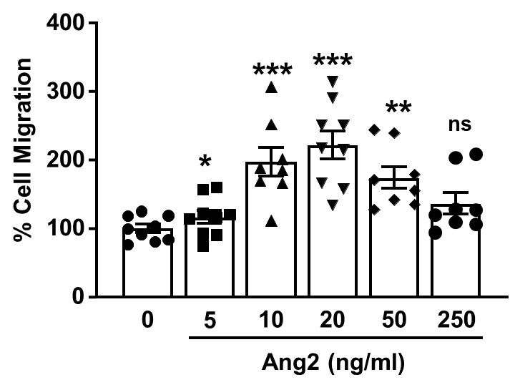
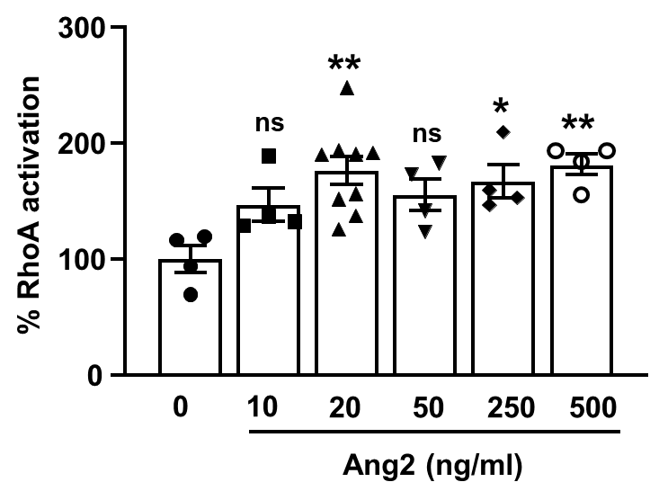
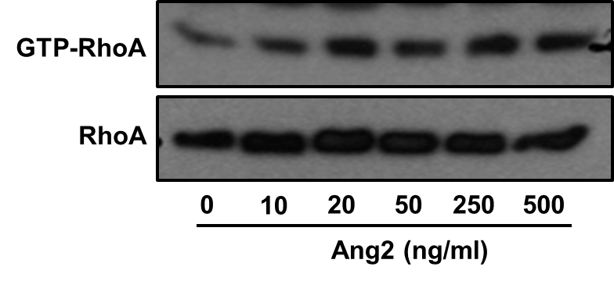
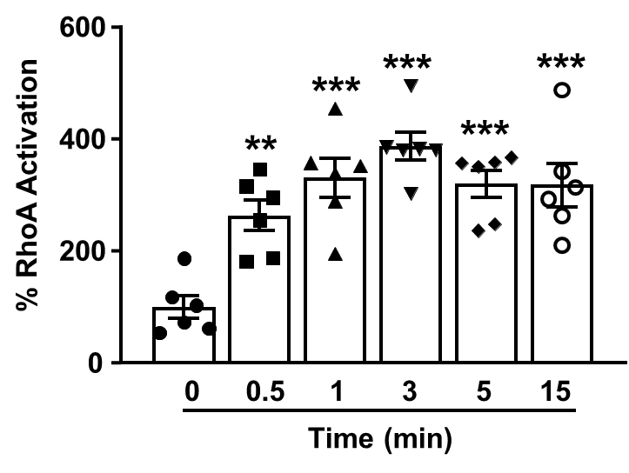
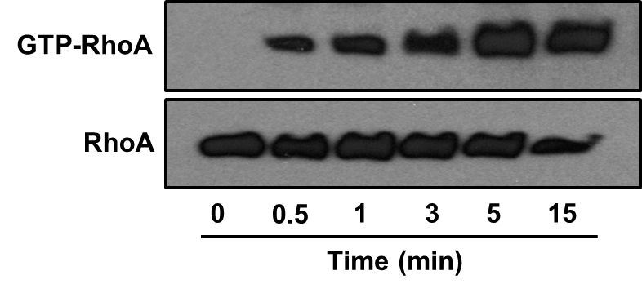
Ang2-drives LEC migration and activates RhoA

Slide 19
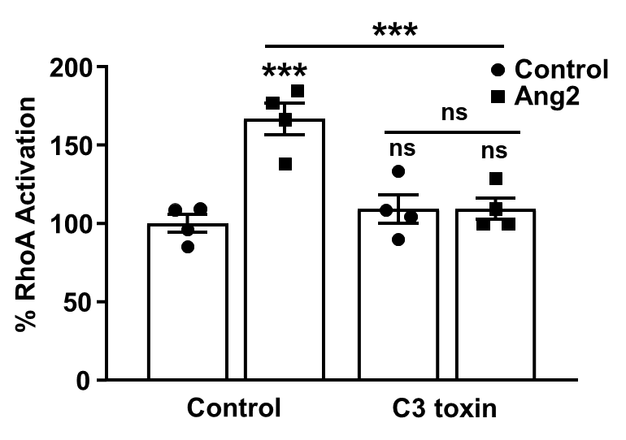
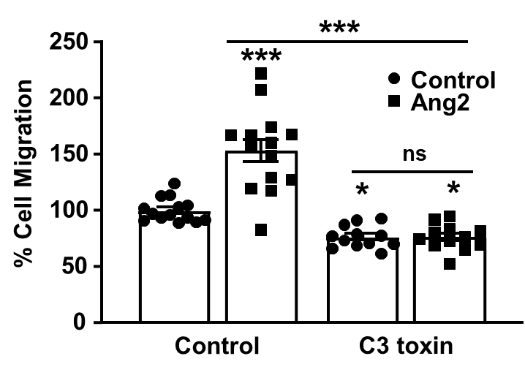
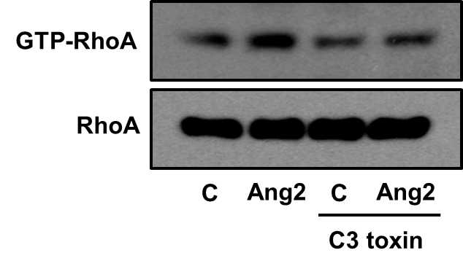
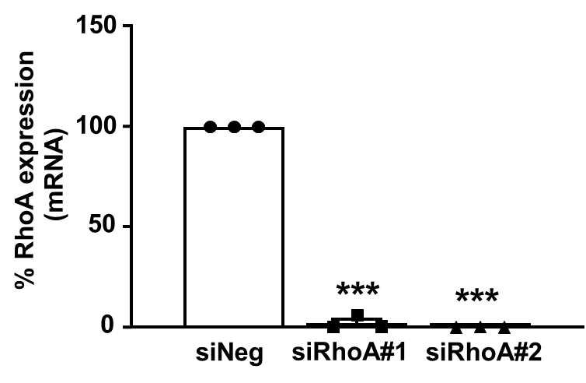
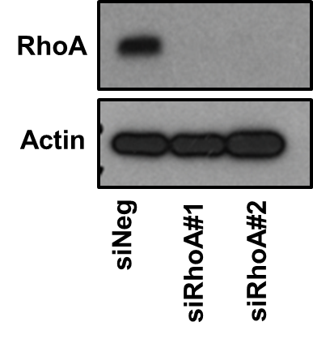
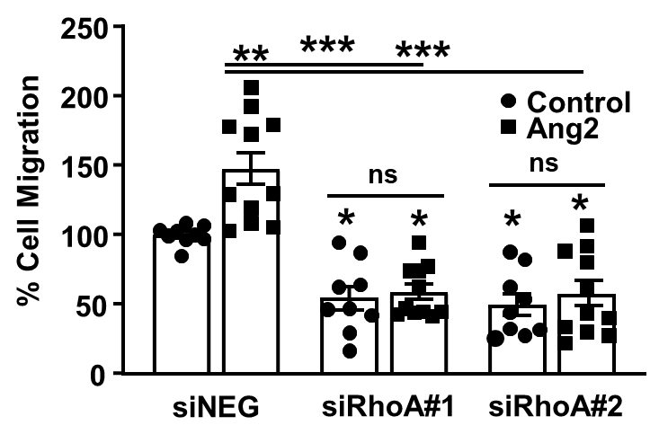
Ang2-induced LEC migration is regulated by RhoA

Slide 20
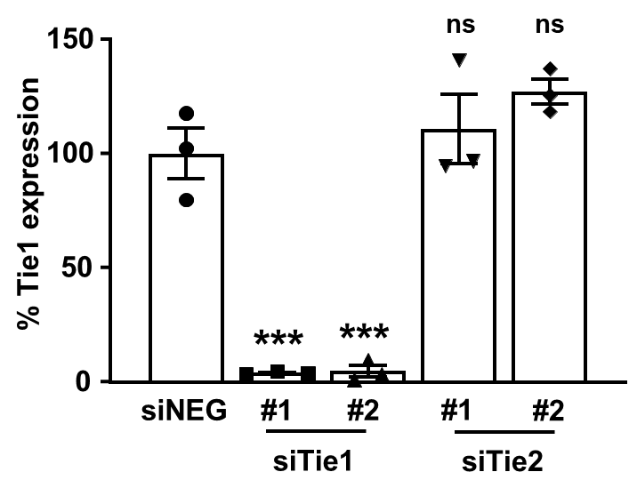
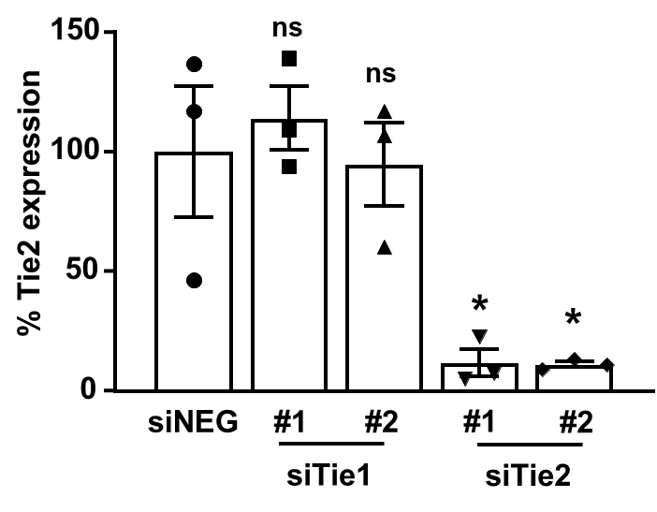
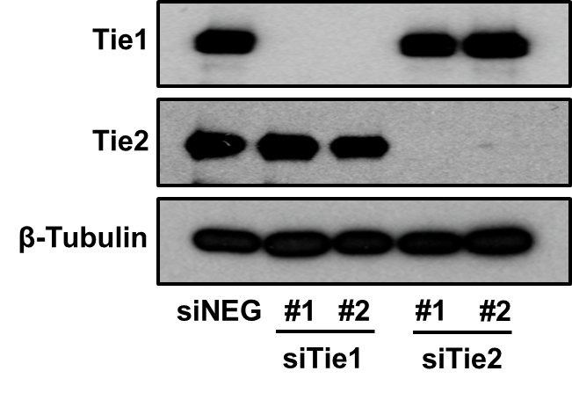
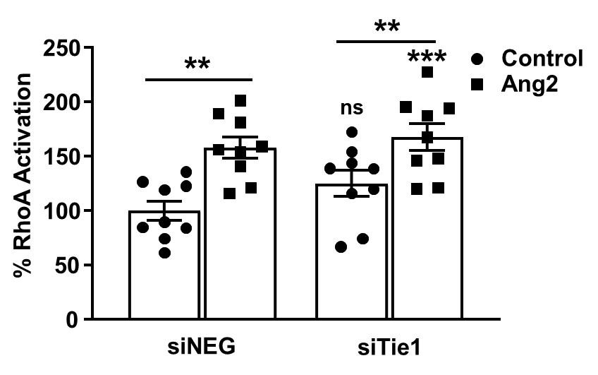
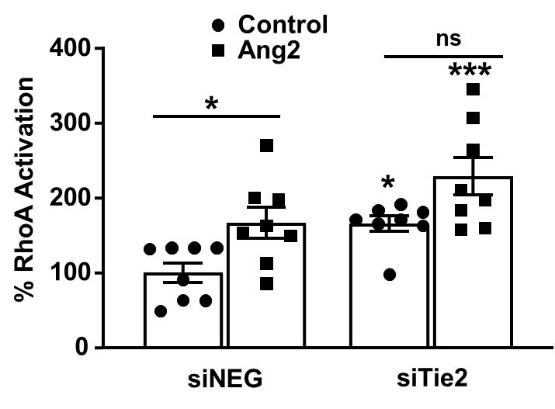
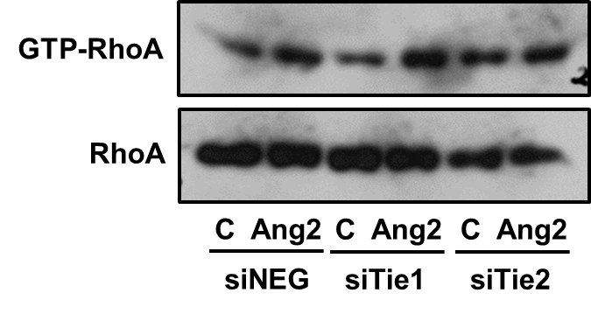
Ang2-induced RhoA activation is not mediated by Tie1 or Tie2

Slide 21
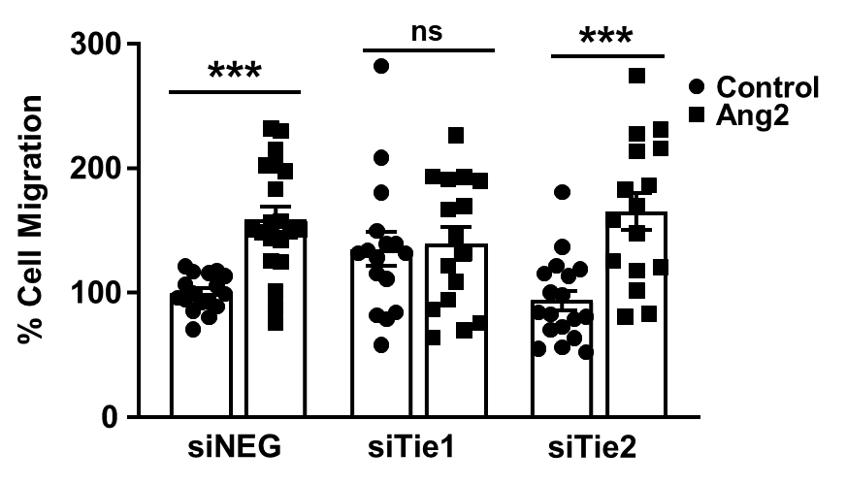
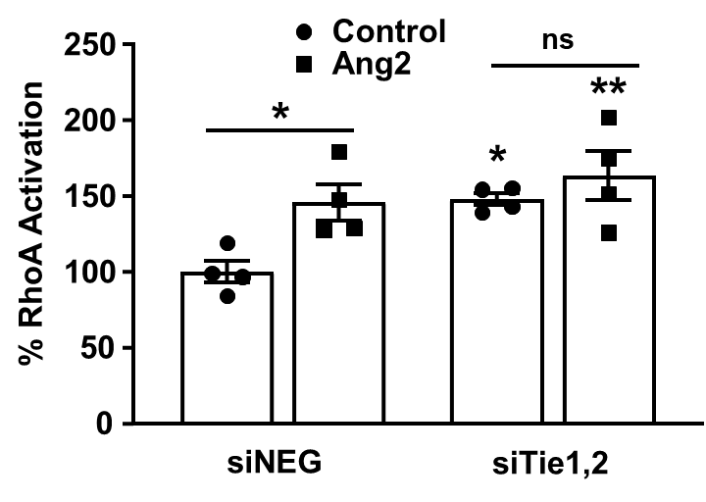
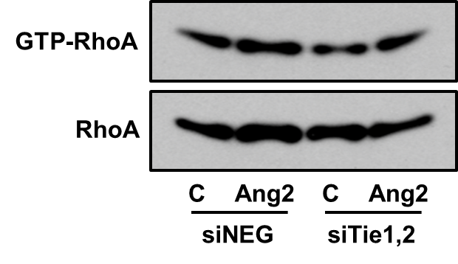
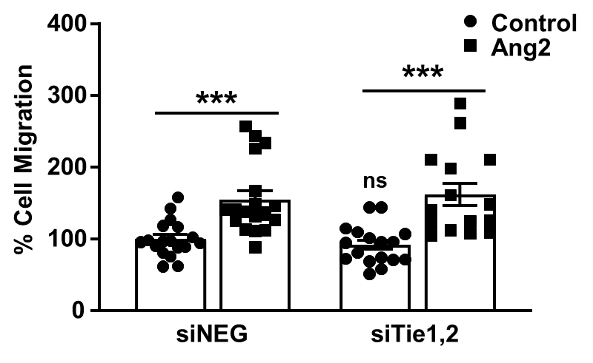
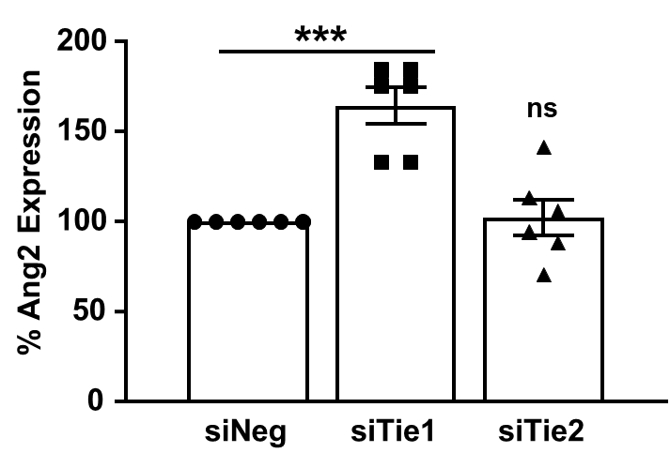
Ang2-induced RhoA migration is not inhibited by Tie1, Tie2 or combined Tie1,2 deficiency

Slide 22
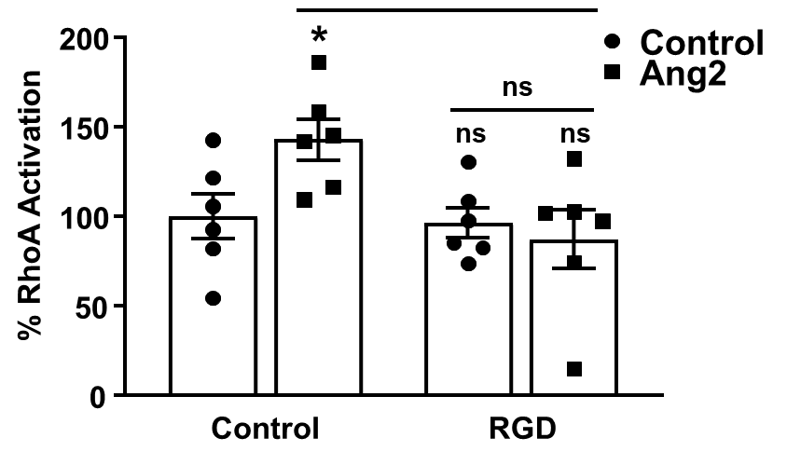
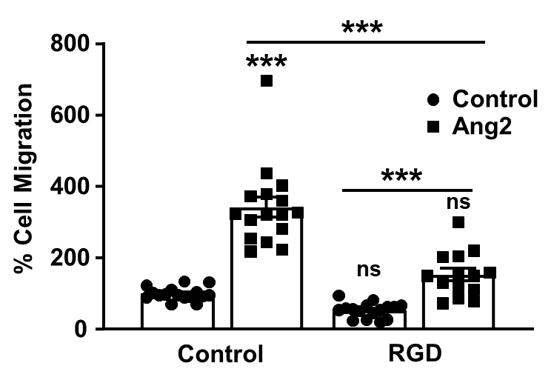
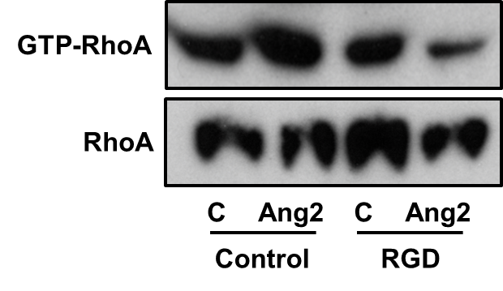
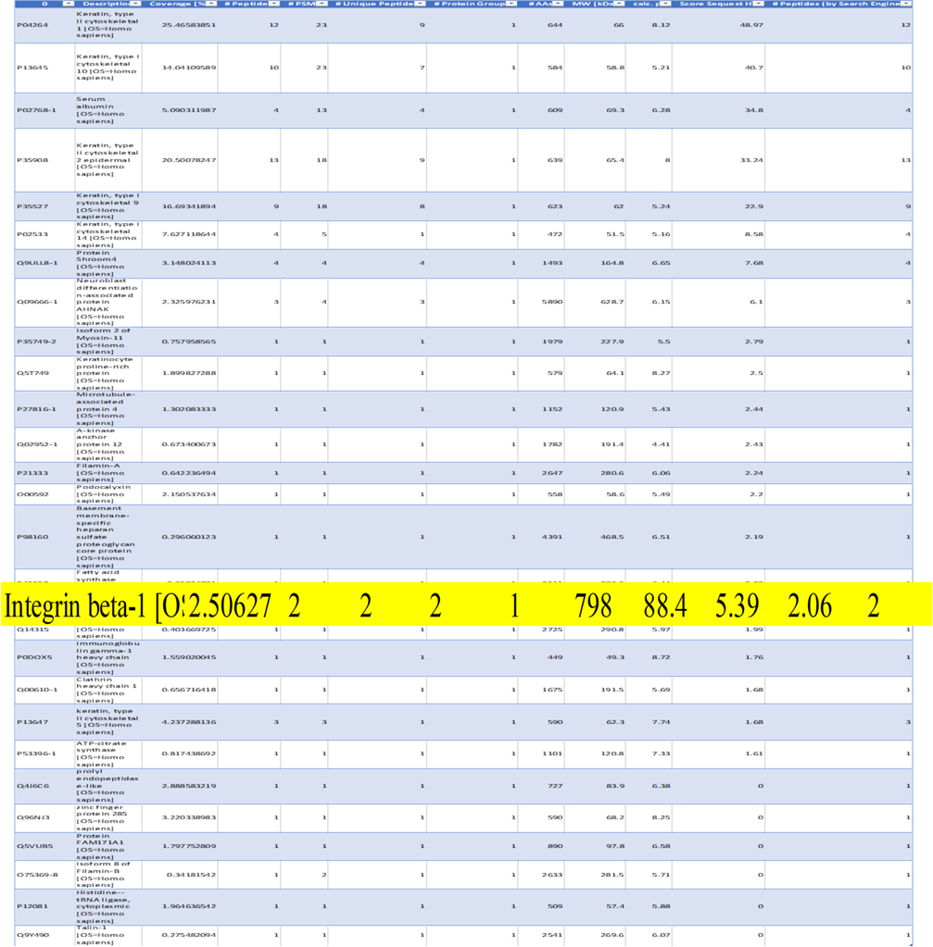
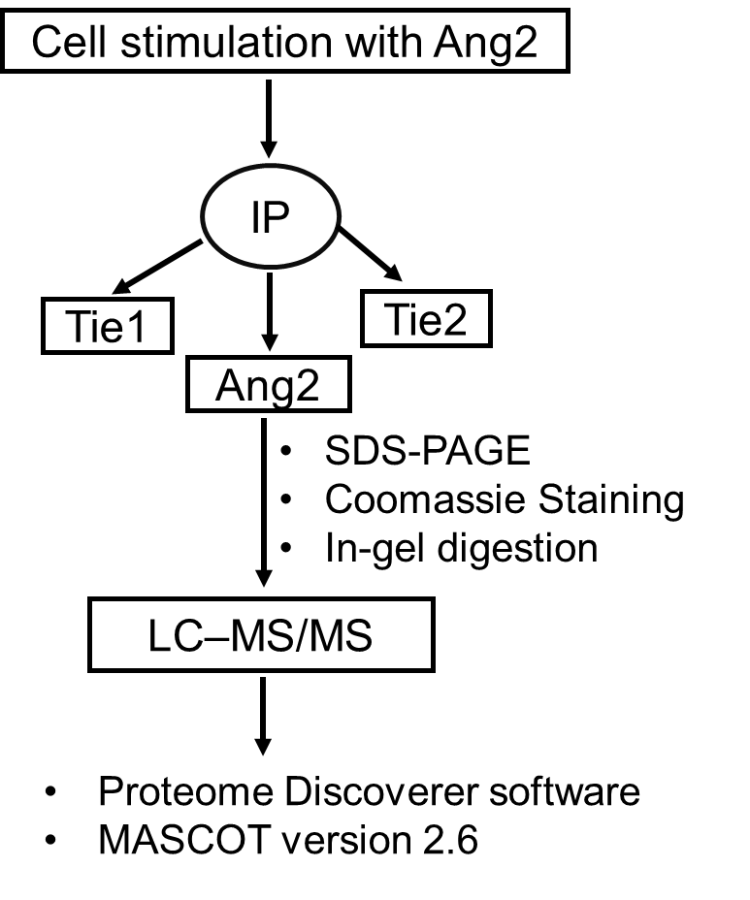
Ang2 activates RhoA in LECs via integrins
Which integrin is involved?

Slide 23
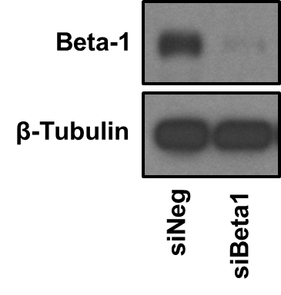
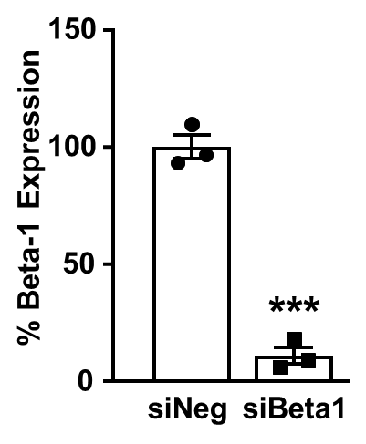
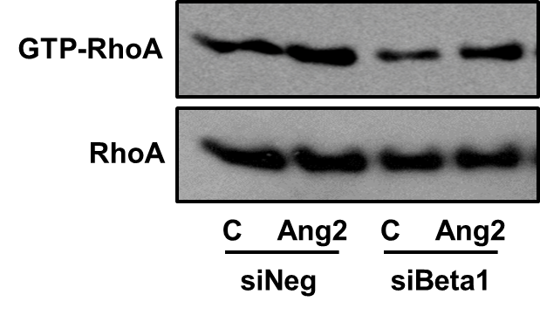
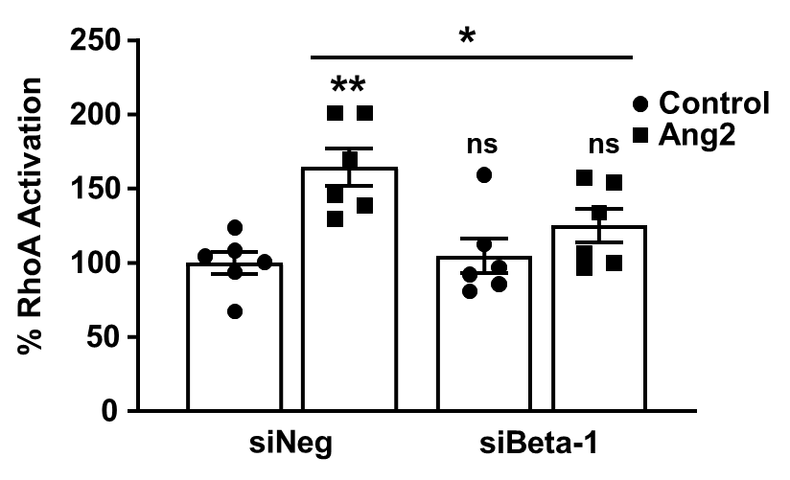
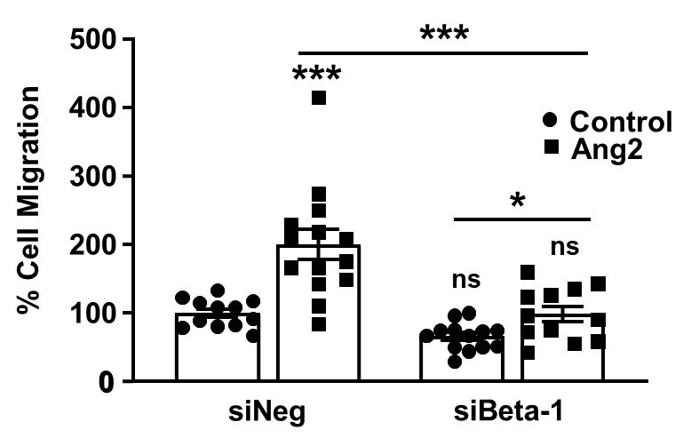
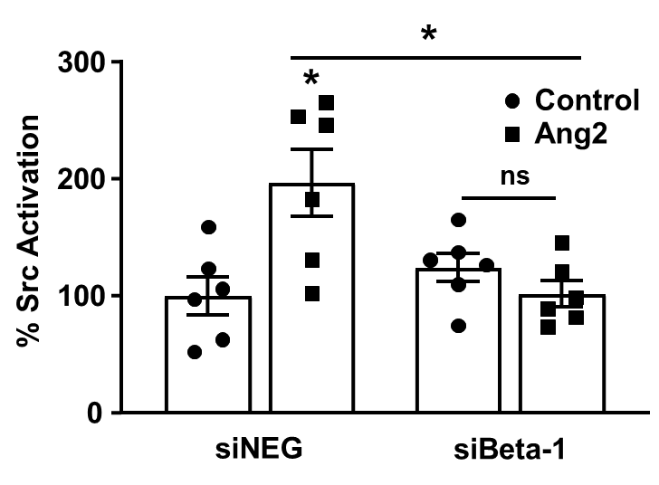
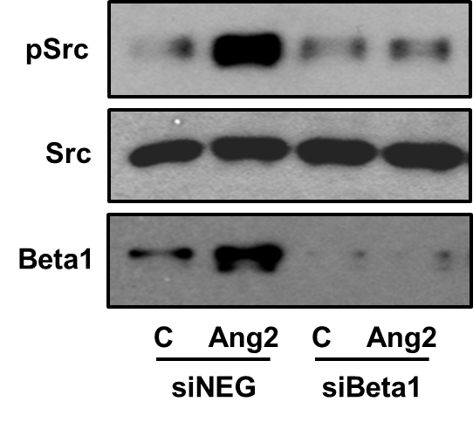
β1 integrin mediates Ang2-induced RhoA activation and LEC migration

Slide 24
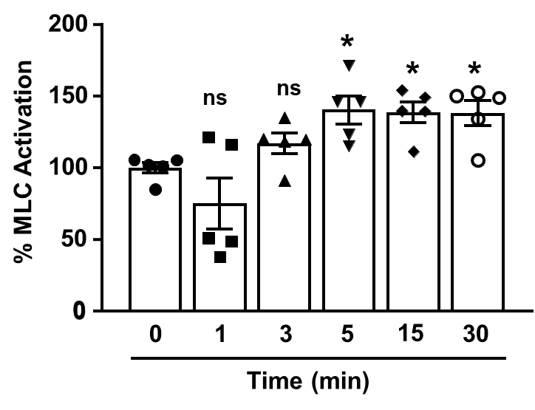
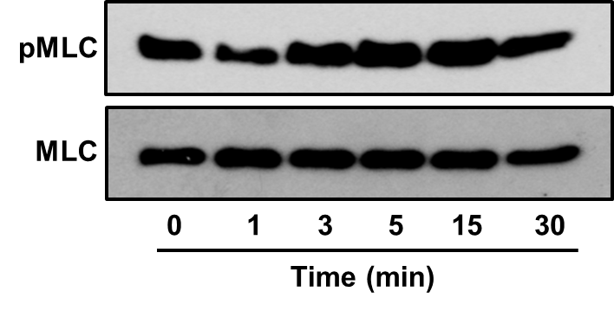
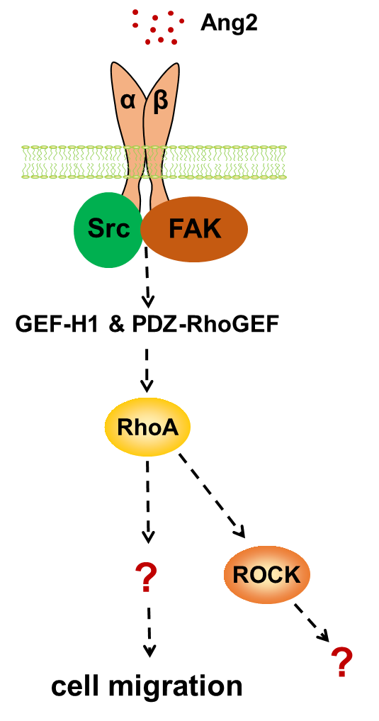
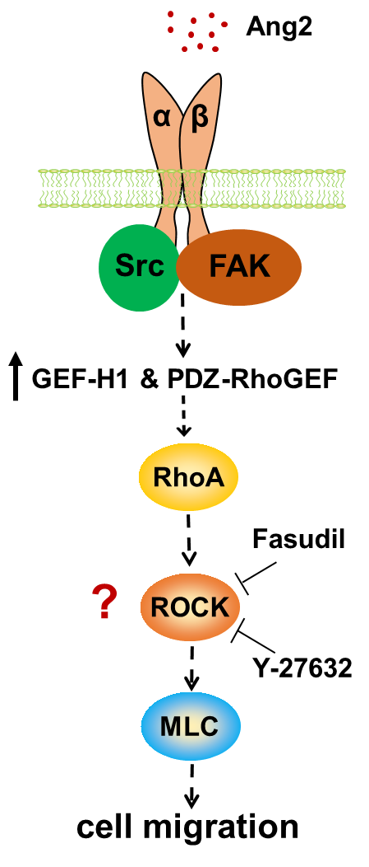
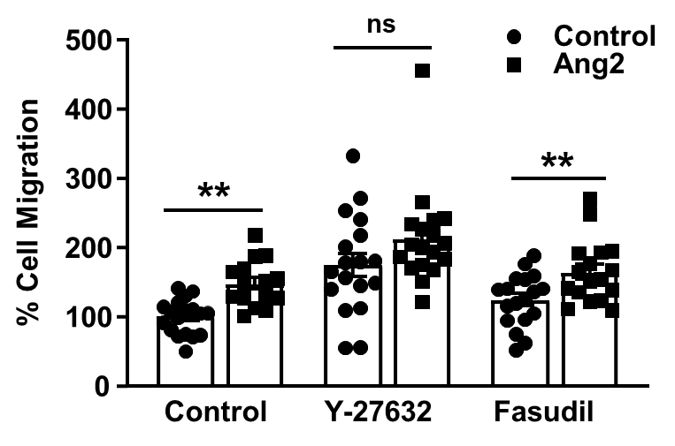
Rho kinase (ROCK), the downstream effector of RhoA is activated by Ang2, but does not regulate LEC migration

Slide 25
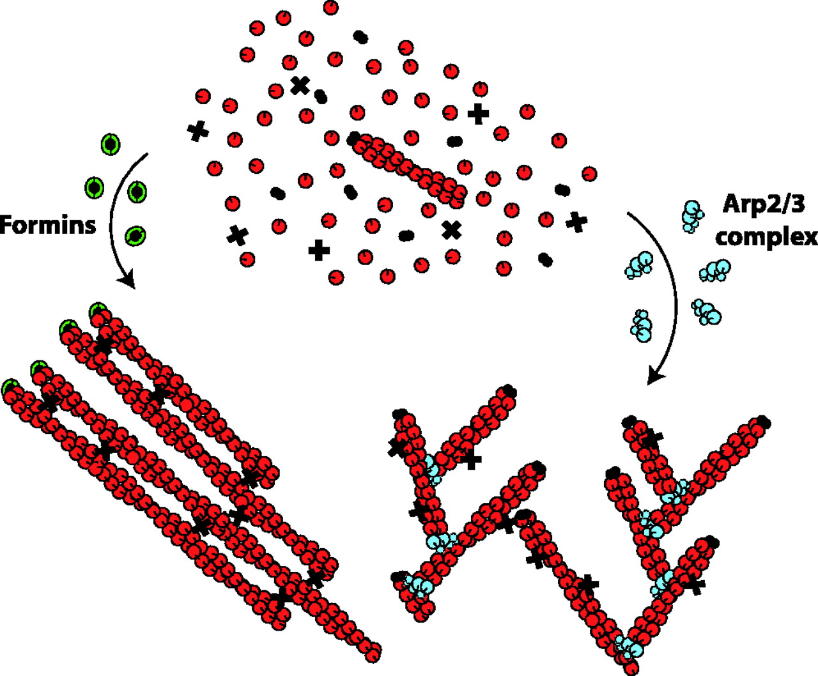
Formins
Formins (formin homology proteins):
Group of proteins associated with the fast growing end of actin filaments.
Are Rho-GTPase effector proteins: activated by Rho GTPase binding to GTPase-binding domains (GBD).
Regulate actin and microtubule cytoskeleton.
Bindschadler and Grath, 2004; Higgs et al., 2005; Breitsprecher and Goode, 2013; Cuhn and Geyer, 2014; Countemache et al., 2018

Slide 26
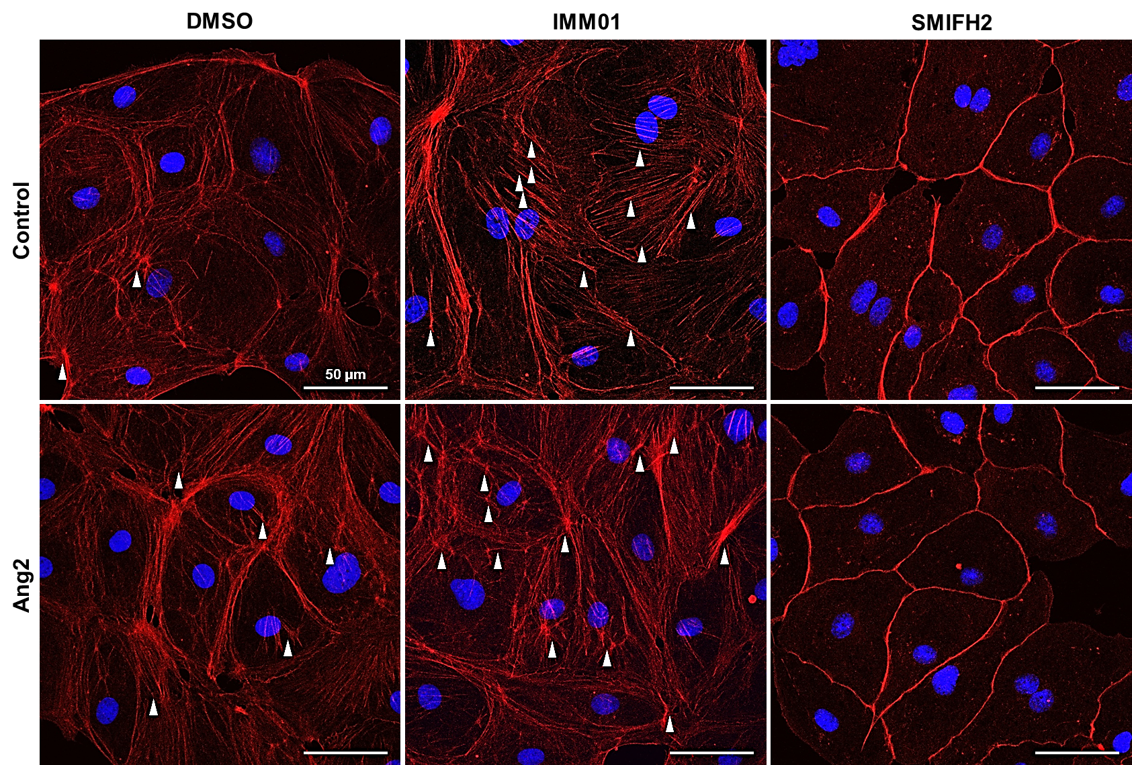
Formins regulate Ang2-induced LEC migration

Slide 27
Formin FHOD1 has a dominant role on Ang2-induced LEC migration

Slide 28
Impact of formins on adherens and tight junctions

Slide 29
Ang2 induces lymphangiogenesis in the ear sponge lymphangiogenesis assay
Akwii RG et al., Methods Mol Biol 2021;2193:85-96.

Slide 30
Conditionally-inducible lymphatic endothelial-specific RhoA-deficient mice
Prox1
Cre-ERT²
RhoA
mTomato
Stop
GFP
Tamoxifen
GFP+ lymphatic endothelial cells
100 μm

Slide 31
Lymphatic endothelial RhoA regulates Ang2-induced lymphangiogenesis

Slide 32
Formin inhibition abrogates Ang2-induced lymphangiogenesis

Slide 33
Summary
Akwii et al. Angiogenesis, 2022.

Slide 34
Άλλα παραδείγματα…

Slide 35
Cancer: Do single targeted therapies work?
With a few exceptions (retinoic acid for PML-RARa translocation in APL, Herceptin for Her2+ breast cancer, Gleevec for CML treatment) monotherapies don’t work.
Reason?
Alternative signaling pathway activation and subsequent drug resistance.
Transcriptome signatures stratify cancers into distinct therapeutic and prognostic categories and thus improve patient management.
Day CP, Merlino G, Van Dyke T. Cell 2015:163(1):39-53.

Slide 36
Preclinical Mouse Cancer Models
5% of new cancer drugs are approved
Why?
Mostly due to lack of efficacy
Preclinical methods are limited in predicting successful outcomes.
However: We may lose valuable information from wrong interpretation of clinical study outcomes!
In some cases a minor fraction of patients is responsive, but all-comer clinical data may mask the responders.
Example: NSCLC patients with EGFR-targeted tyrosine kinase inhibitors (only 10% of patients have activating EGFR mutations)
Screening for EGFR mutations is routine practice
Day CP, Merlino G, Van Dyke T. Cell 2015:163(1):39-53.

Slide 37
Angiogenesis: Is everything a success?
Case of lung cancer:
In non-small-cell lung cancer, anti-angiogenic therapy (i.e. Bevacizuman) has already become standard treatment option. New anti-angiogenic tyrosine kinase inhibitors generated optimistic results in phase II clinical trials but failed in phase III.
What do you think is the reason?

Slide 38
Challenge experienced during clinical development in lung cancer:
In randomized phase II clinical trial in an unselected NSCLC cohort 4 out of 66 treated patients had fatal bleedings.
Solution:
After exclusion of “high-risk” patients, proved to be tolerable in phase III trials.
Most of the phase III studies evaluating anti-angiogenic drugs improved PFS but failed to improve overall survival.
Why?
Ebos JM, Kerbel RS. Nat Rev Clin Oncol 2011;8:210-21.

Slide 39
Reasons for which drugs despite efficacy on tumor response or PFS prolongation don’t change patient’s outcome?
Design of clinical trials
(subsequent lines of treatment, response criteria, consideration of necrosis development)
Mok TS, et al. N Engl J Med 2009;361:947-57.
Jain RK, et al. Nat Rev Clin Oncol 2009;6:327-38.
2. Dosage of investigational drug and choice of combinatorial drugs
(suboptimal dose could be responsible for negative outcome)
Lara PN Jr, et al. J Clin Oncol 2011;29:2965-71.
3. Absence of reliable biomarkers for anti-angiogenic drugs
(non proper selection of patients)
Pircher A, et al. Int J Mol Sci 2011;12:7077-99.
4. Anti-angiogenic drugs might influence the biology of the disease
(initiation of stromal and microenvironmental defense mechanisms, increased metastatic potential)
Ebos JM, Kerbel RS. Nat Rev Clin Oncol 2011;8:210-21.
Ebos JM, et al. Cancer Cell 2009;15:232-9.
Pàez-Ribes M, et al. Cancer Cell 2009;15:220-31.

Slide 40
Two main concerns for anti-angiogenic cancer treatment
1. Tumor resistance (overcompensation from parallel signaling pathways)
2. Adverse effects (from effects of anti-angiogenic agents on normal vasculature)
Al-Husein et al Pharmacotherapy 2012;32(12):1095-110.

Slide 41
Clinical trials for anti-angiogenic drugs should consider:
1. Choice and dose of combinational drugs
2. The stage of disease that the clinical trial is performed
3. Inclusion of a biomarker program
4. Stratification of smoking behavior should be included

Slide 42
Συζήτηση
Δοκιμάζεται ένα νέο φάρμακο για καρκίνο σε Κλινική Φάση Ι και δεν παρουσιάζονται σημαντική τοξικότητα ή άλλα side-effects.
Το φάρμακο προχωράει σε Κλινική Φάση ΙΙ, είναι ανεκτό και αναστέλλει την ανάπτυξη του όγκου και τη μεταστατικότητα. Παράλληλα, παρουσιάζεται σε 3 άτομα από τα 60 (ποσοστό 5%) τοξικότητα και αιμορραγία, οπότε και η κλινική μελέτη σταματάει.
Πώς μπορείτε να καταλάβετε αν το φάρμακο μπορεί να είναι ελπιδοφόρο για να μπει στην αγορά με ασφαλή τρόπο;
RNA sequencing στους όγκους και υγιή ιστό για επίπεδα έκφρασης πρωτεϊνών και μεταλλάξεις σε συγκεκριμένες πρωτεΐνες

