Slide 1

Leadership and Motivation
Inspiring others to achieve shared goals successfully
Notes:
---

Slide 2
Introduction to Leadership and Motivation
Notes:
What is Leadership?, Motivation in Management

Slide 3

What is Leadership?
Core Leadership Definition
  Leadership is guiding and inspiring groups to achieve shared goals with vision and motivation.
Key Leadership Skills
  Effective leaders use decision-making, strategic thinking, and clear communication to achieve success.
Balancing Empathy and Assertiveness
  Leaders balance empathy with assertiveness to meet goals while maintaining team morale.
Fostering Trust and Collaboration
  Strong leadership fosters trust, encourages collaboration, and empowers team ownership.
Notes:
Leadership is the process of guiding, influencing, and inspiring individuals or groups toward achieving common objectives. It is not merely about authority or position but about creating a vision and motivating others to follow it. Effective leadership involves decision-making, strategic thinking, and the ability to communicate clearly. Leaders set the tone for organizational culture and play a critical role in shaping team dynamics. They must balance empathy with assertiveness, ensuring that goals are met while maintaining morale. Leadership also requires adaptability, as challenges and environments constantly evolve. A strong leader fosters trust, encourages collaboration, and empowers team members to take ownership of their roles. By doing so, they create an environment where innovation and productivity thrive. Understanding leadership is essential for management students because it forms the foundation of organizational success and personal growth in professional settings.

Slide 4
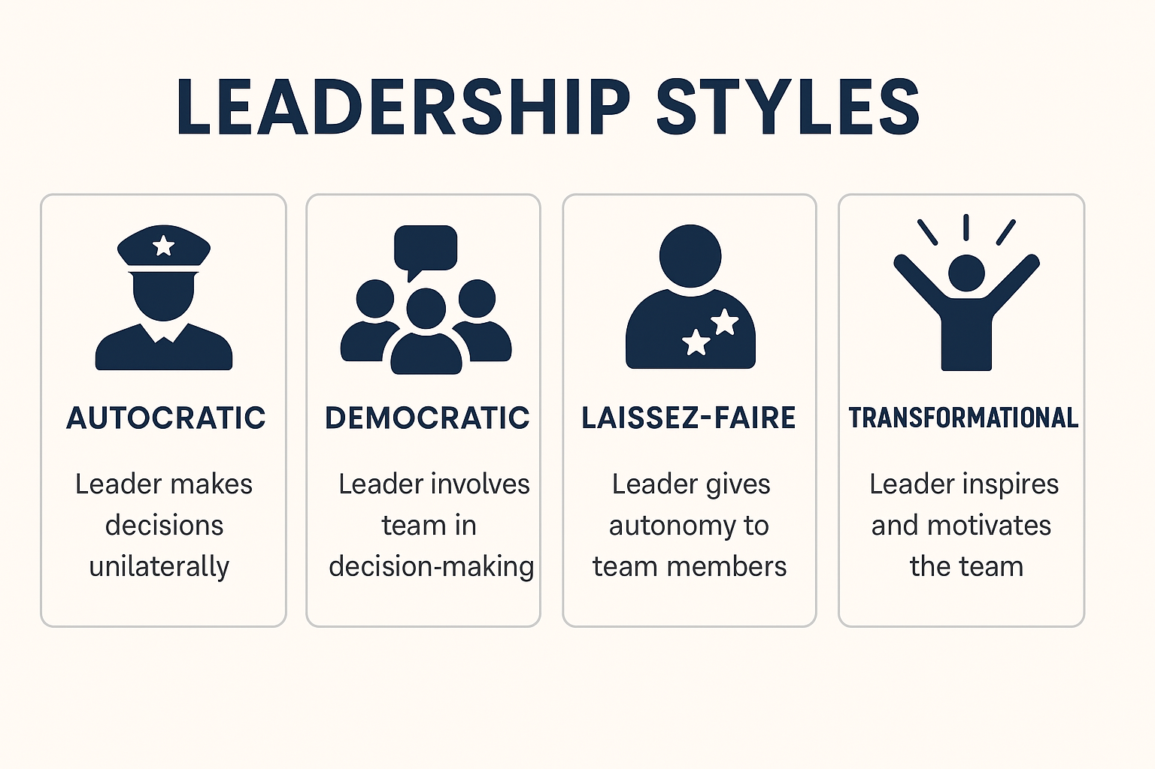


Slide 5
LEADERSHIP STYLES
1. Autocratic
Best for: Crisis situations, time-sensitive decisions, or when tasks require strict compliance.
Why: Clear authority and quick decision-making reduce confusion and delays.
2. Democratic
Best for: Creative projects, problem-solving, and when team expertise is valuable.
Why: Encourages collaboration, boosts morale, and leverages diverse perspectives.
3. Laissez-faire
Best for: Highly skilled, self-motivated teams working on innovative or research-based tasks.
Why: Autonomy fosters creativity and ownership, but only works with disciplined teams.

Slide 6

Motivation in Management
Types of Motivation
  Motivation is divided into intrinsic, arising from personal satisfaction, and extrinsic, influenced by external rewards.
Impact on Performance
  Motivation affects productivity, job satisfaction, and employee retention, driving better organizational outcomes.
Managerial Strategies
  Managers enhance motivation through goal setting, feedback, and creating a supportive work environment.
Aligning Goals
  Aligning individual aspirations with organizational objectives fosters commitment and excellence.
Notes:
Motivation is the driving force behind human behavior in the workplace. It determines how much effort individuals put into achieving organizational goals. There are two primary types of motivation: intrinsic and extrinsic. Intrinsic motivation comes from within, such as personal satisfaction or a sense of accomplishment, while extrinsic motivation is influenced by external factors like rewards, recognition, or financial incentives. Managers must understand what motivates their team members to create strategies that enhance performance. Motivation impacts productivity, job satisfaction, and employee retention. When employees feel valued and inspired, they are more likely to contribute positively to the organization. Conversely, lack of motivation can lead to disengagement and poor results. Effective leaders use motivational techniques such as goal setting, feedback, and creating a supportive work environment. By aligning individual aspirations with organizational objectives, managers can foster a culture of commitment and excellence.

Slide 7
Communication in Management
Notes:
Role of Communication in Leadership, Importance of Communication Between Leaders and Employees

Slide 8

Role of Communication in Leadership
Communication Builds Trust
  Effective communication fosters trust, reduces misunderstandings, and promotes team collaboration in leadership.
Diverse Communication Methods
  Leadership communication includes verbal, non-verbal, written messages, and active listening to ensure clarity.
Communication Drives Engagement
  Transparent communication increases employee engagement, motivation, and effective decision-making in management.
Consequences of Poor Communication
  Poor communication leads to confusion, low morale, and decreased productivity within teams and organizations.
Notes:
Communication is the cornerstone of effective leadership and management. It ensures that ideas, expectations, and feedback are clearly conveyed between leaders, managers, and employees. Good communication builds trust, reduces misunderstandings, and promotes collaboration. Leaders who communicate effectively can articulate their vision, align team efforts, and resolve conflicts efficiently. Communication is not limited to verbal exchanges; it includes non-verbal cues, written messages, and active listening. In management, communication facilitates decision-making and helps maintain transparency. When employees feel informed and heard, they are more engaged and motivated. Poor communication, on the other hand, can lead to confusion, low morale, and decreased productivity. Therefore, mastering communication skills is essential for anyone aspiring to lead successfully. It is a dynamic process that requires clarity, empathy, and consistency to foster strong relationships within an organization.

Slide 9

Importance of Communication Between Leaders and Employees
Building Trust and Engagement
  Effective communication builds trust, sets expectations, and makes employees feel valued, improving job satisfaction.
Facilitating Change and Conflict Resolution
  Clear communication reduces uncertainty during change and helps resolve conflicts efficiently within organizations.
Encouraging Collaboration and Innovation
  Open communication aligns teams with goals and encourages idea sharing, fostering collaboration and innovation.
Consequences of Poor Communication
  Poor communication leads to misunderstandings, frustration, disengagement, and hinders long-term organizational success.
Notes:
The relationship between leaders and employees hinges on effective communication. It is through communication that expectations are set, feedback is provided, and trust is built. Leaders who maintain open channels of communication create an environment where employees feel valued and understood. This leads to higher job satisfaction and better performance. Communication also plays a vital role in conflict resolution and change management. When organizations undergo transitions, clear communication helps reduce uncertainty and resistance. Furthermore, communication fosters collaboration by ensuring that everyone is aligned with organizational goals. It encourages innovation by allowing employees to share ideas freely. In contrast, poor communication can result in misunderstandings, frustration, and disengagement. For leaders, developing strong communication skills is not optional—it is a necessity for building cohesive teams and achieving long-term success.

Slide 10
Insights from Simon Sinek
Notes:
Leadership Principles

Slide 11

Leadership Principles
Starting with Why
  Great leaders inspire action by communicating the purpose behind their actions first, fostering meaningful commitment.
Responsibility Over Authority
  True leadership focuses on responsibility and care rather than authority, emphasizing service to others.
Trust and Empathy
  Leaders prioritize trust and empathy to create safe environments where innovation and risk-taking flourish.
Building Loyalty and Success
  Focusing on purpose and people helps leaders build loyalty and drive sustainable organizational success.
Notes:
Simon Sinek emphasizes that great leaders inspire action by starting with 'why'—the purpose behind their actions—before explaining 'how' and 'what.' This approach creates a sense of meaning and motivates people to commit to a shared vision. According to Sinek, leadership is not about authority but about responsibility and care for those in your charge. Leaders should prioritize trust and empathy, creating environments where people feel safe to take risks and innovate. By focusing on purpose and people, leaders can build loyalty and drive sustainable success. These principles remind us that leadership is fundamentally about service and inspiration, not control or dominance.

Slide 12
Classroom Exercises and Case Studies
Notes:
Case Study: Good Leadership, Case Study: Poor Leadership

Slide 13

Case Study: Good Leadership
Empowering Leadership
  Effective leaders delegate responsibilities and encourage employee creativity to foster empowerment.
Constructive Feedback
  Providing constructive feedback and celebrating achievements promotes a positive work culture.
Impact on Morale and Productivity
  Good leadership increases team morale and productivity through supportive behaviors and recognition.
Applying Leadership Styles
  Successful leadership behaviors can be adapted to different organizational contexts to drive success.
Notes:
Example: A team leader empowers employees by delegating responsibilities and encouraging creativity. This leader provides constructive feedback and celebrates achievements, fostering a positive work culture. Exercise: Discuss how this leadership style impacts team morale and productivity. Identify specific behaviors that contribute to success and suggest how these can be applied in different organizational contexts.

Slide 14

Case Study: Poor Leadership
Micromanagement Impact
  Micromanagement leads to employee frustration, low morale, and reduced team efficiency.
Communication Failures
  Poor communication results in unclear expectations and disconnect between manager and team.
Strategies for Improvement
  Improving communication and trust fosters a supportive and empowering leadership environment.
Empowering Leadership Benefits
  Adopting empowering leadership transforms outcomes by boosting morale and productivity.
Notes:
Example: A manager micromanages tasks, disregards employee input, and fails to communicate expectations clearly. This approach leads to frustration, low morale, and decreased efficiency. Exercise: Analyze the consequences of such leadership behavior. Propose strategies to improve communication and trust within the team. Reflect on how adopting a more empowering leadership style could transform outcomes.

Slide 15
Key Takeaways
Notes:
Summary of Core Concepts

Slide 16

Summary of Core Concepts
Role of Effective Leadership
  Effective leaders inspire teams by fostering trust, clear communication, and a shared sense of purpose.
Motivation and Performance
  Motivation drives performance and is enhanced by understanding and addressing individual employee needs.
Importance of Communication
  Communication ensures clarity, facilitates collaboration, and helps resolve conflicts within teams.
Impact of Leadership Quality
  Good leadership empowers and motivates, while poor leadership leads to disengagement and discouragement.
Notes:
Leadership and motivation are fundamental to organizational success. Effective leaders inspire and guide teams by fostering trust, communication, and purpose. Motivation drives performance and can be enhanced through understanding individual needs. Communication is essential for clarity, collaboration, and conflict resolution. Good leadership empowers and motivates, while poor leadership discourages and disengages. By applying these principles, future managers can create positive, productive work environments that support both organizational goals and employee well-being.

