Slide 1

Consumer Behavior
Insights into purchasing patterns and decision-making processes
University of Patras – Management Science and Technology
Semester 1 – Dr. Manousakis
Notes:
---

Slide 2
Understanding Consumer Behavior
Notes:
---
This slide references information from the following file: https://acgedu30684-my.sharepoint.com/personal/vmanousakis_acg_edu/Documents/Microsoft%20Copilot%20Chat%20Files/Business%20-%20Unit%2010%20_%20Consumer%20Behavior%20.pdf
Consumer Behavior Overview, Buyer’s Black Box

Slide 3

Consumer Behavior Overview
Psychological and Emotional Influence
  Consumer choices are driven by emotions, habits, and personality, beyond purely logical reasoning.
Social and Cultural Impact
  Family, friends, and social media shape consumer preferences and adoption of trends.
Brand Signaling and Identity
  Brands act as storytellers conveying lifestyle, status, and identity to consumers.
Environmental and Analytical Factors
  Pricing, store design, advertising, and data analytics influence buying decisions and predict behavior.
Notes:
---
This slide references information from the following file: https://acgedu30684-my.sharepoint.com/personal/vmanousakis_acg_edu/Documents/Microsoft%20Copilot%20Chat%20Files/Business%20-%20Unit%2010%20_%20Consumer%20Behavior%20.pdf
Consumer behavior refers to the study of how individuals make decisions to spend their resources on consumption-related items. It is influenced by a combination of psychological, social, cultural, and personal factors. Choices are not purely logical; emotions, habits, personality traits, and unconscious drives play a significant role. For example, a consumer might choose a premium smartphone because it 'feels better,' even if a cheaper alternative offers similar features. Social influences such as family, friends, and social media also shape preferences, as seen when teens adopt fashion trends promoted by influencers. Brands act as storytellers, signaling lifestyle, identity, and status—owning a Tesla, for instance, conveys innovation and eco-consciousness. Environmental factors like pricing, store design, and advertising further sway decisions, such as placing candy at checkout to encourage impulse buying. Additionally, data analytics helps marketers predict future behavior by analyzing purchase patterns and online activity, as demonstrated by Netflix recommending shows based on viewing history. Understanding these dynamics is crucial for businesses aiming to create effective marketing strategies that resonate with consumers on multiple levels.

Slide 4

Buyer’s Black Box
Hidden Consumer Motivations
  Consumers’ true motivations often remain hidden behind their observable purchase actions and statements.
Complex Influencing Factors
  Psychological, emotional, social, and cultural factors interact intricately to shape consumer decisions.
The Iceberg Problem
  Visible consumer actions are just the tip of the iceberg, with deeper values and beliefs submerged.
Marketing Research Importance
  Marketers must use research to uncover hidden drivers and design strategies appealing to both seen and unseen motivators.
Notes:
---
This slide references information from the following file: https://acgedu30684-my.sharepoint.com/personal/vmanousakis_acg_edu/Documents/Microsoft%20Copilot%20Chat%20Files/Business%20-%20Unit%2010%20_%20Consumer%20Behavior%20.pdf
The concept of the Buyer’s Black Box highlights the complexity of consumer decision-making processes. While marketers can observe purchases, they cannot directly access the internal thoughts, feelings, and reasoning behind them. For instance, a customer buying organic food might do so for health, taste, or environmental reasons, but these motivations remain hidden. There is often a gap between what consumers say they want and what truly drives their behavior—someone claiming to buy a smartphone for productivity may actually prioritize prestige or camera quality. Psychological, emotional, social, and cultural factors interact in intricate ways, making it difficult to isolate their individual effects. Many decisions are influenced by unconscious habits and biases, such as repeatedly buying the same cereal brand without considering alternatives. Predicting future behavior is therefore challenging and approximate, as loyalty can shift suddenly after a negative experience. This 'iceberg problem' means that while external actions are visible, deeper drivers like values and beliefs remain submerged. Marketers must use research and insights to bridge this gap and design strategies that appeal to both visible and hidden motivators.

Slide 5

Models and Influencing Factors
Notes:
---
This slide references information from the following file: https://acgedu30684-my.sharepoint.com/personal/vmanousakis_acg_edu/Documents/Microsoft%20Copilot%20Chat%20Files/Business%20-%20Unit%2010%20_%20Consumer%20Behavior%20.pdf
Stimulus-Response Model, Factors Influencing Consumer Behavior

Slide 6

Stimulus-Response Model
External Stimuli
  Consumer behavior reacts to external stimuli like advertisements, pricing, packaging, and peer recommendations.
Observable Responses
  Responses include buying, ignoring, comparing, or sharing information influenced by stimuli.
Model Limitations
  The model overlooks internal motivations, emotions, and individual differences influencing decisions.
Complementary Insights
  Marketers must integrate psychological and cultural drivers to develop effective marketing strategies.
Notes:
---
This slide references information from the following file: https://acgedu30684-my.sharepoint.com/personal/vmanousakis_acg_edu/Documents/Microsoft%20Copilot%20Chat%20Files/Business%20-%20Unit%2010%20_%20Consumer%20Behavior%20.pdf
The Stimulus-Response Model views consumer behavior as a reaction to external stimuli such as marketing efforts, product features, and environmental cues. Stimuli include advertisements, packaging, pricing, promotions, and peer recommendations. For example, a '50% off' tag on a jacket acts as a stimulus that may prompt immediate purchase. The response is the observable consumer action—buying, ignoring, comparing, or sharing information. This model simplifies the decision-making process into a pathway: Stimulus → Decision → Response. While useful for understanding basic reactions, it has limitations because it overlooks internal motivations, emotions, and complex decision-making factors. Two consumers exposed to the same advertisement may respond differently due to personal preferences, values, or prior experiences. Therefore, while the model provides a framework for analyzing external influences, marketers must complement it with insights into psychological and cultural drivers to create comprehensive strategies.

Slide 7

Factors Influencing Consumer Behavior
Cultural Factors
  Cultural values, traditions, and norms shape consumer preferences and consumption habits worldwide.
Social Factors
  Family, social roles, and influencers significantly impact buying decisions and consumer behavior.
Personal Factors
  Age, occupation, lifestyle, income, and education directly affect individual purchasing choices.
Psychological Factors
  Motivations, perceptions, attitudes, and beliefs drive consumer decision-making processes.
Notes:
---
This slide references information from the following file: https://acgedu30684-my.sharepoint.com/personal/vmanousakis_acg_edu/Documents/Microsoft%20Copilot%20Chat%20Files/Business%20-%20Unit%2010%20_%20Consumer%20Behavior%20.pdf
Consumer behavior is shaped by four major categories of factors: cultural, social, personal, and psychological. Cultural factors include values, traditions, and norms that guide preferences and consumption patterns. Subcultures, such as those based on nationality, religion, age, or lifestyle, create distinct consumer segments with unique behaviors. Social factors encompass family influence, social roles, and status, as well as reference groups and influencers who set behavioral benchmarks. Personal factors involve age, occupation, lifestyle, income, and education, all of which affect purchasing decisions. Psychological factors include motivations, perceptions, attitudes, and beliefs that drive choices. For instance, educated consumers may respond to rational, evidence-based marketing, while others may prefer emotional appeals. Understanding these factors enables marketers to design targeted campaigns that resonate with specific consumer segments and address their unique needs and aspirations.

Slide 8

Consumer Segmentation and Social Influence
Notes:
---
This slide references information from the following file: https://acgedu30684-my.sharepoint.com/personal/vmanousakis_acg_edu/Documents/Microsoft%20Copilot%20Chat%20Files/Business%20-%20Unit%2010%20_%20Consumer%20Behavior%20.pdf
Culture and Subculture, Social Groups and Influencers

Slide 9

Culture and Subculture
Culture's Role in Consumer Behavior
  Culture shapes society's shared values and norms, fundamentally influencing consumer choices and behaviors.
Nationality-Based Subcultures
  Subcultures based on nationality have unique consumption patterns and brand preferences reflecting their heritage.
Religious and Age Subcultures
  Religious and age groups influence demand for specific products tied to traditions, holidays, and technology use.
Lifestyle and Geographic Subcultures
  Lifestyle choices and geographic location shape preferences for products like organic foods and convenience items.
Notes:
---
This slide references information from the following file: https://acgedu30684-my.sharepoint.com/personal/vmanousakis_acg_edu/Documents/Microsoft%20Copilot%20Chat%20Files/Business%20-%20Unit%2010%20_%20Consumer%20Behavior%20.pdf
Culture represents the overarching values and norms of a society, exerting a fundamental influence on consumer behavior. Within cultures, subcultures form smaller groups with distinct values and behaviors. Examples include nationality-based subcultures like Hispanic or East Asian communities, which exhibit unique consumption patterns and brand preferences. Religious subcultures influence demand for products aligned with specific holidays or dietary restrictions. Age-based subcultures such as Baby Boomers, Millennials, and Gen Z differ in technological preferences and brand loyalties. Geographic regions also shape preferences, as urban consumers may favor convenience-oriented products while rural consumers prioritize practicality. Lifestyle-based subcultures, including fitness enthusiasts or eco-conscious consumers, drive demand for products like organic foods or sustainable goods. Recognizing these distinctions allows marketers to tailor offerings and messages that resonate with diverse consumer groups.

Slide 10
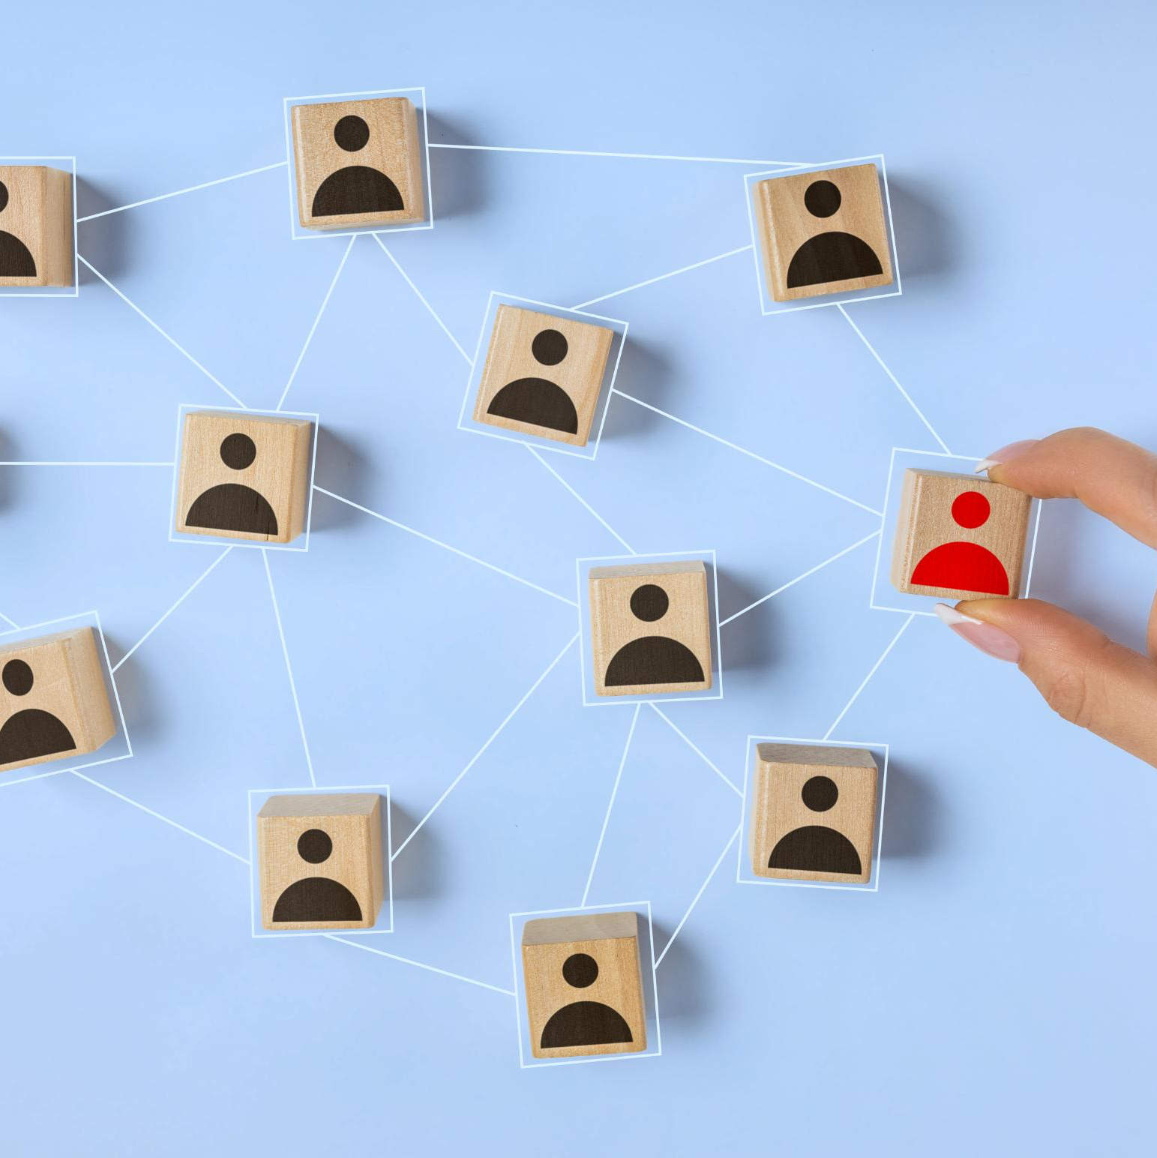
Social Groups and Influencers
Impact of Social Groups
  Membership groups build identity and community, while reference groups set aspirational consumer benchmarks.
Role of Influencers
  Influencers shape public perception and act as trusted brand ambassadors through credibility and personal connection.
Online Social Networks
  Brands use online networks for personalized engagement and targeted campaigns powered by data analytics.
Ethics and Family Influence
  Ethical concerns include transparency and accountability; family influence guides collective purchasing decisions.
Notes:
---
This slide references information from the following file: https://acgedu30684-my.sharepoint.com/personal/vmanousakis_acg_edu/Documents/Microsoft%20Copilot%20Chat%20Files/Business%20-%20Unit%2010%20_%20Consumer%20Behavior%20.pdf
Social groups significantly impact consumer decisions. Membership groups provide identity and community through regular interaction, while reference groups set aspirational benchmarks. Influencers—celebrities, experts, and content creators—shape public perception and act as effective brand ambassadors due to their credibility and personal connection with audiences. Online social networks enable brands to engage consumers through personalized interactions and targeted campaigns using data analytics. However, ethical issues arise in social media marketing, including data minimization, transparency, and accountability. Family influence also plays a critical role, as purchasing decisions often reflect collective needs and preferences. Social roles and status further guide consumer choices, prompting brands to position products as status symbols or lifestyle enhancers. Understanding these dynamics helps marketers craft strategies that leverage social influence while maintaining ethical standards.

Slide 11

Psychological Drivers and Decision Processes
Notes:
---
This slide references information from the following file: https://acgedu30684-my.sharepoint.com/personal/vmanousakis_acg_edu/Documents/Microsoft%20Copilot%20Chat%20Files/Business%20-%20Unit%2010%20_%20Consumer%20Behavior%20.pdf
Motivation and Buying Behavior, Buyer’s Decision Process

Slide 12

Motivation and Buying Behavior
Motivation and Psychological Drives
  Motivation drives individuals to satisfy biological and psychological needs, influenced by unconscious desires and emotions.
Maslow’s Hierarchy of Needs
  Maslow's framework explains consumer priorities from basic physiological needs to self-actualization and fulfillment.
Types of Buying Behavior
  Buying behavior varies by involvement and brand differences, including complex, dissonance-reducing, habitual, and variety-seeking types.
Marketing Implications
  Marketers use emotional appeals, qualitative research, and tailored support to influence motivated buyers effectively.
Notes:
---
This slide references information from the following file: https://acgedu30684-my.sharepoint.com/personal/vmanousakis_acg_edu/Documents/Microsoft%20Copilot%20Chat%20Files/Business%20-%20Unit%2010%20_%20Consumer%20Behavior%20.pdf
Motivation is the inner drive that compels individuals to satisfy needs, whether biological (e.g., hunger) or psychological (e.g., recognition). Freud’s theory suggests that unconscious desires influence behavior, often conflicting with societal norms, encouraging marketers to use symbolic and emotional appeals. Motivation research employs qualitative techniques like interviews to uncover hidden motives, enabling emotionally intelligent branding strategies. Maslow’s hierarchy of needs provides a framework for understanding consumer priorities, from physiological needs to self-actualization. Buying behavior types vary based on involvement and brand differences: complex buying involves high involvement and significant differences, requiring detailed information and comparisons; dissonance-reducing buying involves high involvement but few differences, necessitating reassurance and post-purchase support; habitual buying reflects low involvement and few differences, driven by convenience and loyalty programs; variety-seeking buying involves low involvement but significant differences, encouraging frequent promotions and new product variations.

Slide 13

Buyer’s Decision Process
Need Recognition
  Consumers recognize a problem or desire triggered by internal or external stimuli like hunger or ads.
Information Search
  Consumers gather information from personal, commercial, public, and experiential sources to make decisions.
Evaluation of Alternatives
  Consumers compare product features, prices, and benefits to narrow down their choices.
Purchase Decision and Post-Purchase
  The final choice is influenced by attitudes and situation; satisfaction impacts loyalty and word-of-mouth.
Notes:
---
This slide references information from the following file: https://acgedu30684-my.sharepoint.com/personal/vmanousakis_acg_edu/Documents/Microsoft%20Copilot%20Chat%20Files/Business%20-%20Unit%2010%20_%20Consumer%20Behavior%20.pdf
The buyer’s decision process consists of five stages: need recognition, information search, evaluation of alternatives, purchase decision, and post-purchase behavior. Need recognition occurs when a consumer identifies a problem or desire, triggered by internal or external stimuli such as hunger or advertisements. Information search involves gathering data from personal, commercial, public, and experiential sources. Evaluation of alternatives requires comparing products based on features, prices, and benefits to narrow choices. The purchase decision reflects the final choice, influenced by attitudes and situational factors. Post-purchase behavior determines satisfaction or dissatisfaction, impacting future loyalty and word-of-mouth. Understanding this process helps marketers design strategies that guide consumers smoothly through each stage, ensuring positive experiences and long-term engagement.

Slide 14
Exercises and Key Takeaways
Notes:
Exercise 1: Case Study, Exercise 2: Group Activity, Thank You & Key Takeaways

Slide 15

Exercise 1: Case Study
Psychological and Social Factors
  Consumers choose Tesla influenced by psychological needs, social status, and cultural values that align with innovation and sustainability.
Brand Identity and Environmental Impact
  Tesla’s strong brand identity and commitment to eco-friendly technology attract environmentally conscious consumers.
Influencers and Peer Recommendations
  Influencers and peer recommendations significantly shape consumer perceptions of Tesla as an innovative and desirable brand.
Notes:
Analyze why a consumer chooses Tesla over other brands. Consider psychological, social, and cultural factors influencing this decision. Discuss how brand identity, environmental consciousness, and status aspirations contribute to the choice. Evaluate the role of influencers and peer recommendations in shaping perceptions of Tesla as an innovative and eco-friendly brand.

Slide 16

Exercise 2: Group Activity
Influencer Impact on Gen Z
  Influencers strongly shape Gen Z buying choices by setting trends and creating relatable content.
Key Platforms for Influence
  TikTok and Instagram are primary platforms where influencers engage Gen Z and drive trends effectively.
Marketing Strategies for Gen Z
  Focus on authenticity, social engagement, and ethical practices to appeal to Gen Z consumers.
Role of Data Analytics
  Data analytics enhances personalization and builds loyalty in marketing targeted at Gen Z.
Notes:
Discuss how influencers impact Gen Z buying behavior. Identify key platforms such as TikTok and Instagram where influencers shape trends. Suggest marketing strategies for a new fashion brand targeting Gen Z, focusing on authenticity, social engagement, and ethical practices. Consider how data analytics can enhance personalization and loyalty.

Slide 17

Thank You & Key Takeaways
Complex Consumer Behavior
  Consumer actions are influenced by cultural, social, personal, and psychological factors, making behavior multidimensional.
Ethical Marketing Strategies
  Marketers need to use ethical practices while addressing various drivers of consumer behavior effectively.
Data-Driven Insights
  Leveraging data helps marketers understand motivations and decision-making to build meaningful consumer relationships.
Notes:
Consumer behavior is complex and multidimensional, influenced by cultural, social, personal, and psychological factors. Marketers must adopt strategies that address these diverse drivers while maintaining ethical standards and leveraging data-driven insights. Understanding decision-making processes and motivations enables businesses to create meaningful connections with consumers and foster long-term loyalty.

