Slide 1
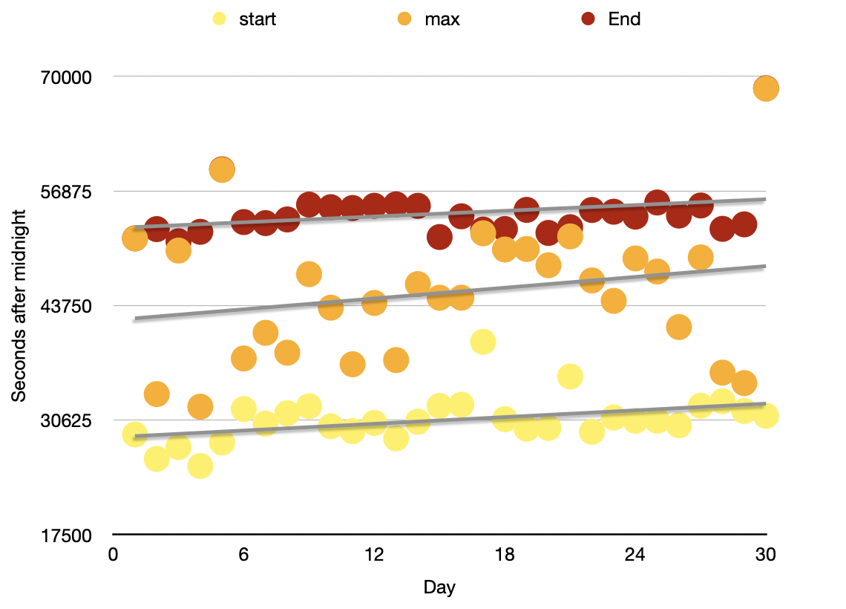
Linear regression in SparkSQL:
Ενεργειακά Δεδομένα από φωτοβολταϊκα Panels (Kw/h).
day | start | max | end
1 | 28970 | 51420 | 51441
2 | 26179 | 33600 | 52499
... data omitted for readability ...
29 | 31660 | 34860 | 53043
30 | 31121 | 68580 | 68629
x | y
x1 | y1
x2 | y2
…… | ………
x30 | y30
Table: Input
x=day, y=start ή max ή end
The equation can be found in any statistical analytics text book: y=m∙x+b
Where m is called the slope which determines the direction of the line and b is called the intercept which defines the distance of the line from 0.
m=∑(x_{i} - ẍ)(y_{i} - ÿ) / ∑(x_{i} - ẍ)² = [(x1- ẍ)(y1- ÿ)+(x2- ẍ)(y2- ÿ)+….+(x30- ẍ)(y30- ÿ)] / [(x1- ẍ)(x1- ẍ)+(x2- ẍ)(x2- ẍ)+….+(x30- ẍ)(x30- ẍ]
b=max y - max x ∙ m, where ẍ and ÿ are the averages of x and y.

Slide 2
Create temp view Bar_Data AS
select
day, avg(day) as day_bar,
start, avg(start) as start_bar,
max, avg(max) as max_bar,
end, avg(end) as end_bar
from Input
day | day_bar | start | start_bar | max | max_bar | end | end_bar
1 | 15.5 | 28970 | 30647.0 | 51420 | 45272.0 | 51441 | 54322.8
2 | 15.5 | 26179 | 30647.0 | 33600 | 45272.0 | 52499 | 54322.8
3 | 15.5 | 27529 | 30647.0 | 50040 | 45272.0 | 51102 | 54322.8
... | ... | ... | ... | ... | ... | ... | ...
Table: Bar_Data

Slide 3
Create temp view Final_Result AS
select
start_slope,
start_bar_max - day_bar_max * start_slope as start_intercept,
max_slope,
max_bar_max - day_bar_max * max_slope as max_intercept,
end_slope,
end_bar_max - day_bar_max * end_slope as end_intercept
from (
select
sum((day - day_bar) * (start - start_bar)) /
sum((day - day_bar) * (day - day_bar)) as start_slope,
sum((day - day_bar) * (max - max_bar)) /
sum((day - day_bar) * (day - day_bar)) as max_slope,
sum((day - day_bar) * (end - end_bar)) /
sum((day - day_bar) * (day - day_bar)) as end_slope,
max(day_bar) as day_bar_max,
max(start_bar) as start_bar_max,
max(max_bar) as max_bar_max,
max(end_bar) as end_bar_max
from Bar_Data)
day | day_bar | start | start_bar | max | max_bar | end | end_bar
1 | 15.5 | 28970 | 30647.0 | 51420 | 45272.0 | 51441 | 54322.8
2 | 15.5 | 26179 | 30647.0 | 33600 | 45272.0 | 52499 | 54322.8
3 | 15.5 | 27529 | 30647.0 | 50040 | 45272.0 | 51102 | 54322.8
... | ... | ... | ... | ... | ... | ... | ...
Table: Bar_Data
Table: Final_Result
start_slope | start_intercept | max_slope | max_intercept | end_slope | end_intercept
128.292324805339 | 28658.4689655172 | 206.255839822024 | 42075.0344827586 | 109.764627363737 | 52621.4482758621

Slide 4
start_slope | start_intercept | max_slope | max_intercept | end_slope | end_intercept
128.292324805339 | 28658.4689655172 | 206.255839822024 | 42075.0344827586 | 109.764627363737 | 52621.4482758621
Table: Final_Result
Predict the future!
With the slope and intercept for each series it's trivial to calculate the prediction for today or tomorrow.
The example uses 30 days history, so tomorrow is the 31st day.
We add the following outer query to the query from above:
select
start_slope * 31 + start_intercept as start,
max_slope * 31 + max_intercept as max,
end_slope * 31 + end_intercept as end
from view3

Slide 5
CREATE TABLE "NBGShares"
(
"x" INTEGER,
"y" INTEGER
)
CREATE VIEW v1 as
select x, avg(x) over () as x_bar,
y, avg(y) over () as y_bar
from NBGShares
x | y
1 | 100
2 | 101
3 | 102
4 | 103
5 | 104
6 | 105
7 | 106
8 | 107
9 | 108
10 | 109
11 | 110
CREATE VIEW v2 as
select slope,
y_bar_max - x_bar_max * slope as intercept
from (
select sum((x - x_bar) * (y - y_bar)) / sum((x - x_bar) * (x - x_bar)) as slope,
max(x_bar) as x_bar_max,
max(y_bar) as y_bar_max
from v1)
CREATE VIEW PREDICT as
select 500*slope+intercept AS predict500th_date
from v2

Slide 6
TWEET_USER_iD | POS_MESSAGE | DATE_YEAR
ABC123_1 | “MESSAGE1” | 30/5/2015
ABC123_2 | “MESSAGE2” | 30/5/2015
ABC123_3 | “MESSAGE3” | 1/6/2015
ABC123_4 | “MESSAGE4” | 1/6/2015
ABC123_5 | “MESSAGE5” | 2/6/2015
………………………. |  | ………………….
ABC123_1200467 | “MESSAGE……….” | 30/5/2023
select date_year, count(tweet_user_id)
from tweet_table
where date_year between 1/1/2018 AND 31/12/2023
group by date_year
having count (tweet_user_id) >= 1000
TWEET_TABLE

