Slide 1

Databricks Academy
An Introduction to Spark’s Architecture

Slide 2
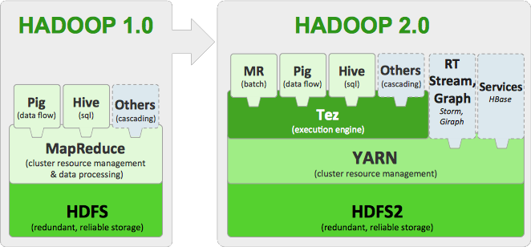
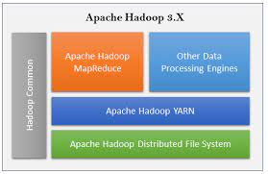
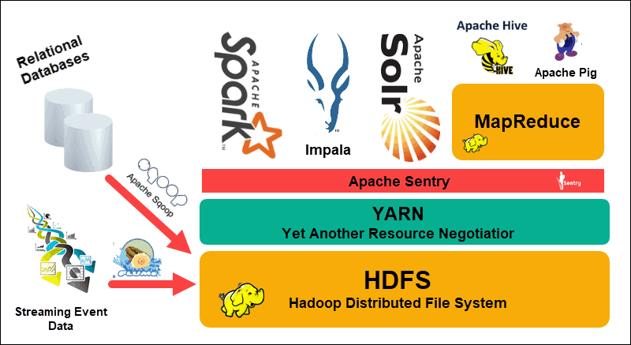
Spark SQL
spark.read.json("s3n://...")
.registerTempTable("json")
results = spark.sql(
"""SELECT *
FROM people
JOIN json ...""")

Slide 3

Introduction to Spark’s Architecturerview
Key Concepts & Terms
This course also introduces the following concepts and terms:
Shared resources
Parallelization
Partitions
Jobs, Stages, and Tasks
Drivers
Executors
Clusters & Nodes
Slots/Cores/Threads

Slide 4
Introduction to Spark’s Architecturerview
Course Outline
This course is divided into three major sections:
Scenario #1: Filtering
Distributed Computing
Scenario #2: Counting
Stages
Scenario #3: Distinct
The Shuffle

Slide 5

Everything I learned about Spark...
Notes:
The first thing we want to do with the data is pretty simple - filter out all of the brown candies.

Slide 6
Everything I learned about Spark...
I hate the brown D&Bs
Notes:
The first thing we want to do with the data is pretty simple - filter out all of the brown candies.

Slide 7
Everything I learned about Spark...
Can you grab the bag...
Notes:
The first thing we want to do with the data is pretty simple - filter out all of the brown candies.

Slide 8
... open the bag...
d&b
d&b
d&b
d&b
d&b
d&b
d&b
d&b
d&b
d&b
d&b
d&b
d&b
d&b
d&b
d&b

Slide 9
Everything I learned about Spark...
... and eat all the brown D&Bs...
d&b
d&b
d&b
d&b
d&b
d&b
d&b
d&b
d&b
d&b
d&b
d&b
d&b
d&b
d&b
d&b

Slide 10

Everything I learned about Spark...
... in only 60 seconds?
d&b
d&b
d&b
d&b
d&b
d&b
d&b
d&b
d&b
d&b
d&b
d&b
d&b
d&b
d&b
d&b
60
Notes:
Can you do that in 30 seconds? It's definitely possible to quickly go up to the pile, bring back the bag to your desk, open it, separate the brown ones, then eat - that is, filter - them. However that might be a reasonable amount of time to guarantee. It's possible to do it quicker still, but we're looking for a reliable time for that task.

Slide 11

Everything I learned about Spark...
How about 100
bags of D&Bs within 60 seconds?
60

Slide 12
Everything I learned about Spark...
Can you solve this problem?
What resources do you have?
What resources do you need?
60
Notes:
A single bag of candies doesn't present that much of a challenge. A single person can easily process it in a reasonable amount of time. But what if we had a lot more data? Many, many bags? Welcome to the era of Big Candy.
Can you do all of the steps above with all of the bags of candies? Almost definitely not by yourself in the same reasonable time frame. However, if we coordinate the entire class in the operation, we can very quickly filter (eat) all of the brown candies in this pile.

Slide 13
Databricks Academy
An Introduction to Spark’s Architecture
Scenario #1, Part 1b: Filtering
(Key Concept: Distributed Computing)

Slide 14


Where do we start?
Notes:
Instructor Notes
Point #1
Point #2
Script
Let's take a look at how we might do this in parallel for several different questions about our candies.

Slide 15
Let’s assume that each student can grab, open, and process a small bag
Notes:
Let's take a look at how we might do this in parallel for several different questions about our candies.

Slide 16
First subdivide the large bag of D&Bs into, smaller, more manageable bags
Notes:
Let's take a look at how we might do this in parallel for several different questions about our candies.

Slide 17
5
6
13
14
15
7
8
1
16
Assign each bag a unique number, or ID
2
3
4
9
10
11
12
Notes:
Let's take a look at how we might do this in parallel for several different questions about our candies.

Slide 18
























Assign each student a unique letter, or ID
Notes:
Let's take a look at how we might do this in parallel for several different questions about our candies.

Slide 19
Student A gets bag #2...
Student B gets bag #3...
Student C gets bag #6...
and so on...
Notes:
Let's take a look at how we might do this in parallel for several different questions about our candies.

Slide 20
Instructions: Eat all the brown D&Bs and pile the rest in the corner.
Notes:
Let's take a look at how we might do this in parallel for several different questions about our candies.

Slide 21
Ready…
Set…
Go!
C
Notes:
Let's take a look at how we might do this in parallel for several different questions about our candies.

Slide 22
Some students are faster than others…
And yet others are a slower than the some...
d&b
d&b
d&b
d&b
d&b
d&b
d&b
d&b
d&b
d&b
d&b
d&b
d&b
d&b
d&b
d&b
d&b
d&b
d&b
d&b
Notes:
Let's take a look at how we might do this in parallel for several different questions about our candies.

Slide 23
…everybody just works at their own pace…
d&b
d&b
d&b
d&b
d&b
d&b
d&b
d&b
d&b
d&b
d&b
d&b
d&b
d&b
d&b
d&b
d&b
d&b
d&b
d&b
d&b
d&b
d&b
d&b
d&b
d&b
d&b
d&b
d&b
d&b
d&b
d&b
d&b
d&b
d&b
d&b
d&b
d&b
d&b
d&b
d&b
d&b
d&b
d&b
d&b
d&b
d&b
d&b
d&b
d&b
d&b
d&b
d&b
d&b
d&b
d&b
d&b
d&b
d&b
d&b
d&b
d&b
d&b
d&b
d&b
d&b
d&b
d&b
d&b
d&b
d&b
d&b
d&b
d&b
d&b
Notes:
Let's take a look at how we might do this in parallel for several different questions about our candies.

Slide 24
4 of our students
are idle again…
d&b
d&b
d&b
d&b
d&b
d&b
d&b
d&b
d&b
d&b
d&b
d&b
d&b
d&b
d&b
d&b
d&b
d&b
d&b
d&b
d&b
d&b
d&b
d&b
d&b
d&b
d&b
d&b
d&b
d&b
d&b
d&b
d&b
d&b
d&b
d&b
d&b
d&b
d&b
d&b
d&b
d&b
d&b
d&b
d&b
d&b
d&b
d&b
d&b
d&b
d&b
d&b
d&b
d&b
d&b
Notes:
Let's take a look at how we might do this in parallel for several different questions about our candies.

Slide 25
5
8
They need new tasks!
1
Students A, E, H, & J,
grab bags #1, #4, #5, & #8
d&b
d&b
d&b
d&b
d&b
4
d&b
d&b
d&b
d&b
d&b
d&b
d&b
d&b
d&b
d&b
d&b
d&b
d&b
d&b
d&b
d&b
d&b
d&b
d&b
d&b
d&b
d&b
d&b
d&b
d&b
d&b
d&b
d&b
d&b
d&b
d&b
d&b
d&b
d&b
d&b
d&b
d&b
d&b
d&b
d&b
d&b
d&b
d&b
d&b
d&b
d&b
d&b
d&b
d&b
d&b
Notes:
Let's take a look at how we might do this in parallel for several different questions about our candies.

Slide 26
And so they just
keep working…
…and working…
…and working…
d&b
d&b
d&b
d&b
d&b
d&b
d&b
d&b
d&b
d&b
d&b
d&b
d&b
d&b
d&b
d&b
d&b
d&b
d&b
d&b
d&b
d&b
d&b
d&b
d&b
d&b
d&b
d&b
d&b
d&b
d&b
d&b
d&b
d&b
d&b
d&b
d&b
d&b
d&b
d&b
d&b
d&b
d&b
d&b
d&b
d&b
d&b
d&b
d&b
d&b
d&b
d&b
d&b
d&b
d&b
d&b
d&b
d&b
d&b
d&b
d&b
d&b
d&b
d&b
d&b
d&b
d&b
d&b
d&b
d&b
d&b
d&b
d&b
d&b
d&b
d&b
d&b
d&b
d&b
d&b
d&b
d&b
d&b
d&b
d&b
d&b
d&b
d&b
d&b
d&b
d&b
d&b
d&b
d&b
d&b
d&b
d&b
d&b
d&b
d&b
Notes:
Let's take a look at how we might do this in parallel for several different questions about our candies.

Slide 27
…and working…
d&b
d&b
d&b
All Done!
d&b
d&b
d&b
d&b
d&b
d&b
d&b
d&b
d&b
d&b
d&b
d&b
d&b
d&b
d&b
d&b
d&b
d&b
d&b
d&b
d&b
d&b
d&b
d&b
d&b
d&b
d&b
d&b
d&b
d&b
d&b
d&b
d&b
d&b
d&b
d&b
d&b
d&b
d&b
d&b
d&b
d&b
d&b
d&b
d&b
d&b
d&b
d&b
d&b
d&b
d&b
d&b
d&b
d&b
d&b
d&b
d&b
d&b
d&b
d&b
d&b
d&b
d&b
d&b
d&b
d&b
d&b
d&b
d&b
d&b
d&b
d&b
d&b
d&b
d&b
d&b
d&b
d&b
d&b
d&b
d&b
d&b
d&b
d&b
d&b
d&b
d&b
d&b
d&b
d&b
d&b
d&b
d&b
d&b
d&b
d&b
d&b
Notes:
Let's take a look at how we might do this in parallel for several different questions about our candies.

Slide 28
Introduction to Spark’s Architecturerview
Spark Architecture Concepts
Driver
Executors
Clusters & Nodes
Slots/Cores/Threads
Shared resources
Parallelization
Partitions
Jobs, Stages, and Tasks

Slide 29
Databricks Academy
An Introduction to Spark’s Architecture
Scenario #1, Part 2: Filtering
(Key Concept: Distributed Computing)

Slide 30
Driver
d&b
d&b
d&b
d&b
d&b
d&b
d&b
d&b
d&b
d&b
d&b
d&b
d&b
d&b
d&b
d&b
d&b
d&b
d&b
d&b
Notes:
Let's take a look at how we might do this in parallel for several different questions about our candies.

Slide 31
Driver
Executors
d&b
d&b
d&b
d&b
d&b
d&b
d&b
d&b
d&b
d&b
d&b
d&b
d&b
d&b
d&b
d&b
d&b
d&b
d&b
d&b
Notes:
Let's take a look at how we might do this in parallel for several different questions about our candies.

Slide 32
Spark Cluster
Driver
Executors
d&b
d&b
d&b
d&b
d&b
d&b
d&b
d&b
d&b
d&b
F
d&b
d&b
d&b
d&b
d&b
d&b
d&b
d&b
d&b
d&b
I
Notes:
Let's take a look at how we might do this in parallel for several different questions about our candies.

Slide 33
Systems like YARN will at
times run multiple executors
in a single node
Spark Cluster
Nodes
d&b
d&b
d&b
d&b
d&b
d&b
d&b
d&b
d&b
d&b
d&b
d&b
d&b
d&b
d&b
d&b
d&b
d&b
d&b
d&b
Notes:
Let's take a look at how we might do this in parallel for several different questions about our candies.

Slide 34
Databricks however, runs
one executor per node
Spark Cluster
Nodes
d&b
d&b
d&b
d&b
d&b
d&b
d&b
d&b
d&b
d&b
d&b
d&b
d&b
d&b
d&b
d&b
d&b
d&b
d&b
d&b
Notes:
Let's take a look at how we might do this in parallel for several different questions about our candies.

Slide 35
Nodes
d&b
d&b
d&b
d&b
d&b
Slots / Threads / Cores
(interchangeable terms)
d&b
d&b
d&b
d&b
d&b
Notes:
Let's take a look at how we might do this in parallel for several different questions about our candies.

Slide 36
Nodes
d&b
d&b
d&b
d&b
d&b
Shared Resources
(RAM, Disk, Network)
d&b
d&b
d&b
d&b
d&b
Notes:
Let's take a look at how we might do this in parallel for several different questions about our candies.

Slide 37
Maximum Parallelization: 12 Tasks
(6 executors, 2 cores each)
d&b
d&b
d&b
d&b
d&b
d&b
d&b
d&b
d&b
d&b
d&b
d&b
d&b
d&b
d&b
d&b
d&b
d&b
d&b
d&b
Notes:
Let's take a look at how we might do this in parallel for several different questions about our candies.

Slide 38
Dataset
d&b
d&b
d&b
d&b
d&b
d&b
d&b
d&b
d&b
d&b
d&b
d&b
d&b
d&b
d&b
d&b
d&b
d&b
d&b
d&b
Notes:
Let's take a look at how we might do this in parallel for several different questions about our candies.

Slide 39
Partitions
d&b
d&b
d&b
d&b
d&b
d&b
d&b
d&b
d&b
d&b
d&b
d&b
d&b
d&b
d&b
d&b
d&b
d&b
d&b
d&b
Notes:
Let's take a look at how we might do this in parallel for several different questions about our candies.

Slide 40
Instructions: Eliminate all the brown candies and pile the rest in the corner.
A Spark Job
(with only 1 stage)
d&b
d&b
d&b
d&b
d&b
d&b
d&b
d&b
d&b
d&b
d&b
d&b
d&b
d&b
d&b
d&b
d&b
d&b
d&b
d&b
Notes:
Let's take a look at how we might do this in parallel for several different questions about our candies.

Slide 41
Databricks Academy
An Introduction to Spark’s Architecture
Scenario #1, Part 3: Review Questions
(Key Concept: Distributed Computing)

Slide 42

What is the relationship between
applications, jobs, stages, and tasks?
Applications consists of zero or more jobs
Jobs consists of one or more stages
Stages consists of one or more tasks
Tasks are a single unit of work
against a single partition of data

Slide 43
How does each task know
which piece of data to process?
The driver assigns one and only one partition
of data to each task and in turn, dictates
that the task be executed in a specific slot
Notes:
The Driver assigns partitions of data (bags of candies) to each Task

Slide 44
If I have 3 executors and each executor has 3 slots,
how many tasks can be executed in parallel?
Answer: 3 * 3 = 9
Notes:
Let's take a look at how we might do this in parallel for several different questions about our candies.

Slide 45
Which component decides how to partition the dataset so it can be distributed for parallel processing?
The driver
d&b
d&b
d&b
d&b
d&b
d&b
d&b
d&b
d&b
d&b
d&b
d&b
d&b
d&b
d&b
d&b
d&b
d&b
d&b
d&b
Notes:
Let's take a look at how we might do this in parallel for several different questions about our candies.

Slide 46
What is the term for the lowest unit of work in a Spark job?
d&b
d&b
d&b
d&b
d&b
d&b
d&b
d&b
d&b
d&b
d&b
d&b
d&b
d&b
d&b
d&b
d&b
d&b
d&b
d&b
d&b
d&b
d&b
d&b
d&b
d&b
d&b
d&b
d&b
d&b
A task
(executed by a slot)
d&b
d&b
d&b
d&b
d&b
d&b
d&b
d&b
d&b
d&b
Notes:
Let's take a look at how we might do this in parallel for several different questions about our candies.

Slide 47
In what environment is
a task executed in?
The executor
(a Java Virtual Machine or JVM)
d&b
d&b
d&b
d&b
d&b
d&b
d&b
d&b
d&b
d&b
d&b
d&b
d&b
d&b
d&b
d&b
d&b
d&b
d&b
d&b
Notes:
We want to make sure that each of the bags are close to the same size to balance our cluster (so we don't have a lot of wasted idle resources), and we want to have one bag per processing core (executor task) at a time. If one person got a giant-sized bag while everyone else got a mini-bag, our candy counting would be skewed. All of the mini-bag counters would have to wait for the giant-bag counter to finish to go to another stage or deliver final results to the instructor.

Slide 48
Databricks Academy
An Introduction to Spark’s Architecture
Scenario #2: Counting
(Key Concept: Stages)

Slide 49
How would I go about counting all of the D&Bs?
Notes:
Let's take a look at how we might do this in parallel for several different questions about our candies.

Slide 50
Databricks Academy
An Introduction to Spark’s Architecture
Scenario #2, Part 1: The Local Count
(Key Concept: Stages)

Slide 51
Stage #1: Local Count
Student A, grab & count bag #1.
Student D, grab & count bag #2.
Student I, grab & count bag #3.
Student J, grab & count bag #4.
2
3
1
4
Notes:
Let's take a look at how we might do this in parallel for several different questions about our candies.

Slide 52
Stage #1: Local Count
Each student is fetching their partition of D&Bs
Notes:
Let's take a look at how we might do this in parallel for several different questions about our candies.

Slide 53
Stage #1: Local Count
I think J is stuck…
I can’t continue, now!
What should I do?
Are you there?
Yo J…
d&b
d&b
d&b
d&b
d&b
d&b
d&b
d&b
d&b
d&b
d&b
d&b
d&b
d&b
d&b
Notes:
Let's take a look at how we might do this in parallel for several different questions about our candies.

Slide 54
Stage #1: Local Count
Stage #1: Local Count
I can cancel J’s task and retry it in another slot
d&b
d&b
d&b
d&b
d&b
d&b
d&b
d&b
d&b
d&b
d&b
d&b
d&b
d&b
d&b
Notes:
Let's take a look at how we might do this in parallel for several different questions about our candies.

Slide 55
Stage #1: Local Count
Stage #1: Local Count
…or I can let J keep running, respawn the task with K, and speculate that K will finish first!
d&b
d&b
d&b
d&b
d&b
d&b
d&b
d&b
d&b
d&b
d&b
d&b
d&b
d&b
d&b
Notes:
Let's take a look at how we might do this in parallel for several different questions about our candies.

Slide 56
Stage #1: Local Count
Student K, grab and count bag #4.
d&b
d&b
d&b
d&b
d&b
d&b
d&b
d&b
d&b
d&b
d&b
d&b
d&b
d&b
d&b
Notes:
Let's take a look at how we might do this in parallel for several different questions about our candies.

Slide 57
Stage #1: Local Count
I’ll settle for the results of Student J or Student K… Whomever finishes first.
And… Student K finished first!
Cancel J’s task
d&b
d&b
d&b
?
d&b
d&b
d&b
d&b
d&b
!
d&b
d&b
d&b
d&b
d&b
d&b
d&b
d&b
d&b
d&b
d&b
d&b
Notes:
Let's take a look at how we might do this in parallel for several different questions about our candies.

Slide 58
Stage #1: Local Count
Stage #1: Local Count
Each task is counting their set of D&Bs
5
4
d&b
d&b
d&b
d&b
d&b
d&b
d&b
d&b
d&b
d&b
5
6
d&b
d&b
d&b
d&b
d&b
d&b
d&b
d&b
d&b
d&b
Notes:
Let's take a look at how we might do this in parallel for several different questions about our candies.

Slide 59
Stage #1: Local Count
A, D, I & K persist their totals for later
Okay, stage #1 is done
5
4
5
4
5
6
5
6
Notes:
Let's take a look at how we might do this in parallel for several different questions about our candies.

Slide 60
Databricks Academy
An Introduction to Spark’s Architecture
Scenario #2, Part 2: The Global Count
(Key Concept: Distributed Computing)

Slide 61
Stage #2: Global Count
Student F, fetch the counts from Students A, D, I & K
6
5
4
5
5
4
5
6
Notes:
Let's take a look at how we might do this in parallel for several different questions about our candies.

Slide 62
Stage #2: Global Count
…sum up the individual counts…
6
5
5
20
4
Notes:
Let's take a look at how we might do this in parallel for several different questions about our candies.

Slide 63
Stage #2: Global Count
Return the results to the driver
Okay, stage #2 is done
20
20
Notes:
Let's take a look at how we might do this in parallel for several different questions about our candies.

Slide 64
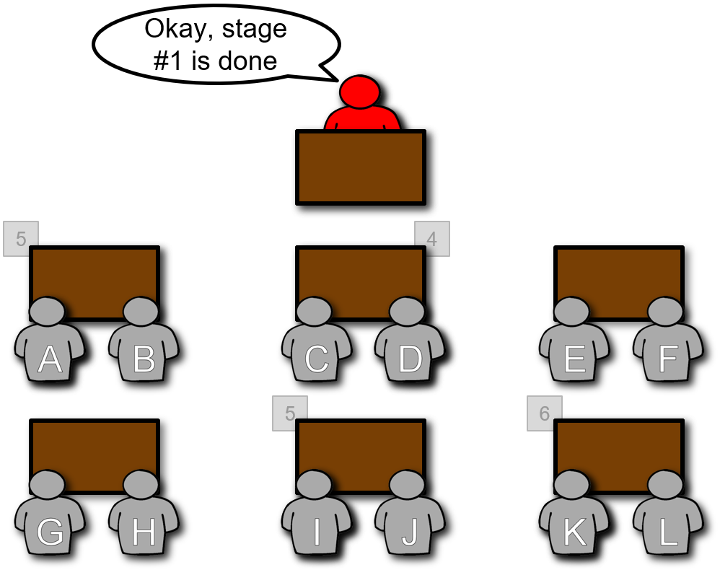
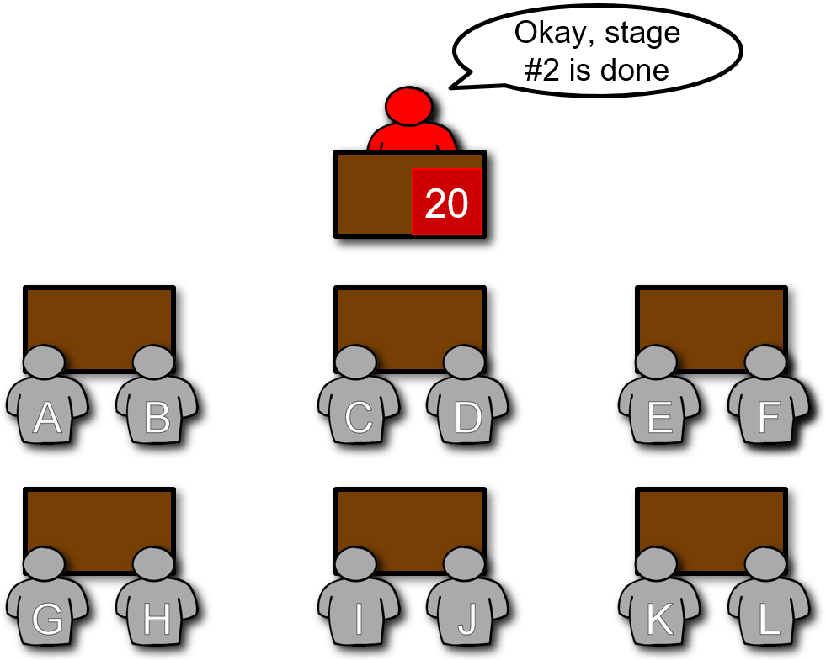
Spark Architecture Concept: Stages
Stage #1: Local Count
Stage #2: Global Count
Notes:
Let's take a look at how we might do this in parallel for several different questions about our candies.

Slide 65
The Local & Global Results
Stage #1
Local Filter
Local Count
Stage #2
Global Filter
Global Count
Notes:
Let's take a look at how we might do this in parallel for several different questions about our candies.

Slide 66
The Local & Global Results
Stage #1
Local Filter
Local Count
Local Distinct
Stage #2
Global Filter
Global Count
Global Distinct
Notes:
Let's take a look at how we might do this in parallel for several different questions about our candies.

Slide 67
The Local & Global Results
Stage #1
Local Filter
Local Count
Local Distinct
Local Sort
Stage #2
Global Filter
Global Count
Global Distinct
Global Sort
Notes:
Let's take a look at how we might do this in parallel for several different questions about our candies.

Slide 68
The Local & Global Results
Stage #1
Local Filter
Local Count
Local Distinct
Local Sort
Local Aggregate
Stage #2
Global Filter
Global Count
Global Distinct
Global Sort
Global Aggregate
Notes:
Let's take a look at how we might do this in parallel for several different questions about our candies.

Slide 69
Databricks Academy
An Introduction to Spark’s Architecture
Scenario #2, Part 3: Review Questions
(Key Concept: Distributed Computing)

Slide 70
What were the jobs, stages,
and tasks in this scenario?
How would I go about counting all of the D&Bs?
The job was to count the D&Bs
Stage #1 was the local count
Stage #2 was the global count
The tasks were first to count each D&B in stage #1, and
later to aggregate & sum the individual counts in stage #2
Notes:
Let's take a look at how we might do this in parallel for several different questions about our candies.

Slide 71
Databricks Academy
An Introduction to Spark’s Architecture
Scenario #3: Distinct
(Key Concept: The Shuffle)

Slide 72
Between the Christmas, Halloween and Valentine D&Bs, how many distinct colors are there?
Notes:
Let's take a look at how we might do this in parallel for several different questions about our candies.

Slide 73
Databricks Academy
An Introduction to Spark’s Architecture
Scenario #3, Part 1: Local Distinct
(Key Concept: The Shuffle)

Slide 74
Stage #1: Local Distinct
Student A, grab & count bag #1.
Student D, grab & count bag #2.
Student I, grab & count bag #3.
Student J, grab & count bag #4.
3
4
2
1
Notes:
Let's take a look at how we might do this in parallel for several different questions about our candies.

Slide 75
Stage #1: Local Distinct
Each student is fetching their partition of D&Bs
Notes:
Let's take a look at how we might do this in parallel for several different questions about our candies.

Slide 76
Stage #1: Local Distinct
Each task is being processed…
d&b
d&b
d&b
d&b
d&b
d&b
d&b
d&b
d&b
d&b
d&b
d&b
d&b
d&b
d&b
d&b
d&b
d&b
d&b
d&b
Notes:
Let's take a look at how we might do this in parallel for several different questions about our candies.

Slide 77
Stage #1: Local Distinct
…and identifying the distinct set of colors.
Okay, stage #1 is done
Orange
Blue
Yellow
Pink
Green
White
Red
d&b
d&b
d&b
d&b
d&b
d&b
d&b
d&b
d&b
d&b
Red
Green
Orange
Red
d&b
d&b
d&b
d&b
Black
d&b
d&b
d&b
d&b
d&b
d&b
Notes:
Let's take a look at how we might do this in parallel for several different questions about our candies.

Slide 78
Databricks Academy
An Introduction to Spark’s Architecture
Scenario #3, Part 2: A Conceptual Shuffle
(Key Concept: The Shuffle)

Slide 79
The Shuffle (Conceptual)
…relocate all the records by key (aka color).
Orange
Blue
Yellow
Pink
Green
White
Red
Red
Green
Orange
Red
Black
Notes:
Let's take a look at how we might do this in parallel for several different questions about our candies.

Slide 80
Databricks Academy
An Introduction to Spark’s Architecture
Scenario #3, Part 3: Global Distinct
(Key Concept: The Shuffle)

Slide 81
Stage #2: Global Distinct
…read in each shuffle file from the remote executors…
Orange
Orange
Blue
Yellow
Pink
Green
White
Red
Red
Red
Green
Red
Green
Red
Orange
Red
Black
Yellow
Notes:
Let's take a look at how we might do this in parallel for several different questions about our candies.

Slide 82
Stage #2: Global Distinct
…reduce the duplicates to a single record per color…
Orange
Orange
Blue
Pink
White
Red
Green
Red
Green
Red
Orange
Red
Black
Yellow
Notes:
Let's take a look at how we might do this in parallel for several different questions about our candies.

Slide 83
Stage #2: Global Distinct
…just one more narrow transformation…
Pink
Orange
#FF00FF
#FF9900
White
Blue
#FFFFFF
#0000FF
Red
Green
#FF0000
#00FE00
Yellow
Black
#FEFE00
#000000
Notes:
Let's take a look at how we might do this in parallel for several different questions about our candies.

Slide 84
Stage #2: Global Distinct
…now they only need to return the results…
Okay, stage #2 is done
#FF9900
#FF00FF
#0000FF
#FFFFFF
#00FE00
#FF0000
#FEFE00
#000000
Notes:
Let's take a look at how we might do this in parallel for several different questions about our candies.

Slide 85
Spark Architecture Concept: Shuffles
Stage #1: Local Distinct
Stage #2: Global Distinct
Notes:
Let's take a look at how we might do this in parallel for several different questions about our candies.

Slide 86


