Slide 1
MapReduce Examples

Slide 2
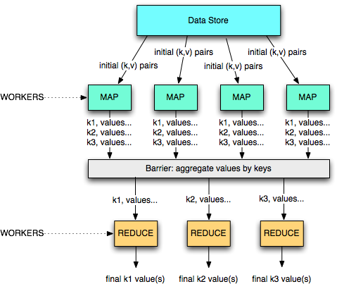
A divide and conquer approach

Slide 3
Example 1: word count
(d1, ‘A B D’)
(A, 2)
(A, 2)
(d2, ‘A B C D’)
(B, 3)
(B, 3)
(d3, ‘ B C D’)
(C, 2)
(A, 3)
(D, 3)
(B, 4)
(A, 3)
(A, 8)
(B, 3)
(B, 10)
(d4, ‘A B C’)
(A, 3)
(d5, ‘A C D’)
(B, 4)
(d6, ‘A D B B’)
(C, 2)
(d7, ‘D B A’)
(D, 3)
(C, 2)
(C, 8)
(D, 3)
(D, 7)
(d8, ‘B B C’)
(A, 3)
(C, 2)
(d9, ‘A A C C’)
(B, 3)
(D, 3)
(d10, ‘ B A D C’)
(C, 4)
(C, 4)
(D, 1)
(D, 1)
M=3
mappers
R=2 reducers

Slide 4
Example 2: URL access frequency
Input: log of web page requests (after a query)
Output: how many times each URL is accessed
  Variant: what are the top-k most-accessed URLs?
Map function
  Parse the log, output a <URL, 1> pair for each access
Reduce function
  For each key URL, a list of n “1” is associated (i.e., added)
  Emit a final pair <URL, n>

Slide 5
Example 3: Reverse Web-link graph
Get all the links pointing to some page
  This is the basis for the PageRank algorithm!
Map function
  output a <target,source> pair for each link to target URL in a page named source
Reduce function
  Concatenate the list of all source URLs associated with a given target URL and emits the pair:
  <target,list(sources)>

Slide 6
Example 4: Inverted index
Get all documents containing some particular keyword
  Used by the search mechanisms of Google, Yahoo!, etc.
  Second input for PageRank
Map function
  Parse each document and emit a set of pairs
  <word, documentID>
Reduce function
  Take all pairs for a given word
  Sort the document IDs
  Emit a final <word,list(document IDs)> pair

Slide 7
Example 4: Inverted index
To be, or not to be
To be is to do
map
map
<to,a>,<be,a>,<or,a>,
<not,a>,<to,a>,<be,a>
<to,b>,<be,b>,<is,b>,
<to,b>,<do,b>
<be,<a,a,b>>,<do,<b>>,<is,<b>>
<not,<a>>,<or,<a>>,
<to,<a,a,b,b>>
reduce
reduce
<be,<a,b>>,<do,<b>>,<is,<b>>,<not,<a>>,<or,<a>>,<to,<a,b>>

Slide 8
Hadoop

Slide 9
Hadoop
Hadoop is the most known open-source MapReduce implementation
  Lots of contributions by Yahoo!, now an Apache foundation project
  Written in Java
  Uses the HDFS file system (amongst others)
  Many extensions and optimizations over the original Google paper
A MapReduce implementation of choice when using Amazon’s cloud services
  EC2: rent computing power and temporary space
  S3: rent long term storage space

Slide 10
HDFS – Hadoop Distrib. File System
A distributed, scalable file system for M-R applications
  Distributed: Runs in a cluster
  Scalable: 10K nodes, 100M files, 10PB storage
  Closed-source optimizations
  HDFS provides a single file system view to the whole cluster
Files are split up in blocks
  Typically 128MB
  Each block is replicated on multiple DataNodes (typically 3)
  Block placement is rack-aware

Slide 11
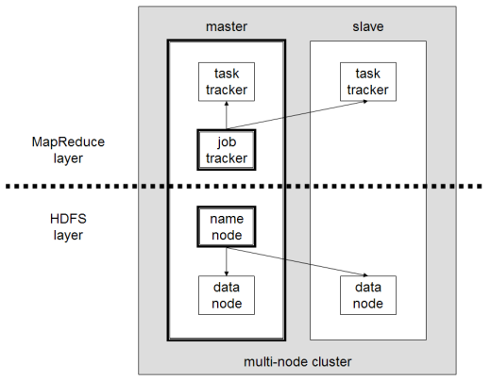
HDFS/MapReduce Architecture
Master/Slave Architecure
HDFS
  A centralized NameNode controls multiple DataNodes
  NameNode: keeps track of which DataNode stores which block
  DataNodes: “dumb” servers storing raw file chunks
MapReduce
  A centralized JobTracker controls multiple TaskTrackers
Placement
  NameNode and JobTracker run on the master
  DataNode and TaskTracker run on workers
  Data locality is exploited

Slide 12
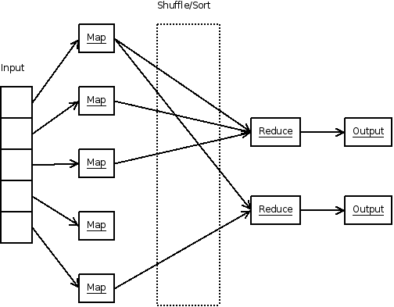
MapReduce

Slide 13


Hadoop: big picture
0. Allocate Hadoop cluster
1. Scp data to cluster
2. Move data into HDFS
EC2
3. Develop code locally
4. Submit MapReduce job
4a. Go back to Step 3
You
Your Hadoop Cluster
5. Move data out of HDFS
6. Scp data from cluster
7. Clean up!
Uh oh. Where did the data go?
courtesy of Prof. Lin, university of Maryland, CC-BY-NC-SA (USA)

Slide 14
On Amazon: EC2 and S3
Copy from S3 to HDFS
EC2
(The Cloud)
S3
(Persistent Store)
Your Hadoop Cluster
Copy from HFDS to S3

Slide 15
Hadoop Usecases

Slide 16



Use cases 1/3
NY Times
  Large Scale Image Conversions
  100 Amazon EC2 Instances, 4TB raw TIFF data
  11 Million PDF in 24 hours and 240$
Facebook
  Internal log processing
  Reporting, analytics and machine learning
  Cluster of 1110 machines, 8800 cores and 12PB raw storage
  Open source contributors (Hive)
Twitter
  Store and process tweets, logs, etc
  Open source contributors (Hadoop-lzo)

Slide 17



Use cases 2/3
Yahoo
  100.000 CPUs in 25.000 computers
  Content/Ads Optimization, Search index
  Machine learning (e.g. spam filtering)
  Open source contributors (Pig)
Microsoft
  Natural language search (through Powerset)
  400 nodes in EC2, storage in S3
  Open source contributors (!) to HBase
Amazon
  ElasticMapReduce service
  On demand elastic Hadoop clusters for the Cloud

Slide 18



Use cases 3/3
AOL
  ETL processing, statistics generation
  Advanced algorithms for behavioral analysis and targeting
LinkedIn
  Used for discovering People you May Know, and for other apps
  3x30 node cluster, 16GB RAM and 8TB storage
Baidu
  Leading Chinese language search engine
  Search log analysis, data mining
  300TB per week
  10 to 500 node clusters

Slide 19
Conclusion

