Slide 1
Massive Failures:Leaving the Ring (or Failing)
Node departures are treated as node failures
Failure of nodes might cause incorrect lookup
  N8 doesn’t know correct successor, so lookup of K19 fails
Solution: successor list
  Each node n knows r immediate successors
  After failure, n contacts first alive successor and updates successor list
  Correct successors guarantee correct lookups
m=6
2^{m}-1 0
N1
N56
N8
lookup(K19) ?
+1
N51
+2
+4
N48
+8
N14
+16
N18
K19
N42
N21
N38
N32

Slide 2
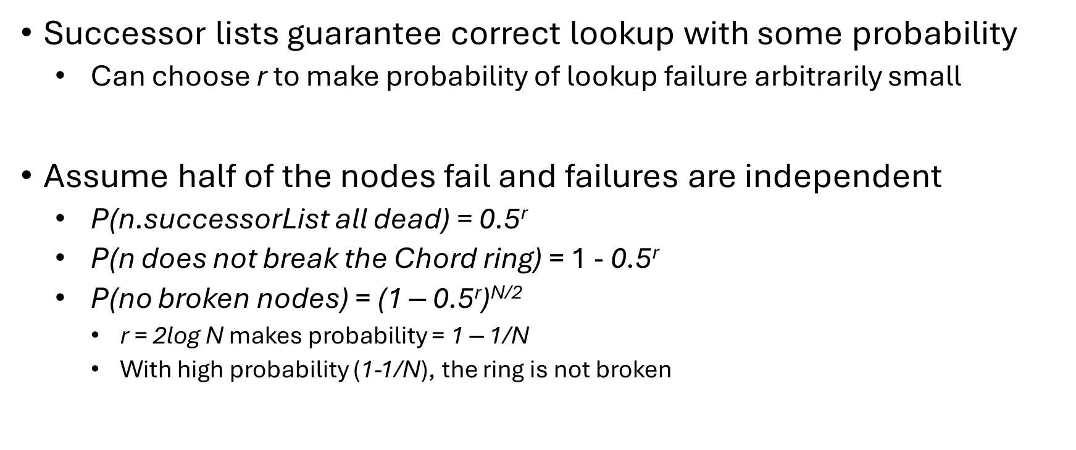
Leaving the Ring (or Failing)

