Slide 1
Software Systems for Big Data Management and Analytics
Distributed Hash Tables
Σ.ΣΙΟΥΤΑΣ, Σ.ΒΟΥΛΓΑΡΗΣ

Slide 2

P2P challenge: Locating content
Who has this paper?
I have it
I have it
Simple strategy: flood (e.g., expanding ring) until content is found
If R of N nodes have a replica, the expected search cost is at least N/R, i.e., O(N)
Need many replicas to keep overhead small
Other strategy: centralized index (Napster)
Single point of failure, high load
Goal: Decentralize the index!
Notes:
As it was clear from the last lecture, one of the main challenges in P2P systems is about locating content.
The simple strategy is to do flooding, or expanding ring search.

Slide 3
Indexed Search
Idea
Store particular content on particular nodes
alternatively: pointers to content
When a node wants this content, go to the node that is supposed to hold it (or knows where it is)
Challenges
Avoid bottlenecks:
Distribute the responsibilities “evenly” among the existing nodes
Self-organization w.r.t. nodes joining or leaving (or failing)
Give responsibilities to joining nodes
Redistribute responsibilities from leaving nodes
Fault-tolerance and robustness
Operate correctly also under failures
Notes:
In order to address this issue, we have to impose some logic, some order with respect to where content is located.
So, instead of searching pretty much at random, we wanna have indexed search.
The main idea to address this issue, is to assign particular content to particular nodes.
For every possible piece of content, a specific node is responsible to store it, or to keep a pointer to its real location.
Anyone looking for some specific content will simply have to locate the particular node responsible for it.
This would save us from flooding, and all network abuse that comes with it.
Building a decentralized index is no trivial task.
In organizing data based on indexes and retrieving it quickly, we borrow a concept from a very classical data structure.
Can anyone guess which one???

Slide 4
Idea: Hash Tables
In a classic Hash Table:
Table has N buckets
Each data item has a key
Key is hashed to find bucket in hash table
Each bucket is expected to hold 1/N of the items, so storage is balanced
In a Distributed Hash Table (DHT), nodes are the buckets
Network has N nodes
Each data item has a key
Key is hashed to find peer responsible for it
Each node is expected to hold 1/N of the items, so storage is balanced
Additional requirement: Also balance routing load!!
insert (key, data)
lookup (key) → data
hash table
0
x
1
key
hash function
pos
2
y
z
3
“Beattles”
h(key)%N
2
...
N-1
hash bucket
0
insert (key, data)
lookup (key) → data
1
key
hash function
pos
2
“Beattles”
h(key)%N
2
...
N-1
node
Notes:
Let me first remind you how a hash table functions.
Each data item is associated with a key. That key could be a string, a number, the contents

Slide 5
DHTs in Context
User Application
store_file
load_file
CFS
File System
Retrieve and store files
Map files to blocks
store_block
load_block
Reliable Block Storage
Storage
Replication
Caching
DHash
lookup
Chord
DHT
Lookup
Routing
send
receive
TCP/IP
Transport
Communication

Slide 6
CHORD (MIT)
Notes:
Ok, let’s now get a bit more technical,
and talk about notions and issues that are fundamental to P2P systems.

Slide 7
Chord (MIT)
Circular m-bit ID space for both keys and node IDs
Node ID = SHA-1(IP address) mod 2^{m}
Key ID = SHA-1(key) mod 2^{m}
Each key is mapped to its successor node
Node whose ID is equal to or follows the key ID
Key distribution
Each node responsible for O(K/N) keys
O(K/N) keys move when a node joins or leaves
m=6
2^{m}-1 0
N1
N56
N8
K54
K10
N51
N48
N14
N42
N21
N38
K24
K38
N32
K30

Slide 8
Basic Chord: State and Lookup
m=6
Each node knows only two other nodes on the ring:
Successor
Predecessor (for ring management)
Lookup is achieved by forwarding requests around the ring through successor pointers
Requires O(N) hops
2^{m}-1 0
N1
N56
N8
K54
lookup(K54)
N51
N48
N14
N42
N21
N38
N32

Slide 9
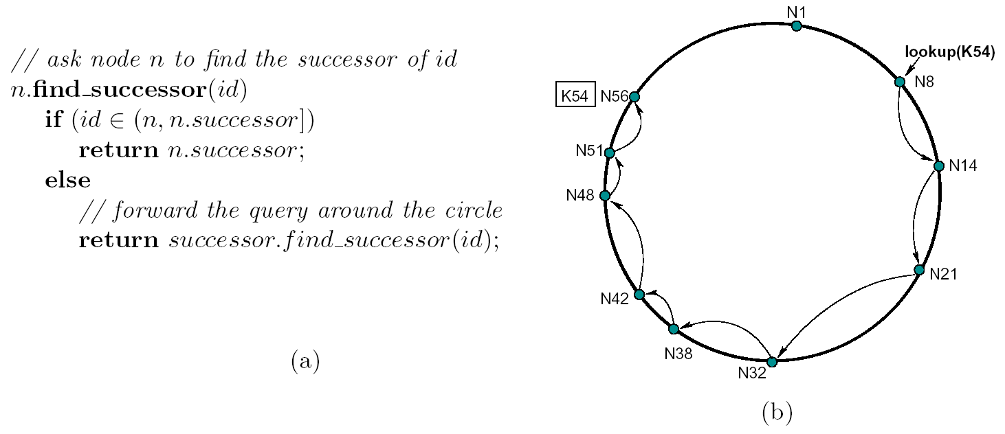
Basic Chord: State and Lookup
Notes:
As you probably suspect, locating the target node with linear complexity is not what we would wish.

Slide 10
Complete Chord
Finger table
N8+1
N14
N8+2
N14
Each node knows these two nodes:
Successor
Predecessor (for ring management)
But also: Each node has m fingers
n.finger(i) points to node on or after 2^{i} steps ahead
n.finger(0) == n.successor
O(log N) state per node
Lookup is achieved by following longest preceding fingers, then the successor
O(log N) hops
m=6
N8+4
N14
2^{m}-1 0
N8+8
N21
N1
N8+16
N32
N8+32
N42
N56
lookup(K54)
N8
K54
+1
N51
+2
+4
N48
+8
N14
+16
+32
N42
N21
N38
N32

Slide 11
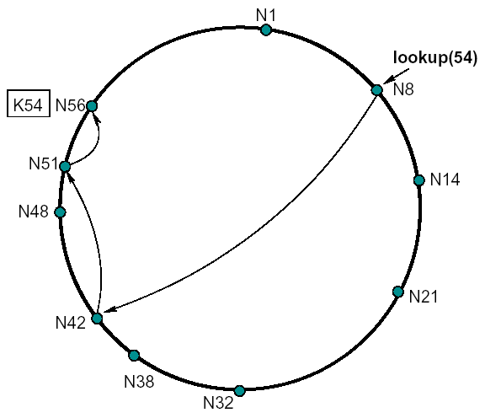
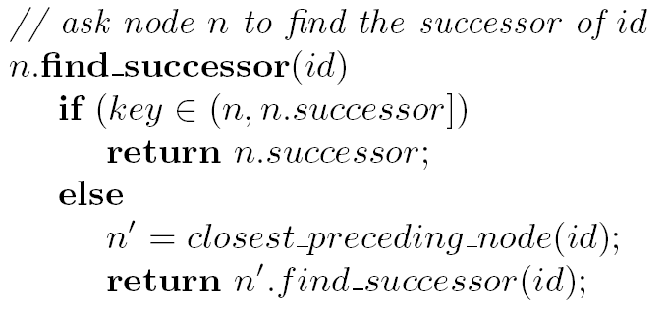
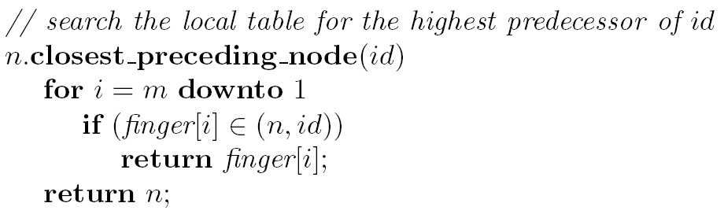
Complete Chord
Finger table
N8+1
N14
N8+2
N14
N8+4
N14
N8+8
N21
N8+16
N32
N8+32
N42

Slide 12
Chord Ring Management
For correctness, Chord needs to maintain the following invariants
Successors are correctly maintained
For every key k, succ(k) is responsible for k
Fingers are for efficiency, not necessarily correctness!
One can always default to successor-based lookup
Finger table can be updated lazily

Slide 13
Joining the Ring
Three step process:
Outgoing links
Initialize predecessor and all fingers of new node
Incoming links
Update predecessors and fingers of existing nodes
Transfer some keys to the new node

Slide 14
Joining the Ring — Step 1
Initialize the new node finger table
Locate any node n in the ring
Ask n to lookup the peers at j+2⁰, j+2¹, j+2²…
Use results to populate finger table of j

Slide 15
Joining the Ring — Step 2
N8+1
N14
Updating fingers of existing nodes
New node j calls update function on existing nodes that must point to j
Nodes in the ranges [j-2^{i} , pred(j)-2^{i}+1]
O(log N) nodes need to be updated
N8+2
N14
m=6
N8+4
N14
2^{m}-1 0
N8+8
N21
N1
N8+16
N32
N28
5
N8+32
N42
N56
N8
N51
12
N48
N14
+16
-16
N42
-16
N21
N38
N28
N32

Slide 16
Joining the Ring — Step 3
Transfer key responsibility
Connect to successor
Copy keys from successor to new node
Update successor pointer and remove keys
N21
N21
N21
N21
N32
N32
N28
N32
N28
N32
N28
K24
K24
K24
K24
K30
K24
K30
K30
K30

Slide 17
Leaving the Ring (or Failing)
Node departures are treated as node failures
Failure of nodes might cause incorrect lookup
N8 doesn’t know correct successor, so lookup of K19 fails
Solution: successor list
Each node n knows r immediate successors
After failure, n contacts first alive successor and updates successor list
Correct successors guarantee correct lookups
m=6
2^{m}-1 0
N1
N56
N8
lookup(K19) ?
+1
N51
+2
+4
N48
+8
N14
+16
N18
K19
N42
N21
N38
N32

Slide 18
Leaving the Ring (or Failing)
Successor lists guarantee correct lookup with some probability
Can choose r to make probability of lookup failure arbitrarily small
Assume half of the nodes fail and failures are independent
P(n.successorList all dead) = 0.5^{r}
P(n does not break the Chord ring) = 1 - 0.5^{r}
P(no broken nodes) = (1 – 0.5^{r})^{N/2}
r = 2log N makes probability = 1 – 1/N
With high probability (1-1/N), the ring is not broken
Notes:
And this completes the mechanism Chord uses to build and maintain its ring.
- Can anyone see any problem?
- Well, the process is quite complex!!
So far we have implicitly treated a node join as an atomic action.
When the joins and leaves of many nodes overlap, we may get inconsistencies in the links.

Slide 19
Stabilization
Case 1: finger tables are reasonably fresh
Case 2: successor pointers are correct, not fingers
Case 3: successor pointers are inaccurate or key migration is incomplete — MUST BE AVOIDED!
Stabilization algorithm periodically verifies and refreshes node pointers (including fingers)
Eventually stabilizes the system when no node joins or fails
N21
N21
n
N28
N32
N28
N32
n
x = n.succ.pred if x in (n, n.succ) n.succ = x
x = n.pred.succ if x in (n.pred, n) n.pred = x

Slide 20
Chord and Network Topology
Nodes numerically-close
are not topologically-close
(1M nodes = 10+ hops)

Slide 21
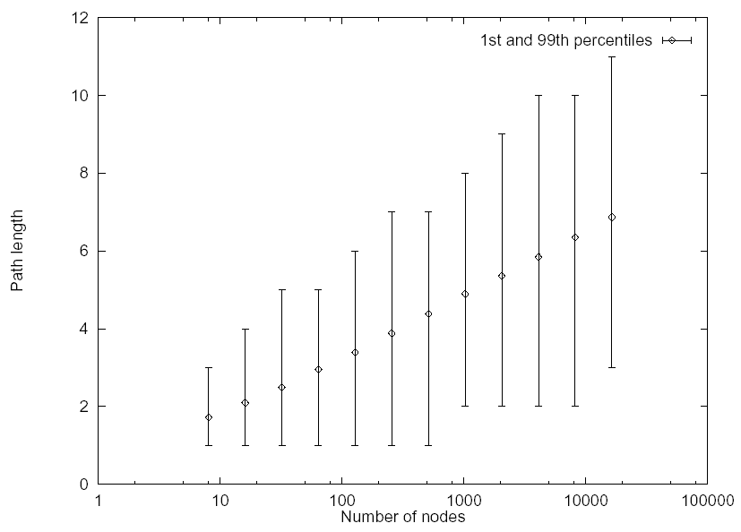
Cost of Lookup
Cost is O(log N), constant is 0.5

Slide 22
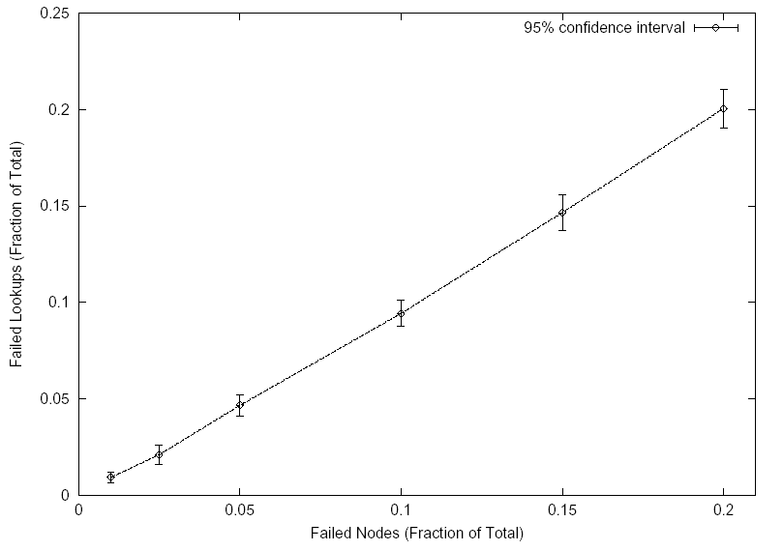
Robustness
Simulation results: static scenario
Failed lookup means original node with key failed (no replicas)
Result implies good balance of keys among nodes!

Slide 23
Chord Discussion
Search types
Only equality
Scalability
Diameter (search and update) in O(log N) w.h.p.
Degree in O(log N)
Construction: O(log² N) if a new node joins
Robustness
Replication might be used by storing replicas at successor nodes

