Slide 1
Software Systems for Big Data Management and Analytics
Εισαγωγή
Σ.ΣΙΟΥΤΑΣ, Σ. ΒΟΥΛΓΑΡΗΣ

Slide 2


What is a Distributed System?
A Distributed System is a software system
in which components located on networked computers
communicate and coordinate their actions
by passing messages.
(Wikipedia)
You know you have a Distributed System when
the crash of a computer you have never heard of
stops you from getting any work done! ☺
(Leslie Lamport)

Slide 3
Brainteaser!
What if you had to build a system for…
  Storing Facebook’s 250.000.000.000 photos ? (TheVerge.com – Sep 2013)
  Adding 350.000.000 photos per day? (BusinessInsider.com – Sep 2013)
  Each of them in 4 different sizes …
How would you…
  Manage Amazon’s infrastructure?
  Compute Google’s scores (page ranks), answering queries , calculating statistics on the Web graph, etc.?
Hint keywords:
  decentralization
  large-scale systems
  massively distributed approaches
Notes:
Let me start with an observation that
distributed applications have grown larger
from large to massive scale!
Let me start with the observation that in the recent years we have experienced a noticeable shift
from the paradigm of passively networked end-computers,
to that of end-computers being active components in distributed applications,
actively participating, interacting, and contributing to those systems.
Distributed applications have grown larger, from large to massive scale.
Certainly, the most famous ---or infamous--- example are file-sharing systems
---controversial with respect to legal issues---
with up to millions of nodes interacting,
but they are not the only example,
neither are they necessarily used for illegal activity.
The increasing number of connected devices, and the proliferation of networks,
provide no indication of a slowdown in this tendency.
Quite on the contrary, we anticipate new, unimaginable applications to come up.
The focus of my research, so far, has been to design fundamental protocols to
build, manage, and handle massive scale decentralized systems.

Slide 4
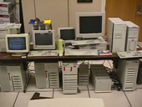
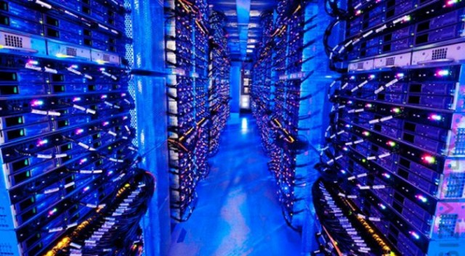
Large-scale companies’ clusters
How many servers at Google?
  shhhhh … it’s a secret!
Estimation runs in the range:
  2006: 200K – 500K
    $2M electricity bill per month
  2012: 1.5M
  2013: 2.3M
  2015: ?!?!?!
Home-made large-scale distributed systems
  no centralization
  tailored to the company needs
Similar approaches at Facebook, Yahoo!, Amazon, Microsoft, etc.
Google’s first cluster at Stanford
Modern Data Center

Slide 5
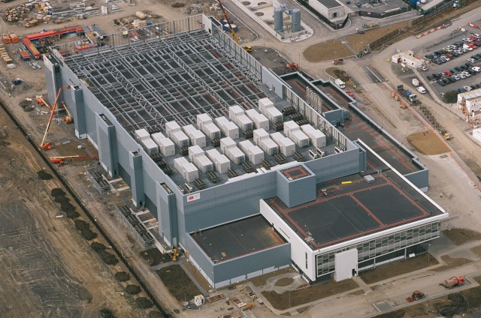
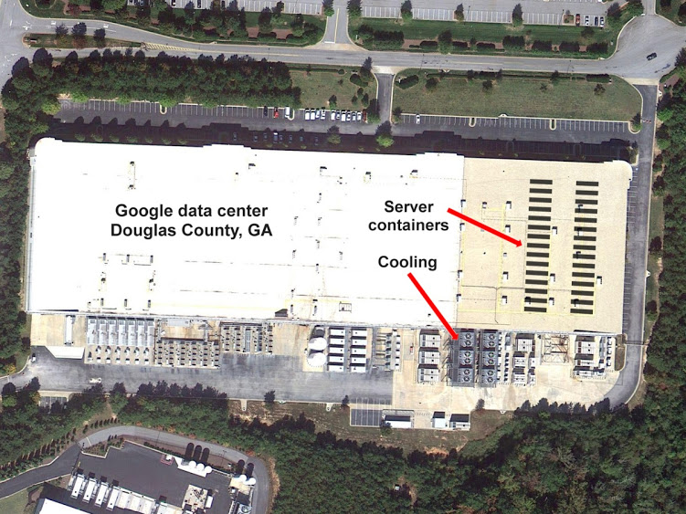
Large-scale companies’ clusters
SCAAAALE!!!
What are the technologies behind systems of such scale??
Microsoft Data Center (Dublin, Ireland)
Google Data Center (Georgia, USA)

Slide 6
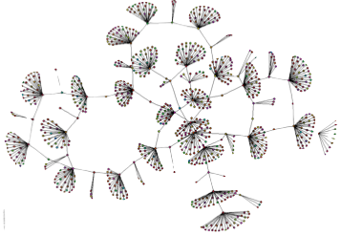
Peer-to-peer networks
Run on normal users’ machines
  Low resources
  Low trust
  Low reliability
  High heterogeneity
  Not dedicated
Typical applications
  file sharing (BitTorrent, eMule, etc.)
  IP telephony (Skype: 40M users!)
  Network storage (OceanStore, PAST)
  Anonymizers (TOR)
a view of the Gnutella
file sharing network

Slide 7
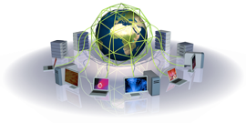
Grid computing
Analogy to the electrical power grid
  One plugs, gets power, pays for what one gets
    but does not need to know where the power is coming from
  One can sell back some power to the network
Companies/labs aggregate their computing resources (data/computing clusters)
  Usage on demand
Used for computationally intensive tasks
  CERN collider experiments analysis
  simulations: economics, weather forecast,
  biology, physics, etc.

Slide 8
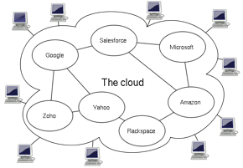
Cloud computing
Amazon, OVH, GreenQlouds, RackSpace, etc., provide many nodes for rent!
  Rent servers and storage space / services
  No need to know where the code is running
  Payment based on usage
  Often based on virtualization (shared servers)
Applications running on the
cloud are not necessarily large-
scale distributed applications
But the cloud services typically are
  E.g., Amazon S3 (Simple Storage Service)

Slide 9
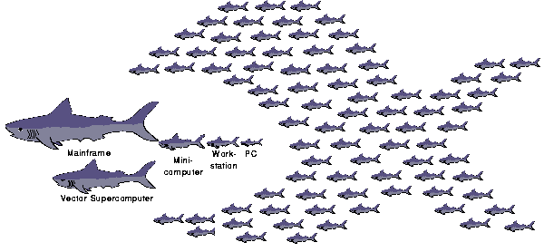
Power in Unity!
Using many small nodes can be more effective than relying on expensive high-end servers

Slide 10
Massive Distributed Applications
Challenges
  Increased scale
  Geographic spread
  Dynamic membership
    Node churn
    Failures
    Prob [ at least one machine fails at a given time ] ≈ 100%
  Multiple administrative domains
Impact on system design
  Centralized control → infeasible!
  Administration costs → increase!
  Imposing explicit control → more complex!
  Need to consider failures as the norm
Notes:
So, the moral story of this introduction is that
→ distributed applications have grown larger, from large to massive scale!
Massive scale, in combination with a very dynamic environment,
with nodes and links failing, nodes joining and leaving at will,
being heterogeneous, etc.,
renders traditional centralized control infeasible, or at least very hard to implement.
Building a sophisticated but deterministic protocol, such as a hierarchical structure to alleviate scale issues,
has tremendous administration costs.
Generally, trying to impose explicit control on these systems, and tracking them by traditional methods becomes increasingly complex.
It is generally becoming too complex to design deterministic protocols for this class of systems.
We basically need to build systems in such a way that they do not depend on the availability of all nodes.

Slide 11
Large-scale Decentralized Systems
Self-configurable
  low administration
  High-level commands, i.e. “join cluster A”, “join application B”
  “Plug-and-play”
Self-organized
  Highly adaptable to changes
  Flexible in dynamic environments
  Robust, Resilient to massive failures
  Load balancing
  High Availability
  Self-healing
High scalability, and elasticity
SIMPLICITY !
Notes:
Well, then, what should decentralized systems be like?
First, they should be self-configurable.
That is, configuration and administration of such systems should be simple!
It should be done by means of high-level commands, such as join this cluster or that application.
They should be plug-and-play, in a decentralized sense.
Then, they should be self-organized.
They should adapt fast and reliably to changes.
In fact, they should be flexible enough to withstand continuous changes, in very dynamic environments.
In the presence of large-scale failures (network partitioning) they should be robust, and they should self-heal.
Of course, they should be highly scalable, and even more, demonstrate elastic capacity.
That means that the capacity of a system should increase by its size.
This way, the larger it gets (and therefore the higher the demand), the more capacity it has to serve that demand.
Such networks can spontaneously adapt to unexpected increase or decrease in demand.
And last , but not least, what we need is simplicity!!
Things are gonna get messy anyway!
is based on the premise that the capacity of a network is as high as the sum of the resources of its nodes: the more peers in the network, the higher its aggregate bandwidth, and the better it can scale and serve new peers. Such networks can thus spontaneously adapt to the demand by taking advantage of available resources.

Slide 12
Course Layout
P2P
  Structured / Unstructured P2P Overlays
  DHTs
  Epidemic Protocols
  Aggregation
  Slicing
  …
Cloud Computing
  MapReduce / Hadoop
  Distributed File Systems (Google File System, Hbase)
  BigTable
  Stream Processing
  Graph Databases
  …
Notes:
So, the moral story of this introduction is that
→ distributed applications have grown larger, from large to massive scale!
Massive scale, in combination with a very dynamic environment,
with nodes and links failing, nodes joining and leaving at will,
being heterogeneous, etc.,
renders traditional centralized control infeasible, or at least very hard to implement.
Building a sophisticated but deterministic protocol, such as a hierarchical structure to alleviate scale issues,
has tremendous administration costs.
Generally, trying to impose explicit control on these systems, and tracking them by traditional methods becomes increasingly complex.
It is generally becoming too complex to design deterministic protocols for this class of systems.
We basically need to build systems in such a way that they do not depend on the availability of all nodes.

Slide 13
Peer-to-Peer
Systems

Slide 14





Peer-to-Peer Systems
Notes:
This course, as you already know apparently, is about P2P and Self-Organizing Networks.
I’ll get to the Self-Organizing part later,
but as far as the P2P term is concerned, I’m sure all of you have heard of it,
and most likely all of you have used P2P systems to download music and movies.
In fact, the term P2P has become very widely known in the last few years,
and known not just to the computer-related crowd but also to the general population,
with frequent articles on TV or general topic newspapers.
This wide reputation of P2P systems is
mainly due to massively popular file-sharing applications,
and more recently for Voice over IP telephony.
P2P has become almost synonymous to applications like BitTorrent, eMule, Gnutella, and (in the earlier days) Napster.
However, P2P is not only that!!
Contrary to common belief, file-sharing is only one aspect of P2P systems.
The goal of this course will be to show you and take a detailed view at various other, very different, and very technical aspects of P2P systems.
Only in today’s lecture we’ll talk a bit about some of these applications.

Slide 15
Historical perspective
1970s - 1980s: Birth of the Internet
  Limited reach of the Internet
  Email, FTP, Telnet
  Share documents and resources between research centers
  Central committee to organize and maintain it
1990s
  Tremendous expansion & diffusion
  Killer apps: WWW and e-Commerce
  Client/Server model
Late 1990s - today
  P2P: An alternative to Client/Server
  Passive clients → active peers
  End-computers play a role, contribute, interact
Notes:
But let’s take a view on the historic flow of events, and how it all started…
In the late 60’s the Internet was born. More precisely, it was called ARPANET at that time, the predecessor of the current Internet.
For a couple of decades, till the end of the 80’s, the Internet has been a tool exclusively for research and military use.
Not known to the public.
In the early ’90s, the Internet started becoming known to the wider public, leading to a global-scale revolution in communications.
The wider population rushes to join the internet.
The killer apps that define the Internet of the ’90s are by far the World Wide Web, and based on that e-Commerce was born too.
In such applications, user’s home computers behave as clients, accessing some Web or e-Commerce service offered by some central authority.
Since the late ’90s, an alternative to the Client/Server model came out, and this is the P2P model.
In P2P, users’ computers are transformed from passive clients to active peers,
playing a role, contributing, interacting directly with other peers.

Slide 16
How it all started
June 1999
  Napster is born / 1st generation of P2P
  Users not only download content but also provide content to others
  Users establish a virtual network, entirely independent of physical network and administrative authorities or restrictions
  Basis: UDP and TCP connections between the peers
December 1999: RIAA files a lawsuit against Napster Inc.
  TARGET: the central lookup server of Napster
  ACHIEVEMENT: Napster popularity skyrocketed!
February 2001: Peak operation
  26.4M users
  2.79 billion files / month
July 2001: Judge orders Napster to pull the plug!
  Napster network breaks down instantly
Notes:
So, let’s take a closer look at how it all started…
Disruption of the Internet community
In June 1999, Napster is born…
…a system that was soon proven to be the 1st massively popular P2P system ever!
Users do not only download content, but also offer content to others, by direct communication among themselves.
People were happily (yet illegally) copying music, but this was too good to be true…
Just half year later the Recording Industry Association of America takes Napster to the court for copyright violation.
Their TARGET was Napster’s central server.
What they ACHIEVED was to help Napster’s popularity skyrocket!!
Indeed, in February 2001, Napster reached peak operation, with 26M users and almost 3bn files/month!!
In July 2001 the judge orders Napster to pull the plug.
The Napster network collapses instantly.

Slide 17

How it continued
March 2000
  Nullsoft releases Gnutella as an open source project
  Fully decentralized
  Additionally to offering files, the peers also take over routing tasks
  No central lookup server → no single point to attack
Later in 2000: Superpeer concept
  Hierarchical routing layer
  Significantly improves scalability and efficiency
  FastTrack (Morpheus, KaZaA)
  eDonkey2000
2001 - 2002
  KaZaA loses ground (many defected files due to weak hash keys to identify files)
  eDonkey and Gnutella regain popularity
  eDonkey becomes most popular file-sharing network: 2-3M online users
  Gnutella v0.6 adopts superpeer architecture (ultrapeers in Gnutella terminology)
Notes:
In the meantime, and while legal problems with Napster were foreseeable in the horizon,
A number of other P2P file-sharing systems came out.
In March 2000, Gnutella was released by Nullsoft, as an open source project.
In Gnutella, there is not central server.
Nodes are linked in a P2P network, and route queries for files among themselves, in a real P2P, decentralized fashion.
The motivation for designing such a system is clear:
Since there was no central server, RIAA and MPAA had no target to attack!
To stop its operation, they would have to attack all participating nodes, something far from trivial, as it amounted to some million users world-wide.
However, Gnutella was not so efficient.
Later on in 2000, some other protocols were designed to improve on efficiency.
The super-peer concept was introduced, in which some nodes act as indexers, in a way similar to the Napster server, serving a portion of the user population.
This makes searching far more efficient than pure P2P search, while there is still no single point of failure or target.
The most famous systems that adopted this technique were FastTrack (KaZaA) and the eDonkey2000 network (eMule).
In the following couple of years, KaZaA lost ground due to …
…
Variety of similar fully decentralized P2P-protocols followed soon:
Audiogalaxy
FastTrack/KaZaA
iMesh
Freenet

Slide 18
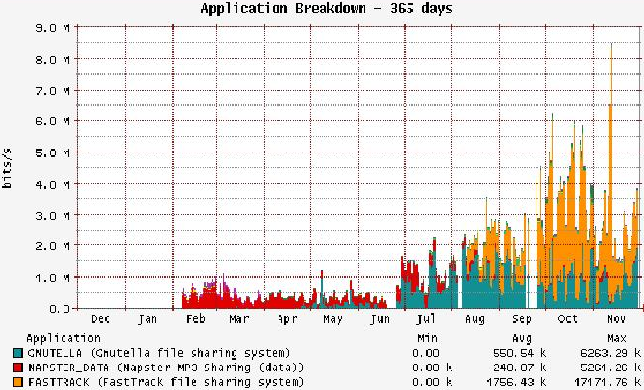
P2P Traffic in 2001
Notes:
This change in the use of the aforementioned systems can be clearly seen in this graph,
depicting the distribution of P2P traffic in 2001.

Slide 19

How it took off!
2002
  First version of BitTorrent released
2003
  BitTorrent causes majority of the observed traffic
  Downloads significantly faster, due to mechanism against free-riding
Middle of 2003
  New P2P concepts develop
  Skype is born: a P2P Voice-over-IP application
In the meantime: More P2P domains explored!
  P2P Routing
  Network Storage
  P2P Multicasting
  Data aggregation
  P2P Streaming
  etc.
Today:
  Major efforts are made to increase the reliability of P2P systems, to use P2P also in mobile networks, etc.
Notes:
Year 2001: Third Generation of P2P initiated
First research started on the third generation of P2P, so called structured P2P networks
Basic characteristics: Usage of a proactive routing algorithm based on Distributed Hash tables (DHTs)

Slide 20
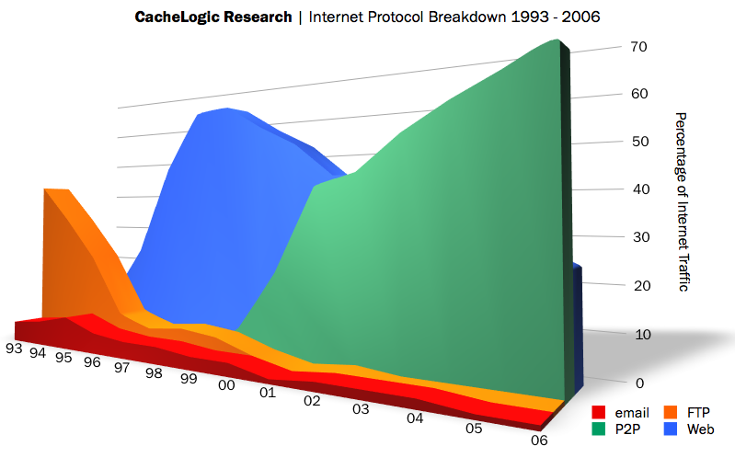
Internet Traffic
Web
P2P
FTP
email
Notes:
And to conclude this short historical introduction on how P2P systems evolved,
I’ll show you this graph that gives you an idea of the magnitude of the effect P2P has had on Internet usage.
It illustrates the percentage of traffic used by Internet application types.
Early enough, till around 93-94, FTP and email are taking up most of the internet traffic.
Later on, in the mid-’90s, as you expect the WWW is almost monopolizing the bandwidth used.
From around 2000 that P2P apps enter the arena, we notice an enormous use of bandwidth by them, which soon becomes orders of magnitude higher than more “traditional” apps.
Note that email, FTP, or even Web traffic seems to be decreasing.
Apparently it has been constantly increasing in absolute numbers,
but P2P traffic increased so much more, that in comparison, traditional applications seem to be using negligible bandwidth nowadays.

Slide 21
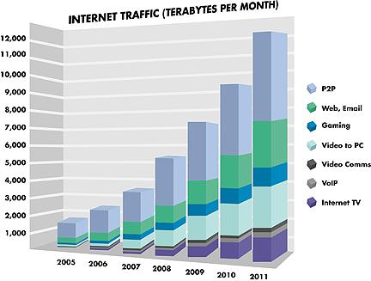
Internet Traffic
Notes:
And to conclude this short historical introduction on how P2P systems evolved,
I’ll show you this graph that gives you an idea of the magnitude of the effect P2P has had on Internet usage.
It illustrates the percentage of traffic used by Internet application types.
Early enough, till around 93-94, FTP and email are taking up most of the internet traffic.
Later on, in the mid-’90s, as you expect the WWW is almost monopolizing the bandwidth used.
From around 2000 that P2P apps enter the arena, we notice an enormous use of bandwidth by them, which soon becomes orders of magnitude higher than more “traditional” apps.
Note that email, FTP, or even Web traffic seems to be decreasing.
Apparently it has been constantly increasing in absolute numbers,
but P2P traffic increased so much more, that in comparison, traditional applications seem to be using negligible bandwidth nowadays.

Slide 22
Peer-to-Peer
Definition

Slide 23
Is application XYZ P2P?
Do nodes contribute to the system?
Do nodes collectively carry out a service?
Are variable connectivity and temporary network addresses the norm?
Do nodes have significant autonomy?
Can they (generally) be heterogeneous?
Who owns the hardware?
  Single-administered entity?
  Distributed among participating users?
Notes:
“Who owns the hardware” is more important than “can the nodes speak to each other”.
“Do nodes contribute” is more important than “can the nodes speak to each other”.

Slide 24
A better definition
P2P is a class of systems where:
Resources available at the edges of the Internet are utilized:
  Storage
  CPU cycles
  Bandwidth
  Content
  Human presence
Service is carried out collectively
  Nodes share both benefits and duties
Irregularities and dynamicity are treated as the norm
Notes:
We have unpredictable IP addresses because there weren't enough to go around when the web happened. It's tempting to think that when enough new IP addresses are created, though, the old "One Device/One Address" regime will be restored, and the Net will return to its pre-P2P architecture.
This won't happen, because no matter how many new IP addresses there are, P2P systems often create addresses for things that aren't machines. Freenet and MojoNation create addresses for content intentionally spread across multiple computers. AIM and ICQ create names which refer to human beings and not machines. P2P is designed to handle unpredictability, and nothing is more unpredictable than the humans who use the network. As the Net becomes more human-centered, the need for addressing schemes that tolerate and even expect temporary and unstable patterns of use will grow.
Irregularities and temporal nature of the network are treated as the norm, not as an exception.
The key characteristic that distinguishes P2P systems from other resource sharing systems is its symmetric communication model between peers, each of which acts as both a client and a server.

Slide 25
Main advantages of P2P
Inherently scalable:
  higher demand → higher contribution!
Increased (massive) aggregate capacity
Utilize otherwise wasted resources
Distribute load and administration
Designed to be fault tolerant
Inherently handle dynamic conditions
Notes:
The interesting property of this model, is that system load and system resources grow aside, and proportionally to the number of participating computers.
As a result, P2P systems tend to be extremely scalable, and can spontaneously adapt to unexpected increase or decrease in demand.

Slide 26
Peer-to-Peer
Issues
Notes:
Ok, let’s now get a bit more technical,
and talk about notions and issues that are fundamental to P2P systems.

Slide 27
Overlay Networks
Focus on the application layer
B
A
C
Overlay Network
Physical Network
Notes:
The most fundamental notion behind P2P systems is that of OVERLAYS.
Computers are connected to each other via routers,
which can (in principle) route packets between any of them.
However, in a P2P application, we only care about the communication between participants of the application.
Moreover [CLICK], we create an abstraction of the physical network, which we call the OVERLAY NETWORK.
The overlay network consists of the participant nodes, and links among them.
The links are logical links.
A link from a node A to a node B means that A can send a message to B, for instance, A knows B’s address.
The fact that a message from A to B goes in reality through some routers, is of no interest to the P2P app.
Basic idea
Treat multiple hops through IP network as one hop in an overlay network
Run routing protocol on overlay nodes
Why?
For membership management — information should be possible to flow between participants, and only them. Since no central authority maintains a list of who the members are and how to reach them, this information should be maintained by nodes themselves.
For functionality — can provide new features such as multicast, active processing, security, caching, transcoding, storing/querying, etc.
#For performance — can run more clever protocol on overlay
#For efficiency — can make core routers very simple
How to build an efficient overlay?
Probably don’t want all N² links — which links to create?
Topology: how to know what is nearby and what is efficient?
How to maintain and update links in case of changes?

Slide 28
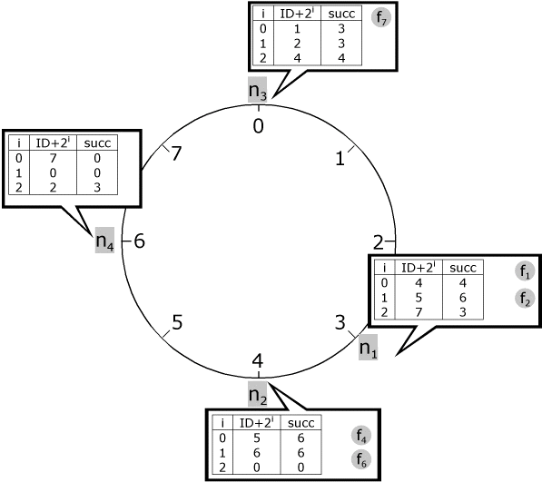
Overlay types
Unstructured P2P
Structured P2P
Centralized P2P
Pure P2P
Hybrid P2P
DHT-Based
Central entity necessary to manage the overlay
Central entity is some kind of index/group database
Example: Napster
No central entities
Any node can be removed without loss of functionality
Example: Gnutella v0.4, Freenet
Multiple & Dynamic central entities
Any node can be removed without loss of functionality
Example: Gnutella v0.6, Freenet
No central entities
Fixed links, determined by node IDs
Any node can be removed without loss of functionality
Examples: Chord, Pastry, CAN
Notes:
Based on the type of overlay employed, P2P systems can be grouped in some categories.
The main distinction is made between structured and unstructured P2P systems.
In short, in unstructured P2P, any two nodes could establish a link among themselves.
Topology evolves at random, or to reflect desired properties of linked nodes.
In structured, the topology is strictly determined by node IDs.
Unstructured are further subdivided in more categories.
Centralized…
Pure…
Hybrid…

Slide 29
Peer-to-Peer
Application Areas
Notes:
So far, I have referred almost exclusively to file-sharing applications, as these are the most widely known.
But I mentioned that P2P is not just file-sharing…
…can someone give me some ideas of P2P systems,
apart from file-sharing of course???

Slide 30
P2P Application Areas
High-level grouping of P2P apps based on shared resource
Content
File sharing
Information Mgmt
Discover
Aggregate
Filter
Collaboration
Instant Messaging
Shared whiteboard
Co-review/edit/author
Gaming
Storage
Network Storage
Caching
Replication
CPU
Internet/Intranet
Distributed Computing
Grid Computing
Bandwidth
Content Distribution
Collaborative download
Edge Services
VoIP
Notes:
A good way to classify P2P applications is based on the type of resource that is shared.
Based on that, we can have a high-level grouping of P2P apps in 5 categories.
In many cases the boundaries of such groups are not clear, and applications can belong to more than one group.
So, the resources that can be shared are:
CONTENT: sharing files, and generally information and data that peers already possess. They could discover content, aggregate content, filter content, and generally manage content that they already possess.
STORAGE: peers offer some of their storage capacity to form a network storage service, to help caching content for faster access, to help replicating content to increase data persistence, etc.
BANDWIDTH: peers offer their bandwidth capacity, to enhance the quick dissemination of information to very large sets of nodes, to facilitate access to some data, etc.
CPU: peers offer their computational capacity, to contribute in solving very computational demanding problems. This is the GRID COMPUTING model.
COLLABORATION: the point of interest is the management of distributed information, such as people’s presence, communication between people, gaming, collaborative editing of files, etc.

Slide 31
P2P Application Areas
High-level grouping of P2P apps based on shared resource
Content
File sharing
Information Mgmt
Discover
Aggregate
Filter
Collaboration
Instant Messaging
Shared whiteboard
Co-review/edit/author
Gaming
Storage
Network Storage
Caching
Replication
CPU
Internet/Intranet
Distributed Computing
Grid Computing
Bandwidth
Content Distribution
Distributed Storage
Edge Services
VoIP

Slide 32
Sharing Content
Killer deployments
Napster
Gnutella
KaZaA/FastTrack
eDonkey2000
BitTorrent
Blue
NPR
Hey
Jude
C
Large distributed storage
Very high variation of content
D
Unstable availability
No guarantees
ER
Star
Wars
Magic
Flute

Slide 33
P2P Application Areas
High-level grouping of P2P apps based on shared resource
Content
File sharing
Information Mgmt
Discover
Aggregate
Filter
Collaboration
Instant Messaging
Shared whiteboard
Co-review/edit/author
Gaming
Storage
Network Storage
Caching
Replication
CPU
Internet/Intranet
Distributed Computing
Grid Computing
Bandwidth
Content Distribution
Distributed Storage
Edge Services
VoIP

Slide 34
Network Storage
OceanStore
PAST
K54
N1
N56
Store(K54)
N8
N51
N48
N14
N42
N21
N38
N32

Slide 35
Network Storage
OceanStore
PAST
K54
N1
N56
Store(K54)
N8
N51
K54
N48
N14
N42
N21
N38
N32

Slide 36
P2P Application Areas
High-level grouping of P2P apps based on shared resource
Content
File sharing
Information Mgmt
Discover
Aggregate
Filter
Collaboration
Instant Messaging
Shared whiteboard
Co-review/edit/author
Gaming
Storage
Network Storage
Caching
Replication
CPU
Internet/Intranet
Distributed Computing
Grid Computing
Bandwidth
Content Distribution
Distributed Storage
Edge Services
VoIP

Slide 37
Contributing Bandwidth
CDNs (Content Distribution Networks)
BitTorrent
File-sharing systems

Slide 38
Contributing Bandwidth
Source server: 100 Mb/s
Clients: 10 Mb/s
1. Antivirus update
100,000 clients
File: 4 MB
2. Daily database update
1000 clients
File: 600 MB
1. 9h:52m
2. 14h:48m
1. 52s
2. 09m:54s
Client/Server
Cooperative
Notes:
90% utilization of the links
Best-case scenario (high server bandwidth, no congestion, no failure)
Intuition: very simplified (simplistic) description

Slide 39
P2P Application Areas
High-level grouping of P2P apps based on shared resource
Content
File sharing
Information Mgmt
Discover
Aggregate
Filter
Collaboration
Instant Messaging
Shared whiteboard
Co-review/edit/author
Gaming
Storage
Network Storage
Caching
Replication
CPU
Internet/Intranet
Distributed Computing
Grid Computing
Bandwidth
Content Distribution
Distributed Storage
Edge Services
VoIP

Slide 40
Sharing CPU
Increasing requirements for High Performance Computing
  i.e., in the field of bio-informatics, logistics or the financial sector
Available computing power of endpoints often unused
Use P2P to bundle processor cycles:
  Forming a cluster of independent, networked computers that are combined into a single logical computer
  Achieve computing power which even the most expensive super-computers can scarcely provide
  “Grid Computing”

Slide 41
P2P Application Areas
High-level grouping of P2P apps based on shared resource
Content
File sharing
Information Mgmt
Discover
Aggregate
Filter
Collaboration
Instant Messaging
Shared whiteboard
Co-review/edit/author
Gaming
Storage
Network Storage
Caching
Replication
CPU
Internet/Intranet
Distributed Computing
Grid Computing
Bandwidth
Content Distribution
Distributed Storage
Edge Services
VoIP

Slide 42
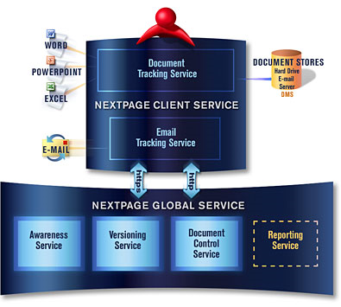
Document Collaboration
Usually centrally organized
But
  In many cases, documents distributed across desktop PCs
  no central repository having any knowledge of their existence
Solution
  P2P networks which create a connected
  repository from the local data
  on the individual peers.
  Indexing and categorization of data by
  each peer on the basis of individually
  selected criteria.
  Self organized aggregation of information
  from areas of knowledge.
http://www.nextpage.com/

