Slide 1
Body Parts on a Chip
Antonis Sakellarios

Slide 2
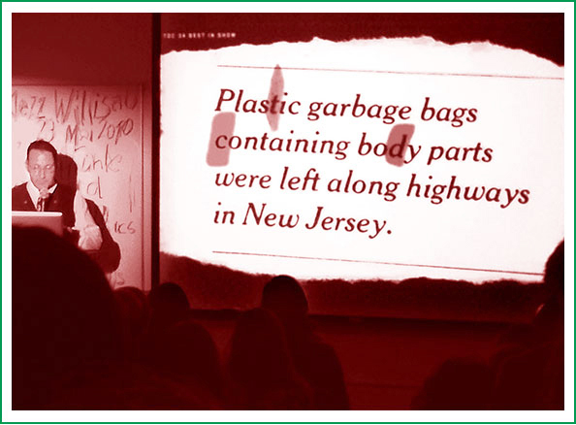
BODY PARTS??

Slide 3
The new “In” thing
VARIETY OF CHIPS
C H I P S
  Everything available as chips, in chips or on chips…..!
  Fish n Chips…..! Now old stuff…! (Still tasty)
  Lab on a Chip over ten years old
  DNA chips (micro arrays) now routine..
  And now Organs on Chips….!

Slide 4
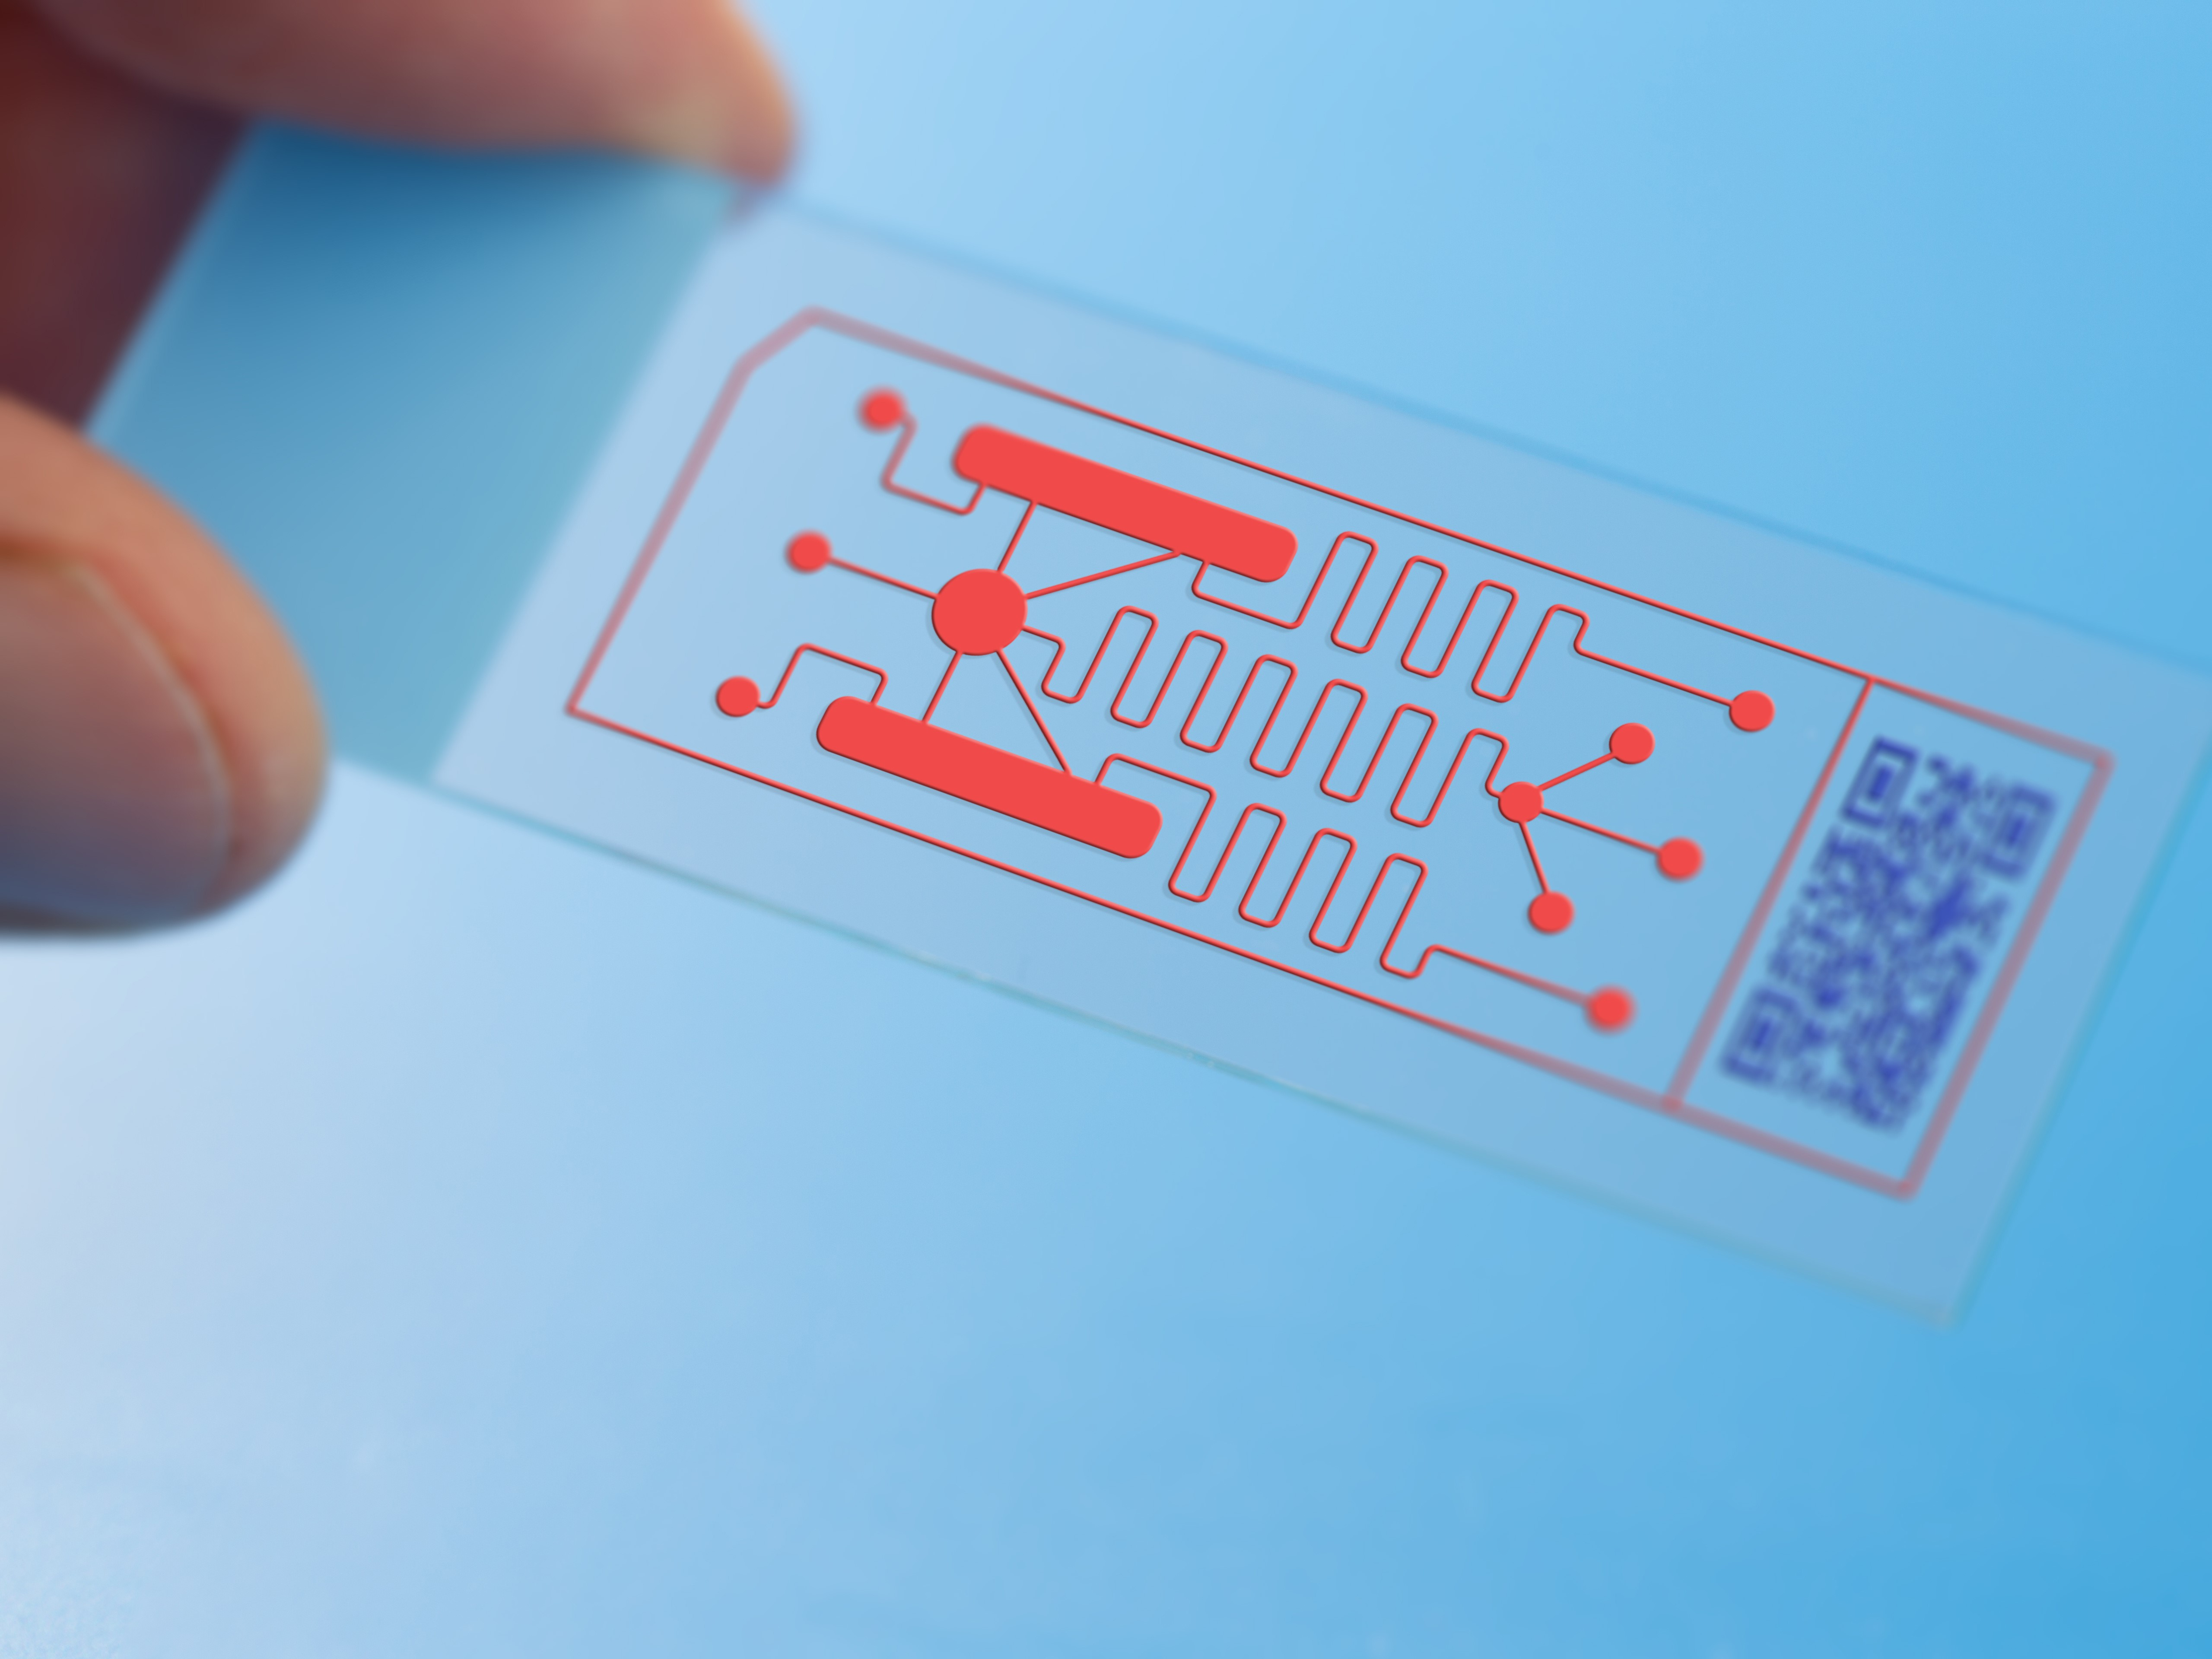
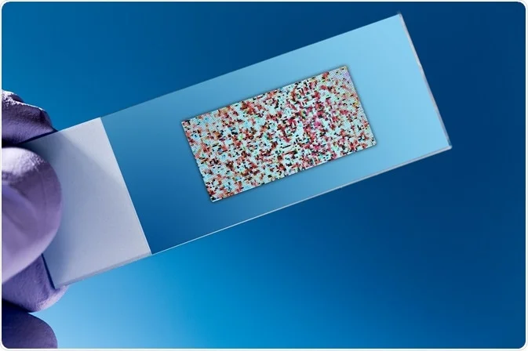
VARIETY OF CHIPS

Slide 5
Physiology redefined
WHY CHIPS?
The zenith of applied physiology is:
  The ability to grow cells outside the body
    Cell & Tissue cultures
    Suffers from nutrient requirements, infections, etc.
  Develop a controlled sterile physiological micro-environment to maintain cells, tissues and organs
    Microfluidic chambers – 3D culture microenvironments

Slide 6
Additional benefits of chips
WHY CHIPS?
Once fully successful, the new technology will do away with:
  Animal testing
    Drug development
    Toxicity assays
It will also allow in-depth understanding of the response of cells, tissues, organs and system to various environmental stimuli

Slide 7
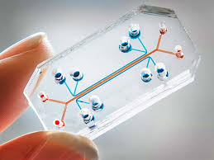
WHAT CHIP?

Slide 8
What Is an Organ-on-a-Chip?
An Organ-on-a-Chip (OoC) is a microengineered system that mimics the structure and function of human organs using living cells cultured within microfluidic devices.
Size: A few centimeters long, transparent, polymer-based (often PDMS).
Core Components:
  Microfluidic channels
  Cell chambers (with organ-specific cells)
  Porous membranes
  Sensors or actuators

Slide 9
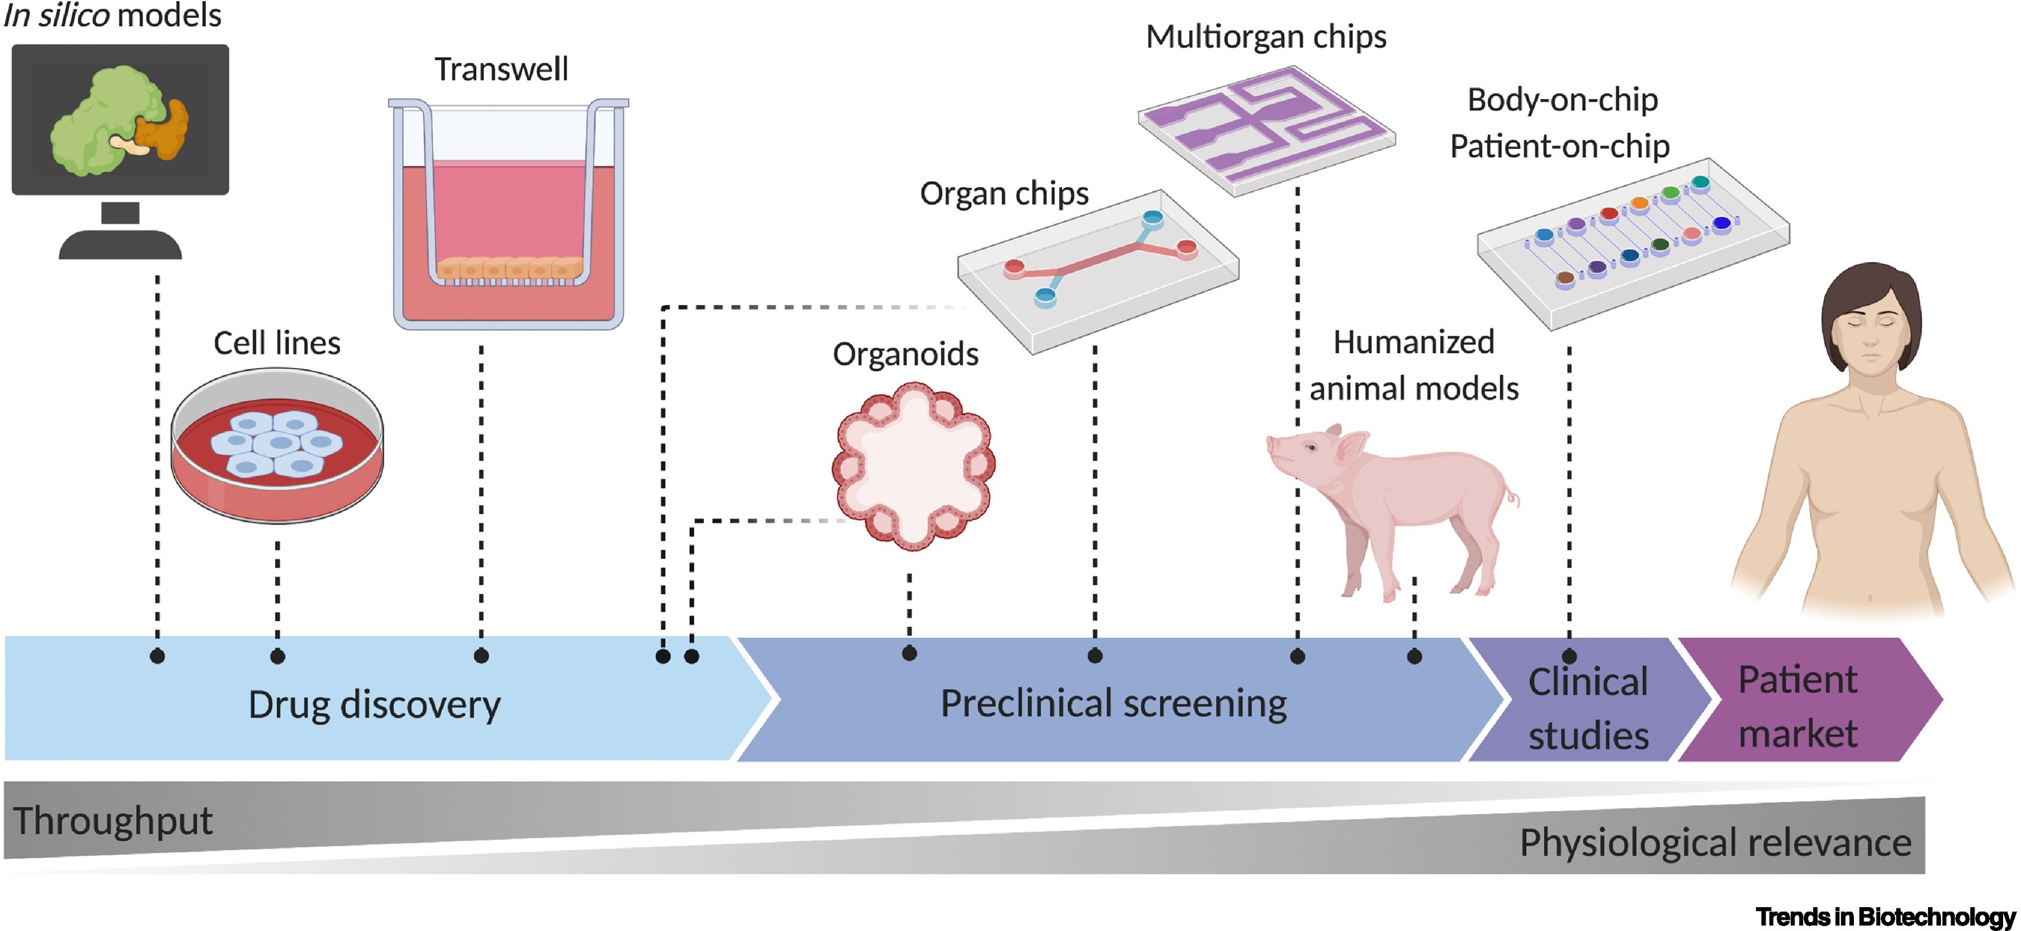
When and why?

Slide 10
How It Works?
Microfluidics simulate blood flow, air movement, or interstitial fluid.
Mechanical forces (like breathing motion or peristalsis) are recreated.
Multiple cell types (e.g., endothelial + epithelial) can be co-cultured.
Sensors allow real-time monitoring of pH, oxygen, metabolites, etc

Slide 11
Applications
Application Area | Purpose
Drug development | Pharmacokinetics / Pharmacodynamics (PK/PD)
Toxicology | Organ-specific toxicity screening
Disease modeling | Inflammation, cancer, viral infections
Personalized medicine | Using patient-derived iPSCs or biopsies
Multi-organ models | Body-on-a-chip for systemic effects

Slide 12
Examples of Organs-on-Chips
Lung-on-a-Chip: Simulates breathing; air and blood flow across a membrane.
Heart-on-a-Chip: Measures cardiomyocyte contractions and electrical signals.
Liver-on-a-Chip: For drug metabolism and hepatotoxicity.
Gut-on-a-Chip: Replicates microbiome, peristalsis, nutrient absorption.
Brain-on-a-Chip: Models blood-brain barrier and neuron-glia interactions.

Slide 13
How to Build or Use One (Basic Steps)
Design the microfluidic layout (CAD-based).
Fabricate using soft lithography (PDMS casting).
Sterilize and seed organ-specific cells.
Connect perfusion system (pumps, reservoirs).
Monitor outputs (optical, electrical, biochemical).

Slide 14
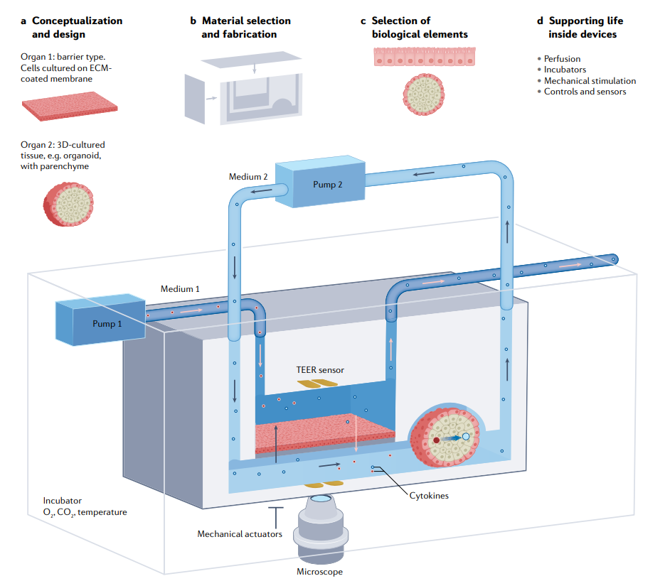
Experimental set-up for a generic two-organ system with supporting peripheral equipment

Slide 15
Extended Process to Build an Organ-on-a-Chip
I. Chip Design & Microfabrication
1. Define Biological Functionality
What organ do you want to mimic?
What physiological features must be recreated? (e.g., flow, stretch, barriers)
What cell types are needed?
2. Design Microfluidic Layout
Use CAD software (e.g., AutoCAD, SolidWorks) to:
  Design fluidic channels (blood, air, interstitial flow)
  Define chambers, valves, and interfaces (e.g., epithelial-endothelial separation)
  Incorporate sensing ports or electrodes if needed

Slide 16
Extended Process to Build an Organ-on-a-Chip
I. Chip Design & Microfabrication
3. Fabricate the Master Mold
Use photolithography to create a mold on a silicon wafer:
  Spin-coat with photoresist (e.g., SU-8)
  Expose to UV light through a mask with the chip layout
  Develop and hard-bake to finalize the mold
4. Cast PDMS Chip
Mix PDMS base and curing agent (usually 10:1)
Pour over the mold and degas to remove bubbles
Cure in an oven (60–80°C for 1–2 hours)
Peel off and punch inlet/outlet holes
5. Bond to Substrate
Treat PDMS and glass/plastic substrate with oxygen plasma
Align and irreversibly bond to form closed channels
Sterilize via autoclaving, UV exposure, or ethanol wash

Slide 17
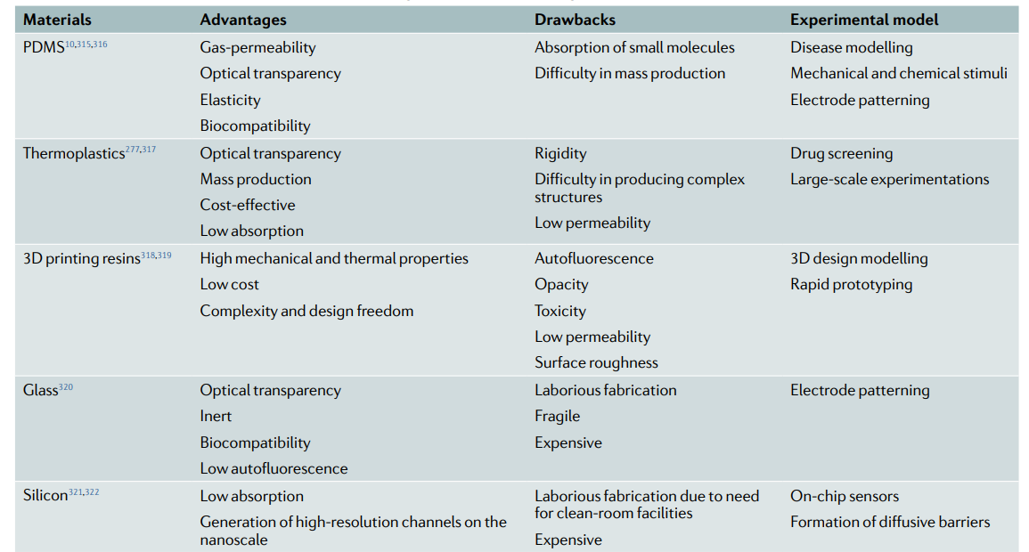
I. Materials for the chip

Slide 18
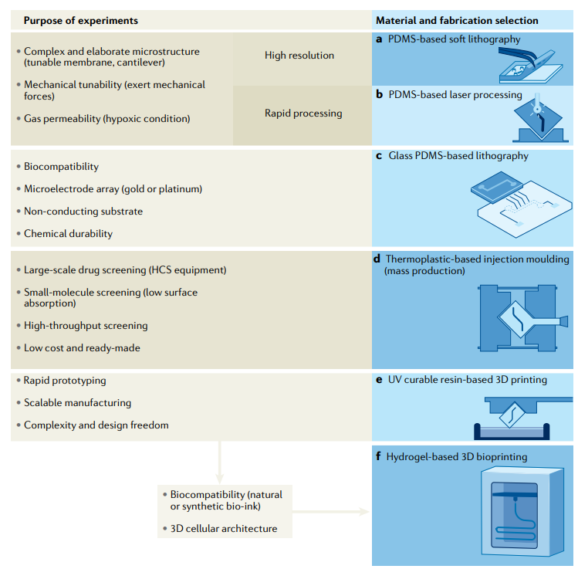
I. Materials for the chip

Slide 19
Extended Process to Build an Organ-on-a-Chip
II. Biological Functionalization
6. Surface Treatment
Modify channels to promote cell adhesion:
  Coat with extracellular matrix proteins (e.g., collagen, fibronectin, Matrigel)
  Or use chemical modification (e.g., poly-L-lysine)
7. Cell Seeding
Introduce specific organ-relevant cells:
  Endothelial (blood vessels), epithelial (gut/lung), cardiomyocytes (heart)
Use appropriate media and conditions
Seed on different surfaces if co-culture is needed (e.g., two chambers separated by porous membrane)

Slide 20
Extended Process to Build an Organ-on-a-Chip
II. Biological Functionalization
8. Maturation and Culture
Allow cells to grow to confluency and differentiate
Apply mechanical stimuli:
  Flow (via syringe or peristaltic pump)
  Stretch (for lung/heart chips)
  Electrical stimulation (for neurons/cardiomyocytes)
9. Introduce Dynamic Flow
Connect the device to a perfusion system:
  Use peristaltic/syringe pumps or pressure-driven systems
  Ensure shear stress mimics physiological conditions
Monitor parameters like:
  Flow rate
  Temperature
  pH and oxygen levels (optionally via sensors)

Slide 21
Extended Process to Build an Organ-on-a-Chip
III. Experimentation & Analysis
10. Drug Testing / Disease Modeling
Introduce drugs, cytokines, toxins, or pathogens
Simulate disease states (e.g., hypoxia, inflammation)
11. Data Acquisition
Use real-time imaging (fluorescence, phase contrast)
Integrate with biosensors:
  TEER (barrier integrity)
  Electrochemical sensing
  Immunoassays or metabolite analysis
12. Data Interpretation
Measure response: viability, signaling, morphology, function
Compare to animal or 2D culture controls
Use computational models (in silico) for extrapolation

Slide 22
Extended Process to Build an Organ-on-a-Chip
III. Experimentation & Analysis
10. Drug Testing / Disease Modeling
Introduce drugs, cytokines, toxins, or pathogens
Simulate disease states (e.g., hypoxia, inflammation)
11. Data Acquisition
Use real-time imaging (fluorescence, phase contrast)
Integrate with biosensors:
  TEER (barrier integrity)
  Electrochemical sensing
  Immunoassays or metabolite analysis
12. Data Interpretation
Measure response: viability, signaling, morphology, function
Compare to animal or 2D culture controls
Use computational models (in silico) for extrapolation

Slide 23
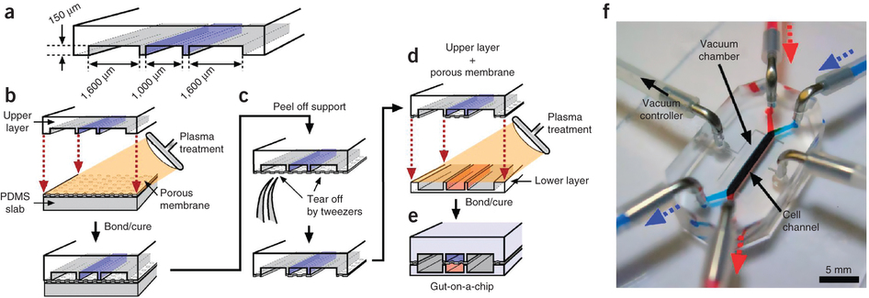
CHIP CONSTRUCT
& ASSEMBLY

Slide 24
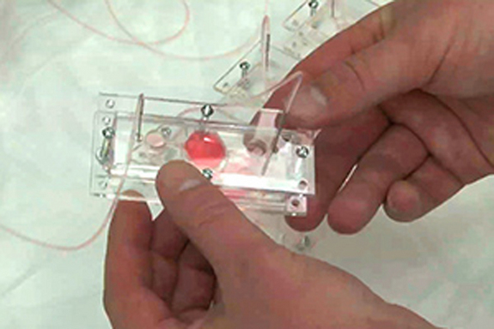
CHIP CONSTRUCT
& ASSEMBLY

Slide 25
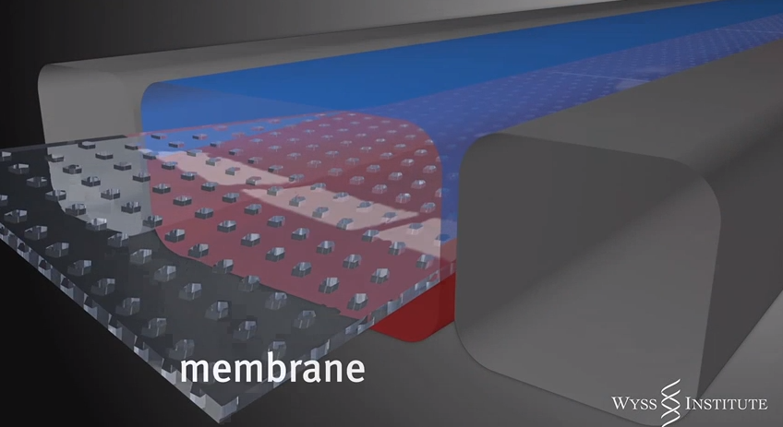
CHIP STRUCTURE

Slide 26
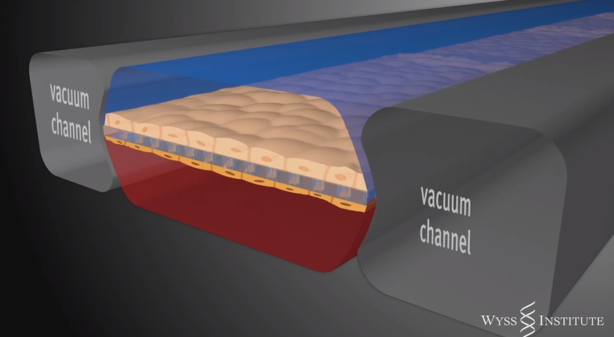
CHIP STRUCTURE

Slide 27
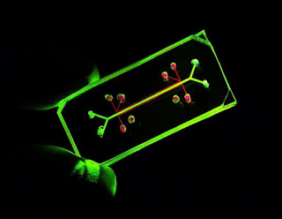
CHIP STRUCTURE

Slide 28
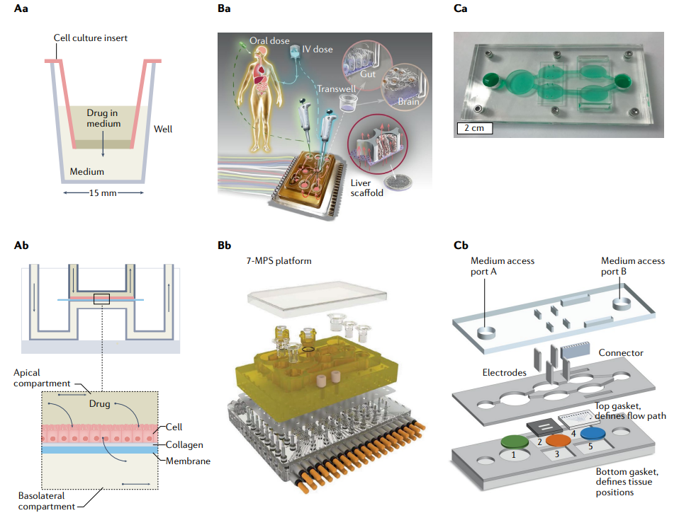
Analysis of the OoC

Slide 29
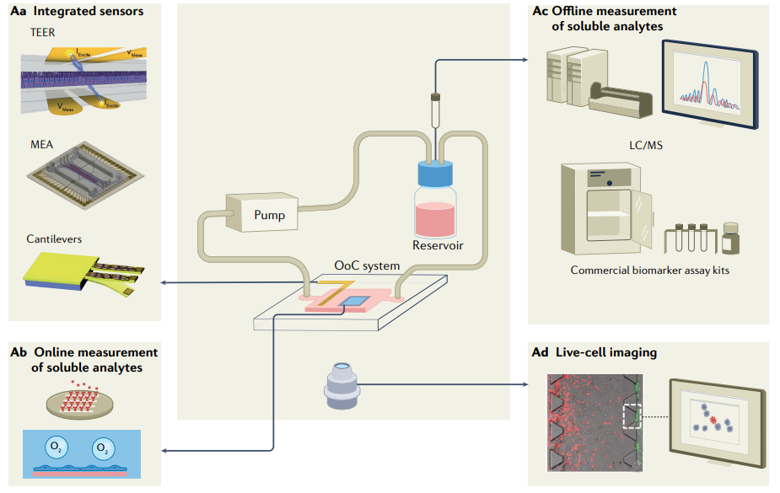
Analysis of the OoC

Slide 30
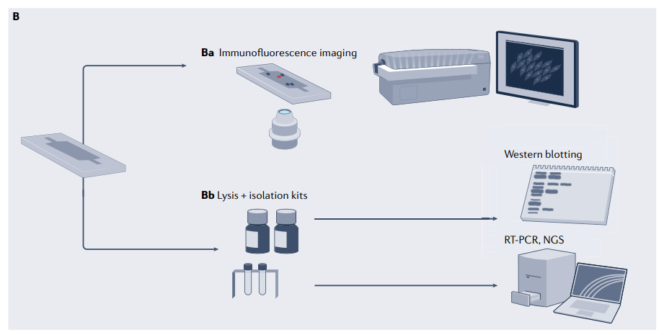
Analysis of the OoC

Slide 31
SOME CHIPS
Current CHIPS
  Lung-on-a-Chip
  Heart-on-a-Chip
  Kidney-on-a-Chip
  Artery-on-a-Chip
  Gut-on-a-Chip
  Liver-on-a-Chip
  Brain
  Blood-brain barrier
Future CHIPS
  Bone marrow
  Skin
  Aerosol drug delivery
Human-on-a-Chip

Slide 32
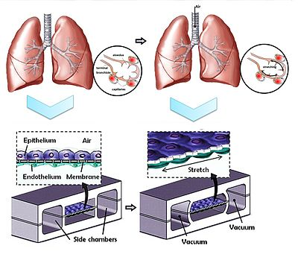
LUNG ON A CHIP
Design:
Two parallel channels separated by a porous membrane
Air flows above the membrane (epithelial cells)
Blood substitute/media flows below (endothelial cells)
Side chambers apply cyclical stretch to simulate breathing

Slide 33
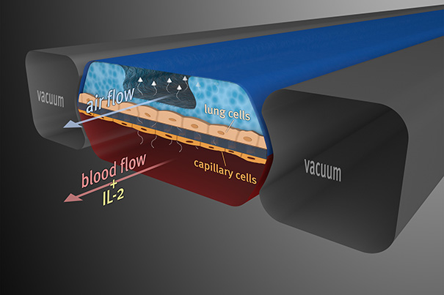
LUNG ON A CHIP

Slide 34
USES / APPLICATIONS
LUNG ON A CHIP
Advanced Physiology of the Alveolar-Endothelial interface & Respiration
Induced pulmonary injuries (pneumonitis)
  Microbes
  Toxins
Understanding of pulmonary inflammatory responses
Testing of aerosol drugs, nanoparticles, and environmental toxins
Benefits:
Realistic gas exchange environment
Demonstrated better prediction of inflammatory response than animal models

Slide 35
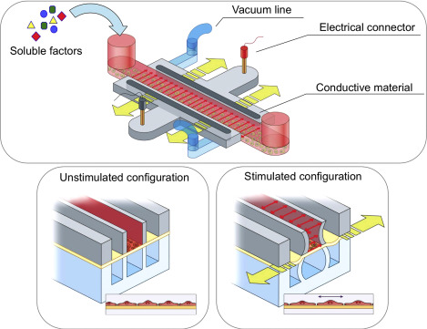
HEART ON A CHIP
Design:
Microchambers or cantilevers seeded with cardiomyocytes
Can apply electrical stimulation and/or mechanical stretch
Flexible substrates allow observation of contractile force

Slide 36
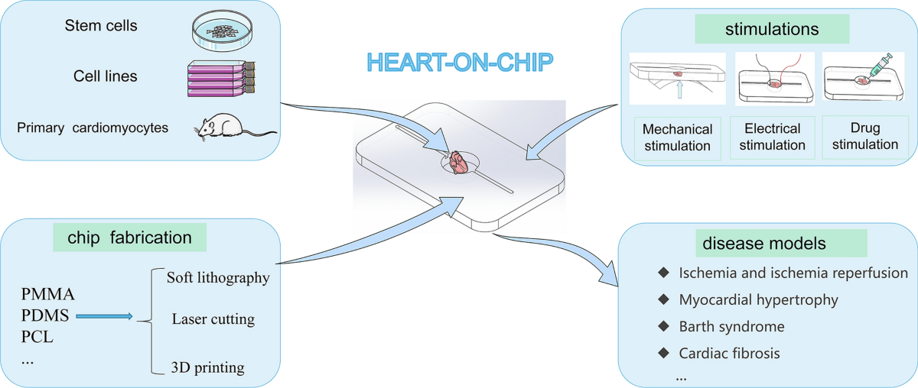
HEART ON A CHIP

Slide 37
USES / APPLICATIONS
HEART ON A CHIP
Advanced physiology of myocardial contractility
Monitoring of myocyte loads and stresses
Induced myocyte injuries
  Ischemic
  Toxic
Physiological & pathological responses of myocytes
Development of personalized cardiac therapies
Disease modeling: Long QT syndrome, cardiomyopathies
Benefits:
Measures real-time beating behavior, force, and conduction velocity
Enables dose-response curves on cardiac cells

Slide 38
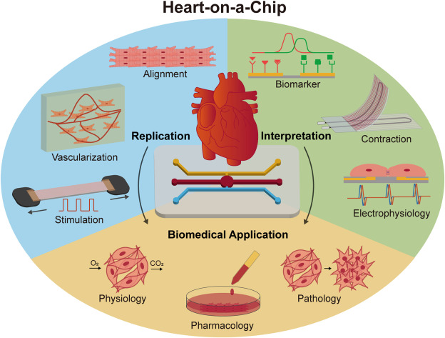
HEART ON A CHIP

Slide 39
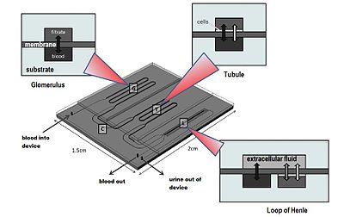
KIDNEY ON A CHIP
NEPHRON

Slide 40
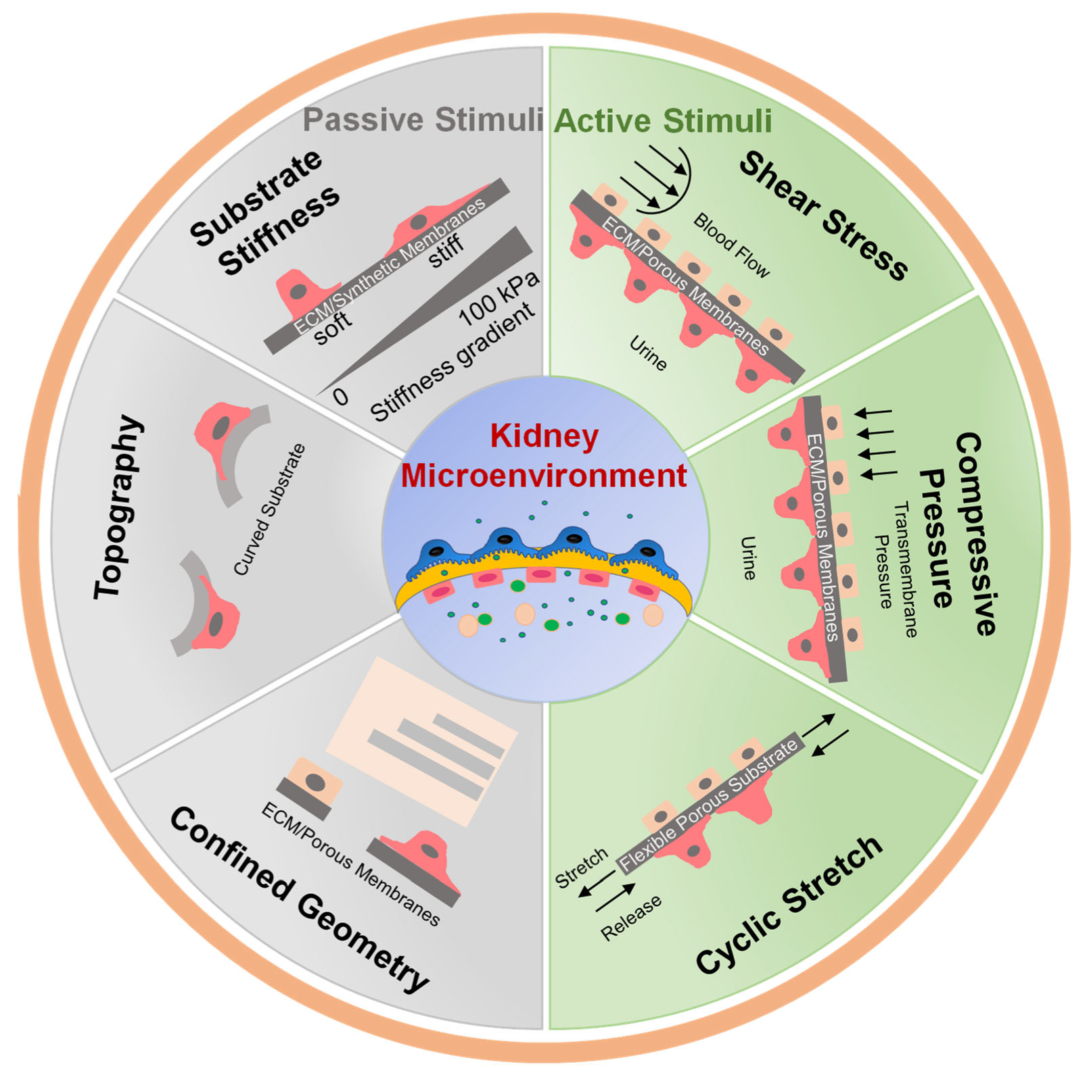
KIDNEY ON A CHIP

Slide 41
USES / APPLICATIONS
KIDNEY ON A CHIP
💊 Drug Testing
Detecting nephrotoxicity from drugs like cisplatin, gentamicin, tenofovir
Evaluating early-stage kidney injury with biomarker readouts
🧬 Disease Modeling
Diabetic nephropathy
Polycystic kidney disease (PKD)
Ischemia-reperfusion injury
🔬 Physiological Studies
Understanding solute and water transport
Investigating the effect of flow, pressure, and pH on renal function
Reproducing glomerular filtration rate (GFR)–like behavior
Benefits
Human cell-based
Dynamic flow and shear stress
Real-time functional monitoring
Scalable and modular

Slide 42
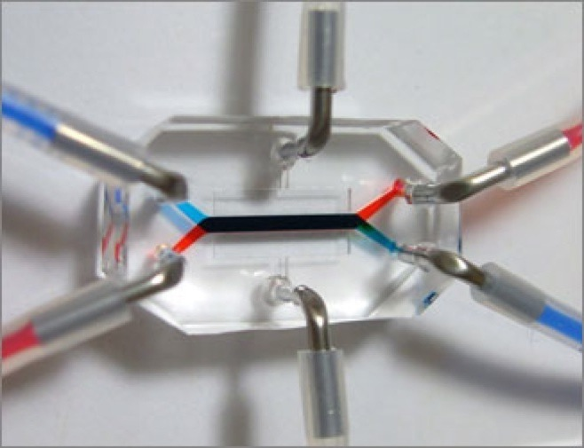
GUT ON A CHIP

Slide 43
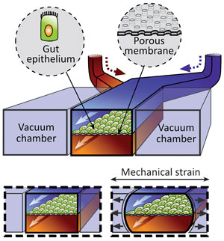
GUT ON A CHIP

Slide 44
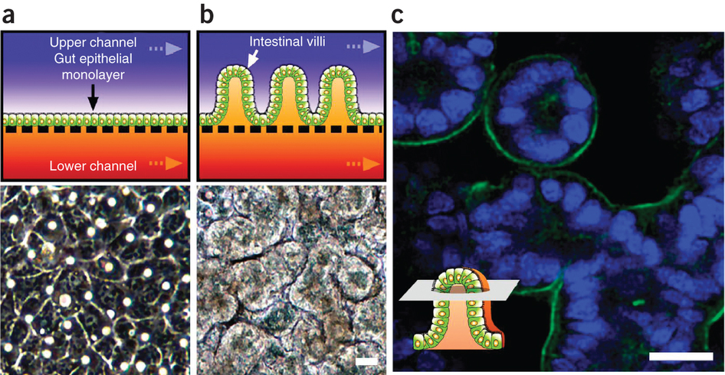
GUT ON A CHIP

Slide 45
USES / APPLICATIONS
GUT ON A CHIP
Advanced Physiology & Biochemistry
Motility disorders
Infectious gut diseases
Food allergies
GI models of neoplastic diseases
Drug testing
Benefits:
Can maintain commensal bacteria long-term
Captures host-microbiome-immune interactions

Slide 46
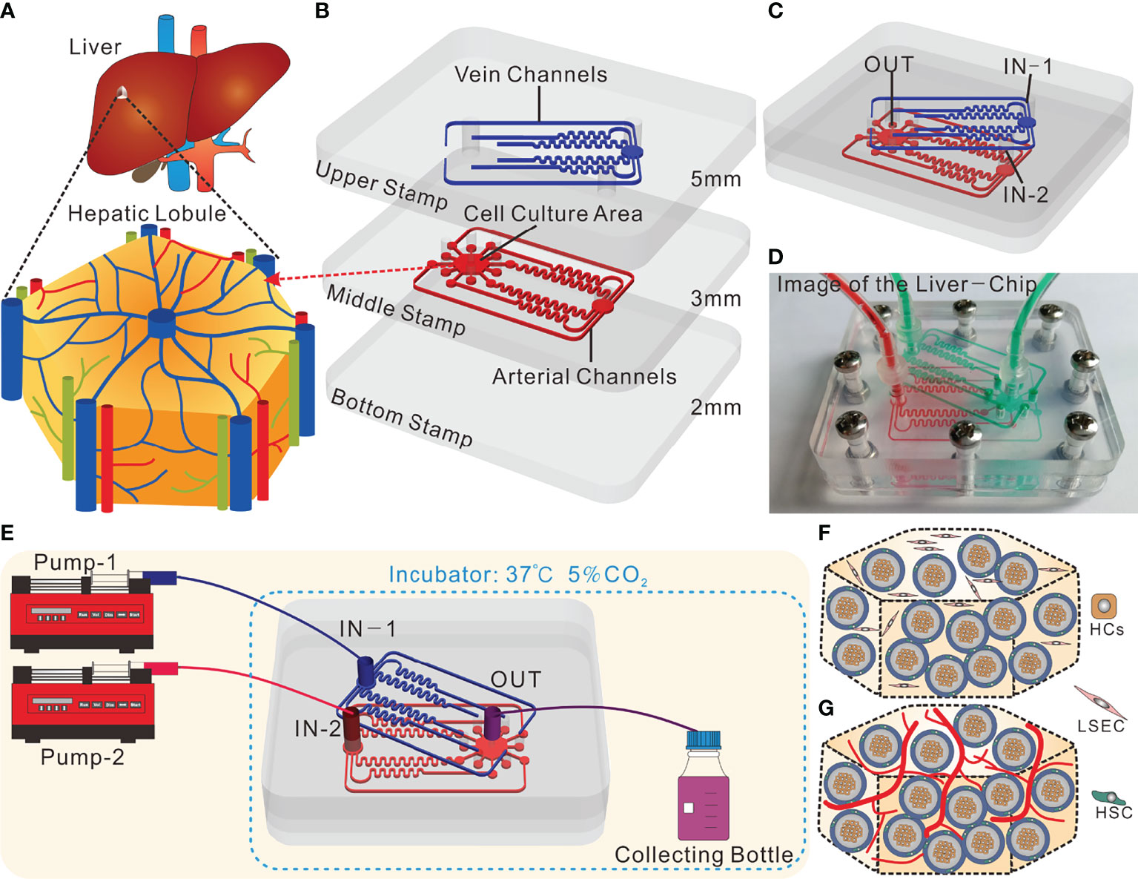
LIVER ON A CHIP
Microfluidic Design
Mimics liver sinusoid architecture
Features dynamic flow that replicates blood perfusion
Allows zonal oxygen gradients, which are important for replicating liver lobule function (zone 1 to zone 3 behavior)

Slide 47
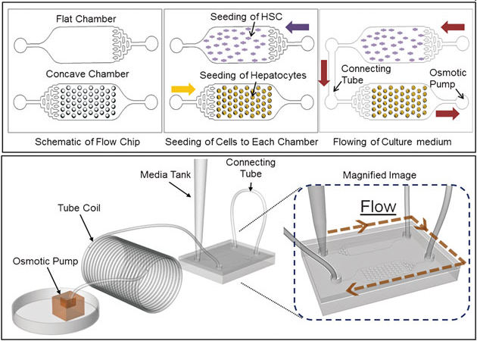
LIVER ON A CHIP

Slide 48
USES / APPLICATIONS
LIVER ON A CHIP
Advanced Biochemistry & Physiology
Drug Reactions / Toxicity
Infectious diseases
Tumors (Primary / secondary)

Slide 49
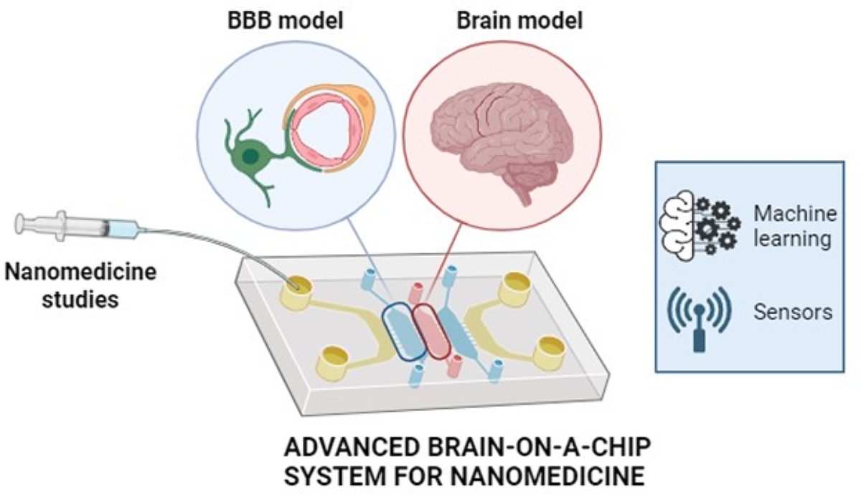
Brain-on-a-Chip / Blood-Brain Barrier-on-a-Chip

Slide 50
Brain-on-a-Chip / Blood-Brain Barrier-on-a-Chip
🔧 Design:
Co-culture of neurons, astrocytes, and endothelial cells
3D matrix or layered chip mimicking BBB
Microfluidic flow simulates nutrient exchange
🩺 Application:
Study of BBB permeability, neurotoxicity, Alzheimer’s
Screening of CNS drugs
Modeling inflammatory diseases (e.g., multiple sclerosis)
📊 Benefits:
Improved modeling of tight junction integrity
Reduces false negatives in CNS drug screening

Slide 51
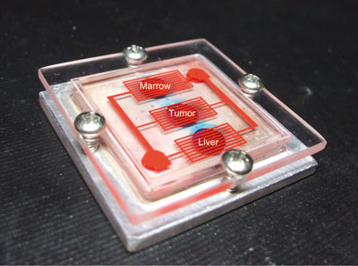
MULTIPLE TISSUES ON A CHIP

Slide 52
USES / APPLICATIONS
MULTIPLE TISSUES ON A CHIP
Modular constructs of any tissues selected
Cellular & Tissue interactions and responses in health and disease conditions
Experimental research / Interventions
Models of disease involving multiple tissues / organs

Slide 53
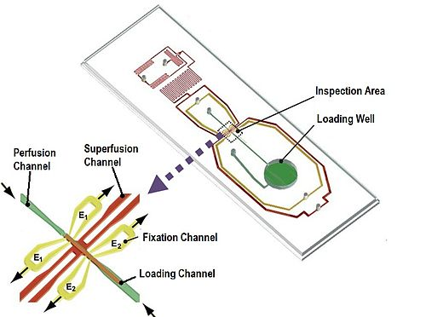
ARTERY ON A CHIP
ORGAN ON A CHIP

Slide 54
USES / APPLICATIONS
ARTERY ON A CHIP
Normal and diseased arteries can be loaded on the chip
Perfusion and Superfusion fluids can be customized
Endothelial / Muscular responses to a wide variety of stimuli (physical & chemical) can be studied

Slide 55
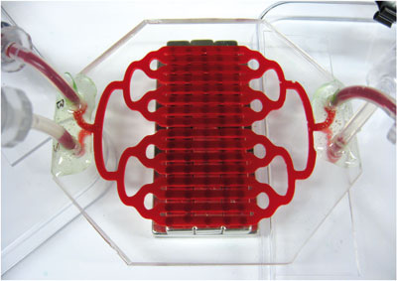
SPLEEN ON A CHIP
ORGAN ON A CHIP

Slide 56
USES / APPLICATIONS
SPLEEN ON A CHIP
Immunology
Hematology
Drug Testing
Infectious diseases

Slide 57
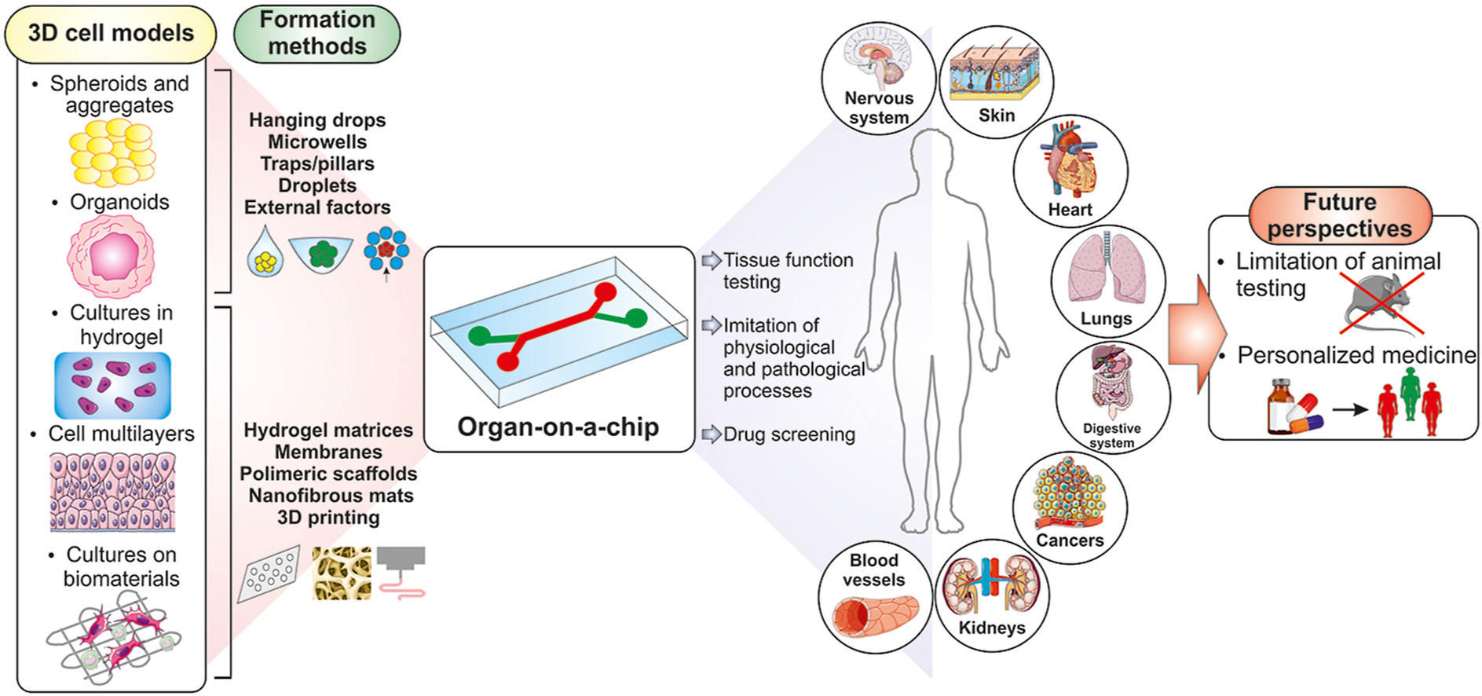
3D cell models for organ-on-a-chip applications

Slide 58
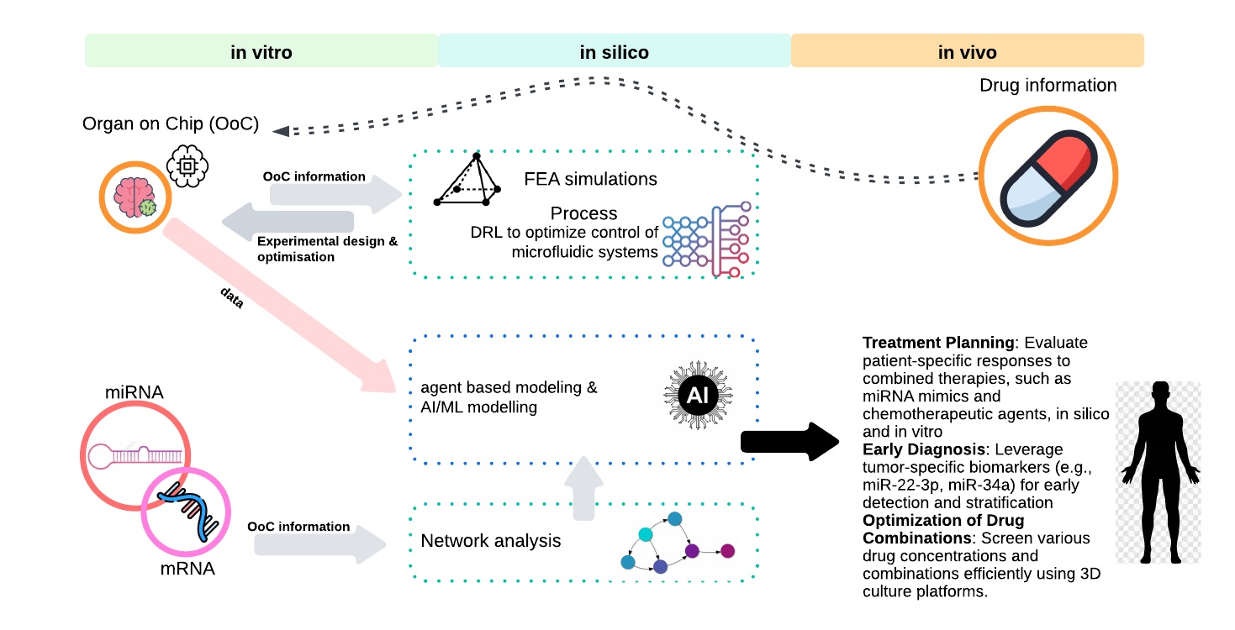
3D cell models for organ-on-a-chip applications

Slide 59
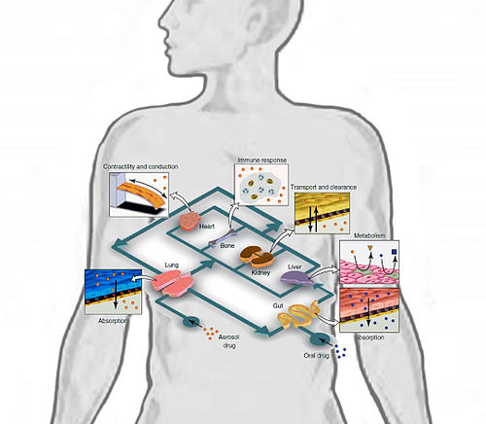
HUMAN BODY ON A CHIP

Slide 60
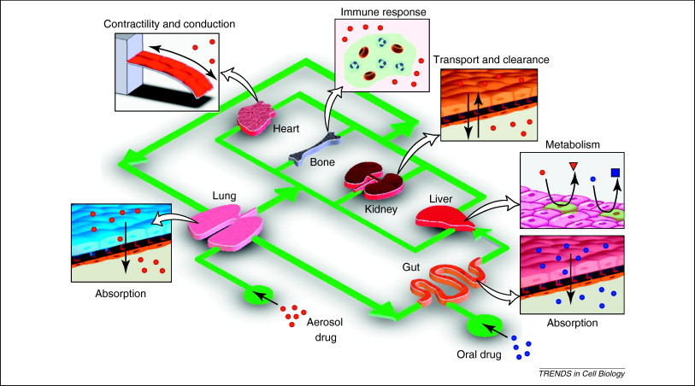
HUMAN BODY ON A CHIP

Slide 61
USES / APPLICATIONS
HUMAN BODY ON A CHIP
Customized constructs based on multiple organs and systems
Will allow detailed study of systemic physiology & pathology
Development of experimental disease models on a whole-body aspect

Slide 62
Integration with In Silico Modeling
Coupled with computational models (FEM, CFD, AI) to:
Simulate transport phenomena
Optimize chip design
Predict drug response or toxicity
Personalize based on patient parameters

Slide 63
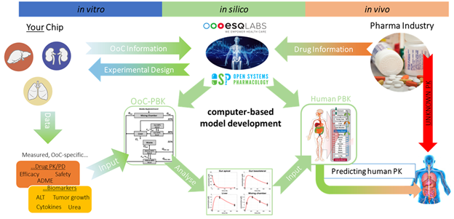
Integration with In Silico Modeling

Slide 64
1. Design and Engineering Optimization
In silico modelling
✅ What It Does:
Simulates fluid dynamics, shear stress, and pressure gradients (using CFD)
Optimizes chip geometry and channel layout for realistic conditions
Models transport of nutrients, drugs, gases, and waste
🔧 Tools Used:
Computational Fluid Dynamics (CFD) – e.g., ANSYS Fluent, COMSOL
Finite Element Method (FEM) – for mechanical strain/stress modeling
Agent-based models – simulate cell behavior and interactions

Slide 65
2. Physiological and Cellular Simulation
In silico modelling
✅ What It Does:
Models cell signaling, metabolism, and electrophysiology under chip conditions
Predicts organ-specific responses (e.g., contraction in heart, GFR in kidney)
Simulates multi-scale interactions: molecular → cellular → tissue
💡 Example:
Use of ODE/PDE models to represent how liver cells metabolize a drug inside a liver-on-a-chip

Slide 66
3. Drug Response Prediction
In silico modelling
✅ What It Does:
Simulates pharmacokinetics/pharmacodynamics (PK/PD) within the chip
Predicts toxicity thresholds and dose-response curves
Enables virtual screening of drug candidates before live chip testing
🎯 Benefit:
Reduces the number of wet-lab trials needed
Supports regulatory approval with quantitative predictions

Slide 67
4. Multi-Organ and Systemic Simulation
In silico modelling
✅ What It Does:
Connects different OoC modules virtually (e.g., gut–liver–kidney)
Simulates inter-organ communication, like hormone signaling or drug metabolism
Reproduces whole-body pharmacology (Body-on-a-Chip + computational body model)

Slide 68
5. Data Integration and Machine Learning
In silico modelling
✅ What It Does:
Analyzes real-time chip data (biosensors, imaging) for predictive modeling
Applies AI/ML models to identify biomarkers or predict outcomes
Builds digital twins of chips or even patients

Slide 69
🎯 Why It Matters
In silico modelling
Purpose | Impact
Design optimization | Better chip performance
Reduced trial-and-error | Saves time and resources
Personalized predictions | Enables precision medicine
Mechanistic understanding | Reveals hidden biological insights
Regulatory confidence | Supports reproducibility and safety

Slide 70
Ethical and Regulatory Considerations
May reduce animal testing → aligns with 3Rs (Replace, Reduce, Refine).
Regulatory approval requires standardization and validation.
Challenges:
  Complexity of models
  Manufacturing scale-up
  Acceptance in clinical pipelines

