Slide 1



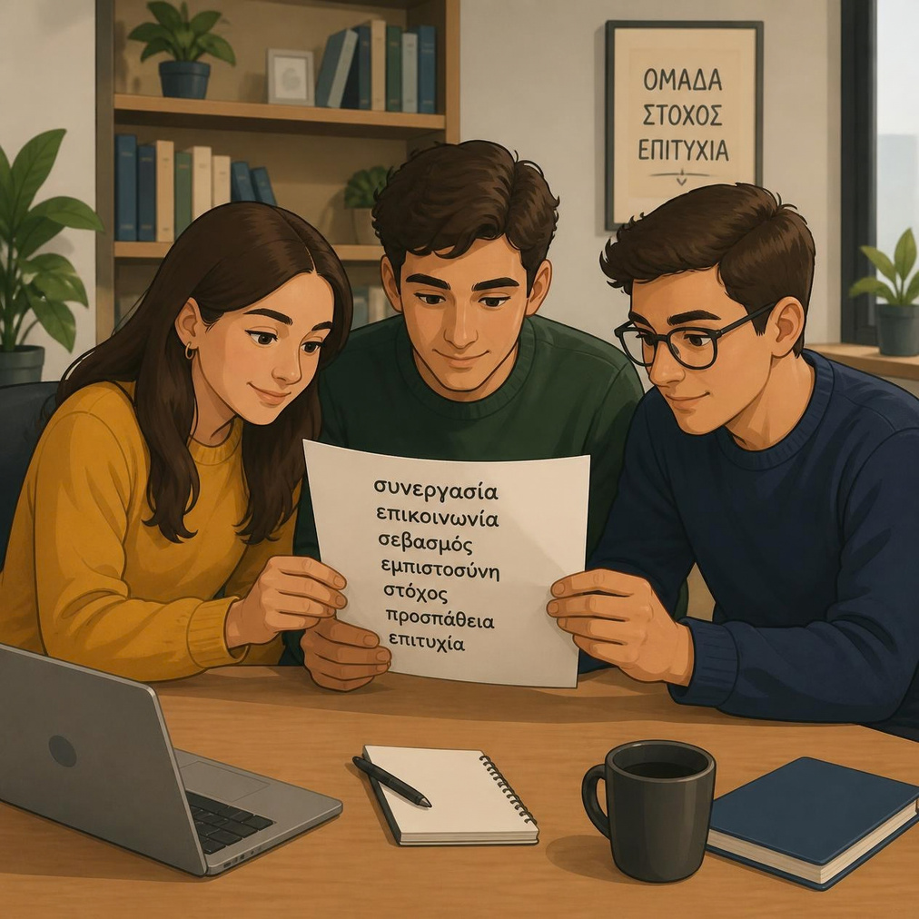

Greek Language and Culture
Giannoulia Afroditi
Teacher - coordinator
Greek Language and Culture Unit
University of Patras
Email: afgiannoul@ac.upnet.gr
afroditigiannoulia@hotmail.com

Slide 2


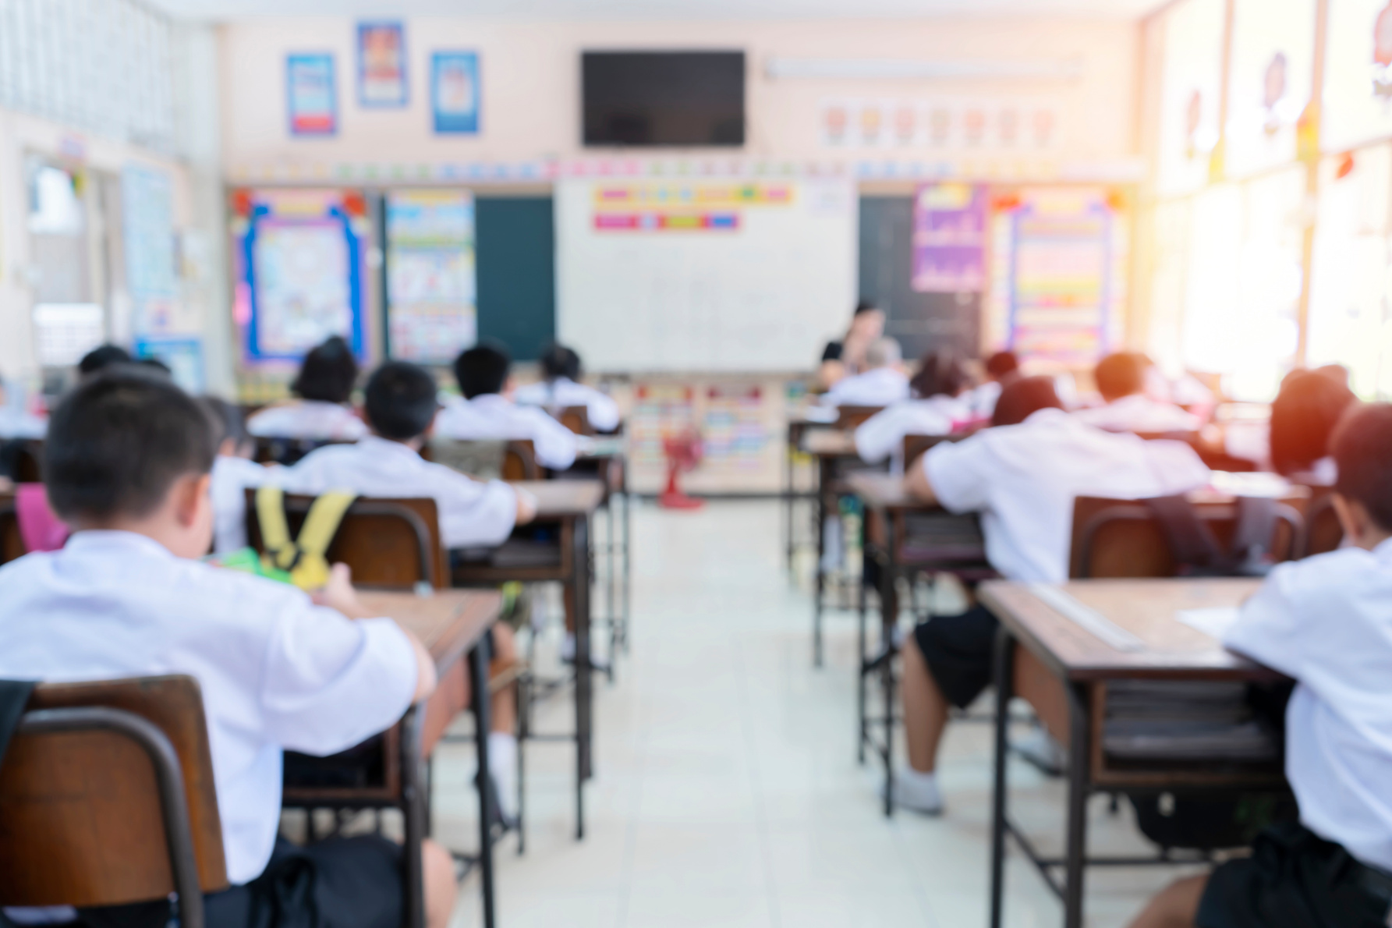

Courses for Erasmus Students
  Modern Greek Language I
  Modern Greek Language II
spring semester
  Introduction to Greek Civilization and Culture

Slide 3


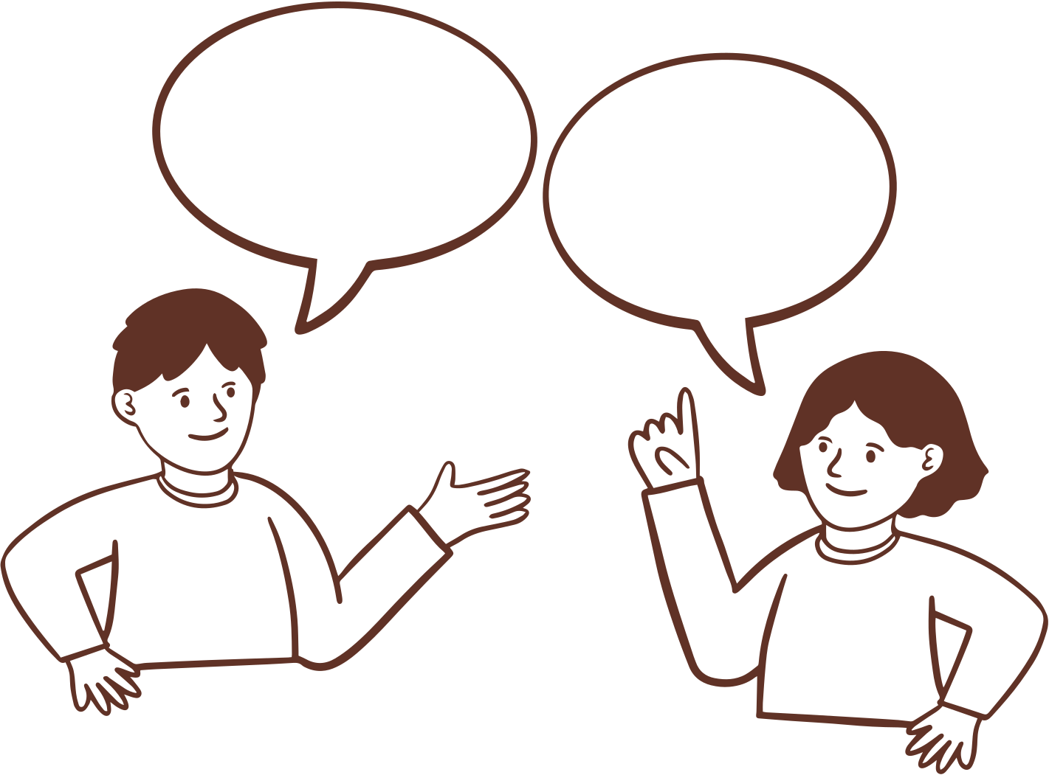
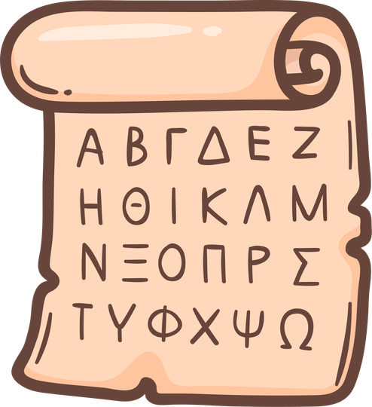






Basic Thematic Units
Alphabet & Phonetics Greetings & Everyday Expressions Introducing Yourself
Everyday Life Weekly Diary & Academic Schedule Transportation & Directions
at the market, at the cafe Days, months, seasons, time

Slide 4




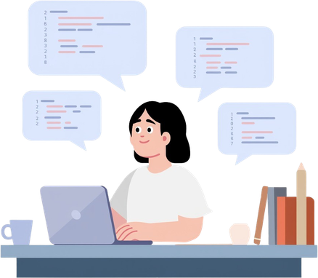

Language Skills & Teaching Methods
Core Language Skills
Learning Tools
Digital Resources
  Reading & Writing
  Listening & Speaking
Standard textbooks for Greek as a foreign language
Eclass,Interactive tools
(Flashcards, Kahoot quizzes)

Slide 5
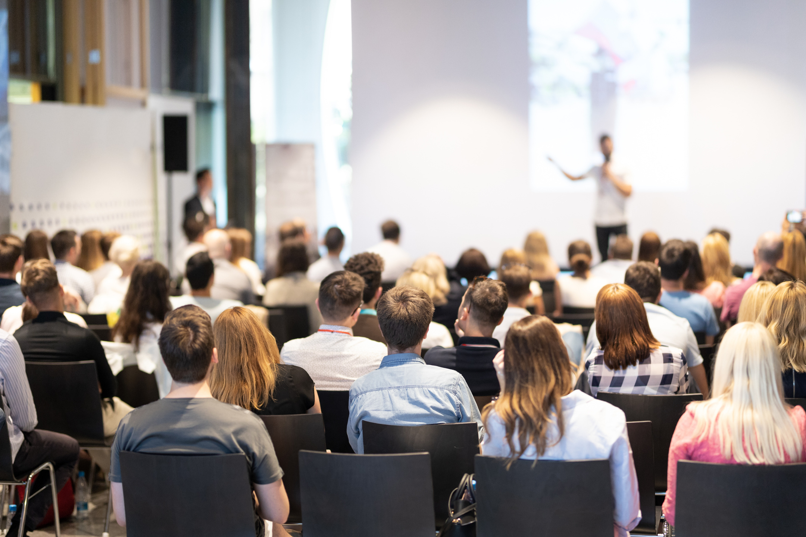
Important Information
  ECTS Credits
The course awards 6 ECTS.
  Assessment
Final written and oral examinations
  Attendance
A maximum of 3 unexcused absences

Slide 6


TIMESCHEDULE
Group 1 Group 2
Mon : 10.00-12.30 Tue: 9.30-12.00
Wed: 9.30-12.00 Thu: 9.30-12.00
Group 3 Group 4
Mon: 12.30-15.00 Tue: 12.00-14.30
Wed: 12.00-14.30 Thu: 12.00-14.30

Slide 7
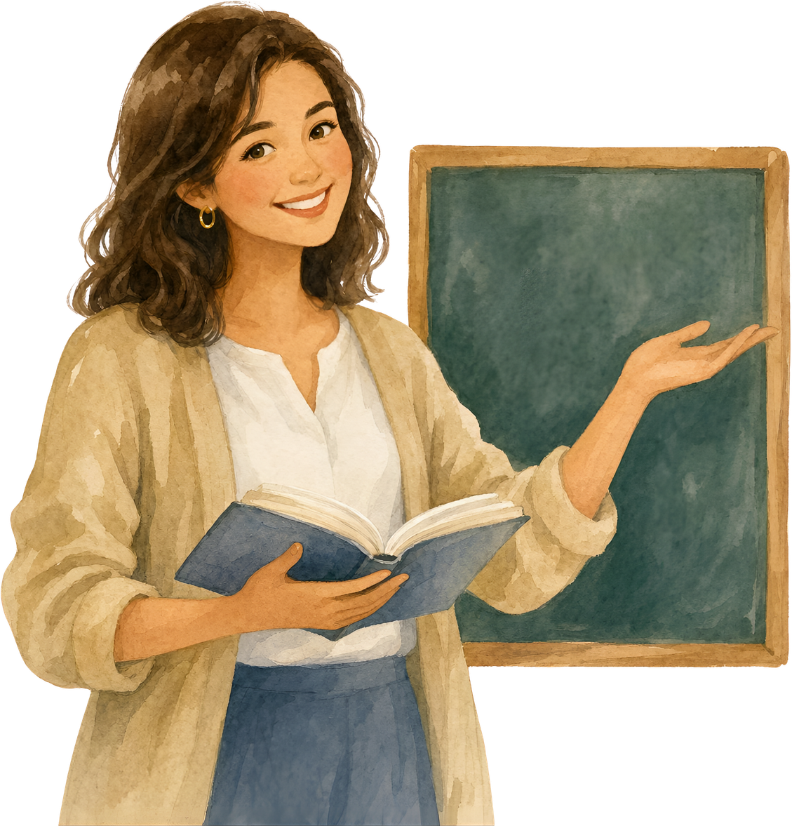
Learning in Action
We are ready to start our journey into the Greek language

