Slide 1


«ENGINEERING GEOLOGY»
Department of Geology
Laboratory of Engineering Geology
LABORATORY EXERCISES: Mechanical Properties of Soils
Exercise 7 : Unconfined Compression Test
Exercise 8 : Direct Shear Test
Exercise 9 : Triaxial Loading Test
Engineering Geology Laboratory Notes

Slide 2

PURPOSE OF THE LABORATORY UNIT
Description of the main laboratory tests for determining the mechanical properties of soils
Calculation of soil shear strength
Understanding the Mohr-Coulomb failure criterion
Basic parameters of soil shear strength: cohesion (c) and Friction angle (φ)

Slide 3

ΔΙΑΤΜΗΤΙΚΗ ΑΝΤΟΧΗ ΕΔΑΦΩΝ
Why do we calculate the shear strength of soils?
The shear strength of soils is considered their most basic characteristic, as it forms the basis for solving crucial problems related to slope stability and the bearing capacity of the foundation soil (Koukis & Sabatakakis 2002).
How do we calculate soil strength in the laboratory?
Unconfined (Uniaxial) Compression Test
Direct Shear Test
Triaxial Loading Test
σ1
σ1
Figure 1: Unconfined compression test (Koukis & Sabatakakis 2002)

Slide 4
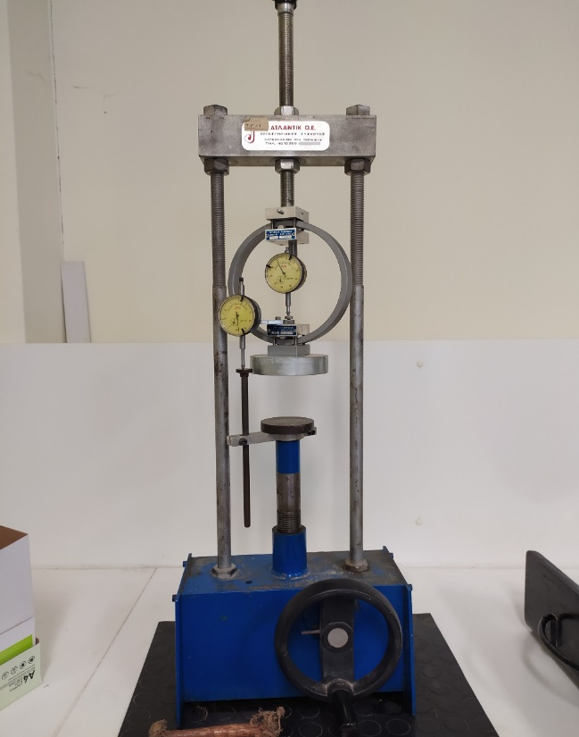
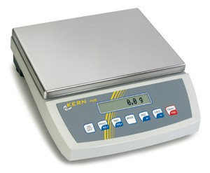
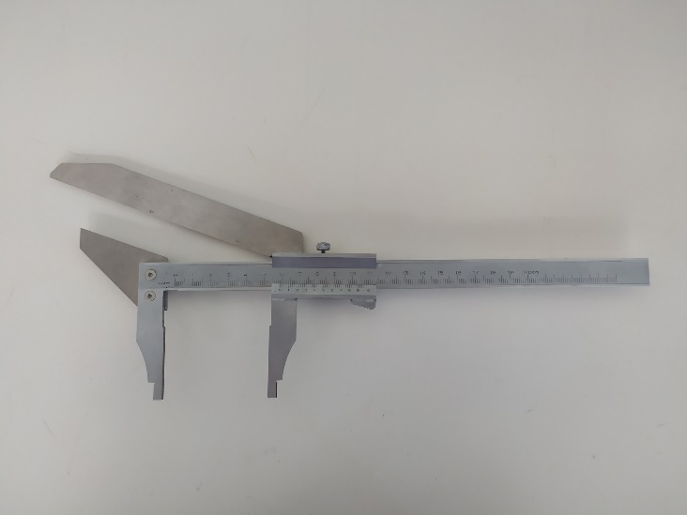
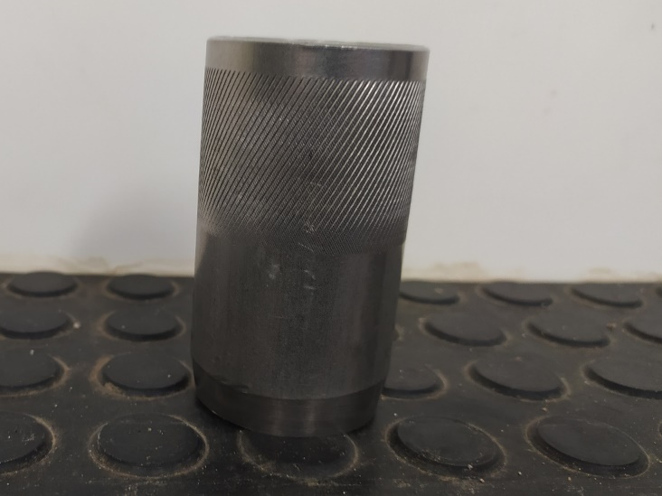
UNCONFINED COMPRESSION TEST
Scope
Calculation of maximum stress of a soil sample under uniaxial-compressive stress
Lab Equipment
Scale
(acc 0.1%)
Caliper
Sampler
Unconfined Compression Apparatus

Slide 5
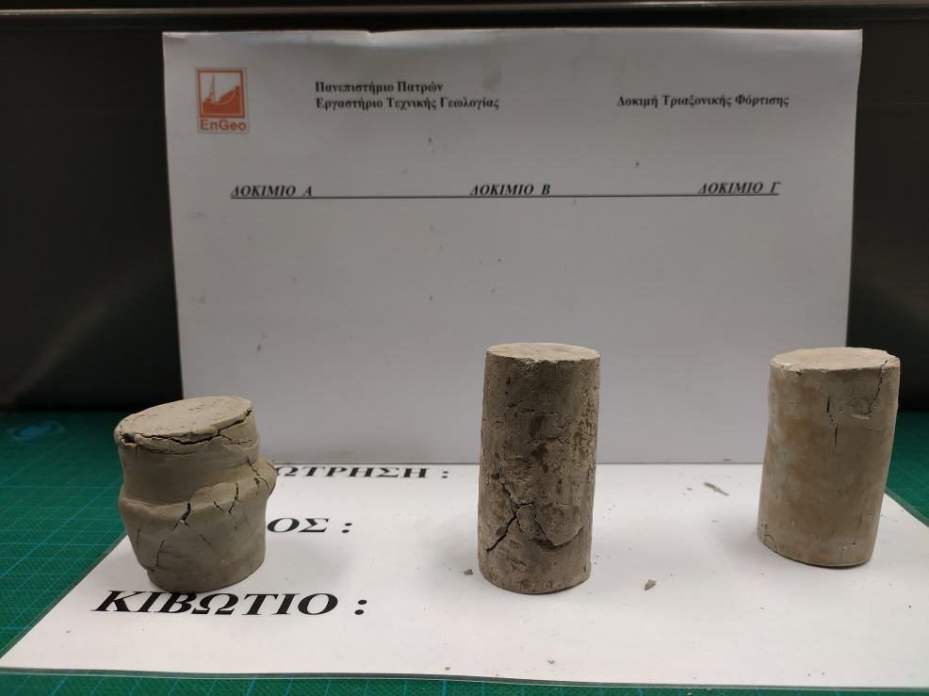
UNCONFINED COMPRESSION TEST METHODOLOGY
Βήματα εκτέλεσης δοκιμής:
Test execution steps:Cylindrical specimen, from an undisturbed sample, with a height-to-diameter ratio of 2 to 3.
Placement of the specimen in the loading device.
Application of compressive load (axis σ1) to the specimen.
Compressive load rate per minute approximately 0.5 to 2% of the strain.
Total duration of the test should not exceed 10 minutes.
The test stops when a decrease in load is observed with an increase in strain, or when the strain reaches 20%.
The presentation of the results of the unconfined compression test is done using the stress-strain curve (ΔL/L), where ΔL is the change in the length of the specimen and L is the initial length of the specimen.
Unconfined compressive strength is the maximum stress value or the stress corresponding to 20% strain.

Slide 6
VIEWING OF UNCONFINED COMPRESSION TEST
https://www.youtube.com/watch?v=6UQB_cCYlfY

Slide 7
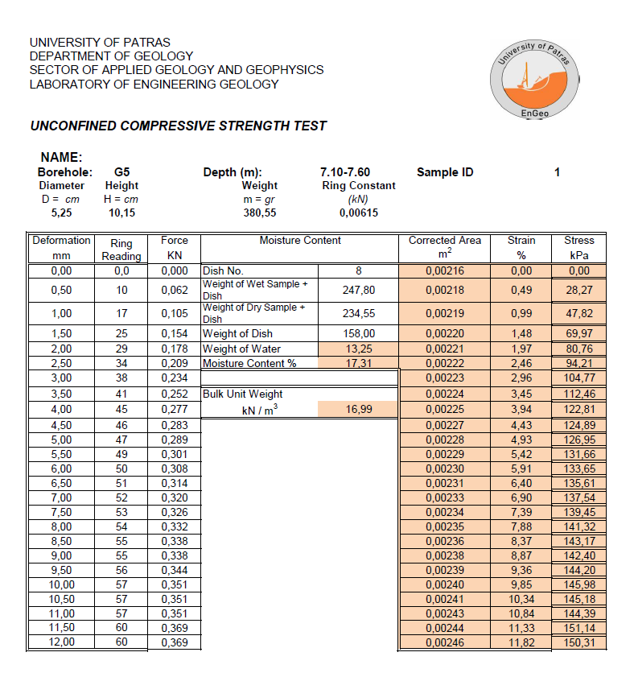
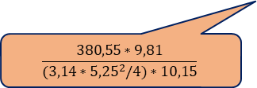
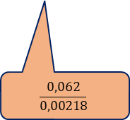
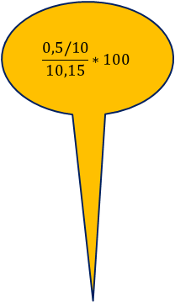
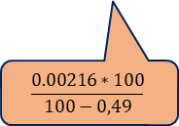
Calculations
(3,14*((5,25/100)^2)/4)
5-7 Decimal Digits
$$\frac{0,5/10}{10,15}∗100$$
3 Decimal DIgits
Calculate the moisture content
Calculate the wet unit weight from the formula:
γ_{b}=ρ*g, where ρ=m/V, with specimen volume V=(π*D²/4)*Η,
Calculate the Strain (%) from the formula:
[Deformation (cm) /Height (cm)]*100
Calculate in m² the 1st Corrected Area (π*D²/4) , D in m
In m² the 2nd Corrected Area :
[1st Corrected Area / 100-Strain (%)]*100.
Calculate in kN the force with the formula:
Force = Ring Reading* Ring Constant
Calculate in kPa the Stress with the formula
Stress = F / A = Ring Reading* Ring Constant/ Corrected Area (m²⁾
247,40-234,55
[13,25/(234,55-158,00)]*100
$$\frac{0.00216∗100}{100−0,49}$$
$$\frac{0,062}{0,00218}$$
$$\frac{380,55∗9,81}{(3,14∗{5,25}^{2}/4)∗10,15}$$

Slide 8
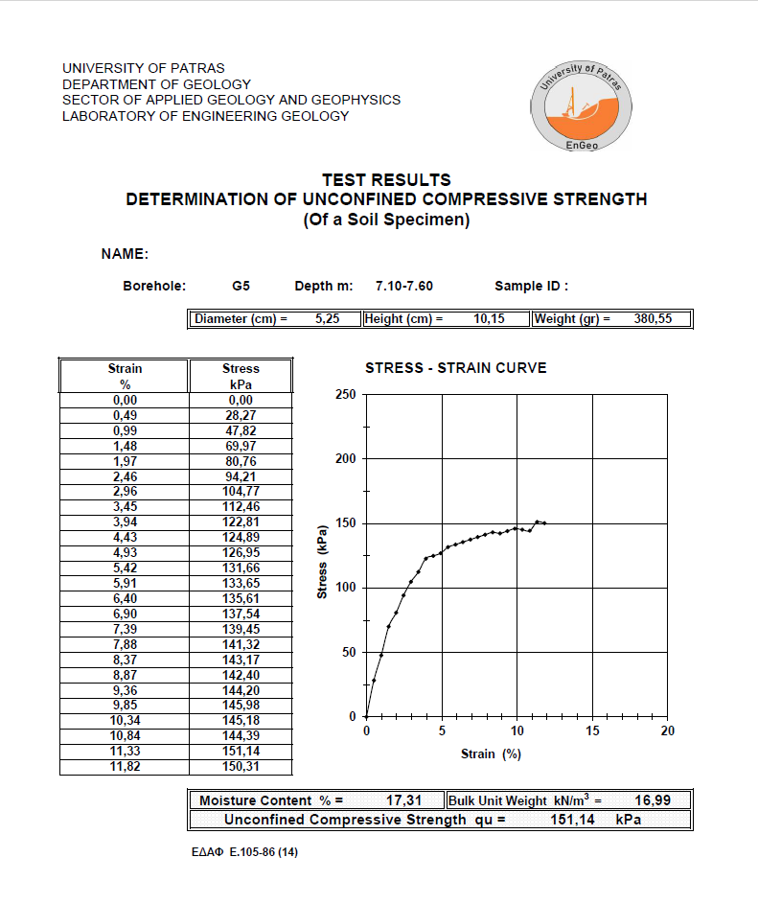
Calculations
Plotting the Stress – Strain (%) diagram
Recording of Results: Moisture Content – Bulk Unit Weight (kN/m³) – Maximum Unconfined Compressive Strength (kPa)

Slide 9
EQUATIONS
Calculation of Moisture Content and Bulk Unit Weight
Moisture Content(%) = (Weight of Water(gr)/Weight of Dry Sample(gr))*100
Bulk Unit Weight(kN/m³) = ρ*g = m*g/V = m*g/(π*D²/4)*Η
Calculation of Strain (%), 1st and 2nd Corrected Area in cm² and m²
Strain (%) = (Deformation (cm)/Height (cm))*100
1st Ring Reading(m²) = π*D²/4 ,D in (m)
2nd and n-th Corrected Area (m²) = [1st Corrected Area / (100 - Strain (%))] * 100
Calculation of Force (kN) and Stress (kPa)
Force (kN) = Ring Reading * Ring Constant
Stress (kPa) = F / A = Force / Corrected Area m² (kPa)

Slide 10
ΠΑΡΑΔΕΙΓΜΑ
ΠΑΝΕΠΙΣΤΗΜΙΟ ΠΑΤΡΩΝ
ΤΜΗΜΑ ΓΕΩΛΟΓΙΑΣ
ΕΡΓΑΣΤΗΡΙΟ ΤΕΧΝΙΚΗΣ ΓΕΩΛΟΓΙΑΣ |  |  |  |  | Ημ/νία,
ΔΟΚΙΜΗ ΠΡΟΣΔΙΟΡΙΣΜΟΥ ΑΝΤΟΧΗΣ ΣΕ ΑΝΕΜΠΟΔΙΣΤΗ ΘΛΙΨΗ
ONOMA: |  |  |  |  | A.M.
Γεώτρηση: | Γ5 | Βάθος m: | 7.10-7.60 | Α/Α Δείγματος : |  |  | 1
Διάμετρος | Ύψος | Βάρος | Σ. Δακτ.
D = cm | H = cm | W = gr | (kN)
5.17 | 10.07 | 383.10 | 0.00615
Παραμόρφ. | Αν. Δακτ. | Φυσική | Υγρασία | Αν. Επιφαν. | Αν. Επιφαν. | Παραμόρφ. | Τάση
mm |  |  |  | cm² | m² | % | kPa
0.00 | 0.0 | Αρ. Δοχείου | 8 | 20.99 | 0.0021 | 0.00 | 0.00
0.50 | 5 | Βάρ. Υγρό+Δοχ. | 247.82 | 21.10 | 0.0021 | 0.50 | 14.58
1.00 | 10 | Βάρ. Ξηρό+Δοχ. | 230.50 | 21.20 | 0.0021 | 0.99 | 29.00
1.50 | 15 | Βάρ. Δοχ. | 159.33 | 21.31 | 0.0021 | 1.49 | 43.29
2.00 | 20 | Βαρ. Νερού | 17.32 | 21.42 | 0.0021 | 1.99 | 57.43
2.50 | 25 | Υγρασία %= | 24.34 | 21.53 | 0.0022 | 2.48 | 71.42
3.00 | 30 |  |  | 21.64 | 0.0022 | 2.98 | 85.27
3.50 | 35 | Υγρό Φαιν. | Βάρος | 21.75 | 0.0022 | 3.48 | 98.97
4.00 | 40 | kN / m³ | 17.77 | 21.86 | 0.0022 | 3.97 | 112.53
4.50 | 45 |  |  | 21.97 | 0.0022 | 4.47 | 125.94
5.00 | 50 |  |  | 22.09 | 0.0022 | 4.97 | 139.21
5.50 | 55 |  |  | 22.21 | 0.0022 | 5.46 | 152.33
6.00 | 60 |  |  | 22.32 | 0.0022 | 5.96 | 165.30
6.50 | 65 |  |  | 22.44 | 0.0022 | 6.45 | 178.13
7.00 | 66 |  |  | 22.56 | 0.0023 | 6.95 | 179.91
7.50 | 65 |  |  | 22.68 | 0.0023 | 7.45 | 176.24
8.00 | 66 |  |  | 22.80 | 0.0023 | 7.94 | 177.99
8.50 | 67 |  |  | 22.93 | 0.0023 | 8.44 | 179.71
9.00 | 67 |  |  | 23.05 | 0.0023 | 8.94 | 178.74
9.50 | 67 |  |  | 23.18 | 0.0023 | 9.43 | 177.76
10.00 | 67 |  |  | 23.31 | 0.0023 | 9.93 | 176.79
10.50 | 67 |  |  | 23.44 | 0.0023 | 10.43 | 175.81
11.00 | 67 |  |  | 23.57 | 0.0024 | 10.92 | 174.84

Slide 11
ΠΑΡΑΔΕΙΓΜΑ-ΔΙΑΓΡΑΜΜΑ ΤΑΣΗΣ-ΠΑΡΑΜΟΡΦΩΣΗΣ
Παραμόρφωση | Τάση
% | kPa
0.00 | 0.00
0.50 | 14.58
0.99 | 29.00
1.49 | 43.29
1.99 | 57.43
2.48 | 71.42
2.98 | 85.27
3.48 | 98.97
3.97 | 112.53
4.47 | 125.94
4.97 | 139.21
5.46 | 152.33
5.96 | 165.30
6.45 | 178.13
6.95 | 179.91
7.45 | 176.24
7.94 | 177.99
8.44 | 179.71
8.94 | 178.74
9.43 | 177.76
9.93 | 176.79
10.43 | 175.81
10.92 | 174.84
Φυσική Υγρασία % = |  | 24.34 | Υγρό Φαιν. Βάρος kN/m³ = |  | 17.77
Αντοχή σε Ανεμπόδιστη Θλίψη σ_{c} = |  |  |  | 179.91 | kPa

Slide 12
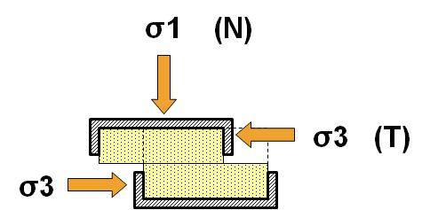
Soil Shear Strength
Why do we calculate the shear strength of soils?
The shear strength of soils is considered their most fundamental characteristic, as it forms the basis for solving crucial problems related to slope stability and the bearing capacity of the foundation soil (Koukis & Sabatakakis 2002).
How do we calculate the shear strength of soils?
Unconfined Compression Test
Direct Shear Test
Triaxial Compression Test
Figure 2: Direct shear test (from Koukis & Sabatakakis 2002)

Slide 13

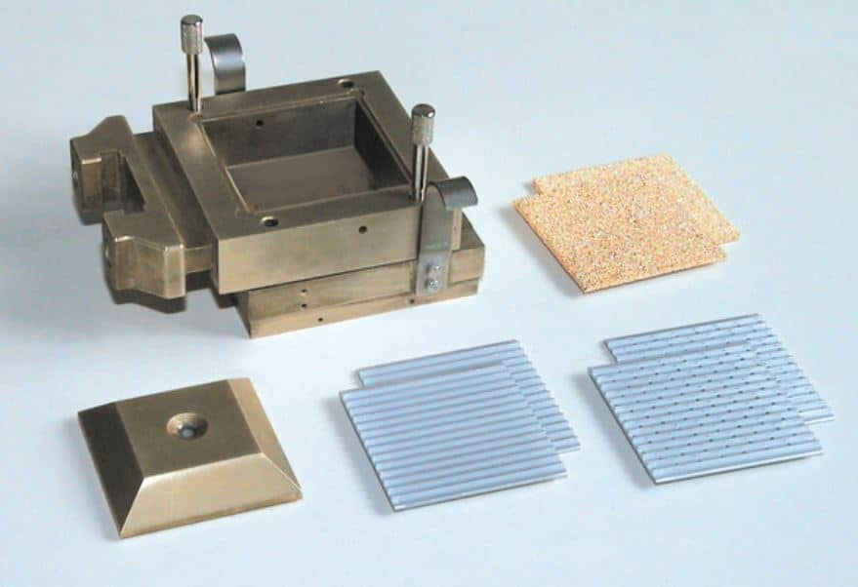
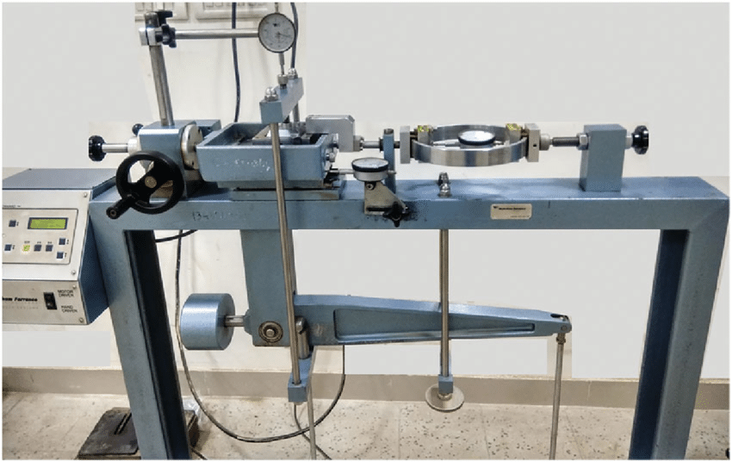
DIRECT SHEAR TEST
Scope
Calculation and determination of the basic shear strength parameters of a soil sample: cohesion (c) and angle of internal friction (φ)
Equipment
Scale
(acc 0.1%)
Caliper
Shear box
Direct Shear Machine

Slide 14
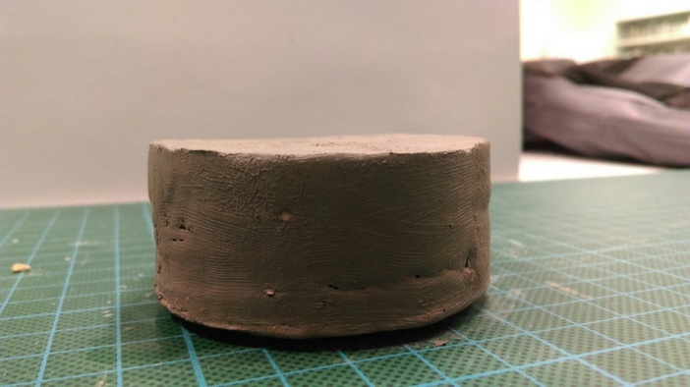
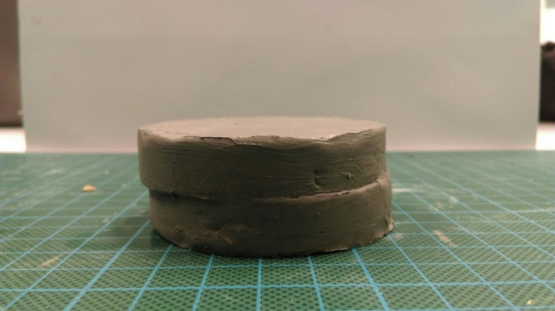
Methodology
Test execution steps:
Cylindrical specimen, from an undisturbed or disturbed sample, with a minimum thickness of 12.5 mm and a diameter of approximately 50 mm.
Placement of the specimen in the shear apparatus.
Application of a constant axial load (σ1 axis) and lateral-shear load (σ3 axis) to the specimen (on a predetermined surface).
Rate of applied shear deformation per minute approximately 0.5 to 2% of the diameter (quick test).
Recording the variation of the soil's shear strength in relation to the normal-axial stress.
Total duration of the test should not exceed 15-20 minutes.
The test stops when a decrease in load is observed with an increase in deformation, or until the deformation reaches 20%.
The test is repeated on similar specimens (at least 3) from the same soil for a different normal load.
The results of the direct shear test are presented using the shear stress (kPa) vs. horizontal displacement (mm) diagram and the maximum shear strength (kPa) vs. normal stress (kPa) diagram.
Finally, the values of the shear strength parameters are presented: cohesion (c) and angle of internal friction (Φ).

Slide 15
VIEWING OF DIRECT SHEAR TEST
https://www.youtube.com/watch?v=gF6BuvV92UY

Slide 16
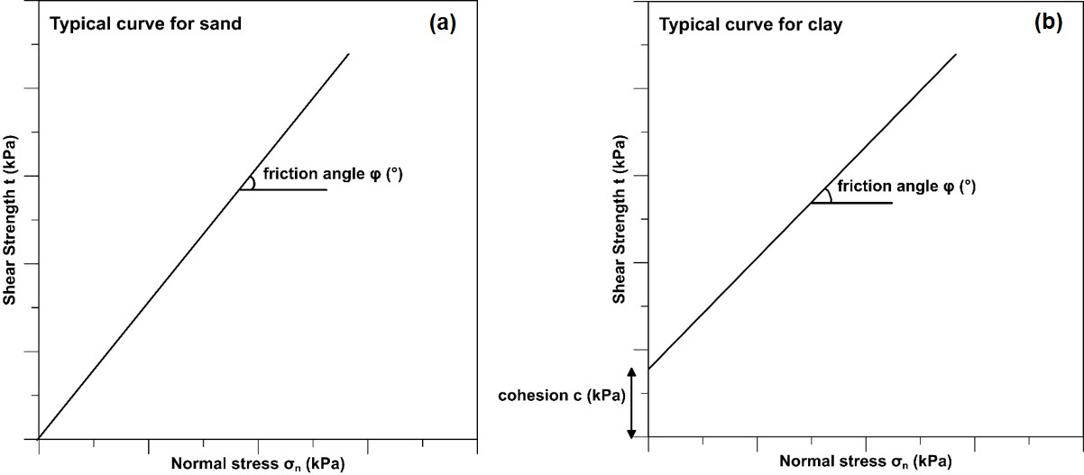
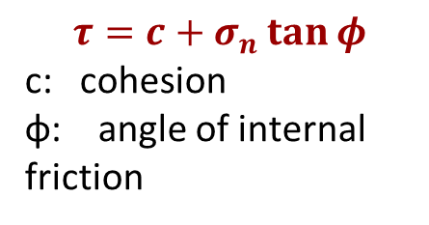
MOHR-COULOMB FAILURE CRITERION
FAILURE ENVELOPE
FAILURE ENVELOPE
$$τ=c+σ_{n}\tan{φ}$$
c: cohesion
φ: angle of internal friction

Slide 17
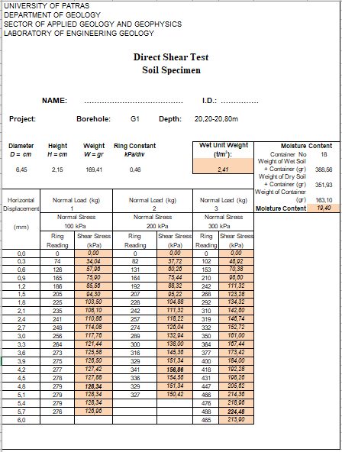
Calculations
Sample information and data
Calculation of Moisture Content and Wet Unit Weight
Calculation of Shear Stress
We calculate the moisture content by dividing the weight of water by the weight of the dry sample.
We calculate the wet unit weight from the formula γb=ρ*g, where ρ=m/V with specimen volume V=(π*D2/4)*Η, g=9,81 m/sec²
We calculate the Shear Stress from the formula: Ring Constant * Ring Reading.
0,46*74
0,46*82
0.46*100

Slide 18
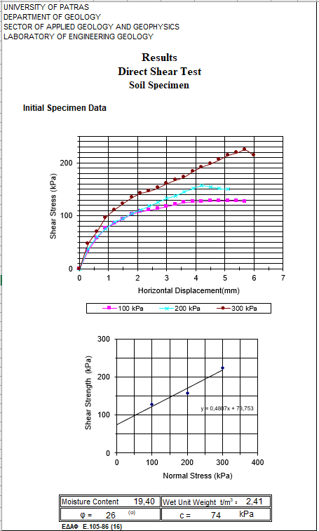
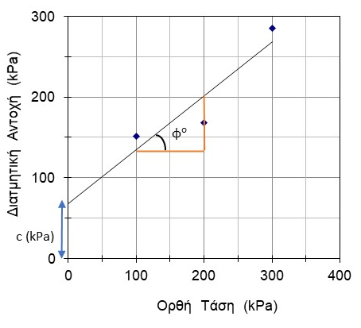
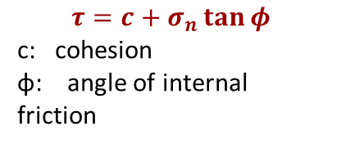
Calculations
Construction of the Shear Stress (kPa) vs. Horizontal Displacement (mm) diagram and the Maximum Shear Strength (kPa) vs. Normal Stress (kPa) diagram.
Recording of Results for Natural Moisture Content – Wet Unit Weight (t/m³) – Angle of Internal Friction (Φº) – Cohesion c (kPa).
$$τ=c+σ_{n}\tan{φ}$$
c: cohesion
φ: angle of internal friction
Γ
Calculation of cohesion (c): Distance from the origin to the intersection of the envelope with the y-axis.
70
Shear Strength
Α
100
Β
Tan ω= ΒΓ/ΑΒ=0,7
ω=tan⁻¹0,7=34
Calculation of the angle of internal friction: slope of the envelope line, tangent of angle ω in degrees.
Normal Stress

Slide 19
EQUATIONS
Calculation of Moisture Content and Wet Unit Weight
Moisture Content (%) = (Weight of water (g) / Weight of dry sample (g)) * 100, Weight of dry sample = Weight of (dry sample + container) (g) – Weight of container (g)
Weight of water (g) = Weight of wet sample - Weight of dry sample
Wet Unit Weight (g/cm³) = m/V = m/(π*D2/4)*Η, 1 gr/cm³ = 1 t/m³. To convert to t/m³, multiply numerator and denominator by *10⁻⁶
Calculation of Shear Stress
We calculate the Shear Stress using the formula: Ring Constant * Ring Reading (kPa)
Calculation of Cohesion (c) and Angle of Internal Friction (Φ)
Calculation of cohesion (c): Distance from the origin to the intersection of the failure envelope with the y-axis (y-intercept)
Calculation of the angle of internal friction: Slope of the failure envelope line, tangent of angle ω:
tan ω = opposite / adjacent
ω⁰ = tan⁻¹(opposite / adjacent)

Slide 20
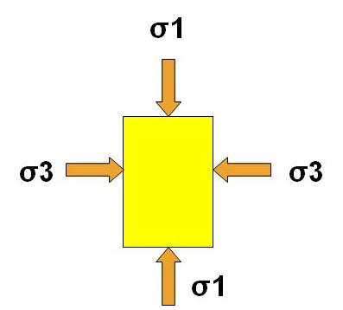
SHEAR STRENGTH OF SOILS
Why do we calculate the shear strength of soils?
The shear strength of soils is considered their most fundamental characteristic, as it forms the basis for solving crucial problems related to slope stability and the bearing capacity of the foundation soil (Koukis & Sabatakakis 2002).
How do we calculate the shear strength of soils?
Unconfined Compression Test
Direct Shear Test
Triaxial Compression Test
Figure 3: Triaxial loading test (from Koukis & Sabatakakis 2002)

Slide 21

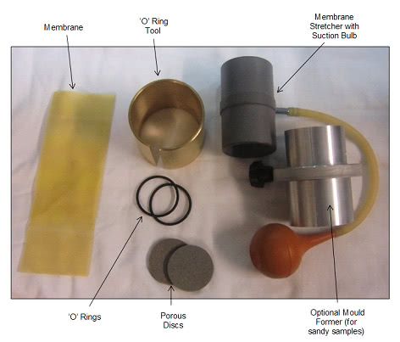
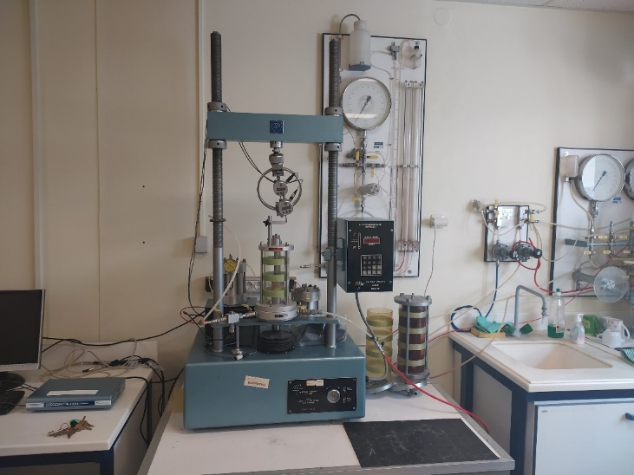
TRIAXIAL COMPRESSION TEST
Scope
Calculation and determination of the basic shear strength parameters of a soil sample: cohesion (c) and angle of internal friction (φ)
Equipment
Scale
(acc 0.1%)
Από VJ Tech
Caliper
Equipment
Triaxial Loading Device

Slide 22
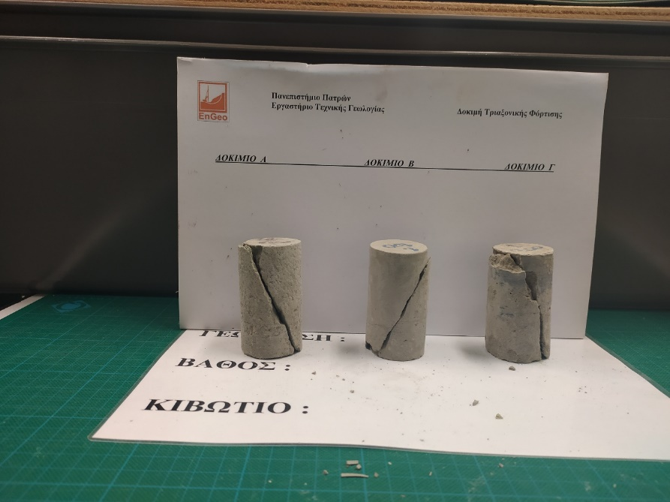
TRIAXIAL LOADING TEST METHODOLOGY (UU)
Test execution steps (Unconsolidated Undrained test - UU):
Cylindrical specimen from a primarily undisturbed soil sample with a diameter-to-height ratio of 1:2 to 1:3.
Placement of the specimen in the triaxial loading apparatus.
Installation of the elastic membrane and saturation of the specimen within the cell.
Application of constant confining pressure (σ3 axis) and varying axial load (σ1 axis) to the specimen.
Recording the variation of soil strength (deviator stress σ1-σ3) in relation to the normal-axial stress.
The test stops when a decrease in load is observed with increasing strain, or when the strain reaches 20%.
The test is repeated on similar specimens (at least 3) from the same soil for different confining pressures (σ3).
The results of the triaxial loading test are presented using the deviator stress $σ_1-σ_3$ (kPa) vs. strain (%) diagram and the maximum shear stress (kPa) vs. normal stress (kPa) diagram (Mohr-Coulomb circles).
Finally, the values of the shear strength parameters are presented: cohesion (c) and angle of internal friction (Φ).

Slide 23
VIEWING OF TRIAXIAL LOADING TEST (UU)
https://www.youtube.com/watch?v=7Hh45k1gqjU

Slide 24

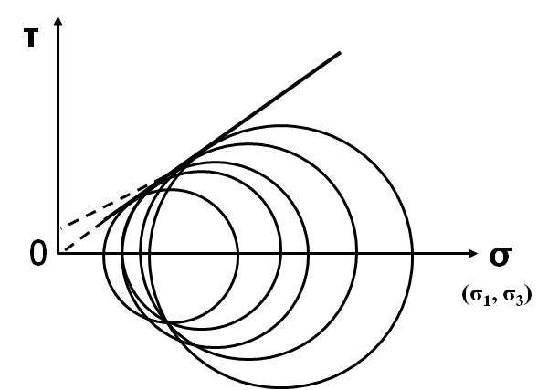
MOHR - COULOMB FAILURE CRITERION
Mohr circle: graphical representation of the stress state at the moment of failure on the failure plane.
Center (C): (σ₁+σ₃)/2
Radius (R) : (σ₁ - σ₃)/2
Mohr envelope: τ = f(σ)
τ = f(σ) (linear)
τ = c + σ_{n} . tanφ
c: cohesion
φ: angle of internal friction
Figure 4: Graphical representation of the Mohr-Coulomb failure criterion (from Koukis & Sabatakakis 2002)
Από Civil-Engineering-Texas Tech University

Slide 25
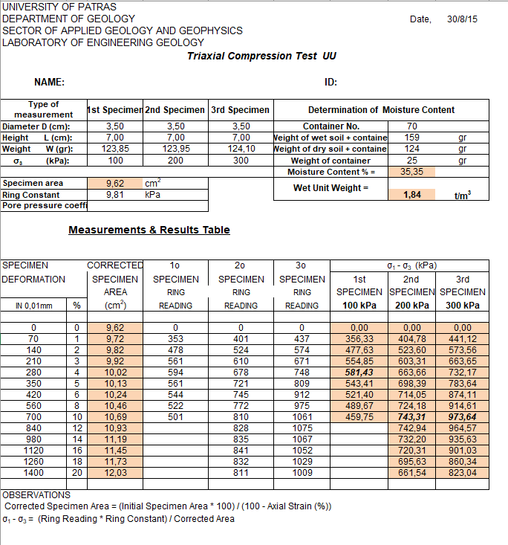



Calculations
Sample information and data
Calculation of Moisture Content and Wet Unit Weight
Calculation of Corrected Specimen Area
Calculation of principal deviator stress σ1-σ3 (kPa) for each specimen
(159-124)/(124-25)*100
(3,14*3,50^2/4)
$$\frac{123,95}{(3,14∗{3,50}^{2}/4)∗7}$$
We calculate the moisture content by dividing the weight of water by the weight of the dry sample.
We calculate the wet unit weight using the formula γb=ρ*g , where ρ=m/V with specimen volume V=(π*D²/4)*Η, g=9,81 m/sec² .
We calculate in cm² the 1st corrected area (π*D²/4) and in cm² the 2nd corrected area: (Initial Area / 100 - Strain(%)) *100.
We calculate the principal deviator stress σ1 - σ3 using the formula: (Ring Constant * Ring Reading) / Corrected Area.
$$\frac{9,62∗100}{100−1}$$
$$\frac{353∗9,81}{9,72}$$

Slide 26
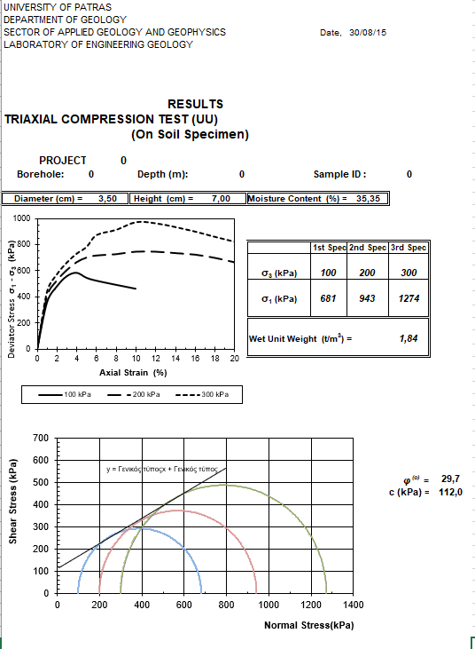
Calculations
Construction of the Deviator Stress σ1-σ3 (kPa) – Strain (%) plot and the Shear Stress (kPa) – Normal Stress (kPa) plot.
Calculation of σ1 and σ3 stresses, construction of Mohr circles and the failure envelope.
Recording of Results: Natural Moisture Content – Wet Unit Weight (t/m³) – Angle of Internal Friction (φ⁰) – Cohesion c (kPa).
973+300
Radius
Construction of Mohr circles with:
Center (C) : (σ₁+σ₃)/2
Radius (R): (σ₁ - σ₃)/2
581+100
743+200
Γ
Α
φ
Β
tanφ= ΒΓ/ΑΒ
φ=tan⁻¹ΒΓ/ΑΒ
Calculation of cohesion (c)
Distance from the origin to the intersection of the envelope with the y-axis.
Center
Calculation of the angle of internal friction: slope of the envelope line, tangent of angle ω in degrees.

Slide 27
EQUATIONS
Calculation of Moisture Content and Wet Unit Weight
Moisture Content (%) = (Weight of water (gr) / Weight of dry sample (gr)) * 100
Weight of dry sample = (Weight of dry sample + container (gr)) – Weight of container (gr)
Weight of water (gr) = Weight of wet sample – Weight of dry sample
Wet Unit Weight (gr/cm³) = m/V =m/(π*D²/4)*Η
To convert to t/m³, multiply by 10⁻⁶
Calculation of Strain (%), 1st and 2nd Corrected Area in cm² and m²
1st Corrected Area (cm²) = π*D²/4
2nd Corrected Area (cm²) = (1st Corrected Area / (100 - Strain (%))) * 100
Calculation of Stress σ1-σ3 (kPa)
Stress σ1-σ3 (kPa) = (Ring Reading * Ring Constant) / Corrected Area
Calculation of Cohesion (c) and Angle of Internal Friction (φ)
Calculation of cohesion (c): Distance from the origin to the intersection of the failure envelope with the y-axis.
Calculation of the angle of internal friction: Slope of the failure envelope line, tangent of angle ω, tanω= opposite / adjacent, ω⁰= tan⁻¹(opposite / adjacent).

