Slide 1
Waste management

Slide 3
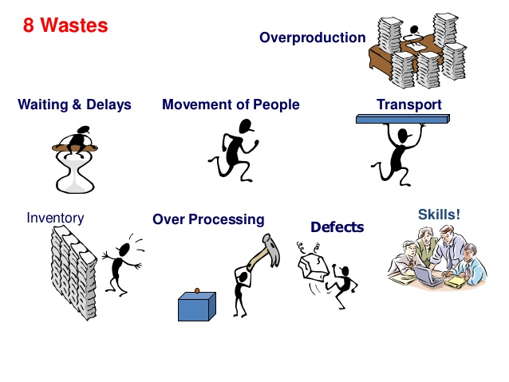
Οι 8 σπατάλες (muda) (Πηγή: leanbenchmark.org)

Slide 4
Waste Overproduction - Producing items for which there are no orders or unnecessarily producing more than demanded. Waiting - Idle time and delays for workers or machines. Over-processing - A manufacturing process that is unnecessary complex and does not add value, Taking unneeded steps to process the parts. Movement - Unnecessary movement of people, Any wasted motion employees have to perform during the course of their work, such as looking for, reaching for, or stacking parts, tools, etc. Transportation - Unnecessary movement of materials, creating inefficient transport, or moving materials, parts or finished goods into or out of storage or between processes. Inventory - Unnecessary storage of raw materials, intermediates or semi finished goods and finished goods that add cost. Defect - Error in producing the products or materials, resulting in scrap or rework. Under utilization of HR - The waste of not using people to the best of their unique abilities.

