Slide 2
A data-driven improvement technique
An organizational phenomenon
A total quality improvement philosophy
A process improvement framework
A problem-solving methodology
A management philosophy
A science

Slide 3
Six sigma
Blends management, financial and methodological elements
To make improvements to processes and products concurrently

Slide 4
Six sigma
Uses both statistical and non-statistical tools/techniques
To eliminate process variation
To improve process performance and capability

Slide 5
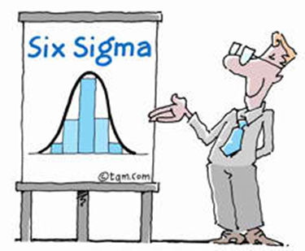
d > 6s
LSL
USL
Sig sigma definition
m
3s
6s
LSL
d > 6s
USL
m
3s
6s
m = the mean value of the quality characteristic, s = standard deviation of a sample USL, LSL = Upper and Lower Specification Limit

Slide 6
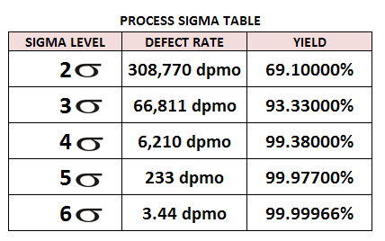
The term Six Sigma is defined as having less than 3.4 defects per million opportunities or a success rate of 99.99966%.
The higher the sigma level, the less likely it is that a process will create defective parts.

