Slide 1
Lean manufacturing - Toyota Production System

Slide 2
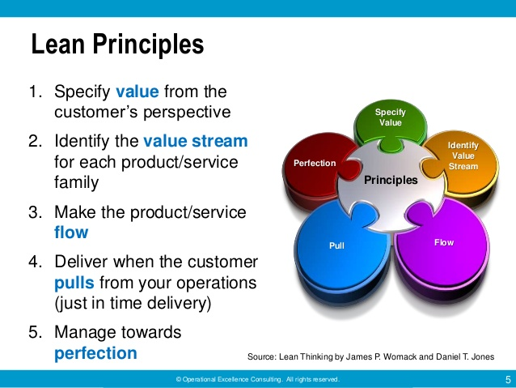

Slide 3
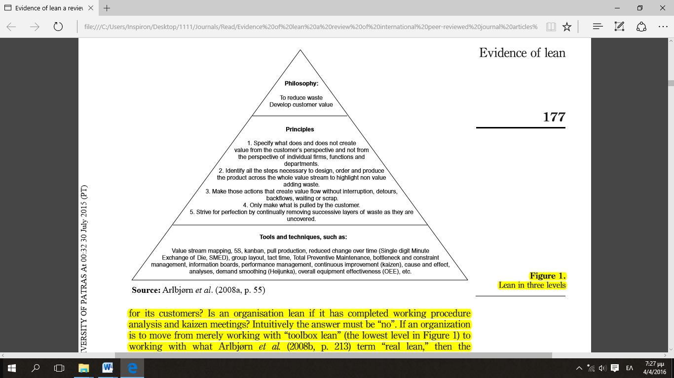

Slide 4
Definition of leanness: Continuous improvement of the combined efficiency–effectiveness attributes Bayou and Korvin (2008)

Slide 5
Lean Sigma
Lean and Six Sigma are focused on continuous improvement of the system.
Lean
Eliminate waste
Achieve flow and pull
Six Sigma
Eliminate defects
Reduce variation in processes

