Slide 1
Total Quality Management in the pursue of
Business Excellence
Dr. Evangelos Psomas

Slide 2

The European Foundation for Quality Management (EFQM) Business Excellence Model
Is widely recognized as a representative theory to improve traditional TQM by expanding the quality concept into a holistic management concept.
TQM and Business Excellence offer a sound way of managing organizations in the 21st century.

Slide 3
In organizations, the EFQM model is widely used in different ways:
as a tool for self-assessment
as a way to benchmark with other organizations
as a guide to identify areas for improvement
as the basis for a common vocabulary and a way of thinking
as a structure for the organization’s management system.

Slide 4
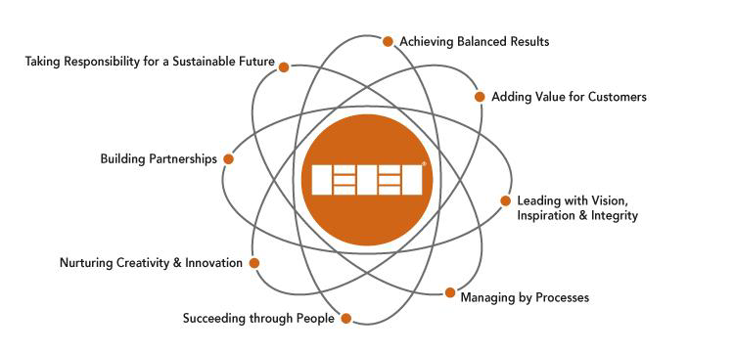
Fundamental concepts of Excellence

Slide 5
The EFQM-Model of Excellence – The criteria

Slide 6







Πιστοποιήσεις Επιχειρηματικής Αριστείας
Levels of Excellence
Οι «σταθμοί» του Ταξιδιού
Συγκριθείτε με τις καλύτερες Επιχειρήσεις στην Ευρώπη
Σχεδιάστε και Καταγράψτε τη πρόοδό σας…
300 – 399 βαθμοί
400 – 499 βαθμοί
> 500 βαθμοί
Δημιουργήστε Πάθος και Δέσμευση…

Slide 7

3 different levels exist
1st level
EFQM Committed to Excellence
It is the first milestone in the journey towards Excellence.
An organisation needs to identify 3 priority improvement initiatives from a self-assessment and, over the next 6 – 12 months implement these projects (they are validated by an external assessor).

Slide 8

2nd level
EFQM Recognised for Excellence (3, 4, 5 star)
It recognises the efforts and identifies good practices.
Organisations assess themselves against the EFQM Model above 300 points.
The assessment is carried out by an independent team of EFQM Assessors.

Slide 9

3rd level
EFQM Excellence Award (Finalist, Prize Winner, Award Winner).
Compare the organisation against other world-class leaders based on complete assessment by an expert assessor team spending on average 500 hours on each application.
All applicants are qualified at 500 points before they can enter the Award process.

Slide 10
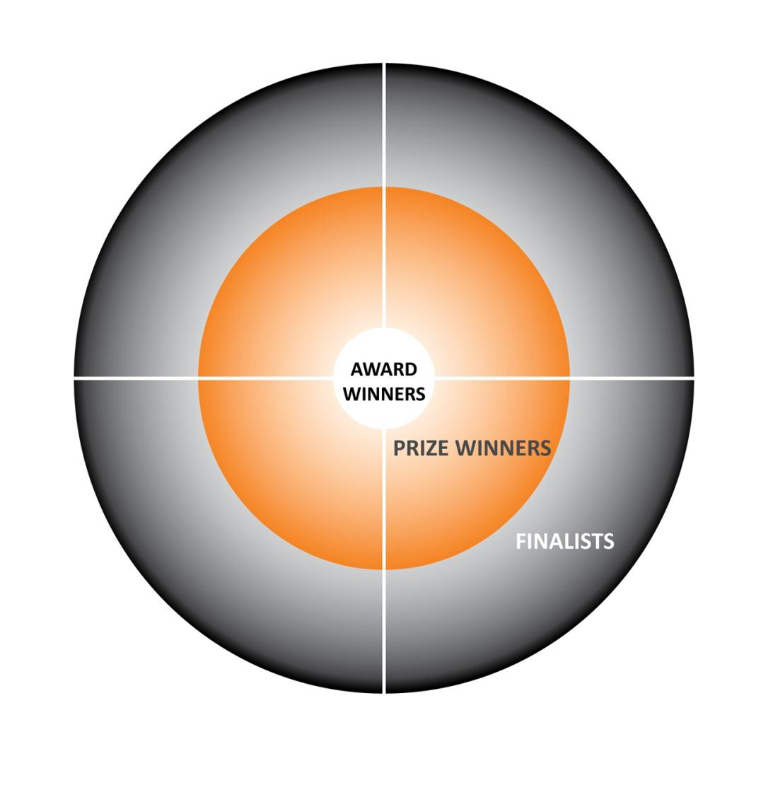

Slide 11
A road to Business Excellence

Slide 12
Top countries with companies that reached the final phase of EQA

Slide 13
Some relevant known prior adopters
EFQM/Baldrige Award Winners....
TNT Express
TNT Post Group
Philips Distribution
DHL
FedEx
Other TQM adopters in Transport and Shipping...
•Train Operating Companies in UK (part of franchise bid)
•Maersk
•P & O Ferries
• 3663 First for Food Service

Slide 14
Some additional information and milestones associated with the EFQM model:
The first organization that has been distinguished with the Award Winner category was Rank Xerox (UK branch).
In 2000 for the first time an university did reach the Finalist category – Marmara University, Faculty of Engineering, Turkey.
In 2001 for the first time a teaching institution did win an award – St. Mary’s College, in Northern Ireland.
During the time period that ranged from 1992 to 2009, 13 teaching institutions reached the final phase of the EQA, including three universities.
In 2005 the first hospital – Zumarraga Hospital, Spain, was distinguished in the Prize Winner category.
In 1999 the first financial institution – Bank International d’Andorra, Andorra, was distinguished in the Prize Winner category.

