Slide 1
University of Patras
Department of Business Administration of
Food and Agricultural Enterprises
Patra, Greece
RISK-BASED THINKING
IN ISO 9001:2015
Evangelos L. Psomas
Assistant Professor
18-19 April 2018, Rome, Italy

Slide 2

The structure of the presentation
ISO Objectives and Risk.
What is Risk? Examples.
Risk-based thinking?
Why use risk-based thinking?
What Should I Do?
Key Points to Remember
Risk Assessment
Risk Register
Where is risk addressed in ISO 9001:2015?
Conclusion

Slide 3
The Main Objectives of International Standards and Risk
To provide confidence in the organization’s ability to consistently provide customers with conforming goods and services.
To enhance customer satisfaction.
The concept of “risk” in the context of the international standards relates to the uncertainty in achieving these objectives.

Slide 4
What is Risk?
Risk is the possibility of events or activities impeding the achievement of an organization’s strategic and operational objectives.
Examples:
Suppliers does meet delivery requirements.
e.g. Medium Probability and high impact.
Customer does not provide timely feedback on interim releases.
e.g. Low Probability and medium impact.
A project is delayed because of insufficient test resources.
e.g. Medium Probability and medium impact.

Slide 5
Risk Based Thinking
Risk-based thinking is something we all do automatically and often sub-consciously.
For example: If I wish to cross a road I look for traffic before I begin. I will not step in front of a moving car.
The concept of risk has always been implicit in ISO 9001 – the 2015 revision makes it more explicit and builds it into the whole management system.
Risk-based thinking is already part of the process approach.
Risk-based thinking makes preventive action part of the routine.
Risk is often thought of only in the negative sense.
Risk-based thinking can also help to identify opportunities. This can be considered to be the positive side of risk.

Slide 6
Why use risk-based thinking?
Risk-based thinking:
establishes a proactive culture of improvement,
assists with regulatory compliance,
assures consistency of quality of products and services,
improves customer confidence and satisfaction,
successful companies intuitively take a risk based approach.

Slide 7
What Should I Do?
Identify what the risks and opportunities are in your organization – it depends on context.
ISO 9001:2015 will not automatically require you to carry out a full, formal risk assessment, or to maintain a “risk register”.
ISO 31000 (“Risk management — Principles and guidelines”) will be a useful reference (but not mandated).

Slide 8
What Should I Do?
Analyse and prioritize the risks and opportunities in your organization
– what is acceptable?
– what is unacceptable?
Plan actions to address the risks
– how can I avoid or eliminate the risk?
– how can I mitigate the risk?
Implement the plan – take action
Check the effectiveness of the actions – does it work?
Learn from experience – continual improvement

Slide 9
Key Points to Remember
Risk Based Thinking = Preventative Action
Risk Based Thinking is everybody’s business!
Risk Based Thinking is not just the responsibility of management
Risk Based Thinking must become an integral part of the organizational culture.

Slide 10
Risk Assessment
Risk can be defined by two (2) parameters –
Severity - This is the Seriousness of the harm
Probability - This is the Probability that the harm will occur

Slide 11
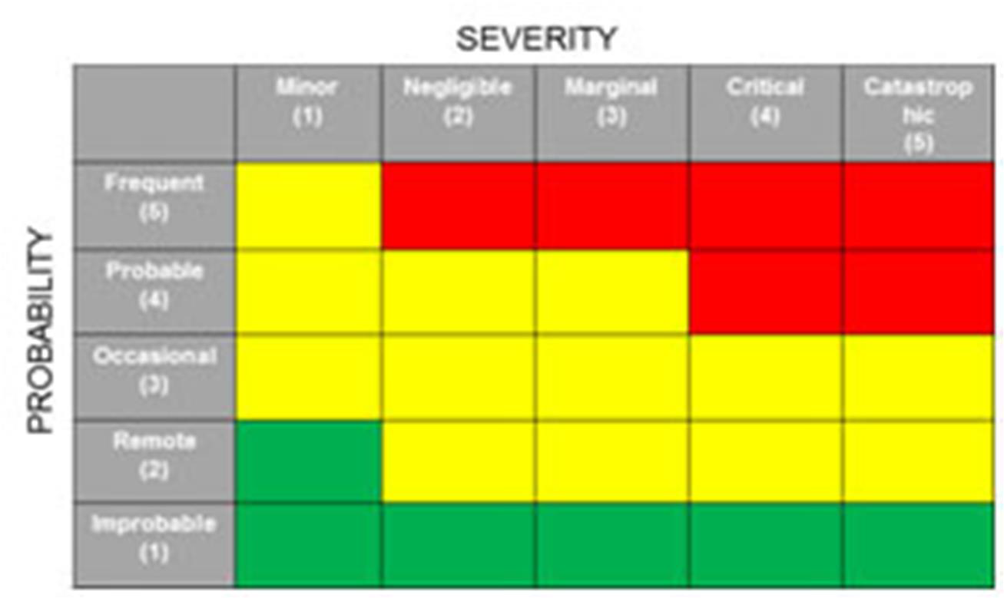
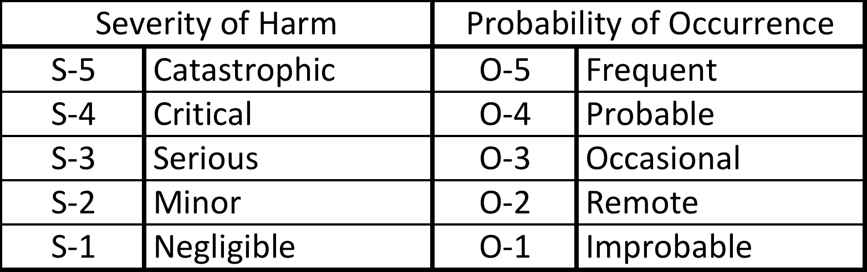
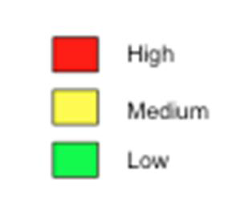
Risk Assessment - Quantitative

Slide 12
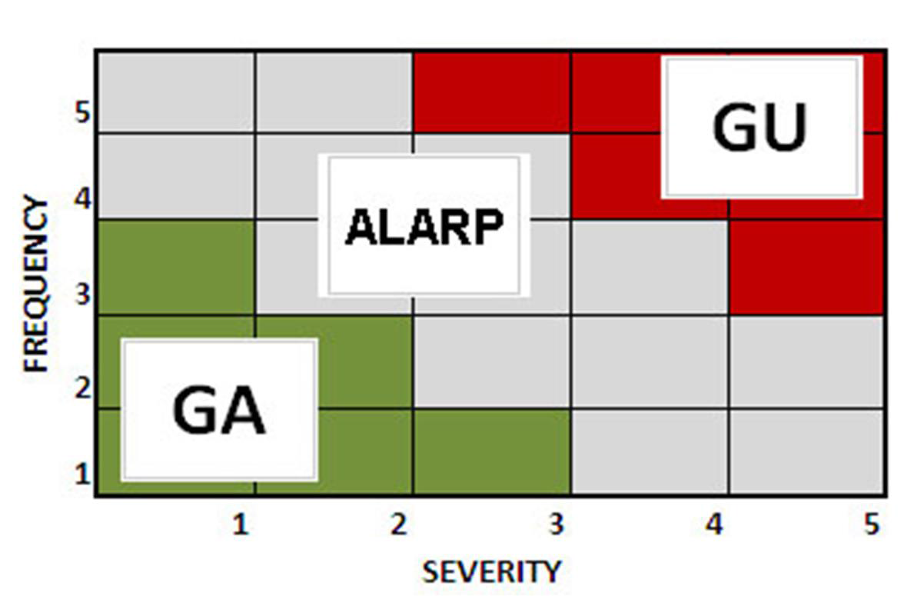

Slide 13
The Importance of a Risk Register
The risk register becomes essential as it records identified risks, their severity, and the actions steps to be taken.
It can be a simple document, spreadsheet, or a database system, but the most effective format is a table.
A table presents a great deal of information in just a few pages.

Slide 14
Components of a Risk Register
There is no standard list of components that should be included in the risk register. Some of the most widely used components are:
Dates that risks are identified.
Description of the Risk.
Risk Type (business, project, stage): Classification of the risk: Business risks relate to delivery of achieved benefit, project risks relate to the management of the project such as timeframes and resources, and stage risks are risks associated with a specific stage of the plan.
Likelihood of Occurrence.
Severity of Effect.
Countermeasures: Actions to be taken to prevent, reduce, or transfer the risk.
Owner
Status: Indicates whether this is a current risk or if risk can no longer arise.

Slide 15
Where is risk addressed in ISO 9001:2015?
The concept of risk-based thinking is explained in the introduction of ISO 9001:2015 as an integral part of the process approach.
ISO 9001:2015 uses risk-based thinking in the following way:
Introduction - The concept of risk-based thinking is explained.
Clause 4 – The organization is required to determine its QMS processes and to address its risks and opportunities.
Clause 5 – Top management is required to
promote awareness of risk-based thinking
determine and address risks and opportunities that can affect product /service conformity.

Slide 16
Where is risk addressed in ISO 9001:2015?
Clause 6 – The organization is required to identify risks and opportunities related to QMS performance and take appropriate actions to address them.
Clause 7 – The organization is required to determine and provide necessary resources.
Clause 8 – The organization is required to manage its operational processes.
Clause 9 – The organization is required to monitor, measure, analyse and evaluate effectiveness of actions taken to address the risks and opportunities.
Clause 10 – The organization is required to correct, prevent or reduce undesired effects and improve the QMS and update risks and opportunities.

Slide 17
Conclusion
Risk-based thinking:
is not new
is something you do already
is on-going
ensures greater knowledge of risks and improves preparedness
increases the probability of reaching objectives
reduces the probability of negative results
makes prevention a habit

Slide 18
Other useful documents
ISO 31000:2009 Risk Management – Principles and guidelines
PD ISO/TR 31004:2013 Risk management - Guidance for the implementation of ISO 31000
ISO 31010:2010 Risk management - Risk assessment techniques

Slide 19
Thank you for your attention!

