Slide 1
The four levels in the evolution of TQM

Slide 2
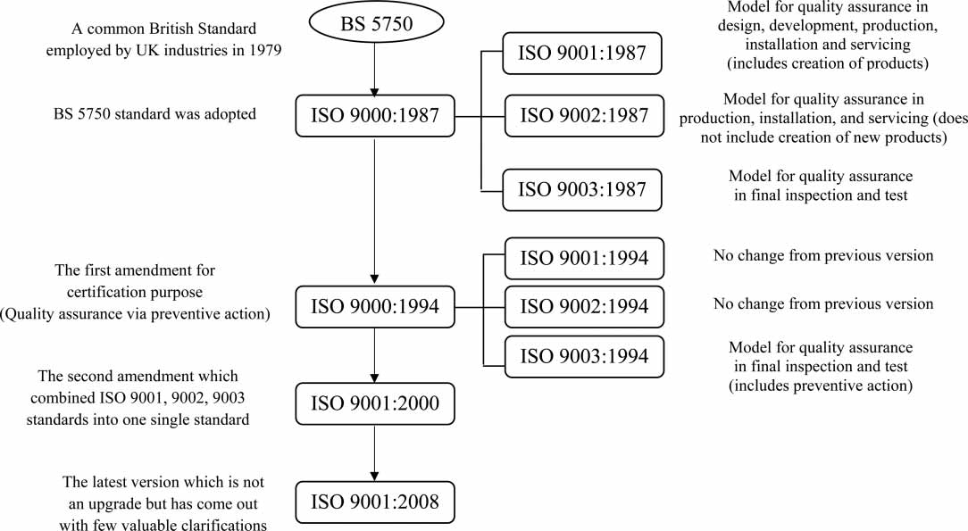

Slide 3
Evolution of the quality concept

Slide 4

History of Quality Management
1931 – Shewhart
1979 – Crosby
1976, 1985 – Ishikawa
1986 – Deming
1986 – Juran
1991 – Feigenbaum
1987 – ISO 9000
1987 – Malcom Baldrige Award
1988 – EFQM
1991 – European Quality Award

