Slide 1
1. Long bone implants

Slide 2
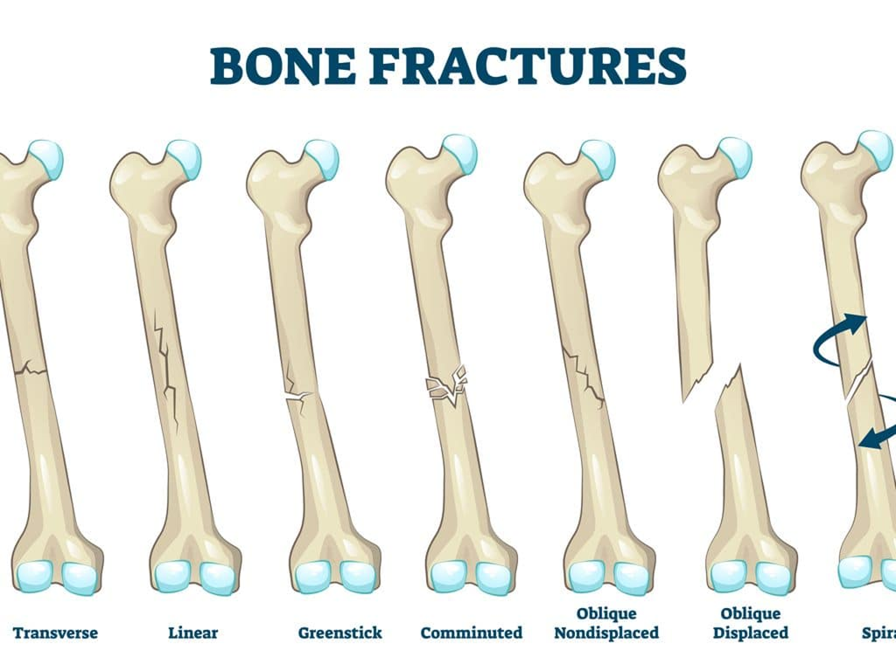
Fractures are categorized according to their form.
Grouping is useful in determining prognosis and management:
A comminuted fracture: This is when the bone continues to have its normal shape and the fracture looks like a crack on the x-ray.
Transverse fracture: It is perpendicular to the long axis of the bone. In many cases, once reassigned, it remains firmly in place.
Oblique fracture: It is oblique to the long axis of the bone. It is unstable and leaves the position of restoration.
Crushing fracture: It is the fracture where the bone, due to the exercise of great force, has been broken into several pieces.
Intra-articular fracture: It is the fracture where there is damage to the articular surface. It may cause arthritis in the joint in the long run.
Detachment fracture: It is the fracture where a small part of the bone has been detached from its position, but without the bone losing its supporting capacity.
Selected fracture: These are the fractures where skin injury is present. Depending on the degree of exposure of the bone to the wound, they are divided into three categories. The third category is where the bone is exposed outside the skin. In complicated fractures there is a risk of microbial inflammation and osteomyelitis.

Slide 3
Long bone implants
Osteosynthesis Materials
The main osteosynthesis materials are:
Wire
Screws
Plaques
Angular heels
Intramedullary cells
External osteosynthesis devices
The metals from which they are made are:
Cobalt-nickel alloys
Stainless medical steel
Titanium

Slide 4
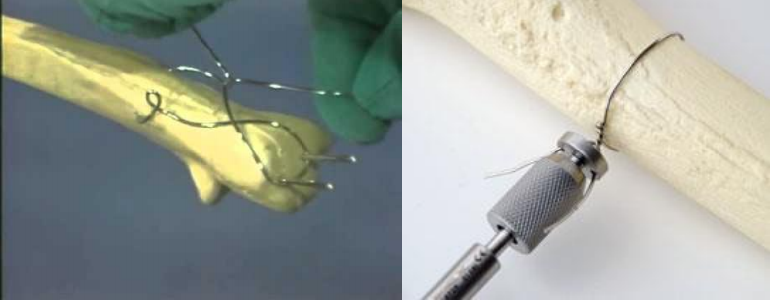
Long bone implants
Wire
The wire is used to hold small pieces of bone
In combination with Kirchner type needles, it can be used as a traction tape for the internal osteosynthesis of fractures (olecranon – patella)

Slide 5
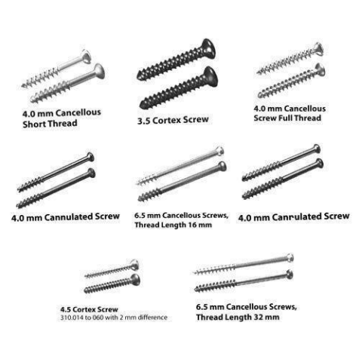
Long bone implants
Screw
The screw is a very useful material in the osteosynthesis of fractures
It is possible to use it alone (inter-destructive compression), or by stabilizing other materials such as plates & stones
There are many types of bone screws, but there are two main types:
Spongy
Cortical

Slide 6
Long bone implants
Plaques
There are various types of plates, most of which are used to achieve a completely stable osteosynthesis, but & plates for the application of biological osteosynthesis, which provides relative stability

Slide 7
Long bone implants
The main types of plaque
Dynamic Compression Plate (D.C.P. Dynamic Compression Plate)
Dynamic compression plate of partial (limited) contact (L.C.-D.C.P. Limited Contact - Dynamic Compression Plate)
Tubular plates
Reconstruction Plates
Special plates (Type Y, Type T, Type Cobra, etc.)

Slide 8
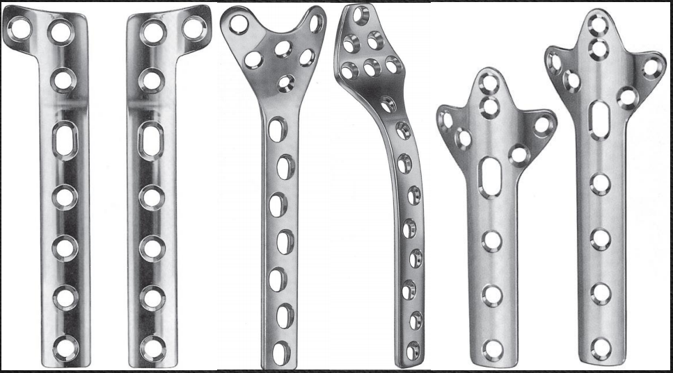
Long bone implants

Slide 9
Long bone implants
Intramedullary Helios
Intramedullary arthrodesis is indicated in the treatment of fractures mainly of the diaphysis of long luminal bones
They are applied either open or closed with the help of a fluoroscopic machine
Intramedullary Helios
There are several types of intramedullary cords
The main ones are:
Unsecured helos with glyphs
Unsecured helos without glyphing
Insurable helos with glyphing
Insurable helos without glyphs

Slide 10
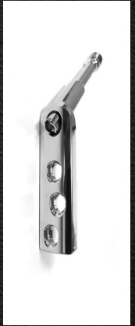
Long bone implants
Angular Suns
They consist of plate and iron
They are indicated in the osteosynthesis of fractures of the central & distal end of the femur (transtrochanteric & supracondylar femur fractures)
The main categories of these threads are:
Fixed Angle Angular Heels
Variable angle angled heels
Angled fixed angle screws with sliding screw

Slide 11
External Osteosynthesis
Device, which is placed outside the body & which stabilizes fracture ends using pins, which connect the bone to the device
External osteosynthesis is a safe method for fracture stabilization
External osteosynthesis systems, depending on the type of their frame, are divided into:
One sided
Bilaterally
Circularly
External Osteosynthesis
♦ Advantages:
It does not impair the bone perfusion in the area of ​​the fracture
No major surgical trauma is required for placement
It is useful for stabilizing open fractures
It can be adjusted without requiring new surgery.
It is considered a good choice in cases of increased risk of inflammation
It is a fairly safe method in cases of bone infection
♦ Disadvantages:
Development of inflammation of the skin at the points of entry of the needles
Stiffness (femur fractures)
It is relatively bulky and often not tolerated by the patient

Slide 12
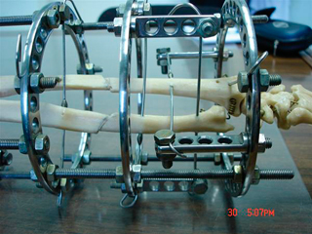
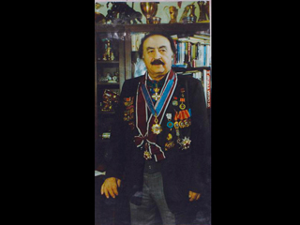
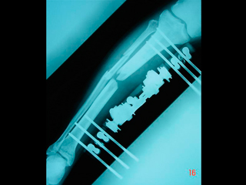
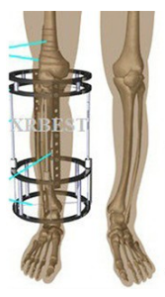
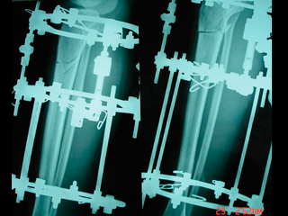
http://www.klinikiagiosloukas.gr/issues.php?i=13&a=164
The method invented and applied by the world-famous orthopedic surgeon G. Ilizarov for the lengthening and correction of bone and joint deformities has successfully toured the world and offered quality of life to thousands of patients.
https://www.newsbeast.gr/health/arthro/2067784/katagmata-knimis

Slide 13
Η μέθοδος Ιλιζάρωφ (Ilizarov)
http://www.klinikiagiosloukas.gr/issues.php?i=13&a=164
For the first time in world medical practice, Ilizarov put into practice the method of growing the tissues of the organism. In other words, he observed and proved that after osteotomy and with the removal of parts of the bone, new bone is created. At the same time, vessels, nerves and soft tissue are created (expansive histogenesis method). At the same time, he created the external osteosynthesis of the bones which consists of needles, rings and rods. By applying the method, people gained the unique ability to increase their body height, correct post-traumatic deformities and heal from hereditary and acquired skeletal diseases.

Slide 14
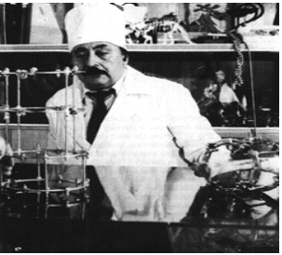
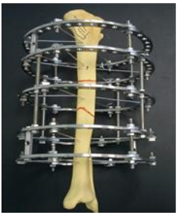
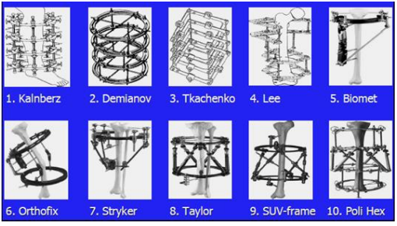
Β. Κεχαγιάς, Θ. Γρίβας. Περιγραφή Των Κυκλικών Πλαισίων Τύπου Ilizarov. Επιστημονικά Χρονικά 2014;19(2): 171-179.
Ο Gavriil Abramovich Ilizarov (15/06/1921- 24/07/1992) was a Russian doctor
Ilizarov device
Cyclic systems of external ossification of various types

Slide 15
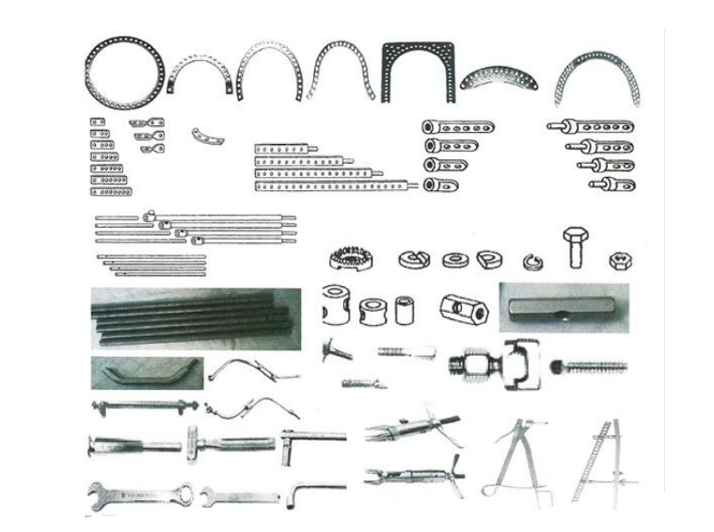
Β. Κεχαγιάς, Θ. Γρίβας. Περιγραφή Των Κυκλικών Πλαισίων Τύπου Ilizarov. Επιστημονικά Χρονικά 2014;19(2): 171-179.
In particular, it consists of:
• rings of various types (full, half rings, 5/8, with curved ends),
• arches,
• connecting plates (straight, twisted, curved, with threaded ends),
• connecting rods (threaded, with holes, telescopic, Z-shaped),
• simple and oiled needles,
• nails,
• special half pins,
• male and female supports and especially for half pins,
• screws (slotted, connecting, Russian type),
• nuts,
• washers (slotted, toothed, conical, spherical),
• threaded sockets,
• flexible links,
• simple and dynamic needle tensioners,
• surgical chisels,
• hammers,
• keys,
• angle meters,
• cutters,
• pliers,
• bone clamps,
• surgical drills and
• surgical burs.

Slide 16
Β. Κεχαγιάς, Θ. Γρίβας. Περιγραφή Των Κυκλικών Πλαισίων Τύπου Ilizarov. Επιστημονικά Χρονικά 2014;19(2): 171-179.
Results
The advantages of the Ilizarov system are as follows:
• great stability,
• percutaneous approach and closed reduction of the fracture,
• minimizing the risk of infections,
• reduced blood loss and need for transfusions,
• possibility of correcting the deformation of the axis during the healing of the fracture,
• loading of the affected leg from the first postoperative day,
• removal of this at outpatient level.
The disadvantages of this are as follows:
• soft tissue infection through the needles,
• loosening of needles, sutures and screws,
• mood disorders and mild depressive symptoms.
Conclusion
In summary, we must note that the Ilizarov method and device is an effective alternative proposal for dealing with intractable orthopedic problems. This is based on the biomechanical principle of axial compressive loading and micromotion in the osteogenesis zone, stimulating bone bridging of the fracture, with the result that this method is successful in cases where other methods have failed. But the Ilizarov device is a complex system of many mechanical parts. Its application is therefore quite difficult and requires a significant learning curve from the orthopedic surgeon, in order to cope with the difficulties of the surgical operations.

Slide 17
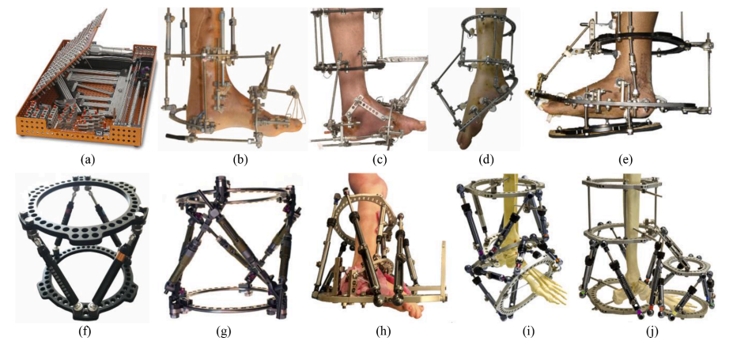
Taylor Spatial Frame
(a) Mechanical parts of IEF, (b-e) clinical application of IEF, (f) Taylor Spatial Frame, (g) Ortho-SUV Frame, (h-j) clinical application of HEF
Ilizarov external fixator (IEF) (εξωτερικός σταθεροποιητής)
Hexapod external fixator (ΗΕF) (εξάποδος εξωτερικός σταθεροποιητής)
Taylor Spatial Frame (χωρικό πλαίσιο)

Slide 18
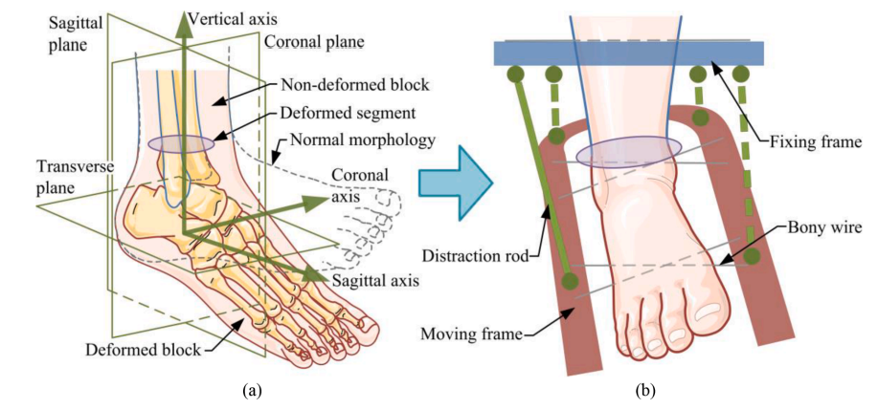
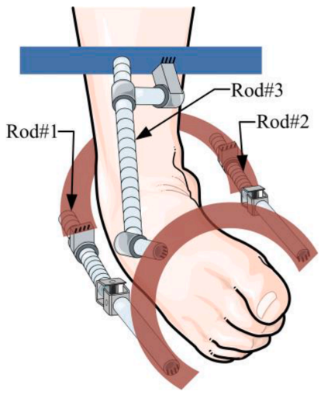
Deformity form of foot and ankle deformity.
(b) Correction pattern using an external fixator.

Slide 19
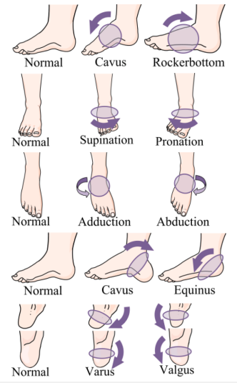
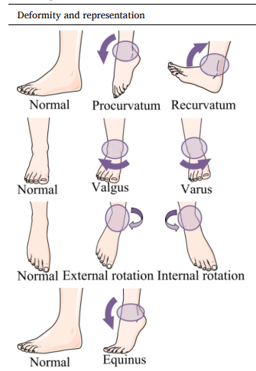

Slide 20
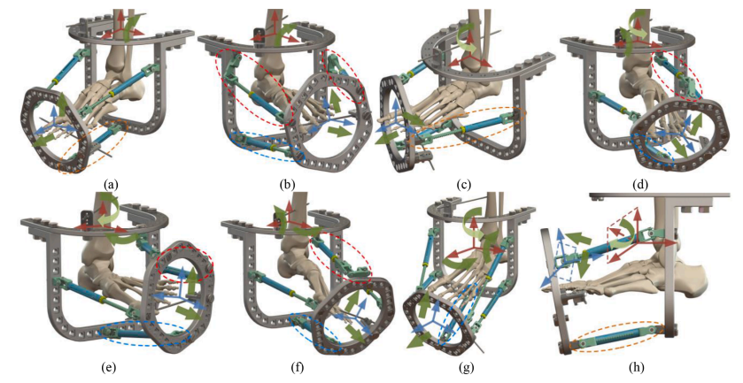
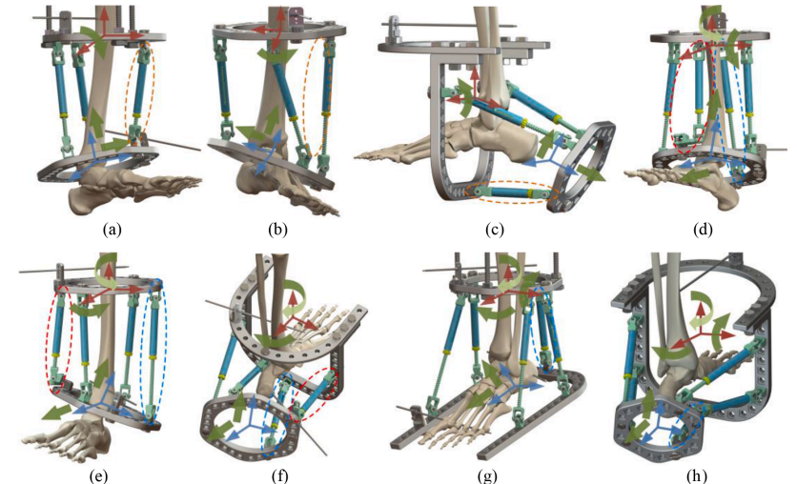

Slide 21
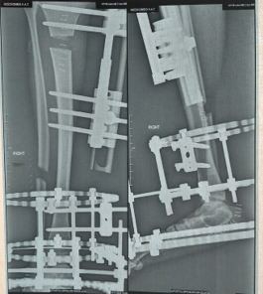
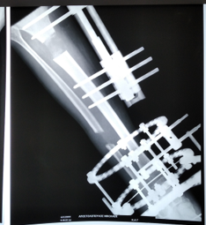
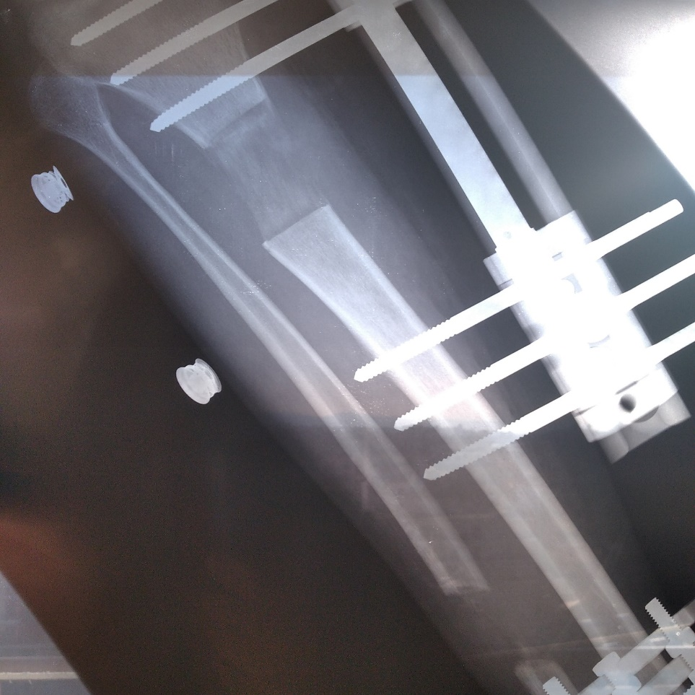
10-11-22
15-12-22
26-01-23
Σχηματισμός οστού
Κάλυψη ανισοσκελίας 43 χιλ. Το κενό καλύπτεται με οστό μεγαλύτερης πυκνότητας
Τομή στην κνήμη για αντιμετώπιση ανισοσκελίας (3 εβδομάδες μετά το χειρουργείο-απομάκρυνση 1χιλ/24 ώρες, χρησιμοποιώντας την τεχνική Ilizarov)
Από 10-11-22 η απομάκρυνση του οστού γινόταν με (0,5χιλ/24 ώρες)
έως 31-01-22.
Bone formation
Inequality coverage 43 mm. The gap is covered with denser bone
Incision in the tibia to treat inequality (3 weeks after surgery-removal of 1mm/24 hours, using the Ilizarov technique)
From 10-11-22 the bone was removed with (0.5 mm/24 hours) until 31-01-22.

Slide 22
Ενδεικτική βιβλιογραφία
Β. Κεχαγιάς, Θ. Γρίβας. Περιγραφή Των Κυκλικών Πλαισίων Τύπου Ilizarov. Επιστημονικά Χρονικά 2014;19(2): 171-179.
http://www.klinikiagiosloukas.gr/issues.php?i=13&a=164
Εμφυτεύματα μακρών οστών – Wikipedia
Υλικά Οστεοσύνθεσης – Wikipedia
Configuration synthesis and structural design of lower-mobility parallel external fixators based on corrective degree-of-freedom classification

