Slide 1
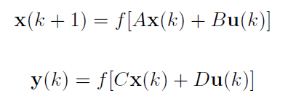
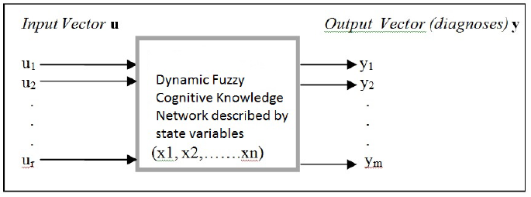
A New approach of Dynamic Fuzzy Cognitive Knowledge Networks in Modelling Diagnosing Process of Meniscus Injury
A. Anninou, P. Groumpos, P. Poulios, I. Gkliatis
Department of Electrical and Computer Engineering, University of Patras, Greece
Abstract
Abstract
Treatment Stage
Present a novel approach of Fuzzy Cognitive Maps
Testing for accuracy in diagnosing knee injuries
New model is based on experts knowledge and experience
New Input u-Treatment→ New states x, New Outputs y
x(k+1)=f[Ax(k)+Bu(k)]
y(k+1)=f(Cx(k+1)
Daily analgesics (NSAIDs) were administered for 6 weeks
New approach of Dynamic Fuzzy Cognitive Knowledge Network is proposed
Update classic methodology of Fuzzy Cognitive Maps in order to overcome its drawbacks
The new method is tested for its accuracy in a Decision Support System, diagnosing knee injuries by using 17 real cases of patients
Diagnosing of meniscus injury and distinguishing between acute and degenerative injury
Observation of the evolution of the injury by administering a proposed treatment by the physician
Very satisfactory results for both two diagnosing levels and treatment stage
Diagnoses are in total agreement with Magnetic Resonance Imaging outcomes
Close collaboration between engineers and medical doctors to construct the model
Wide use in many real time problems.
Results
16 out of 17 patients suffered from meniscal tear
10 cases were positive to degenerative injury
6 cases positive to acute injury
1st patient: full rehabilitation in degenerative injury after NSAIDs
Methods
Dynamic Fuzzy Cognitive Knowledge Networks:
Same construction procedure
Two Equations
Fuzzy States
Fuzzy Inputs
Fuzzy Outputs
Conclusions-Future Research
New modelling method reduces classic FCM drawbacks
Combination of initial states and inputs are sufficient to provide information about both the future states and outputs
Integrated model for knee injuries diagnosis
Verified results by MRI
Diagnosing Meniscus Injury
References
First Level: Meniscus Tear or not
Second Level: Acute or Degenerative Injury

Slide 2
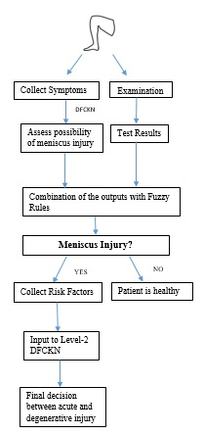
A New approach of Dynamic Fuzzy Cognitive Knowledge Networks in Modelling Diagnosing Process of Meniscus Injury
A. Anninou, P. Groumpos, P. Poulios, I. Gkliatis
Department of Electrical and Computer Engineering, University of Patras, Greece
Methods
Abstract
Treatment Stage
Present a novel approach of Fuzzy Cognitive Maps
Testing for accuracy in diagnosing knee injuries
New model is based on experts knowledge and experience
New Input u-Treatment→ New states x, New Outputs y
x(k+1)=f[Ax(k)+Bu(k)]
y(k+1)=f(Cx(k+1)
Daily analgesics (NSAIDs) were administered for 6 weeks
A_{i} →
States
Results
Inputs
16 out of 17 patients suffered from meniscal tear
10 cases were positive to degenerative injury
6 cases positive to acute injury
1st patient: full rehabilitation in degenerative injury after NSAIDs
Methods
States-States Relationships: Matrix A
States-Inputs Relationships: Matrix B
States-Outputs Relationships: Matrix C
Outputs
Dynamic Fuzzy Cognitive Knowledge Networks:
Same construction procedure
Two Equations
Fuzzy States
Fuzzy Inputs
Fuzzy Outputs
Diagnostic Procedure
Conclusions-Future Research
Algorithm:
Step 1: Ask experts to define the basic concepts
Step 2: Separate them into Fuzzy States, Inputs and Outputs
Step 3: Experts construct weight matrices between Outputs-States, Outputs-Inputs, States-States, States-Inputs, using linguistic variables
Step 4: Convert weight matrices into numeric values using defuzzification method of Center of Area (CoA)
Step 5: Detect initial states in time unit “k”
Step 6: Compute Initial Output in “k” from y(k)=f[Cx(k)+Du(k)]
Step 7: Detect new Input in our system in time unit “k”
Step 8: Compute new States in time unit “k+1”, with Eq. (2)
Step 9: Compute new output in “k+1” according to Eq. (3)
Step 10: Renew the input value in “k+2”
Step 11: Repeat steps 8-10 until desired time variable is reached
New modelling method reduces classic FCM drawbacks
Combination of initial states and inputs are sufficient to provide information about both the future states and outputs
Integrated model for knee injuries diagnosis
Verified results by MRI
Diagnosing Meniscus Injury
References
First Level: Meniscus Tear or not
Second Level: Acute or Degenerative Injury

Slide 3
A New approach of Dynamic Fuzzy Cognitive Knowledge Networks in Modelling Diagnosing Process of Meniscus Injury
A. Anninou, P. Groumpos, P. Poulios, I. Gkliatis
Department of Electrical and Computer Engineering, University of Patras, Greece
Diagnosing Meniscus Injury
Abstract
Treatment Stage
Present a novel approach of Fuzzy Cognitive Maps
Testing for accuracy in diagnosing knee injuries
New model is based on experts knowledge and experience
First Level
y: Meniscal Tear
x: States-Symptoms Checklist:
Clicking
Catching
Giving way/weakness
Localized pain
Episodic pain
Pain with activity
Pain with pivoting/twisting
Change in quality/pattern of pain
Locking
Acute swelling
Subacute swelling
Weight bearing
Continued in athletic activity
Fuzzy Rules:
IF the output is between 0-3.0125 THEN the output fuzzy variable is "Low“
IF the output is between 3.0126-6.025, THEN the output fuzzy variable is "Medium
If one or more tests from the list: T1, T2, T3, T4, T5, T6 are positive THEN the patient suffers from meniscal tear. IF Meniscal Tear is Medium AND only test T7 is positive THEN the patient does not suffer from meniscal tear.
IF the output is between 6.026-9.0375, THEN the output fuzzy variable is "High“
IF the output is between 9.0376-12.05, THEN the output fuzzy variable is "Very High"
New Input u-Treatment→ New states x, New Outputs y
x(k+1)=f[Ax(k)+Bu(k)]
y(k+1)=f(Cx(k+1)
Daily analgesics (NSAIDs) were administered for 6 weeks
Results
16 out of 17 patients suffered from meniscal tear
10 cases were positive to degenerative injury
6 cases positive to acute injury
1st patient: full rehabilitation in degenerative injury after NSAIDs
Methods
Dynamic Fuzzy Cognitive Knowledge Networks:
Same construction procedure
Two Equations
Fuzzy States
Fuzzy Inputs
Fuzzy Outputs
Conclusions-Future Research
Clinical Tests
x: Risk Factors:
Sport activity
Systemic laxity
History of previous injury/surgery
Time From initial ACL Injury>2-5 years
Lifting weight routine
Age>60 years old
Male gender
Work related/frequently kneeling-squatting
Using stairs frequently
BMI>25 kgr/m²,
Standing/walking routine
Chronic recurring pain and swelling after exercise, Minor trauma/Insignificant traumatic injury, Quads wasting/VMO assymetry, Pain/symptoms bilaterally present, Vaguer / more subtle symptoms ( no knee block), Knee OA present
New modelling method reduces classic FCM drawbacks
Combination of initial states and inputs are sufficient to provide information about both the future states and outputs
Integrated model for knee injuries diagnosis
Verified results by MRI
Diagnosing Meniscus Injury
OUTPUT: Meniscal Tear on not
Second Level
References
First Level: Meniscus Tear or not
Second Level: Acute or Degenerative Injury

Slide 4
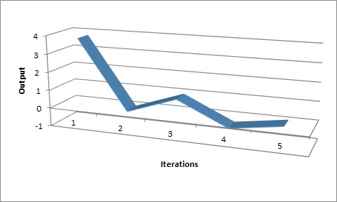
A New approach of Dynamic Fuzzy Cognitive Knowledge Networks in Modelling Diagnosing Process of Meniscus Injury
A. Anninou, P. Groumpos, P. Poulios, I. Gkliatis
Department of Electrical and Computer Engineering, University of Patras, Greece
Abstract
Treatment Stage
Treatment Stage
Present a novel approach of Fuzzy Cognitive Maps
Testing for accuracy in diagnosing knee injuries
New model is based on experts knowledge and experience
Νοnsteroidal anti inflammatory drugs (NSAIDs) for 6 weeks → improve knee function
4 re-examinations → 4 iterations
Input values: u1=, u2=0.5, u3=u4=1
New Input u-Treatment→ New states x, New Outputs y
x(k+1)=f[Ax(k)+Bu(k)]
y(k+1)=f(Cx(k+1)
Daily analgesics (NSAIDs) were administered for 6 weeks
Results
16 out of 17 patients suffered from meniscal tear
10 cases were positive to degenerative injury
6 cases positive to acute injury
1st patient: full rehabilitation in degenerative injury after NSAIDs
Methods
Dynamic Fuzzy Cognitive Knowledge Networks:
Same construction procedure
Two Equations
Fuzzy States
Fuzzy Inputs
Fuzzy Outputs
Conclusions-Future Research
New modelling method reduces classic FCM drawbacks
Combination of initial states and inputs are sufficient to provide information about both the future states and outputs
Integrated model for knee injuries diagnosis
Verified results by MRI
Diagnosing Meniscus Injury
References
First Level: Meniscus Tear or not
Second Level: Acute or Degenerative Injury

Slide 5
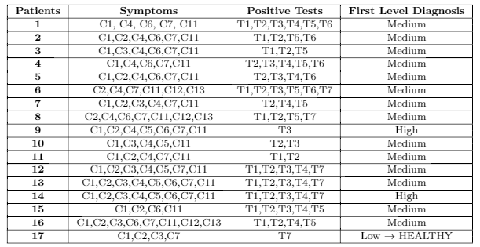
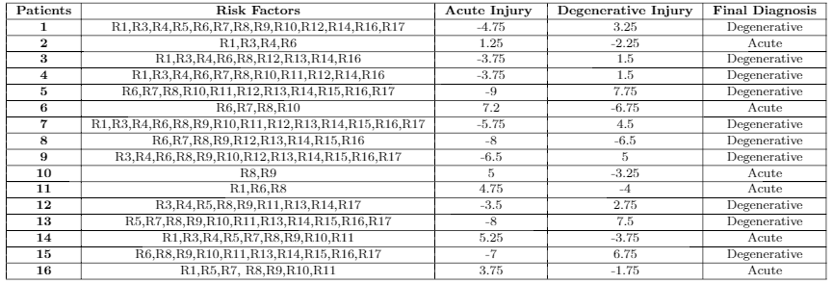
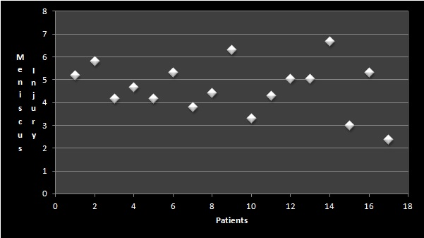
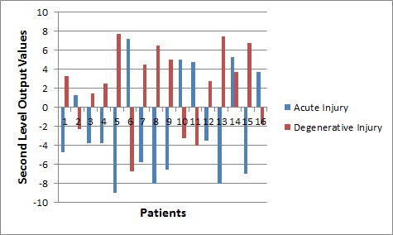
A New approach of Dynamic Fuzzy Cognitive Knowledge Networks in Modelling Diagnosing Process of Meniscus Injury
A. Anninou, P. Groumpos, P. Poulios, I. Gkliatis
Department of Electrical and Computer Engineering, University of Patras, Greece
Abstract
Results
Treatment Stage
Present a novel approach of Fuzzy Cognitive Maps
Testing for accuracy in diagnosing knee injuries
New model is based on experts knowledge and experience
First Level
New Input u-Treatment→ New states x, New Outputs y
x(k+1)=f[Ax(k)+Bu(k)]
y(k+1)=f(Cx(k+1)
Daily analgesics (NSAIDs) were administered for 6 weeks
Results
16 out of 17 patients suffered from meniscal tear
10 cases were positive to degenerative injury
6 cases positive to acute injury
1st patient: full rehabilitation in degenerative injury after NSAIDs
Methods
Second Level
Dynamic Fuzzy Cognitive Knowledge Networks:
Same construction procedure
Two Equations
Fuzzy States
Fuzzy Inputs
Fuzzy Outputs
Conclusions-Future Research
New modelling method reduces classic FCM drawbacks
Combination of initial states and inputs are sufficient to provide information about both the future states and outputs
Integrated model for knee injuries diagnosis
Verified results by MRI
Diagnosing Meniscus Injury
References
First Level: Meniscus Tear or not
Second Level: Acute or Degenerative Injury

Slide 6
A New approach of Dynamic Fuzzy Cognitive Knowledge Networks in Modelling Diagnosing Process of Meniscus Injury
A. Anninou, P. Groumpos, P. Poulios, I. Gkliatis
Department of Electrical and Computer Engineering, University of Patras, Greece
Abstract
Conclusion
Treatment Stage
Present a novel approach of Fuzzy Cognitive Maps
Testing for accuracy in diagnosing knee injuries
New model is based on experts knowledge and experience
New Input u-Treatment→ New states x, New Outputs y
x(k+1)=f[Ax(k)+Bu(k)]
y(k+1)=f(Cx(k+1)
Daily analgesics (NSAIDs) were administered for 6 weeks
A new DFCKN model for knee injuries
Simple
Real-time
Fast
Reliable
Satisfactory results for 17 real cases
Helps physicians for a first and accurate diagnosis without having to use modern imaging techniques (MRI) in every single patient
Concepts classification
New intervention → New input
MRI verification
Treatment influence
Results
16 out of 17 patients suffered from meniscal tear
10 cases were positive to degenerative injury
6 cases positive to acute injury
1st patient: full rehabilitation in degenerative injury after NSAIDs
Methods
Dynamic Fuzzy Cognitive Knowledge Networks:
Same construction procedure
Two Equations
Fuzzy States
Fuzzy Inputs
Fuzzy Outputs
Conclusions-Future Research
New modelling method reduces classic FCM drawbacks
Combination of initial states and inputs are sufficient to provide information about both the future states and outputs
Integrated model for knee injuries diagnosis
Verified results by MRI
Future Research
Diagnosing Meniscus Injury
New simulations with more clinical data
Clinical use in real-time medical diagnosis
Integrated treatment proposal
Use of methodology in a wide range of applications
References
First Level: Meniscus Tear or not
Second Level: Acute or Degenerative Injury

