Slide 1
Metastability & Synchronizers
1

Slide 2
Metastability – Introduction (1/2)
Metastability events are common in digital circuits, and synchronizers are necessary to protect from their fatal effects
Any flip-flop can be made metastable easily
  Sample its data input simultaneously with the clock’s sampling edge and you get metastability
In the past, synchronizers required to handle only asynchronous inputs
Nowadays, with multiple clock domains on the same chip, synchronizers are required when on-chip data crosses the clock domain boundaries

Slide 3
Metastability – Introduction (2/2)
Understanding metastability and the correct design of synchronizers to prevent it is sometimes an art
Stories of malfunction and bad synchronizers are legion
Synchronizers cannot always be synthesized easily, they are hard to verify, and often what has been good in the past may be bad in the future
Papers, patents, and application notes giving wrong instructions are numerous, as well as library elements and IP cores from reputable sources that might be ‘‘unsafe” at any speed

Slide 4
What is Metastability ??
Consider the crosscut through a vicious miniature-golf trap
  Hit the ball too lightly, and it remains in position 1
  Hit it too hard, and it reaches position 2
Can you make it stop and stay at the middle position?
However, even the ball has landed and stopped in metastable state, a slightest disturbance (e.g., the wind) will make it fall to either side
  It is not a steady state; it is called metastable state
We cannot really tell which side it will eventually fall

Slide 5
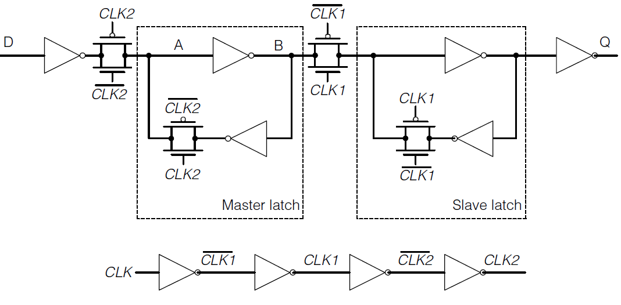
Metastability in Flip Flops
In FFs, metastability means indecision as to whether the output should be 0 or 1
In metastability, the voltage levels of nodes A and B of the master latch are roughly midway between logic 1 and 0
  Exact voltage levels depend on transistor sizing
  They are also affected by the latch design, process variations …
  The voltage levels are not necessarily the same for the two nodes A, B
For the sake of simplicity, we assume that V_{A} = V_{B} = V_{DD} / 2

Slide 6
How does the master latch enter metastability?
0
0
1
1
1
0
Let CLK=0, D = 0, (A, B) = (1, 0), then D changes 0→1 => A=0, B=1
When CLK=1, it disconnects D from A and closes the loop A→B→A
If A and B are around their metastable levels, it would take them some time until to diverge toward a legal digital value
Popular definition: if the FF’s output changes later than the nominal t_{pCQ} delay, then the FF has been metastable

Slide 7
Metastability – Transfer Function
When the latch is transparent, the sampling switch closes, and the hold switch opens (Fig. a)
When the latch is opaque, the switches’ operations inverse (Fig. b)
The circuit has two stable states, Α=C=‘0’ & Α=C=‘1’
  Both the steady and metastable states are depicted in the plot of the transfer function

Slide 8
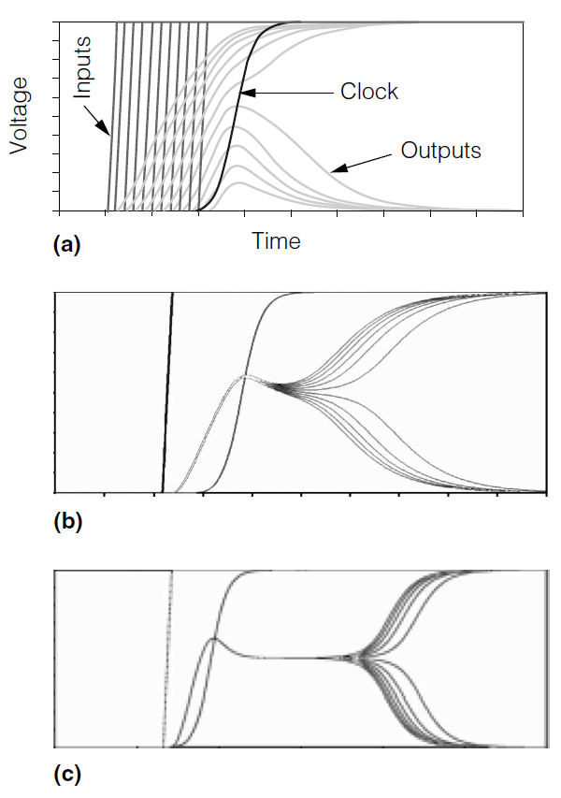
Simulation of Metastability
Circuit simulations of entering metastability in the master latch
  Waveforms for multiple inputs D, CLK2, and Q signals
  The input edge is moved in steps of 100ps, 1ps, and 0.1fs in the top, middle, and bottom
When the input switches not close to the CLK edge, the latch operates normally
When the input switches close to the clock edge, the latch becomes metastable
  Remains in metastable state for some time and randomly stabilizes to a steady state
In Fig. (c), the duration of metastability is more profound

Slide 9
How often metastability occurs ?? (1/2)
Probability theory is used to find how often the latch enters to metastability
  It is assumed that data change at any time point with uniform distribution
We define a short window T_{W} =T_{s}+T_{h} around the clock’s sampling edge
  If data changes during T_{w}, the latch could become metastable
If data has changed sometime during a clock cycle and since the occurrence of that change is uniformly distributed over T_{C} (clock cycle), the probability of entering to metastability, is T_{W}/T_{C} = F_{C}T_{W}
  It is the probability of D’s having changed within the T_{W} window
But input D may not change every cycle; if D changes at a rate of F_{D}, the rate of entering metastability is Rate = F_{D}F_{C}T_{W}

Slide 10
How often metastability occurs ?? (2/2)
Assume F_{C} = 1GHz, F_{D} = 100MHz, and T_{W} = 20ps
Then, Rate = F_{D} F_{C} T_{W} = 2x10⁶ times/sec
The latch enters to metastability very often
Metastability exists in real world, we must learn to live with it

Slide 11
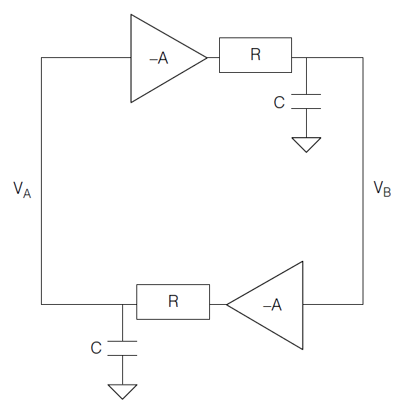
How fast does the latch exit from metastability?? (1/3)
In metastability, the two inverters operate at the linear region
  Using small-signal analysis, they can be modeled as negative amplifiers
  Each inverter drives, through its output resistance R, a capacitive load C
Typically, the master latch becomes metastable and resolves before the second phase of the clock cycle
In rare cases, when the master latch resolves precisely half a cycle after the onset of metastability, the slave latch could enter metastability

Slide 12
How fast does the latch exit from metastability?? (2/3)
The circuit’s behavior is described by a set of first–order differential equations
We define V= V_{A}–V_{B} and τ = (RC)/(A-1)
The solution is V = Ke^{t/τ}
  Higher capacitive load and lower inverter gain impede the resolution of metastability
  The latch is exponentially sensitive to capacitance
  Different latch circuits often differ mainly on the capacitive load they have to drive
In the past, τ was shown to scale with technology scaling
But new evidence has recently emerged indicating that in future technologies τ may deteriorate rather than improve

Slide 13
How fast does the latch exit from metastability?? (3/3)
Probabilistic analysis shows that if a latch is metastable at t=0, the probability it will remain metastable at t > 0 is e^{t/τ} ; it diminishes exponentially fast
In other words, even if the latch became metastable, it would leave the metastable state very fast
However, the final steady state is chosen randomly
If this random state is used as input in a subsequent circuit, system’s functionality will be wrong

Slide 14
Synchronizer – Goals
If a latch receives asynchronous inputs, we can’t guarantee that it will never become metastable
  It will become metastable at the high rate of Rate = F_{D} F_{C} T_{W}
Instead, we can compute the reliability that it will fail due to metastability
Synchronizer’s goal is to minimize this failure probability
Goal: resolve metastability within a synchronization interval, S
  So that we can safely sample the output of the latch (or flip-flop)
Failure: the flip-flop became metastable after the clock’s sampling edge, and it is still metastable S time later

Slide 15
Mean Time Between Failures (1/2)
The two events are independent, so we can multiply their probabilities
prob(failure) = prob(enter in Metastability) x prob(time to exit after S) = T_{W}F_{C} e^{-S/τ}
We also know that the rate of entering metastability = F_{D} F_{C} T_{W}
Thus, the rate of the expected failures = F_{C} T_{W} F_{D} e^{-S/τ}
The inverse of the failure rate is the Mean Time Between Failures (MTBF)
Thus, MTBF = (e^{S/τ}) / (T_{W} F_{D} F_{C} )

Slide 16
Mean Time Between Failures (2/2)
Assume an ASIC design in 28nm CMOS process
  F_{C} = 1 GHz , τ =10ps, T_{W} = 20ps (both are close to typical gate delay)
  Data changes every 10 clock cycles at the input of the flip-flop
  One clock cycle is allocated for resolution (S = T_{C})
Using the formula of MTBF, we obtain MTBF = 4x10²⁹ years /chip
  It is many orders of magnitude longer than the expected lifetime of the product
The failure probability (not exit of metastable state) is very small but not zero
Hoverer, even the latch exits with very high probability, how do we know that the produced value is the correct one ??
Synchronizers address this issue

Slide 17
Metastability & synchronization reliability in FFs (1/2)
What happens at the FF during metastability and what can we see at its output?
  We can see a signal that hovers around V_{DD}/2 or that it can oscillate ??
  This is not exactly the case
If node A is around V_{DD}/2, the chance that we can still see the same value at Q, three inverters later (or even one inverter, if the slave latch is metastable) is practically zero

Slide 18
Metastability & synchronization reliability in FFs (2/2)
The output, Q, will most likely be either 0 or 1
As V_{A} resolves, Q may (or may not) toggle at some later time
If this toggle happens later than the nominal t_{pCQ}, then we know that the flipflop was metastable
This is exactly what we want to mask with the synchronizer

Slide 19
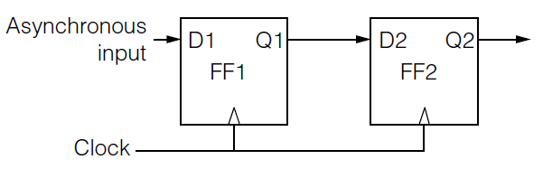
The 2-Flip-Flop Synchronizer – Circuit Design
A simple but probably the most widely-used synchronizer
FF1 could become metastable. But FF2 samples Q1 one cycle later => S = T_{C} (synchronization time equals to one clock cycle)
  Any logic and wire delays along the path from FF1 to FF2 are subtracted from the resolution time
  Thus, S=T_{C} - t_{pCQ(FF1)} - t_{SETUP(FF2)} - t_{PD(wire),} and so on
A failure means that Q2 is unstable (it may change later than t_{pCQ}),
  We can compute MTBF for that event

Slide 20
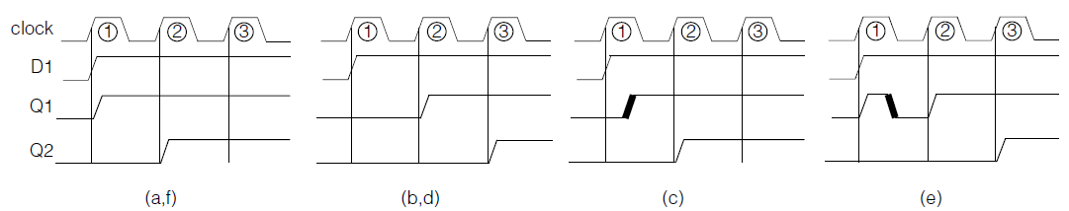
The 2-Flip-Flop Synchronizer – Operation (1/4)
Consider the above cases in which D1 switches dangerously close to the rising clock edge
What really happens inside the circuit of the 2-FFs synchronizer?
Any one of six outcomes could result

Slide 21
The 2-Flip-Flop Synchronizer – Operation (2/4)
Case_a: Q1 switches at the beginning of the 1st cycle and Q2 copies this on the 2nd cycle (No metastability occurs)
Case_b: Q1 completely misses D1. It will surely rise on cycle 2, and Q2 will rise one cycle later (No metastability occurs)

Slide 22
The 2-Flip-Flop Synchronizer – Operation (3/4)
Case_c: FF1 becomes metastable, but its output stays low. It resolves later and Q1 rises (bold rising edge). This will happen before the end of the cycle (except, maybe, once every MTBF years). Then, Q2 rises in cycle 2
Case_d: FF1 becomes metastable, its output stays low, and when it resolves, the output still stays low. This appears the same as case_b. Q1 is forced to rise in cycle 2, and Q2 rises in cycle 3

Slide 23
The 2-Flip-Flop Synchronizer – Operation (4/4)
Case_e: FF1 goes metastable, and its output goes high. Later, it resolves to low (glitch on appears Q1). By the end of cycle 1, Q1 is low. It rises in cycle 2, and Q2 rises in cycle 3
Case_f: FF1 goes metastable, its output goes high, and it later resolves to high. Q1 appears the same as case_a. Q2 rises in cycle 2

Slide 24
The 2-Flip-Flop Synchronizer – Discussion (1/3)
The bottom line is that Q2 is never metastable in practice (except, maybe, once every MTBF years)
  Q2 goes high either after one or two cycles
The synchronization circuit exchanges the ‘‘analog’’ uncertainty of metastability for a simpler ‘‘digital’’ uncertainty of whether the output switches one or two cycles later
Other than this uncertainty, output Q is a solid, legal, and correct digital signal

Slide 25
The 2-Flip-Flop Synchronizer – Discussion (2/3)
What does happen when it really fails?
Once every MTBF years, FF1 becomes metastable and resolves exactly one clock cycle later
Q1 might then switch exactly when FF2 samples it, possibly making FF2 metastable
Is this as unrealistic as it sounds? No
Note: the two FFs should be placed near each other else the wire delay between them would detract from the resolution time S

Slide 26
The 2-Flip-Flop Synchronizer – Discussion (3/3)
This, however, is only the half of the story
To ensure correct operation, we assumed that D1 stays high for at least two cycles, so that FF1 is guaranteed to sample 1 at its input on the rising clock of cycle 2
How would the sender know how long D1 must be kept high?
We have no idea how fast the sender’s clock is ticking
  We can’t simply count cycles

Slide 27
Synchronization Protocol – Handshake protocol (1/3)
To solve this problem, the receiver must send back an ack signal
Handshake protocol
The sender sends req (known as request, strobe, ready, valid); req is synchronized by receiver (top synchronization circuit)
The receiver sends ack signal; ack is synchronized by the sender
Only then, the sender is allowed to change req again
  This roundtrip handshake is the key to correct synchronization

Slide 28
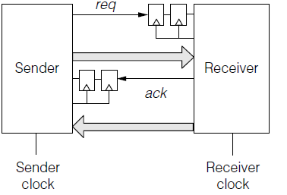
Synchronization Protocol – Handshake protocol (2/3)
Now we can add data that needs to cross over
The sender places data on the bus going to the right, and raises req
Once the receiver gets wind of req (synchronized to its clock), it stores the data and sends back ack
It could also send back data on the bus going to the left

Slide 29
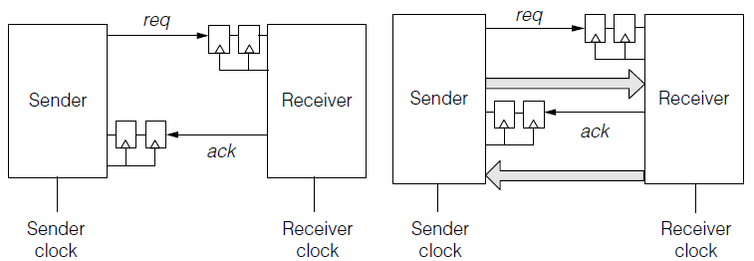
Synchronization Protocol – Handshake protocol (3/3)
When the sender receives ack, it can store the received data and also start a new cycle
The synchronizer doesn’t synchronize the data, it synchronizes the control signals

Slide 30
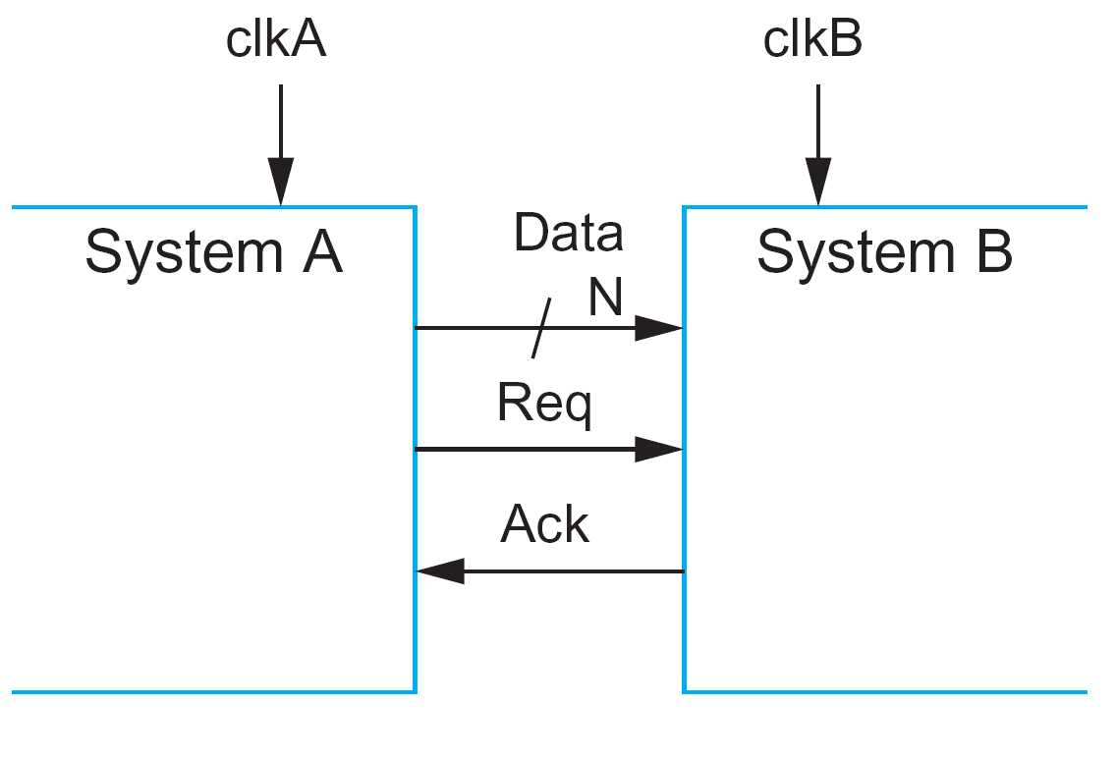
Two– and Four–Phase Handshake Protocols
The most widely-used categorization classifies the handshake protocols in two main classes: two and four phase protocols
The four-phase protocol is sensitive to voltage levels
The two-phase one is sensitive to the edges

Slide 31
Four–Phase Handshake Protocol
The sender (System A) puts the data on the bus and rises Req indicating transmission of valid data
The receiver (system B), samples an asserted Req, synchronizes it to its clock domain (clkB), receives data, and then, rises Ack indicating the receiving of the data
System A receives Ack, synchronizes it to its clock domain (clkA) and de-asserts Req. Then, system A de-asserts Ack
Four transitions (switches) take place

Slide 32
Two–Phase Handshake Protocol
The sender (System A) put the data on the bus and change the value of Req (either 0→1 or 1→0) indicating transmission of valid data
The receiver (system B), samples the switch of Req, synchronizes it to its clock domain, receives data, and switches Ack indicating the receiving of the data
Two transitions take place

Slide 33
Two-Phase Handshake protocol – Details (1/4)

Slide 34
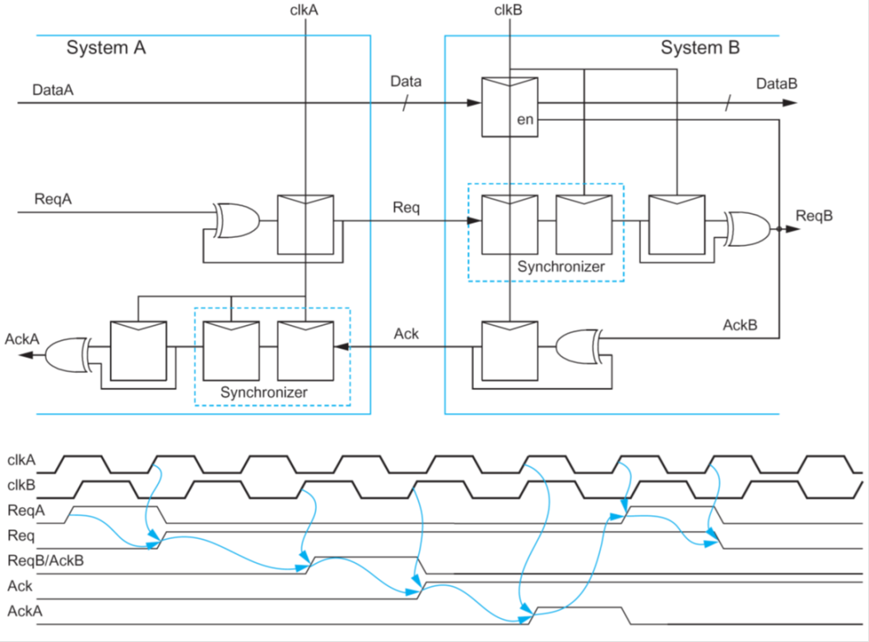
Two-Phase Handshake protocol – Details (2/4)
Two systems with different clocks are communicate
Each system includes
  A synchronizer
  A pulse_to_level circuit
  A level_to_pulse circuit
  System A also includes a read register

Slide 35
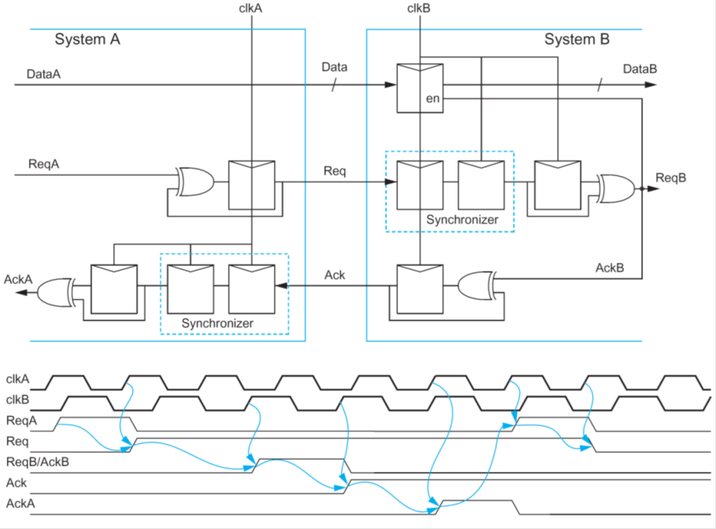
Two-Phase Handshake protocol – Details (3/4)
When DataA is ready, system A, sets ReqA=1 for one cycle
The pulse_to_level circuit of System A produces Req =1 at the next cycle
Req is received by System B and synchronized to clock clkB

Slide 36
Two-Phase Handshake protocol – Details (4/4)
The output (high level voltage) of synchronizer is driven to the level_to_ pulse circuit and a one-cycle pulse, ReqB/AckB, is produced
  It is used as enable for the data register of system B to read the transmitted data & as AckB for system A
Ack is fed to pulse_to_ level circuit and Ack=1 is produced
Ack is synchronized by system Β and then a pulse is produced

Slide 37
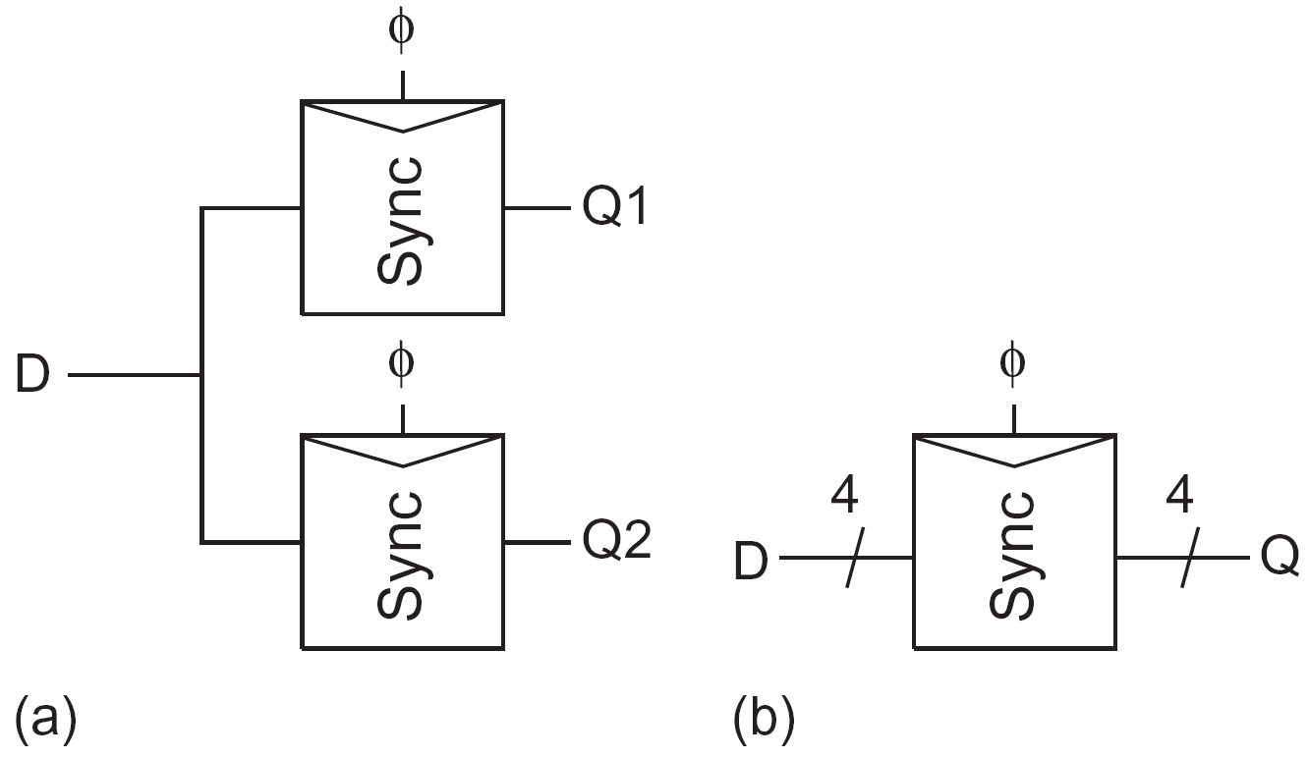
Synchronization Protocol – Discussion
Attempts to synchronize the data bit by bit may lead to catastrophic results
  Even if all data lines toggle simultaneously, some bits might pass through after one cycle, while others might take two cycles because of metastability
  That’s a complete loss of data
Another forbidden practice is to synchronize the same asynchronous input by two different parallel synchronizers
  One might resolve to 1 while the other resolves to 0
  It leads to an inconsistent state

Slide 38
Synchronizers – Application (1/3)
The two-flip-flop synchronizer comes in many flavours
In other cases, two flip-flops might not be enough
  The clock may be fast (e.g. μPs that operate faster than 1 GHz)
  The supply voltage may go very low (in near-threshold designs)
  The temperature may rise above 100 C or drop far below
If S=T_{C}, F_{C} =1GHz, F_{D}=1kHz, and due to low voltage and high temperature t=100ps and T_{W}=200 ps, MTBF=1min (approximately)
Three flip-flops in synchronizer would increase the MTBF to about one month
If we use four flip-flops, MTBF=1000 years

Slide 39
Synchronizers – Applications (2/3)
Similar synchronization concepts are used for signals other than data that cross clock domains
Input signals might arrive at an unknown timing
The trailing edge of the reset signal and of any asynchronous inputs to flip-flops are typically synchronized to each clock domain in a chip
Clock-gating signals are synchronized to eliminate clock glitches when the clocks are gated or when a domain switches from one clock to another
Scan test chains are synchronized when crossing clock domains
These applications are usually well understood and are well supported by special EDA tools for physical design

Slide 40
Synchronizers – Applications (3/3)
The key issues are latency and throughput. It may take
  2 cycles of the receiver clock to receive req,
  2 more cycles of the sender clock to receive ack, and
  Possibly one more on each side to digest its input and change state
If req and ack must be lowered before new data can be transferred, consider another penalty of 3 + 3 cycles
No wonder, then, that we used F_{D} much lower than F_{C}
This slow pace is fine for many cases, but occasionally we want to work faster
Luckily, there are suitable solutions

Slide 41
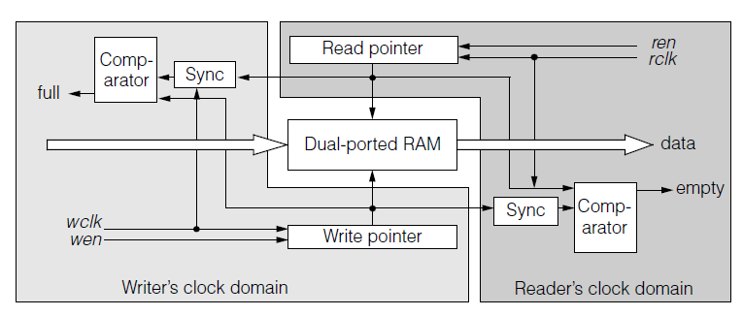
Two-clock FIFO synchronizer (1/6)
The most common fast synchronizer uses a two-clock FIFO buffer
Its advantages are hard to beat
  You don’t have to design it (it is available as a predesigned library element or IP core), and it is (usually) fast

Slide 42
Two-clock FIFO synchronizer (2/6)
The writer places data on the input bus and asserts wen (write enable)
If FIFO’s full signal is not asserted, the data was accepted and stored
The reader asserts ren (read enable), and if FIFO’s empty signal is not asserted then data was produced at the output

Slide 43
Two-clock FIFO synchronizer (3/6)
The RAM is organized as a cyclic buffer
Each data word is written into the cell pointed to by the write pointer and is read out when the read pointer reaches that word
On write and on read operations, the write and the read pointers are properly modified (increase, decrease)

Slide 44
Two-clock FIFO synchronizer (3/6)
When the two pointers point to the same word, the FIFO buffer is empty
  To determine this, the two pointers must be compared
However, they belong to two different clock domains
Thus, the write pointer has to be synchronized with rclk (read clock) when compared (on readers clock domain in figure)

Slide 45
Two-clock FIFO synchronizer (4/6)
Thus, the synchronization is applied to the pointers, rather than to the data
When a new data word is written into an empty FIFO buffer, it might take one or two rclk cycles before the new write pointer passes through the synchronizer and de-asserts empty

Slide 46
Two-clock FIFO synchronizer (5/6)
But when the two pointers are far from each other, no synchronization latency is incurred
When the RAM holds k words, a newly inserted word will stay there for at least k rclk cycles before it is read out
The pointers are usually maintained in Gray code so that only a single bit at a time changes in the synchronizer

Slide 47
Two-clock FIFO synchronizer – Discussion
The FIFO solution usually works. It is nontrivial to design, but it’s often available in libraries
The key question for the user of a library FIFO buffer is how large the RAM should be (how deep should the buffer be)
  The common approach says ‘‘when in doubt, double it’’
The two-clock FIFO synchronizer are used in a network on chip (NoC) offering connectivity among many modules on a chip
  This is a refreshing idea: let someone else (NoC vendor or designer) integrate your chip and take care of all clock domain crossings
There are other fast synchronizers, which require a higher design effort than simply using the common FIFO synchronizer
  The faster they are, the more complex the circuit
Most cases can be solved effectively with a good FIFO synchronizer

Slide 48
Mistakes in Synchronizers (1/2)
The use of wrong (not proper) latches/FFs results in a bad synchronizer
Synchronizer is based on the positive feedback that drives the output in a valid logic level
For this reason, dynamic latches must be avoided (circuits a – d in figure)
Latch (f) of the figure is a very good choice

Slide 49
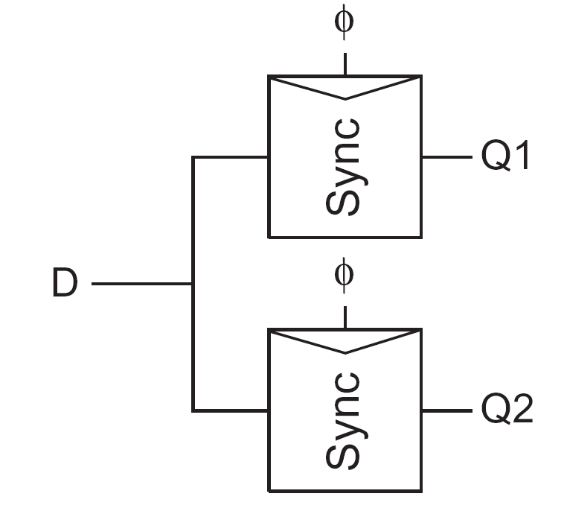
Mistakes in Synchronizers (2/2)
The same signal, D, drives the two synchronizers
If D is stable within T_{W} then, Q1 = Q2
But if D switches within T_{W}, metastability appears and both synchronizers operate that may result in different Q1 and Q2 values
  It is difficult to select the correct one – it is unknown
If the system requires both Q1 and Q2 to be the same data, they must be provided by the same synchronizer

Slide 50
Arbiter
If the two inputs, Req1 and Req2, arrive at different time instances, the latch will operate without problems
If the two inputs arrive at the same time point then, the latch becomes metastable
The metastability filter (placed at the latch’s output) holds the acknowledge signals Ack1, and Ack2, in low level (the corresponding transistors are open) until the voltage difference at nodes n1 and n2 exceeds V_{TH}.
Then, metastability has been resolved indicating a decision has taken

