Slide 1
CDRs
CLOCK DATA RECOVERY CIRCUITS and TECHNIQUES

Slide 2
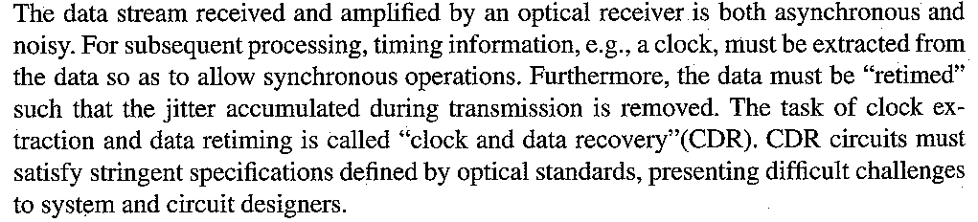
CDRs –General Considerations

Slide 3
Why CDR Is Needed
Clock and Data Recovery (CDR) is a fundamental function in high-speed digital communication systems, used to extract a timing reference (clock) from a received serial data stream and correctly sample the data without requiring a separate transmitted clock signal.
Modern communication links typically use embedded-clock signaling (e.g., NRZ, PAM4), where clock information must be recovered from data transitions. This reduces pin count, improves noise immunity, and simplifies routing—but requires highly sophisticated CDR circuits to reconstruct the sampling clock.
No Clock is Transmitted
In serial I/O and optical links, the transmitter does not send a clock along with data. Instead, the receiver must derive the clock from data transitions.

Slide 4
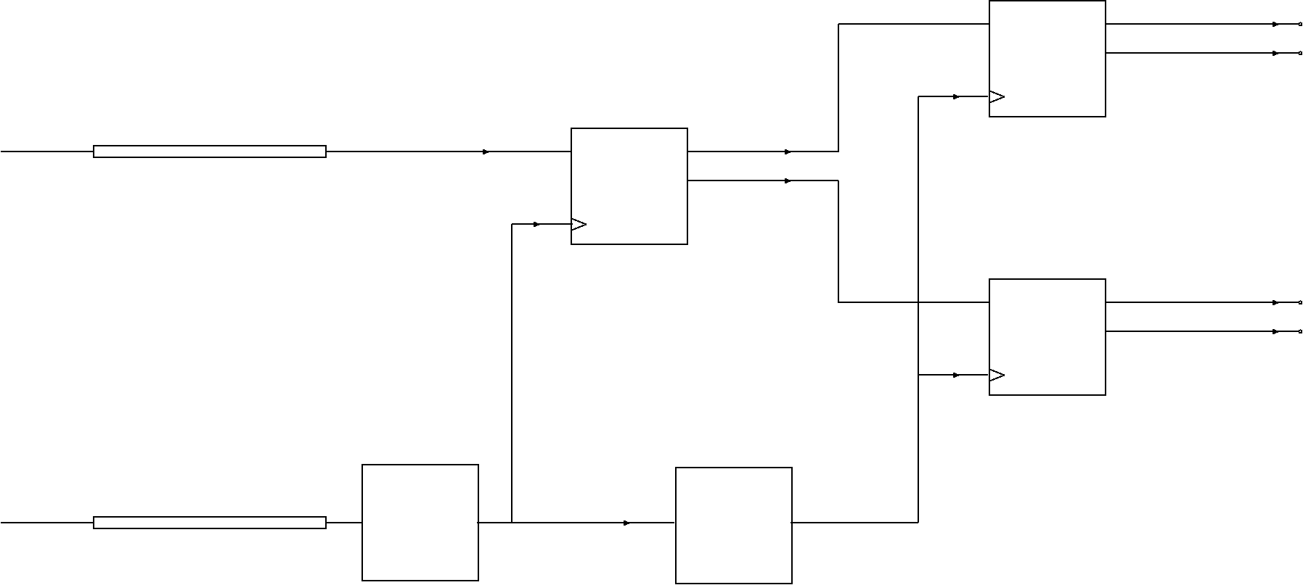
Motivation for CDR: Deserializer (1)
Input data
1:2
DMUX
1:2
DMUX
channel
1:2
DMUX
Input clock
If input data were accompanied by a well-synchronized clock, deserialization could be done directly.
Notes:
Will discuss details of DMUX circuitry later.
The important concept here is that to do any digital processing, a synchronizing clock is necessary...

Slide 5
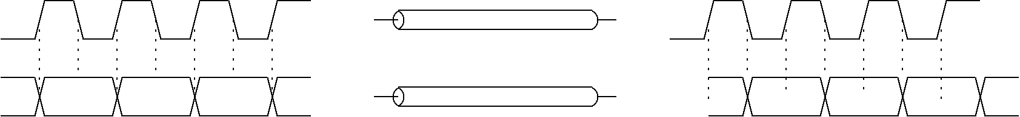
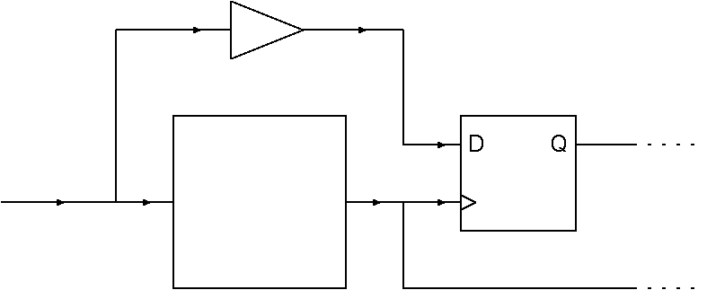
Motivation for CDR (2)
Providing two high-speed channels (for data & clock) is expensive.
Alignment between data & clock signals can vary due to different channel characteristics for the different frequency components. Hence retiming would still be necessary.
Clock
Data
retimed data
input data
Clock
Recovery
circuit
recovered clock
PLLs naturally provide synchronization between external and internal timing sources.
A CDR is often implemented as a PLL loop with a special type of PD...

Slide 6
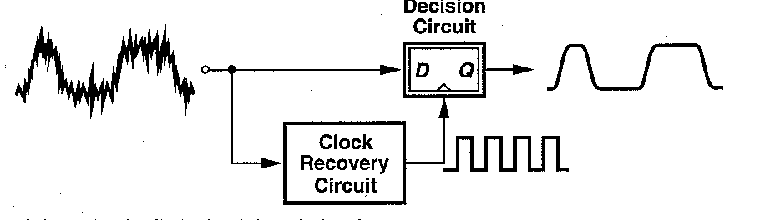
CDRs –General Considerations
In order to perform synchronous operations such as retiming and demultiplexing on ran­dom data, optical receivers must generate a clock. As illustrated in Fig. 9.1, a clock recovery circuit senses the data and produces a periodic clock. A D flipflop driven by the clock then retimes the data; i.e., it samples the noisy data, yielding an output with less jitter. As such, the flipflop is sometimes called a ’’decision circuit.

Slide 7
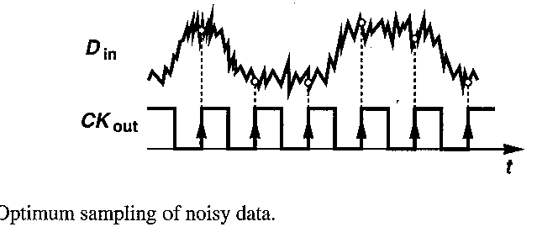
CDRs –General Considerations
The clock generated in the circuit of previous Figure must satisfy three important conditions.
It must have a frequency equal to the data rate; e.g., a data rate of 10 Gb/s (each bit 100 ps wide) translates to a clock frequency of 10 GHz (with a period of 100 ps).
It must bear a certain phase relationship with respect to data, allowing optimum sampling of the bits by the clock. As exemplified by the waveforms shown in Fig. 9.2, if the rising edges of the clock coincide with the midpoint of each bit, then the sampling occurs farthest from the preceding and following data transitions, providing maximum margin for jitter and other timing uncertainties.
It must exhibit a small jitter
We follow the above conditions to develop the foundation for CDR design, beginning with the first.

Slide 8
Fundamentals of Clock Recovery in Serial Communication
The Need for Clock Recovery
Serial links transmit data without an accompanying clock signal. This eliminates an extra wire or optical channel but creates the need for timing reconstruction at the receiver. Clock recovery must satisfy:
Frequency Recovery: The receiver clock frequency must match the transmitter’s bit rate, compensating for process, voltage, temperature (PVT) variations and oscillator drift.
Phase Recovery: The sampling instant must land in the center of the data eye.
Jitter Tracking: The receiver must track slow variations while filtering high-frequency jitter.
Tolerance to Long Runs: Line codes may include long runs of identical bits; a free-running oscillator would drift during such sequences without a closed-loop mechanism.
CDR solves these challenges through feedback control.

Slide 9
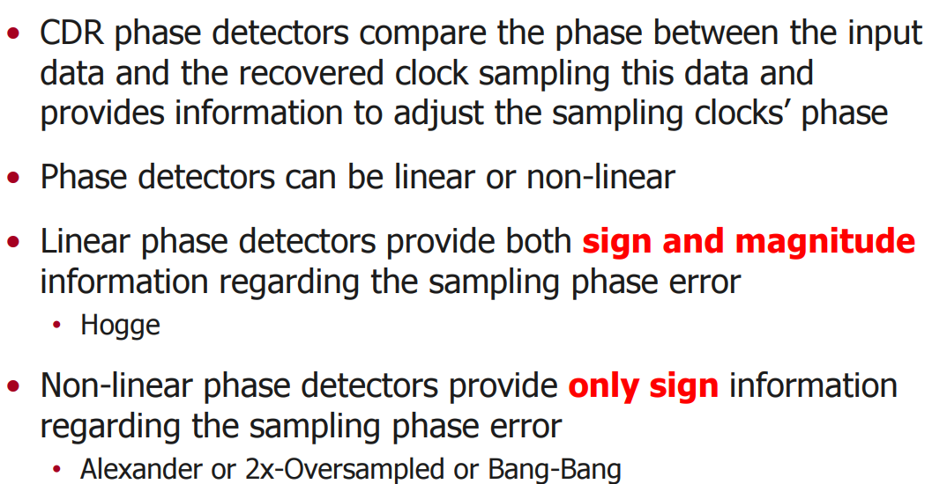
CDR categories

Slide 10
Why Use a PLL for Clock Data Recovery (CDR)?
CDR Needs a Clock Aligned to the Incoming Data
In serial communication systems, the transmitter sends no explicit clock. The receiver must reconstruct it by analyzing edge transitions of the data. A PLL naturally performs three things required for CDR:
Phase alignment – locks sampling instant to the data eye center
Frequency alignment – tracks transmitter clock drift
Stability – filters noise and jitter for reliable sampling
A PLL achieves exactly this: it continuously adjusts a local oscillator so its phase and frequency match a reference signal—in this case, the incoming data transitions.

Slide 11
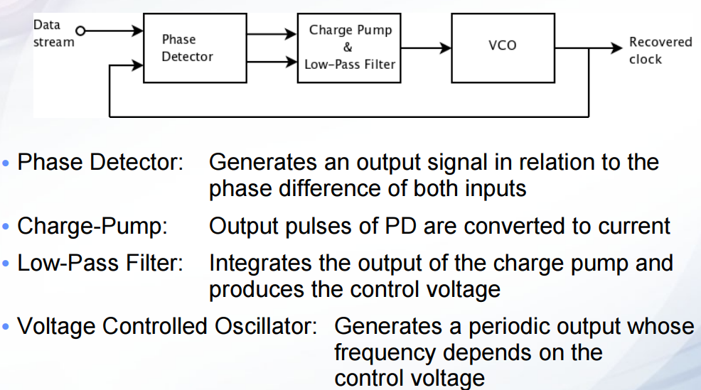
Description of a conventional Phase Locked Loop (PLL)

Slide 12
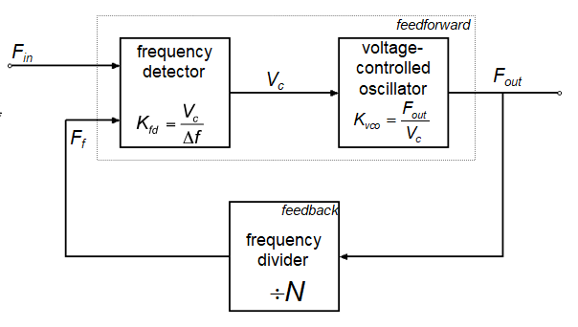
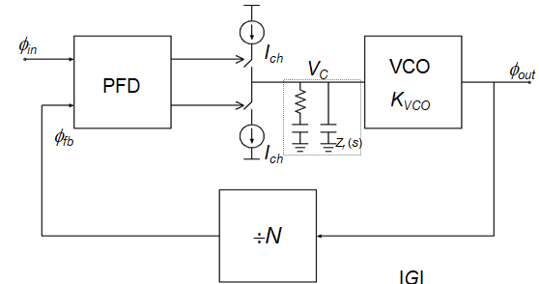
Description of a conventional PLL
Simple PLL topology-frequency multiplier
Type II PLL with PFD & Charge Pump

Slide 13
How PLLs Implement the Classical CDR Control Loop
A PLL naturally provides the three components of a CDR loop:
CDR Functions → PLL Component
Detect timing error → Phase Detector (PD)
Filter the error → Loop Filter
Generate new sampling clock→ VCO

Slide 14
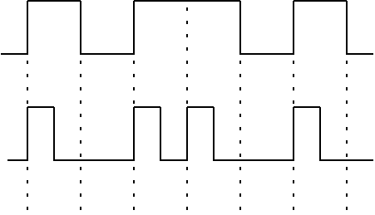
Return-to-Zero vs. Non-Return-to-Zero Formats-Why CDR is necessary for NRZ transmission but not for RZ?
NRZ
RZ
1
0
1
1
0
1
0
CDR is necessary for NRZ because NRZ signals often contain long runs of identical bits with no transitions, so the receiver cannot directly extract clock timing from the data waveform.
With RZ, every bit period contains a pulse that returns to zero, meaning:
the signal has a transition every symbol
the receiver directly sees symbol boundaries
timing ambiguity never accumulates
Therefore, RZ inherently carries clock information, while NRZ does not.
In summary
CDR is necessary for NRZ because:
-NRZ does not guarantee transitions.
-Clock cannot be extracted without a feedback recovery loop.
-Long runs of identical bits cause loss of synchronization.
CDR is not required for RZ because:
-RZ produces pulses every bit.
-Symbol timing is embedded in the waveform.
-Receiver can extract timing directly from the pulse train.

Slide 15
Why CDR is necessary for NRZ transmission but not for RZ?
Feature Summary Table
Feature | NRZ | RZ
Built-in timing information | ❌ None | ✔ Present
Guaranteed transitions | ❌ No | ✔ Yes (per bit period)
Need CDR/PLL | ✔ Necessary | ❌ Not strictly required
Drift tolerance | Low | High
Spectral width | Narrow | Wider
Efficiency | High | Lower
Complexity of receiver | Higher (needs CDR) | Lower

Slide 16
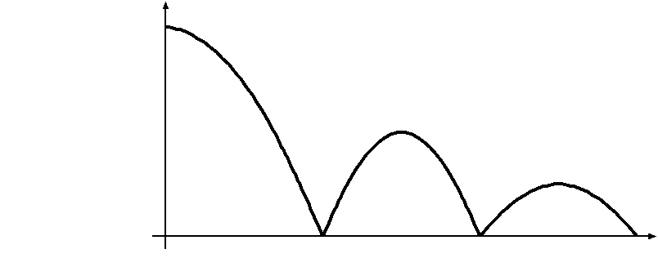
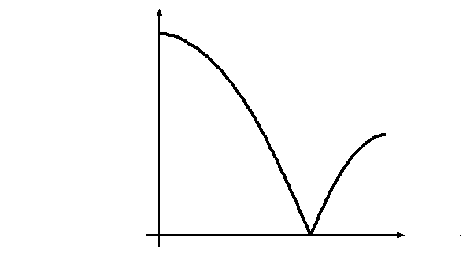
Return-to-Zero vs. Non-Return-to-Zero Formats
NRZ
f
T_{b}
RZ
f
1
0
1
1
0
1
0
RZ spectrum has energy at 1/T_{b} conventional phase detector can be used.
On the contrary NRZ spectrum has null at 1/T_{b} and thus, as shown in the following slides
CDR techniques should be employed
Even though NRZ requires CDR, it is more bandwidth-efficient, (see fig. above) RZ needs more spectral width, which is unacceptable for dense WDM or high-speed electrical channels. Thus, despite needing CDR, NRZ remains dominant in many systems because of : lower bandwidth
simpler lasers needed, lower dispersion and is better for high spectral efficiency
Therefore RZ is rarely used beyond early optical systems or specialized low-speed channels.

Slide 17
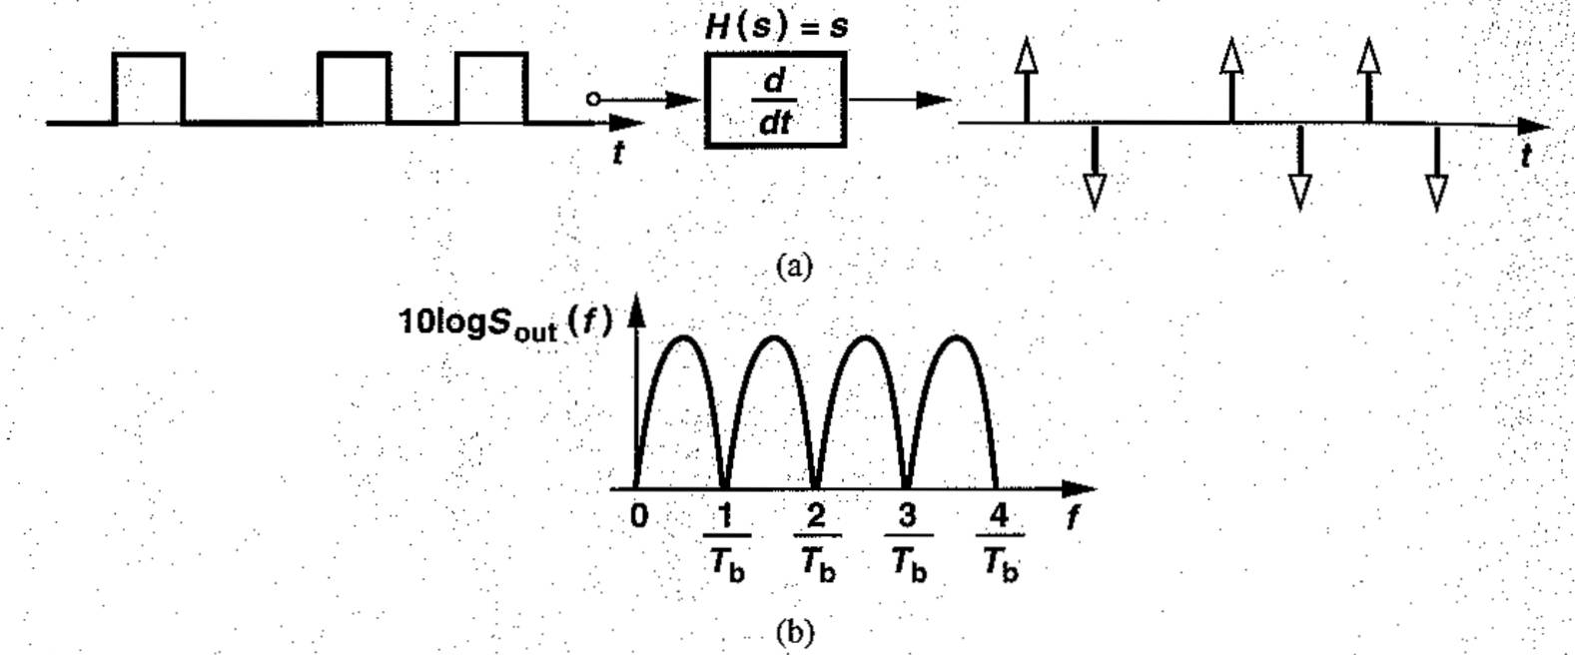



CDR-Edge Detection
(a) Differentiation of data, (b) resulting spectrum
How can a circuit produce a clock that has a frequency, fck, equal to the bit rate, Rb?
Recall that random binary data contains no spectral line at the bit rate, providing no direct information for clock extraction. To create such a spectral line, the data may undergo “edge detection ”
Illustrated in Fig. (a) is an attempt at edge detection, where the data waveform is differentiated at the time domain. Unfortunately, however, the positive and negative pulses still yield no spectral line because differentiation is a linear operation and hence incapable of generating new frequency component
Since a differentiator has a transfer function H (s) = s, we multiply the input power spectral density Sin (f) by (H(jω) ) ² and get a sinusoidal behaviour (Fig.b) still falling to zero at f=n/Tb
Notes:
differentiation is a linear operation and hence incapable of generating new frequency component

Slide 18
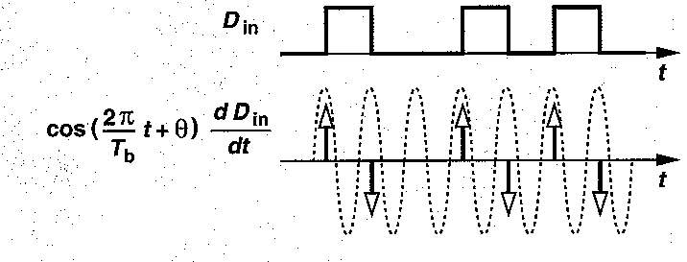
CDR-Edge Detection
To determine whether a signal contains a spectral line at a certain frequency, f0 , we could multiply the signal by cos(2πf0 t + θ) and compute the time average (i.e., correlation of the signal with the cosine). If the average assumes a nonzero value for some θ, then the signal contains such a component.
As an example it is shown in Fig. above a sinusoid with period Tb and arbitrary phase that is multiplied by two equal and opposite impulses that are Tb seconds apart, yielding a zero average in each bit

Slide 19
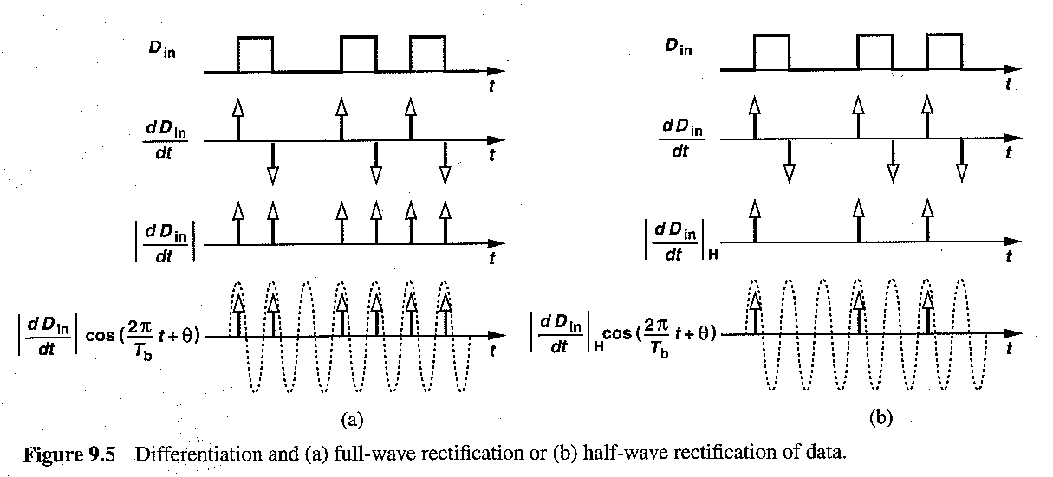
CDR-Edge Detection
However, if the negative impulses corresponding to the falling edges of data are converted to positive ones, then the product of the data waveform and the cos(2πt/Tb+ θ ) will exhibit a nonzero average. Indeed, in Fig. 9.5(a) above , if all the data transitions are represented by impulses having the same polarity, the correlation is nonzero.
The waveforms of Fig. 9.5(a) reveal that differentiation and rectification of a random binary sequence (also called edge detection) generates a frequency component at the bit rate. The result in Fig. 9.5(a) is obtained by “full-wave” rectification
Alternatively, we can perform “half-wave” rectification, where only positive (or negative) impulses are retained as shown in Fig. 9.5(b) This technique ignores half of the data transitions, but it is used in some cases if data suffers from pulsewidth distortion.
The combination of differentiation and rectification is called edge detection. It should be noted that edge detection need not generate impulses’,-any stream of narrow unipolar pulses corresponding to the data transitions still yields a nonzero correlation

Slide 20
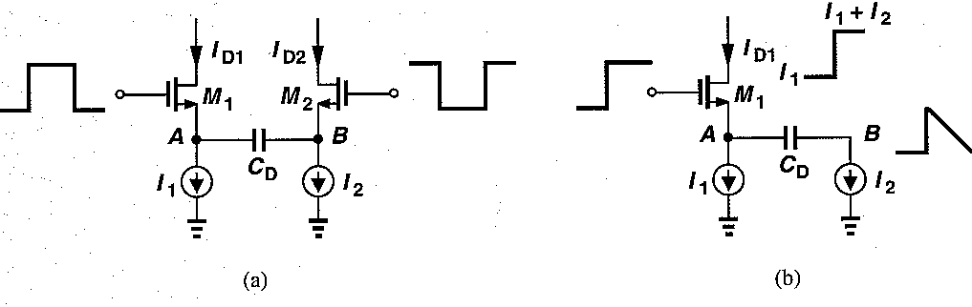
CDR-Edge Detectors Circuit
Figure 9.6 (a) Differentiator circuit, (b) pulse shapes for one data edge.
in Fig. 9.6(a) is a simple, yet efficient differentiator circcuit Each rising transition at the gate of M1 momentarily turns M2 off, allowing both I1 and I2 to flow through M1.
.The source voltage of M2 , Vb, then falls at a rate of I2/CD until M2 turns on-[Fig. 9.6(b).
Similarly, rising transitions at the gate of M2 momentarily turn M1 off. Thus, each data transition at the input creates short pulses of equal and opposite amplitudes in I1 and I2

Slide 21
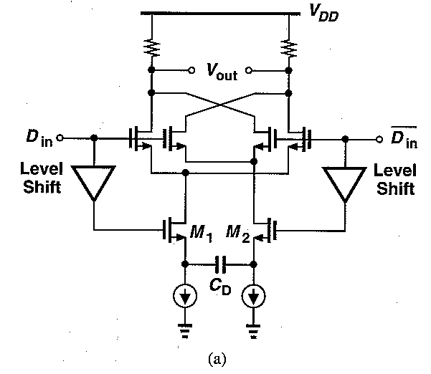
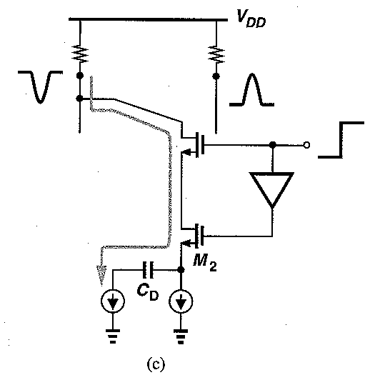
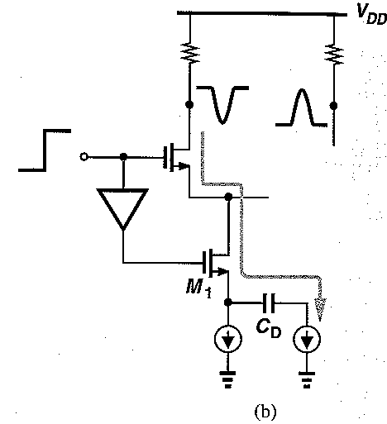
CDR-Edge Detectors Circuit
Figure 9.7 (a) Edge detector circuit, (b) simplified circuit for rising data edge, (c) simplified circuit for falling data edge.
The differentiated signal produced by the circuit of Fig. 9.6(a) from previous slide can be rectified by the circuit of Fig. 9.7(a). For each positive or negative data edge at the input, the circuit reduces to that in Fig. 9.7(b) or (c), respectively, generating only unipolar impulses at the output.
Notes:
The level shift stages (e.g., source followers) ensure that M1 and M2 remain in saturation

Slide 22

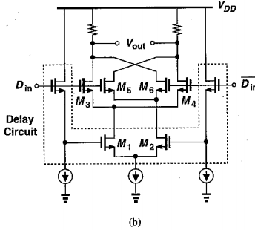
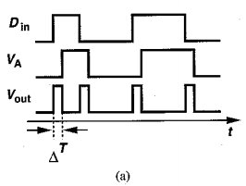
CDR-Digital Edge Detectors
(a) Digital edge detector architecture and waveforms
(b) circuit implementation of (a).
The circuits shown in previous slides exemplify analog implementation of edge detectors. This is suited to extremely high speeds, i.e., speeds at which flipflops fail but such a simple realization still provides a frequency component at the bit rate
At lower speeds, digital edge detectors prove more robust and versatile. (It is obvious though that if for the digital circuitry –gates and FFs – CML based implementations are used these can cope for very high speeds at the cost though of increased power and area)
Figure 9.8(a) above depicts an example, where the data sequence and its delayed version are XORed, thereby producing a positive pulse of width ΔT on each data edge.
The circuit lends itself to a compact implementation:
As shown in Fig. b), a differential current-mode XOR employing levelshift source followers for the bottom input introduces significant delay in one signal path before XORing the drain currents of M1 and M2 with the gate voltages of M3-M6

Slide 23
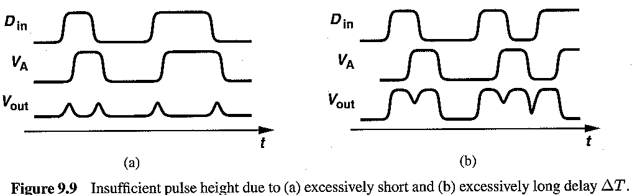
CDR-Digital Edge Detectors
The choice of the delay, ΔT, in Fig. 9.8(a)of previous slide becomes a critical issue at high speeds.
First, suppose ΔT is not sufficiently large. Then, as illustrated in Fig. 9.9(a) above, the finite time constants in the circuit prohibit the XOR output from reaching a full level
For example, if ΔT = 10 ps and the time constants in the XOR are on the order of 50 ps, then the output pulses suffer from a small amplitude, providing little energy at a frequency equal to the bit rate.
Next, suppose ΔT is excessively large, i.e., it is approximately equal to the bit period.
In that case, as shown in Fig. 9.9(b) above, the time overlap between each data pulse and its delayed version is small, prohibiting edge detection. Thus, if the data rate is near the speed limit of the technology, no value of ΔT may produce adequate pulse height at the output.
It is nevertheless important to note that clock extraction from random data requires edge detection because oscillators can be locked to only impulsive frequency content (i.e., a spectral “line”).

Slide 24
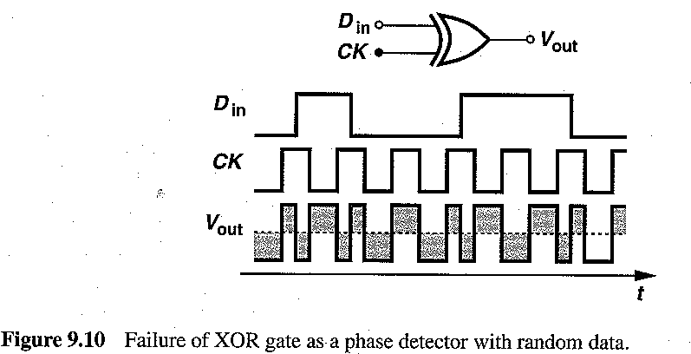
CDR- Phase Detectors (first Attempt)
Phase Detection Following edge detection, a clock must be generated hat samples the data bits at their peak values. This is accomplished by measuring the phase difference between the data and the clock and driving it toward the desired value.
Since the spectrum of random data exhibits a null at the bit rate, the phase detectors used for periodic signals may completely fail if they sense random data. For example, as shown in Fig. 9.10, above an XOR gate computing the phase difference between CK and Din produces a zero average at the output if the ONEs and ZEROs in Din occur with equal probabilities. (The XOR output is assumed to be differential).
This result can also be reached from an analog viewpoint: the XOR gate is represented by an analog multiplier (mixer) and the clock is replaced by its first harmonic, xout= Din cosωοt, where ωο=2π/Tb. Recall that this product displays a zero average.

Slide 25
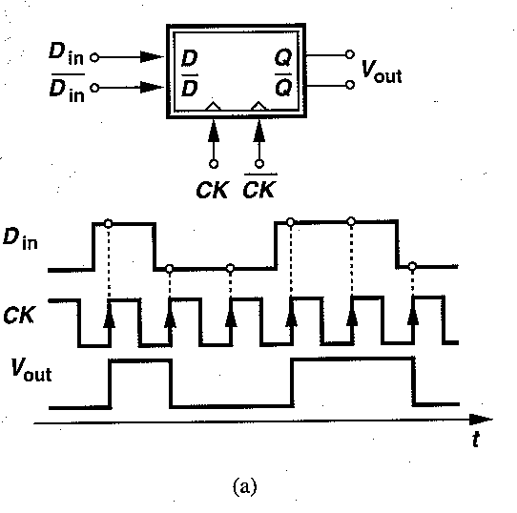
CDR- Phase Detectors (2nd Attempt)
Let us now consider as a 2nd attempt a D flipflop (DFF) for the task of phase detection. First, suppose the flipflop senses the random data at its D input and the recovered clock at its clock input. As shown in Fig. 9.11 (a), each rising transition of the clock samples the level of the data waveform, thereby producing a delayed replica of Din
Unfortunately, if the random sequence contains equal numbers of ONEs and ZEROs, then the average output is still zero.

Slide 26
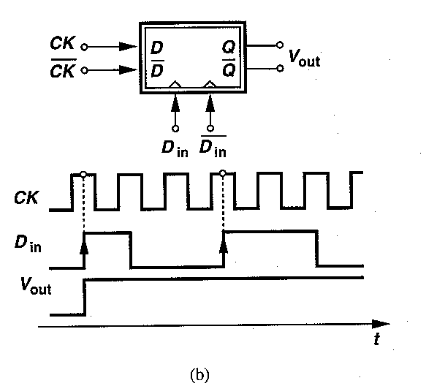
CDR- Phase Detectors (DFF phase detector-the right choice)
Let’s assume now that the data and clock ports of the D Flip-Flop are swapped so that each rising edge of data samples the clock waveform [Fig. (b) above].
In this case, if the data lags the clock, the flipflop continues to sample the high levels of CK, generating a positive output. Conversely, if the data leads the clock, the flipflop produces a negative output.
Thus, the average output signifies the polarity of the phase difference between Din and CK. We call the arrangement of Fig. (b) above a DFF phase detector.

Slide 27
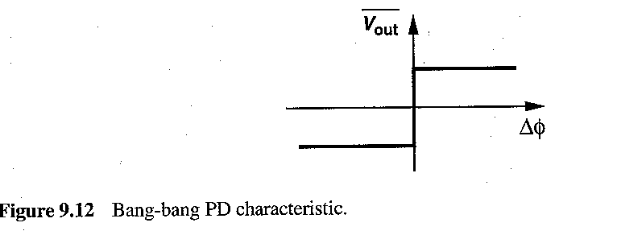
DFF Phase Detector (Characteristic)
Input-output characteristic of a DFF PD. As shown in the previous slide Figure, the D flipflop output assumes only one of two values depending on whether the data lags or leads the clock. As a result, the characteristic appears as shown in Fig. 9.12 above exhibiting an extremely nonlinear behavior
As shown in abobe figure, this characteristic provides a very high gain in the vicinity of Δφ= 0 and a zero gain elsewhere. This is an example of a “bang-bang” characteristic, where the output jumps from one extreme to another with a slight change in the input.

Slide 28
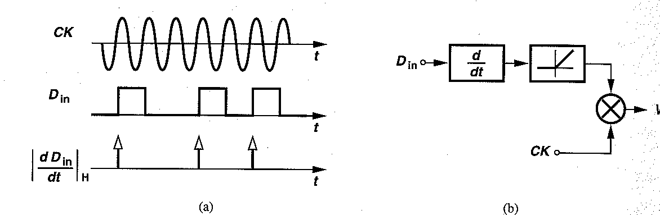
DFF Phase Detector (use as edge detector) `
Figure 9.13 (a) Equivalence of DFF operation to impulse sampling, (b) analog implementation of the concept.
Another important property of the DFF PD relates to edge detection. Consider the waveforms shown in Fig. 9.13(a), where each rising transition of data samples the clock. The operation is equivalent to multiplying the clock waveform by impulses that occur at each positive edge of data, a behavior similar to that of an edge detector using a half-wave rectifier [Fig. 9.5(b)].
It should be noted though that in this case the FF should not work as edge-triggered but as a latch.
Modeled as shown in Fig. 9.13(b), a DFF PD therefore differentiates and half-wave rectifies the data and multiplies the result by the clock. If the data and the clock exhibit unequal rates, then the output contains a “beat” equal to the difference between the two. The beat component is in fact necessary for phase locking.
Notes:
Note that a DFF does not provide such a property if it is configured as shown in Fig. 9.11(a)

Slide 29
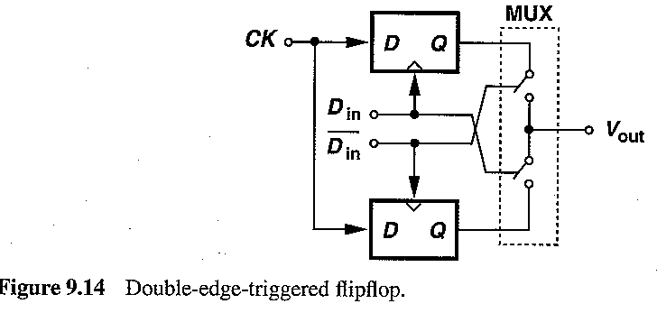
DFF Phase Detector (use as edge detector) `
A D flip-flop can perform differentiation and full wave rectification. This is possible if the circuit samples the clock on both rising and falling edges of data.
Depicted in Fig. 9.14 is a double-edge-triggered (DET) flip-flop consisting of two latches that operate on opposite phases of Din and a MUX that selects each latched output.

Slide 30
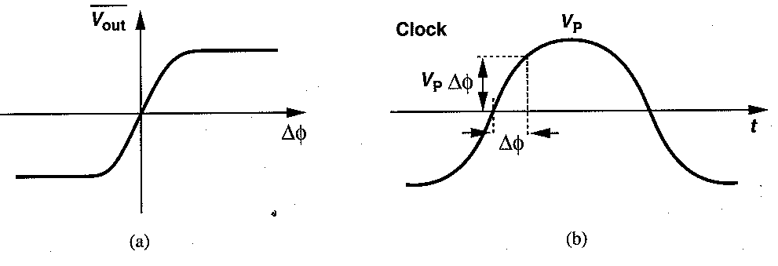
Simple CDR circuit using DFF phase detector
Figure 9.16 (a) Actual bang-bang characteristic, (b) realistic clock waveform
Focusing in DFF Characteristic: We now consider a more realistic bang-bang characteristic, where the gain in the vicinity of A0 = 0 is finite Fig. 9.16(a) above. In a DFF PD, the finite slope arises from metastability: If the clock waveform is sampled near its zero crossings, the output may not reach the full logical level in one bit period. In other words, as the phase difference between the clock and the data approaches zero, the PD output developed in one bit period also decreases. More specifically, we assume both the master and the slave latches in the flipflop are metastable and write the output after one bit period as
Vout= Vo exp Tb/tr (9.5), where Vo denotes the initial voltage and tr the regeneration time constant. Approximating the clock by a sinusoid, Vck = Vp sinωt, we note that a small phase difference of Δφ translates to a voltage Vck(Δφ) ≈ Vp Δφ, see Fig. 9.16(b) above. Substituting this value for Vo in previous Equation. (9.5) yields: Vout= Vp Δφ exp Tb/tr => Vout/Δφ= Vp exp Tb/tr ,
i.e. the gain of the phase detector after one bit period is finite and constant in the metastable region, yielding a linear characteristic. The PD characteristic remains linear for phase differences that are small enough to produce an unsaturated” output. Denoting the saturated output by Vsat, we can determine the maximum phase difference for linear operation as Δφmax= Vsat/Vp exp -Tb/tr. In a typical design, Vsat ≈ 0.5Vp ,Tb ≈ 4tr, giving Δφmax ≈ 0.0092 rad ≈0.525°
At the overall it could be mentioned that the clock zero crossings lock to the data edges, fluctuating in the metastability region most of the time. If the rising edge of the clock is locked to data, then its falling edge appears in the center of the data eye and can be used to strobe the decision circuit.

Slide 31
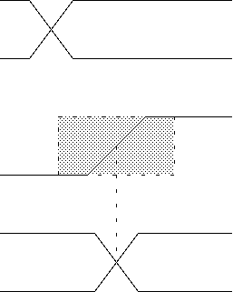
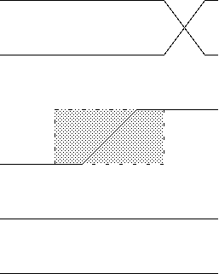
DFF Setup & Hold Time
At CK rising edge, the master latches and the slave drives.
D
t_{setup}
t_{hold}
CK
Q
When a data transition occurs within the setup & hold region, metastability occurs.
Shaded area indicates vicinity of CK rising edge where data transition is forbidden.
Total width of this area is commonly referred to as “setup & hold time.”
Notes:
Shaded area indicates vicinity of CK rising edge where data transition is forbidden.
Total width of this area is commonly referred to as “setup & hold time.”

Slide 32
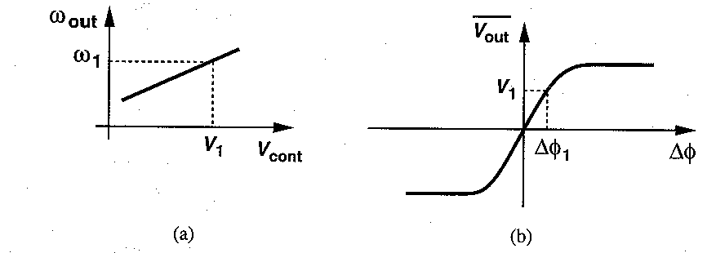
Simple CDR circuit using DFF phase detector
Using the graphical method dictated by the above figures, we can estimate from Figure (a) above the required control voltage V1 at the output of the LPF, i.e. at the VCO input , having as input the locking (data) frequency ω1 . Consecutively , using the control voltage V1 as input we can estimate from Figure (b) above the phase difference with which the loop must lock
The foregoing study has tacitly assumed a periodic data stream so that the phase detector becomes metastable on each rising (or falling) data edge when the loop is locked. With random data, on the other hand, the time for regeneration reaches nTb, where n denotes the number of consecutive ONEs or ZEROs. As a result, with a string of several consecutive ONEs or ZEROs, the output is likely to reach a logical level, leading to a critical drawback.
In the absence of data transitions, the PD continues to produce a high or low level, thus forcing the oscillator voltage to vary. As a result, for long runs, the VCO frequency changes substantially, creating a large jitter and that is one of the drwbacks of this CDR
Notes:
The foregoing study has tacitly assumed a periodic data stream so that the phase detector becomes metastable on each rising (or falling) data edge when the loop is locked. With random data, on the other hand, the time for regeneration reaches nTb, where n denotes the number of consecutive ONEs or ZEROs. As a result, with a string of several consecutive ONEs or ZEROs, the output is likely to reach a logical level, leading to a critical drawback.
In the absence of data transitions, the PD continues to produce a high or low level, thus forcing the oscillator voltage to vary. As a result, for long runs, the VCO frequency changes substantially, creating a large jitter.

Slide 33
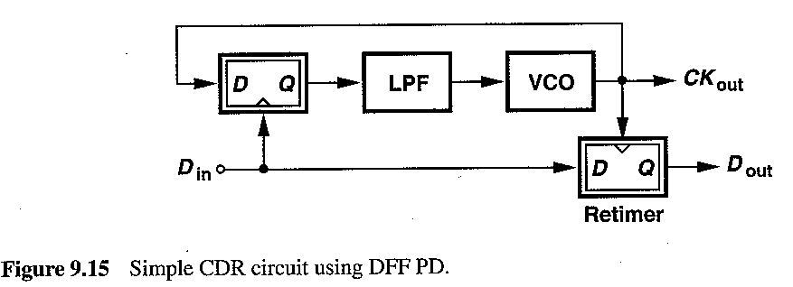
Simple CDR circuit using DFF phase detector
Simple CDR Circuit Based on the topologies presented so far for both edge and phase detection, we have the basic components to construct a simple CDR circuit, analyzing its behavior and shortcomings.
As described in Fig. 9.15above, to generate the clock waveform, we employ a VCO, and to define its frequency and phase, we phase-lock the VCO to the input data. Also, to retime the data, we add another DFF that is clocked by the VCO output. Note that the recovered clock, CKout, drives the D input of the phase detector and the clock input of the retimer.
The circuit of Fig. 9.15 operates as follows. Upon turn-on, the DFF multiplies the edgedetected data by the VCO output, generating a beat that drives the VCO frequency towards the input bit rate. If the initial difference between the VCO frequency and the data rate is sufficiently small, then the loop locks, establishing a well-defined phase relationship between Din and Ckout
. Even for a slight phase error, the PD generates a large output, driving the loop toward lock.

Slide 34
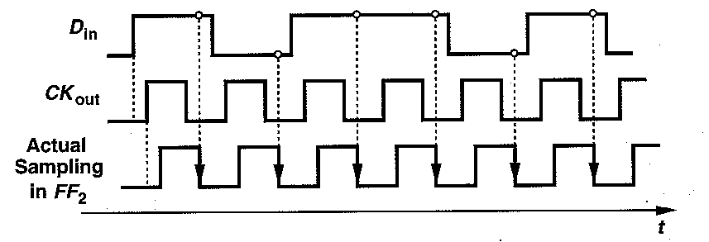
Simple CDR circuit using DFF phase detector (Drawbacks)
Figure 9.18 Problem of skew resulting from DFF delays
Skew Problem from FF Delays
Data retiming exhibits significant phase offset at high speeds.
In typical latches, the delay from the D input to the output (called the “D-to-Q delay”) is unequal to that from the CK input to the output (called the “CK-to-Q delay”). Figure 9.18 above illustrates an example where the CK-to-Q delay is longer than the D-to-Q delay by ΔT. Note that the skew is explicitly referred to the CK input of each flipflop. Here, the PD locks such that the data leads the clock by ΔT, sampling the clock closer to the zero crossing after the data experiences the intrinsic delay of the PD. The VCO output suffers from even more delay as it propagates through the decision circuit, sampling the data far from the middle of the eye. In other words, if the difference between the CK-to-Q and D-to-Q delays is equal to ΔT, then the retiming suffers from a skew of 2ΔT.

Slide 35
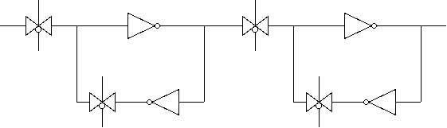
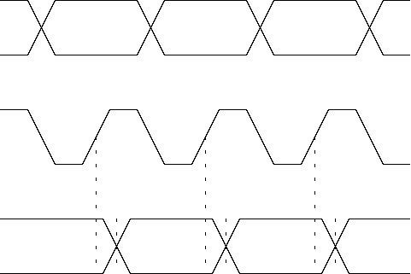
DFF Clock-to-Q Delay
CK
CK
D
QI
Q
CK
CK
CK
CK
CK
Slave
CK
Master
D
D0
D1
D2
t_{ck-q} is determined by delays of transmission gate and inverter.
CK
Q
D0
D1
D2
t_{ck-q}
Notes:
Tck-q is generally larger than data-q delay.
We’ll now go back to our study of PDs for NRZ data.

Slide 36
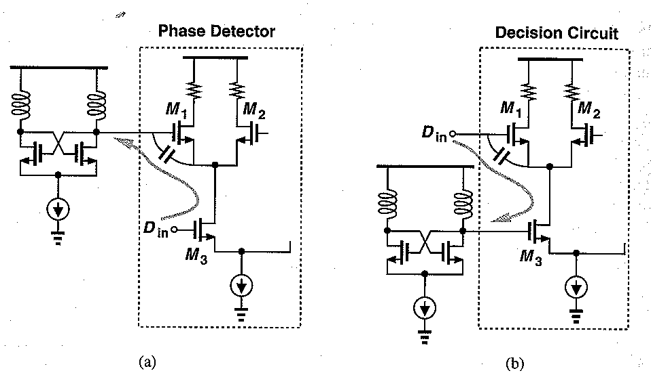
Simple CDR circuit using DFF phase detector (Drawbacks)
Figure 9.19 Feedthrough of random data to VCO.
Another drawback of the simple CDR architecture of previous slides relates to the feedthrough of data to the VCO output through both flip-flops. Figure 9.19 above describes this phenomenon for the PD and the decision circuit.
In Fig. 9.19(a), data transitions turn M1-M2 on and off, drawing transient currents from the VCO. Similarly, in Fig. 9.19(b), data edges couple through the gate-source capacitance of M1 and the gate-drain overlap capacitance of M3 to the oscillator.
The random arrival of the data transitions therefore introduces jitter at the VCO output. For this reason, the VCO must be followed by a buffer stage exhibiting a high reverse isolation.
In following slides, various CDR architectures will be presented that alleviate these issues

Slide 37
Other Phase Detector techniquesfor Random Data
As mentioned in previous slides, PDs for random data must provide two essential functions: data transition detection and (2) phase difference detection.
However, the skew effect illustrated in previous slides (Fig. 9.18) makes it desirable to retime the data inside the phase detector, thereby eliminating the explicit decision circuit and the skew associated with it.
This observation immediately leads to another: if the data is to be retimed by the VCO output, then the flipflop(s) in the phase detector must be strobed by the latter rather than the former. In other words, unlike the DFF PD of Fig. 9.11(b), the phase detector must sample the incoming data by the VCO signal.

Slide 38
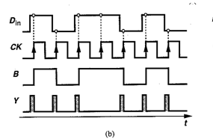
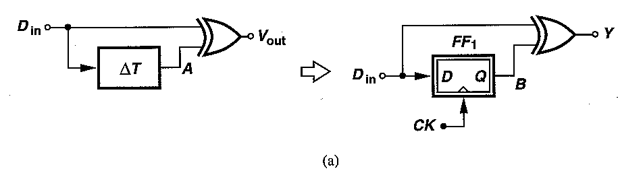
Hogge Phase Detectors
Figure 9.20 (a) Simple PD using synchronous edge detection, (b) PD output for a data pattern
How can a PD detect data transitions if it samples the data by the VCO output? Recall that a single DFF fails to operate as a phase detector if it is used in such a mode.
However, recognizing that a DFF produces a delayed replica of the input data, we can replace the delay element in the edge detector with a DFF –see Fig. 9.20(a) above.
Since sample B changes only on the CK edges, Y =Din(XOR)B contains pulses whose width represents the phase difference between Din and CK [see Fig. 9.20(b) above].
It is important to note that (a) the circuit produces a pulse for each data transition, thereby providing edge detection, and (b) the width of the output pulses varies linearly with the input phase difference, suggesting that the circuit can operate as a linear PD. We call this type of output “proportional pulses.

Slide 39
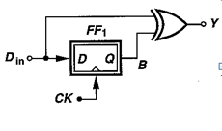
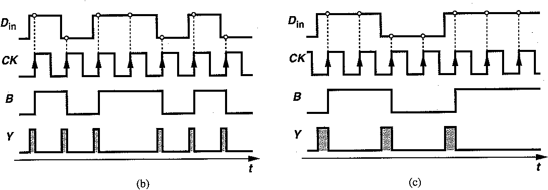
Hogge Phase Detectors
Figure 9.20 (a) Simple PD using synchronous edge detection, (b) PD output for a data pattern, (c) PD output for a different data pattern.
It may appear that the topology of Fig. 9.20(a) above satisfies the requirements of a phase detector.
Unfortunately, however, the average value of the output is a function of the data transition density, failing to uniquely represent the phase difference for various data patterns.
For example, as illustrated in Figs. 9.20(b) and (c) above, the average output remains unchanged if the transition density falls by a factor of two and the phase difference rises by the same factor. In other words, two different phase errors may result in the same dc output, leading to false lock.
To overcome this ambiguity, the proportional pulses must be accompanied by reference pulses. The latter are pulses that appear on data edges but exhibit a constant width, thus eliminating the pattern dependency.

Slide 40
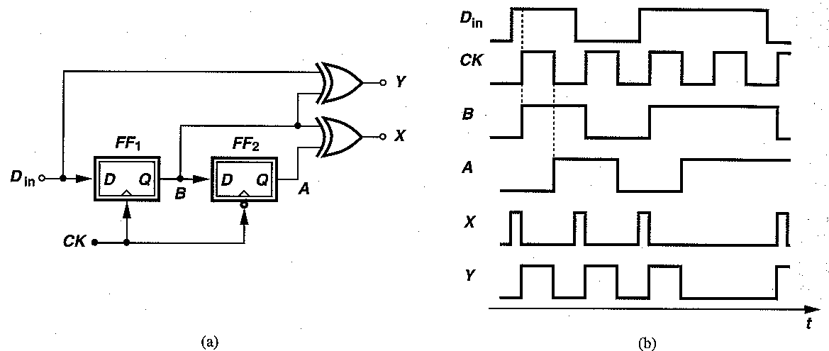
Hogge Phase Detectors
Figure 9.21 (a) Hogge phase detector and (b) its waveforms.
How can reference pulses be generated? We note that, if the retimed data at point B in Fig. 9.20(a) above is delayed by half a clock cycle, and XORed with itself [Fig. 9.21(a)], then pulses of width Tck/2 are produced for each data transition.
As depicted in Fig.9.21(b), the difference between the areas under X and Y can be viewed as the PD output, eliminating the ambiguity due to transition density. Note that under locked condition, X and Y produce equal pulse widths. This circuit is called the “Hogge phase detector” Let us summarize thus far. To avoid skews in the decision circuit, we choose to sample the data by the clock even in the phase detector. This in turn requires explicit edge detection, carried out by a DFF and an XOR gate. Finally, we produce a reference pulse to eliminate ambiguity for different data transition densities.
Recall that the principal motivation behind the above development is to retime the data inside the PD. Indeed, both flipflops in Fig. 9.21 above operate as decision circuits as well, thereby providing retimed data.

Slide 41
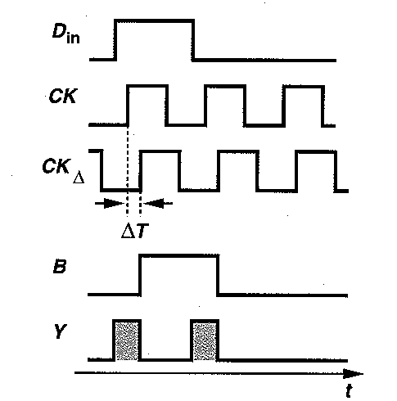
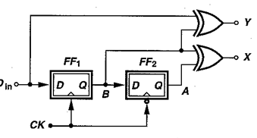
Hogge Phase Detectors-Non Idealities
Figure 9.22 Performance of Hogge PD in the presence of FF delays.
In this slide the behavior of the Hogge PD in the presence of finite delays in the flipflops is examined . As illustrated in Fig. 9.22 above, owing to the CK-to-Q delay, ΔΤ, of FF1, B changes ΔT seconds after the clock rises, yielding a pulse at the Y output that is ΔT seconds wider than the actual phase difference between Din and CK.
Τhe CK-to-Q delay of FF2 simply shifts the pulses at A by ΔT, still producing a pulsewidth equal to one clock period. As a result, X continues to produce pulses of width TckI/2 for each data transition. This means, with a zero input phase difference, the proportional pulses are wider than the reference pulses by ΔT seconds.
Thus, under locked condition, Din and CK must sustain a skew of ΔT so as to equalize the widths of the X and Y pulses .
The above skew effect becomes a serious issue at high speeds. Since ΔT can be a significant fraction of the clock period, a systematic phase offset of several tens of degrees may arise after the loop is locked, degrading the clock phase margin and hence the jitter tolerance .To resolve this difficulty, we can either narrow the proportional pulses by ΔT or widen the reference pulses by the same amount.

Slide 42
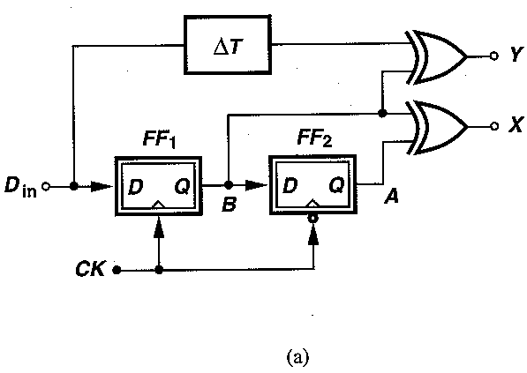
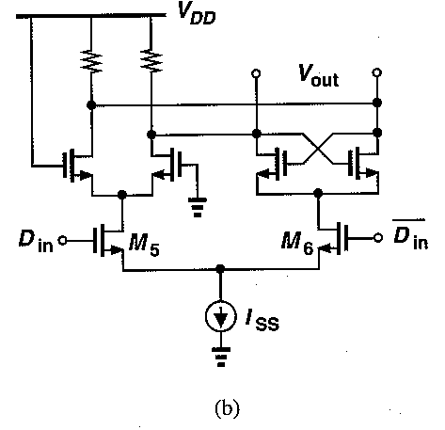
Hogge Phase Detectors-Non Idealities
Figure 9.23 (a) FF delay compensation in Hogge PD, (b) realization of delay cell.
The skew phenomenon in Fig. 9.22 appears simply because the clock experiences a delay that data does not. Thus, if an equal delay is inserted in the data path, the skew is removed and the pulsewidth restored. Depicted in Fig. 9.23(a), the idea is to ensure that the edges of Din and B arrive at the inputs of the XOR gate simultaneously , without carrying the effect of ΔΤ
Of course, to avoid process and temperature variabilities, the delay stage must be an exact replica of the CLK-to-Q path of the flipflop. Figure 9.23(b) depicts a current-steering example, where the D input of the latch is set to a logical ONE and the circuit simply provides a delay
corresponding to the CLK-to-Q path.

Slide 43
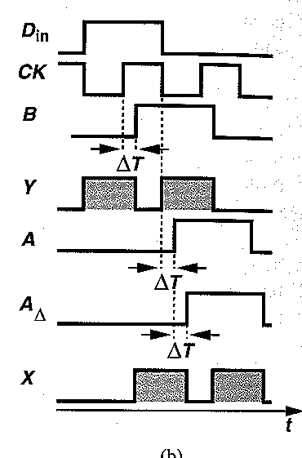
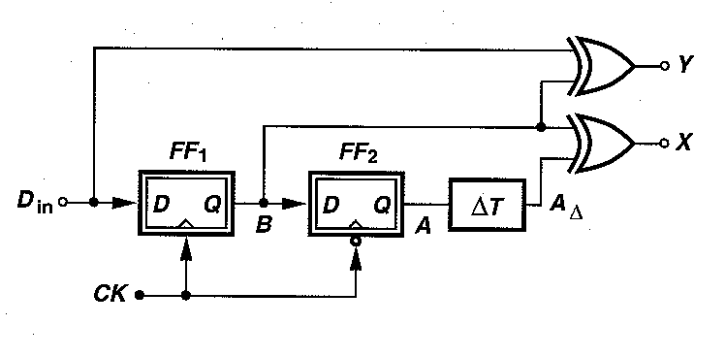
Hogge Phase Detectors-Non Idealities
Fig. on left: Alternative delay compensation technique for Hogge PD, (b) Fig. on right: circuit waveforms
The second method involves widening the reference pulses by ΔT . As shown in Fig. above, this is accomplished by inserting a delay stage between A and the input of the second XOR gate. We note that, since A lags B by Tck /2 ΑΔ lags B by Tck/2+ ΔT.
Thus, B (XOR) A exhibits a pulsewidth of Tck/2 + ΔT.

Slide 44
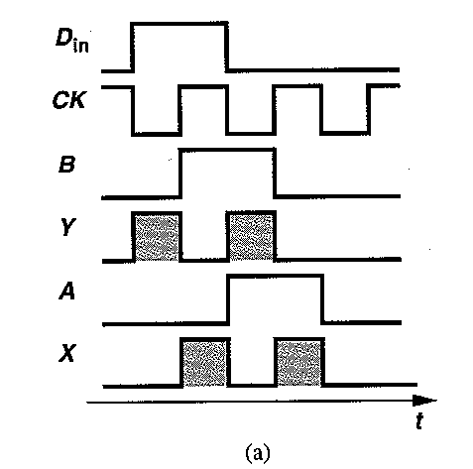

Hogge Phase Detectors-Non Idealities
Figure 9.25 (a) Hogge PD waveforms, b) resulting triwave produced by a charge pump.
Another drawback of the Hogge phase detector stems from the half-cycle skew between
the two XOR outputs . As illustrated in Fig. 9.25(a) above for locked conditions, the PD produces the reference pulse after the proportional pulse, thereby creating a skew of Tck/2 between the two.
What is the effect of such a skew? Suppose the XOR gates drive a charge pump and a loop filter-see Fig. 9.25(b) above. When the proportional pulse appears, the top current source turns on for half a clock period, forcing Vout to rise by (Ip/Cp)(Tck/2).
Next, the reference pulse turns on the bottom current source, bringing Vout to its original
value. Thus, for each data transition, a triangular pulse is generated that exhibits a nonzero net area. As a result, the VCO phase (which is proportional to the integral of the control voltage) is severely disturbed

Slide 45

Hogge Phase Detector-Remedy for the triwave issue
The Hogge PD can be modified so as to ameliorate the above issue. In Fig.9.26 above is an example where one more latch and two more XOR gates are added. Note that, in contrast to the Hogge PD, here X2 senses the inputs and outputs of a latch (rather than a flipflop).
The additional XOR gates create two reference pulses offset by Tck/2 and Tck with respect to the original reference pulse, thereby producing a negative triangular pulse whose area is constant.
Consequently, the two triangular pulses yield a net zero area under locked condition, lowering the effect on the VCO phase.
.
Notes:
The Hogge topology is a linear phase detector, generating a vanishing average as the phase difference approaches zero. Thus, a charge pump driven by a Hogge PD experiences little “activity” when the CDR loop is locked

Slide 46

CDR Circuit using Hogge Phase Detector
Figure 9.27 shows a CDR loop incorporating a Hogge PD.
The XOR outputs drive a charge pump and a loop filter
The need for a charge pump in linear CDR loops poses serious speed limitations. Under the locked conditon, the XOR outputs contain pulses only half a bit period wide, requiring a very broad bandwidth at these nodes to ensure complete switching of the charge pump and hence avoid a dead zone

Slide 47

Pros-Cons

Slide 48


Slide 49

Alexander Phase Detector- Basic Principles
(a) Three-point sampling of data by clock
The Alexander configuration is another example of PDs providing inherent data retiming. The main idea is that, if the clock strobes the data waveform at multiple points in the vicinity of expected transitions, then the resulting samples can provide the necessary information.
Figure 9.28(a) above describes the Alexander PD principle explained above, also known as the “early-late” detection method.
Using three data samples, S1-S3, taken by three consecutive clock edges, the PD can determine whether a data transition is present and whether the clock leads or lags the data. In the absence of data transitions, all three samples are equal and no action is taken. If the falling edge of the clock leads (is “early”), then the last sample, S3, is unequal to the first two. Conversely, if the clock lags (is “late”), then the last two samples, S2 and S3, are equal but unequal to the first sample, S1. Thus, S1 (XOR) S2 and S2 (XOR) S3 provide the early-late information in the following sense:
(a) if S1 (XOR) S2 is high and S2 (XOR) S3 is low, then the clock is late;
(b) if S1 (XOR) S2 is low and S2 (XOR) S3 is high, then the clock is early;
(c) if Si (XOR) S2 = S2 (XOR) S3, then no data transition is present.

Slide 50

Alexander Phase Detector- Basic Architecture
(b) Alexander phase detector, and (c) its waveforms.
Based on the previous slide observations, the topology of Figure b above is derived. The Flip-flop FF1 samples S1 and S3 on the rising edge of CK and FF2delays the result by one clock cycle. FF3 samples S2 on the falling edge of CK and FF4 delays this sample by half a clock cycle.
Let us examine the waveforms at various points in the Alexander PD. As shown in Fig. 9.28(c), the first rising edge of CK samples a high data level. The second rising edge of CK then: produces a delayed version of the first sample at the output of FF2 , and it samples the low level on the input data. The values of S1 and S3 are therefore valid for comparison at t= T1, remaining constant for one clock period.
On the first falling edge of CK in Fig. 9.28(c), FF3 samples a high level on the input data and on the next rising edge, FF4reproduces this level. The key point here is that the choice of clock phases for the four flipflops ensures that S1, S2 , and S3 reach valid levels for comparison at t = T1, and remain at these levels for one clock period. As a result, the XOR gates generate valid outputs simultaneously.

Slide 51


Alexander Phase Detector- Characteristic
Figure 9.29 Alexander PD waveforms for (a) late and (b) early clock.
How does a CDR loop using an Alexander PD lock? Let us first study the PD’s behavior as the phase difference between Din and CK, Δφ, varies from a negative value to a positive value. As shown in Fig. 9.29(a), if the clock is late (Δφ < 0), X assumes a high level for each data transition and Y a low level. Thus, the average PD output, (X — Y)avg remains at a high positive value.
Conversely, if Δφ>0 [Fig. 9.29(b)], then (X – Y)avg assumes a high negative value. As Δφ approaches zero, the second sample, S2, falls in the vicinity of the data zero crossing, thereby driving FF3 and FF4 into metastability—a behavior similar to the DFF PD we studied in [previous section

Slide 52


Alexander Phase Detector- Metastablility issues
(a)
(b)
(c)
The above study implies that the Alexander PD is a bang-bang system, exhibiting a very high gain in the vicinity of Δφ= 0. Consequently, the CDR loop locks such that S2 coincides with the data zero crossings. However, the use of the XOR gates to generate the final output requires a closer examination of the circuit in metastability.
Suppose the differential outputs of FF3 and FF4 are near zero while the other flipflops produce valid logical outputs. How do the XOR gates respond to such inputs? Considering a typical XOR implementation shown in Fig. (c) above we note that if one differential input is large and the other small, then the differential output is near zero. From a small-signal point of view, the XOR operates as an analog multiplier, generating a zero output if one of the inputs falls
to zero.
Sensing Q4, both XOR gates in Fig. (a) above produce small differential outputs under metastability, yielding a small average output for the overall PD. Thus, the CDR loop can,
in principle, lock such that the XOR gates experience metastable inputs most of the time.

Slide 53
Alexander Phase Detector- Metastablility issues
(a)
(b)
(c)
But what happens if the XOR circuits suffer from random offset voltages? For example, what if asymmetries in the differential pair M1, M2 of Fig. (c) result in an input-referred offset of +20 mV for one XOR gate? To compensate for such an offset, sample S2 must slightly deviate from the data zero crossings Another important effect in the Alexander PD relates to systematic delay mismatches in the XOR gates, i.e., the skew between the A and B paths in Fig. (d) above.
While exhibiting a bang-bang characteristic, the Alexander PD offers two critical advantages over a simple DFF PD.
First, it retimes the data automatically, producing a valid data waveform at the output of FF1 and FF2 in Fig. (b). Second, in the absence of data transitions, it generates a zero dc output, leaving the oscillator control undisturbed.
As a result, for long data runs, the VCO frequency drifts only due to device electronic noise rather than due to a high or low level on the control line.

Slide 54

CDR Architecture using Alexander PD
Figure 9.31 above, shows a CDR circuit employing an Alexander PD. The XOR gates drive voltage-to-current (V/I) converters, the two outputs are summed in the current domain, and
the result is applied to the loop filter.
In contrast to the Hogge PFD architecture (Fig. 9.27), this CDR circuit need not incorporate a charge pump because the high gain of the Alexander PD yields a small phase offset under locked condition. This is an important advantage because the XOR ouputs in Fig. 931 need not switch at high speeds; the V/I converters sense only the average value.
Note that, with Hogge or Alexander PDs, the loop gain is a function of the data transition density because the oscillator control line remains idle in the absence of data edges.

Slide 55


Slide 56
Half-Rate Phase Detectors
At very high speeds, it may be difficult to design oscillators that provide an adequate tuning range with reasonable jitter. For this reason, CDR circuits may sense the input random data at full rate but employ a VCO running at half the input rate.
This technique also relaxes the speed requirements of the phase detector and, in some CDR configurations, the frequency dividers.
Called “half-rate” architectures, such CDR topologies require a phase detector that provides a valid output while sensing a full-rate random data stream and a half-rate clock.

Slide 57



Half-Rate Phase Detectors
Figure 9.32 (a) DFF as a full-rate PD.
Figure 9.32 (b) Failure of a DFF as a half-rate PD.
It is important to note that none of the three phase detectors studied thus far can operate with a half-rate clock.
For example, a DFF PD sensing a half-rate clock responds as shown in Fig. 9.32 (b) above , creating both negative and positive outputs for a constant phase difference, in contrast to a full-rate DFF PD (shown in Fig.9.32 (a) above.

Slide 58



Half-Rate Phase Detectors
Figure 9.33 (a) Hogge circuit as a full-rate PD.
Figure 9.33 (b) Failure of Hogge circuit as a half-rate PD.
To arrive at a linear half-rate PD, let us first examine the Hogge configuration and understand its failure mechanism.
As illustrated in Fig. 9.33(b) above in contrast to a full rate Hogge PFD (Fig.9.33 (a)), since half of the clock transitions are absent, the random sequence can be chosen such that the half-rate clock continues to sample a high level on the data waveform, failing to recognize the data transitions. As a result, the proportional and reference pulses are invalid.
The above observation suggests that data transitions may be detected if both edges of the half-rate clock are utilized to sample the input data leading to the next slide topoloogy

Slide 59

Half-Rate Hogge Phase Detectors
Based on the above mentioned (in previous slide) it is deduced that data transitions may be detected if both edges of the half-rate clock are utilized to sample the input data.
Consider the topology shown in Fig.9.34 above, where two D latches, L1-L2, operate on the opposite edges of the clock. Note that each latch is transparent for half of the clock cycle, passing data transitions to its output.
Assuming Din leads CK by ΔT and L1 is transparent when CK is high, we observe that A goes high before CK falls and remains high until CK rises. In other words, L1 produces a pulsewidth equal to Tck/2+ ΔT.
On the other hand, if L2 is transparent when CK is low, then B goes high when CK falls and remains high only until Din falls. That is, L2 generates a pulsewidth of Tck/2 - ΔT. Thus, A (xor)B exhibits a pulse of width ΔT for each data transition

Slide 60

Half-Rate Hogge Phase Detectors
Figure 9.35 Complete linear half-rate Hogge PD.
The above study implies that the simple topology of Fig. 9.34 can indeed operate as a linear phase detector because it (a) detects data edges and (b) produces proportional pulses.
Beyond that , as shown during the examination of the (full-rate ) Hogge topology, this circuit should also provide a reference output so as to uniquely represent the phase error for different data transitions. Towards this direction, to the latches of the previous topology are added two more (creating a master-slave flipflop in each path) and subsequently perform XOR on the outputs (Fig. 9.35 above).
In the presence of data transitions, the outputs of L3 and L4 change on the falling and rising edges of the clock, respectively. As a result, C (XOR) D contains a pulse of width Tck /2 for each input data edge, serving as the reference output .

Slide 61
Half-Rate Hogge Phase Detectors
Figure 9.35 Complete linear half-rate Hogge PD.
What is the status of a CDR loop employing the PD of Fig. 9.35 above when it locks to random data
If the clock edge is to strobe the data in the middle of the eye, then the proportional pulses are Tck/4 seconds wide whereas the reference pulses are Tck/2 seconds wide. The disparity between the average values of these outputs is removed by scaling down the effect of the output of the second XOR by a factor of two, i.e., by halving the corresponding current source in the charge pump.
The linear characteristic of the circuit allows simple formulation of the loop dynamics.
Notes:
The half-rate PD of Fig. 9.35 above also retimes and demultiplexes the data, producing two streams at the outputs of L3 and L4.

Slide 62

Half-Rate Alexander Phase Detectors
Figure 9.36 ( α) Alexander circuit as a full-rate PD.
Figure 9.36 (b). Failure of Alexander circuit as a half-rate PD.
Let us now consider the early-late method for half-rate operation. Since the Alexander PD already requires sampling on both clock edges for full-rate detection, it must employ additional phases of the clock if it is to operate in the half-rate mode. As illustrated in Fig.
9.36 above, the rising and falling edges of a half-rate clock sample only two points, detecting data transitions but failing to provide the phase difference information.

Slide 63

Half-Rate Alexander Phase Detectors
Figure 9.37 (a) Use of quadrature clocks for half-rate phase detection, (b) half-rate binary phase detector
As shown in Fig. 9.37(a) above, the solution involves sampling the data by both the in-phase and quadrature phases of the clock, CKI and CKQ, respectively.
Now, A1 , A2, and A3 play the same role as the consecutive samples in a full-rate counterpart. As depicted in Fig. 9.37(b) above, the implementation incorporates three flipflops sampling the data by CKI and CKQ and two XOR gates producing A1 (XOR) A2 and A2(XOR) A3. Under the locked condition, the rising edge of CKQ occurs in the vicinity of the data zero crossings.
To facilitate you more the corresponding architecture of the Alexander PFD is shown again in the next slide

Slide 64
Alexander Phase Detector- Basic Architecture
(b) Alexander phase detector, and (c) its waveforms.
Based on the previous slide observations, the topology of Figure b above is derived. The Flip-flop FFi1samples S1 and S3 on the rising edge of CK and FF2delays the result by one clock cycle. FF3 samples S2 on the falling edge of CK and FF4 delays this sample by half a clock cycle.
Let us examine the waveforms at various points in the Alexander PD. As shown in Fig. 9.28(c), the first rising edge of CK samples a high data level. The second rising edge of CK then: produces a delayed version of the first sample at the output of FF2 , and it samples the low level on the input data. The values of S1 and S2 are therefore valid for comparison at t= T1, remaining constant for one clock period.
On the first falling edge of CK in Fig. 9.28(c), FF3 samples a high level on the input data and on the next rising edge, FF4reproduces this level. The key point here is that the choice of clock phases for the four flipflops ensures that S1, S2 , and S3 reach valid levels for comparison at t = T1, and remain at these levels for one clock period. As a result, the XOR gates generate valid outputs simultaneously.

Slide 65


Half-Rate Alexander Phase Detectors
The flip-flops in the circuit of previous slide (and in Figure (b above) generate skewed outputs, requiring additional retiming latches before the results are applied to the XOR gates. The effect of the skews must be examined for locked condition, i.e., when CKQ samples the data zero crossings, driving FF3 into metastability.
As depicted in Fig. 9.38 above, if A2 is metastable, so are A1(XOR A2 and A2 (XOR) A3, but since A3 holds its value for Tck/4 seconds after A2 changes, A2 (XOR) A3 produces an extraneous pulse of width Tck/4 disturbing the VCO. It is therefore desirable to delay A1 by Tck/2 and A2 by Tck/4

Slide 66
Frequency Detectors for Random Data
Most CDR circuits require a means of frequency detection in addition to phase detection.
The idea is to drive the VCO frequency toward the desired value by a frequency-locked loop and, when the frequency error reaches a sufficiently small value, allow the PLL to take over and perform phase locking.
This “aided acquisition” is necessary because the capture range of typical PLLs is quite small, especially if they operate with random data. With the narrow loop bandwidths specified by optical standards, the capture range may not exceed a few percent of the data rate.
Thus, if the VCO center frequency varies by, say, ±10% with process and temperature, a simple PLL fails to lock.

Slide 67


Frequency Detectors for Random Data
A frequency detector (FD) must generate an output whose average represents the polarity and (possibly) the magnitude of the input frequency difference. Let us first assume both inputs are periodic and consider a multiplier (mixer) as a possible FD. Denoting the inputs by x₁(t) = A1 cosω₁t and x₂(t) = A2cos ω2t, we express their product as
The component at ω1+ω2 can be removed by low-pass filtering, but the term (A1A2/2)cos(ω1 — ω2)t still exhibits a zero average. It is possible to differentiate the result with respect to time (Fig. 9.39 above), thereby obtaining an amplitude proportional to the frequency difference.
Nevertheless, the average is still zero. In other words, a single multiplier, even followed by a frequency differentiator, fails to detect the frequency difference.

Slide 68




Frequency Detectors for Random Data
Figure 9.40 (a) Quadricorrelator, (b) FD including edge detection.
We must therefore modify the circuit so as not to obtain a sin(ω1- ω2)t component. As shown in Fig. 9.40(a) above, a possible solution is to multiply one of the inputs, χ1(t) by both the in-phase and quadrature phases of the other, χ2,Ι (t)= A2cosω2t and χ2,Q(t)= A2 sinω2t. Thus we get:
=>
The key point is that χc(t) changes sign with ω1-ω2..
The topology of Fig. 9.40(a) above is called a “quadricorrelator”. Requiring that χ1(t) contain a spectral line, the circuit must be preceded by an edge detector for operation with random NRZ data [Fig. 9.40(b) above.
In order to facilitate the reader to derive the above output, the following trigonometric functions are employed: Cosa cosb =1/2 (cos(a+b) +cos (a-b)
Sina sinb= 1/2 (cos (a-b) – cos (a+b)
Sina cosb = ½ (sin (a+b) + sin (a-b)

Slide 69

Frequency Detectors for Random Data
In the above analysis, we assumed that the LPF at the output of the quadricorrelator
suppresses the other cross product, namely, cos2(ω1 — ω2 )t. In an FLL, however, as the VCO frequency is driven toward the input frequency ω1-ω2 may fall to arbitrarily small values, eventually creating a large “ripple” at the output. The ripple may lead to difficulty in the final settling of the loop or the transition to phase locking. Figure 9.41 shows a “balanced” version ,which suppresses the (cos2(ω1 — ω2 )t ) component at 2(ω1-ω2) in the output adder (i.e. xout =2 (ω1-ω2), thus improving the lock behavior.
In order to facilitate the reader to derive the above output, the following trigonometric functions are employed: Cosa cosb =1/2 (cos(a+b) +cos (a-b)
Sina sinb= 1/2 (cos (a-b) – cos (a+b)
Sina cosb = ½ (sin (a+b) + sin (a-b)

Slide 70



Frequency Detectors for Random Data
Figure 9.42 Sampling of quadrature clocks by data to determine frequency difference.
It is possible to construct a digital version of the quadricorrelator.
Recall from previous slides that a DFF that samples the clock by the data can be viewed as an edge detector followed by a multiplier (see also small figure on the top right). In fact, a DFF PD operating on both edges of the data produces a beat output if a PD translates a phase shift in the clock to an equal shift in the beat waveform.
We can therefore employ two DFF PDs that sample the quadrature phases of the clock by the data edges (Fig. 9.42 above), generating two beat waveforms that bear a 90° phase difference. Note the resemblance between these outputs and those at ports A and B in Fig. 9.40(a).
We must now make an important observation in the circuit of Fig. 9.42 above. As the difference between the data rate and the clock frequency goes from negative to positive, the phase difference between xΑ and xΒ jumps from +90° to -90° as will be explained next.

Slide 71
DFF Phase Detector (use as edge detector) `
Figure 9.13 (a) Equivalence of DFF operation to impulse sampling, (b) analog implementation of the concept.
Another important property of the DFF PD relates to edge detection. Consider the waveforms shown in Fig. 9.13(a), where each rising transition of data samples the clock. The operation is equivalent to multiplying the clock waveform by impulses that occur at each positive edge of data, a behavior similar to that of an edge detector using a half-wave rcctifier [Fig. 9.5(b)]. Modeled as shown in Fig. 9.13(b), a DFF PD therefore differentiates and half-wave rectifies the data and multiplies the result by the clock. If the data and the clock exhibit unequal rates, then the output contains a “beat” equal to the difference between the two. The beat component is in fact necessary for phase locking.
Notes:
Note that a DFF does not provide such a property if it is configured as shown in Fig. 9.11(a)

Slide 72


Frequency Detectors for Random Data
Figure 9.43 FD waveforms for fast and slow clocks.
Let us consider the output waveforms for both a fast clock and a slow clock (Fig. 9.43) above. If CK is fast and the rising data transition at t = t1 samples a ONE on CKI and a ZERO on CKQ, then the next rising edge of data appears somewhat later than t = TCK + t1, sampling a point on CKI closer to its next falling edge and a point on CKQ closer to its next rising edge. Thus, after some cycles, at t =t2, Din begins to sample a high level on both CKI and CKQ; i.e., xB(t) goes high while xa(t) is high.
Now suppose the clock is slow. As illustrated in Fig. 9.43(b), the next rising edge of data samples closer to the falling edge of CKQ. Thus, after data edges drift enough, xB(t) goes high while xA(t) is low.

Slide 73

Frequency Detectors for Random Data
Figure 9.44 Complete frequency detector.
The foregoing observation proves essential to completing the circuit of Fig. 9.42 (i.e. of a full frequency detector).
If the rising edges of xB(t) are used to sample the levels on xA(t), then for fvco > Rb, the result is high and for fvco <Rb it is low (Rb is the data , (Din), frequency). As shown in in Fig. 9.44 above, the overall frequency detector exhibits a bang-bang characteristic.

Slide 74



Frequency Detectors for Random Data
Figure 9.45 (a) Failure of FD of Fig. 9.44 in the presence of a large frequency error, (b) actual FD characteristic.
The use of a frequency detector does not increase the capture range indefinitely.
In fact, a brief examination of the FD of Fig. 9.44 (in previous slide) reveals its capture limitations.
Suppose fcK-Rb is so large that the positive data edges in Fig. 9.43(a) -2 slides before-, drift considerably from one bit to the next. Then, the outputs of FF1 and FF2 appear as shown in Fig. 9.45(a), indicating that FF3 is metastable for most of the samples.
In essence, the bang-bang characteristic of Fig. 9.44 is modified as depicted in Fig. 9.45(b) to reflect the lack of a reliable average as the frequency error increases. In practice, the capture range of an FLL incorporating the FD of previous slide (Fig. 9.44) falls below approximately 15%.

Slide 75
CDR Overall Architectures
With our study of phase and frequency detectors so far, we can now develop complete CDR architectures. Each architecture must include
(a) frequency and phase acquisition to ensure lock despite process and temperature variations of the VCO frequency, and
(b) data retiming inside the PD to avoid systematic skews.
A critical difficulty in modem CDR circuits stems from the use of low supply voltages.
As mentioned before, the gain of VCOs must increase as the supply is scaled down
because the tuning range must remain a constant percentage of the center frequency. As a result, for a given ripple on its control line, the VCO suffers from greater jitter.
A method of alleviating this issue is to decompose the VCO control into “fine” and “coarse” inputs, allowing the latter to remain quiet after the system is phase-locked. This concept is described in the context of some CDR architectures.

Slide 76


CDR Architectures-Full-Rate Referenceless Architecture
Figure 9.46 (a) CDR architecture incorporating FD and PD. (b) FD architecture
Frequency detectors capable of handling random data obviate the need for external reference frequencies. Figure 9.46 above, depicts a referenceless architecture, where Loop I employs the FD presented in previous slides -Fig. 9.44 -(shown also in Figure on the right above) and Loop II incorporates one of the phase detectors studied in previous Sections/slides. Upon start-up or loss of phase lock, the FD produces a dc level that drives the VCO frequency toward the input data rate. When the frequency error falls within the capture range of Loop I, the PD takes over and phase-locks the clock to the data.
The above architecture entails three issues.
First, as the CDR circuit transfers the control of the VCO from the FD to the PD, the two loops may interact so heavily that the overall system fails to phase-lock. In this case, the two loops continue to “fight” indefinitely.
Second, with the actual random data produced in a network, short-term spectral lines close but unequal to the nominal data rate may appear occasionally, possibly confusing the frequency detector.
Third, if, in phase-lock, the edges of CKI . or CKQ happen to be aligned with those of Din , the FD may still produce extraneous pulses. For these reasons, the bandwidth of the frequency-locked loop is typically chosen to be much smaller than that of the PLL. These issues must be studied carefully for each design.

Slide 77

CDR Architectures-Full-Rate Referenceless Architecture
Note that the architecture shown in previous slide (Fig. 9.46) employs only one control line for the oscillator and must therefore ensure a very small ripple.
It is possible to modify the system as shown in Fig.9.47, where Loop I drives only the coarse control. This modification also permits independent choice of the PLL and FLL bandwidth

Slide 78

CDR Overall Architectures-Use of Dual VCOs
Figure 9.48 CDR architecture using two VCOs.
An architecture with dual VCOs is examined here with an external reference as well. Recall that it is desirable to decompose the VCO control into fine and coarse inputs. A CDR architecture using such a scheme is shown in Fig. 9.48 above. Here, Loop I phase locks VCO1 to the input data through the fine control. Since the gain of VCO1 with respect to the fine input is relatively low, ripple on this line translates to a small jitter at the output.
Of course, the fine control may not provide enough tuning range to encompass process and
temperature variations. Loop II is therefore added to lock VCO2, a replica of VCO1, to N x fREF, with the resulting control voltage applied to the coarse input of VCO1 as well.
If NxfREF is exactly equal to the input data rate, the two VCOs match perfectly, and the total gain of VCO1 is equal to the gain of VCO2, then the fine control of VCO1 stabilizes at a voltage equal to that on the coarse control. The low-pass filter consisting of R1 and C1 suppresses the ripple generated in Loop II, presenting a low-noise control to VCO2.

Slide 79
CDR Overall Architectures-Use of Dual VCOs
Figure 9.48 CDR architecture using two VCOs.
The architecture of Fig. 9.48 above, while reducing the effect of ripple faces two issues.
First, inevitable random mismatches between the two VCOs lead to a substantial center frequency mismatch even though the oscillators share the same coarse input.
For this reason, Loop I must still achieve a sufficiently wide capture range to guarantee lock despite the initial frequency error. With a typical frequency mismatch of a few percent, random-data PDs may not provide adequate capture range.
Second, even if the oscillators match perfectly, the incoming data rate is not exactly equal to NxfREF because the reference frequency in the far-end transmitter is derived from a crystal oscillator that may suffer from an error of 5 to 10 ppm with respect to the fREF generator in the receiver.
Consequently, VCO1 and VCO2 operate at slightly different frequencies, possibly pulling each other through the substrate or supply lines. The use of differential swings for both VCOs alleviates this issue, but random asymmetries in each circuit still give rise to a finite amount of crosstalk. It is interesting to note that the large bandwidth of Loop II partially corrects for the pulling experienced by VCO1. Loop I, on the other hand, has a bandwidth commensurate with optical standards and cannot counteract pulling effects on VCO1. Another general concern in this architecture lies in the fact that If LC tanks are employed for both VCOs, the large area occupied by on-chip inductors creates difficulties in signal and power lines routing .

Slide 80

CDR Overall Architectures-Dual-Loop Architecture with External Reference
Figure 9.49 CDR architecture using external reference.
A relatively simple CDR architecture that acquires frequency and phase in two steps is shown in Fig.9.49 above.
Using a single VCO, the circuit first enables Loop II, thereby beginning to lock the oscillator to NxfREF. The lock detector monitors the difference between fB and fREF, disabling Loop II and enabling Loop I when the frequency error drops to a sufficiently small value (e.g., 0.1%).
Thus, Loop I begins with a frequency error well within its capture range, locking the VCO to the data. The lock detector continues to operate so that Loop II can be activated again if Loop I loses lock due to unexpected noise.

Slide 81
CDR Overall Architectures-Dual-Loop Architecture with External Reference
Figure 9.49 CDR architecture using external reference.
Let us compare this architecture with that of using dual VCOs in previous slides (Figs. 9.48 and 9.49). Both topologies require an external reference but the latter need not deal with frequency mismatches or oscillator pulling. However, the former allows the use of fine and coarse controls for the oscillator whereas the latter does not.
Another issue in the Dual-Loop architecture (only one VCO) of Fig. 9.49 above relates to the transition from Loop II to Loop I. If the switches that perform this transition disturb the control voltage significantly, then the VCO frequency may jump by a large amount, falling out of the capture range of Loop I. Thus, the charge injection and clock feedthrough of the switches must be examined carefully.

Slide 82

CDR Overall Architectures-Dual-Loop Architecture with External Reference
Figure 9.49 CDR architecture using external reference.
Figure 9.50 (a) Simple and (b) switchable loop filters.
The transition from Loop II to Loop I also requires attention to the design of the lowpass filter(s) preceding the VCO. Consider the filter shown in Fig. 9.50(a), where C2 < 0.2Cp so that it has negligible effect on the stability. The damping factor of Loop II is given by
typically necessitating large values for Rp, Ip, or Cp to compensate for the effect of N. However, such values of Rp and Cp may not yield the required transfer function for Loop I, making it desirable to change Rp or Cp when this loop takes over.
Consider the scenario illustrated in Fig. 9.50(b), where Cp1 stores the required
oscillator control voltage when Loop II is active. Capacitor Cp2 is added in parallel with Cp1 upon transition to Loop I because this loop requires a greater capacitor. However, charge sharing between Cp1 and Cp2 heavily corrupts the stored voltage, possibly driving the VCO frequency out of the capture range of Loop I.

Slide 83
JITTER IN CDR CIRCUITS

Slide 84
JITTER IN CDR CIRCUITS
CDR circuits targeting optical communication standards must satisfy stringent and difficult jitter specifications. In this section, we describe the CDR jitter characteristics of interest in optical systems and present methods of estimating such characteristics. Optical standards often express jitter in terms of the bit period, also called the “unit interval” (UI). For example, a jitter of 0.01 UI (10 mUI) refers to 1 % of the bit period.
Recall that jitter represents
the deviation of the zero crossings of a waveform from their ideal points on the time axis, or, from another perspective,
the deviation of each period from its ideal value. We also note that the rate of change of jitter is reflected in the input-output transfer function of PLLs.
CDR loops are characterized by “jitter transfer,” “jitter generation,” and “jitter tolerance.”

Slide 85
JITTER IN CDR CIRCUITS-Jitter Transfer
The jitter transfer function of a CDR circuit represents the output jitter as the input jitter is varied at different rates. This characteristic is indeed the same as the closed-loop transfer function defined for PLLs
What is the desirable jitter transfer function for CDR loops?
We note that if the input jitter varies slowly, i.e., if the zero crossings wander from their ideal points at a low rate, then the output must follow the input to ensure phase-locking.
On the other hand, if the input jitter varies rapidly, the CDR circuit must filter the jitter, i.e., the output must track the input to a lesser extent.
Thus, the jitter transfer should exhibit a low-pass characteristic, as is the case with phase-locked loops.

Slide 86



Role of ζ in PLL Response
Before starting discussing the jitter issues we will first introduce the meaning and the role of the parameters ζ and ωn

Slide 87


Role of ζ in PLL Response

Slide 88

JITTER IN CDR CIRCUITS-Jitter Transfer
Figure 9.51 Jitter transfer function.
The jitter transfer required by optical standards must meet two difficult specifications.
First, the CDR bandwidth is very small, i.e., approximately 120 kHz in OC-192. In other words, a 10-Gb/s CDR loop must attenuate jitter components above 120 kHz. The small loop bandwidth provides little suppression of the VCO phase noise, necessitating low-noise
oscillator design.
Second, “jitter peaking,” i.e., the amount of peaking in the jitter transfer, must be less than 0.1 dB (<< 1.2%) (Fig. 9.51 above). This constraint demands careful attention to the poles and zeros in the PLL.
The reader may wonder why SONET imposes the above requirements on CDR design.
Long-haul networks employ many data regenerators in the signal path, suppressing the effect of fiber nonidealities periodically. It is therefore important to minimize the jitter accumulated through the chain of the repeaters

Slide 89





Derivation of PFD/PLL Transfer Function H(s)
A linear model of charge-pump PLLs is shown in Fig. 8.33 (left),
From PFD
From PFD
Figure 8.33 (Left)Linear model of simple charge-pump PLL (Right-Cicruit Diagram of charge pump and LPF
This model gives an open-loop transfer function
Since the loop gain has two poles at the origin, this topology is called a “type II” PLL. The closed-loop transfer function, denoted by H(s) for the sake of brevity, is thus equal to H(s)/(1+H(s))
This result is alarming because the closed-loop system contains two imaginary poles at
and is therefore unstable. The instability arises due to the fact that the loop gain has only two poles at the origin (i.e., two ideal integrators). To stabilize the system a resistor is added in series with the loop filter capacitor as shown in the figure (Fig. 8.35) of next slide

Slide 90



Derivation of PFD/PLL Transfer Function H(s)
From PFD
From PFD
Figure 8.35 Addition of zero to charge-pump PLL (equivalently addition of resistor Rp to LPF)
It follows that the PLL open-loop transfer function is equal to:
and hence

Slide 91



Derivation of PFD/PLL Transfer Function H(s)
From PFD
From PFD
Figure 8.35 Addition of zero (resistor Rp) to charge-pump PLL
As derived in previous slide the Transfer Function H(s) of the stabilized PFD /PLL is
By setting as ωn and ζ the following quantities
H(s) is formed as :

Slide 92





JITTER IN CDR CIRCUITS-Jitter Transfer (Bandwidth Reduction)
Bandwidth Reduction: How can the bandwidth of a CDR loop be reduced?
Let us first determine the — 3-dB bandwidth of a simple charge-pump PLL. Rewriting the transfer function as:
(9.14)
we must obtain the value of so= jω (-3dB )such that
=>
It follows that
=>
(9.18)
The above observation leads to two important results. First, CDR loops must often incorporate large off-chip capacitors to achieve a small bandwidth. Second, such loops typically exhibit a large ζ (as high as 10 or 20), and their transfer functions can be simplified to develop more insight.

Slide 93





JITTER IN CDR CIRCUITS-Jitter Transfer (Bandwidth Reduction)
As mentioned in previous slide the transfer function (9.14) can be simplified to develop more insight. Since ωn is small, the term ωn² can be neglected in Eq.(9.14)
for some range of s = jω, yielding
(9.19)
(9.21)

Slide 94



JITTER IN CDR CIRCUITS-Jitter Transfer (Bandwidth Reduction)
We must now answer an important question: for what range of s is the approximation given by (9.19) valid? Considering again the magnitude of H(s) in (9.14),
we note that a sufficient condition is (2ζ ωn ω)² >> ωn⁴ because it guarantees both the numerator and denominator of (9.14) are reduced to those of (9.19),
That is,
(9.22
Thus, if ω is greater than 3 to 4 times of ωn/(2ζ), the magnitude of the transfer function can be approximated by that of a one-pole system (eq. (9.19)). This falls well below the - 3-dB frequency because ω (-3dB) = 2ζωn >> ωn/(2ζ). Consequently, the one-pole approximation holds for most of the range.
Another effect that we have thus far ignored relates to the input data transition density, D_{T}. Recall that the phase detectors studied in previous slides generate a zero output in the absence of data transitions, and in general exhibiting a gain proportional to D_{T}. To take this effect into account, we simply multiply the charge pump current by D_{T}.
For example, if ONEs and ZEROs occur with equal probabilities and the phase detector
operates with only the rising or falling edges of data, then D_{T}. = 0.5.

Slide 95







JITTER IN CDR CIRCUITS-Jitter Transfer (Jitter Peaking)
Jitter Peaking As mentioned earlier, jitter peaking must not exceed 0.1 dB in SONET.
Let us now examine the closed-loop transfer function given by Eq. (9.14),
for this effect.
The zero is given by
(9.30)
a quantity independent of the data transition density. The two poles are equal to
Since ζ>>1, the square root can be approximated as :
Thus it is derived
(9.31)
(9.32)

Slide 96

JITTER IN CDR CIRCUITS-Jitter Transfer (Jitter Peaking)
Figure 9.53 (a) Position of poles and zeros of a type IIPLL,
The relation of poles and zeros are described graphically in Fig. 9.53(a). From this several interesting results can be derived.
First, the zero always appears before the poles, inevitably leading to peaking.
Second, the zero and the first pole differ in magnitude by ωn/8ζ³, a small value since ζ>> 1.
Third, the ωz-ωp1 pair falls well below ωp2 since ωn/(2ζ) <<2 ζ ωn.
Fourth, ωp2 is slightly lower than ω(-3dB), by an amount equal to the magnitude of ωp1

Slide 97




JITTER IN CDR CIRCUITS-Jitter Transfer (Jitter Peaking)
Figure 9.53 (b) corresponding jitter transfer function.
Figure 9.53(b) above shows a plot of the magnitude of the closed-loop transfer function.
The magnitude begins to rise at 20 dB/dec at ω= ωz, assumes a constant value for ω >ωp1, and begins to fall at 20 dB/dec at ω>ωp2 dropping by —3 dB at ω= 2ζωn. With
logarithmic scales, the value of jitter peaking, Jp, can be written as:
=>
=>

Slide 98




JITTER IN CDR CIRCUITS-Jitter Transfer (Jitter Peaking)
To express Jp in decibels, we recognize that
which, since 4ζ² >> 1, reduces to
For example, to ensure 20 log Jp <0.1 dB, ζ must exceed 4.66. We can also express jitter
peaking in terms of the CDR parameters as follows:
If Rp is lowered to obtain a smaller jitter bandwidth (see 9.20 and 9.21) , then Cp must be raised substantially to maintain Jp constant. This is indeed the same trend required to achieve a constant ζ.

Slide 99

JITTER IN CDR CIRCUITS-Jitter Generation
Jitter generation refers to the jitter produced by a CDR circuit itself when the input random data contains no jitter. We summarize the sources of jitter as follows:
VCO phase noise due to electronic noise of its constituent devices;
ripple on the control voltage;
coupling of data transitions to the VCO through the phase detector and retiming circuits;
supply and substrate noise.
First the contribution of the VCO to CDR jitter is considered . The idea is to derive
the jitter of a phase-locked CDR in terms of the jitter of free-running VCO. Recall that the phase noise due to white noise sources and the cycle-to-cycle jitter of a free-running VCO are related by the following equation:
(9.42)
where ωο denotes the oscillation frequency and Sφ(Δω) represents the relative phase noise power at an offset frequency of Δω

Slide 100




JITTER IN CDR CIRCUITS-Jitter Generation
Figure 9.54 Accumulation of cycle-to-cycle jitter in a phase-locked oscillator: (a) actual behavior and (b) conceptual behavior.
We must therefore take into account the effect of noise shaping by the PLL. It can be proven that for a loop bandwidth of 2πfu, the jitter rises with the square root of time (as if the oscillator were free-running) until t1=1/(2πfu) and “saturates” thereafter (Fig. 9.54 above). It can be proved that the total jitter accumulated over time t1 by a free-running oscillator is equal to
Substituting (9.42) in (9.43) yields the closed-loop jitter as
(9.42)
For example, if ΔT_{PLL} must be less than 0.25 ps, rms, at 40 GHz and fu =20 MHz, then
Sφ(Δω) must not exceed —79 dBc/Hz at 1-MHz offset

Slide 101


JITTER IN CDR CIRCUITS-Jitter Generation
Another source of jitter in CDR circuits is the ripple on the control voltage.
Various mismatches lead to a net injection into the loop filter on every phase comparison instant even if the loop is locked. With random data, the ripple is also generally random.
Owing to the high gain of low-voltage VCOs, the frequency modulation resulting from the ripple may be significant, thus yielding large jitter.
For periodic modulation of a VCO, it is possible to calculate the output jitter.
In particular it is proved that with a modulating sinusoid Vm cos(ωm t) the cycle-to-cycle jitter is given by:
For fm << fo, this expression reduces to

Slide 102

JITTER IN CDR CIRCUITS- Jitter Tolerance
(b)
Figure 9.55 Effect of (a) slow and (b) fast jitter on data retiming
Jitter Tolerance Our analysis of jitter properties has thus far focused on their effect on the recovered clock.
However, the quality of the retimed data is also important. How should a CDR circuit perform retiming if the input data contains substantial jitter? From our studies of CDR loops, we make the following observations: (a) for slowly-varying jitter at the input, the recovered clock tracks the phase variations, always sampling the data in the middle of theeye [Fig. 9.55(a)] and guaranteeing a low bit error rate;
(b) for rapidly-varying jitter, the clock cannot fully track the input phase variations, failing to sample the data optimally [Fig. 9.55(b)] and creating a greater BER. These are natural properties of CDR circuits but they must still conform to certain requirements posed by optical standards.

Slide 103


JITTER IN CDR CIRCUITS-Jitter Tolerance
Figure 9.56 Example of jitter tolerance mask.
Jitter tolerance specifies how much input jitter a CDR loop must tolerate without increasing
the bit error rate. Illustrated in Fig. 9.56, the specification is typically described by a mask as a function of the jitter frequency.
For example, the CDR must withstand a peak-to-peak jitter of 15 UI if the jitter varies at a rate below 100 Hz. Note that the tolerance test is performed with a random sequence whose phase is modulated at different rates for different parts of the mask.
It is instructive to quantify the jitter tolerance of a typical CDR loop and compare the
result with the mask shown in Fig. 9.56 above. At a given jitter frequency, we must increase the magnitude of the input excess phase, φin, until the error rate begins to rise. This occurs when the phase error, φin - φout, approaches one-half unit interval, bringing the sampling edge of the clock close to the zero-crossing points of data. Thus, an approximate condition
to avoid increasing the BER is

Slide 104

JITTER IN CDR CIRCUITS-Jitter Tolerance

Slide 105



JITTER IN CDR CIRCUITS-Jitter Tolerance
Figure 9.57 Jitter tolerance of a type II PLL
Equation (9.51), , contains two poles at the origin and two zeros
coincident with the poles of H(s) (see equations 9.30- 9.32). Consequently, as depicted in Fig. 9.57 above, |G_{JT}| falls at a rate of 40 dB/dec for ω< ωp1 and at 20 dB/dec for ωpi <ω < ωp2, approaching 1/2 UI for ω > ωp2- The SONET mask is also superimposed in this plot.
Let us make some interesting observations from the above results. First, the magnitude
of G_{JT} at s = j |jωp1|be calculated as
(9.51)

Slide 106

JITTER IN CDR CIRCUITS-Jitter Tolerance
From previous slide it was derived that
(9.51)
(9.31)
(9.32)

Slide 107

JITTER IN CDR CIRCUITS-Jitter Tolerance
(α)
(b)
Figure 9.58 Jitter tolerance for different values of (a) ζ and (b) ωn.
Figure 9.58(a) above plots |G_{JT}| for two different values of ζ, revealing that if ζ, increases and ωn remains constant, jitter tolerance is more easily met. Moreover, Fig. 9.58(b) suggests that as ωn increases while ζ remains constant, jitter tolerance improves.
The above observations point to an important trade-off in CDR design: if ωn is decreased
so as to lower the jitter transfer bandwidth, then jitter tolerance degrades substantially at high jitter frequencies.
A difficult situation arises in OC-192, where the jitter bandwidth is only 120 kHz but the fourth jitter tolerance corner frequency (f4 in Fig. 9.56) is 4 MHz. If 2ζωn =2π x 120 kHz, then it may be impossible to satisfy the jitter tolerance mask by a single phase-locked CDR circuit.

Slide 108
Back-up slides

Slide 109
Why CDR is necessary for NRZ transmission but not for RZ?
NRZ
RZ
CDR is necessary for NRZ because NRZ signals often contain long runs of identical bits with no transitions, so the receiver cannot directly extract clock timing from the data waveform.
With RZ, every bit period contains a pulse that returns to zero, meaning:
the signal has a transition every symbol
the receiver directly sees symbol boundaries
timing ambiguity never accumulates
Therefore, RZ inherently carries clock information, while NRZ does not.

Slide 110
Why CDR is necessary for NRZ transmission but not for RZ?
Even though NRZ requires CDR, it is more bandwidth-efficient.
Compare required bandwidth:
Scheme | Approx Bandwidth (Normalized)
NRZ | 1×
RZ (50% duty cycle) | ~2×
RZ (33% duty cycle) | ~3×
RZ needs more spectral width, which is unacceptable for dense WDM or high-speed electrical channels.
Thus, despite needing CDR, NRZ remains dominant in many systems because:
lower bandwidth
simpler lasers
lower dispersion
better for high spectral efficiency
Therefore RZ is rarely used beyond early optical systems or specialized low-speed channels.

Slide 111
Why CDR is necessary for NRZ transmission but not for RZ?
7. Summary Table
Feature | NRZ | RZ
Built-in timing information | ❌ None | ✔ Present
Guaranteed transitions | ❌ No | ✔ Yes (per bit period)
Need CDR/PLL | ✔ Necessary | ❌ Not strictly required
Drift tolerance | Low | High
Spectral width | Narrow | Wider
Efficiency | High | Lower
Complexity of receiver | Higher (needs CDR) | Lower

Slide 112
Why CDR is necessary for NRZ transmission but not for RZ?
NRZ
RZ
Final Summary
CDR is necessary for NRZ because:
NRZ does not guarantee transitions.
Receiver timing would drift.
Clock cannot be extracted without a feedback recovery loop.
Long runs of identical bits cause loss of synchronization.
CDR is not required for RZ because:
RZ produces pulses every bit.
Symbol timing is embedded in the waveform.
Receiver can extract timing directly from the pulse train.
No long-run drift or ambiguity.

