Slide 1

Human Experience basics

Slide 2



The shifting focus of human – technology interaction
From
Usefulness
To
Ease of Use
To
Sense Making
Techno-centric focus
Cognitivist focus
Phenomenological focus
Functional requirements
Technical reliability
Resource efficiency
Human Factors
Usability engineering
Human efficiency / effectiveness
Human activity
Expectations / Experience
Feelings / significance

Slide 3
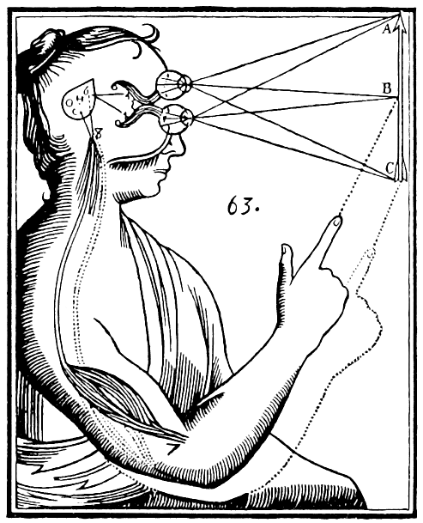
To understand human experience, we need to make a shift from dominant views such as:
The mind – body duality
Feelings are as much body (hormones) as they are mind (thoughts)
Hormones may provoke thoughts and vice-versa; their intermingling may create self-reinforcing loops
Language and abstract thinking are based on physical traits
Self awareness (consciousness) is bounded by the specificity of one’s body
René Descartes's illustration of dualism. Inputs are passed on by the sensory organs to the epiphysis in the brain and from there to the immaterial spirit.

Slide 4
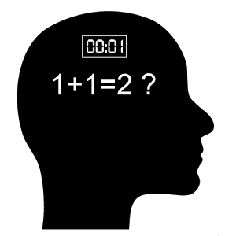
To understand human experience, we need to make a shift from well-established ideas such as:
Biological memory as an information storage device
The mind as a logical / symbolic machine
Human memories are productions, not retrieved data (ενθύμιση / ανάκληση)
Most thoughts (even calculations) are streams of relived experiences more than they are logical operations
We mostly think intuitively (heuristics mental rules of thumb, cognitive biases) rather than rationally

Slide 5

To understand human experience, we need to make a shift from well-established ideas such as:
The independence of the animal from its environment
Our perception shapes the environment in which we live, as we are shaped by it
Our self-awareness is bounded by the medium in which we live
The environment of a bat vs of that of a human (see affordances)
Where does the blind man's self begin? At the tip of the stick? At the handle of the stick? Or at some point halfway up the stick? (Gregory Bateson, Ecology of Mind)

Slide 6
Cognitivist View
Phenomenological View
E
E
Semiosis
E
Acts
Interprets
Input through the senses
Symbolizing
Intentions
E
Theoretical thinking
Reflection
Perceives
Context
embodies
Pre-Reflective
Thinking-Acting
Planning
Senses
Output through the body
Direct-Unhampered
Thinking-Acting
  Humans are unavoidably EMBEDED in the Environment.
  Context is the dynamic result of the Actor – Environment coupling
  Cognitive representations are INTERPRETATIONS that in their turn may become embodied as EXPERIENCE liable itself to further interpretation
  Through the semiotic process (e.g. language), Humans can reflect even upon their own reflections and also embody them as feelings
The Cartesian body - Mind dichotomy
Body as a machine receiving signals and following plans
Mind as symbol manipulator / computer
Environment uninfluenced by body or mind

Slide 7

Dimensions of human experience
Not only positive /negative but also fulfilling / shallow, momentary/enduring , corporeal / affective, symbolic / visceral, exciting / boring, dangerous / safe
Personal development
learning, exercise
Health
Corporeal
psychic
Effectiveness
productive
results
Values
personal
Socio-cultural
«Tiring– but very enjoyable»
«Difficult– but so attractive»
«Easy– but so boring»
«Compelling– but shameful!»
Happiness
Play, joy

Slide 8
Experience Journey Mapping in depth…
Streams of Experience - Objects of Attention & Intentionality
We experience in more than one ways; these ways define moments of lived experience (X-moments)
Each X-moment is always targeted / attracted by an “Object of Attention”
This fundamental property of Human Experience is termed Intentionality
Intentionality is manifested through motivations, expectations and actions
A sequence of “X-moments“ defines an “X-cycle”, a stream of experience – a story of life
intentionality
Physically Acting
Perceiving
Reflecting
Feeling
δυνητικό
δυνητικό
δυνητικό
Exp. journey map is a sequence of “objects of attention”
(lived or supposed)

Slide 9

Ready-to-Hand vs Present-at-Hand
While hammering, the hammer remains imperceptible to the hammerer, him being entirely focused on the nail. However, if something goes wrong -like the nail bending-, the hammer suddenly appears as an object (M. Heidegger - Being and Time)

Slide 10
Living experience & levels of consciousness
Interpretation N+2
Interpretation N+1
Interpretation N > > > > > > > > > > > > > > > > > cumulative past Experience
3
intentions
expectations
intentions
expectations
intentions
expectations
2
X-Moment t(i-1)
X-Moment t(i)
Feelings
impulses
Feelings
impulses
Living X t(i-1) Living X t(i) Living X t(i-1
1
Living X (flow) – is felt but cannot be articulated through language
Pre-reflective X, (significant moments) can –in principle- be articulated
Reflective X (or conscious) articulable, always posterior, cumulative

Slide 11
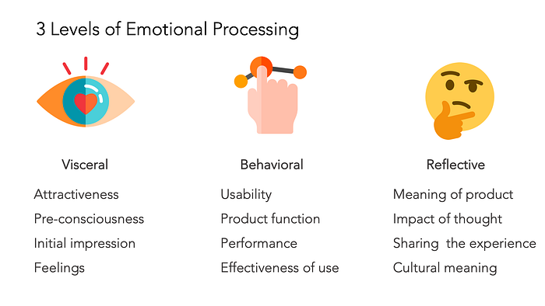
Affective design
The three levels of experience according to Donald Norman
https://www.interaction-design.org/literature/article/norman-s-three-levels-of-design

Slide 12
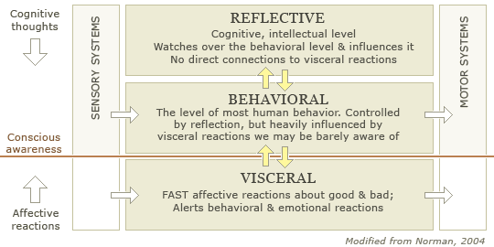
Affective design
The three levels of experience according to Donald Norman
An Ad banner on a website has a strong visceral salience. But for the experienced user the behavioral level intervenes and inhibits it

Slide 13
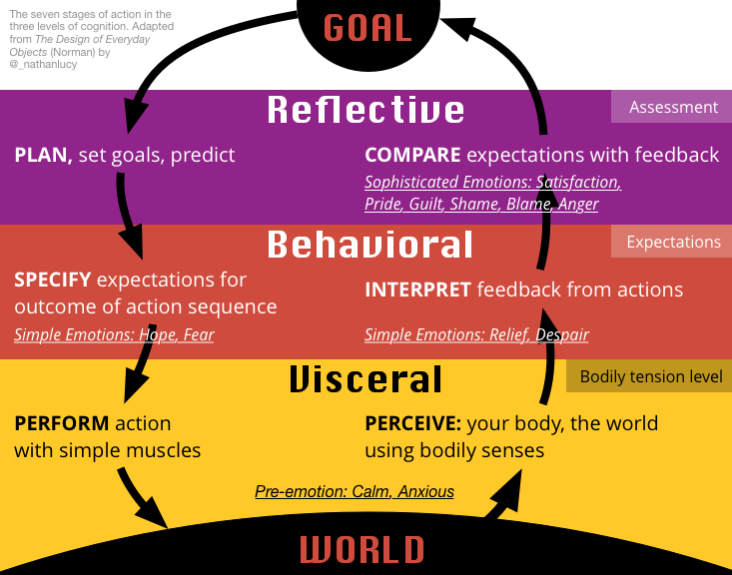
Mapping levels of Experience on the action cycle

Slide 14
Phenomenological (felt) variables can they be studied?
desire
confidence
trust
mobilization
startle / breakdown
anguish
denial
expectation
shame
commitment
nostalgia
incertitude
Aren't they purely subjective?

Slide 15
Subjectivity is neither equal to arbitrariness nor randomness
SUBJECTIVITY= AUTONOMY of Experience
Experience can be influenced but NOT dictated
INTER-Subjectivity = the ability of teams of humans to share and agree on “similar subjective experiences”
“habitus” (i.e. embodied dispositions), “common sense”, “practices” & “norms”, “thought communities” (from Aristotle up to Bourdieu)

Slide 16
How do we go about?
Ethnography – discovering social / microsocial phenomena
Deep observation to reveal unacknowledged habits & practices
Direct involvement – adopting a second person perspective
Cognitive elicitation methods - Probed experiential accounts
Think aloud/ assisted retrospective verbalization
Confrontation sessions between subject matter experts
Any other novel or even ancient method you may devise and feels opportune

Slide 17
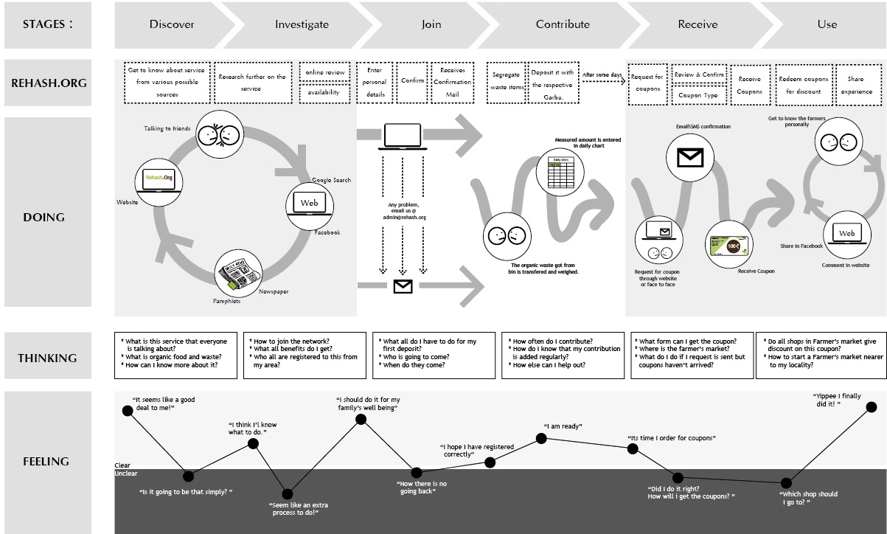
Example of experience journey map

Slide 18
Design FOR experience beyond instilling positive feelings to enhancing meaning making
Giving pace and enriching an unavoidable waiting in a hospital
Instilling trust in an electronic monetary transaction
Helping balance conflictual imperatives in decision making
Reducing the sentimental impact of a negative situation
Reinforcing motivation, personal confidence and feeling of achievement in educational situations

Slide 19
Experience design : an oxymoron?
Can we design the acting – thinking flow of another person?
Design as proposition ⬅➔ Design as prescription or imposition
Design for experience ought to respect the autonomy of the person who will be called to live it through
The designer’s intent or expectations are neither right nor wrong – they are suggestions – a potentiality of a future felt (subjective) reality
Need for a clear ethical stance by the designer(s)

Slide 20

Eye-caching - effective - playful
Visceral Behavioral reflective
Experience cannot be properly said to be “designed”
it can be probed or influenced through design of proper material and semiotic affordances,
with the due respect in the autonomy of the individual human being it is addressed to

Slide 21
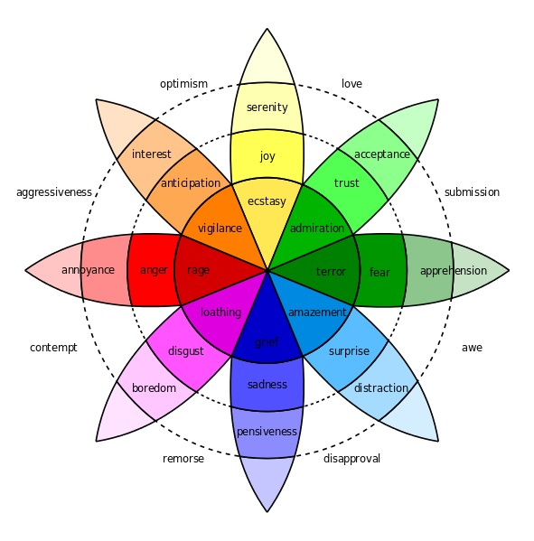
Plutchik’s Psycho-evolutionary Theory of Emotion
The 8 basic emotions types:
Anger
Disgust
Fear
Sadness
Anticipation
Joy
Surprise
Trust
primary emotions are an evolutionary development
the response to each such emotion is the one that is likely to deliver the highest level of survival possibility.
The model lacks pride / shame dimension

Slide 22
The basic conflicting emotional pairs
Joy and Sadness
Trust and Disgust
Fear and Anger
Surprise and Anticipation

Slide 23
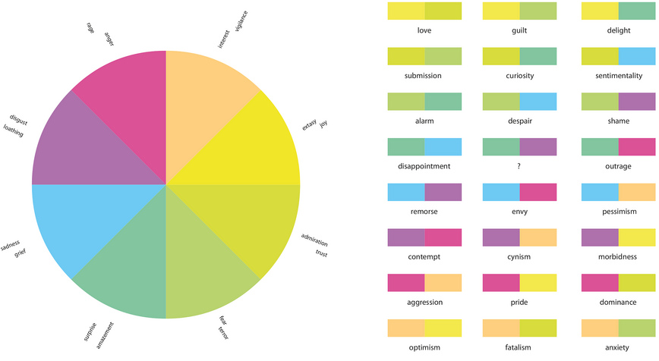
can be used by designers to examine the complexities of emotion and to act as a “colour palette” for emotional design
blending different emotions will create different levels of emotional response and intensities of that response
Plutchik’s
Wheel of Emotion

Slide 24
