Slide 2
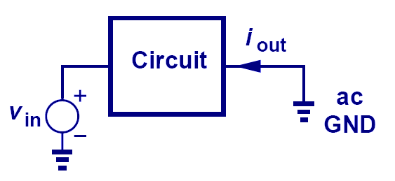
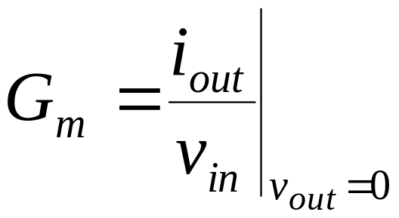
Short-Circuit Transconductance
The short-circuit transconductance of a circuit measures its strength in converting input voltage to output current.

Slide 3
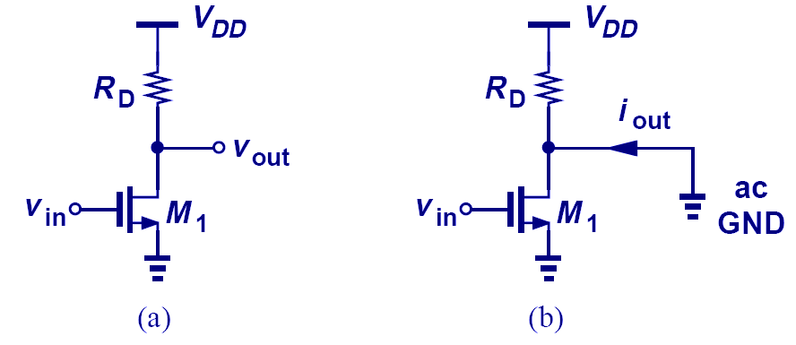
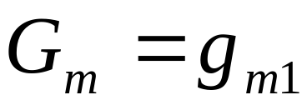
Transconductance Example

Slide 4
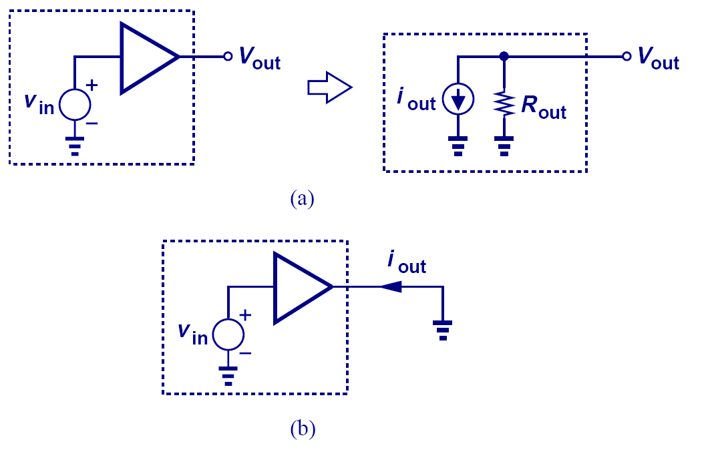
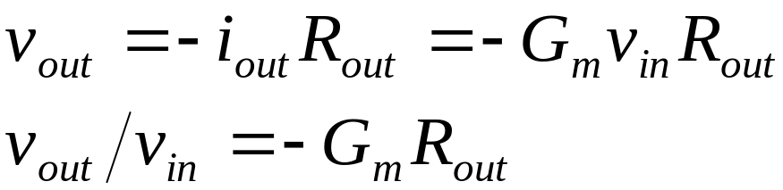
Derivation of Voltage Gain
By representing a linear circuit with its Norton equivalent, the relationship between V_{out} and V_{in} can be expressed by the product of G_{m} and R_{out}.

Slide 5
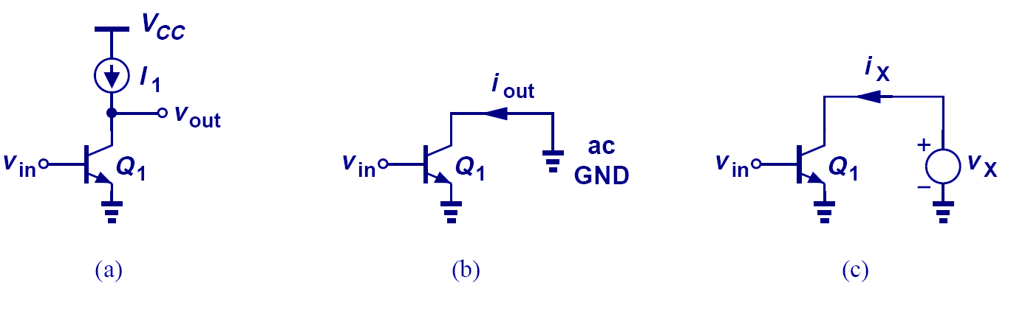
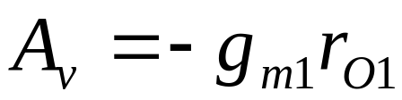
Example: Voltage Gain

Slide 6
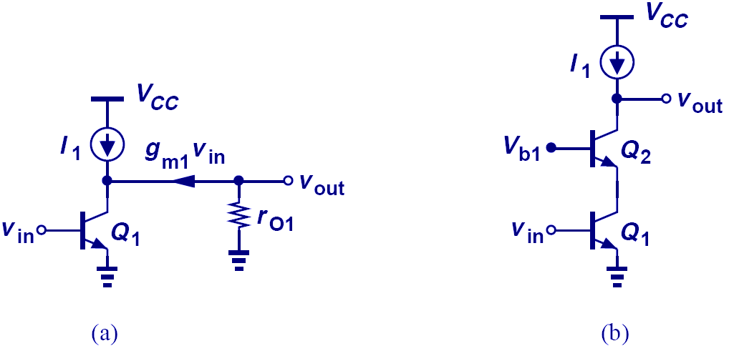
Comparison between Bipolar Cascode and CE Stage
Since the output impedance of bipolar cascode is higher than that of the CE stage, we would expect its voltage gain to be higher as well.

Slide 7
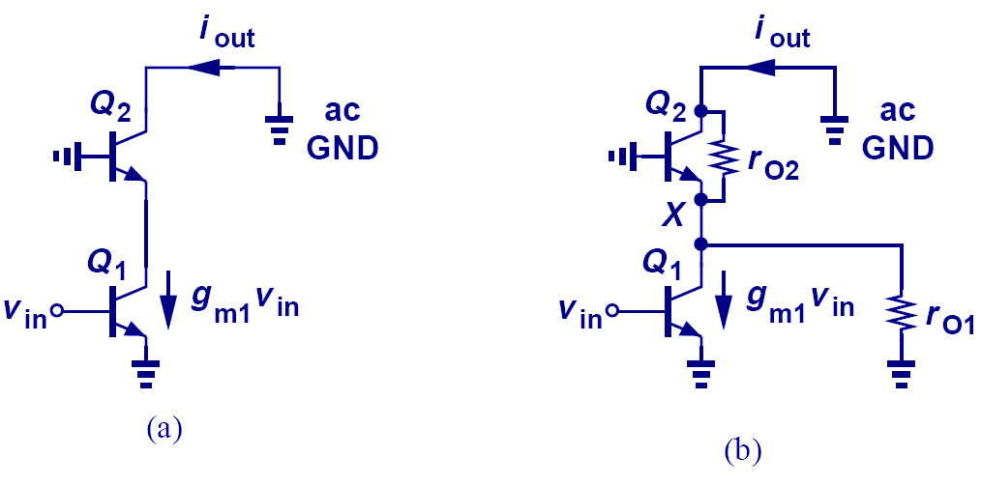
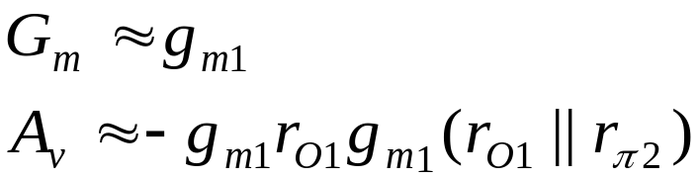
Voltage Gain of Bipolar Cascode Amplifier
Since r_{O} is much larger than 1/g_{m}, most of I_{C,Q1} flows into the diode-connected Q₂. Using R_{out} as before, A_{V} is easily calculated.

Slide 8
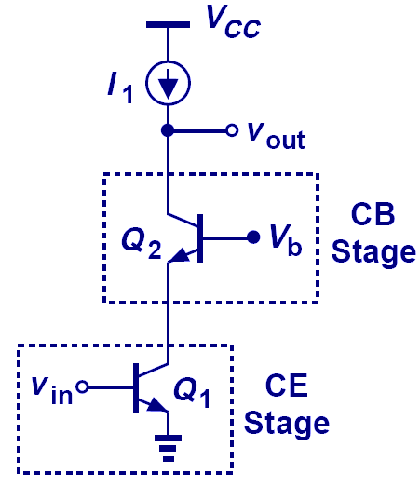
Alternate View of Cascode Amplifier
A bipolar cascode amplifier is also a CE stage in series with a CB stage.

Slide 9
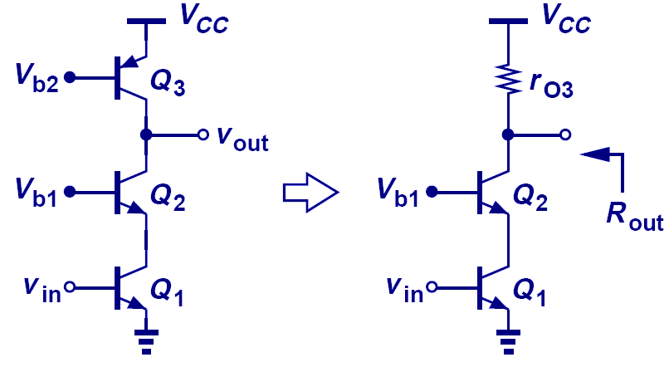
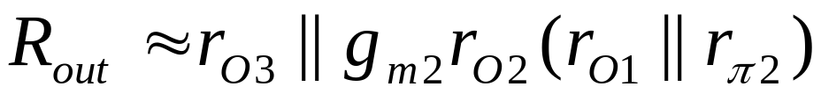
Practical Cascode Stage
Since no current source can be ideal, the output impedance drops.

Slide 10
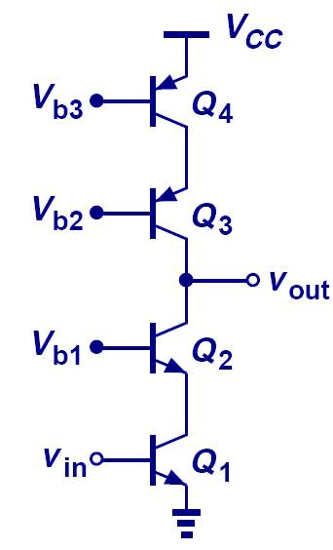
Improved Cascode Stage
In order to preserve the high output impedance, a cascode PNP current source is used.

Slide 11
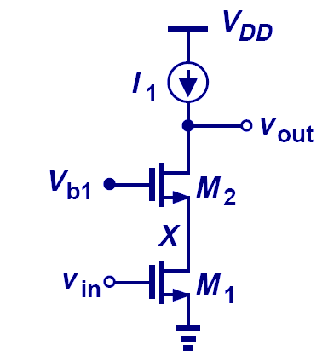
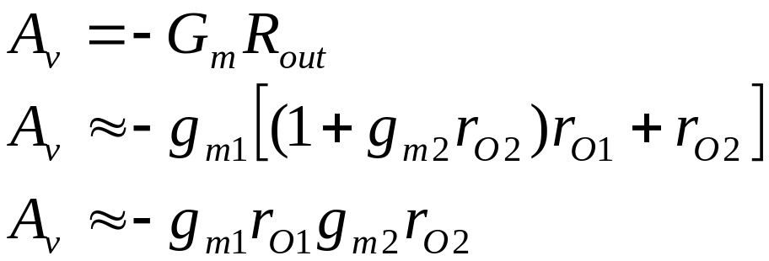
MOS Cascode Amplifier

Slide 12
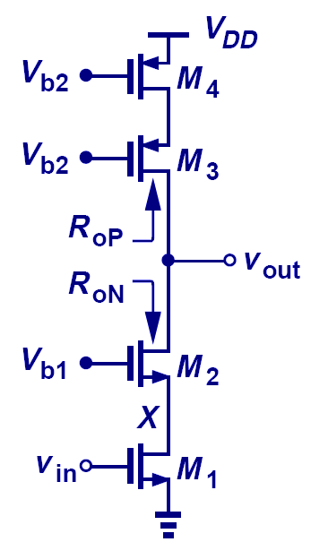
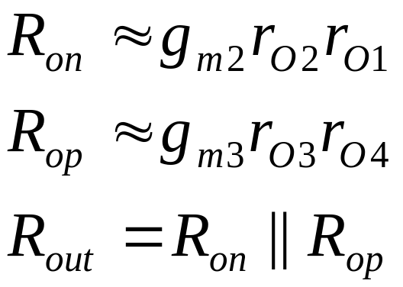
Improved MOS Cascode Amplifier
Similar to its bipolar counterpart, the output impedance of a MOS cascode amplifier can be improved by using a PMOS cascode current source.

Slide 13
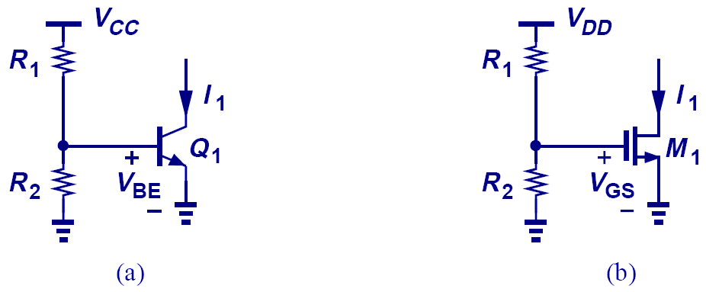
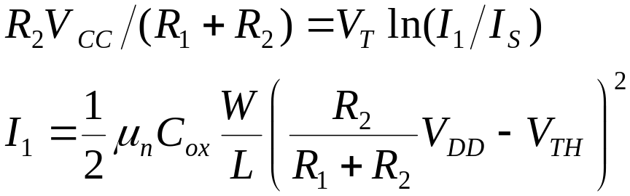
Temperature and Supply Dependence of Bias Current
Since V_{T}, I_{S}, μ_{n}, and V_{TH} all depend on temperature, I₁ for both bipolar and MOS depends on temperature and supply.

Slide 14
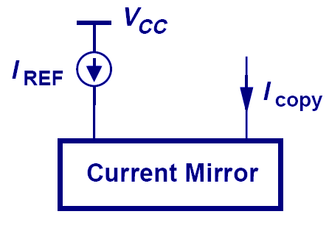
Concept of Current Mirror
The motivation behind a current mirror is to sense the current from a “golden current source” and duplicate this “golden current” to other locations.

Slide 15
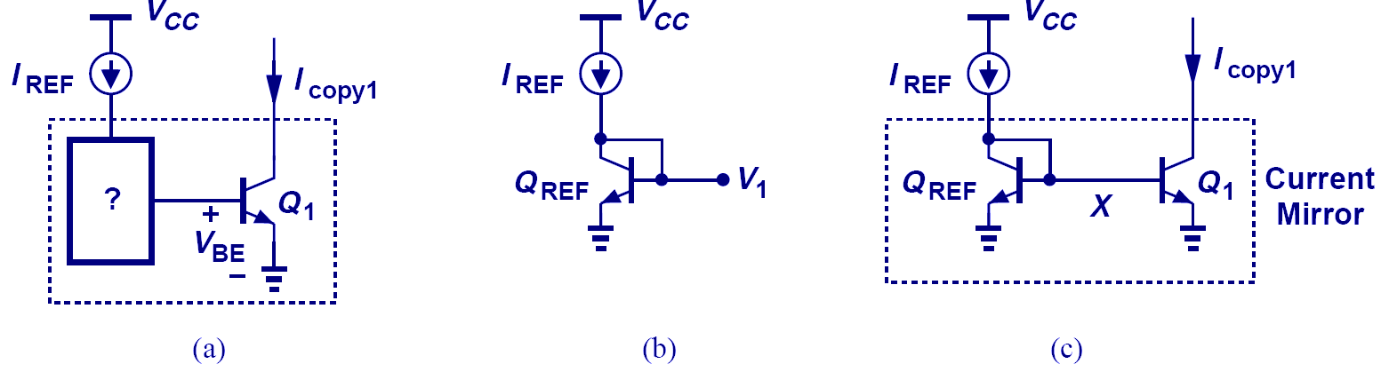
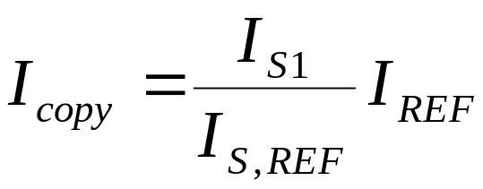
Bipolar Current Mirror Circuitry
The diode-connected Q_{REF} produces an output voltage V₁ that forces I_{copy1} = I_{REF}, if Q₁ = Q_{REF}.

Slide 16
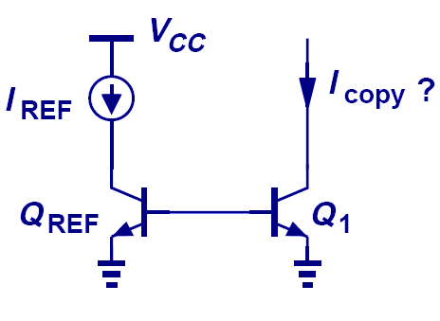
Bad Current Mirror Example I
Without shorting the collector and base of Q_{REF} together, there will not be a path for the base currents to flow, therefore, I_{copy} is zero.

Slide 17
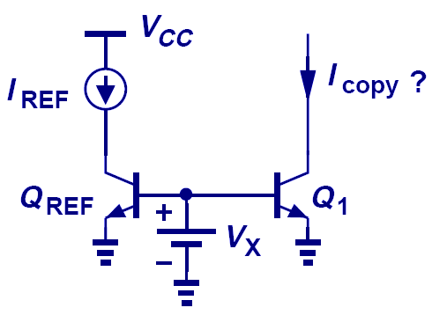
Bad Current Mirror Example II
Although a path for base currents exists, this technique of biasing is no better than resistive divider.

Slide 18
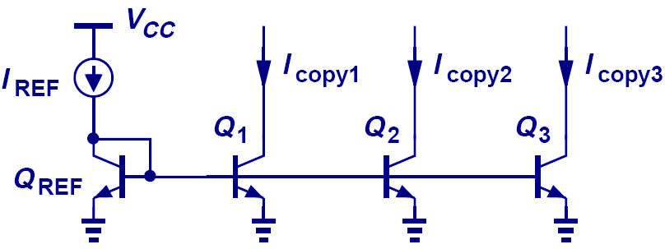
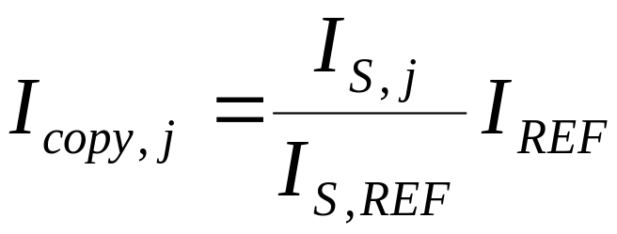
Multiple Copies of I_{REF}
Multiple copies of I_{REF} can be generated at different locations by simply applying the idea of current mirror to more transistors.

