Slide 1
University of Patras Department of Business Administration of Food and Agricultural Enterprises
Six Sigma in the services sector
Evangelos L. Psomas

Slide 2
A breakthrough strategy
To cope with the turbulent business environmental changes
To meticulously deploy the scarce funds available
To keep on providing quality products and services
To deliver multidirectional benefits in a relatively shorter duration of time
6 sigma

Slide 3
A data-driven improvement technique
An organizational phenomenon
A total quality improvement philosophy
A process improvement framework
A problem-solving methodology
A management philosophy
A science

Slide 4
Six sigma
Blends management, financial and methodological elements
To make improvements to processes and products concurrently

Slide 5
Six sigma
Uses both statistical and non-statistical tools/techniques
To eliminate process variation
To improve process performance and capability

Slide 6
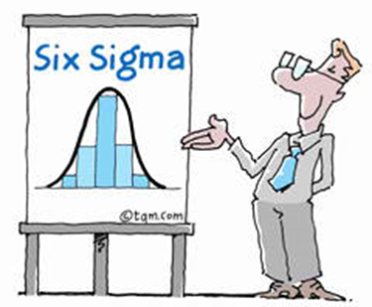
d > 6s
LSL
USL
Sig sigma definition
m
3s
6s
LSL
d > 6s
USL
m
3s
6s
m = the mean value of the quality characteristic, s = standard deviation of a sample USL, LSL = Upper and Lower Specification Limit

Slide 7
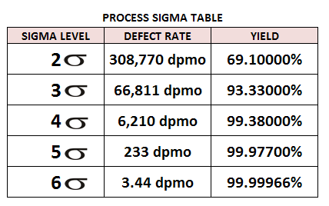
The term Six Sigma is defined as having less than 3.4 defects per million opportunities or a success rate of 99.99966%.
The higher the sigma level, the less likely it is that a process will create defective parts.

Slide 8
Six-Sigma Problem Solving Approach
Six Sigma Quality
Define
Measure
Analyze
Improve
Control
DMAIC

Slide 9
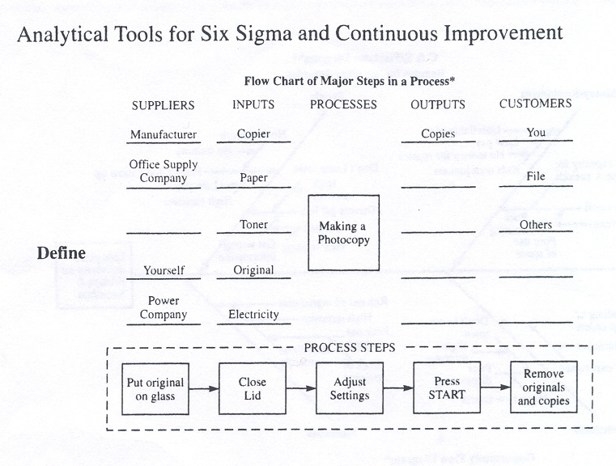
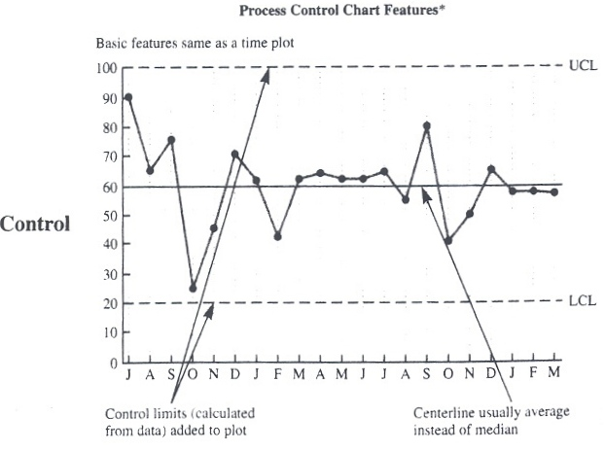
Six Sigma Quality

Slide 10
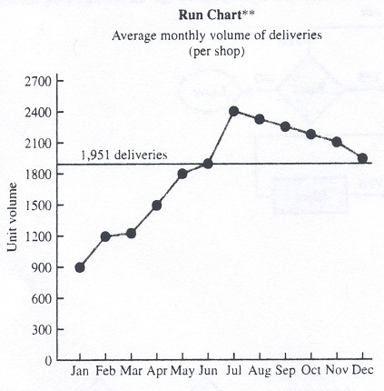
Six Sigma Quality

Slide 11
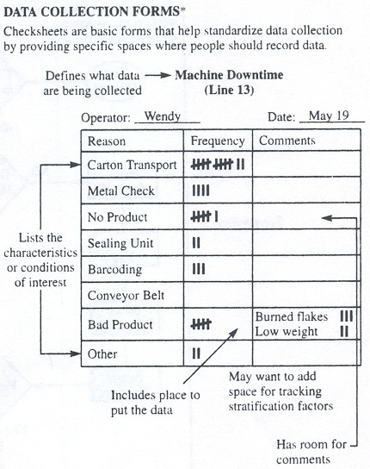
Six Sigma Quality

Slide 12
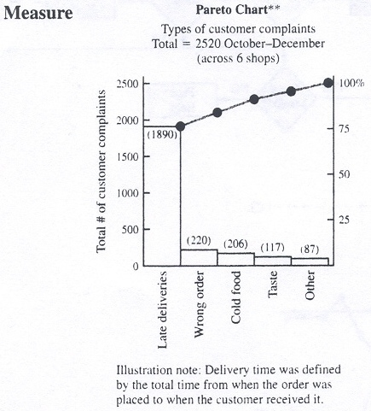
Six Sigma Quality

Slide 13
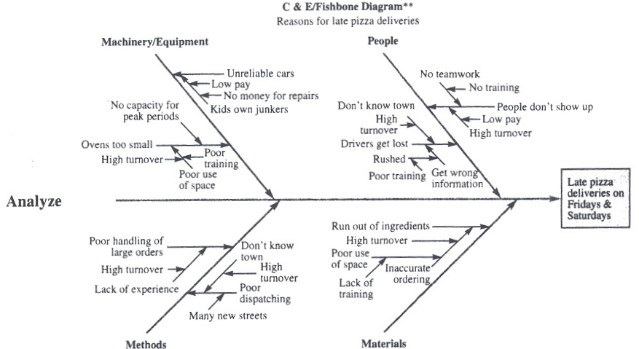
Six Sigma Quality

Slide 14
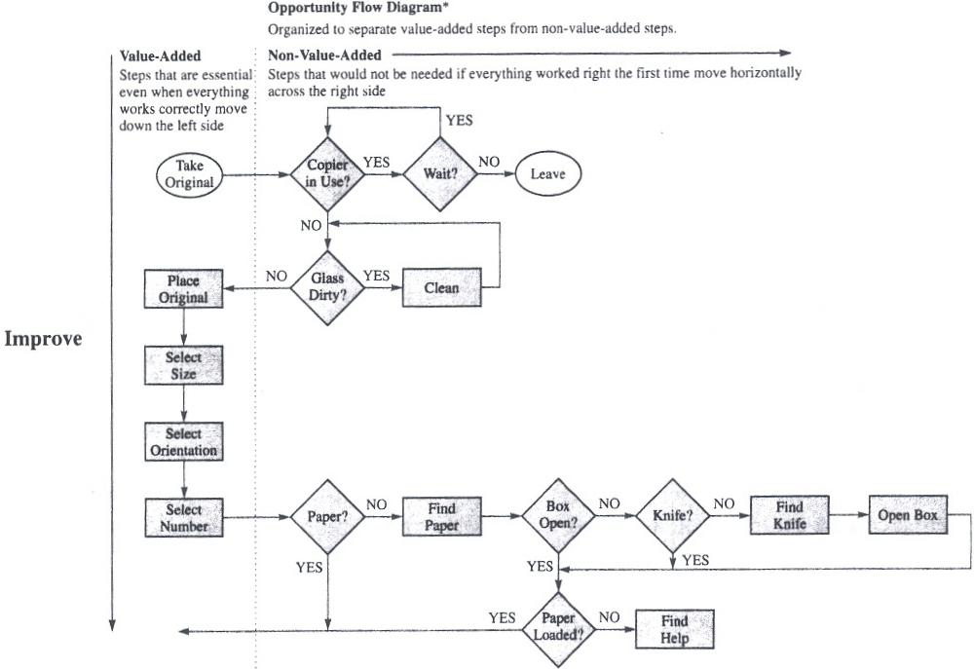
Six Sigma Quality

Slide 15
Six Sigma Quality

Slide 16
Tools for Six-Sigma and Quality Improvement
Elementary statistics
Advanced statistics
Product design and reliability
Process control
Process improvement
Implementation and teamwork

Slide 17
Applied to all types of organizations
Manufacturing companies
Private organizations
Service companies
Public organizations
Small and medium sized enterprises
Large sized enterprises

Slide 18
Applied to functional areas
Engineering
Banking services
Administrative support
Educational institutions
Research libraries
Supply chain operations (including food)
Retail companies
Healthcare services
Marketing services
Call center services

Slide 19
Difficulties of Six Sigma
The selection of the process parameters to be statistically analyzed
Management of the Six Sigma projects (e.g. selection, extent and time required)
Implementation cost
Lack of a sustainable, structured and no paper-loaded approach
Lack of strategic planning in line with 6σ principles
Inadequate employees’ know-how, skills, training

Slide 20
Benefits from Six Sigma
Customer satisfaction
Improved company position in the market
Process management improvement
Improvement of internal operations
Employees benefits
Improvement of financial performance

Slide 21
Thank you for your attention!

